Slide 1





Lessons from cognitive research, academic teaching and training experiences
Workshop on
Effective academic teaching
Università di Salerno
June 15th, 2016
Allegra Via
IBBE, CNR, Italy
ELIXIR-ITA
Sapienza Università di Roma, Italy

Slide 2

Allegra Via
At the University of Bologna I teach
A module on Protein interactions tools and resources
My teaching experience
Programming and web programming to biologists and bioinformaticians
Macromolecular structures to Engineers
Biochemistry to Physicists
Lesson preparation
Write down learning objectives
Design the session (time allocated for each activity)
Prepare questionnaires, slides, practicals, challenges, etc
Course preparation
Compile a programme, define topics in detail and structure them in sessions, identify competences required for each session
Lesson delivery
Students briefly introduce the lesson topic
Diagnostic questionnaire, group discussion, content delivery
I assign tasks, students carry them out and present the outcome
Course materials
Google forms, slides, links, literature references, videos

Slide 3
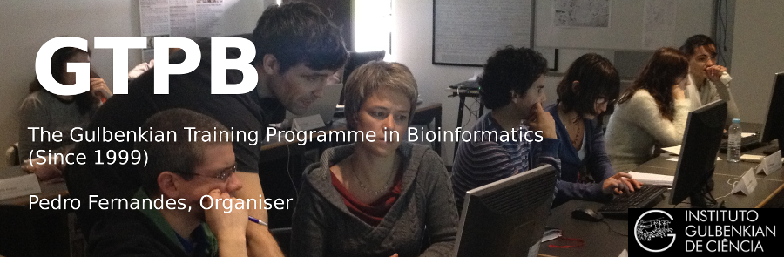

What changed my teaching philosophy
Kristian Rother
http://www.academis.eu

Slide 4
My assumptions
Teaching == content delivery/knowledge transfer
Knowledge of the topic + good performance == good teaching
Am I a good teacher? Yes, I'm! (based on students' evaluation)
If they pass the exam => they have learnt

Slide 5
What are my objectives?
What is learning?
How can I assess it has occurred?
How can I help maximise students' learning?
Do I really need to be a good performer?

Slide 6
University instructors (and scientists more in general)…
are not taught any cognitive science
default to teaching the way they were taught
don't know how learning works (how could they?)
regularly do things that interfere with learning and fail to do things that promote it

Slide 7
What is learning?
A process that leads to a change, which occurs as a result of experience and increases the potential for improved performance and future learning
Ambrose, S.A., Bridges, M.W., DiPietro, M., Lovett, M.C., & Norman, M.K. (2010). How learning works: Seven research-based principles for smart teaching.

Slide 8
What is learning?
Learning is a process, not a product (we can only infer that it has occurred from students' products or performance)
Learning involves change in knowledge, beliefs, behaviours, or attitudes
Learning is not something done to students, but rather something students themselves do
Ambrose, S.A., Bridges, M.W., DiPietro, M., Lovett, M.C., & Norman, M.K. (2010). How learning works: Seven research-based principles for smart teaching.

Slide 9
Different people will have different ways of learning
Learning styles (Theorist, Reflector, Pragmatist, Activist)
Novice/competent practitioner/expert
Two types of knowledge
Declarative knowledge: what (knowledge of facts, theories, methods, etc)
Procedural knowledge: how and when to apply theories and methods

Slide 10
Why lecturing does not promote learning?
Regardless their way of learning, each student receives exact the same information at the exact same pace
Students respond differently to the same presented material (get it, bored, lost…)
Students have to listen and take notes → no way to think and make connections
The teacher is busy in transferring content → no time to brainstorm, discuss challenging problems, make connections

Slide 11
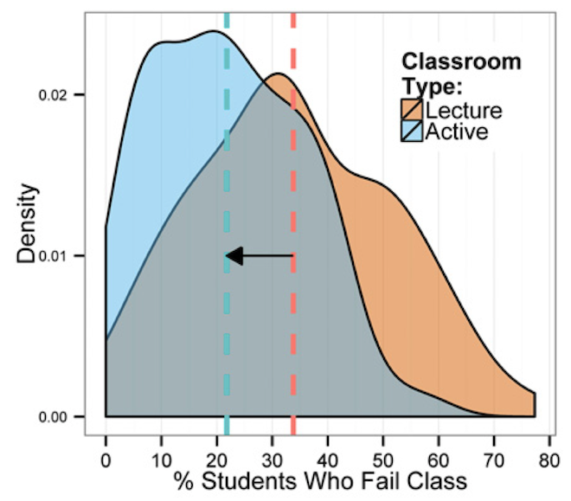
Freeman et al. PNAS (2014) Active learning increases student performance in science, engineering, and mathematics.

Slide 12


Learning by doing

Slide 13
Three approaches to start with
Flipped classes
Peer instruction
Diagnostic questionnaires

Slide 14
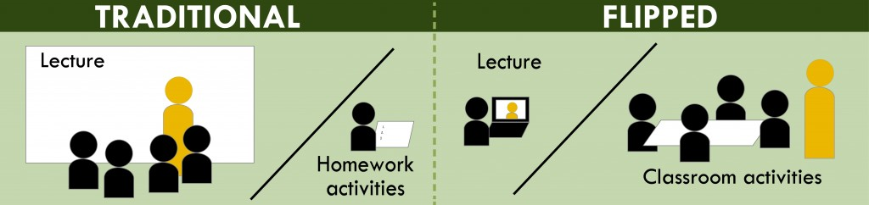
Flipped classes

Slide 15

Let the coach take the place of the star

Slide 16
Flipped classes
The teacher creates his own video or find an appropriate one online to assign students as homework (but also books/papers/links/etc)
The students watch the lecture at home as homework (or study a textbook, etc)
Students are given a questionnaire at the beginning of class that lets the teacher know if the video The points can be included in the students’ overall grade

Slide 17
Flipped classes
Students spend class time working on projects or problem-solving based on the information from the videos.
Teachers are seen as a guide and coach to help students with problem-solving strategies and differentiate learning during this applied instruction time

Slide 18
Peer instruction
Instructor poses question based on students' responses to their pre-class reading
Students reflect on the question
Students commit to an individual answer
Instructor reviews student responses
Students discuss their thinking and answers with their peers
Students then commit again to an individual answer
The instructor again reviews responses and decides whether more explanation is needed before moving on to the next concept

Slide 19
Diagnostic questionnaires
Pre-course (collect info about students' factual knowledge)
Pre-session (check what they already know, use them to stimulate discussion, brainstorming and peer instruction)
In session (MCQs with distractors to tests for conceptual misunderstanding and check whether learning is occurring)

Slide 20
What you have to be aware of
Course/lesson design and plan
Materials preparation
These approaches require a lot of work (and motivation)
Difficulties (technological, high number of students, infrastructure, time subtracted to research)

Slide 21
What you have to be aware of
It takes more time than you think – How hard can it be to pre-record a lecture you've given a hundred times? Very hard.
Use other people's stuff! There is lots of high-quality material available for educators to use and repurpose. Do it.
Expect push-back from students – Sitting through a lecture is easy. Learning is hard.
Keep your options open! You don't have to flip every lesson. Pick a few lessons each year. Keep it simple.
Have a plan for your extra class time! Make sure you plan out how you will use your class time. That's the whole point, after all.

Slide 22
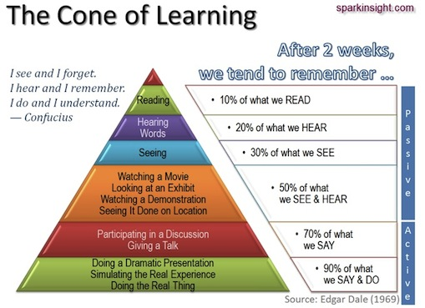

Slide 23
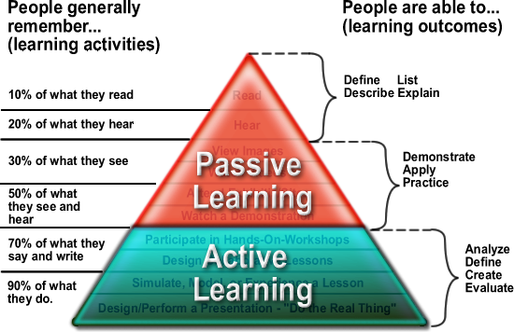

Slide 24
Allegra Via
At the University of Bologna I teach
A module on Protein interactions tools and resources
My teaching experience
Programming and web programming to biologists and bioinformaticians
Macromolecular structures to Engineers
Biochemistry to Physicists
Lesson preparation
Write down learning objectives
Design the session (time allocated for each activity)
Prepare questionnaires, slides, practicals, challenges, etc
Course preparation
Compile a programme, define topics in detail and structure them in sessions, identify competences required for each session
Lesson delivery
Students briefly introduce the lesson topic
Diagnostic questionnaire, group discussion, content delivery
I assign tasks, students carry them out and present the outcome
Course materials
Google forms, slides, links, literature references, videos

Slide 25
Learning styles relating to Kolb
Honey and Mumford, 1986
Four main categories of learning style
Activist – challenges, new experiences and problems, excitement and freedom
Pragmatist – Practically based, immediately relevant learning activities, scope for practice and using theory
Reflector – structured learning activities with time to observe, reflect and think
Theorist – logical, rational structure and clear aims – time for methodical exploration

Slide 26
Seven instructional principles coming from cognitive research
Principle P1: Students’ prior knowledge can help or hinder learning
Principle P2: How students organize knowledge influences how they learn and apply what they know.
Principle P3: Students’ motivation determines, directs, and sustains what they do to learn.
Principle P4: To develop mastery, students must acquire component skills, practice integrating them, and know when to apply what they have learned.
Ambrose, S.A., Bridges, M.W., DiPietro, M., Lovett, M.C., & Norman, M.K. (2010). How learning works: Seven research-based principles for smart teaching.

Slide 27
Seven instructional principles coming from cognitive research
Principle P5: Goal-directed practice coupled with targeted feedback enhances the quality of students’ learning.
Principle P6: Students’ current level of development interacts with the social, emotional, and intellectual climate of the course to impact learning.
Principle P7: To become self-directed learners, students must learn to assess the demands of the task, evaluate their own knowledge and skills, plan their approach, monitor their progress, and adjust their strategies as needed.
Ambrose, S.A., Bridges, M.W., DiPietro, M., Lovett, M.C., & Norman, M.K. (2010). How learning works: Seven research-based principles for smart teaching.

Slide 28
Translate the principles into teaching strategies
Strategy S1: Collect data about students and use it to design instruction
Strategy S2: Be explicit about your learning goals, learning objectives, and expectations
Strategy S3: Scaffold complex tasks
Strategy S4: Help students learn to function like experts
Strategy S5: Establish a supportive class climate

Slide 29
Sarah Morgan
Sarah Morgan is the Training programme manager at EMBL-EBI, responsible for the daily management of the external user training programme which includes training on-site at Hinxton, off-site at host organisations and online. Prior to joining EMBL-EBI Sarah was a lecturer in Molecular Medicine at Cranfield University, running an MSc Programme in Advanced Biosciences and researching cell-surface interactions and tumour diagnostics.

Slide 30
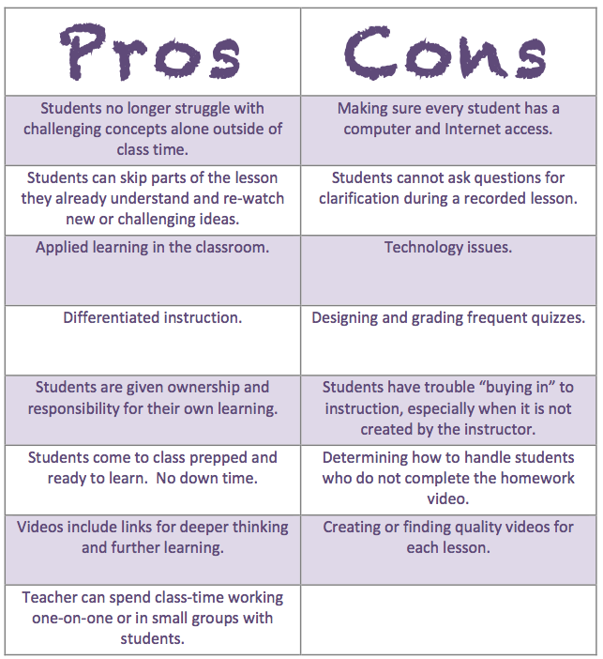

Slide 31
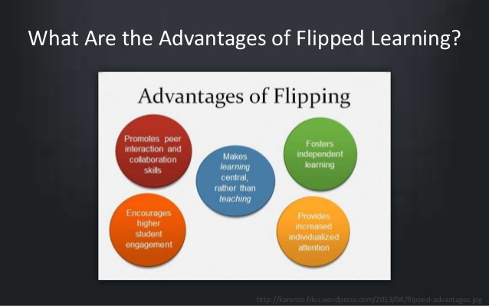

Slide 32
Gabriella Rustici
Gabriella leads the Bioinformatics Training Facility @ the University of Cambridge. She earned her PhD in Genetics from the University of Cambridge in 2004, working on transcription profiling of the fission yeast cell cycle, and has worked for several years at the European Bioinformatics Institute (EMBL-EBI) focusing on training and educating the life science community to use bioinformatics resources for the analysis and interpretation of high-throughput data.

Slide 33
What do we need?
We need to share a common, collaborative vision of what it is we want in our schools and classrooms.
We need to speak the same language, a language we create together as we build collective intelligence.
Which means we need to make time to talk to each other, to do action research together, to share what we are learning with learner artifacts and deep reflection about what is working and what isn’t working.
We need to fail together and then overcome together.
We need to have conversations and form schema around learning in a digital age both within our school learning community and outside in networks and communities worldwide.
We need to build leadership density in our teachers and our students.
We need to own what we believe and then incorporate the transformation we seek into every area of school culture.
We need to be chanting: empowerment, collaboration, equity, agency, self actualization, and transcendence for kids and for us all within a system that serves as the birth place for every other profession. We need to be chanting these things instead of technology, technology, technology.
S. Nussbaum-Beach @ http://plpnetwork.com/2015/03/10/shift-active-learning-technology-answer/

