Slide 1
UNIX command line

Slide 2
In this module you will learn:
What is the computer shell
What is the command line interface (or Terminal)
What is the filesystem tree and how to navigate it
Where and how to write a program
How to run programs on Unix

Slide 3

The shell
The shell is an interpreter (a program) that lets you interact with the operating system
graphical shell
command-line shell
graphical interface
command-line interface

Slide 4
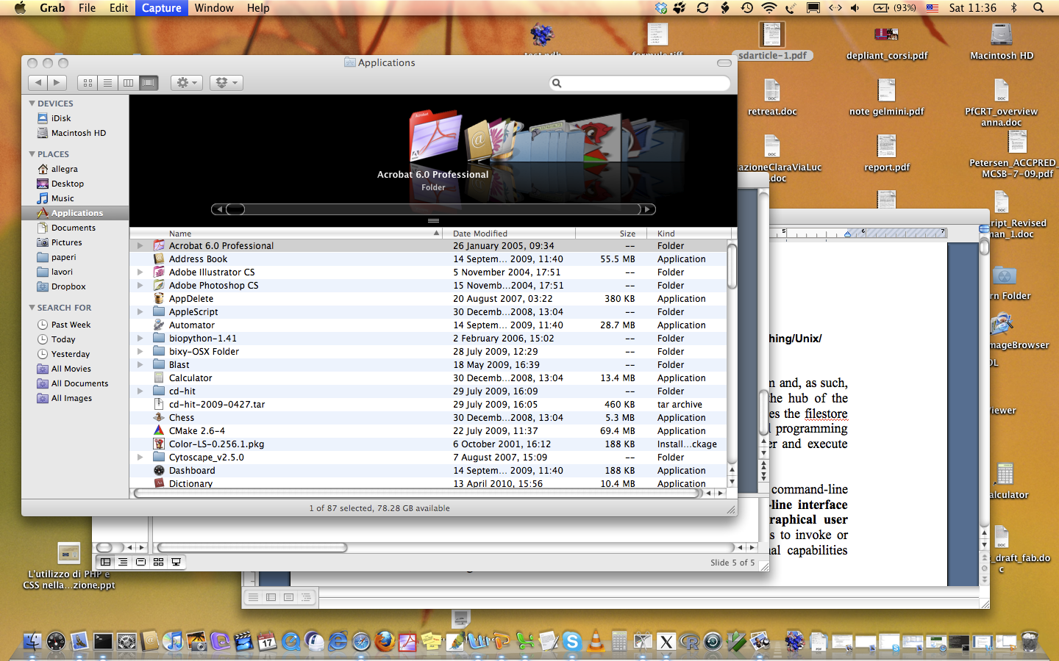
graphical interface

Slide 5


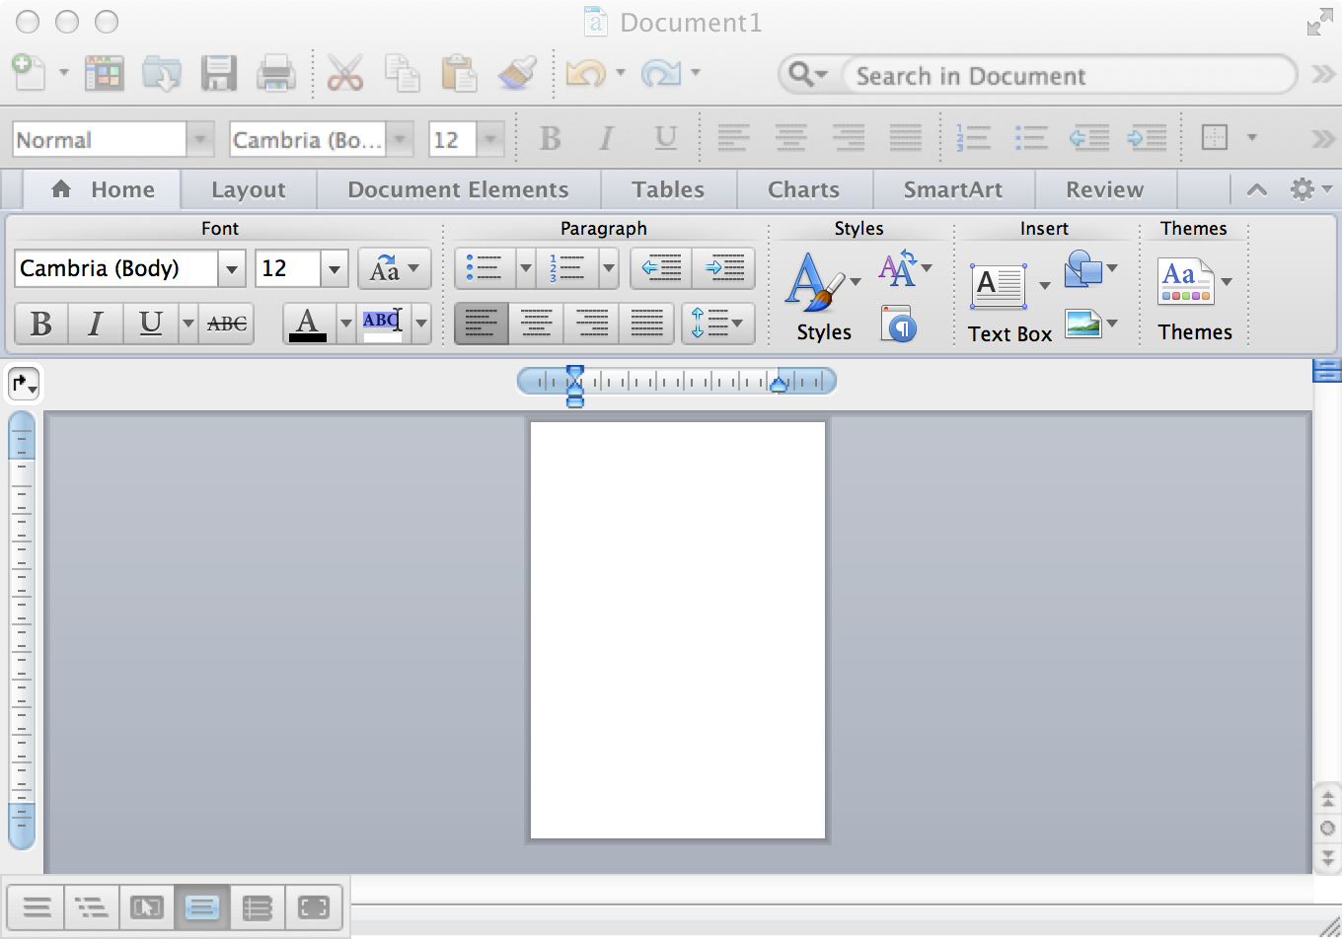
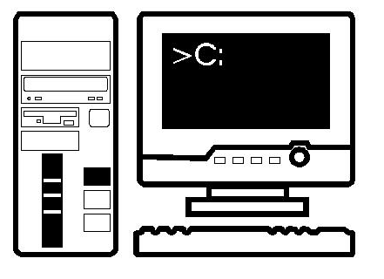
What happens when you double click on the icon of an application?
command

Slide 6
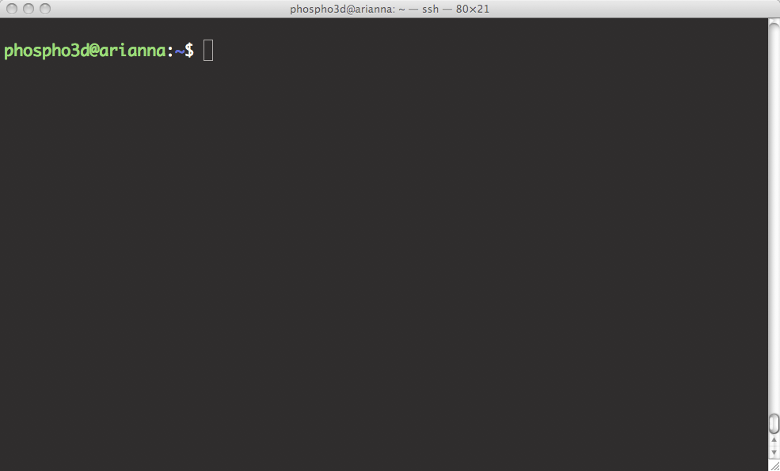
command-line interface
prompt
Here you write the command

Slide 7
The command-line interface (terminal) allows you:
to send typed instructions to the computer (i.e., run programs, move/view files, etc.)
to see the output that results from those instructions.
Every time you type any Unix command and press enter, the computer will attempt to follow your instructions and then, when finished, return you to the command prompt.

Slide 8
Open a command-line terminal on your computer

Slide 9
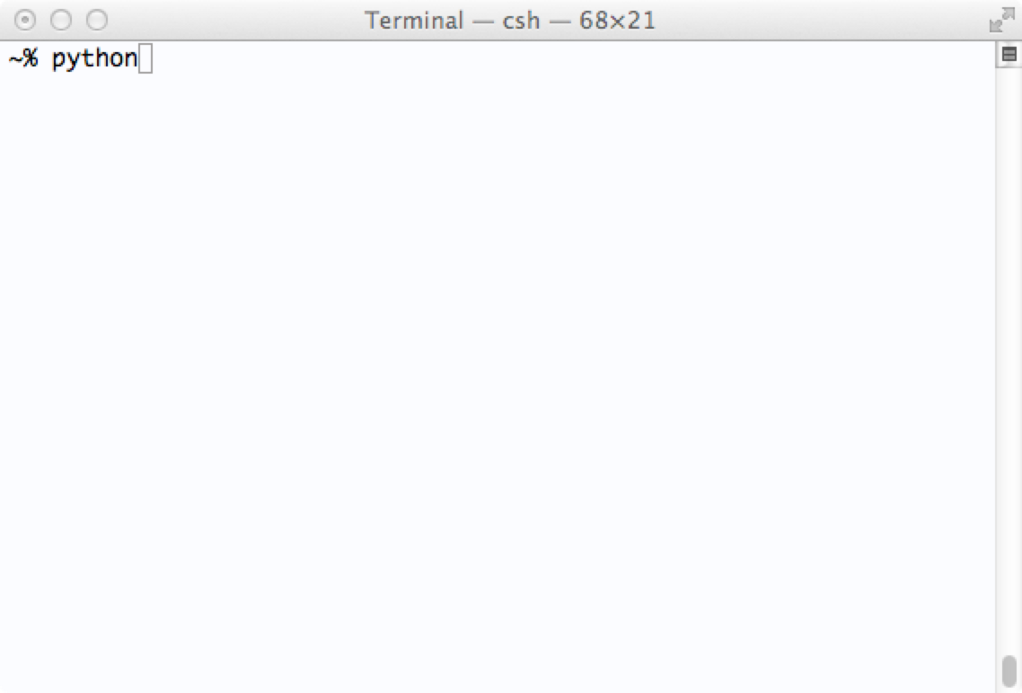
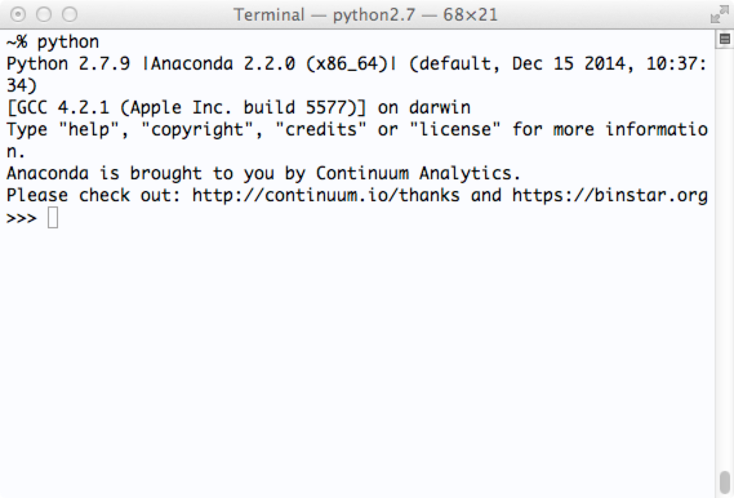
You can type a program name at the terminal prompt and then type [Return]
command

Slide 10
The Terminal can be customised
Change default color
Change text size and font
Increase/decrease transparency
Resize it
Have multiple windows open side by side
Change the command prompt (most commonly a $ or % sign)
Make the cursor blinking

Slide 11
Type the Unix command ‘ls’ at the command prompt
What happens?

Slide 12
The directory structure
The file-system is arranged in a hierarchical structure, like an inverted tree
Root (/)
usr
home
bin
etc
var
tmp
kristian
allegra
phospho
courses
tmp
data
applications
The top of the hierarchy is traditionally called root
When you first login, the current working directory is your home directory (containing files and directories that only you can modify)

Slide 13
Navigating the filesystem tree
Slashes separate parts of the directory path:
/home/allegra/courses/TGAC2015/Academis_Linux.pdf
What else do you need?
Find out where you are in the filesystem
Change directory
Find your way home
Make a new directory
Remove a file
Remove a directory

Slide 14
Everything in Unix is either a file or a process
A process is an executing program identified by a unique PID
(PID = Process IDentifier)
A file is a collection of data

Slide 15
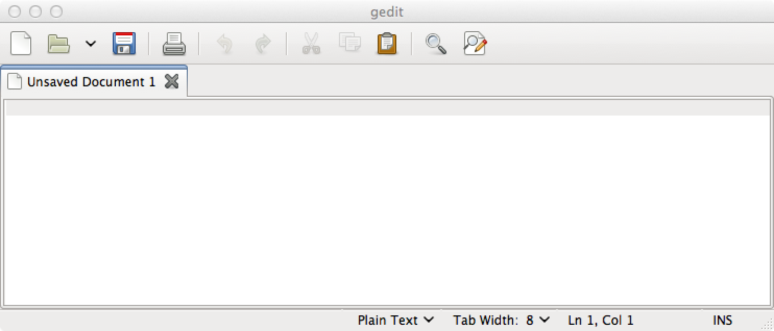
Access your home directory using the command-line interface
Start the gedit text editor
Create a text file “myfile.txt” and save it in your home directory
Go to the command-line interface and type “ls” at the prompt

Slide 16
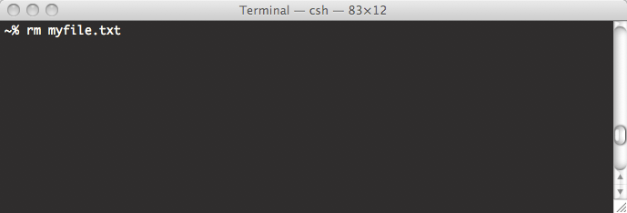
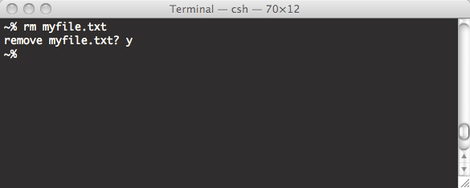
About Unix commands
Commands are themselves programs
%rm myfile.txt [Return]
  • The shell searches the file containing the program rm
  • executes the program rm on myfile.txt
  • After the process rm myfile.txt has finished running,
  the shell returns the prompt % to you, indicating that it is waiting for
  further commands.
Here you can type a new command

Slide 17
General remarks
• If you've made a typo: CTRL-u to cancel the whole line
• Unix is case-sensitive
• There are commands that can take options
• The options change the behaviour of the command
• UNIX uses command-line completion

Slide 18
General remarks
• %command_name -options <file> [Return]
• %man <command name> [Enter]
• %whatis <command name> [Enter]

Slide 19
General remarks
• CTRL-A sets the cursor at the beginning of the line
• CTRL-E sets the cursor at the end of the line
• You can use up and down arrows to recall commands
• The command whereis tells you where is a given program
• You can use a text editor to write stuff

Slide 21
File system security (access rights)
Each file (and directory) has associated access rights, which may
be found by typing ls -l
permissions
owner
size in bytes
-rwxr-xr-- 1 gould admin 2541 2009-08-19 16:57 new_scop.txt
d
number of links
group owner
date and time of the
last modification
file's name
Access rights on directories
    r allows users to list files in the directory
    w allows users to delete files from the directory or move files into it
    x allow users to access files in the directory

Slide 22
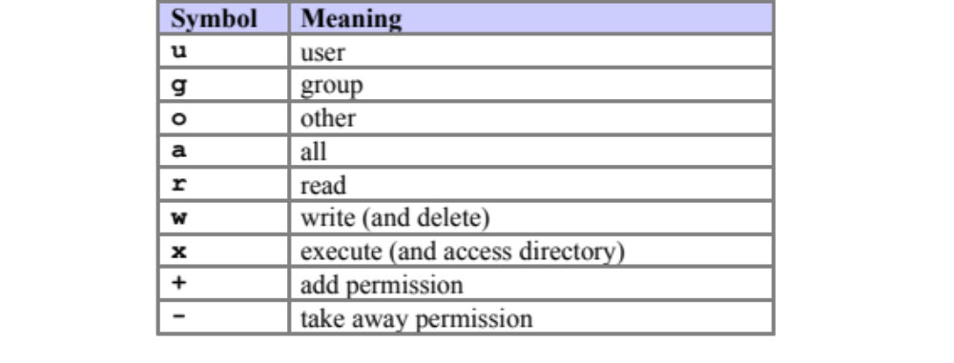
Changing access rights: chmod
%chmod go-rwx myfile.txt
%chmod a+x my_script

Slide 24
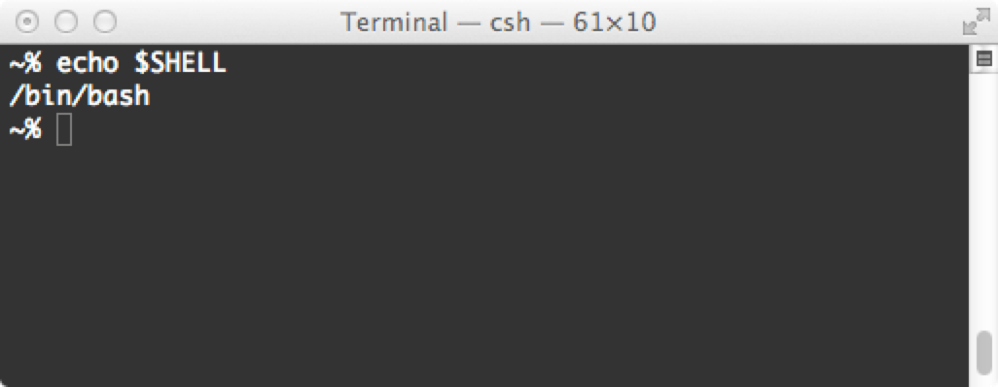
The Unix shell
The shell is a command-line interpreter that lets you interact with Unix
The shell takes what you type and decides what to do with it
The shell is actually a scripting language somewhat like Python
It is always possible to change shell (either temporarily or permanently)

Slide 25
UNIX environment variables
Unix keeps track of several special variables that are associated with your account
Written in upper-case letters
Start with a $
echo $SHELL
printenv SHELL
setenv or printenv

Slide 26
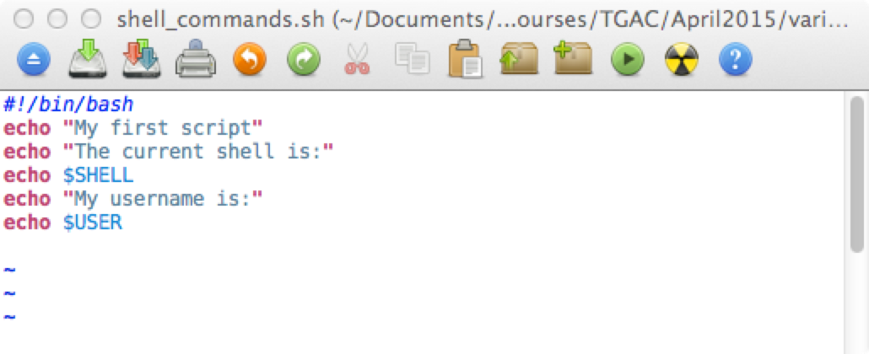
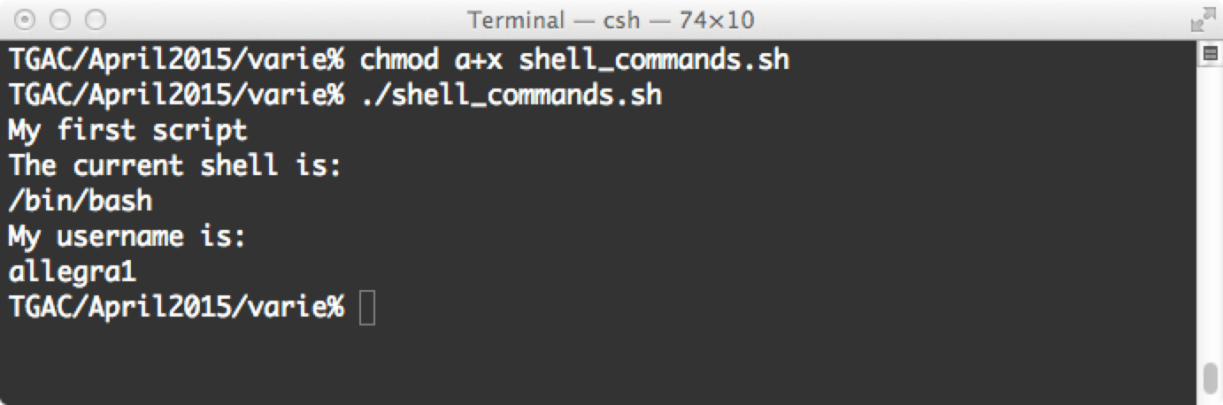
You can write shell commands in a file and make the file executable

Slide 27
#!/bin/bash
"Aha, you want to use the program located at /bin/bash to interpret all the instructions that follow"
Bradnam&Korf - Unix and Perl to the Rescue

Slide 28
Where Unix searches for programs?
Once you have made a script executable you can always run it by prefixing its name with a path:
./shell_commands.sh
~allegra1/Documents/didattica/TrainingCourses/TGAC/April2015/varie/shell_commands.sh
Anytime you are running a program, Unix will check through a list of predefined directories to see if that program exists in any of those locations.
If it finds a match, it will try running the program and stop looking in any other directory.
If it cannot find a match, it will print "command not found"

Slide 29
echo $PATH
If the system returns a message saying "command: Command not found", this indicates that either the command doesn't exist at all on the system or it is simply not in your path.
# for shells in the bash family
export PATH=$PATH:~/allegra1/TGAC
# for shells in the csh family
setenv PATH $PATH\:~/allegra1/TGAC
Any program in ~/allegra1/TGAC can be run from anywhere in the filesystem (as long as the program file is executable)
You can use tab-completion
Your scripts will be treated like any Unix command

Slide 30
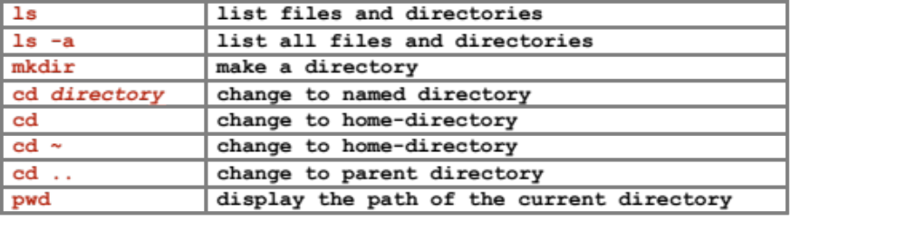
Listing files and directories
The directories ‘.’, ‘..’, and ‘~’
% ls -a [Enter]
% cd . [Enter]
% cd .. [Enter]
% ls ~/oeiras

Slide 31
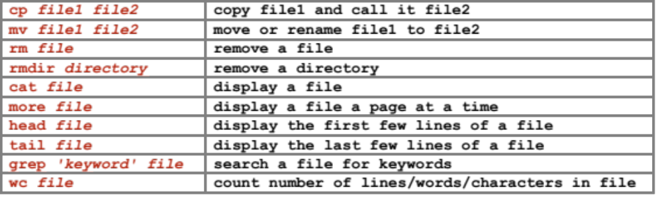
Handling files and directories
more
less
clear

Slide 32
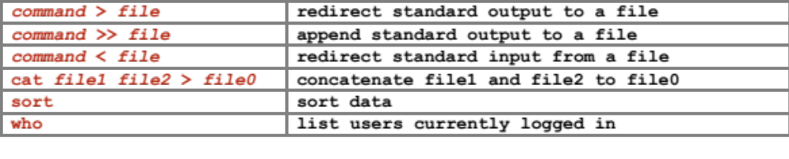
Redirection

