Slide 1
final alignment (.sam/.bam)
variant calling
SNPs/indels
single/multi-sample
samtools
raw variants (.vcf)
variant score recalibration
known SNPs/indels
big datasets
variant filtering and validation
vcftools
in silico vs in vitro validation
ready-to-use variants (.vcf)

Slide 2
final alignment (.sam/.bam)
variant calling
SNPs/indels
single/multi-sample
samtools
raw variants (.vcf)
variant score recalibration
known SNPs/indels
big datasets
variant filtering and validation
vcftools
in silico vs in vitro validation
ready-to-use variants (.vcf)

Slide 3
variant calling
SNPs
indels
SV
samtools
GATK:
1. Unified Genotyper
2. Haplotype caller
Dindel
samtools
GATK:
1. Unified Genotyper
2. Haplotype caller
SVMerge – pipeline combining many different tools

Slide 4
variant calling - SNPs
Examine the bases aligned to position and look for differences
SNP calling vs genotyping
Homozygous vs Heterozygous SNPs
Factors to consider:
Base call qualities of each supporting base
Mapping qualities of the reads supporting the SNP (increased read length or paired-end help MQ scores)
Sequencing depth
Individual vs multi-sample calling

Slide 5
variant calling – visualisation in IGV

Slide 6
variant calling – VCF file
Standardised format for storing DNA polymorphism data
SNPs, indels, SV
Rich annotations
Can be indexed for fast data retrieval of variants from a range of positions
Can store variant information over many samples
Record meta-data about the site
dbSNP accession, filter status
Very flexible
Tags can be introduced to describe new types of variants
Different VCF files may contain different information/annotations
Two sections:
Header
Data

Slide 7
variant calling – VCF file
Header
lines starting with ##: arbitrary number of meta-information lines
line starting with #: column definition – mandatory columns include:
CHROM chromosome
POS position of the start of the variant
ID unique identifier of the variant (e.g. rs number for SNPs)
REF reference allele
ALT comma separated list of alternate non-reference alleles
QUAL phred-scaled quality score
FILTER site filtering information
INFO user extensible annotation (e.g. samtools and GATK may differ in this)
samples follow
Data
one line per site (all columns described above per line); useful information per site and per sample

Slide 8
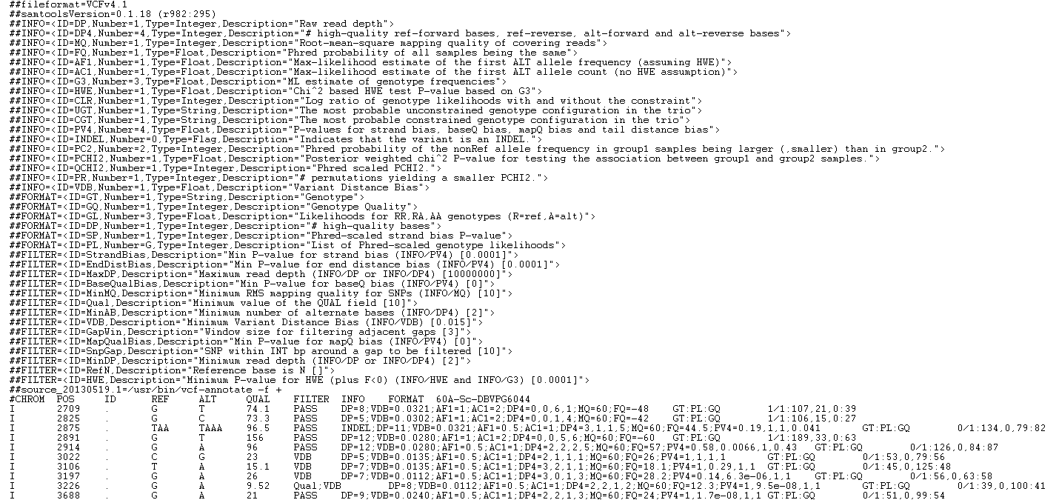
variant calling – VCF file
How many samples are included in the vcf?
Did site 3106 pass the filters? If not, why? And site 2825?
What type of variant is site 2875?
What is the genotype at position 2709? And what is its genotype quality?

Slide 9
variant calling – samtools mpileup
samtools mpileup -u -Q 20 -q 50 -g -s -f Saccharomyces_cerevisiae.EF4.68.dna.toplevel.fa library_final_sorted.bam | bcftools call -mv - > variants_raw.vcf
What is the meaning of the options for samtools mpileup? And for bcftools view?
Check your vcf
more variants_raw.vcf
What if you use the option -t in samtools mpileup? What’s the difference you observe in the two vcf files?

Slide 10
final alignment (.sam/.bam)
variant calling
SNPs/indels
single/multi-sample
samtools
raw variants (.vcf)
variant score recalibration
known SNPs/indels
big datasets
variant filtering and validation
vcftools
in silico vs in vitro validation
ready-to-use variants (.vcf)

Slide 11
variant calling – filtering variants
Common cautions:
Base quality BQ20
Depth (min and max) very dependent on your average
Mapping quality MQ50/60
Strand-bias p-value>0.05
SNP density dependent on the genome [e.g. no more than 1 SNP/4bp]
Indel proximity not closer than 10bp to an indel
Keep in mind your project may have some specific requirements
For example, if you are studying homologous regions (or you are using a distant reference genome), which is the parameter you should tailor first?
Some filters may be applied during the variant calling while others are applied afterwards
Further reading: “Consensus Rules in Variant Detection from Next-Generation Sequencing Data” Jia et al 2012 PLoS One

Slide 12
variant calling – variant quality score recalibration
Available in GATK.
It aims at producing well-calibrated probabilities for the variants called.
It develops a continuous, co-varying estimate of the relationship between SNP call annotations ( e.g. MQ, QD…) and the probability that a SNP is a true genetic variant versus a sequencing or data processing artefact.
It needs “true sites” to be trained.
We are not going to use it, because it needs big datasets (either many samples, or whole genome data) to work properly.
You can find more information at
http://www.broadinstitute.org/gatk/gatkdocs/org_broadinstitute_sting_gatk_walkers_variantrecalibration_VariantRecalibrator.html

Slide 13
variant calling – vcftools
http://vcftools.sourceforge.net/docs.html
It not only allows to filter variants but it includes all sorts of useful options to handle your vcf files and extract useful information out of it
module load vcftools
cat variants_raw.vcf | vcf-annotate –f d=2/w=10 > variants_flt.vcf
more variants_flt.vcf
If you consider the first ten variants, how many did not pass the filters applied? And why?

Slide 14
variant calling – evaluating
Specificity vs Sensitivity = False Positive vs False Negative
our sequenced sample
TP
true positive
FP
false positive
TN
true negative
FN
false negative
external source of variation [same sample] – good quality data
high specificity
low FP
high sensitivity
low FN

Slide 15
variant calling – validation
external source of known variation – sequencing a sample for which you have independent data will help to understand the quality of your data (also reducing the need for experimental validation)
experimental validation – select a number of newly discover variants to be tested with a different technology (usual sanger sequencing); the rate of false discovery will give an estimate of how well the sequencing performed
lack of standards for validation rates and acceptable false discovery rates

Slide 16
final alignment (.sam/.bam)
variant calling
SNPs/indels
single/multi-sample
samtools
raw variants (.vcf)
variant score recalibration
known SNPs/indels
big datasets
variant filtering and validation
vcftools
in silico vs in vitro validation
ready-to-use variants (.vcf)

