Slide 1

Profiling known RNA editing events in RNAseq experiments
Alessandro Silvestris PhD – RTDA UNIBA
asilvestris@aliceposta.it

Slide 2
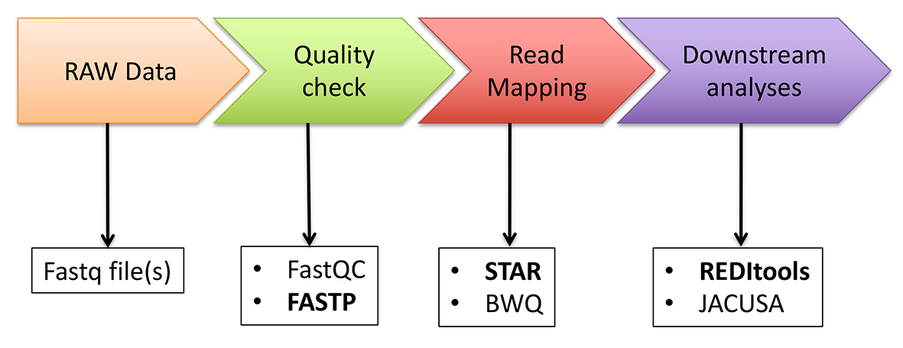
RNA editing detection and quantification
De novo approach
RNA editing candidates can be detected using REDItools. There are two current versions: 1) REDItools 1.3 or 2) REDItools 2.0. REDItools2 is a faster re-implementation of REDItools1 for HPC clusters. Its serial version is about ten times faster than REDItools1.
“Known” approach
While the de novo approach provides a list of most likely editing candidates, the "known" approach focuses on a limited pool of known events in order to better investigate RNA editing dynamics in different experimental contexts. The "known" approach can be carried out using the REDItools package and a list of events from own data or from public databases such as DARNED, RADAR and REDIportal.

Slide 3
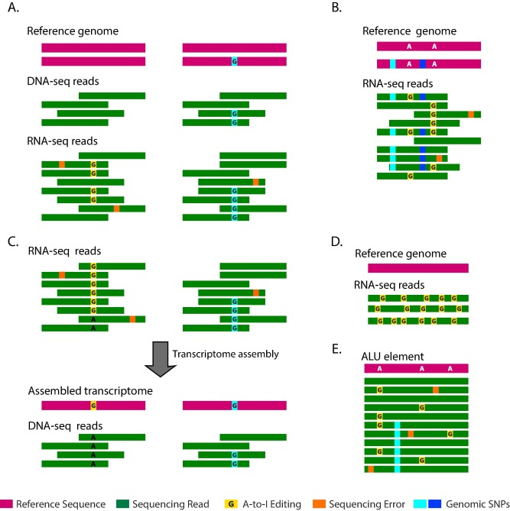
Quantifying RNA editing in deep transcriptome datasets
The quantification of RNA editing is important to compare values across samples and study its potential role in different experimental conditions or in human disorders.
Determine the fraction of edited transcripts of a site (editing levels) by dividing the number of the ‘G’-containing transcripts that map to the site, by the total number of transcripts mapped to the position.
For example, the editing levels of the leftmost editing site in Fig. E is 4/11 as we found evidence for editing in 4 reads out of 11 reads.

Slide 4
The accuracy of measuring the editing levels of a site depends on the site coverage in the RNA-seq dataset, which in turn is determined mainly by the sequencing depth and the expression levels of the transcript of interest. Unfortunately, sufficient coverage for each editing site is often not available in a typical RNA-seq. In order to overcome this limitation have been developed metrics for unbiased RNA editing quantification in a sample:
Overall editing level
The overall editing is defined as the total number of reads with G at all known editing positions over the number of all reads covering the positions without imposing specific sequencing coverage criteria. It can be calculated using REDItools tables obtained imposing loosing parameters.
ALU editing index
The Alu editing index (AEI) is a metric to quantify the global RNA editing activity of sample and is defined as the weighted average of editing events occurring in all Alu elements. The pipeline to calculate AEI is described in Roth et al. (2019) and available here.
Recoding index
The overall editing calculated at recoding positions residing in coding protein genes is named recoding index (REI). It has been initially described in Silvestris et al. (2019). This metric, used to investigate the activity of ADAR2, can be calculated using REDItools tables obtained imposing loosing parameters and a list of recoding sites from REDIportal.

Slide 5
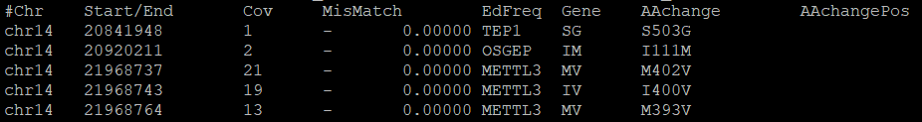
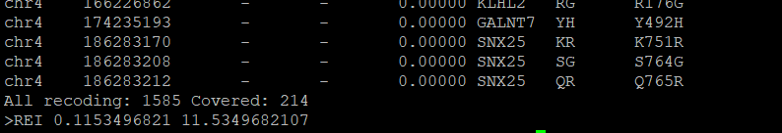
How to calculate the Recoding Editing Index (REI)
Download REDIportal nonsynonymous editing annotation (1585 sites)
cd /home/student_X/RNAseq/DnaRna_
wget https://raw.githubusercontent.com/BioinfoUNIBA/QEdit/master/Example_files/nonsynonymous_table_NONREP_2BS.txt
Index your REDItools output table by tabix
bgzip /home/Student_X/RNAseq/DnaRna_/outTable_X <- must be obtained by running REDItools with coverage and minimal editing
filters turned off
tabix -s 1 -b 2 -e 2 -c R outTable_X.gz
Run the GetREI.py script on a REDItools table
python /data/QEdit/scripts/GetREI.py -i outTable_X.gz -r nonsynonymous_table_NONREP_2BS.txt

Slide 6
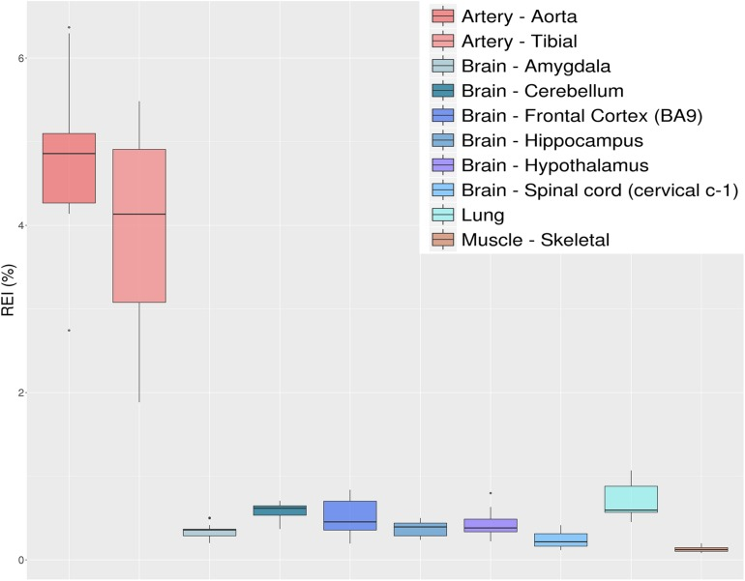
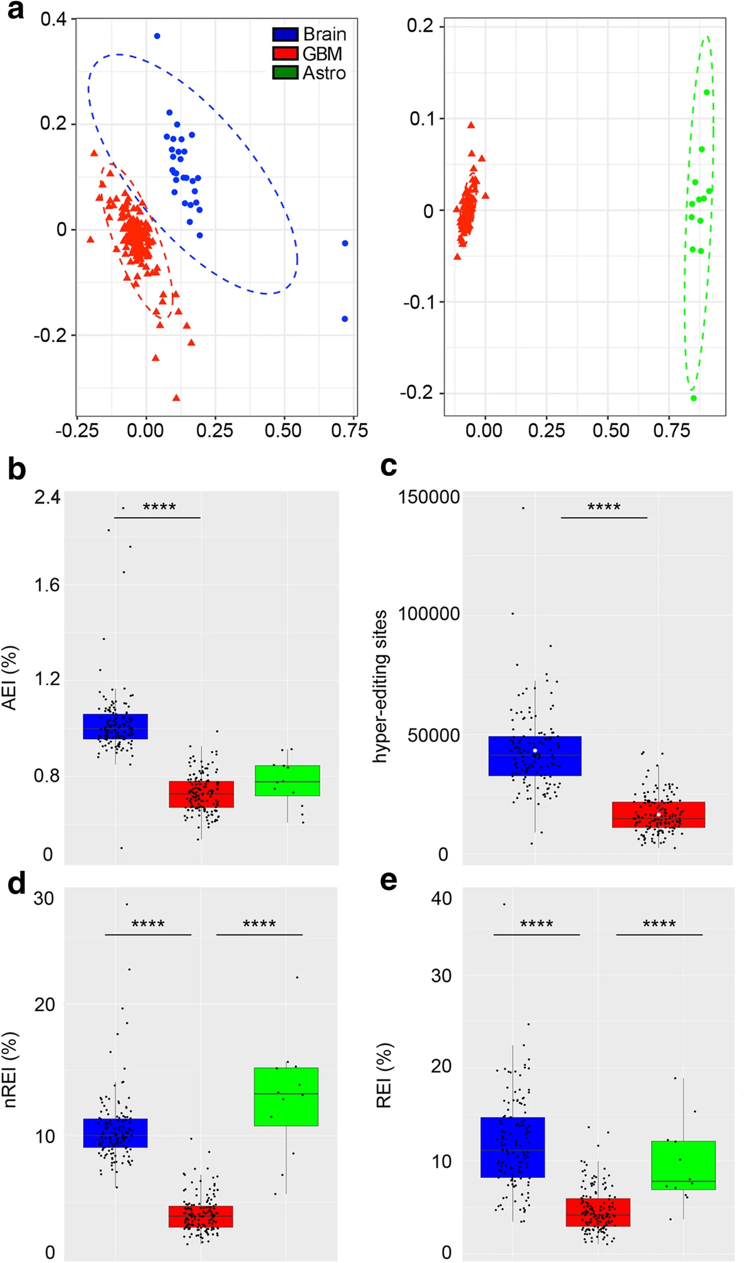
Recoding Editing Index (REI)
Distributions of recoding editing index (REI) values over 10 selected tissues from the GTEx project reported as box-plots. REI is calculated as the weighted average of editing levels over all known recoding sites from the REDIportal database. Most brain sub-tissues show similar levels of recoding editing. A remarkable exception is represented by the aorta and tibial artery showing a surprisingly high editing level.
From Dynamic inosinome profiles reveal novel patient stratification and gender-specific differences in glioblastoma
From Quantifying RNA Editing in Deep Transcriptome Datasets

Slide 7
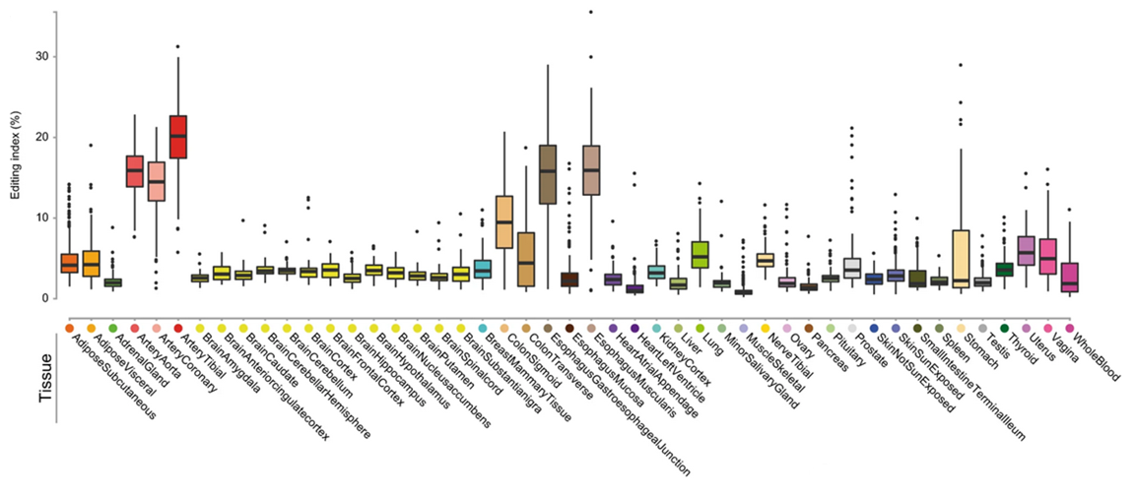
CDS
Box-and-whisker plots, depicting the distribution of per-tissue CDS editing index values reveal that although the number of edited sites in the brain is large, CDS editing activity (number of deamination events) is comparable to most other tissues and is much lower than in arteries, colon or esophagus. Box-and-whisker plots show the medians (horizontal lines), upper and lower quartiles (box edges), and 1.5 × the interquartile range (whiskers).
From: Landscape of adenosine-to-inosine RNA recoding across human tissues

Slide 8
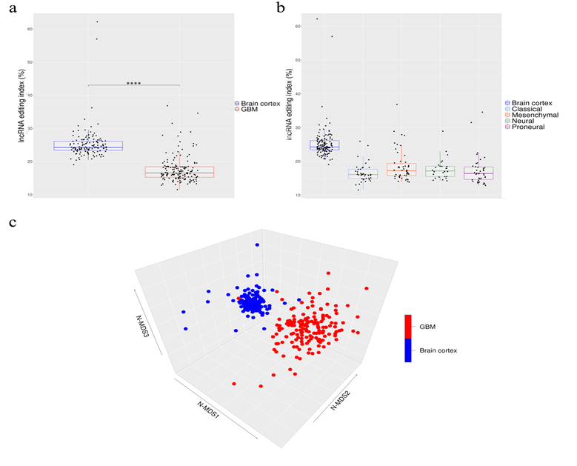
Overall amount of A-to-I RNA editing in long non-coding RNAs (a) Boxplots showing the distributions of long non-coding editing index values across normal brain cortex (132 samples) and primary glioblastomas (156 samples) and (b) glioblastoma subtypes. Two-tailed Mann–Whitney U test was applied. **** p ≤ 0.0001 (c) 3D-MDS (multidimensional scaling) analysis of RNA editing profiles in glioblastoma and normal cerebral cortex. Red and blue points indicate respectively GBMs and normal brains.
From De Novo A-to-I RNA Editing Discovery in lncRNA

Slide 9
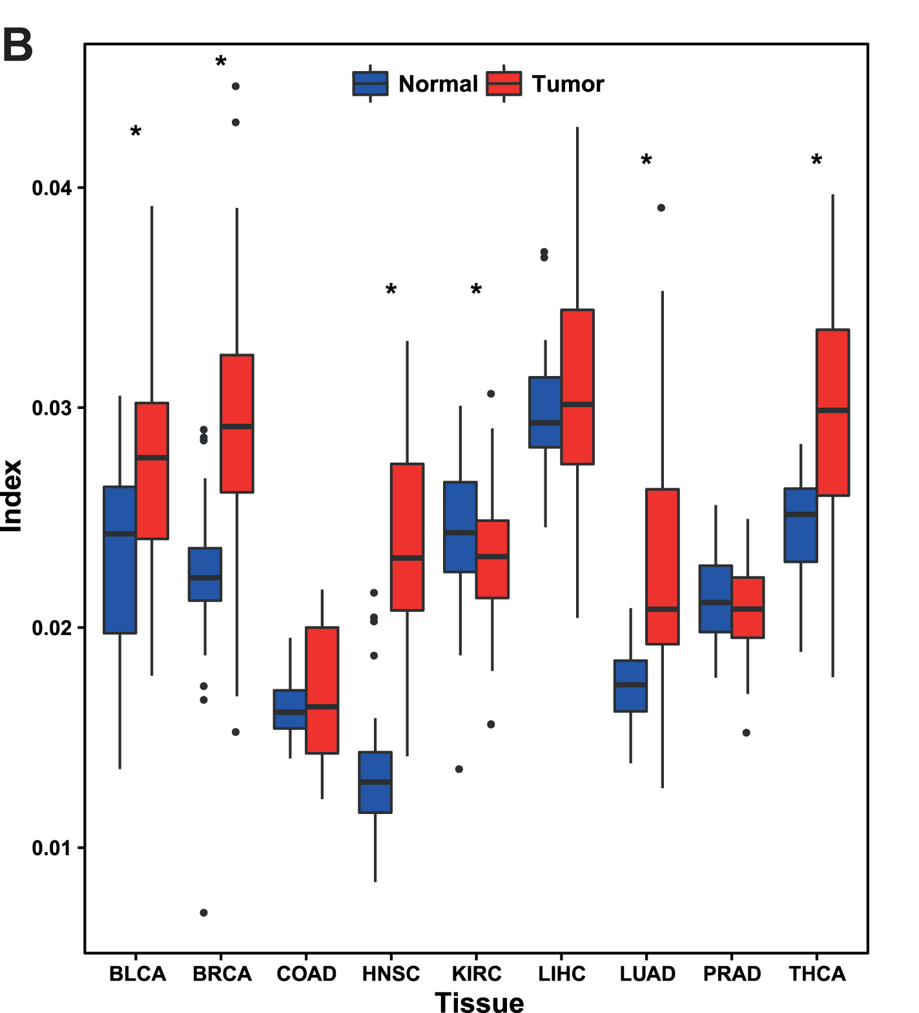
Calculation of editing levels of known sites across all samples
We collected a list of 129 A-to-I editing sites within mature human miRNAs from 17 different studies. In order to measure the editing levels at these sites, we used the same alignment of the TCGA data to the human genome and kept only bases with Phred score Q ≥ 30. We used mpileup for base calling for each of the known editing sites and calculated the editing levels as the ratio between the number of G bases and the sum of A and G bases.
We looked for sites showing editing at a level significantly higher than 1% (using the binomial test followed by FDR multiple testing correction) in at least one of the 55 samples types.
microRNA
Editing of microRNA targets is elevated in tumors. Boxplot of editing index per sample for matched samples in 9 different cancers. Targets-editing is significantly (P < 0.05 Wilcoxon signed-rank test) higher in 5 cancers and lower in 1
From Human cancer tissues exhibit reduced A-to-I editing of miRNAs coupled with elevated editing of their targets

Slide 10
RECAP:
Download and unzip REDIportal annotations
wget http://srv00.recas.ba.infn.it/webshare/rediportalDownload/table1_full.txt.gz gunzip table1_full.txt.gz
Prepare REDIportal annotations for REDItools
awk ‘OFS="\t"{sum+=1; print $1,"rediportal","ed",$2,$2,".",$5,".","gene_id \""sum"\"; transcript_id \""sum"\";"}’ table1_full.txt > atlas.gtf
sort -V -k1,1 -k4,4n atlas.gtf > atlas.sorted.gtf
bgzip atlas.sorted.gtf
tabix –p gff atlas.sorted.gtf.gz
Annotate ALU, REP NON ALU and NON REP sites using known editing events from REDIportal: python /data/REDItools/accessory/AnnotateTable.py –a /data/atlas.sorted.gtf.gz -n ed -k R -c 1 -i outTable_613813579_chr4.out.rmsk.snp.alu -o outTable_613813579_chr4.out.rmsk.snp.alu.ed -u python /data/REDItools/accessory/AnnotateTable.py –a /data/atlas.sorted.gtf.gz -n ed -k R -c 1 -i outTable_613813579_chr4.out.rmsk.snp.nonalu -o outTable_613813579_chr4.out.rmsk.snp.nonalu.ed -u python /data/REDItools/accessory/AnnotateTable.py –a /data/atlas.sorted.gtf.gz -n ed -k R -c 1 -i outTable_613813579_chr4.out.rmsk.snp.nonrep -o outTable_613813579_chr4.out.rmsk.snp.nonrep.ed -u
Extract known editing events from ALU, REP NON ALU and NON REP sites and convert in TAB for editing levels quantification with REDItoolKnown: mv outTable_613813579_chr4.out.rmsk.snp.alu.ed alu mv outTable_613813579_chr4.out.rmsk.snp.nonalu.ed nonalu mv outTable_613813579_chr4.out.rmsk.snp.nonrep.ed nonrep cat alu.ed nonalu.ed nonrep.ed > alu-nonalu-nonrep.ed awk -v FS="\t" -v OFS="\t" '{if ($19=="ed") print}' alu-nonalu-nonrep.ed > knownEditing # from de novo protocol
where $19=="ed" selects only known RNA editing events.

Slide 11
mkdir /home/student_X/artery
cd /home/student_X/artery
mkdir SRR1083076
cd SRR1083076
cp /data/artery/SRR1083076/knownEditing .
sort -k1,1 -k2,2n knownEditing > knownEditing_sorted
bgzip knownEditing_sorted
tabix –p vcf knownEditing_sorted.gz
Now repeat each of the above steps for the other 5 samples the changing SRR code accordingly:
mkdir SRR1091254
mkdir SRR1368668
mkdir /home/student_X/brain
cd /home/student_X/brain
mkdir SRR1086680
mkdir SRR1311771

Slide 12
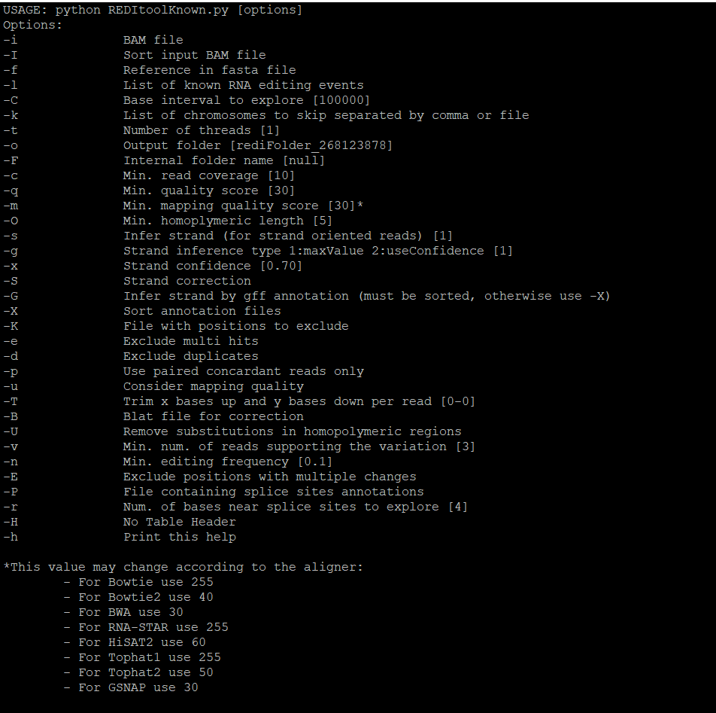
REDItoolKnown.py
REDItoolKnown.py has been developed to explore the RNA editing potential of RNA-Seq data sets using known editing events. Such events can be downloaded from DARNED database or generated from supplementary materials of a variety of publications. Known RNA editing events have to be stored in TAB files.

Slide 13
After generating the tab file sorted containing the list of known sites for each sample run the REDItoolKnown script to quantify the editing levels at these sites:
python /data/REDItools/main/REDItoolKnown.py -i /data/artery/SRR1083076/SRR1083076.bam -f /data/data_reditools/Epitranscriptome_course_2023/refs/GRCh37.primary_assembly.genome_chrs_4_14_19.fa -o /home/student_X/SRR1083076 -l /home/student_X/artery/SRR1083076/knownEditing_sorted.gz –m 255 –e –p –u –E –c 5 –v 1
python /data/REDItools/main/REDItoolKnown.py -i /data/artery/SRR1091254/SRR1091254.bam -f /data/data_reditools/Epitranscriptome_course_2023/refs/GRCh37.primary_assembly.genome_chrs_4_14_19.fa -o /home/student_X/SRR1091254 -l /home/student_X/artery/SRR1091254/knownEditing_sorted.gz –m 255 –e –p –u –E –c 5 –v 1
python /data/REDItools/main/REDItoolKnown.py -i /data/artery/SRR1368668/SRR1368668.bam -f /data/data_reditools/Epitranscriptome_course_2023/refs/GRCh37.primary_assembly.genome_chrs_4_14_19.fa -o /home/student_X/SRR1368668 -l /home/student_X/artery/SRR1368668/knownEditing_sorted.gz –m 255 –e –p –u –E –c 5 –v 1
python /data/REDItools/main/REDItoolKnown.py -i /data/brain/SRR1086680/SRR1086680.bam -f /data/data_reditools/Epitranscriptome_course_2023/refs/GRCh37.primary_assembly.genome_chrs_4_14_19.fa -o /home/student_X/SRR1086680 -l /home/student_X/brain/SRR1086680/knownEditing_sorted.gz –m 255 –e –p –u –E –c 5 –v 1
python /data/REDItools/main/REDItoolKnown.py -i /data/brain/SRR1311771/SRR1311771.bam -f /data/data_reditools/Epitranscriptome_course_2023/refs/GRCh37.primary_assembly.genome_chrs_4_14_19.fa -o /home/student_X/SRR1311771 -l /home/student_X/brain/SRR1311771/knownEditing_sorted.gz –m 255 –e –p –u –E –c 5 –v 1

Slide 14
Differential RNA editing
The identification of differential RNA editing is still an open question. Nonetheless, dysregulated RNA editing at recoding events can be calculated employing the Mann-Whitney U-test described in Silvestris et al. (2019) or the statistical pipeline proposed by Tran et al. (2019) Both pipelines are embedded with the get_DE_events.py script.
Prepare a comma separated sample informations file (e.g ArteryAorta_vs_BrainCerebellum.sif) required as input by the get_DE_events.py script.
A csv sample file containing the main informations about each sample to be used in the experiment.
A name for Samples group1 (e.g. ArteryAorta)
A name for Samples group2 (e.g BrainCerebellum)
An example file is provided:
Sample,Group,Type
SRR1083076,GROUPA,ArteryAorta
SRR1086680,GROUPB,BrainCerebellum
SRR1091254,GROUPA,ArteryAorta
SRR1311771,GROUPB,BrainCerebellum
SRR1368668,GROUPA,ArteryAorta
Create a confortable workdir (e.g. ArteryAorta_vs_BrainCerebellum) and enter it
mkdir ArteryAorta_vs_BrainCerebellum && cd ArteryAorta_vs_BrainCerebellum

Slide 15
Run sample_path_folder_creator.py that will copy the Reditools tables in different directories following the sample/Group subdivisions reported in the sample informations file (.sif).
python /data/QEdit/scripts/sample_path_folder_creator.py /home/student_X/ArteryAorta_vs_BrainCerebellum.sif
Note. The script assumes that REDItools outputs (e.g. SRR1071289, SRR1101591) are contained in a "tables" folder in your main working directory, otherwise modify the last line of the script accordingly.
Run the get_DE_events.py script (Mann-Whitney U-test) on multiple REDItools tables following the sample/Group subdivions reported in the sample informations file (.sif). The option -sig yes in combination with -cpval 2 (BH correction), returns only significantly edited positions. MtsA and mtsB, represents the minimum threshold of samples per group on which the statistical tests are applied.
python /data/QEdit/scripts/get_DE_events.py -input_file /home/student_X/ArteryAorta_vs_BrainCerebellum.sif > DE_res
Alternatively, run the get_DE_events.py script on the same samples applying the the statistical pipeline proposed by Tran et al. (2019)
python /data/QEdit/scripts/get_DE_events.py -linear -input_file ArteryAorta_vs_BrainCerebellum.sif

Slide 16
get_DE_events.py
This scripts and its related files are part of the supplemental material for the paper "Quantifying RNA editing in deep transcriptome datasets"
This script compares REDItools output table arising from multiple samples and returns dysregulated RNA editing by means of the Mann-Whitney U-test described in Silvestris et al. (2019) or the statistical pipeline proposed by Tran et al. (2019). REDItoools output table are pre-filtered according to these main following criteria.
RNAseq coverage per position (default 10 reads)
Minimum editing frequency per position (default 10%)
For each editing candidate, the script applies the MannWhitney test to check the significance between the two groups, A and B. By default the test is carried out only if the number of editing events per position is equal to 50% of the samples per group. This treshold can be manually modified (for both groups) by playing with the -mtsA and -mtsB options respectively. Returned p-values can be corrected using Benjamini Hochberg or Bonferroni tests.
Usage:
usage: get_DE_events.py [-h] [-c MIN_COVERAGE] [-cpval PVALUE_CORRECTION]
[-input_file SAMPLES_INFORMATIONS_FILE]
[-gene_pos_file GENE_POS_FILE] [-f MIN_EDIT_FREQUENCY]
[-mtsA GROUPA_MIN_SAMPLE_TESTING]
[-mtsB GROUPB_MIN_SAMPLE_TESTING]
[-sig ONLY_SIGNIFICANT]
[-siglevel STATISTICAL_SIGNIFICANCE] [-linear]
[-graph] [-chr_col CHR_COLUMN] [-rsite RSITE]

Slide 17
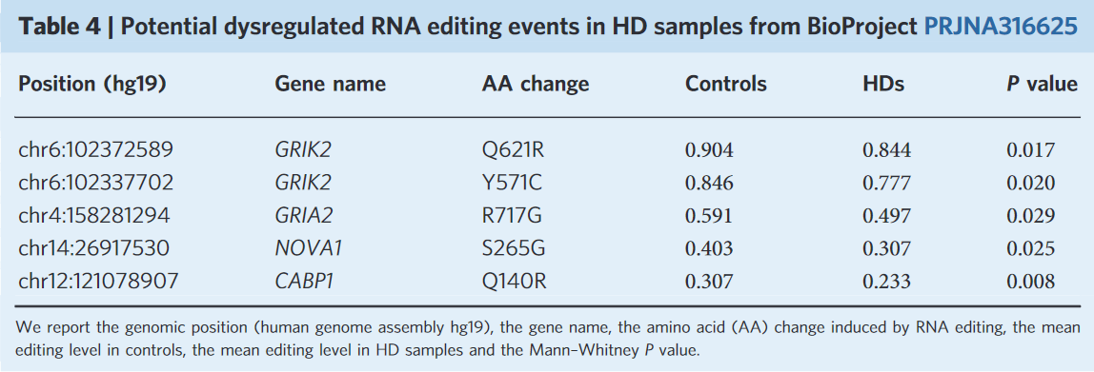
optional arguments: -h, --help show this help message and exit
-c MIN_COVERAGE Coverage-q30
-cpval PVALUE_CORRECTION 1 --> Bonferroni correction / 2 --> Benjamini Hochberg
-input_file SAMPLES_INFORMATIONS_FILE (.sif) Comma separated file e.g: Sample,Group,Type (e.g SRR1093527,GROUPA,BrainCerebellum..., SRR1088437,GROUPB,ArteryTibial... etc) An example file is provided here
-gene_pos_file GENE_POS_FILE nonsynonymous_table_NONREP derived from Rediportal NOTE: A gene_pos file is required by -graph or -rsite. An example file can be found here here.
-f MIN_EDIT_FREQUENCY Editing Frequency
-mtsA GROUPA_MIN_SAMPLE_TESTING min percentage of groupA samples
-mtsB GROUPB_MIN_SAMPLE_TESTING min percentage of groupB samples
-sig ONLY_SIGNIFICANT Return only statistically significant editing events
-siglevel STATISTICAL_SIGNIFICANCE cutoff level to reject H0 hypothesis default 0.05
-linear Enable linear statistical model (Tran et al., 2019).
-graph R graph compatible table containing the following columns: Site|Delta|Mannwhitney|pval|Benjamini Hochberg corrected pvalue|status NOTE: THIS OPTION CAN BE USED ONLY IN COMBINATION with -Gene_pos_file
-chr_col CHR_COLUMN If set to "yes" a chromosome_position column will be added to R graph table. NOTE: THIS OPTION IS SPECIFIC FOR -graph & -Gene_pos_file COMBINATION
-rsite RSITE If set to "yes" all recoding sites will be shown in the output table. NOTE: THIS OPTION ONLY WORKS IN DEFAULT MODE.
e.g. python ../REDItools/accessory/get_DE_events.py -cpval 2 -input_file sample_information.csv -sig yes

Slide 18
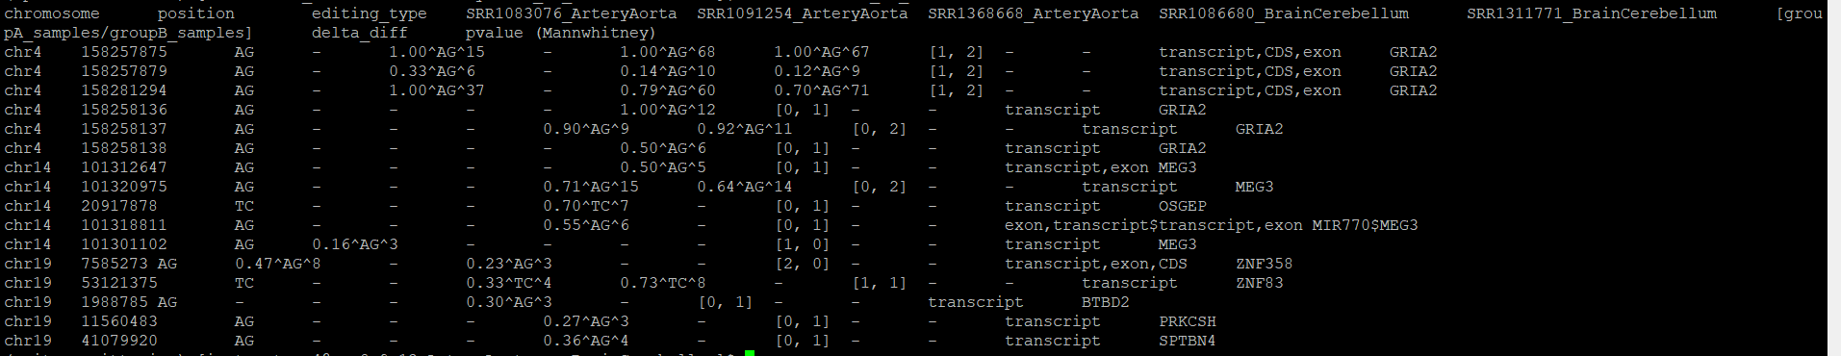
Annotate editing events with the UCSC refGene transcriptome annotation to add gene and region information:
python /data/REDItools/accessory/AnnotateTable.py -a /data/data_reditools/Epitranscriptome_course_2023/refs/refGene_sorted.gtf.gz -i DE_res -o annotated_DE_res -u -n refgene -k 'chromosome'

Slide 19
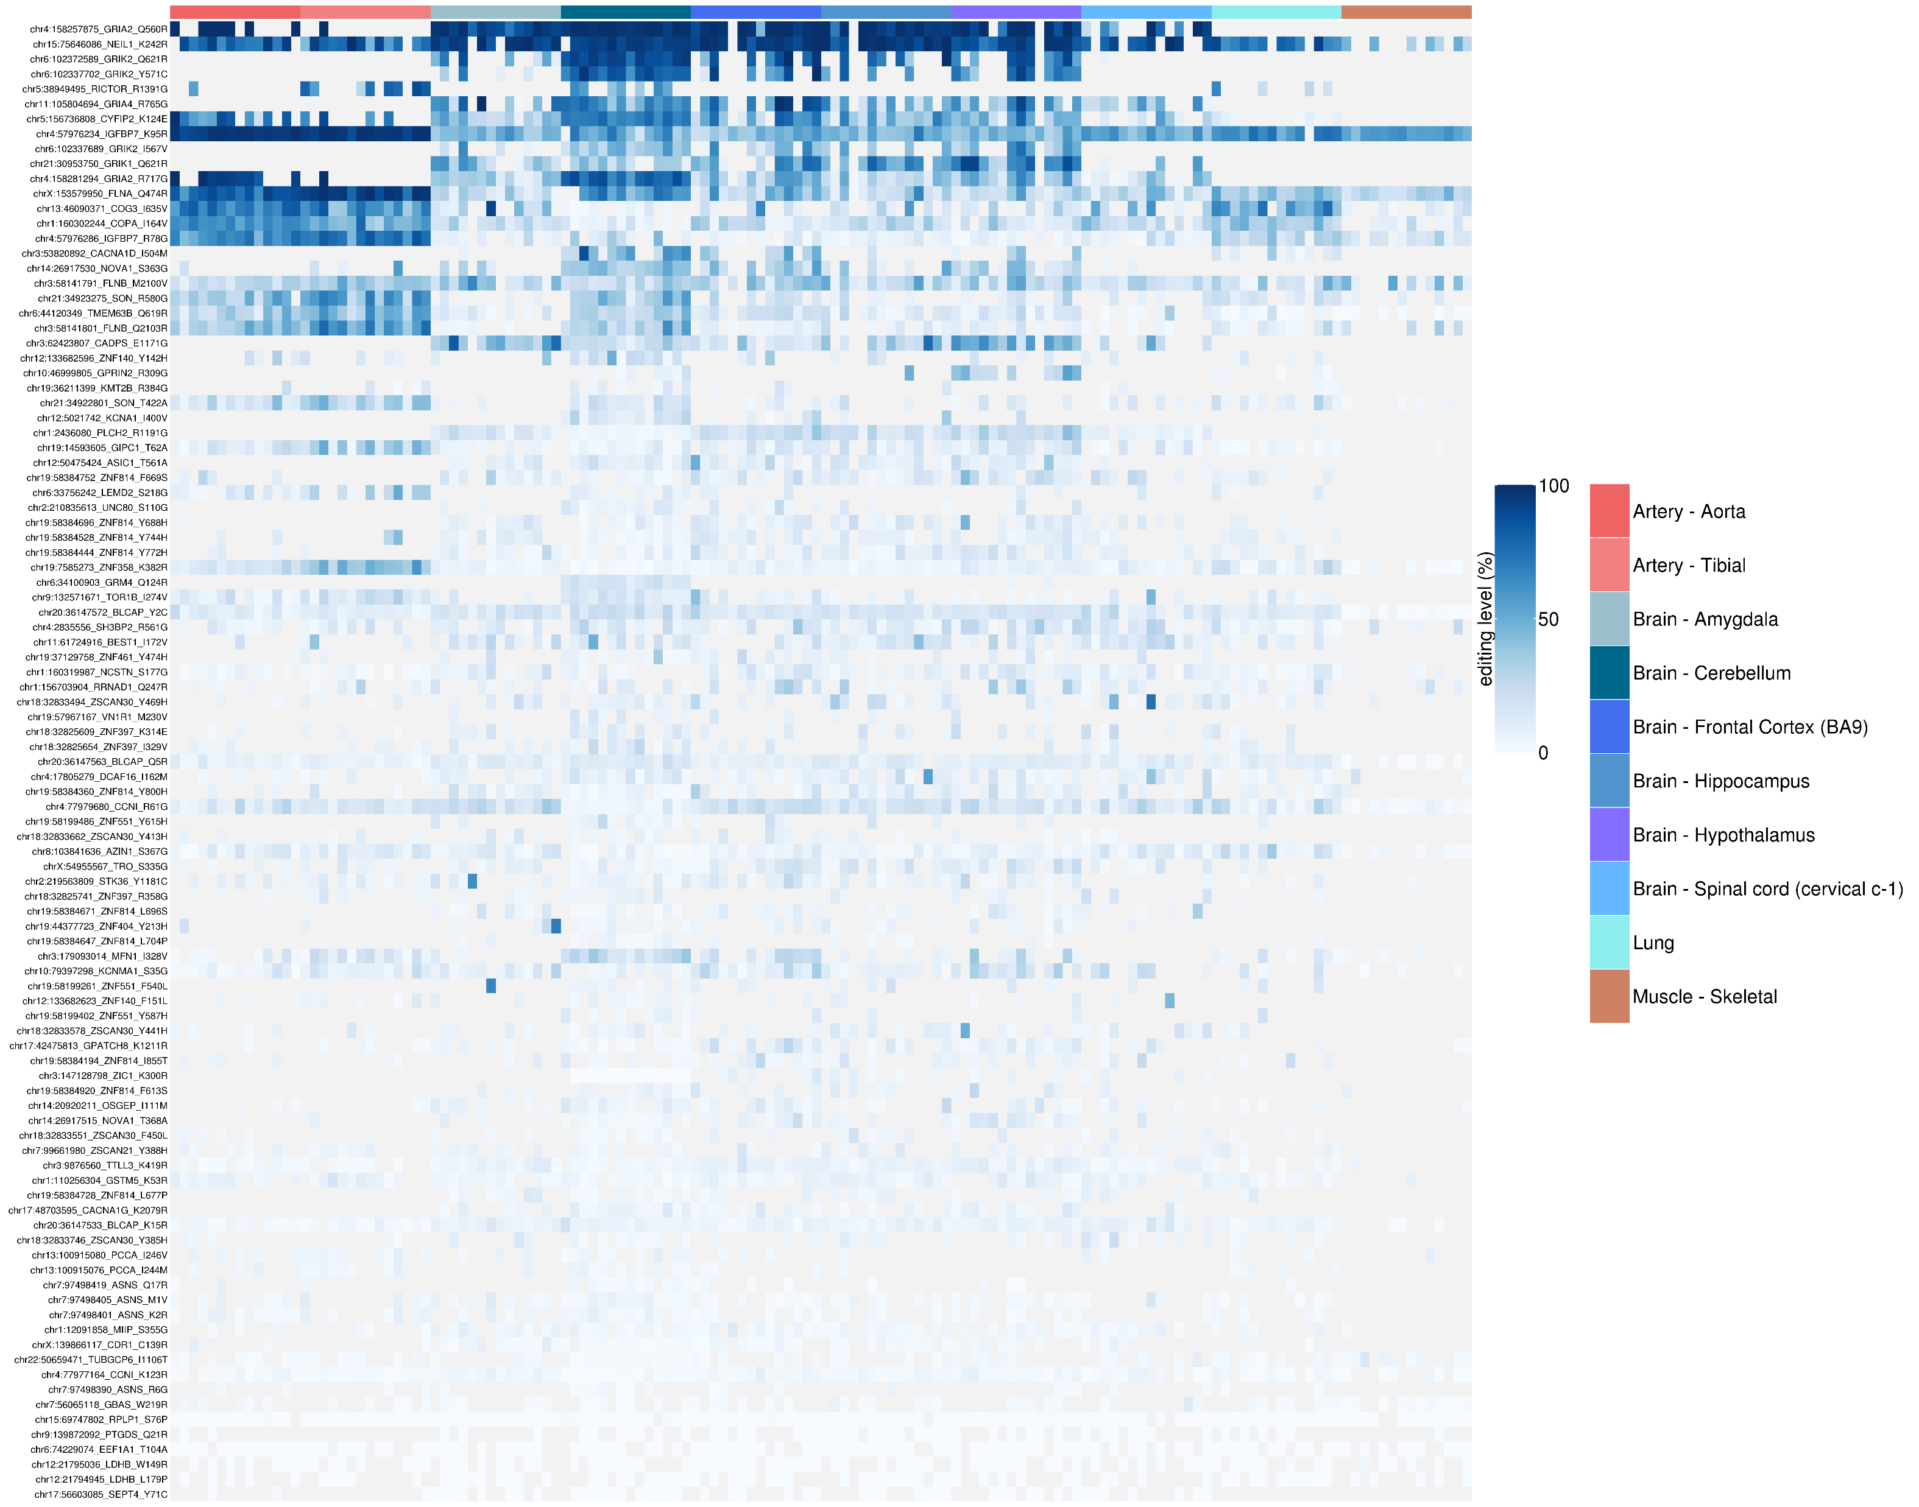
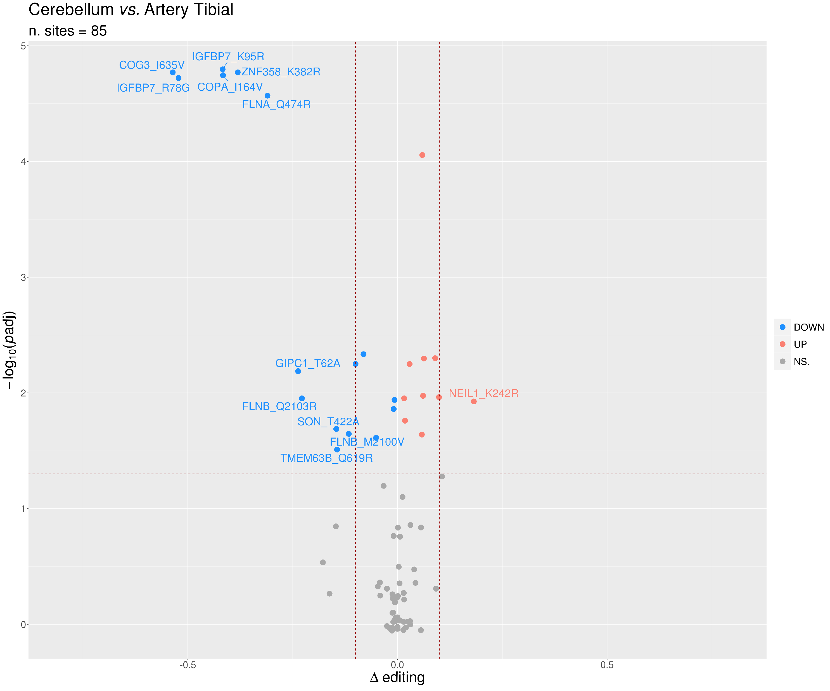
Editing levels visualization examples heatmap
(https://github.com/BioinfoUNIBA/QEdit):
volcano plot

Slide 20
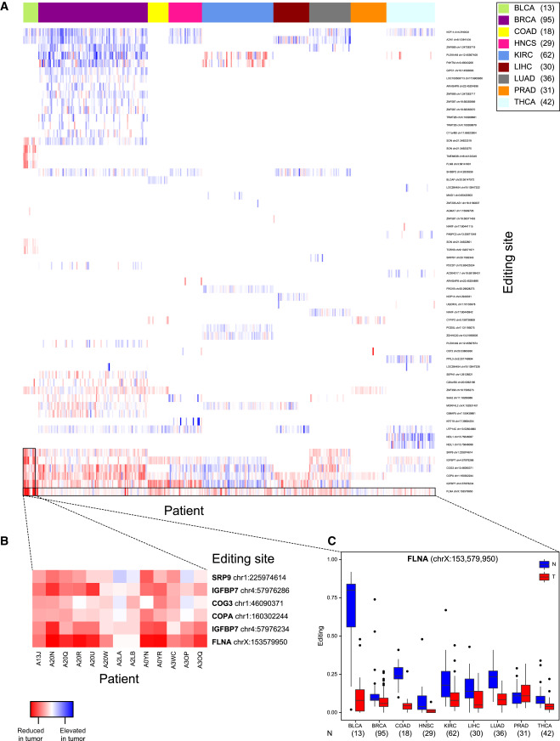
Pan-cancer Editing Alteration in Coding Sequences
To analyze editing in the coding sequences, we compiled a list of editing sites to be tested for alteration in cancer. We took all sites documented in the RADAR database (Ramaswami and Li, 2014) in coding regions (UCSC annotation, 47,025 sites), supplemented by novel sites detected using the hyper-editing scheme within coding sequence (8,299 sites). We then excluded synonymous sites within Alu repeats, sites located in immunoglobulins (likely to be due to somatic hyper-mutations) and known SNPs (dbSNP 135). We did keep the following three sites: chr20, 36147572; chr5,156736808; and chrX,153579950 in the BLCAP, CYFIP2, and FLNA sites, respectively, which are known editing sites (Levanon et al., 2005). We further removed all sites annotated by wAnnovar (Chang and Wang, 2012) as residing in non-coding regions, resulting in 9,484 sites. We then quantified the editing levels in these sites using the REDItools script (Picardi and Pesole, 2013), trimming six bases at both ends of the reads.
For each of the sites, differences in editing level between normal and cancer tissues were evaluated using the χ2 test followed by 5% FDR multiple-testing correction. Finally, we discarded sites where the absolute difference in the average editing level between normal and cancer samples was less than 5%
From Elevated RNA Editing Activity Is a Major
Contributor to Transcriptomic Diversity in Tumors

Slide 21
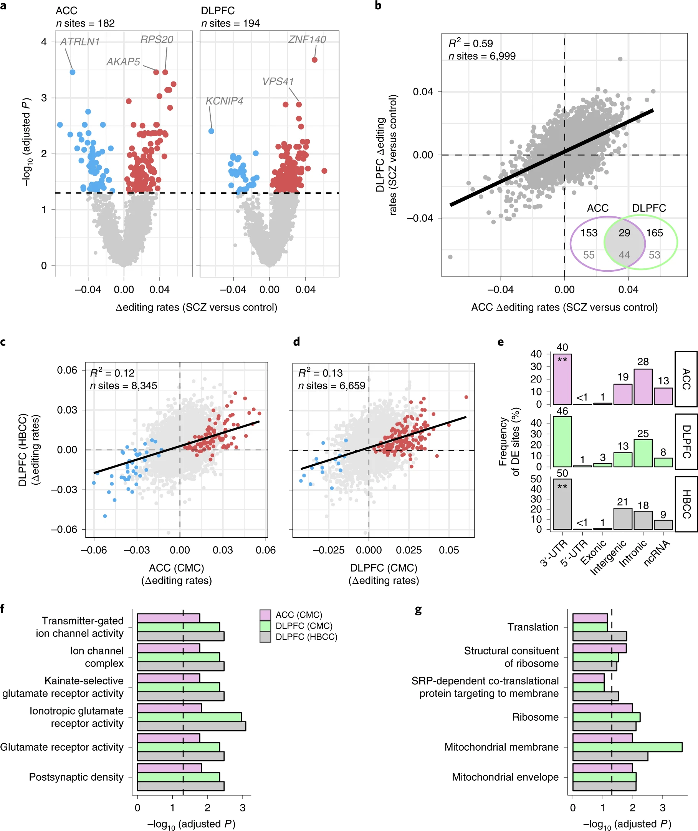
From: Global landscape and genetic regulation of RNA editing in cortical samples from individuals with schizophrenia
Fig. 3: Identification of differentially edited sites in SCZ.
a, Differential editing sites in the ACC (n_{control} = 245, n_{SCZ} = 225) and DLPFC (n_{control} = 286, n_{SCZ} = 254). The dotted line marks a multiple test-corrected level of significance (adjusted P < 0.05, limma, linear regression with Benjamini–Hochberg correction).
Red points indicate over-edited sites and blue points indicate under-edited sites. For the top three sites, their respective gene bodies have been indicated.

