Slide 1

Welcome to the Life Science DMP- workshop on Zoom
Turn your video on while speaking
Use the chat function for questions
Mute yourself while not speaking
Use the ‘hand up’ function if you want to contribute directly
Please use the ‘rename’ function to indicate your department (if you want)

Slide 2

Data Management Plans and a short introduction to ELIXIR & Digital Life Norway
Korbinian Bösl
Data management coordinator
ELIXIR Norway/Digital Life Norway
10th December 2020
Illustrative Icons from Font Awesome licensed under Creative Commons Attribution 4.0 International License

Slide 3
Schedule
10.12.2020
0900 - 0915 Introduction
0915 - 0945 Requirements from institutions & funding bodies
0945 - 1015 Information on national and local storage infrastructures
1015 - 1030 Short break
1030 - 1230 Data preservation, archiving and sharing

Slide 4
Schedule
11.12.2020
0900 - 1000 Key legal requirements for research in the GDPR and Health research act
        Personal Data Act
        Health Research Act
1000 - 1015 Short break
1015 - 1045 Licensing of data, biological material and software
1045 - 1100 Intro Data Steward Wizard
1100 - 1300 Hands on training and assistance to generate a data

Slide 5
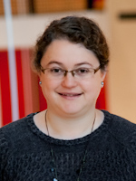

Elin Stangeland

Slide 6



Elin Stangeland
Lars Soligard
Gard O Sundby Thomassen

Slide 7
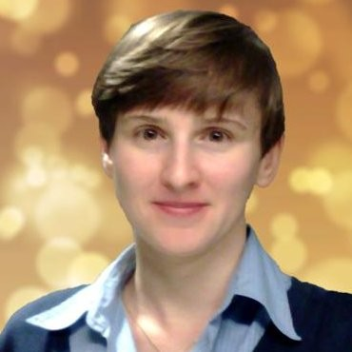

Elin Stangeland
Lars Soligard
Gard O Sundby Thomassen
Eszter Agnes Papp

Slide 8




Elin Stangeland
Lars Soligard
Gard O Sundby Thomassen
Eszter Agnes Papp
+
Federico Bianchini
Korbinian Bösl

Slide 9
ELIXIR Europe
‘Data for Life’
Mission:
To operate a sustainable European infrastructure for biological information, supporting life-science research and its translation to society, the bio-industries, environment and medicine

Slide 10
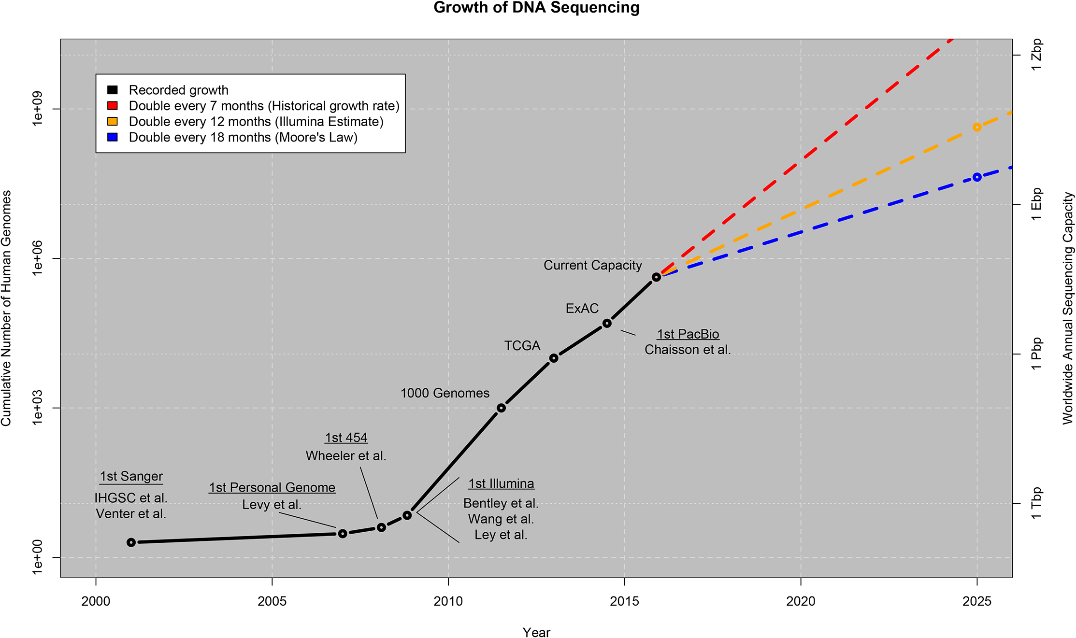
ELIXIR Europe
From: Stephens, Z. D. et al. Big Data: Astronomical or Genomical? PLOS Biology 13, e1002195 (2015).
licensed under Creative Commons Attribution 4.0 International License

Slide 11

ELIXIR Europe
Data stored in
ELIXIR/EBI-EMBL
Repositories
Cook, C. E. et al. The European Bioinformatics Institute in 2018: tools, infrastructure and training. Nucleic Acids Res 47, D15–D22 (2019).
licensed under Creative Commons Attribution 4.0 International License

Slide 12

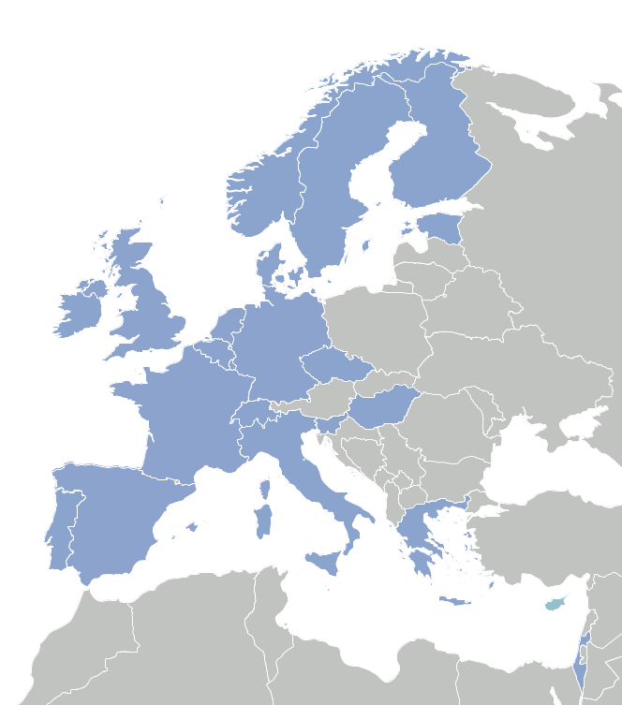

Slide 13

A distributed infrastructure to scale with the challenge
ELIXIR data infrastructure for Europe’s life science research sector
ELIXIR Nodes build local bioinformatics capacity throughout Europe
ELIXIR Nodes build on national strengths and priorities

Slide 14

ELIXIR Services
Data deposition:
ENA, EGA, PDBe, EuropePMC, …

Slide 15
ELIXIR Services
Data deposition:
ENA, EGA, PDBe, EuropePMC, …
q
Data management:
Genome annotation
Data management plans

Slide 16
ELIXIR Services
Data deposition:
ENA, EGA, PDBe, EuropePMC, …
q
Data management:
Genome annotation
Data management plans
D
Added value data:
UniProt, Ensembl, OrphaNet, …

Slide 17

ELIXIR Services
Data deposition:
ENA, EGA, PDBe, EuropePMC, …
q
Data management:
Genome annotation
Data management plans
D
Added value data:
UniProt, Ensembl, OrphaNet, …
Data Interoperability:
FAIRSharing, identifiers.org, OLS,
Bioschemas, …

Slide 18

ELIXIR Services
Data deposition:
ENA, EGA, PDBe, EuropePMC, …
Compute:
Secure data transfer, cloud computing, AAI
q
Data management:
Genome annotation
Data management plans
D
Added value data:
UniProt, Ensembl, OrphaNet, …
Data Interoperability:
FAIRSharing, identifiers.org, OLS,
Bioschemas, …

Slide 19

ELIXIR Services
Data deposition:
ENA, EGA, PDBe, EuropePMC, …
Compute:
Secure data transfer, cloud computing, AAI
q
Data management:
Genome annotation
Data management plans
Bioinformatics tools:
Bio.tools, Benchmarking: OpenEBench
D
Added value data:
UniProt, Ensembl, OrphaNet, …
Data Interoperability:
FAIRSharing, identifiers.org, OLS,
Bioschemas, …

Slide 20
ELIXIR Services
Data deposition:
ENA, EGA, PDBe, EuropePMC, …
Compute:
Secure data transfer, cloud computing, AAI
q
Data management:
Genome annotation
Data management plans
Bioinformatics tools:
Bio.tools, Benchmarking: OpenEBench
I
Industry:
Innovation and SME programme
Bespoke collaborations
D
Added value data:
UniProt, Ensembl, OrphaNet, …
Data Interoperability:
FAIRSharing, identifiers.org, OLS,
Bioschemas, …

Slide 21

ELIXIR Services
Data deposition:
ENA, EGA, PDBe, EuropePMC, …
Compute:
Secure data transfer, cloud computing, AAI
q
Data management:
Genome annotation
Data management plans
Bioinformatics tools:
Bio.tools, Benchmarking: OpenEBench
I
Industry:
Innovation and SME programme
Bespoke collaborations
D
Added value data:
UniProt, Ensembl, OrphaNet, …
Training:
TeSS, Data Carpentry, eLearning
Data Interoperability:
FAIRSharing, identifiers.org, OLS,
Bioschemas, …

Slide 22


ELIXIR Structure
Five technical Platforms for Compute, Data, Tools, Interoperability, and Training

Slide 23
ELIXIR Structure
Five technical Platforms for Compute, Data, Tools, Interoperability, and Training
Complemented by Communities for specific use cases within e.g. Human data, Metabolomics, Proteomics, Marine Metagenomics, Microbial Biotechnology, Structural Bioinformatics and others

Slide 24

ELIXIR Structure
The Norwegian node of ELIXIR Europe
Currently funded by:
  The Research Council of Norway (until 2021)
  The involved institutions; UiB, UiO, NMBU, NTNU and UiT
  Users
Services to national users
  Infrastructure, support and training
Deliverables to ELIXIR Europe
  Tools and databases

Slide 25
Our additional user services - Norway
Support – through our HelpDesk
Training – in using our tools and workflows, and in data management
Bioinformatics infrastructure
Analysis, sharing and storage of data
contact@bioinfo.no

Slide 26

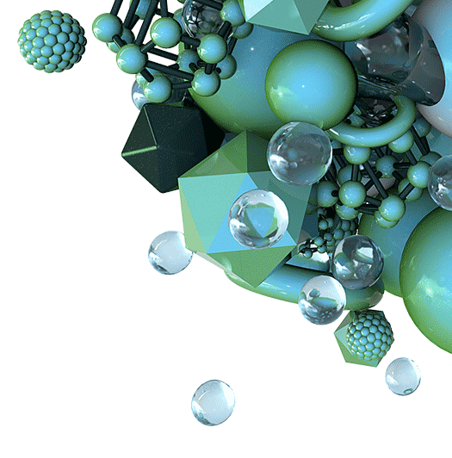
Support for trans-disciplinary participating projects:
Responsible Research and Innovation
Innovation and industry involvement
Training & Research school
Competence and infrastructure – incl. Data Management
Outreach & Communication

Slide 27
Support for trans-disciplinary participating projects:
Responsible Research and Innovation
Innovation and industry involvement
Training & Research school
Competence and infrastructure – incl. Data Management
Outreach & Communication
RCN: Collaborative Projects to meet Societal and Industry-related Challenges Apply by 17th February 2021 and join DLN

Slide 28
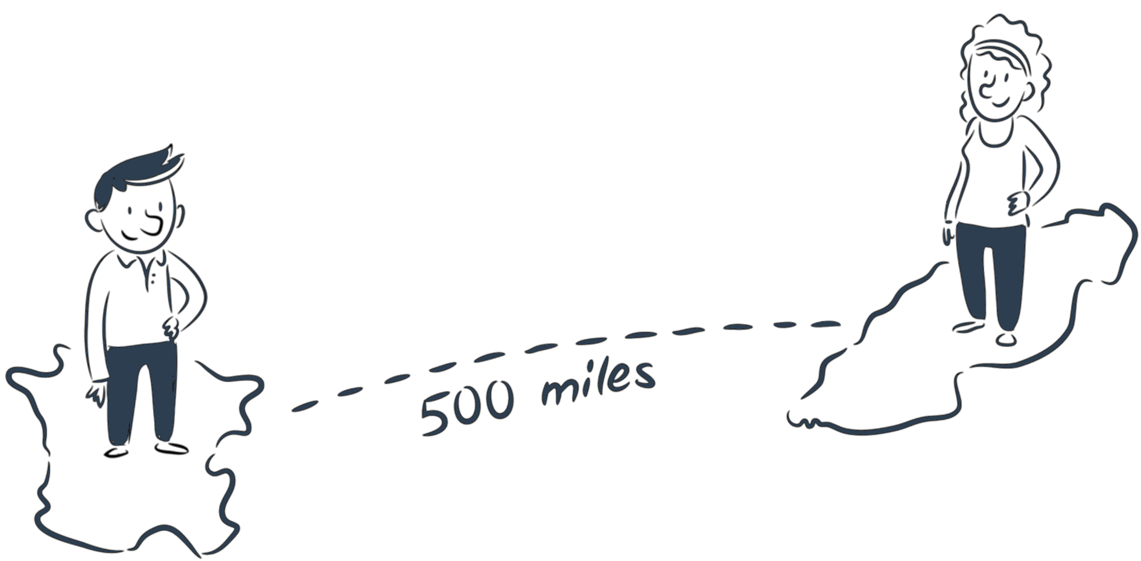



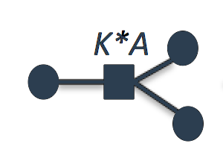
Data Management
Make research data and related metadata discoverable, accessible and understandable today, tomorrow, and well into the future.

Slide 29


Slide 30


Slide 31


Slide 32


Slide 33


Slide 34


Slide 35


Slide 36
R

Slide 37
R
Discover,
Reuse & cite
Plan &
Design
Share &
Publish
Collect &
Capture
Manage, store &
preserve
Collaborate &
Analyse

Slide 38
Data creation &
deposit
R
Discover,
Reuse & cite
Plan &
Design
Share &
Publish
Collect &
Capture
Manage, store &
preserve
Collaborate &
Analyse

Slide 39
Data creation &
deposit
R
Discover,
Reuse & cite
Plan &
Design
Share &
Publish
Collect &
Capture
Manage, store &
preserve
Collaborate &
Analyse
Managing active
data

Slide 40
Data creation &
deposit
R
Discover,
Reuse & cite
Plan &
Design
Share &
Publish
Collect &
Capture
Manage, store &
preserve
Collaborate &
Analyse
Archives &
Data repositories
Managing active
data

Slide 41
Data catalogues & registries
Data creation &
deposit
R
Discover,
Reuse & cite
Plan &
Design
Share &
Publish
Collect &
Capture
Manage, store &
preserve
Collaborate &
Analyse
Archives &
Data repositories
Managing active
data

Slide 42



Slide 44


Slide 45


Slide 46


Slide 47


Slide 48



Slide 49








Slide 50


sensitive
data

Slide 52
Data Management Plan?
sensitive
data

Slide 53


/
/
/
/
/

Slide 54

]
/
/
/
/
/
/
sensitive
data

Slide 55

/
/
/
/
/
/
sensitive
data

Slide 56


Data catalogues & registries
Data creation &
deposit
Open Data
Archives &
Data repositories
Managing active
data
“As open as possible - as closed as necessary”

Slide 57
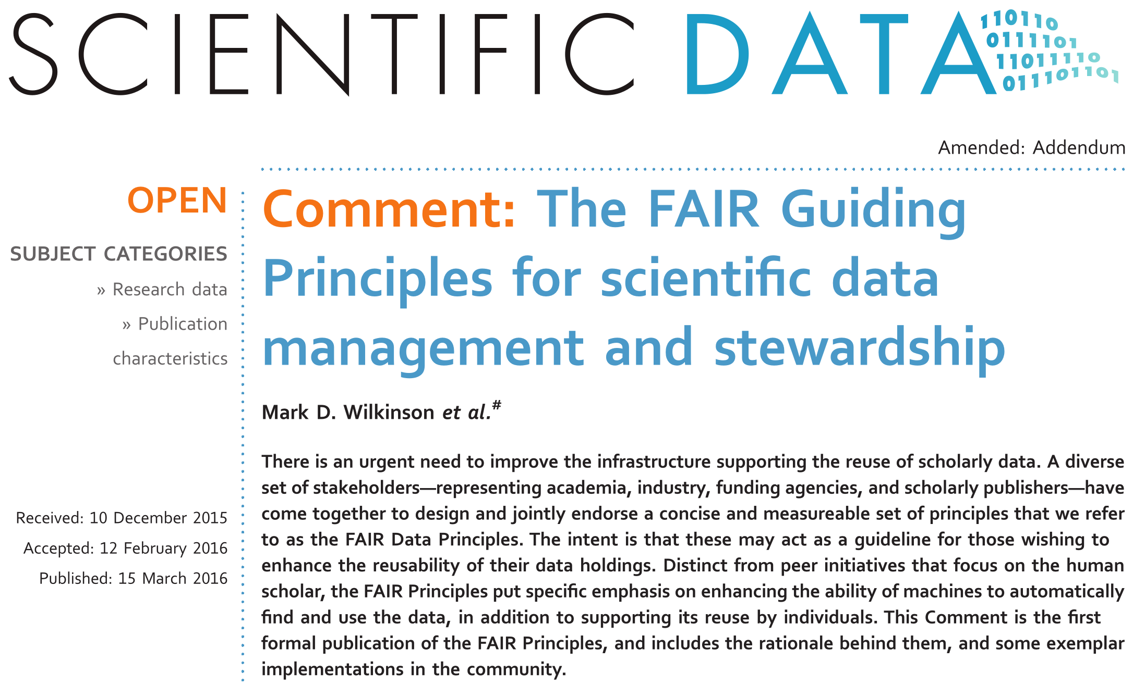
https://doi.org/10.1038/sdata.2016.18

Slide 58
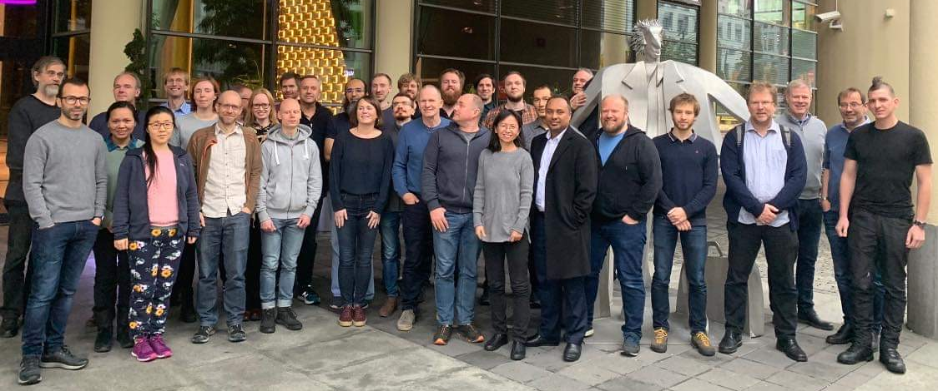


N elixir-norway.org
digitallifenorway.org
E contact@bioinfo.no
contact@digitallifenorway.org
korbinian.bosl@uib.no
T @elixirnorway
@DigitaltLiv
@BoslKorbinian

