Slide 1

Archiving, preserving, sharing
Korbinian Bösl
Data management coordinator
ELIXIR Norway/Digital Life Norway
10th December 2020
Illustrative Icons from Font Awesome licensed under Creative Commons Attribution 4.0 International License

Slide 2






















sensitive
data

Slide 3
Why should I deposit my data?
4 Increased Visibility (SEO) → 25% more citations
doi.org/10.1371/journal.pone.0230416

Slide 4
Why should I deposit my data?
4 Increased Visibility (SEO) → 25% more citations
D Value added Databases → more citations
doi.org/10.1371/journal.pone.0230416

Slide 5
Why should I deposit my data?
4 Increased Visibility (SEO) → 25% more citations
D Value added Databases → more citations
r FAIRification – Funding requirements //
doi.org/10.1371/journal.pone.0230416

Slide 6
Why should I deposit my data?
4 Increased Visibility (SEO) → 25% more citations
D Value added Databases → more citations
r FAIRification – Funding requirements //
$ Safe money on storage
doi.org/10.1371/journal.pone.0230416

Slide 7

FAIR illustrations icons from ARDC 2018 licensed under Creative Commons Attribution 4.0 International License

Slide 8
FAIR illustrations icons from ARDC 2018 licensed under Creative Commons Attribution 4.0 International License

Slide 9
FAIR illustrations icons from ARDC 2018 licensed under Creative Commons Attribution 4.0 International License

Slide 10
FAIR illustrations icons from ARDC 2018 licensed under Creative Commons Attribution 4.0 International License

Slide 11
FAIR illustrations icons from ARDC 2018 licensed under Creative Commons Attribution 4.0 International License

Slide 12
What is a PID and why do we need it?
FAIR illustrations icons from ARDC 2018 licensed under Creative Commons Attribution 4.0 International License

Slide 13
A PID consists of 2 components:
  a unique identifier
  a service that locates the resource over time even when it's location changes

Slide 14


Examples for digital objects
Digital Object Identifiers
Handels
Archival Resource Keys (ARK)
Perisitant Uniform Resource Locator (PURL)
Universal Resource Name (URN)
Identifiers.org<

Slide 15


PIDs exits also for
 Persons
$ Funding bodies
 Institutions
 Instruments (soon)

Slide 16
PIDs exits also for
 Persons
$ Funding bodies
 Institutions
 Instruments (soon)

Slide 17
PIDs exits also for
 Persons
$ Funding bodies
 Institutions
 Instruments (soon)

Slide 18
PIDs exits also for
 Persons
$ Funding bodies
 Institutions
 Instruments (soon)

Slide 19
Why do we need standard vocabularies?
FAIR illustrations icons from ARDC 2018 licensed under Creative Commons Attribution 4.0 International License

Slide 20
How many way can you say “female”?

Slide 21
How many way can you say “female”?
18-day pregnant females
female (lactating)
individual female
worker caste (female)
2 yr old female
female (pregnant)
lgb*cc females
sex: female
400 yr. old female
female (outbred)
mare
female, other
adult female
female parent
female (worker)
female child
asexual female
female plant
monosex female
femal
castrate female
female with eggs
ovigerous female
3 female
cf.female
female worker
oviparous sexual females
female (phenotype)
cystocarpic female
female, 6-8 weeks old
worker bee
female mice
dikaryon
female, virgin
female enriched
female, spayed
dioecious female
female, worker
pseudohermaprhoditic female
femlale
diploid female
female(gynoecious)
remale
metafemale
f
femele
semi-engorged female
sterile female
famale
female, pooled
sexual oviparous female
normal female
femail
femalen
sterile female worker
sf
female
females
strictly female
vitellogenic replete female
female - worker
females only
tetraploid female
worker
female (alate sexual)
gynoecious
thelytoky
hexaploid female
female (calf)
healthy female
female (gynoecious)
female (f-o)
hen
probably female (based on morphology)
female (note: this sample was originally provided as a \"male\" sample to us and therefore labeled this way in the brawand et al. paper
and original geo submission; however, detailed data analyses carried out in the meantime clearly show that this sample stems from
a female individual)"
Courtesy of N. Silvester, European Nucleotide Archive, EMBL-EBI

Slide 22


Slide 23


Slide 24



Slide 25


Uberon
Onthologies
enable hierarchical searches

Slide 26
Meta data standards
MINSEQE

Slide 27

Meta data standards
Taxonomy
Organism
Experimental factors
Tissue
Sequencing data - e.g. FASTQ
Processed data
Linked publications, contact data, general information
sample - data relationships
Experimental + data processing protocols
MINSEQE
Uberon

Slide 28

Controlled vocabulary & Ontologies

Slide 29

Controlled vocabulary & Ontologies

Slide 30

Controlled vocabulary & Ontologies

Slide 32
Meta data standards
MINSEQE
MIAME
...

Slide 33
Meta data standards
MINSEQE
MIAME
...
HUPO-PSI TraML
MIAPE
...

Slide 34
Meta data standards
MINSEQE
MIAME
...
SRA-XML
HUPO-PSI TraML
MIAPE
...

Slide 35

Community standards vs. formal ISO standards
https://xkcd.com/927/
https://elixir-europe.org/events/elixir-guest-webinar-two-universes-one-world-community-standards-vs-formal-iso-standards-life

Slide 36

Which metadatastandard?
fairsharing.org

Slide 37
Data format standards
Common formats
Non-proprietary formats (accessible with open source tools)
Avoiding binary data formats (data corruption)
Examples: FASTQ, TIFF, mzML,...

Slide 38
Data format standards
FASTQ
MAGE-ML
...
FASTA
FASTQ
...
mzML
mzQuantML
...

Slide 39
Where should I deposit my data?
Preferably somewhere
where most things are taken care of?

Slide 40

How to choose?
molecular biology
1637 databases
Rigden, D. J. & Fernández, X. M. licensed under Creative Commons Attribution 4.0 International License
The 27th annual Nucleic Acids Research database issue and molecular biology database collection. Nucleic Acids Res 48, D1–D8 (2020).

Slide 41








-
Deposition

Slide 42

Where should I deposit my data?
fairsharing.org
re3data.org

Slide 43
Where should I deposit my data?
Fits?
Yes
Domain
&
Datatype
specific
SRA

Slide 44
Where should I deposit my data?
No
Fits?
Yes
Yes
Domain
&
Datatype
specific
Domain
specific
SRA

Slide 45


Where should I deposit my data?
No
Fits?
No
Yes
Yes
Yes
Domain
&
Datatype
specific
Domain
specific
National
SRA

Slide 46
Where should I deposit my data?
No
Fits?
No
No
Yes
Yes
Yes
Yes
Domain
&
Datatype
specific
Domain
specific
National
Institutional
SRA

Slide 47



Where should I deposit my data?
No
Fits?
No
No
No
Yes
Yes
Yes
Yes
Domain
&
Datatype
specific
Domain
specific
National
Institutional
generic
SRA

Slide 48
Where should I deposit my data?
No
Fits?
No
No
No
Yes
Yes
Yes
Yes
Domain
&
Datatype
specific
Domain
specific
National
Institutional
own effort
generic
Standardization
SRA

Slide 49
Where should I deposit my data?
No
Fits?
No
No
No
Yes
Yes
Yes
(often)
Visibility for peers
Yes
Domain
&
Datatype
specific
Domain
specific
National
Institutional
own effort
generic
Standardization
SRA

Slide 50
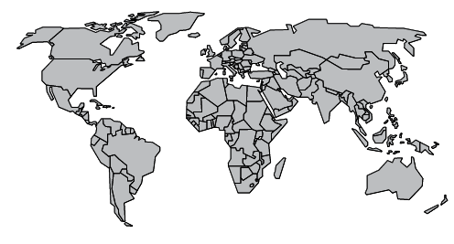
Multiple Repositories – similar datatypes

Slide 51
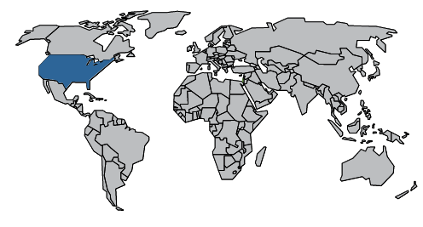
SRA

Slide 52


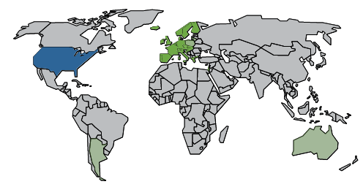
SRA

Slide 53


SRA

Slide 54
SRA

Slide 55


5
SRA

Slide 56
5
SRA

Slide 57
5
2017
SRA

Slide 58








Slide 59


Slide 60
Where should I deposit my data?
Free of charge
elixir-europe.org/platforms/data/core-data-resources
elixir-europe.org/platforms/data/elixir-deposition-databases

Slide 61
Where should I deposit my data?
Free of charge
Quick upload (Aspera)
elixir-europe.org/platforms/data/core-data-resources
elixir-europe.org/platforms/data/elixir-deposition-databases

Slide 62
Where should I deposit my data?
Free of charge
Quick upload (Aspera)
Not operated by single university/government
elixir-europe.org/platforms/data/core-data-resources
elixir-europe.org/platforms/data/elixir-deposition-databases

Slide 63

Where should I deposit my data?
Free of charge
Quick upload (Aspera)
Not operated by single university/government
Guided submission process
elixir-europe.org/platforms/data/core-data-resources
elixir-europe.org/platforms/data/elixir-deposition-databases

Slide 64
Where should I deposit my data?
Free of charge
Quick upload (Aspera)
Not operated by single university/government
Guided submission process
Generous embargo regulation (2yrs → )
elixir-europe.org/platforms/data/core-data-resources
elixir-europe.org/platforms/data/elixir-deposition-databases

Slide 65
Where should I deposit my data?
Free of charge
Quick upload (Aspera)
Not operated by single university/government
Guided submission process
Generous embargo regulation (2yrs → )
API access (upload from NeLS planned)
elixir-europe.org/platforms/data/core-data-resources
elixir-europe.org/platforms/data/elixir-deposition-databases

Slide 66


Where should I deposit my data?
...
elixir-europe.org/platforms/data/core-data-resources
elixir-europe.org/platforms/data/elixir-deposition-databases

Slide 67

Where should I deposit my data?
...
elixir-europe.org/platforms/data/core-data-resources
elixir-europe.org/platforms/data/elixir-deposition-databases

Slide 68
Where should I deposit my data?
...
elixir-europe.org/platforms/data/core-data-resources
elixir-europe.org/platforms/data/elixir-deposition-databases

Slide 69

Where should I deposit my data?
...
elixir-europe.org/platforms/data/core-data-resources
elixir-europe.org/platforms/data/elixir-deposition-databases

Slide 70




Where should I deposit my data?
...
elixir-europe.org/platforms/data/core-data-resources
elixir-europe.org/platforms/data/elixir-deposition-databases

Slide 71
Where should I deposit my data?
...
elixir-europe.org/platforms/data/core-data-resources
elixir-europe.org/platforms/data/elixir-deposition-databases

Slide 72
Experimental conditions/design
SOPs
treatment protocol
sample collection protocol
growth protocol
nucleic acid extraction protocol
conversion protocol
nucleic acid library construction protocol
nucleic acid sequencing protocol
MINSEQE
SOPs
high throughput sequence alignment protocol
normalization data transformation protocol
Ensembl ID
RefSeq ID
fastq
bam
csv/tsv

Slide 73

Experimental conditions/design
SOPs
Sample collection
Extraction
Chromatography
Mass/NMR spectrometry
CIMR - ISA-tab
SOPs
Data transformation
Metabolite identification
SMILES
InCh
mzML
nmrML

Slide 74

NIRD archive
National, free depositing repository
Domain agnostic
Dublin-core metadata standard
DOI accessible
Supports machine readable metadata
harvesting
https://archive.norstore.no/

Slide 75

Generic archives
Less standard metadata → Re-usability ⤋
Domain agnostic → Findability ⤋
Guided submission process
Commercial actors: Size limitations, ...
https://zenodo.org/
https://b2share.eudat.eu/
https://figshare.com/

Slide 76




What about sensitive data?
Central metadata accessibility
Secure storage
Implemented data access committees
Norwegian EGA
(for data that can not leave the country)
ega-archive.org

Slide 77

NSD archive
Domain agnostic
DOI accessible
Implemented data access committees
Main data type: Questionaires, ...
https://arkivering.nsd.no/

