Slide 1


Data management requirements from the RCN
Marta Eide
Senior adviser Data and models
Centre for Digital Life Norway

Slide 2

“National Strategy on access to and sharing of research data”
19/12/2017
Publicly funded research data refers to:
(i) data collected or generated for use for or as a result of publicly funded ­research, and
(ii) data underpinning publications that are the result of publicly funded ­research, regardless of the source of the data.
https://www.regjeringen.no/en/dokumenter/national-strategy-on-access-to-and-sharing-of-research-data/id2582412/
Notes:
Four years ago, the government published the national strategy on access to and sharing of research data.
And just do define what is publicly funded research data:

Slide 3
“National Strategy on access to and sharing of research data”
19/12/2017
Publicly funded research data refers to:
(i) data collected or generated for use for or as a result of publicly funded ­research, and
(ii) data underpinning publications that are the result of publicly funded ­research, regardless of the source of the data.
Basic principles:
Research data must be as open as possible, as closed as necessary.
Research data should be managed and curated to take full advantage of their potential.
Decisions concerning archiving and management of ­research data must be taken within the research community.
https://www.regjeringen.no/en/dokumenter/national-strategy-on-access-to-and-sharing-of-research-data/id2582412/
Notes:
The strategy focus on three basic principles:

Slide 4
“National Strategy on access to and sharing of research data”
19/12/2017
Stipulations to draw up data management plans
Researchers are facing stricter requirements and greater expectations concerning research data management from scientific journals, research funders and their own institutions.
The Government expects:
the research institutions to develop procedures for (i) approving data management plans...
https://www.regjeringen.no/en/dokumenter/national-strategy-on-access-to-and-sharing-of-research-data/id2582412/
Notes:
Finally, the strategy also states that:

Slide 5
“National Strategy on access to and sharing of research data”
19/12/2017
Stipulations to draw up data management plans
Researchers are facing stricter requirements and greater expectations concerning research data management from scientific journals, research funders and their own institutions.
The Government expects:
the research institutions to develop procedures for (i) approving data management plans...
The strategy applies from 2018 to 2021
an evaluation planned for summer 2021.
https://www.regjeringen.no/en/dokumenter/national-strategy-on-access-to-and-sharing-of-research-data/id2582412/

Slide 6






FAIR-principles
Data Management Plan
Storage
Archival
Ethics
Deposition
https://www.uib.no/en/foremployees/142184/university-bergen-policy-open-science
https://innsida.ntnu.no/wiki/-/wiki/English/NTNU+Open+Data
https://www.nmbu.no/en/research/for_researchers/researchdata/node/34680
https://www.uio.no/english/for-employees/support/research/research-data-management/policies-and-guidelines/index.html
https://intranett.uit.no/Content/532111/cache=20170109133727/Principles%20and%20guidelines%20for%20research%20management%20at%20UiT_010917.pdf
Notes:
Each institutions therefor have their own policy for open science and data management.
As this will be topic in the parallell session, I will not go further into detail, but rather focus on the overall requirements from the RCN

Slide 7
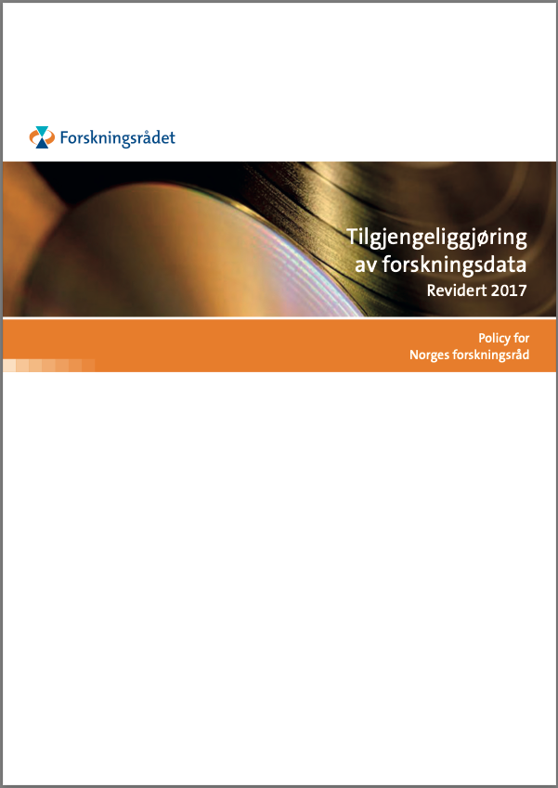
The Research Council of Norway’s Policy for Open Access to Research Data
Originally 2014, updated Dec/2017
New:
“… requiring that R&D-performing institutions or companies should assess whether projects receiving funding from the Research Council must develop a data management plan.”
and
“The FAIR Guiding Principles for scientific data management and stewardship are included as a main principle in the Research Council’s policy”
https://www.forskningsradet.no/contentassets/e4cd6d2c23cf49d4989bb10c5eea087a/the-research-council-of-norways-policy-for-open-access-to-research-data.pdf
Notes:
The RCNs policy for open access of research data was originally published in 2014. In 2017, following the new national strategy, they also updated this.
Most were as before, but they also included that:
We will come back to this in a bit.

Slide 8

RCNs guidelines for storage, dissemination and sharing of research data
Research data...
https://www.forskningsradet.no/contentassets/e4cd6d2c23cf49d4989bb10c5eea087a/the-research-council-of-norways-policy-for-open-access-to-research-data.pdf

Slide 9

Research data...
...must be stored/archived in a safe and secure manner.
https://www.forskningsradet.no/contentassets/e4cd6d2c23cf49d4989bb10c5eea087a/the-research-council-of-norways-policy-for-open-access-to-research-data.pdf
Notes:
The institution is responsible for selecting relevant storing solution.
The project should explicitly address how to store data long-time, and if relevant how to manage data that is not relevant for long time storage

Slide 10
Research data...
...must be stored/archived in a safe and secure manner.
...must be made accessible for reuse.
https://www.forskningsradet.no/contentassets/e4cd6d2c23cf49d4989bb10c5eea087a/the-research-council-of-norways-policy-for-open-access-to-research-data.pdf
Notes:
To all relevant users, on equal terms, ...as long as there are no ethical/legal etc reasons not to.

Slide 11

Research data...
...must be stored/archived in a safe and secure manner.
...must be made accessible for reuse.
...should be made accessible at an early stage [latest at publication]
https://www.forskningsradet.no/contentassets/e4cd6d2c23cf49d4989bb10c5eea087a/the-research-council-of-norways-policy-for-open-access-to-research-data.pdf
Notes:
Other data not published but of relevance for other research should be published in reasonable time - no later than three years.

Slide 12

Research data...
...must be stored/archived in a safe and secure manner.
...must be made accessible for reuse.
...should be made accessible at an early stage [latest at publication]
...must be accompanied by standardised metadata.
https://www.forskningsradet.no/contentassets/e4cd6d2c23cf49d4989bb10c5eea087a/the-research-council-of-norways-policy-for-open-access-to-research-data.pdf
Notes:
International standards to search and use data. Should also describe quality.

Slide 13
Research data...
...must be stored/archived in a safe and secure manner.
...must be made accessible for reuse.
...should be made accessible at an early stage [latest at publication]
...must be accompanied by standardised metadata.
...must be provided with a license for access, reuse and redistribution.
https://www.forskningsradet.no/contentassets/e4cd6d2c23cf49d4989bb10c5eea087a/the-research-council-of-norways-policy-for-open-access-to-research-data.pdf
Notes:
Internationally recognized, as few restrictions as possible

Slide 14
Research data...
...must be stored/archived in a safe and secure manner.
...must be made accessible for reuse.
...should be made accessible at an early stage [latest at publication]
...must be accompanied by standardised metadata.
...must be provided with a license for access, reuse and redistribution.
...should preferably be made accessible at no charge.
https://www.forskningsradet.no/contentassets/e4cd6d2c23cf49d4989bb10c5eea087a/the-research-council-of-norways-policy-for-open-access-to-research-data.pdf
Notes:
and never higher than what they cost to make them available

Slide 15

Research data...
...must be stored/archived in a safe and secure manner.
...must be made accessible for reuse.
...should be made accessible at an early stage [latest at publication]
...must be accompanied by standardised metadata.
...must be provided with a license for access, reuse and redistribution.
...should preferably be made accessible at no charge.
... must be described in a data management plan.
https://www.forskningsradet.no/contentassets/e4cd6d2c23cf49d4989bb10c5eea087a/the-research-council-of-norways-policy-for-open-access-to-research-data.pdf
Notes:
Approved by the research-performing institution, and made available if possible.

Slide 16


Illustrative Icons from Font Awesome licensed under Creative Commons Attribution 4.0 International License

Slide 17
Project planning and proposal:
No DMP required
But, you should consider:
Ethical and legal aspects
Storage and computing (budgeting?)
DM personnel and time (budgeting?)
Illustrative Icons from Font Awesome licensed under Creative Commons Attribution 4.0 International License

Slide 18
When awarded funding from RCN:
Full DMP required
“This plan must be delivered in connection with the revised grant application.”
“If you decide that a data management plan is not needed, you must provide an explanation.”
Illustrative Icons from Font Awesome licensed under Creative Commons Attribution 4.0 International License

Slide 19

Core requirements to data management plan
Published 2019
https://www.forskningsradet.no/contentassets/e4cd6d2c23cf49d4989bb10c5eea087a/se_rdm_practical_guide_final.pdf
Notes:
So what does the data management plan need to include?
RCN uses the core requirements from the Science Europe practical guide to international alignment of research data management.

Slide 20
Core requirements to data management plan
6 core requirements:
Data description & Collection/re-use
Documentation & Data quality
Storage & Backup
Legal & Ethical requirements
Data sharing & Preservation
Responsibilities & Resources
https://www.forskningsradet.no/contentassets/e4cd6d2c23cf49d4989bb10c5eea087a/se_rdm_practical_guide_final.pdf

Slide 21

Core requirements to data management plan
Updated Jan 2021
Including guidance for reviewers (evaluation rubric)
RCN does not [yet?] refer to the updated guide
https://www.scienceeurope.org/our-resources/practical-guide-to-the-international-alignment-of-research-data-management/

Slide 22

When awarded funding from RCN:
Full DMP required
Public and openly accessible!
One possibility is
Illustrative Icons from Font Awesome licensed under Creative Commons Attribution 4.0 International License
Notes:
An important point to remember here is that the DMP are to be made public and openly accessible. (exact timing not specified by RCN)

Slide 23
During your project:
Update the DMP
“You will not be asked to report on changes to the plan during the project period.”
Illustrative Icons from Font Awesome licensed under Creative Commons Attribution 4.0 International License

Slide 24
Final report of project:
Final version of DMP
“We will request a final version of the data management plan in connection with the final report of the project.”
Illustrative Icons from Font Awesome licensed under Creative Commons Attribution 4.0 International License

Slide 25
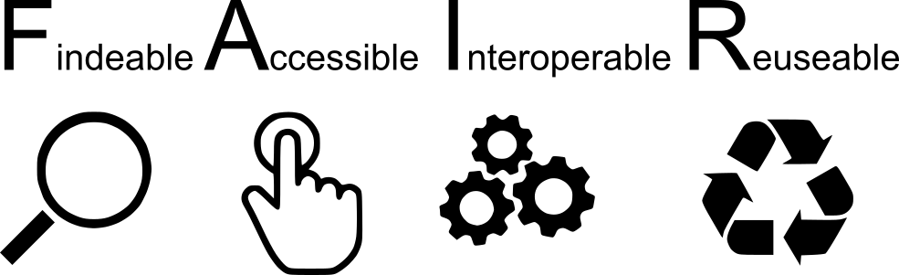
Data quality
RCN recommends following the international FAIR principles

Slide 26
Data quality
RCN recommends following the international FAIR principles
Open Data
Notes:
Remember that open data and the FAIR principles don’t necessarily overlap.
As the A is Accessible under well-defined conditions, FAIR data can be made accessible only to a small group of people (for example new results shared in a project).
And open data are not necissarily FAIR, if it is not stored so that it can be findable and interoperable.

Slide 27

FAIR illustrations icons from ARDC 2018 licensed under Creative Commons Attribution 4.0 International License

Slide 28

Horizon 2020
Open Research Data Pilot (ORD pilot):
“...takes into account the need to balance openness and protection of scientific information, commercialisation and Intellectual Property Rights (IPR), privacy concerns, security as well as data management and preservation questions.”
"as open as possible, as closed as necessary"
“Beneficiaries must develop and update a data management plan (DMP) and manage responsibly all digital research data generated in the action in line with the FAIR principles.”
https://ec.europa.eu/research/participants/docs/h2020-funding-guide/cross-cutting-issues/open-access-data-management/data-management_en.htm

Slide 29
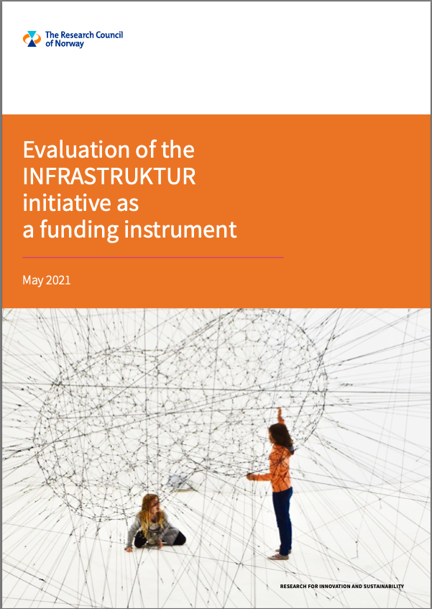
• All types of research funding should require a proper data stewardship plan that includes data management during the project. The data stewardship plans must also ensure that research data be available for access and reuse where appropriate and subject to appropriate safeguards, also after completion of the project (suggested time frame: 10 years) and also cover provisions for appropriate long-term preservation. These aspects should be based on compliance with the FAIR guiding principles and include budget plans.
• RCN should develop a proper and effective policy for data stewardship so that the data generated through their investments do not go to waste and science is properly served. Such a data stewardship policy should be implemented in the applications scheme with relevant criteria for receiving RI funds. The policy should be developed in close dialogue with the RPOs to ensure that the institutions implement it together with their data strategies to create a data-responsible Norwegian research system. This policy should particularly ensure that all new undertakings include a data stewardship plan or protocols that explicitly address data capture, management, integrity, confidentiality, retention, sharing and publication.
Notes:
Finally, I would like to mention the recent publication of the Evaluation for the INFRASTRUCTURE initiative of the RCN. The initiative was launched in 2009, and has been important in developing norwegian e-infrastructure and FAIR datasharing.
In the evaluation, the initiative generally gets high praise, but there are some advice for improvements:

Slide 30
Good luck next week!
Contact information:
website: https://www.digitallifenorway.org
e-mail: marta.eide@uib.no

