Slide 1

Metadata Standards & Ontologies
Federico Bianchini
Data Steward
University of Oslo/ELIXIR Norway
Illustrative Icons from Font Awesome licensed under Creative Commons Attribution 4.0 International License

Slide 2
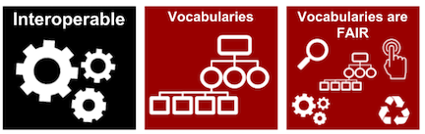
Controlled vocabularies
Vocabulary a collection of preferred terms used to annotate and retrieve content. Predefined terms are mandated to make each entry unambiguous and consistent.
The controlled vocabulary used to describe datasets needs to be resolvable using globally unique and persistent identifiers.
In practice, why do we need controlled vocabularies?
FAIR illustrations icons from ARDC 2018 licensed under Creative Commons Attribution 4.0 International License

Slide 3
How many ways can you say “female”?

Slide 4
How many ways can you say “female”?
18-day pregnant females
female (lactating)
individual female
worker caste (female)
2 yr old female
female (pregnant)
lgb*cc females
sex: female
400 yr. old female
female (outbred)
mare
female, other
adult female
female parent
female (worker)
female child
asexual female
female plant
monosex female
femal
castrate female
female with eggs
ovigerous female
3 female
cf.female
female worker
oviparous sexual females
female (phenotype)
cystocarpic female
female, 6-8 weeks old
worker bee
female mice
dikaryon
female, virgin
female enriched
female, spayed
dioecious female
female, worker
pseudohermaprhoditic female
femlale
diploid female
female(gynoecious)
remale
metafemale
f
femele
semi-engorged female
sterile female
famale
female, pooled
sexual oviparous female
normal female
femail
femalen
sterile female worker
sf
female
females
strictly female
vitellogenic replete female
female - worker
females only
tetraploid female
worker
female (alate sexual)
gynoecious
thelytoky
hexaploid female
female (calf)
healthy female
female (gynoecious)
female (f-o)
hen
probably female (based on morphology)
female (note: this sample was originally provided as a \"male\" sample to us and therefore labeled this way
in the brawand et al. paper and original geo submission; however, detailed data analyses carried out in the
meantime clearly show that this sample stems from a female individual)"
Courtesy of N. Silvester, European Nucleotide Archive, EMBL-EBI

Slide 5
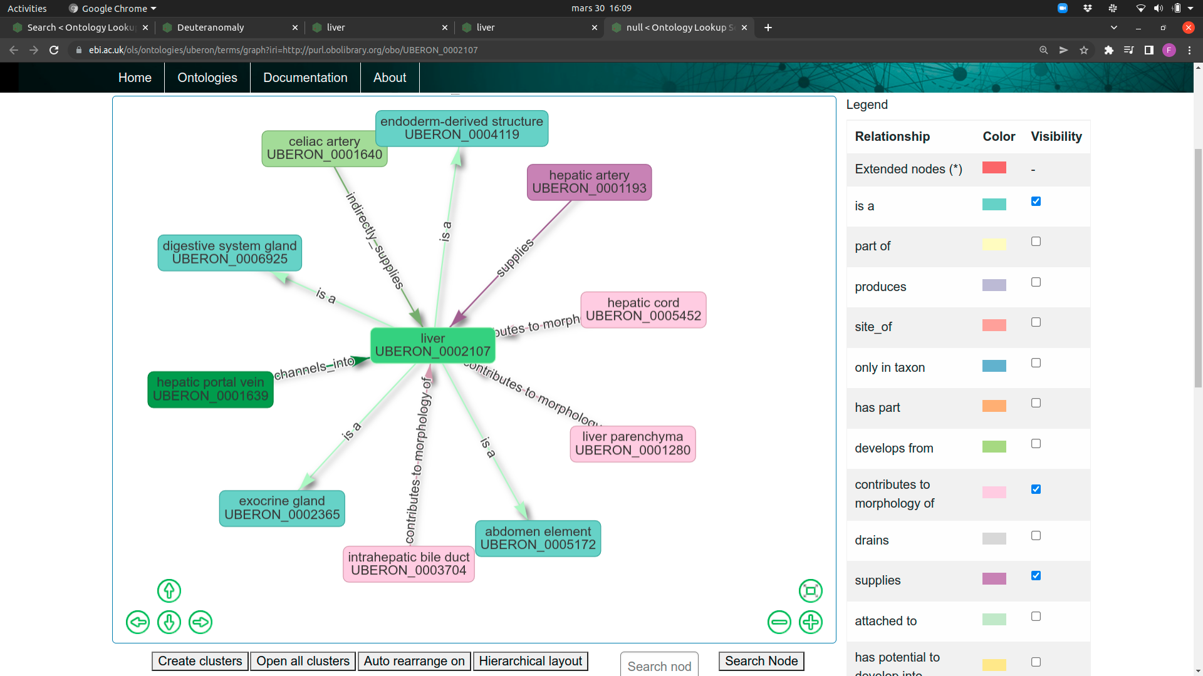
Ontologies
Ontology a set of concepts and categories in a subject area or domain that shows their properties and the relations between them.

Slide 6


Slide 7


Slide 8



Slide 9


Uberon
Onthologies
enable hierarchical searches

Slide 10

Controlled vocabulary & Ontologies

Slide 11

Controlled vocabulary & Ontologies

Slide 12

Controlled vocabulary & Ontologies

Slide 13
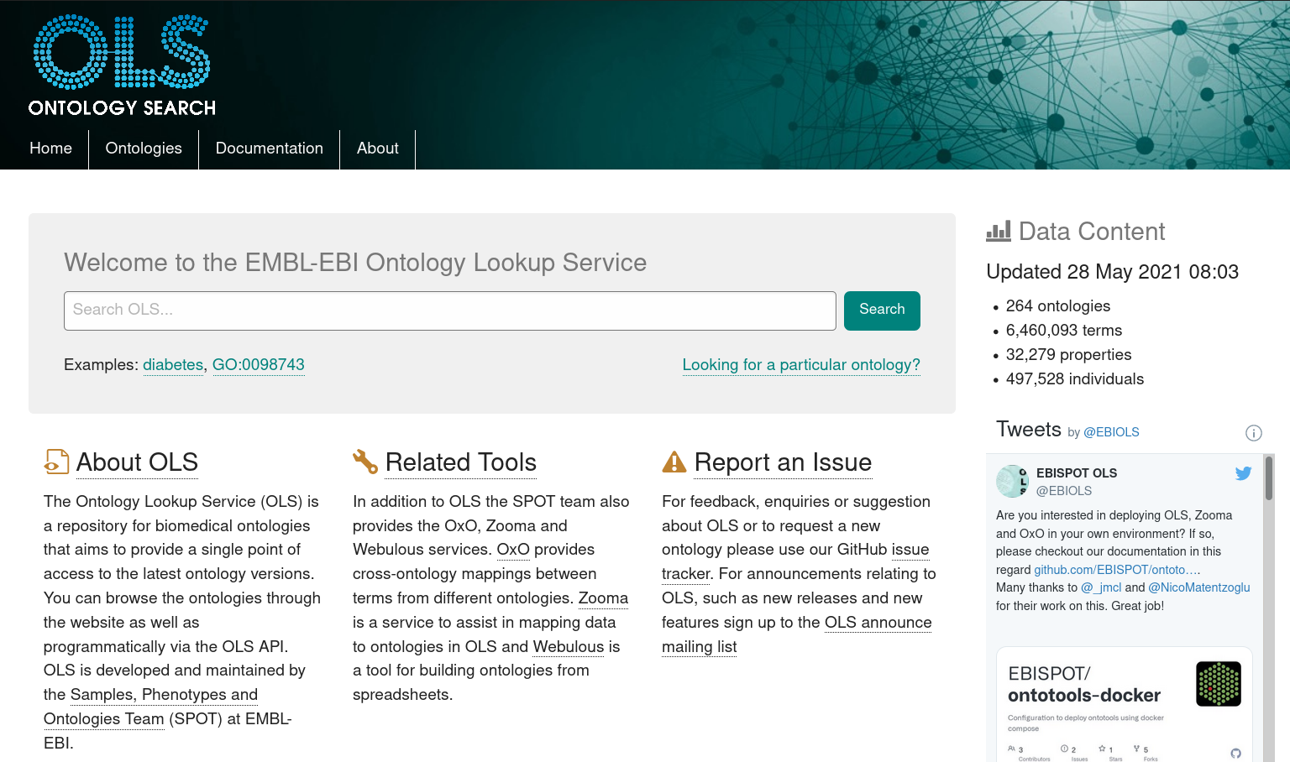
https://www.ebi.ac.uk/ols/index

Slide 14

What is a metadata standard?
FAIR illustrations icons from ARDC 2018 licensed under Creative Commons Attribution 4.0 International License

Slide 15

but often following the same concept:
Investigation
Study(s)
Assay(s)
Technology & domain specific

Slide 16
but often following the same concept:
Investigation
Study(s)
Assay(s)
Persons
Organizations
Publications
Technology & domain specific

Slide 17
but often following the same concept:
Investigation
Study(s)
Assay(s)
Persons
Organizations
Publications
Design
Factor
Protocol
Technology & domain specific

Slide 18
but often following the same concept:
Investigation
Study(s)
Assay(s)
Persons
Organizations
Publications
Design
Factor
Protocol
Technology & domain specific
Measurement
Technology
Materials
Data

Slide 19
but often following the same concept:
Investigation
Study(s)
Assay(s)
Persons
Organizations
Publications
Design
Factor
Protocol
Controlled Vocabularies
Ontologies
Standards
Technology & domain specific
Measurement
Technology
Materials
Data

Slide 20







MINSEQE

Slide 21
MINSEQE
Administrative information:
Persons
Organizations
Publications

Slide 22
Experimental conditions/design
protocols:
treatment
sample collection
growth
nucleic acid extraction
conversion
nucleic acid library construction
nucleic acid sequencing
MINSEQE
Administrative information:
Persons
Organizations
Publications

Slide 23
Experimental conditions/design
protocols:
treatment
sample collection
growth
nucleic acid extraction
conversion
nucleic acid library construction
nucleic acid sequencing
MINSEQE
protocols:
high throughput sequence alignment
normalization data transformation
Administrative information:
Persons
Organizations
Publications
fastq
bam
csv/tsv

Slide 24
Experimental conditions/design
protocols:
treatment
sample collection
growth
nucleic acid extraction
conversion
nucleic acid library construction
nucleic acid sequencing
MINSEQE
protocols:
high throughput sequence alignment
normalization data transformation
Administrative information:
Persons
Organizations
Publications

Slide 25
Experimental conditions/design
protocols:
treatment
sample collection
growth
nucleic acid extraction
conversion
nucleic acid library construction
nucleic acid sequencing
MINSEQE
protocols:
high throughput sequence alignment
normalization data transformation
Administrative information:
Persons
Organizations
Publications
Ensembl ID
RefSeq ID
fastq
bam
csv/tsv

Slide 26


Experimental conditions/design
protocols:
treatment
sample collection
growth
nucleic acid extraction
conversion
nucleic acid library construction
nucleic acid sequencing
MINSEQE
Taxonomy
protocols:
high throughput sequence alignment
normalization data transformation
Administrative information:
Persons
Organizations
Publications
Ensembl ID
RefSeq ID
fastq
bam
csv/tsv

Slide 27
Experimental conditions/design
protocols:
treatment
sample collection
growth
nucleic acid extraction
conversion
nucleic acid library construction
nucleic acid sequencing
MINSEQE
Taxonomy
protocols:
high throughput sequence alignment
normalization data transformation
Administrative information:
Persons
Organizations
Publications
Ensembl ID
RefSeq ID
fastq
bam
csv/tsv
Interlinking with other resources

Slide 28

Experimental conditions/design
protocols:
treatment
sample collection
growth
nucleic acid extraction
conversion
nucleic acid library construction
nucleic acid sequencing
MINSEQE
Taxonomy
protocols:
high throughput sequence alignment
normalization data transformation
https://www.ebi.ac.uk/fg/annotare
Administrative information:
Persons
Organizations
Publications
Ensembl ID
RefSeq ID
fastq
bam
csv/tsv
Interlinking with other resources

Slide 29








Slide 30
Meta data standards
MINSEQE
MIAME
...

Slide 31
Meta data standards
MINSEQE
MIAME
...
HUPO-PSI TraML
MIAPE
...

Slide 32
Meta data standards
MINSEQE
MIAME
...
SRA-XML
HUPO-PSI TraML
MIAPE
...

Slide 33

Which metadata standard?
Demo
fairsharing.org

Slide 34
Data format standards
Common formats
Non-proprietary formats (accessible with open source tools)
Avoiding binary data formats (data corruption)
Examples: FASTQ, TIFF, mzML,...

Slide 35
Data format standards
FASTQ
MAGE-ML
...
FASTA
FASTQ
...
mzML
mzQuantML
...

Slide 36


Metadata tracking platforms
Domain specific:
COPO for plant sciences
MOLGENIS for biobanking
...
https://copo-project.org/ https://www.molgenis.org/
https://openbis.ch/ https://seek4science.org/

Slide 37


Metadata tracking platforms
Domain specific:
COPO for plant sciences
MOLGENIS for biobanking
...
Adaptable (configuration requires domain knowledge):
Proprietary ELNs/LIMS - often poor support for ontologies
openBIS - open source ELN/LIMS
SEEK
https://copo-project.org/ https://www.molgenis.org/
https://openbis.ch/ https://seek4science.org/

Slide 38

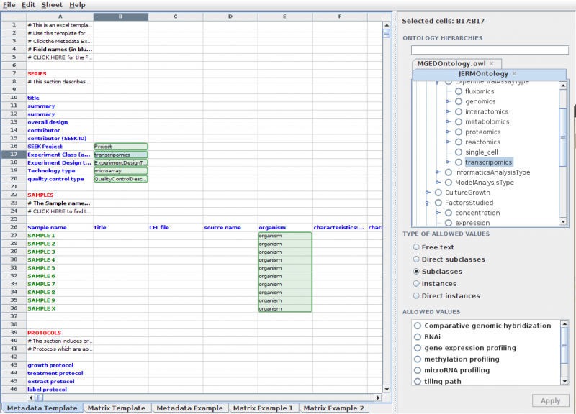
SEEK
https://seek4science.org/
https://rightfield.org.uk/
Notes:
RightField is an open-source tool for adding ontology term selection to Excel spreadsheets.
This means that for each annotation field, RightField can specify a range of allowed terms from a chosen ontology (subclasses, individuals or combinations). The resulting spreadsheet presents these terms to the users as a simple drop-down list.
Once such a template sheet is made, it can easily be re-used and edited to fit new needs in the project.

Slide 39


https://seek4science.org/
https://fairdomhub.org/
Notes:
The project were introduced to the SEEK platform through DLN.
First, to clarify some terms:
FAIRDOM is a European infrastructure project facilitating FAIR data management.
The SEEK is a database and web interface for sharing data, models and simulations management in systems biology.
fairdomhub.org is the publicly available instance of a FAIRDOM-SEEK commons

Slide 40
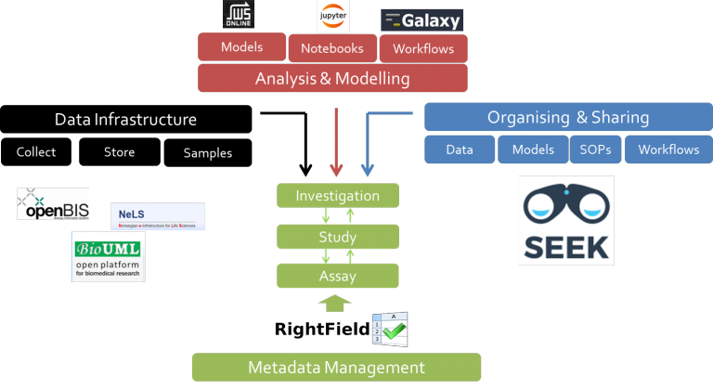
FAIRDOM integration
fair-dom.org
seek4science.org - github.com/seek4science/seek
rightfield.org.uk - github.com/myGrid/RightField
Notes:
In FAIRDOM, data infrastructure (like openBIS and NeLS) is combined with analysis and modelling (for example from jupyter or Galaxy) and organizing and sharing through SEEK. Finally, the Metadata is organized in the ISA structure, where you can implement ontology terms using RightField.

Slide 41

Except where otherwise noted, this work is licensed under:
https://creativecommons.org/licenses/by/4.0/

