Slide 1


Data Management Requirements
Korbinian Bösl
Data management coordinator
ELIXIR Norway/Digital Life Norway
Illustrative Icons from Font Awesome licensed under Creative Commons Attribution 4.0 International License

Slide 2
Life cycle
RDM life cycle from RDMkit licensed under Creative Commons Attribution 4.0 International License

Slide 3
Requirements
Funder
Ethical & Legal
Project
& Domain specific
Institutional
RDM life cycle from RDMkit licensed under Creative Commons Attribution 4.0 International License

Slide 4
Requirements
Funder
Ethical & Legal
Project
& Domain specific
Institutional
RDM life cycle from RDMkit licensed under Creative Commons Attribution 4.0 International License

Slide 5
Data Management plan?
Funder
Ethical & Legal
Project
& Domain specific
Institutional
RDM life cycle from RDMkit licensed under Creative Commons Attribution 4.0 International License

Slide 6
Data Management plan?
Funder
Ethical & Legal
Project
& Domain specific
Institutional
RDM life cycle from RDMkit licensed under Creative Commons Attribution 4.0 International License

Slide 7


“National Strategy on access to and sharing of research data”
2017
Publicly funded research data refers to:
(i) data collected or generated for use for or as a result of publicly funded ­research, and
(ii) data underpinning publications that are the result of publicly funded ­research, regardless of the source of the data.
Basic principles:
Research data must be as open as possible, as closed as necessary.
Research data should be managed and curated to take full advantage of their potential.
Decisions concerning archiving and management of ­research data must be taken within the research community.
https://www.regjeringen.no/en/dokumenter/national-strategy-on-access-to-and-sharing-of-research-data/id2582412/
Notes:
The strategy focus on three basic principles:

Slide 8


The Research Council of Norway’s Policy for Open Access to Research Data
Original 2014, updated 2017
“… requiring that R&D-performing institutions or companies should assess whether projects receiving funding from the Research Council must develop a data management plan.”
“The FAIR Guiding Principles for scientific data management and stewardship are included as a main principle in the Research Council’s policy”
https://www.forskningsradet.no/contentassets/e4cd6d2c23cf49d4989bb10c5eea087a/the-research-council-of-norways-policy-for-open-access-to-research-data.pdf
Notes:
following the new national strategy in 2017, RCN also updated their policy for open access.
Most were as before, but they also included that:
We will come back to this in a bit.

Slide 9
Research data...
… must be stored/archived in a safe and secure manner.
… must be made accessible for reuse.
… should be made accessible at an early stage [latest at publication]
… must be accompanied by standardised metadata.
… must be provided with a license for access, reuse and redistribution.
… should preferably be made accessible at no charge.
... must be described in a data management plan
https://www.forskningsradet.no/contentassets/e4cd6d2c23cf49d4989bb10c5eea087a/the-research-council-of-norways-policy-for-open-access-to-research-data.pdf
Illustrative Icons from VectorLab, Zulfahmi Al Ridhawi, Deemak Daksina & Vectorsmarket at Noun Project licensed under Creative Commons Attribution 4.0 International License
Notes:
Approved by the research-performing institution, and made available if possible.

Slide 10

Open Data
“As open as possible - as closed as necessary”

Slide 11

Illustrative Icons from VectorLab, Zulfahmi Al Ridhawi, Deemak Daksina & Vectorsmarket at Noun Project licensed under Creative Commons Attribution 4.0 International License

Slide 12
2023
Potential impact of the proposed research
The extent to which the planned outputs are openly accessible to ensure reusability of the research outputs and enhance reproducibility
FAIR, available and reusable data [software, algorithms, protocols, models, workflows, electronic notebooks, and other tools]
Early sharing through pre-registration and preprints, open access to software, workflows, tools, etc
https://www.forskningsradet.no/en/processing-grant-applications/processing-applications/assessment-open-science/
Illustrative Icons from VectorLab, Zulfahmi Al Ridhawi, Deemak Daksina & Vectorsmarket at Noun Project licensed under Creative Commons Attribution 4.0 International License

Slide 13
2023
Communication and exploitation
The extent to which the appropriate open science practices are implemented as an integral part of the proposed project to ensure open sharing and wide distribution of research outputs.
Early and open sharing (preprints or pre-registration and/or registration reports)
Full and immediate open access publication
https://www.forskningsradet.no/en/processing-grant-applications/processing-applications/assessment-open-science/
Illustrative Icons from VectorLab, Zulfahmi Al Ridhawi, Deemak Daksina & Vectorsmarket at Noun Project licensed under Creative Commons Attribution 4.0 International License

Slide 14
No full DMP required (- but helpful)
You should consider:
§§ Ethical and Legal issues
Storage and computing (budgeting?)
Budgeting for RDM-personnel & time effort
https://www.forskningsradet.no/en/research-policy-strategy/open-science/research-data/
Illustrative Icons from VectorLab, Zulfahmi Al Ridhawi, Deemak Daksina & Vectorsmarket at Noun Project licensed under Creative Commons Attribution 4.0 International License

Slide 15
§§Ethical and Legal issues
REK approval necessary (for sharing of data?)
GDPR considerations
IPR aspects
Which Research Ethical Guidelines apply for this project?
RRI
https://www.forskningsradet.no/en/research-policy-strategy/open-science/research-data/
Illustrative Icons from VectorLab, Zulfahmi Al Ridhawi, Deemak Daksina & Vectorsmarket at Noun Project licensed under Creative Commons Attribution 4.0 International License

Slide 16
Storage and Computing
Is access to computing/storage secured?
Will we have to pay for data storage (of sensitive data?)
How will data be accessed & transferred?
https://www.forskningsradet.no/en/research-policy-strategy/open-science/research-data/
Illustrative Icons from VectorLab, Zulfahmi Al Ridhawi, Deemak Daksina & Vectorsmarket at Noun Project licensed under Creative Commons Attribution 4.0 International License

Slide 17
Budgeting for RDM-personnel & time effort
Will we need help from a Data Steward (and budget for this)?
Will we need with data analysis, data warehousing or deposition?
https://www.forskningsradet.no/en/research-policy-strategy/open-science/research-data/
Illustrative Icons from VectorLab, Zulfahmi Al Ridhawi, Deemak Daksina & Vectorsmarket at Noun Project licensed under Creative Commons Attribution 4.0 International License

Slide 18
2018
When awarded funding
Full DMP required
If you decide that a data management plan is not needed, you must provide an explanation.
I don’t know of any - do you?
Even if you only reuse others data, you should describe where and how it is accessible & how your processed data can be accessed or reproduced?
https://www.forskningsradet.no/en/research-policy-strategy/open-science/research-data/
Illustrative Icons from VectorLab, Zulfahmi Al Ridhawi, Deemak Daksina & Vectorsmarket at Noun Project licensed under Creative Commons Attribution 4.0 International License

Slide 19
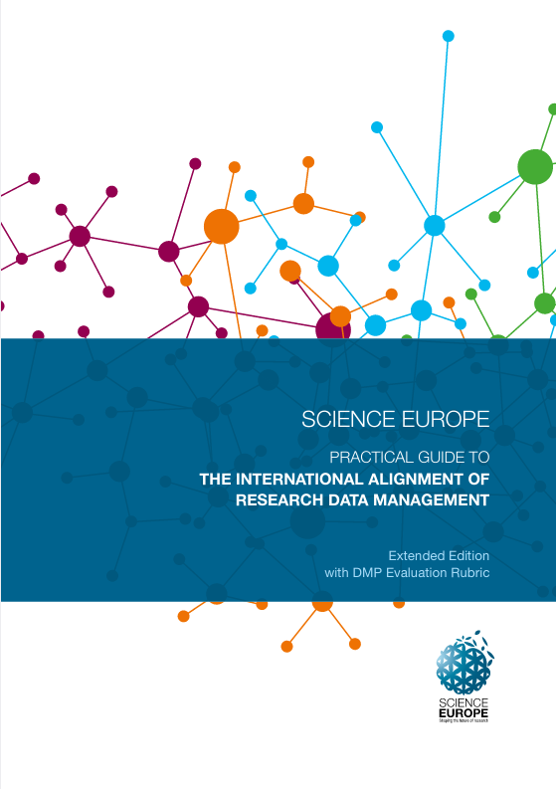
When awarded funding
Full DMP required
Documentation, formats, volume
Quality assurance including Metadata standards
Backup during project
Sharing & Preservation
Ethical and Legal aspects - including IPR
Who is responsible in the project?
To which trustworthy repository will the data be submitted?
https://www.forskningsradet.no/en/research-policy-strategy/open-science/research-data/ https://www.scienceeurope.org/our-resources/practical-guide-to-the-international-alignment-of-research-data-management/
Illustrative Icons from VectorLab, Zulfahmi Al Ridhawi, Deemak Daksina & Vectorsmarket at Noun Project licensed under Creative Commons Attribution 4.0 International License

Slide 20
When awarded funding
Full DMP required
The Research Council of Norway does not assess the content of submitted plans. It is the responsibility of the Project Owner to approve that the plan is in line with the institution's requirements and guidelines before it is submitted.
https://www.forskningsradet.no/en/research-policy-strategy/open-science/research-data/ https://www.scienceeurope.org/our-resources/practical-guide-to-the-international-alignment-of-research-data-management/
Illustrative Icons from VectorLab, Zulfahmi Al Ridhawi, Deemak Daksina & Vectorsmarket at Noun Project licensed under Creative Commons Attribution 4.0 International License

Slide 21


Full DMP required
Data management plans are to be made public and openly accessible.
Different possibilities:
https://www.forskningsradet.no/en/research-policy-strategy/open-science/research-data/ https://www.scienceeurope.org/our-resources/practical-guide-to-the-international-alignment-of-research-data-management/
Illustrative Icons from VectorLab, Zulfahmi Al Ridhawi, Deemak Daksina & Vectorsmarket at Noun Project licensed under Creative Commons Attribution 4.0 International License

Slide 22
DMP is constantly updated
Changes do not have to reported to RCN
Early deposition & sharing
https://www.forskningsradet.no/en/research-policy-strategy/open-science/research-data/ https://www.scienceeurope.org/our-resources/practical-guide-to-the-international-alignment-of-research-data-management/
Illustrative Icons from VectorLab, Zulfahmi Al Ridhawi, Deemak Daksina & Vectorsmarket at Noun Project licensed under Creative Commons Attribution 4.0 International License

Slide 23
Final version of the data management plan in connection with the final report of the project.
Data is deposited to trustworthy repository
https://www.forskningsradet.no/en/research-policy-strategy/open-science/research-data/ https://www.scienceeurope.org/our-resources/practical-guide-to-the-international-alignment-of-research-data-management/
Illustrative Icons from VectorLab, Zulfahmi Al Ridhawi, Deemak Daksina & Vectorsmarket at Noun Project licensed under Creative Commons Attribution 4.0 International License

Slide 24

Please contact us!
Horizon Europe
Open Science (OA, RDM, citizens engagement etc.) embedded throughout HE
14. Dissemination and exploitation of research results &
16. Open science
  “Open science practices are addressed and evaluated under ‘excellence’ as they are considered a part of the methodology.”
  “Data management plans are mandatory for all projects generating or reusing data and should be aligned with the D&E plan.”
https://ec.europa.eu/info/funding-tenders/opportunities/docs/2021-2027/horizon/guidance/programme-guide_horizon_en.pdf
https://ec.europa.eu/info/funding-tenders/opportunities/docs/2021-2027/common/agr-contr/general-mga_horizon-euratom_en.pdf
Notes:
We can also look to the international requirements, like from Horizon Europe program
As part of the European Commission’s goal to advance Open Science policy and practices – it is a mandatory component in Horizon Europe that all projects involving data include a DMP. Practically speaking, an initial DMP should be presented in the proposal. Later on, funded projects are required to provide a detailed DMP as a mandatory deliverable within 6 months from the grant signature date.

Slide 25
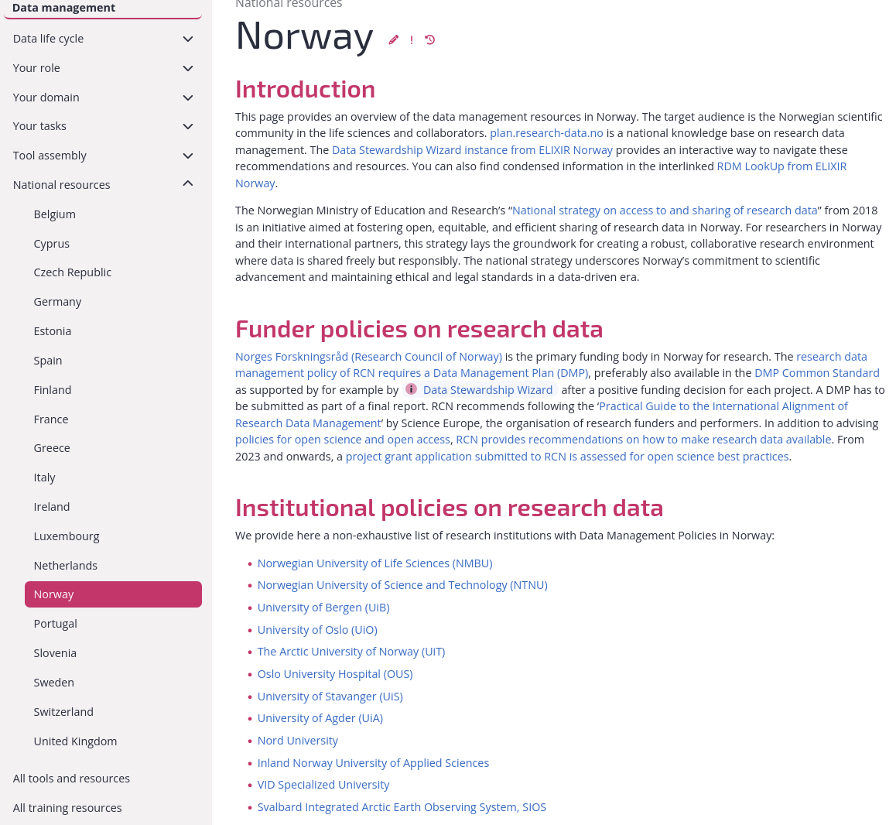
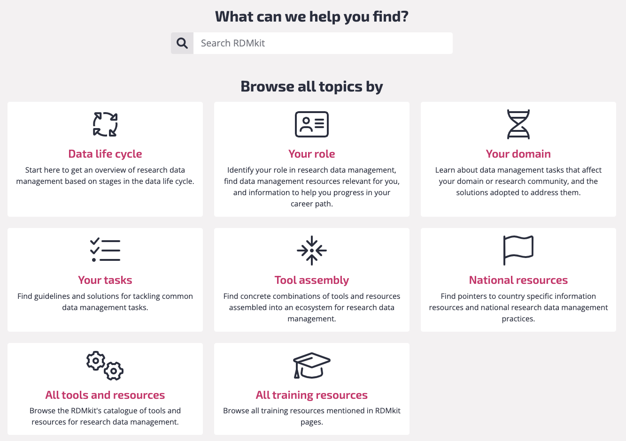

https://rdmkit.elixir-europe.org/national_resources

Slide 26







Filled questionnaire → Template → DMP in various formats
once per funding body .docx, .tex, .html, .json, incl. maDMP
Full compliance:
Adapted for users
in Norway
Login
Recommended by
https://ds-wizard.org
https://github.com/ds-wizard

Slide 27
Introduction
The FAIR data principles

Slide 28

FAIR: Findable Data
Metadata are crucial: the data are found through the metadata.
Deposition on a repository is one of the FAIR principles, such an (external) service has to be in place.

Slide 29
FAIR: Accessible Data
Technical implementations for accessing data, authentication and authorisation (FAIR not OPEN).
Metadata always available, also when the dataset no longer exist.

Slide 30
FAIR: Interoperable Data
Adoption of community-defined standards and definitions.
Consistent metadata annotation allows linking across datasets.

Slide 31
FAIR: Reusable Data
To ensure successful reusability, you need:
Rich metadata
License
Data “history” (experimental technique, author, publication)
Community standards (e.g. from domain repository of choice)
Notes:
Lack of license
Provenance: where is data coming from

