Slide 1
Data Management Requirements
Federico Bianchini
Senior Engineer/Data steward
University of Oslo – ELIXIR Norway
Illustrative Icons from Font Awesome licensed under Creative Commons Attribution 4.0 International License

Slide 2

“National Strategy on access to and sharing of research data”
19/12/2017
Publicly funded research data refers to:
(i) data collected or generated for use for or as a result of publicly funded ­research, and
(ii) data underpinning publications that are the result of publicly funded ­research, regardless of the source of the data.
https://www.regjeringen.no/en/dokumenter/national-strategy-on-access-to-and-sharing-of-research-data/id2582412/
Notes:
Lets start with the big picture:
Four years ago, the government published the national strategy on access to and sharing of research data.
And just do define what is publicly funded research data:

Slide 3
“National Strategy on access to and sharing of research data”
19/12/2017
Publicly funded research data refers to:
(i) data collected or generated for use for or as a result of publicly funded ­research, and
(ii) data underpinning publications that are the result of publicly funded ­research, regardless of the source of the data.
Basic principles:
Research data must be as open as possible, as closed as necessary.
Research data should be managed and curated to take full advantage of their potential.
Decisions concerning archiving and management of ­research data must be taken within the research community.
https://www.regjeringen.no/en/dokumenter/national-strategy-on-access-to-and-sharing-of-research-data/id2582412/
Notes:
The strategy focus on three basic principles:

Slide 4
“National Strategy on access to and sharing of research data”
19/12/2017
Stipulations to draw up data management plans
Researchers are facing stricter requirements and greater expectations concerning research data management from scientific journals, research funders and their own institutions.
The Government expects:
the research institutions to develop procedures for (i) approving data management plans...
https://www.regjeringen.no/en/dokumenter/national-strategy-on-access-to-and-sharing-of-research-data/id2582412/
Notes:
Finally, the strategy also stipulates that researchers are facing stricter requirements. And the government expects that the reseacrh institutions develop procedures for approving data management plans

Slide 5
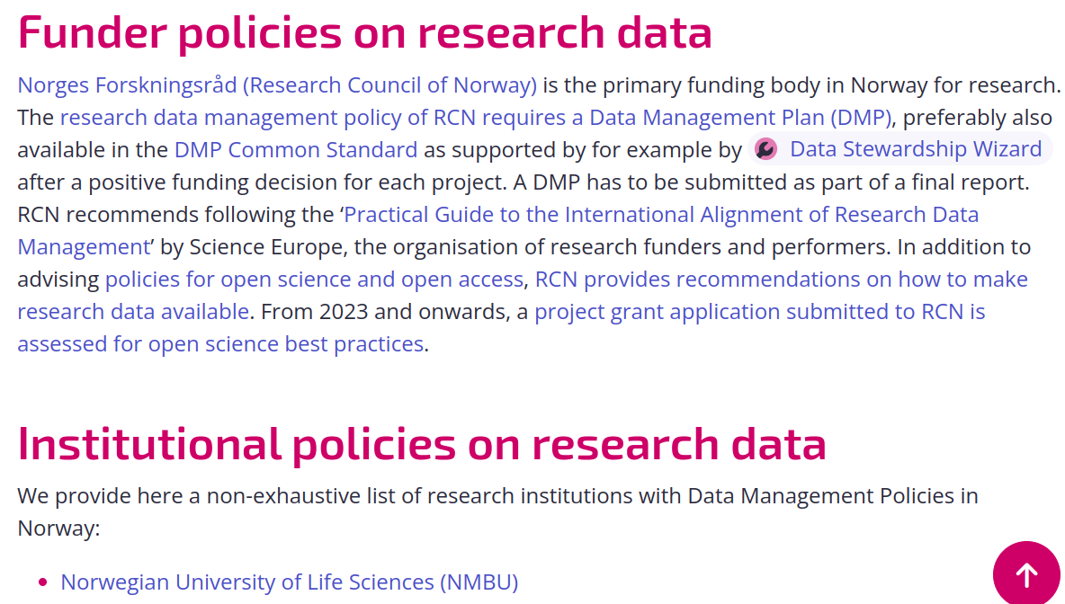
https://rdmkit.elixir-europe.org/no_resources

Slide 6
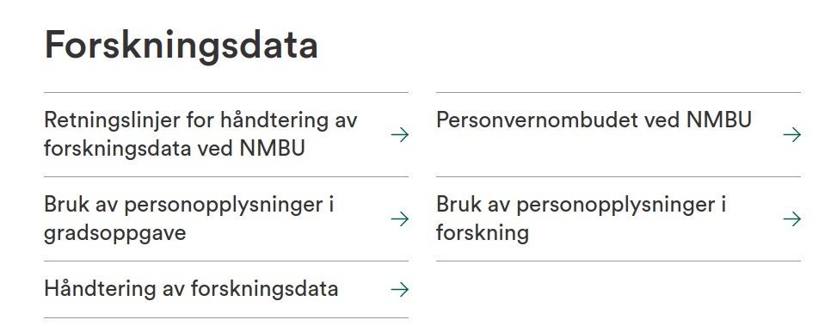
Institutional Guidelines
https://www.nmbu.no/forskning/forskningsdata

Slide 7
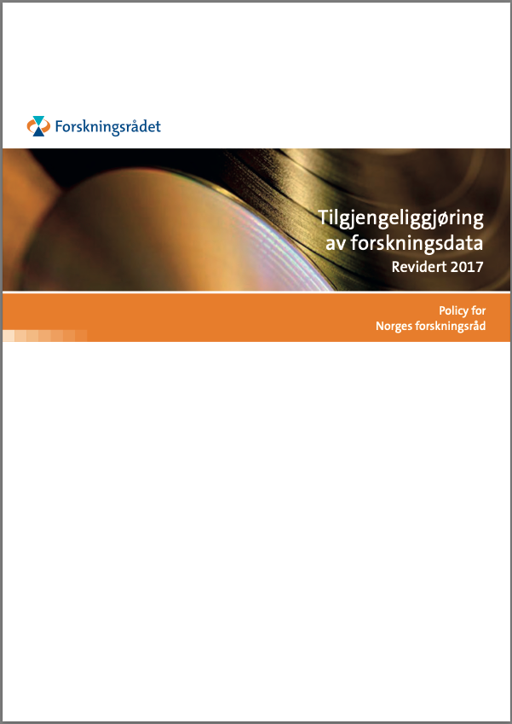
The Research Council of Norway’s Policy for Open Access to Research Data
Originally 2014, updated Dec/2017
New:
“… requiring that R&D-performing institutions or companies should assess whether projects receiving funding from the Research Council must develop a data management plan.”
and
“The FAIR Guiding Principles for scientific data management and stewardship are included as a main principle in the Research Council’s policy”
https://www.forskningsradet.no/contentassets/e4cd6d2c23cf49d4989bb10c5eea087a/the-research-council-of-norways-policy-for-open-access-to-research-data.pdf
Notes:
following the new national strategy in 2017, RCN also updated their policy for open access.
Most were as before, but they also included that:
We will come back to this in a bit.

Slide 8

RCNs guidelines for storage, dissemination and sharing of research data
Research data...
https://www.forskningsradet.no/contentassets/e4cd6d2c23cf49d4989bb10c5eea087a/the-research-council-of-norways-policy-for-open-access-to-research-data.pdf

Slide 9

Research data...
...must be stored/archived in a safe and secure manner.
https://www.forskningsradet.no/contentassets/e4cd6d2c23cf49d4989bb10c5eea087a/the-research-council-of-norways-policy-for-open-access-to-research-data.pdf
Notes:
The institution is responsible for selecting relevant storing solution.
The project should explicitly address how to store data long-time, and if relevant how to manage data that is not relevant for long time storage

Slide 10
Research data...
...must be stored/archived in a safe and secure manner.
...must be made accessible for reuse.
https://www.forskningsradet.no/contentassets/e4cd6d2c23cf49d4989bb10c5eea087a/the-research-council-of-norways-policy-for-open-access-to-research-data.pdf
Notes:
To all relevant users, on equal terms, ...as long as there are no ethical/legal etc reasons not to.

Slide 11

Research data...
...must be stored/archived in a safe and secure manner.
...must be made accessible for reuse.
...should be made accessible at an early stage [latest at publication]
https://www.forskningsradet.no/contentassets/e4cd6d2c23cf49d4989bb10c5eea087a/the-research-council-of-norways-policy-for-open-access-to-research-data.pdf
Notes:
Other data not published but of relevance for other research should be published in reasonable time - no later than three years.

Slide 12

Research data...
...must be stored/archived in a safe and secure manner.
...must be made accessible for reuse.
...should be made accessible at an early stage [latest at publication]
...must be accompanied by standardised metadata.
https://www.forskningsradet.no/contentassets/e4cd6d2c23cf49d4989bb10c5eea087a/the-research-council-of-norways-policy-for-open-access-to-research-data.pdf
Notes:
International standards to search and use data. Should also describe quality.

Slide 13
Research data...
...must be stored/archived in a safe and secure manner.
...must be made accessible for reuse.
...should be made accessible at an early stage [latest at publication]
...must be accompanied by standardised metadata.
...must be provided with a license for access, reuse and redistribution.
https://www.forskningsradet.no/contentassets/e4cd6d2c23cf49d4989bb10c5eea087a/the-research-council-of-norways-policy-for-open-access-to-research-data.pdf
Notes:
Internationally recognized, as few restrictions as possible

Slide 14
Research data...
...must be stored/archived in a safe and secure manner.
...must be made accessible for reuse.
...should be made accessible at an early stage [latest at publication]
...must be accompanied by standardised metadata.
...must be provided with a license for access, reuse and redistribution.
...should preferably be made accessible at no charge.
https://www.forskningsradet.no/contentassets/e4cd6d2c23cf49d4989bb10c5eea087a/the-research-council-of-norways-policy-for-open-access-to-research-data.pdf
Notes:
and never higher than what they cost to make them available

Slide 15

Research data...
...must be stored/archived in a safe and secure manner.
...must be made accessible for reuse.
...should be made accessible at an early stage [latest at publication]
...must be accompanied by standardised metadata.
...must be provided with a license for access, reuse and redistribution.
...should preferably be made accessible at no charge.
... must be described in a data management plan.
https://www.forskningsradet.no/contentassets/e4cd6d2c23cf49d4989bb10c5eea087a/the-research-council-of-norways-policy-for-open-access-to-research-data.pdf
Notes:
Approved by the research-performing institution, and made available if possible.

Slide 16


DMP requirements in an RCN project
https://www.forskningsradet.no/en/Adviser-research-policy/open-science/open-access-to-research-data/
Illustrative Icons from Font Awesome licensed under Creative Commons Attribution 4.0 International License
Notes:
So just to go through it using a practical example:

Slide 17
DMP requirements in an RCN project
Project planning and proposal:
No DMP required
But, you should consider:
Ethical and legal aspects
Storage and computing (budgeting?)
DM personnel and time (budgeting?)
Illustrative Icons from Font Awesome licensed under Creative Commons Attribution 4.0 International License

Slide 18
DMP requirements in an RCN project
When awarded funding from RCN:
Full DMP required
“This plan must be delivered in connection with the revised grant application.”
“If you decide that a data management plan is not needed, you must provide an explanation.”
Illustrative Icons from Font Awesome licensed under Creative Commons Attribution 4.0 International License

Slide 19
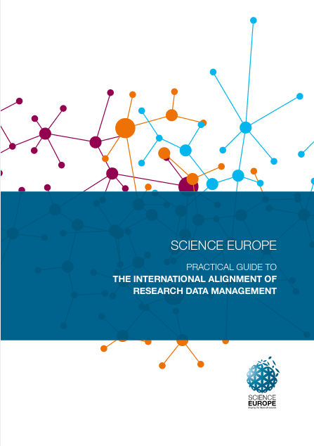
Core requirements to data management plan
Published 2019
https://www.forskningsradet.no/contentassets/e4cd6d2c23cf49d4989bb10c5eea087a/se_rdm_practical_guide_final.pdf
Notes:
So what does the data management plan need to include?
RCN uses the core requirements from the Science Europe practical guide to international alignment of research data management.

Slide 20
Core requirements to data management plan
6 core requirements:
Data description & Collection/re-use
Documentation & Data quality
Storage & Backup
Legal & Ethical requirements
Data sharing & Preservation
Responsibilities & Resources
https://www.forskningsradet.no/contentassets/e4cd6d2c23cf49d4989bb10c5eea087a/se_rdm_practical_guide_final.pdf
Notes:
Using Data stweardship wizard, this will ensure that you fill inn all requirements

Slide 21

Core requirements to data management plan
Updated Jan 2021
Including guidance for reviewers (evaluation rubric)
RCN does not [yet?] refer to the updated guide
https://www.scienceeurope.org/our-resources/practical-guide-to-the-international-alignment-of-research-data-management/

Slide 22

DMP requirements in an RCN project
When awarded funding from RCN:
Full DMP required
Public and openly accessible!
One possibility is
Illustrative Icons from Font Awesome licensed under Creative Commons Attribution 4.0 International License
Notes:
An important point to remember here is that the DMP are to be made public and openly accessible. As the RCN is not specifying when in the process this should happen, we recommend for example Zenodo - where you can publish your DMP and update with different versions.

Slide 23
DMP requirements in an RCN project
During your project:
Update the DMP
“You will not be asked to report on changes to the plan during the project period.”
Illustrative Icons from Font Awesome licensed under Creative Commons Attribution 4.0 International License
Notes:
The data management plan is supposed to be a living document, that evolve along with your research project.
However, RCN will nor be asked to report on these changes.

Slide 24
DMP requirements in an RCN project
Final report of project:
Final version of DMP
“We will request a final version of the data management plan in connection with the final report of the project.”
Illustrative Icons from Font Awesome licensed under Creative Commons Attribution 4.0 International License

Slide 25
Introduction
The FAIR data principles

Slide 26
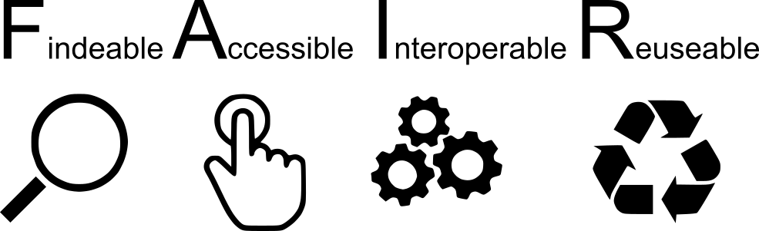
Open Data
As open as possible and as close as necessary
Data that is not open should also be FAIR
A system for authentication and authorisation should be in place

Slide 27

FAIR: Findable Data
Metadata are crucial: the data are found through the metadata.
Deposition on a repository is one of the FAIR principles, such an (external) service has to be in place.

Slide 28
FAIR: Accessible Data
Technical implementations for accessing data, authentication and authorisation (FAIR not OPEN).
Metadata always available, also when the dataset no longer exist.

Slide 29
FAIR: Interoperable Data
Adoption of community-defined standards and definitions.
Consistent metadata annotation allows linking across datasets.

Slide 30
FAIR: Reusable Data
To ensure successful reusability, you need:
Rich metadata
License
Data “history” (experimental technique, author, publication)
Community standards (e.g. from domain repository of choice)
Notes:
Lack of license
Provenance: where is data coming from

Slide 31
Introduction
The Machine-Actionable DMP standard

Slide 32
The machine-actionable DMP standard (maDMP)
Machine-actionable:
Information structured in a consistent way so that machines can be programmed against the structure.
Formats such as JSON, XML, RDF
Standard:
Contains “minimum information”, but can also be customised.
All tools supporting this format become interoperable

Slide 33
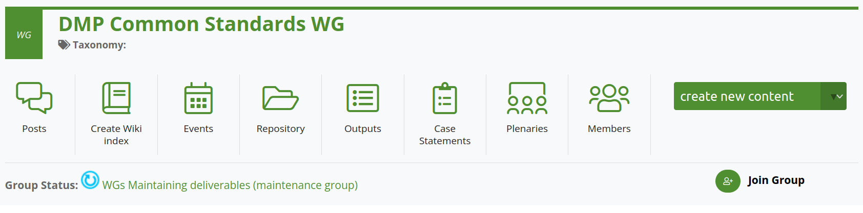


Research Data Alliance (RDA) working group (WG)
https://www.rd-alliance.org/groups/dmp-common-standards-wg

Slide 34

Who recommends/requires a maDMP 1
What a data management plan should include
The Research Council recommends using a service for data management plans that allows the project to generate a machine-actionable data management plan, for example according to the RDA Common Standard. Until further notice, the project must upload the data management plan in the format of pdf, .doc(x) or similar. We are working on developing our systems to facilitate machine-actionable data management plans. We also recommend assigning your data management plan a persistent identifier, such as a DOI. Several services for data management plans offer this.
https://www.forskningsradet.no/en/research-policy-strategy/open-science/research-data/

Slide 35
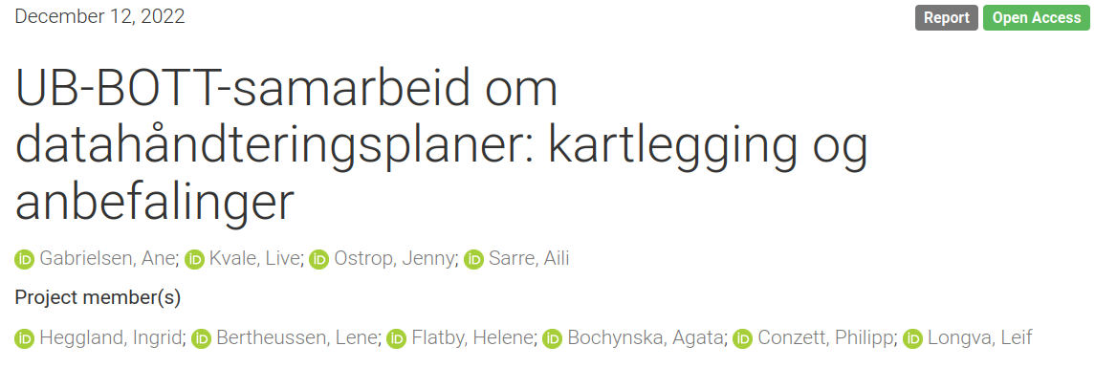
Who recommends/requires a maDMP 2
https://doi.org/10.5281/zenodo.7428542

Slide 36
Who recommends/requires a maDMP 2
Prosjektgruppen slutter seg også til anbefalingen fra Forskningsrådet om å bruke verktøy som kan generere maskinhåndterbare datahåndteringsplaner (f.eks. etter RDA Common Standard) og publisering av DMPer.
https://doi.org/10.5281/zenodo.7428542

Slide 37
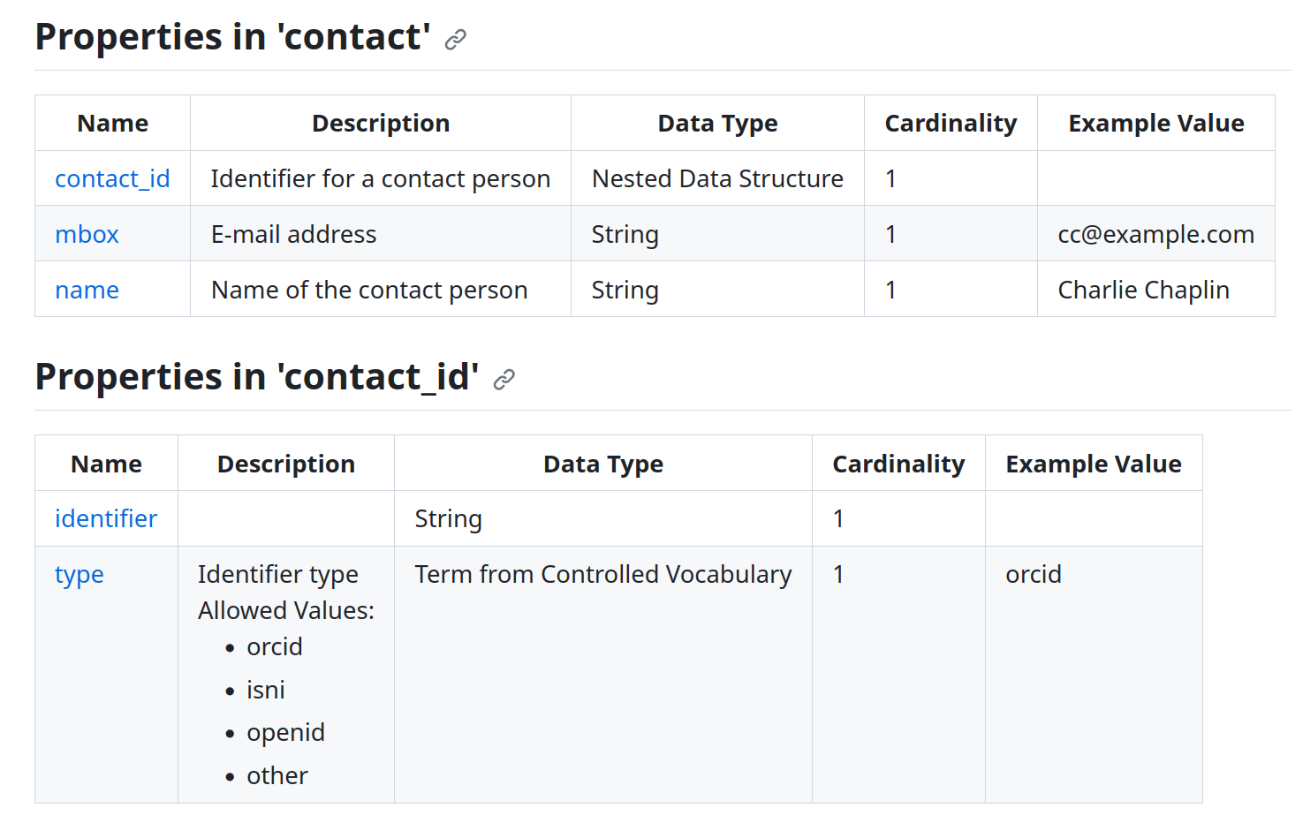
JSON schema of maDMP
https://github.com/RDA-DMP-Common/RDA-DMP-Common-Standard

Slide 38
JSON schema of maDMP
This specific format is already implemented in DSW.
Filling out a DMP produces a document compliant with maDMP
This will be demonstrated in the demo today

Slide 39

Except where otherwise noted, this work is licensed under:
https://creativecommons.org/licenses/by/4.0/

