Slide 1

Welcome to the Life Science DMP- workshop on Zoom
Turn your video on while speaking (optional)
Use the ‘hand up’ function for questions or just unmute yourself
Mute yourself while not speaking
... or ask questions in the chat
Please use the ‘rename’ function to indicate your department & institution

Slide 2

Data Management Plans and a short introduction to ELIXIR & Digital Life Norway
Korbinian Bösl
Data management coordinator
ELIXIR Norway/Digital Life Norway
Illustrative Icons from Font Awesome licensed under Creative Commons Attribution 4.0 International License

Slide 3
Schedule
21.08.2023
0830 - 0900 Login support
0900 - 0915 Introduction
0915 - 0930 Requirements from the RCN
0930 - 1000 Parallel session: Local recommendations & storage infrastructures Institutional DMP guidelines
1000 - 1015 Short break
1015 - 1100 Introduction DSW
1100 - 1120 Information on national storage infrastructures
NeLS/StoreBioInfo
NIRD
TSD
1120 - 1135 Short break
1135 - 1230 Persistent identifiers, Controlled Vocabularies & Ontologies

Slide 4
Schedule
22.08.2023
0900 - 1000 Key legal and ethical requirements for research in the GDPR and Health research act
Personal Data Act
Health Research Act
1000 - 1010 Short break
1010 - 1050 Relevant deposition repositories/ data archives
domain specific archives (ELIXIR/EMBL-EBI, NCBI)
Dataverse NO
EGA
NIRD archive
NSD
1050 - 1100 Short break
1100 - 1115 Licensing of data, biological material and software
1115 - 1230 Hands on training and assistance to generate a data management plan

Slide 5



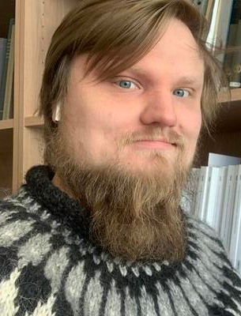
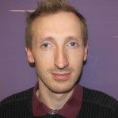
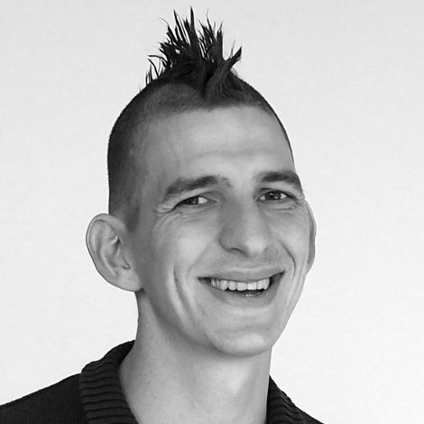





Espen Åberg
Nazeefa
Fatima
Federico Bianchini
Illimar
Rekand
David
Dolan
Korbinian Bösl

Slide 6
ELIXIR Europe
‘Data for Life’
Mission:
To operate a sustainable European infrastructure for biological information, supporting life-science research and its translation to society, the bio-industries, environment and medicine

Slide 7

ELIXIR Europe
Data stored in
ELIXIR/EBI-EMBL
Repositories
Cook, C. E. et al. The European Bioinformatics Institute in 2018: tools, infrastructure and training. Nucleic Acids Res 47, D15–D22 (2019).
licensed under Creative Commons Attribution 4.0 International License

Slide 8

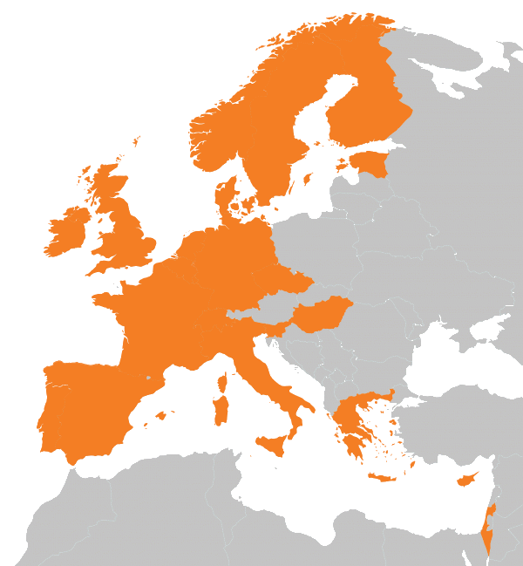
https://elixir-europe.org/about-us/who-we-are

Slide 9
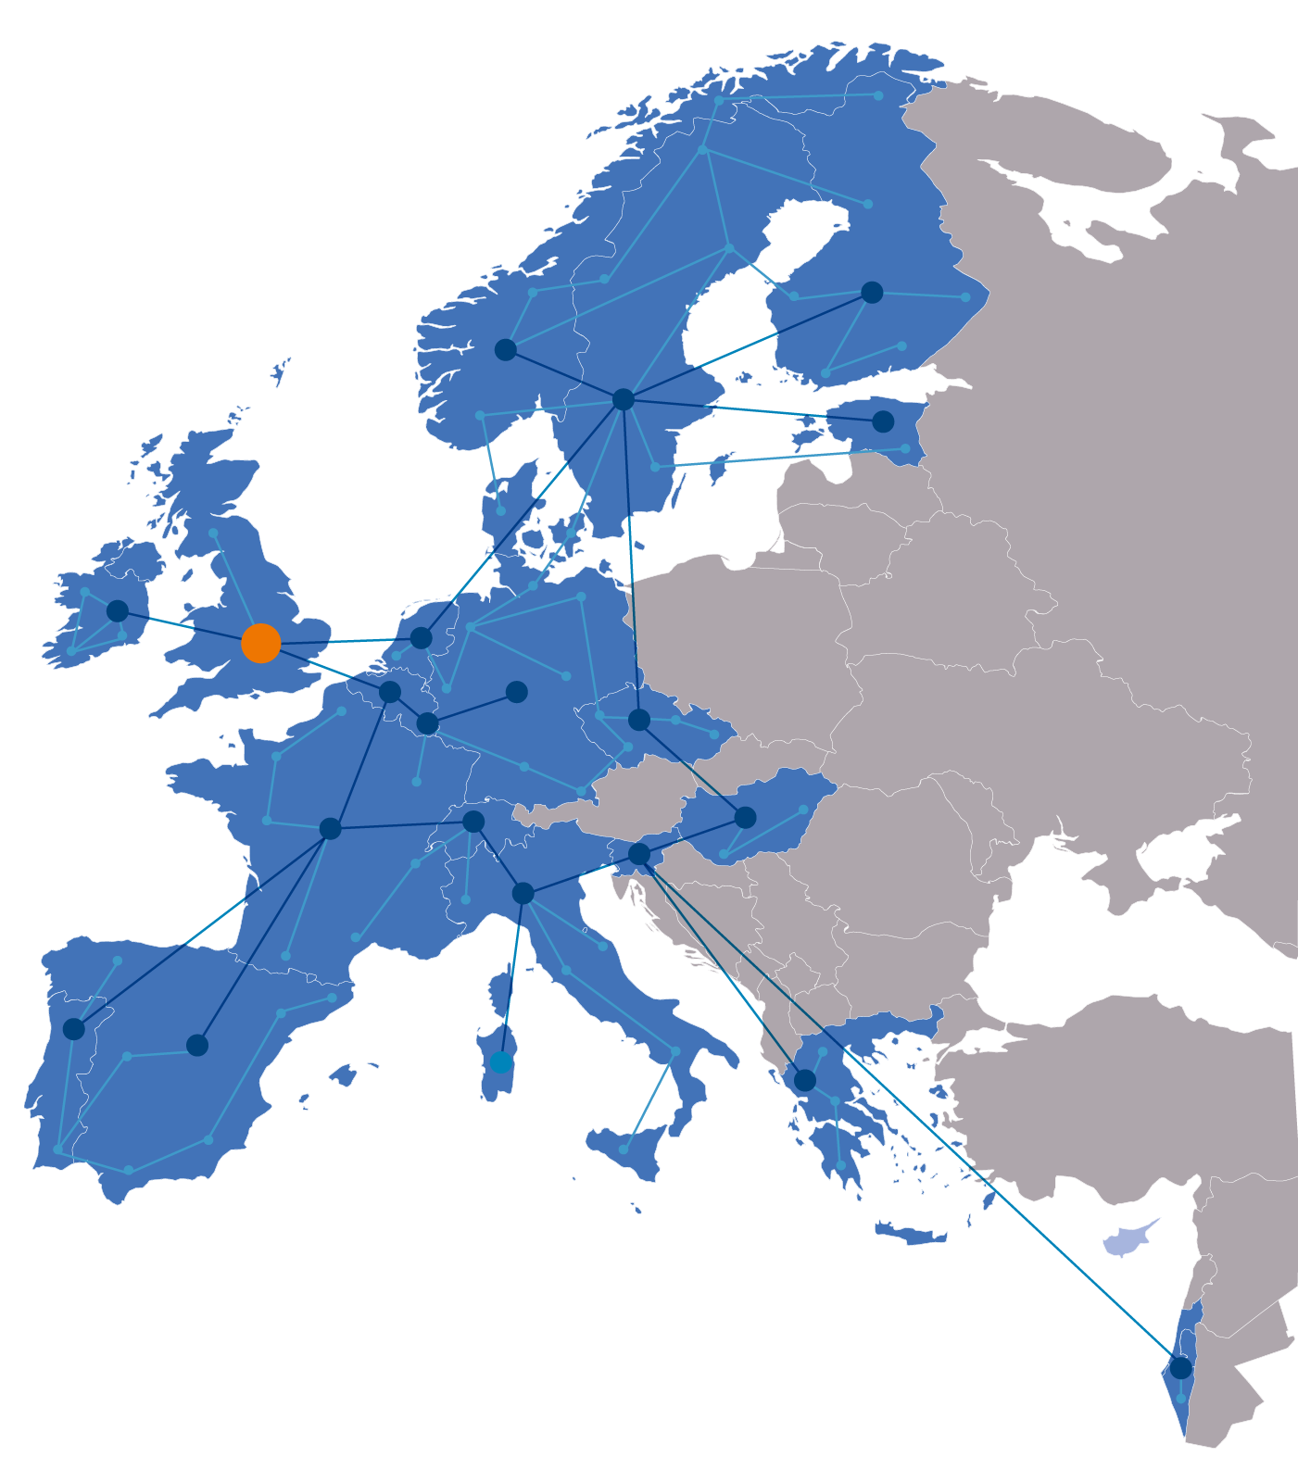
ELIXIR Services
Data deposition:
ENA, EGA, PDBe, EuropePMC, …
Compute:
Secure data transfer, cloud computing, AAI
Data management:
Genome annotation
Data management plans
RDMkit
Bioinformatics tools:
Bio.tools, Benchmarking: OpenEBench
Industry:
Innovation and SME programme
Bespoke collaborations
Added value data:
UniProt, Ensembl, OrphaNet, …
Training:
TeSS, Data Carpentry, eLearning
Data Interoperability:
FAIRSharing, identifiers.org, OLS,
Bioschemas, …

Slide 10

A distributed infrastructure to scale with the challenge
ELIXIR data infrastructure for Europe’s life science research sector
ELIXIR Nodes build local bioinformatics capacity throughout Europe
ELIXIR Nodes build on national strengths and priorities

Slide 11

ELIXIR Structure
Five technical Platforms for Compute, Data, Tools, Interoperability, and Training

Slide 12
ELIXIR Structure
Five technical Platforms for Compute, Data, Tools, Interoperability, and Training
Complemented by Communities for specific use cases within e.g. Human data, Metabolomics, Proteomics, Marine Metagenomics, Microbial Biotechnology, Structural Bioinformatics and others

Slide 13



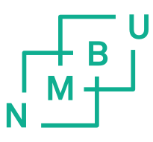
ELIXIR Structure
The Norwegian node of ELIXIR Europe
Currently funded by:
  The Research Council of Norway (until 2026)
  The involved institutions; UiB, UiO, NMBU, NTNU and UiT
  Users
Services to national users
  Infrastructure, support and training
Deliverables to ELIXIR Europe
  Tools and databases

Slide 14
Our additional user services - Norway
Support – through our HelpDesk 1 day of service free of charge (enabled by RCN)
Training – in using our tools and workflows, and in data management
Bioinformatics infrastructure
Analysis, sharing and managing of data
support@elixir.no

Slide 15






Centre for Digital Life Norway (DLN 2.0) facilitates transdisciplinary research, innovation, and education in Life Science
Transdisciplinary collaborations
www.digitallifenorway.org
Education and career development
Responsible research and innovation
Innovation and commercialisation
Data management
Notes:
Korbinian and I are collegues in the Centre for Digital Life
DLN is an national initiative that includes the major instituations across the country. The centre aims to transform Norwegian biotechnology research and education. We offer guidance and support in the following focus areas:

Slide 16

35 transdisciplinary biotechnology projects all over the country.
Biotechnology with digital technology: health, aquaculture, agriculture & industrial biotechnology.
Notes:
Currently, 35 projects are connected to the centre.
They all vary greatly in their research are and approaches, but share a digital biotechnology approach.

Slide 17
Join us!
Open call for Digital Life Norway project membership
contact@digitallifenorway.org
... and join the DLN Research School at any time
https://www.digitallifenorway.org/news/open-call-project-membership.html
https://www.digitallifenorway.org/research-school/membership/index.html
Notes:
Currently, 35 projects are connected to the centre.
They all vary greatly in their research are and approaches, but share a digital biotechnology approach.

Slide 18
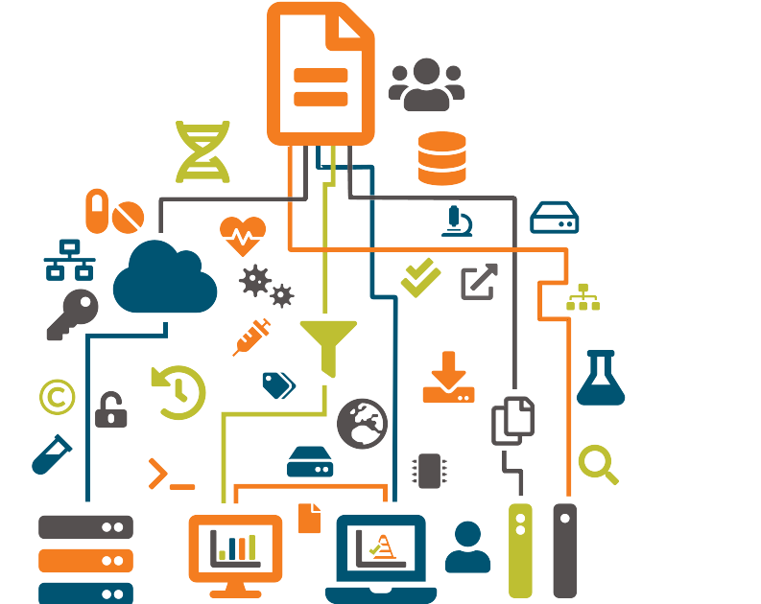
Data Management
Make research data and related metadata discoverable, accessible and understandable ...
... today, tomorrow, and well into the future.
... across geographical distances.
... enabling efficient collaboration; even across disciplines.

Slide 19








Slide 20
R

Slide 21
Data catalogues & registries
Data creation &
deposit
R
Discover,
Reuse & cite
Plan &
Design
Share &
Publish
Collect &
Capture
Manage, store &
preserve
Process &
Analyse
Archives &
Data repositories
Managing active
data

Slide 22



Slide 24


Slide 25


Slide 26


Slide 27


Slide 28

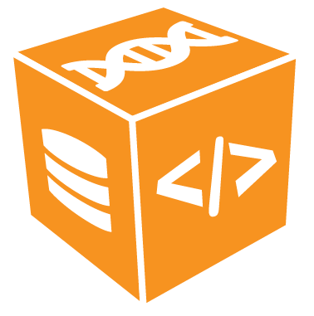

Slide 29








Slide 30


sensitive
data

Slide 32
Data Management Plan?
sensitive
data

Slide 33


/
/
/
/
/

Slide 34

]
/
/
/
/
/
/
sensitive
data

Slide 35
A user-oriented guide to the FAIR RDM practices in life sciences
increase
self-sufficiency
support researchers to know and utilise RDM services
build capacity and skills in every research institute
pool the expertise of the community for the community
To support the data needs of Europe’s estimated 500,000 life scientists
https://rdmkit.elixir-europe.org
Notes:
Bridge the gap between ELIXIR and real researcher/data stewards in projects in our countries and nodes.

Slide 36
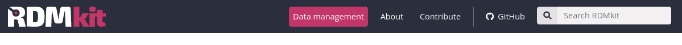
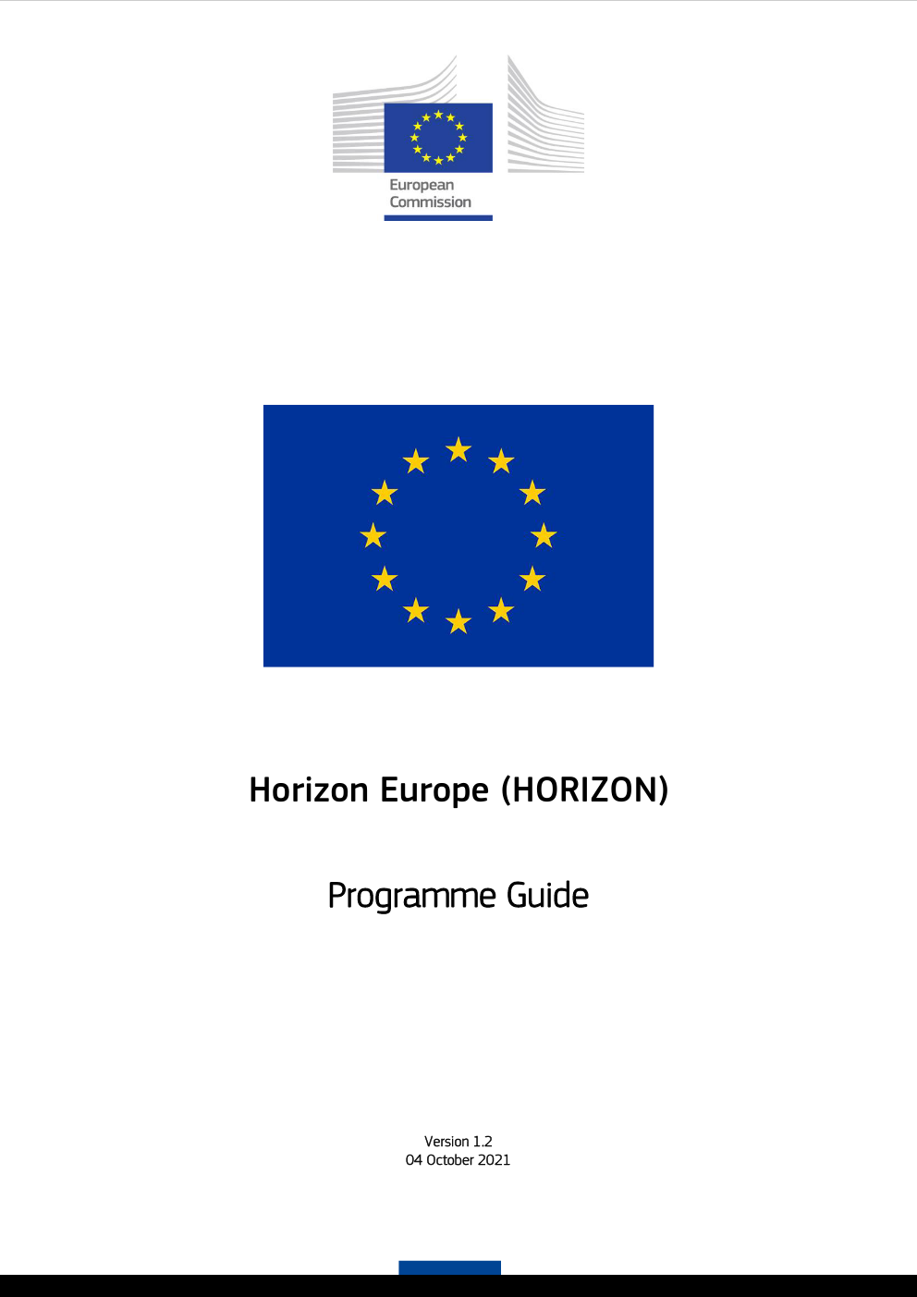
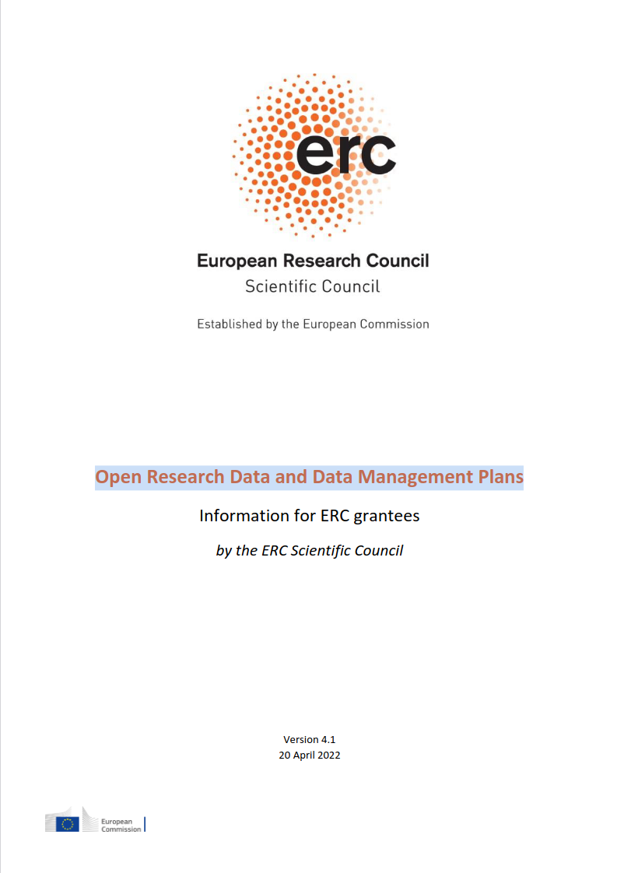
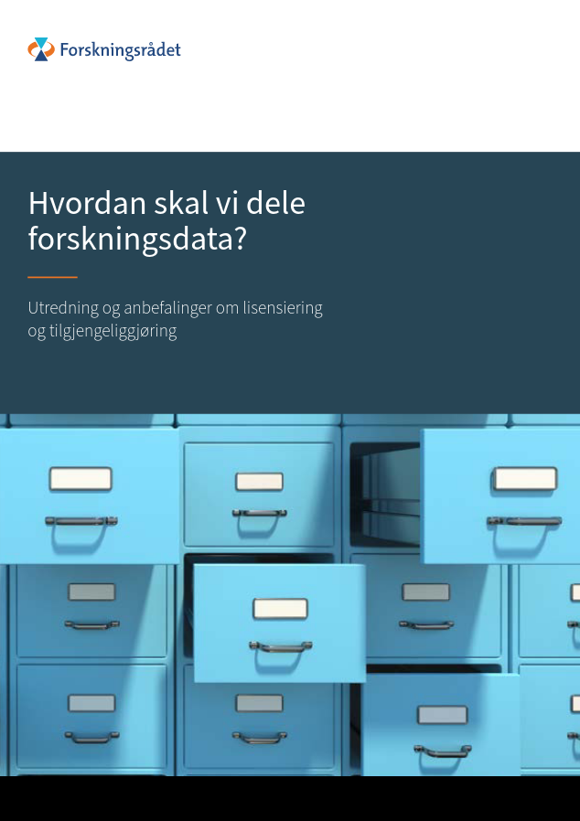

Recommended by:
EC: Horizon Europe Program Guide
ERC: Research Data and Data Management Plans
Research Council of Norway

Slide 37


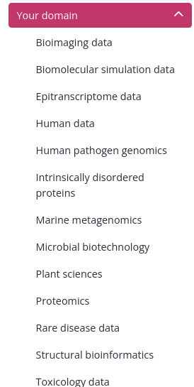
rdmkit.elixir-europe.org

Slide 38
Continuously growing ...
rdmkit.elixir-europe.org

Slide 39













elixir.no support@elixir.no @elixirnorway
digitallifenorway.org contact@digitallifenorway.org @DigitaltLiv
The Data Stewardship Wizard is provided by:

Slide 40

Except where otherwise noted, this work is licensed under:
https://creativecommons.org/licenses/by/4.0/

