Slide 1

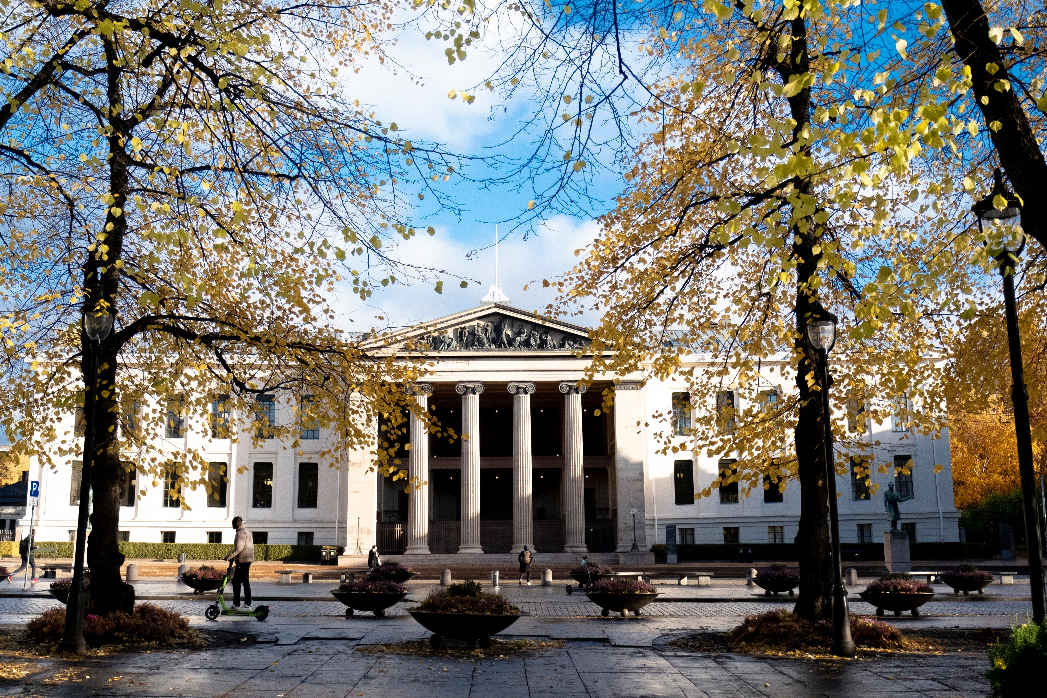



Research Data
Management at UiO
Live Håndlykken Kvale
Digital Scholarship Center, University Library
26.September 2022

Slide 2

Agenda
•
Data management policies and
guidelines at UiO
•
Where to find more information?
•
Courses and skills development
•
Data management plans
•
Where to get help?
S. Kjellin, UiO

Slide 3

Policies and guidelines at UiO

Slide 4
University of Oslo’s policy
The University of Oslo wants to manage research data according to international
standards, such as the FAIR principles and CARE principles, and thereby support
the development of a global research community in which research data is widely
shared. By doing so, UiO contributes to:
•
Improved quality of research
•
Increased transparency in the research process and better opportunity for
verifiability of scientific results
•
Increased cooperation and less duplication of research
•
Increased innovation in the private and public sectors
•
Efficiency improvement and better utilization of public funds
https://www.uio.no/english/for-employees/support/research/research-data-management/policies-and-guidelines/

Slide 5
Research data at UiO must:
•
be made openly available for reuse
•
have a data management plan
•
have metadata
•
be archived in a responsible manner
•
be equipped with licenses for access, reuse and redistribution
•
be made available as early as possible
•
be made openly available, but costs for distribution can be covered
https://www.uio.no/english/for-employees/support/research/research-data-management/policies-and-guidelines/

Slide 6
Research data should be:
•
accurate, complete, genuine, and reliable
•
findable, accessible, interoperable and reusable
•
securely stored and/or archived
•
maintained in accordance with legal and research-ethical obligations
•
shareable with others in line with relevant ethical principles for sharing of research
data
•
made accessible at the earliest possible time, but after research team’s first right
of use period

Slide 7
Exceptions to sharing research data open access
•
Security considerations
•
Sensitive personal data
•
Other legal provisions
•
Commercial conditions

Slide 8
Responsibilities
•
UiO is responsible for facilitating the information flow, competence measures and
research support systems that simplify the implementation process of the
principles and requirements mentioned above.
•
Researchers and students are responsible for managing research data
according to the principles and requirements stated above.
•
Supervisors of ph.d candidates and students have a special responsibility for
ensuring that candidates and students attend courses and manage research data
according to the above guidelines.

Slide 9
Where do I find more information about this?

Slide 10
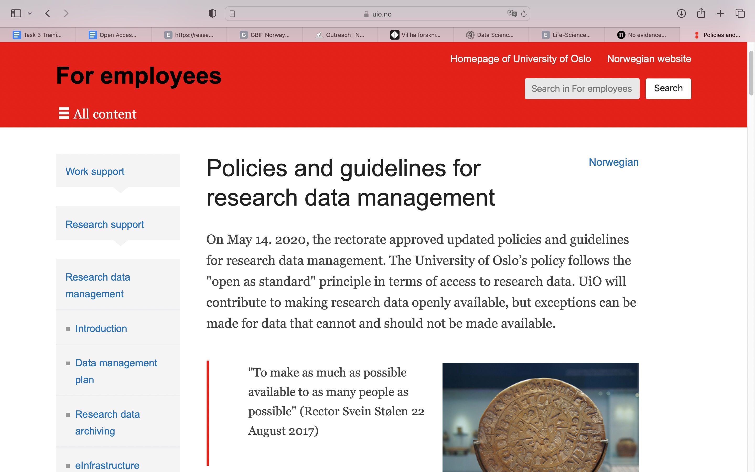
https://www.uio.no/english/for-employees/support/research/research-data-management-old/policies-and-guidelines/

Slide 11
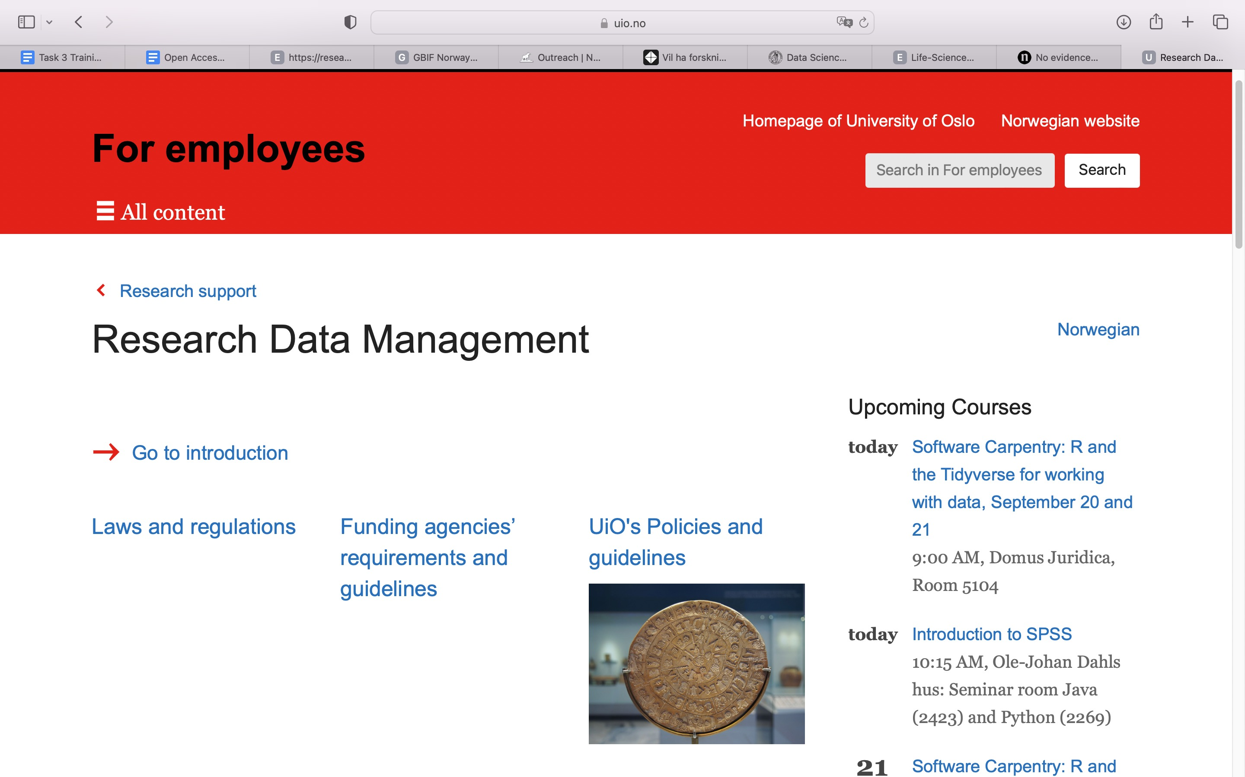
https://www.uio.no/english/for-employees/support/research/research-data-management/index.html

Slide 12
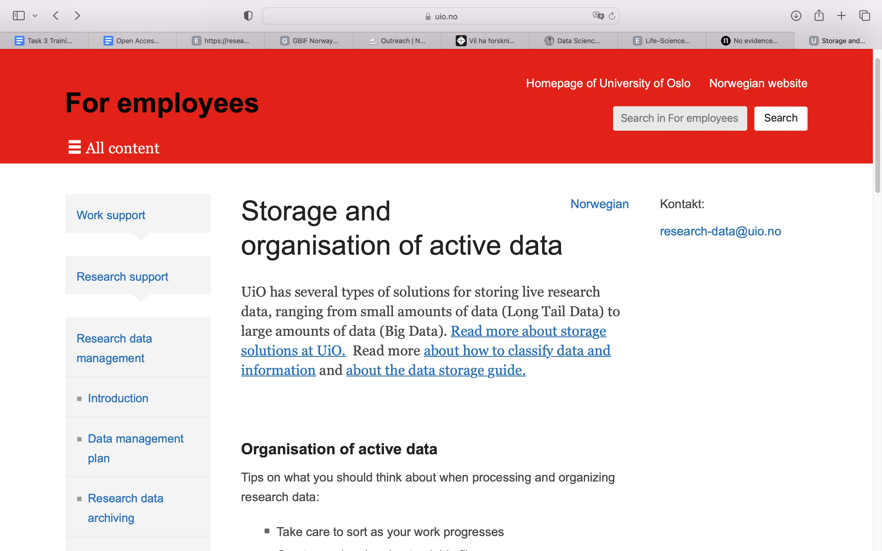
https://www.uio.no/english/for-employees/support/research/research-data-management-old/storage/index.html

Slide 13
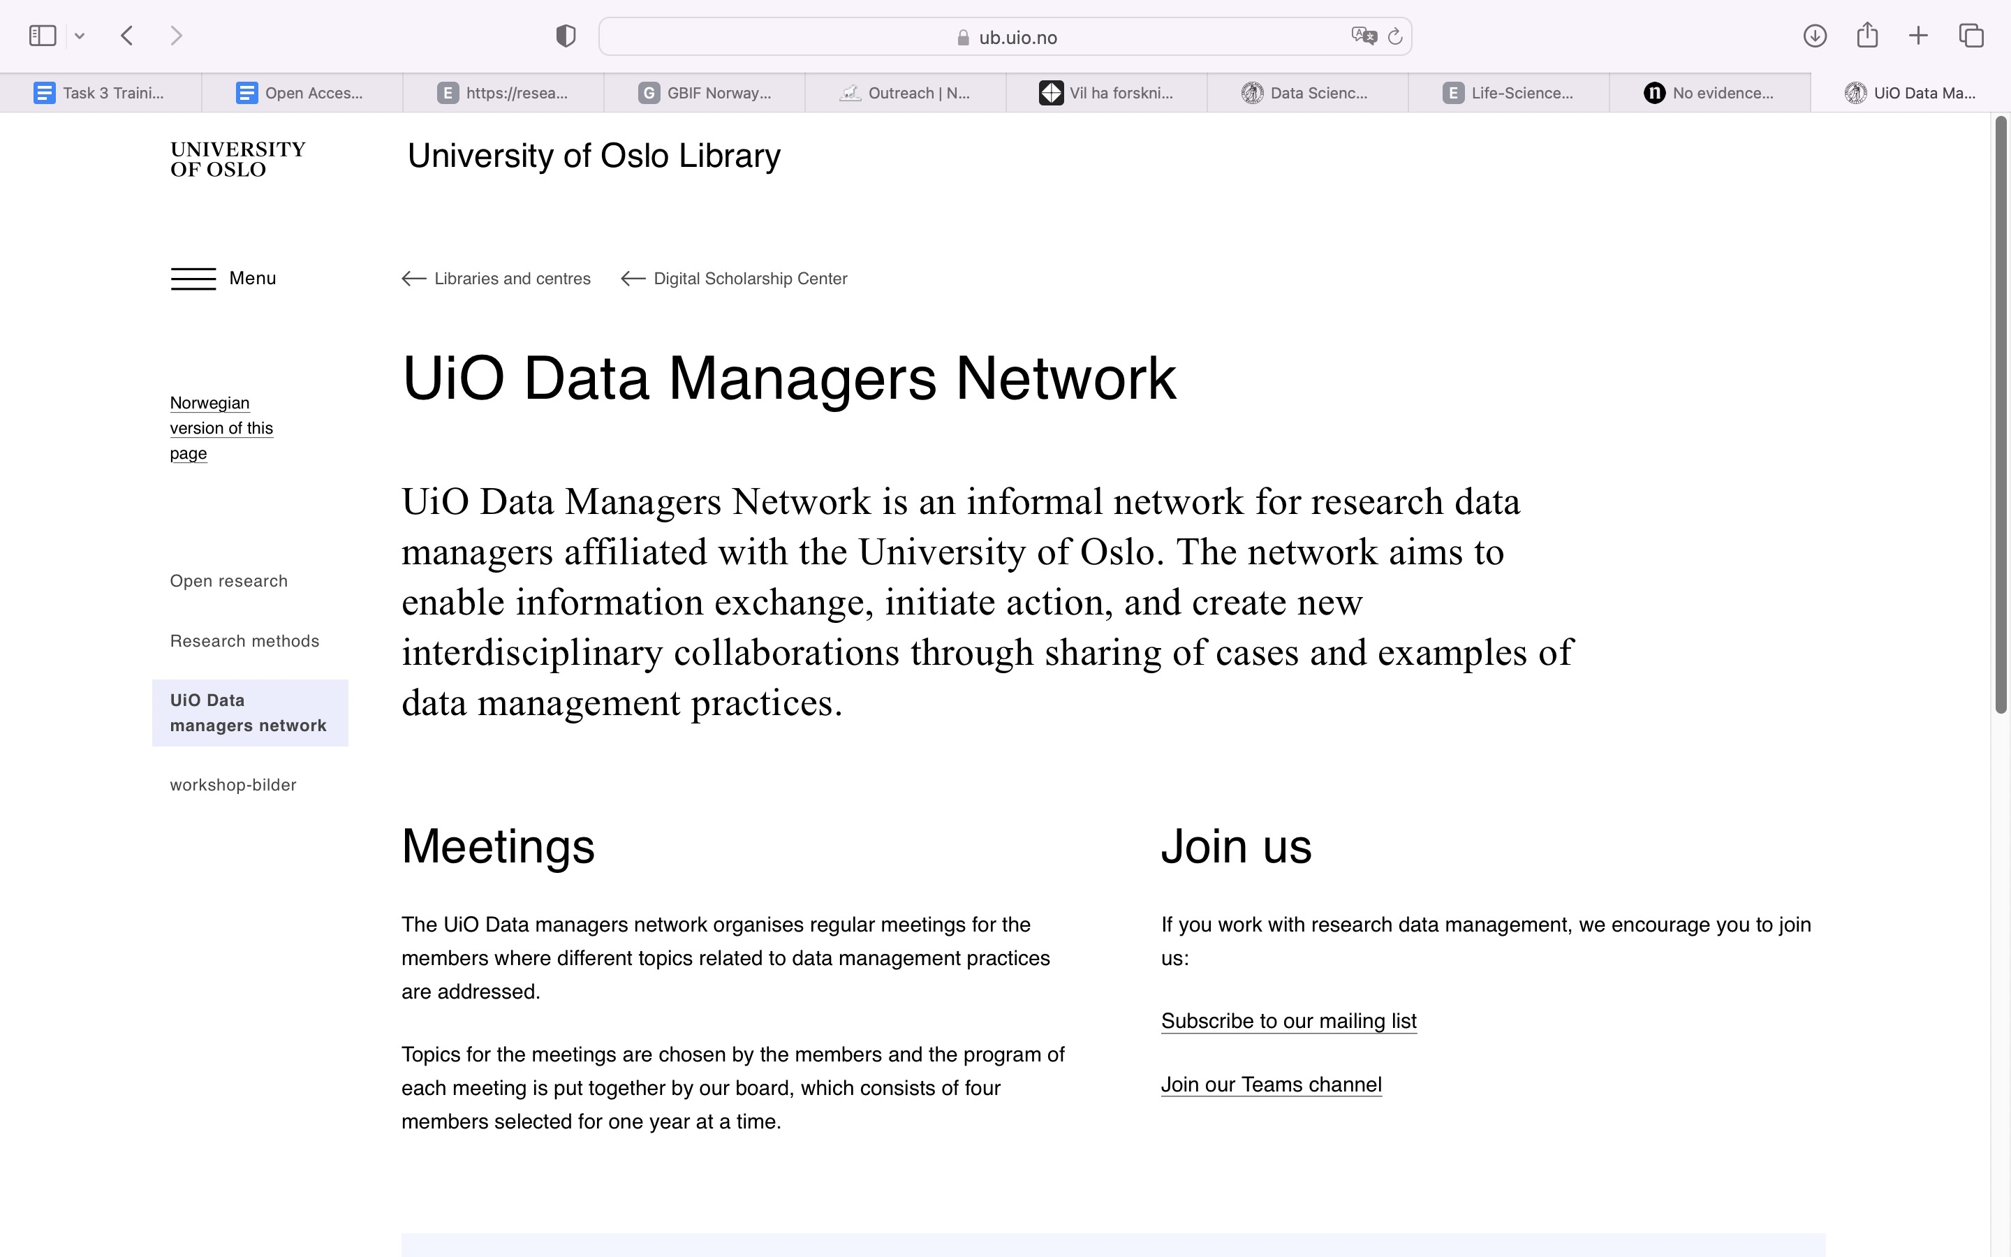
13
https://www.ub.uio.no/english/libraries/dsc/data-managers-network/index.html

Slide 14
What about data management plans?

Slide 15


The Data Management Plan
(DMP)
•
Is a living document that accompanies
the research project
•
Specifies the kind of data that will be
generated
•
Outlines how the data will be described
•
Explains where the data will be stored
•
Conveys whether and how the data can
be shared

Slide 16
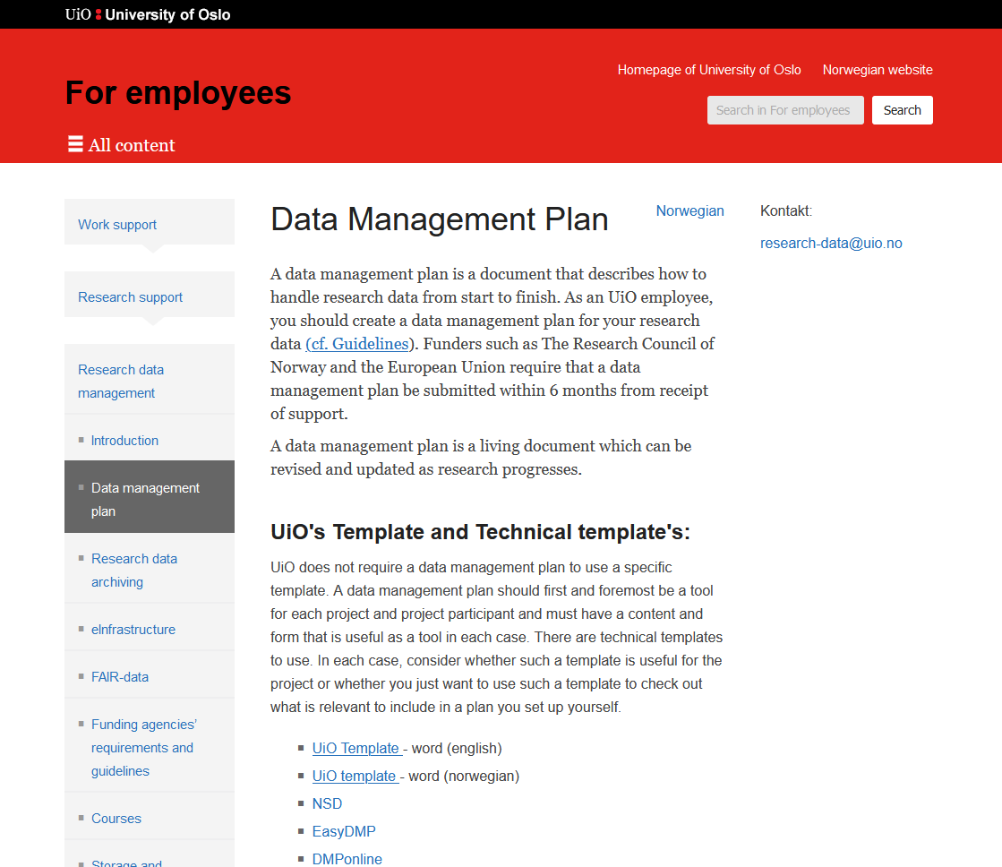

Slide 17
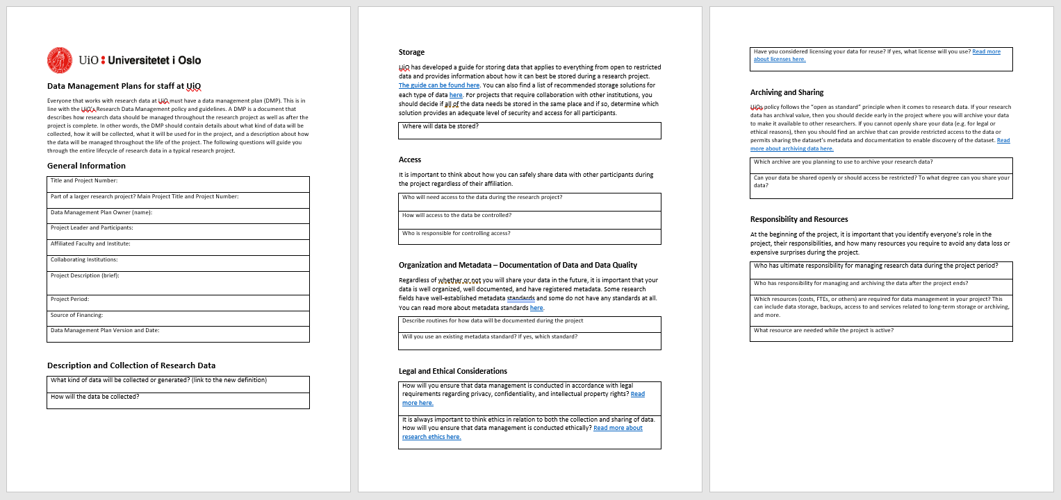

Slide 18
Where to get help?

Slide 19
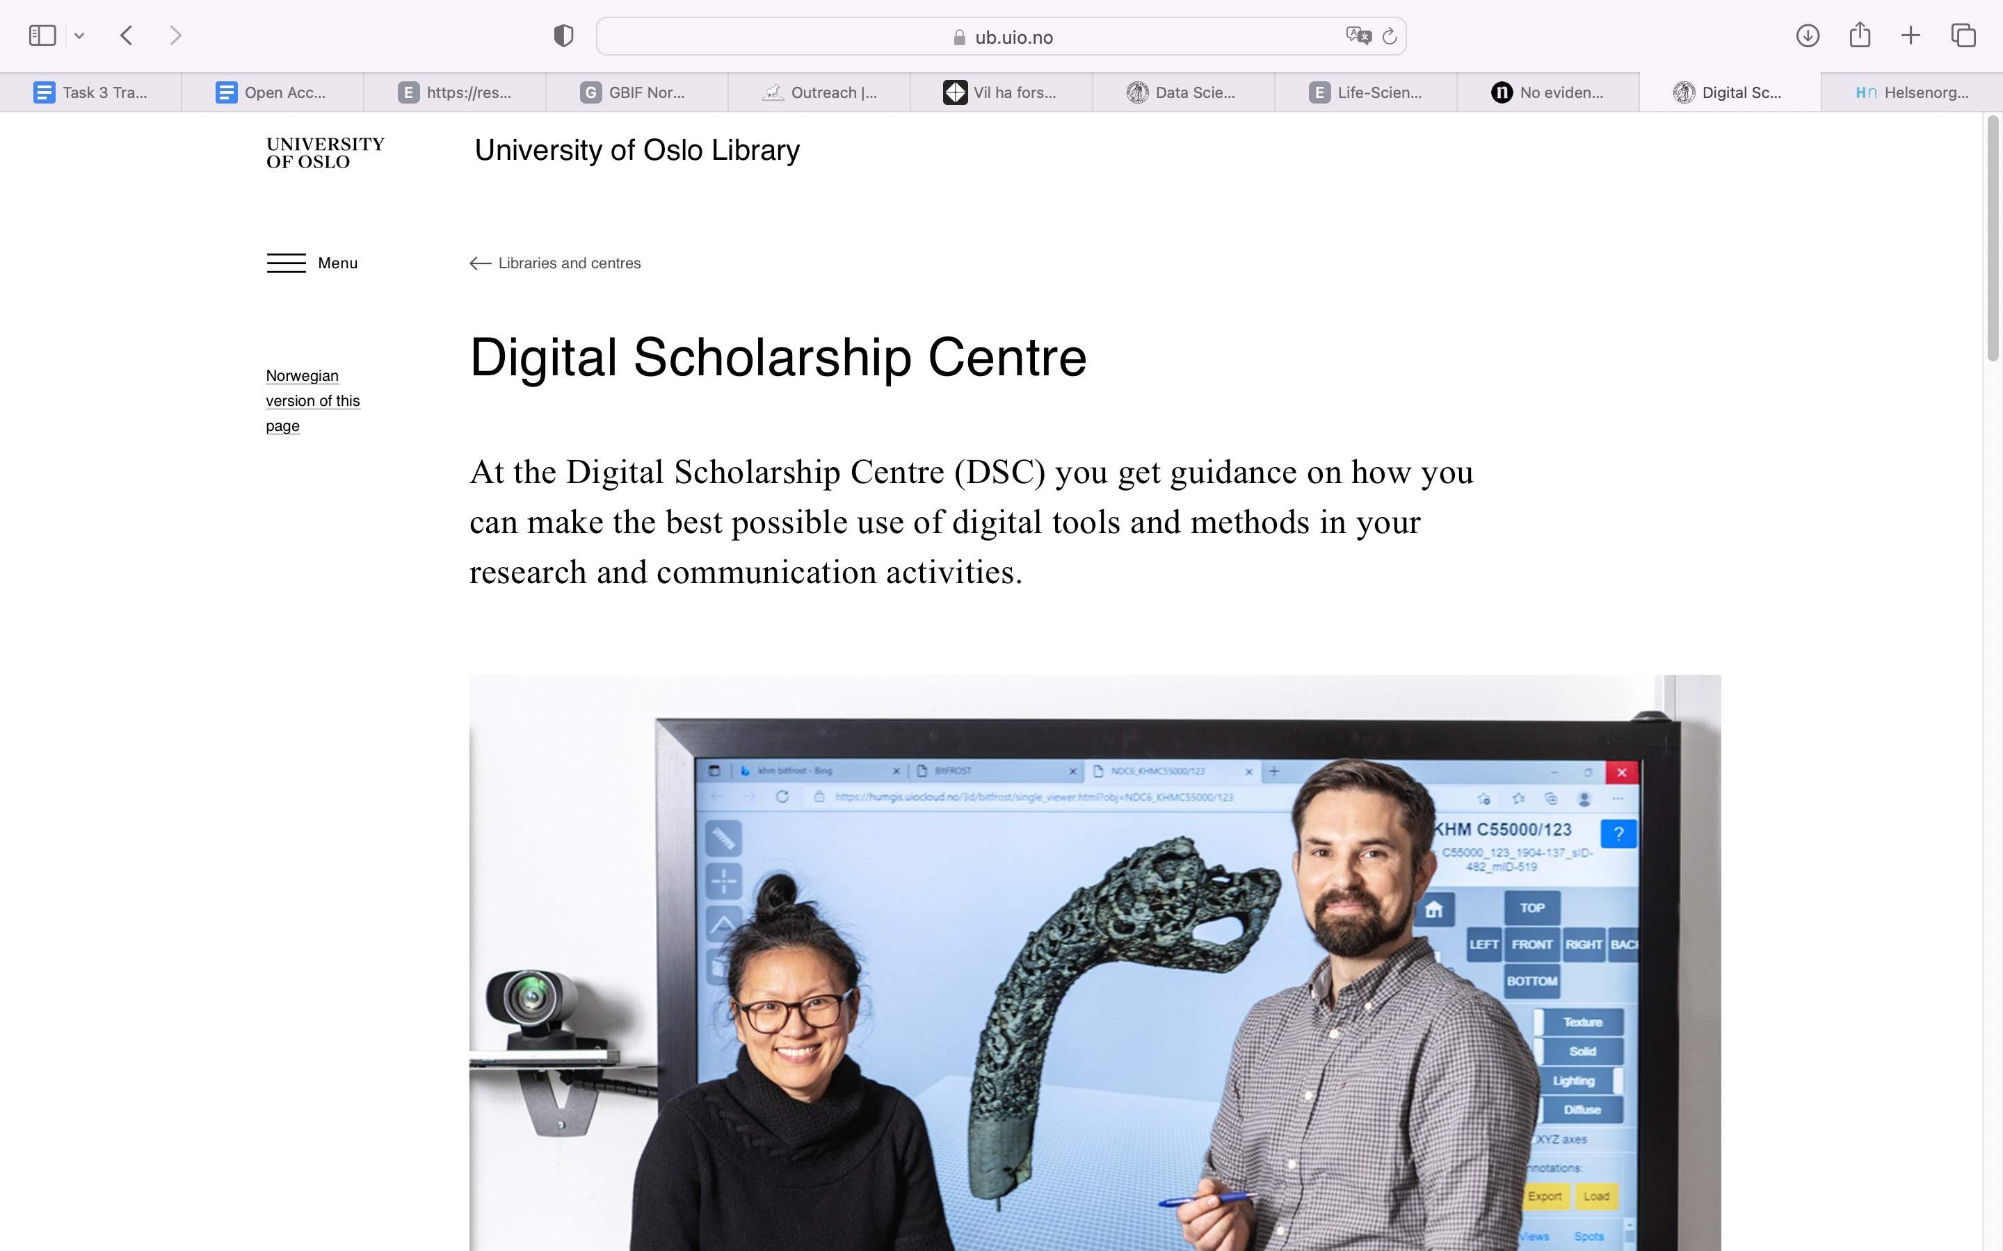
https://www.ub.uio.no/english/libraries/dsc/

Slide 20
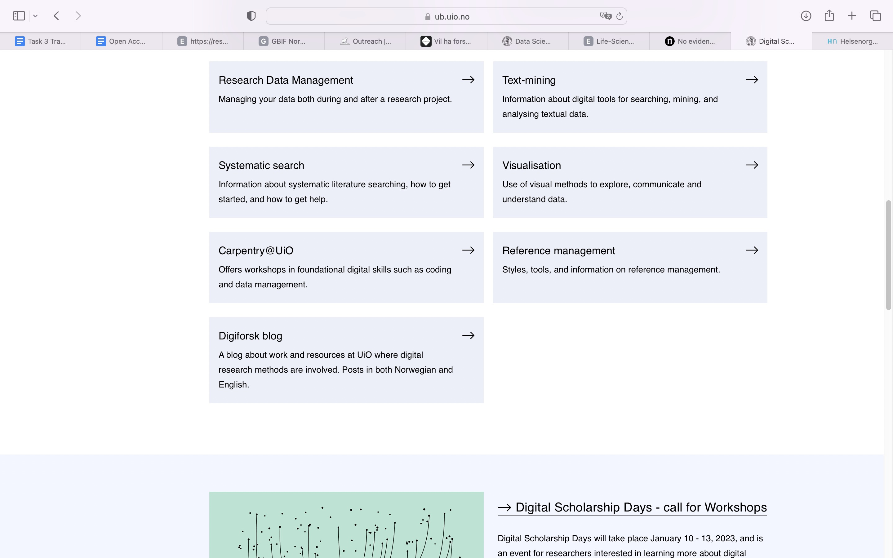
research-data@uio.no
https://www.ub.uio.no/english/libraries/dsc/

Slide 21
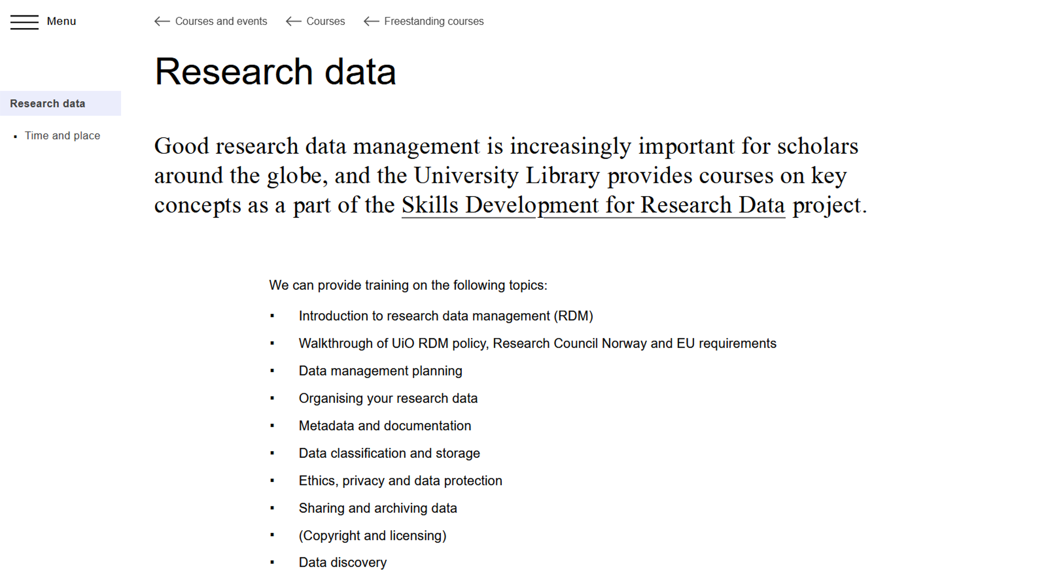
https://www.ub.uio.no/english/courses-events/courses/other/research-data/

Slide 22
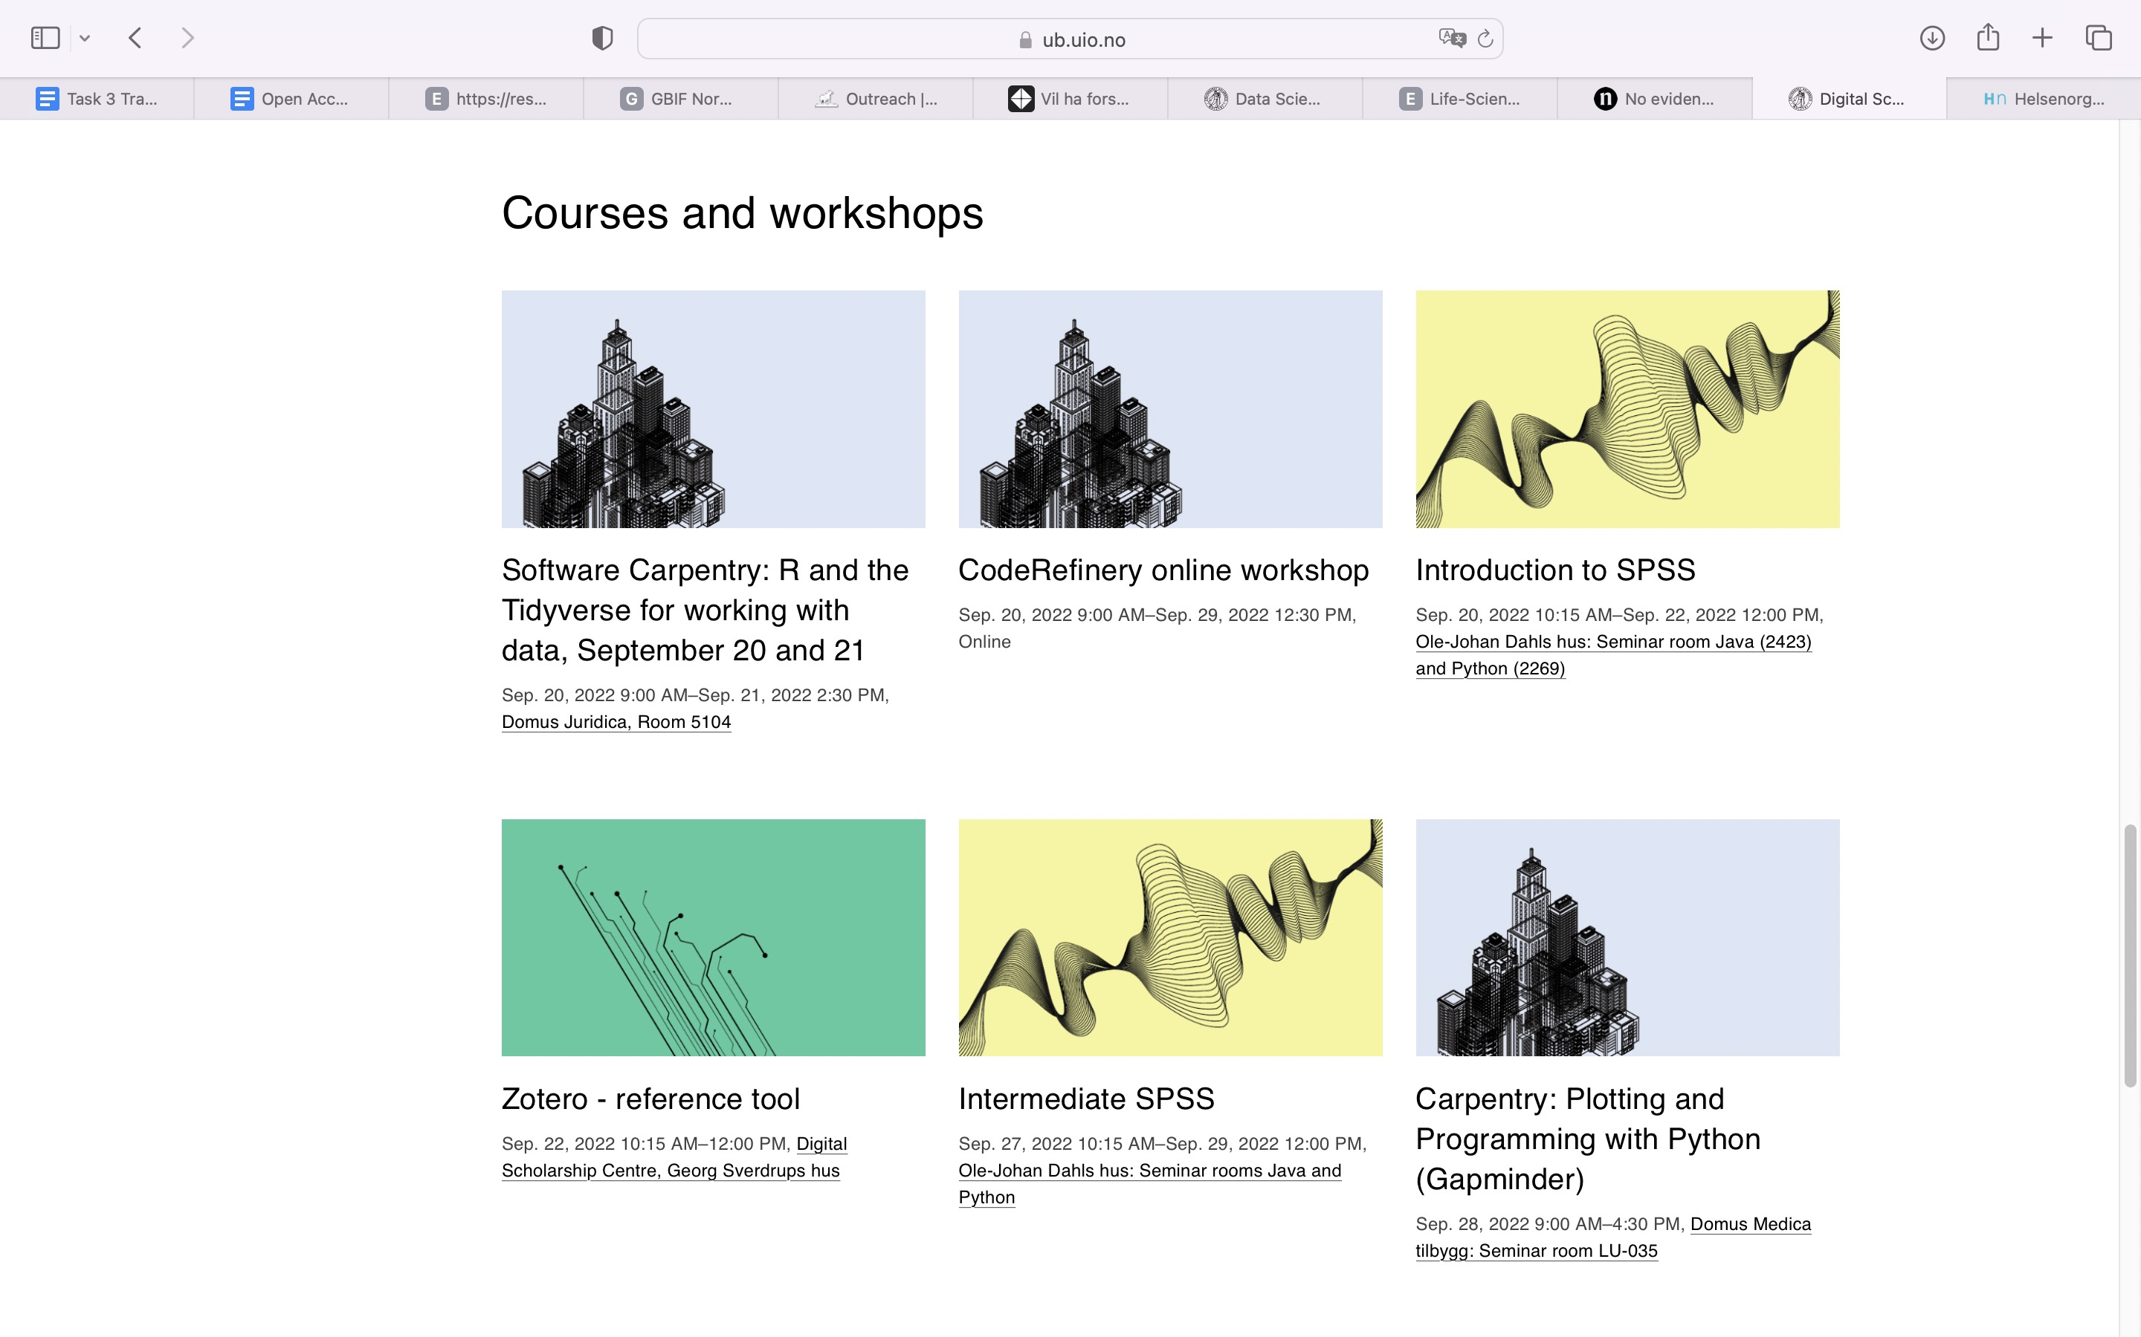
https://www.ub.uio.no/english/libraries/dsc/

Slide 23
Thank you!
Questions?
research-data@uio.no

