Slide 1
Local recommendations & storage infrastructures
UiT
Erik Hjerde
ELIXIR Norway

Slide 2







Typical flow in a research project
PUBLICATION
DATA
DATA STORAGE
EXPERIMENT
METADATA
DATA DEPOSITION
DATA ANALYSIS

Slide 3
Local recommendations
Institutional DMP guidelines
Data management
PUBLICATION
DATA
DATA STORAGE
Open science
EXPERIMENT
METADATA
DATA DEPOSITION
DATA ANALYSIS
Storage infrastructures

Slide 4


Local recommendations - Responsibility
As a general rule, UiT owns all research data produced by employees at UiT
Researcher:
Data management plan
Storing and archiving data
Open access to data
Collect and preserve metadata
Licencing
UiT:
Guide and support researchers
Provide data storage infrastructure
Provide data archiving
Borrowed from Lars Figenschou, UB
Notes:
The researcher shall ensure that the research data is securely stored, backed up, and archived, in accordance with the Information security management system at UiT
The researcher shall write a data management plan in an early phase of the project and preferably within six months of the start of the project

Slide 5



Local recommendations - DMP
All projects at UiT where handling of research data is relevant must have a DMP
This includes all registrations, notes, and reporting which are produced or arise in the course of research, and which are regarded as being of scientific interest and/or scientific potential.
The format of these may include, but is not limited to, numbers, text, source code, photographs, films, and sound
METADATA
SEQUENCE
DATA
IMAGE
DATA
NOTES
SOUND
DATA
Borrowed from Lars Figenschou, UB

Slide 6
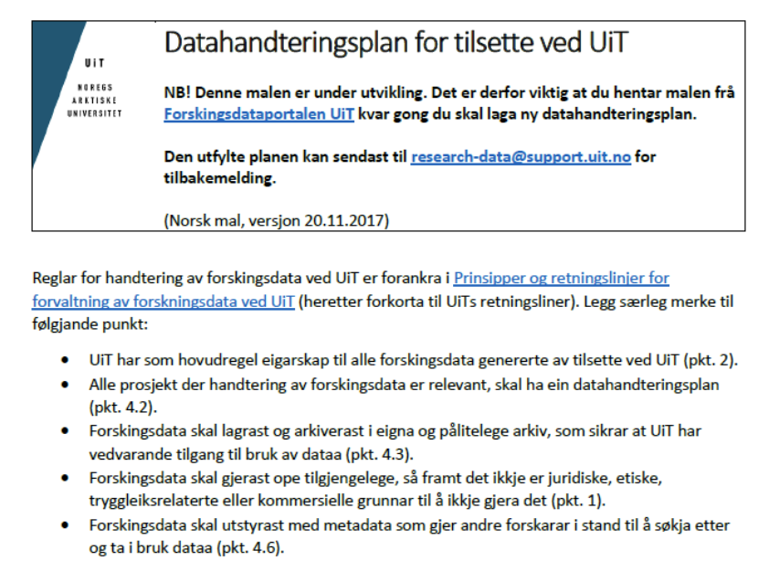
Local recommendations - DMP
Many data management planning tools available
Many templates depending on the financing source
For life science research projects we recommend the Data Stewardship Wizard
UiT provide a template for other projects here: uit.no/forskningsdata
Borrowed from Lars Figenschou, UB

Slide 7
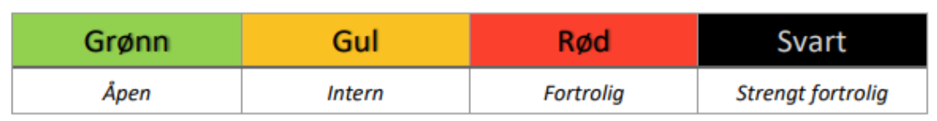
Local recommendations – Data storage
UiT Information Security Governance
You are responsible for the correct classification of your information
https://uit.no/sikkerhet
4 classes of confidentiality
Borrowed from Erik Axel Vollan, ITA

Slide 8
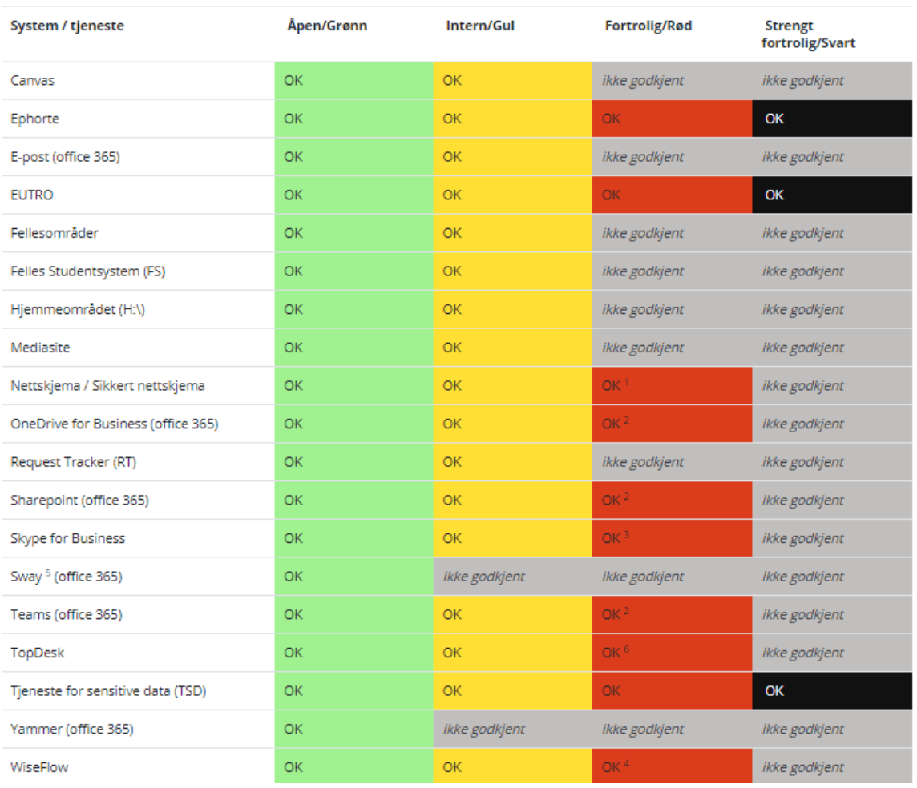
Local recommendations – Data storage
Classification dictates storage options
Borrowed from Erik Axel Vollan, ITA

Slide 9
Local recommendations – Data storage
Storage resources at UiT
New projects contact ITA via helpdesk to get storage access
Base quota of 5 TB free storage per user
Pricing model for large projects (0.5 – 1 NOK/GB/Year)
Users must fill out a form describing data, giving some metadata
Terminal or ssh/sftp clients
LOCAL MACHINE
UiT DATA STORAGE
Borrowed from Erik Axel Vollan, ITA

Slide 10
Local recommendations – Data storage
Challenge with instrument/laboratory data
Instruments live much longer than their control PCs
Software may not run on modern operating systems and can not be updated
PCs must restricted to closed networks
Users transport data using USB memory sticks
ITA have a service for automatic transfer of data from instruments to central storage.
Storage from several instruments
Remote Desktop access to instruments
Borrowed from Erik Axel Vollan, ITA

Slide 11




Local recommendations - Archiving
Three main types of research data repositories:
Domain-specific repositories, e.g. BioModels, Database of Genomic Variants Archive
Institutional repositories, e.g. UiT Open Research Data
General purpose repositories, e.g. Zenodo, Figshare, Harvard Dataverse
For life science data we recommend to go for the domain specific data repositories
Borrowed from Lars Figenschou, UB
Notes:
Open science contributes to making research results available, and to make the research process itself more transparent and verifiable.

Slide 12
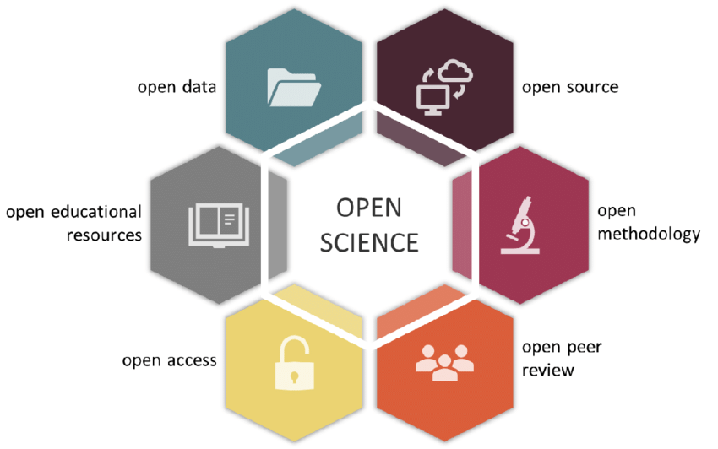
Local recommendations – Open science
UiT follow EU's objectives and guidelines for open science:
open publications
open research data
software
source code
methodology
peer review
teaching resources
Notes:
Open science contributes to making research results available, and to make the research process itself more transparent and verifiable.

Slide 13
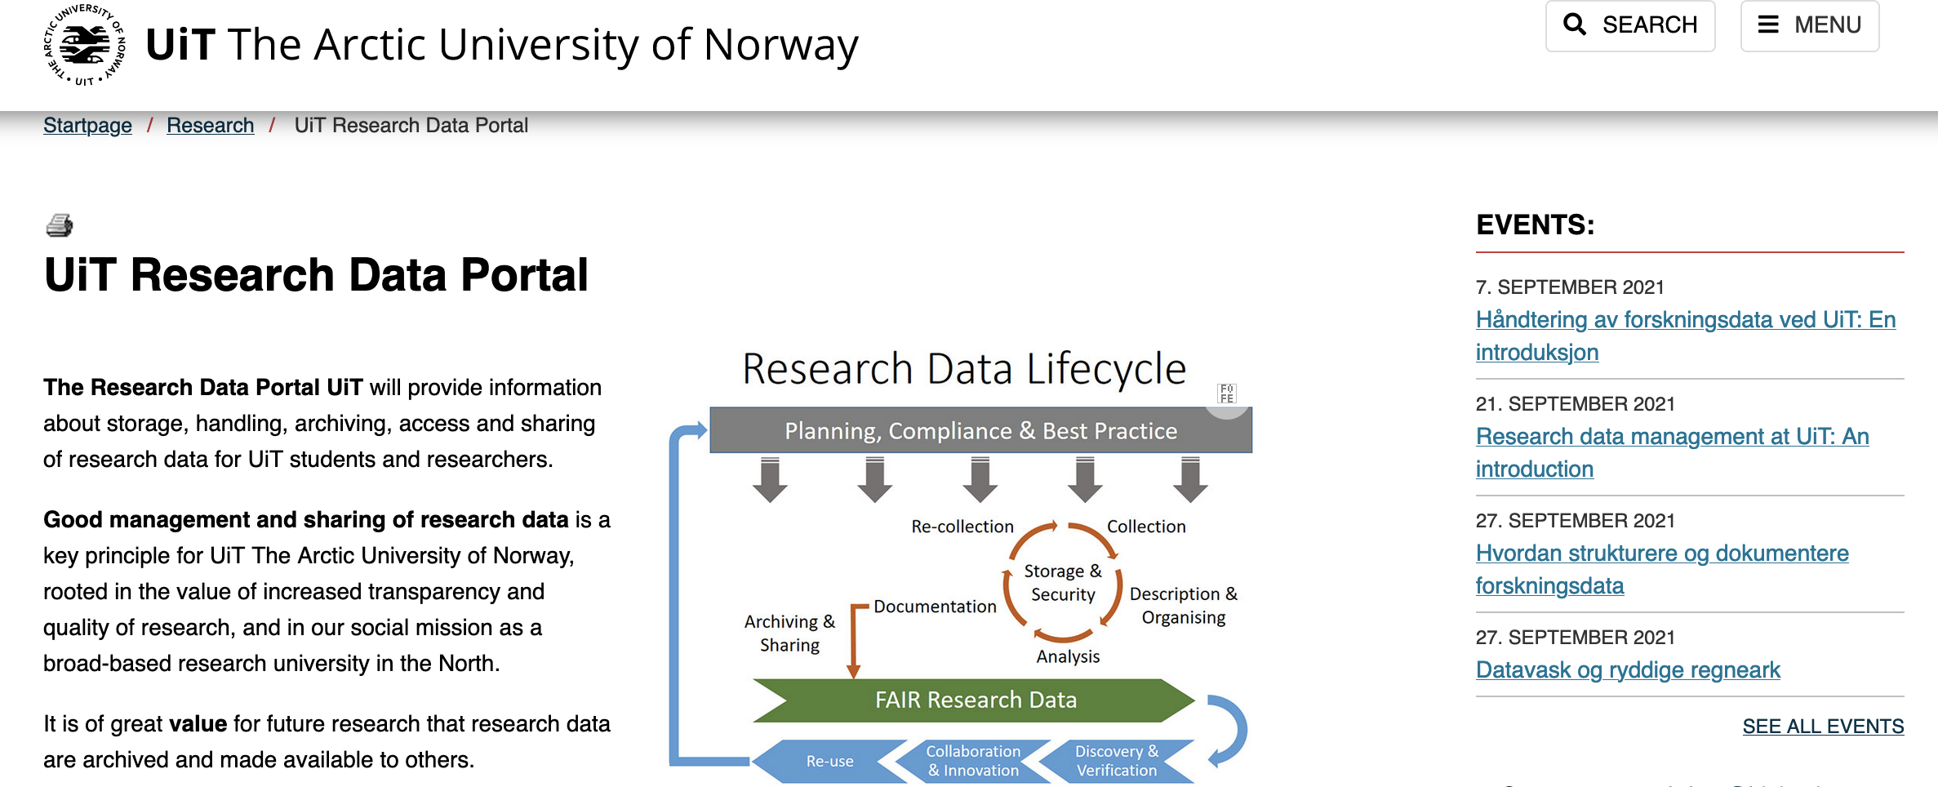
Local recommendations – More information
UiT provides research data management support and training:
UiT Research Data Portal: https://uit.no/researchdata or https://uit.no/forskningsdata
E-mail Support: research-data@support.uit.no or researchdata@hjelp.uit.no
UiT Open Research Data: http://opendata.uit.no/

