Slide 1

University of Bergen
Policy for Open Science
Jenny Ostrop
Bergen University Library
research-data@uib.no
2021-04-21
Notes:
1

Slide 2

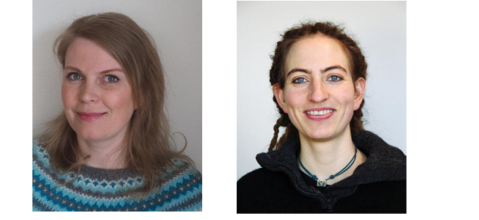
UNIVERSITY LIBRARY RESEARCH DATA TEAM
Introduction courses and guidance:
Open Science
Open Data: why, how and where?
UiB Open Research data
Data Management Plan
More information on our web pages:
Open Access to Research data
Data Management Plans
Kjersti H. Enerstvedt (PhD)
Senior Academic Librarian
Subject specialist for Earth Sciences and Technology
kjersti.enerstvedt@uib.no
Jenny Ostrop (PhD)
Senior Academic Librarian
Subject specialist for Mathematics and Informatics
jenny.ostrop@uib.no

Slide 3

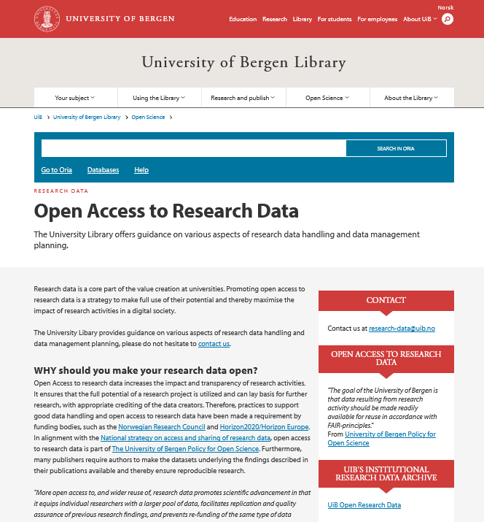
https://www.uib.no/en/ub/111372/open-access-research-data
Notes:
3

Slide 4
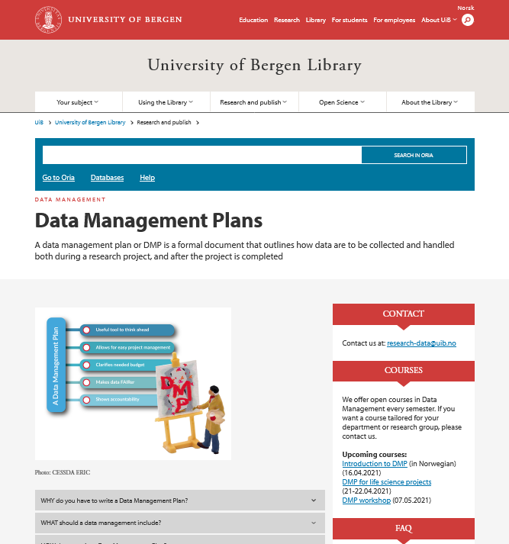
https://www.uib.no/en/ub/143694/data-management-plans
Notes:
3

Slide 5
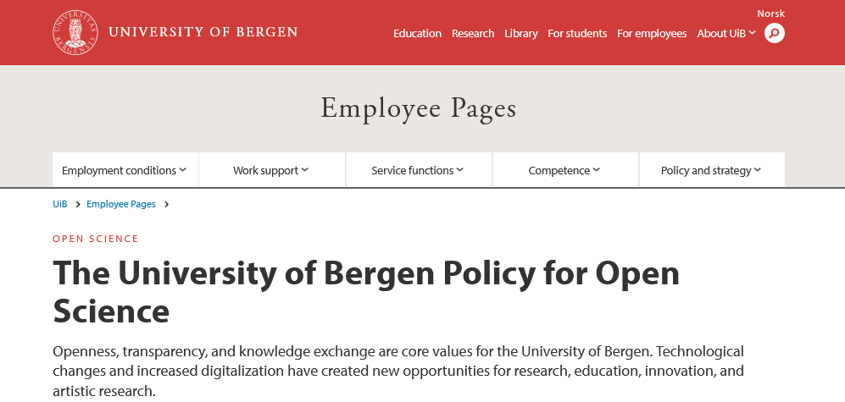
Adopted by the University Board on September 24, 2020
https://www.uib.no/en/foremployees/142184/university-bergen-policy-open-science
Notes:
3

Slide 6
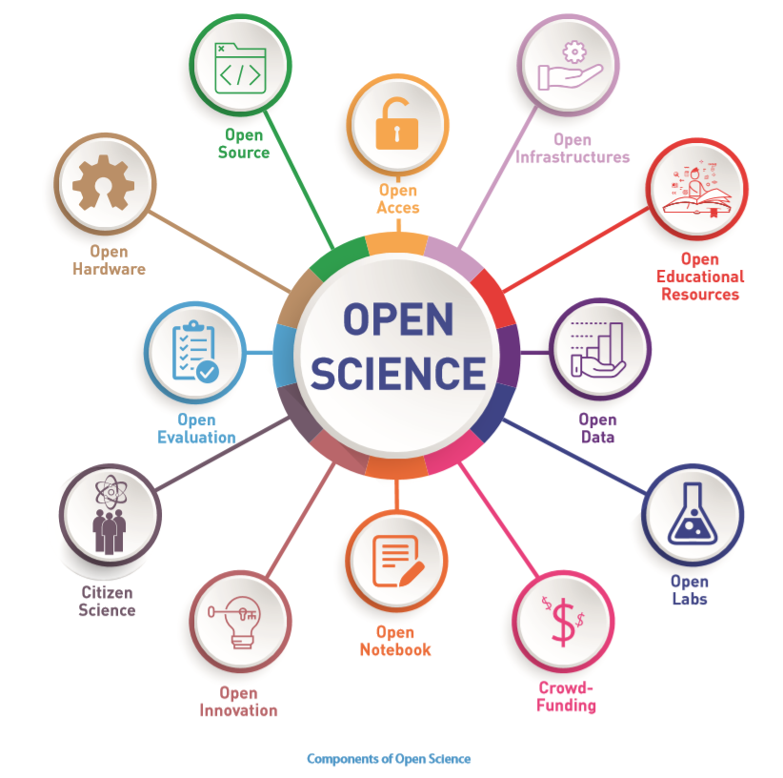
UiB’s policy for open science
Open access to research publications and artistic research
Open access to research data
Open Innovation
Citizen Science
Open educational resources
Source: https://en.unesco.org/sites/default/files/open_science_brochure_en.pdf
https://www.uib.no/en/foremployees/142184/university-bergen-policy-open-science
Notes:
4

Slide 7
Open access to research data
“The goal of the University of Bergen is that data resulting from research activity should be made readily available for reuse in accordance with FAIR-principles”
https://www.uib.no/en/foremployees/142184/university-bergen-policy-open-science
Notes:
5

Slide 8
Open access to research data
UiB has established the following principles for open access to research data:
(...)
All research projects lead by researchers at UiB will have a data management plan.
(...)
https://www.uib.no/en/foremployees/142184/university-bergen-policy-open-science
Notes:
6

Slide 9

research-data@uib.no

Slide 10

Except where otherwise noted, this work is licensed under http://creativecommons.org/licenses/by/4.0/

