Slide 1

Requirements from funding bodies & institutions
Korbinian Bösl
Data management coordinator
ELIXIR Norway/Digital Life Norway
9th of March 2021
Illustrative Icons from Font Awesome licensed under Creative Commons Attribution 4.0 International License

Slide 2



19/12/2017
National strategy on access to and sharing of research data
Research data must be as open as possible, as closed as necessary
Research data should be managed and curated to take full advantage of their potential.
Decisions concerning archiving and management of ­research data must
be taken within the research community
...
The Government expects:
the research institutions to develop procedures for (i) approving data management plans
…
https://www.regjeringen.no/en/dokumenter/national-strategy-on-access-to-and-sharing-of-research-data/id2582412/

Slide 3





FAIR-principles
Data Management Plan
Storage
Archival
Ethics
Deposition
https://innsida.ntnu.no/wiki/-/wiki/English/NTNU+Open+Data
https://www.nmbu.no/en/research/for_researchers/researchdata/node/34680
https://www.uio.no/english/for-employees/support/research/research-data-management/policies-and-guidelines/index.html
https://intranett.uit.no/Content/532111/cache=20170109133727/Principles%20and%20guidelines%20for%20research%20management%20at%20UiT_010917.pdf

Slide 4



https://www.forskningsradet.no/contentassets/e4cd6d2c23cf49d4989bb10c5eea087a/the-research-council-of-norways-policy-for-open-access-to-research-data.pdf

Slide 5
Research data...
https://www.forskningsradet.no/contentassets/e4cd6d2c23cf49d4989bb10c5eea087a/the-research-council-of-norways-policy-for-open-access-to-research-data.pdf

Slide 6

Research data...
...must be stored/archived in a safe and secure manner.
https://www.forskningsradet.no/contentassets/e4cd6d2c23cf49d4989bb10c5eea087a/the-research-council-of-norways-policy-for-open-access-to-research-data.pdf

Slide 7
Research data...
...must be stored/archived in a safe and secure manner.
...must be made accessible for reuse.
https://www.forskningsradet.no/contentassets/e4cd6d2c23cf49d4989bb10c5eea087a/the-research-council-of-norways-policy-for-open-access-to-research-data.pdf

Slide 8

Research data...
...must be stored/archived in a safe and secure manner.
...must be made accessible for reuse.
...should be made accessible at an early stage [latest at publication]
https://www.forskningsradet.no/contentassets/e4cd6d2c23cf49d4989bb10c5eea087a/the-research-council-of-norways-policy-for-open-access-to-research-data.pdf

Slide 9

Research data...
...must be stored/archived in a safe and secure manner.
...must be made accessible for reuse.
...should be made accessible at an early stage [latest at publication]
...must be accompanied by standardised metadata.
https://www.forskningsradet.no/contentassets/e4cd6d2c23cf49d4989bb10c5eea087a/the-research-council-of-norways-policy-for-open-access-to-research-data.pdf

Slide 10
Research data...
...must be stored/archived in a safe and secure manner.
...must be made accessible for reuse.
...should be made accessible at an early stage [latest at publication]
...must be accompanied by standardised metadata.
...must be provided with a license for access, reuse and redistribution.
https://www.forskningsradet.no/contentassets/e4cd6d2c23cf49d4989bb10c5eea087a/the-research-council-of-norways-policy-for-open-access-to-research-data.pdf

Slide 11
Research data...
...must be stored/archived in a safe and secure manner.
...must be made accessible for reuse.
...should be made accessible at an early stage [latest at publication]
...must be accompanied by standardised metadata.
...must be provided with a license for access, reuse and redistribution.
...should preferably be made accessible at no charge.
https://www.forskningsradet.no/contentassets/e4cd6d2c23cf49d4989bb10c5eea087a/the-research-council-of-norways-policy-for-open-access-to-research-data.pdf

Slide 12

Research data...
...must be stored/archived in a safe and secure manner.
...must be made accessible for reuse.
...should be made accessible at an early stage [latest at publication]
...must be accompanied by standardised metadata.
...must be provided with a license for access, reuse and redistribution.
...should preferably be made accessible at no charge.
... must be described in a data management plan.
https://www.forskningsradet.no/contentassets/e4cd6d2c23cf49d4989bb10c5eea087a/the-research-council-of-norways-policy-for-open-access-to-research-data.pdf

Slide 13


https://www.forskningsradet.no/contentassets/e4cd6d2c23cf49d4989bb10c5eea087a/se_rdm_practical_guide_final.pdf

Slide 14
Description & Re-use
https://www.forskningsradet.no/contentassets/e4cd6d2c23cf49d4989bb10c5eea087a/se_rdm_practical_guide_final.pdf

Slide 15
Description & Re-use
Documentation & Data quality
https://www.forskningsradet.no/contentassets/e4cd6d2c23cf49d4989bb10c5eea087a/se_rdm_practical_guide_final.pdf

Slide 16
Description & Re-use
Documentation & Data quality
Storage & Backups
https://www.forskningsradet.no/contentassets/e4cd6d2c23cf49d4989bb10c5eea087a/se_rdm_practical_guide_final.pdf

Slide 17
Description & Re-use
Documentation & Data quality
Storage & Backups
Legal & Ethical requirements
https://www.forskningsradet.no/contentassets/e4cd6d2c23cf49d4989bb10c5eea087a/se_rdm_practical_guide_final.pdf

Slide 18
Description & Re-use
Documentation & Data quality
Storage & Backups
Legal & Ethical requirements
Sharing & Preservation
https://www.forskningsradet.no/contentassets/e4cd6d2c23cf49d4989bb10c5eea087a/se_rdm_practical_guide_final.pdf

Slide 19
Description & Re-use
Documentation & Data quality
Storage & Backups
Legal & Ethical requirements
Sharing & Preservation
Responsibilities & Resources
https://www.forskningsradet.no/contentassets/e4cd6d2c23cf49d4989bb10c5eea087a/se_rdm_practical_guide_final.pdf

Slide 20
Description & Re-use
Documentation & Data quality
Storage & Backups
Legal & Ethical requirements
Sharing & Preservation
Responsibilities & Resources Alignment with FAIR-principles
https://www.forskningsradet.no/contentassets/e4cd6d2c23cf49d4989bb10c5eea087a/se_rdm_practical_guide_final.pdf

Slide 21

27.01.2021
Update by Science Europe
https://www.scienceeurope.org/our-resources/practical-guide-to-the-international-alignment-of-research-data-management/

Slide 22
27.01.2021
Update by Science Europe
including evaluation rubric
https://www.scienceeurope.org/our-resources/practical-guide-to-the-international-alignment-of-research-data-management/

Slide 23
27.01.2021
Update by Science Europe
including evaluation rubric
RCN does not [yet?] refer to the updated guide
https://www.scienceeurope.org/our-resources/practical-guide-to-the-international-alignment-of-research-data-management/

Slide 24
Illustrative Icons from Font Awesome licensed under Creative Commons Attribution 4.0 International License

Slide 25

Illustrative Icons from Font Awesome licensed under Creative Commons Attribution 4.0 International License

Slide 26

Illustrative Icons from Font Awesome licensed under Creative Commons Attribution 4.0 International License

Slide 27
Illustrative Icons from Font Awesome licensed under Creative Commons Attribution 4.0 International License

Slide 28
No DMP required
Illustrative Icons from Font Awesome licensed under Creative Commons Attribution 4.0 International License

Slide 29
No DMP required
But you should consider:
Ethical and Legal aspects
Storage and computing (budgeting?)
Budgeting for DM-personnel & time effort
§§
Illustrative Icons from Font Awesome licensed under Creative Commons Attribution 4.0 International License

Slide 30
No DMP required
Examples:
REK approval necessary (for sharing of data?)
§§
Illustrative Icons from Font Awesome licensed under Creative Commons Attribution 4.0 International License

Slide 31
No DMP required
Examples:
REK approval necessary (for sharing of data?)
GDPR considerations
§§
Illustrative Icons from Font Awesome licensed under Creative Commons Attribution 4.0 International License

Slide 32
No DMP required
Examples:
REK approval necessary (for sharing of data?)
GDPR considerations
IPR aspects
§§
Illustrative Icons from Font Awesome licensed under Creative Commons Attribution 4.0 International License

Slide 33
No DMP required
Examples:
REK approval necessary (for sharing of data?)
GDPR considerations
IPR aspects
Which Research Ethical Guidelines apply for this project?
§§
Illustrative Icons from Font Awesome licensed under Creative Commons Attribution 4.0 International License

Slide 34
No DMP required
Examples:
Is access to computing/storage secured?
Illustrative Icons from Font Awesome licensed under Creative Commons Attribution 4.0 International License

Slide 35
No DMP required
Examples:
Is access to computing/storage secured?
Will we have to pay for data storage (of sensitive data?)
Illustrative Icons from Font Awesome licensed under Creative Commons Attribution 4.0 International License

Slide 36
No DMP required
Examples:
Is access to computing/storage secured?
Will we have to pay for data storage (of sensitive data?)
How will data be accessed & transferred?
Illustrative Icons from Font Awesome licensed under Creative Commons Attribution 4.0 International License

Slide 37
No DMP required
Examples:
Will we need help from a Data Steward (and budget for this)?
Illustrative Icons from Font Awesome licensed under Creative Commons Attribution 4.0 International License

Slide 38
No DMP required
Examples:
Will we need help from a Data Steward (and budget for this)?
Will we need with data analysis, data warehousing or deposition?
Illustrative Icons from Font Awesome licensed under Creative Commons Attribution 4.0 International License

Slide 39
Full DMP required
If you decide that a data management plan is not needed, you must provide an explanation.
Illustrative Icons from Font Awesome licensed under Creative Commons Attribution 4.0 International License

Slide 40
Full DMP required
If you decide that a data management plan is not needed, you must provide an explanation.
I don’t know of any - do you?
Illustrative Icons from Font Awesome licensed under Creative Commons Attribution 4.0 International License

Slide 41
Full DMP required
If you decide that a data management plan is not needed, you must provide an explanation.
I don’t know of any - do you?
Even if you only reuse others data, you should describe where and how it is accessible & how your processed data can be accessed or reproduced?
Illustrative Icons from Font Awesome licensed under Creative Commons Attribution 4.0 International License

Slide 42
Full DMP required
Documentation, formats, volume
Illustrative Icons from Font Awesome licensed under Creative Commons Attribution 4.0 International License

Slide 43
Full DMP required
Documentation, formats, volume
Quality assurance including Metadata standards
Illustrative Icons from Font Awesome licensed under Creative Commons Attribution 4.0 International License

Slide 44
Full DMP required
Documentation, formats, volume
Quality assurance including Metadata standards
Backup during project
Illustrative Icons from Font Awesome licensed under Creative Commons Attribution 4.0 International License

Slide 45
Full DMP required
Documentation, formats, volume
Quality assurance including Metadata standards
Backup during project
Sharing & Preservation
Illustrative Icons from Font Awesome licensed under Creative Commons Attribution 4.0 International License

Slide 46
Full DMP required
Documentation, formats, volume
Quality assurance including Metadata standards
Backup during project
Sharing & Preservation
Ethical and Legal aspects - including IPR
Illustrative Icons from Font Awesome licensed under Creative Commons Attribution 4.0 International License

Slide 47
Full DMP required
Documentation, formats, volume
Quality assurance including Metadata standards
Backup during project
Sharing & Preservation
Ethical and Legal aspects - including IPR
Who is responsible in the project?
Illustrative Icons from Font Awesome licensed under Creative Commons Attribution 4.0 International License

Slide 48
Full DMP required
Documentation, formats, volume
Quality assurance including Metadata standards
Backup during project
Sharing & Preservation
Ethical and Legal aspects - including IPR
Who is responsible in the project?
To which trustworthy repository will the data be submitted?
Illustrative Icons from Font Awesome licensed under Creative Commons Attribution 4.0 International License

Slide 49
Full DMP required
Data management plans are to be made public and openly accessible.
Illustrative Icons from Font Awesome licensed under Creative Commons Attribution 4.0 International License

Slide 50

Full DMP required
Data management plans are to be made public and openly accessible.
One possibility:
Illustrative Icons from Font Awesome licensed under Creative Commons Attribution 4.0 International License

Slide 51
DMP is constantly updated
Illustrative Icons from Font Awesome licensed under Creative Commons Attribution 4.0 International License

Slide 52
DMP is constantly updated
… changes to the plan don’t have to be reported to RCN
Illustrative Icons from Font Awesome licensed under Creative Commons Attribution 4.0 International License

Slide 53
Final version of the data management plan in connection with the final report of the project.
Data is deposited to trustworthy repository
Illustrative Icons from Font Awesome licensed under Creative Commons Attribution 4.0 International License

Slide 54

Horizon 2020 → Horizon Europe
Open Research Data Pilot (ORD pilot)
Default since 2017 → mandatory 2021
-
DMP
outline
DMP
After 6 month
Update upon significant changes

Slide 55
Horizon 2020 → Horizon Europe
Data summary
FAIR data implementation
Resources
Data security
Ethics
https://ec.europa.eu/research/participants/data/ref/h2020/grants_manual/hi/oa_pilot/h2020-hi-oa-data-mgt_en.pdf
https://ec.europa.eu/research/participants/data/ref/h2020/grants_manual/hi/oa_pilot/h2020-hi-oa-data-mgt_en.pdf

Slide 56








In addition major publishers also ask your data to be deposited
Illustrative Icons from Font Awesome licensed under Creative Commons Attribution 4.0 International License

Slide 57


















/
/
/
/
/
/
sensitive
data

Slide 58


Data catalogues & registries
Data creation &
deposit
Open Data
Archives &
Data repositories
Managing active
data
“As open as possible - as closed as necessary”

Slide 59
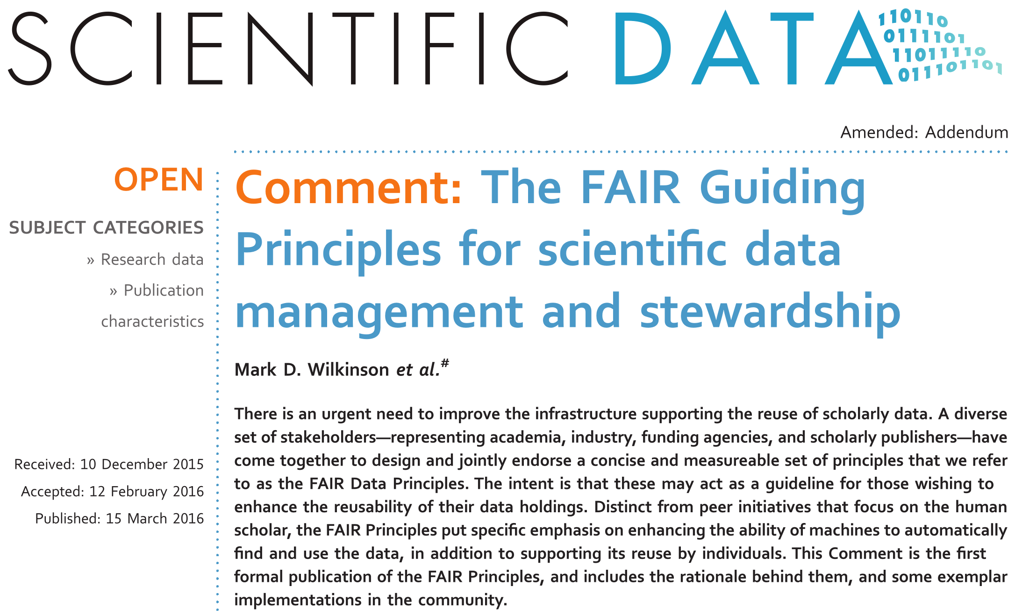
Mark D. Wilkinson et al. https://doi.org/10.1038/sdata.2016.18 licensed under Creative Commons Attribution 4.0 International License

Slide 60

FAIR illustrations icons from ARDC 2018 licensed under Creative Commons Attribution 4.0 International License

Slide 61


Identifiers.org
FAIR illustrations icons from ARDC 2018 licensed under Creative Commons Attribution 4.0 International License

Slide 62
Identifiers.org
FAIR illustrations icons from ARDC 2018 licensed under Creative Commons Attribution 4.0 International License

Slide 63
community metadata standards
+
FAIR illustrations icons from ARDC 2018 licensed under Creative Commons Attribution 4.0 International License

Slide 64

...
FAIR illustrations icons from ARDC 2018 licensed under Creative Commons Attribution 4.0 International License

Slide 65
FAIR illustrations icons from ARDC 2018 licensed under Creative Commons Attribution 4.0 International License

Slide 66



HTTP, FTP, SMTP, ...
FAIR illustrations icons from ARDC 2018 licensed under Creative Commons Attribution 4.0 International License

Slide 67

FAIR illustrations icons from ARDC 2018 licensed under Creative Commons Attribution 4.0 International License

Slide 68
FAIR illustrations icons from ARDC 2018 licensed under Creative Commons Attribution 4.0 International License

Slide 69
FAIR illustrations icons from ARDC 2018 licensed under Creative Commons Attribution 4.0 International License

Slide 70
FAIR illustrations icons from ARDC 2018 licensed under Creative Commons Attribution 4.0 International License

Slide 71
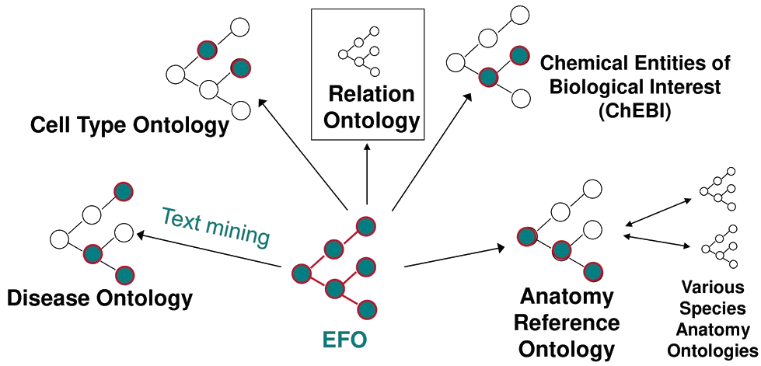

FAIR illustrations icons from ARDC 2018 licensed under Creative Commons Attribution 4.0 International License

Slide 72
FAIR illustrations icons from ARDC 2018 licensed under Creative Commons Attribution 4.0 International License

Slide 73
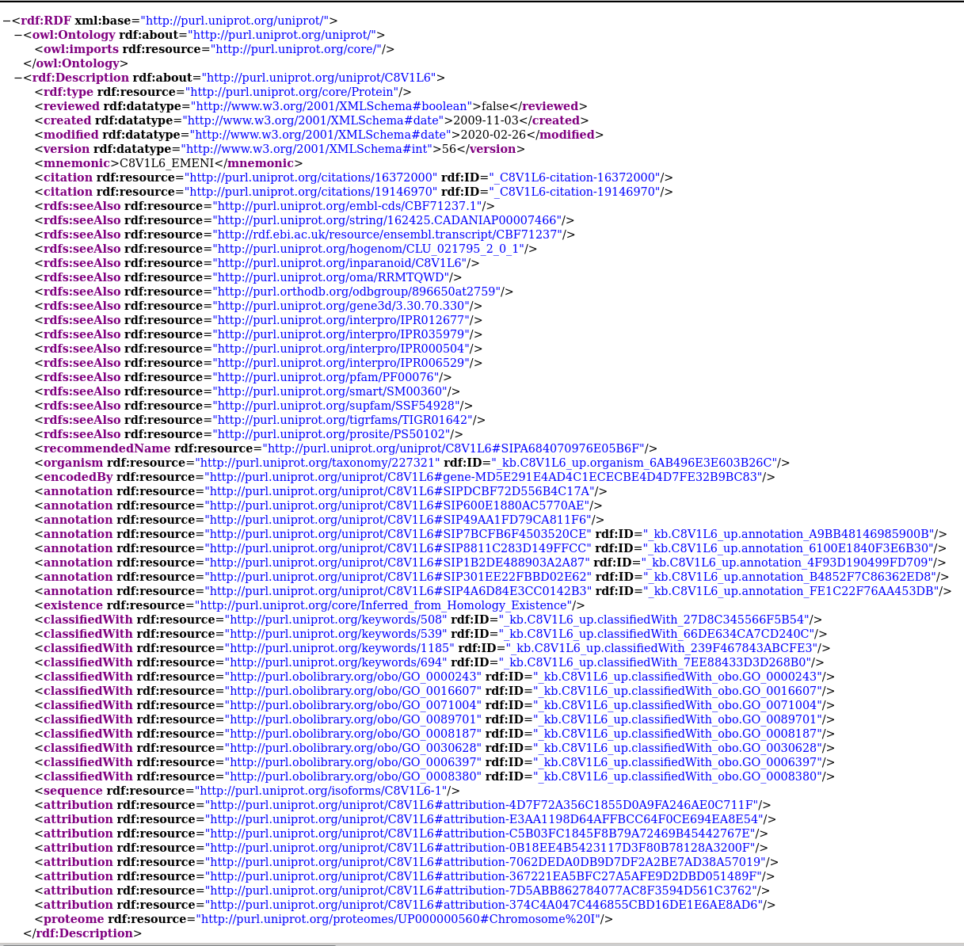

FAIR illustrations icons from ARDC 2018 licensed under Creative Commons Attribution 4.0 International License

Slide 74
FAIR illustrations icons from ARDC 2018 licensed under Creative Commons Attribution 4.0 International License

Slide 75
Describe the scope of your data: for what purpose was it generated/collected?
Mention any particularities or limitations about the data that other users should be aware of.
Specify the date of generation/collection of the data, the lab conditions, who prepared the data, the parameter settings, the name and version of the software used.
Is it raw or processed data?
Ensure that all variable names are explained or self-explanatory
Clearly specify and document the version of the archived and/or reused data.
FAIR illustrations icons from ARDC 2018 licensed under Creative Commons Attribution 4.0 International License

Slide 76
Describe the scope of your data: for what purpose was it generated/collected?
Mention any particularities or limitations about the data that other users should be aware of.
Specify the date of generation/collection of the data, the lab conditions, who prepared the data, the parameter settings, the name and version of the software used.
Is it raw or processed data?
Ensure that all variable names are explained or self-explanatory
Clearly specify and document the version of the archived and/or reused data.
FAIR illustrations icons from ARDC 2018 licensed under Creative Commons Attribution 4.0 International License

Slide 77


Ideal:
But also more closed license possible - has to be defined !
FAIR illustrations icons from ARDC 2018 licensed under Creative Commons Attribution 4.0 International License

Slide 78
Where does the sample come from?
Where other analysed performed on the same sample?
On what is this based?
Which reference data was used?
….
FAIR illustrations icons from ARDC 2018 licensed under Creative Commons Attribution 4.0 International License

Slide 79

MAGE-TAB
EFO
MIAME
ISA-TAB
PDBx/mmCIF
FAIR illustrations icons from ARDC 2018 licensed under Creative Commons Attribution 4.0 International License

Slide 80
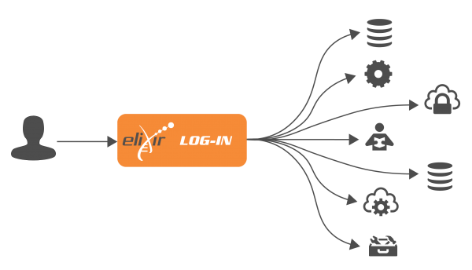


Data Steward Wizard
Adapted for users & laws
in Norway
Login:
compatible
elixir-no.ds-wizard.org

