Slide 1

Data Stewardship Wizard
Korbinian Bösl
Data management coordinator
ELIXIR Norway/Digital Life Norway
1oth of March 2021
Illustrative Icons from Font Awesome licensed under Creative Commons Attribution 4.0 International License

Slide 2

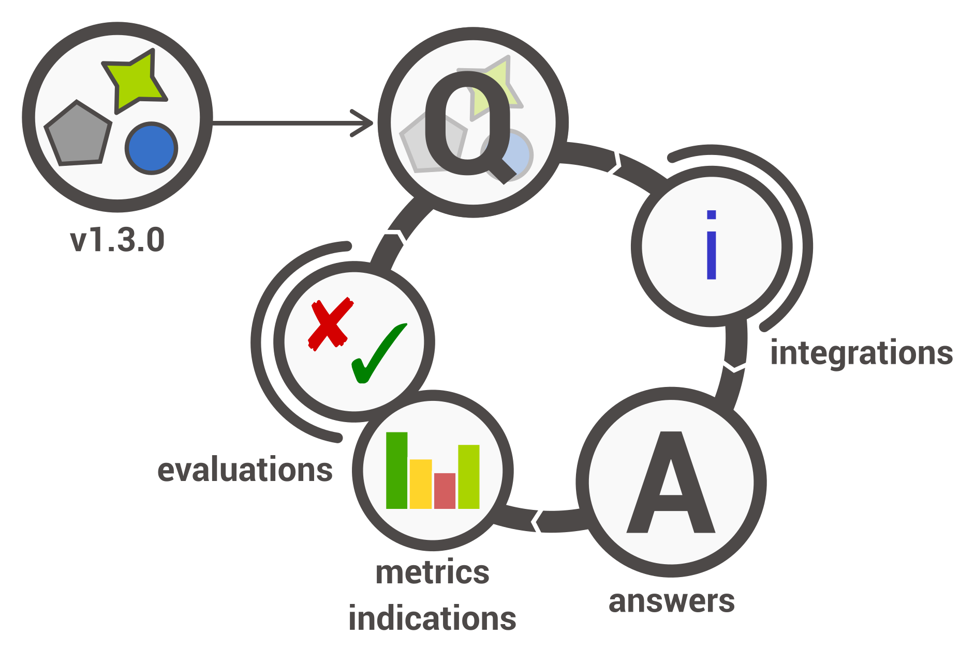

elixir-no.ds-wizard.org
ds-wizard.org
github.com/ds-wizard

Slide 3
Filled questionnaire → Template → DMP in various formats
once per funding body .docx, .tex, .html, .json
elixir-no.ds-wizard.org
https://ds-wizard.org
https://github.com/ds-wizard

Slide 4


Filled questionnaire → Template → DMP in various formats
once per funding body .docx, .tex, .html, .json
Full compliance:
elixir-no.ds-wizard.org
https://ds-wizard.org
https://github.com/ds-wizard

Slide 5

Filled questionnaire → Template → DMP in various formats
once per funding body .docx, .tex, .html, .json
Full compliance:
Adapted for Norwegian users
elixir-no.ds-wizard.org
https://ds-wizard.org
https://github.com/ds-wizard

Slide 6
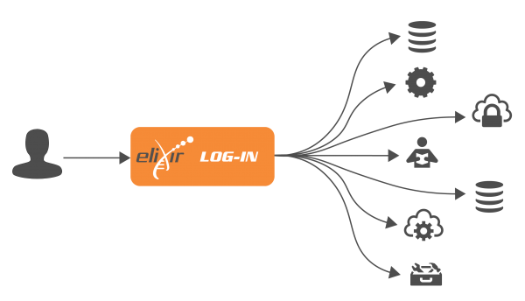

Filled questionnaire → Template → DMP in various formats
once per funding body .docx, .tex, .html, .json
Full compliance:
Adapted for Norwegian users
Login:
elixir-no.ds-wizard.org
https://ds-wizard.org
https://github.com/ds-wizard

Slide 7
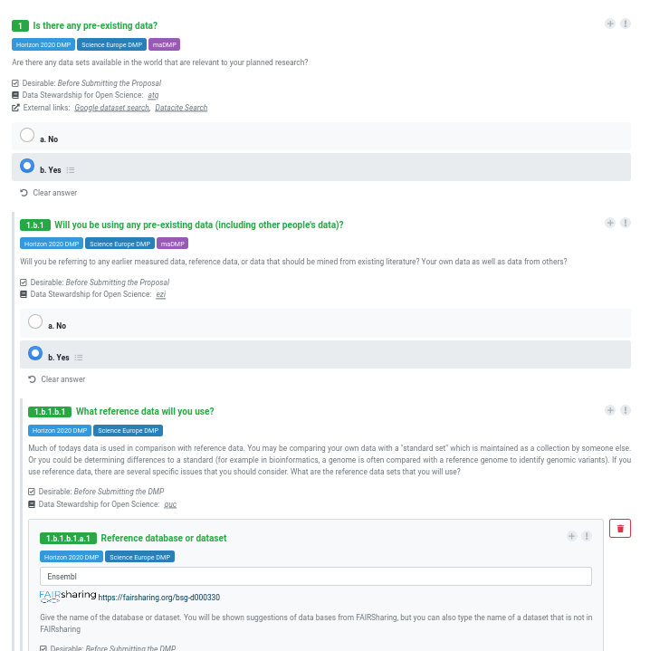
Build your DMP by following a decision tree with defined questions
elixir-no.ds-wizard.org
https://ds-wizard.org
https://github.com/ds-wizard

Slide 8





-
DMP

Slide 9
Horizon 2020 → Horizon Europe
Open Research Data Pilot (ORD pilot)
Default since 2017 → mandatory 2021
-
DMP
outline
DMP
After 6 month
Update upon significant changes

Slide 10

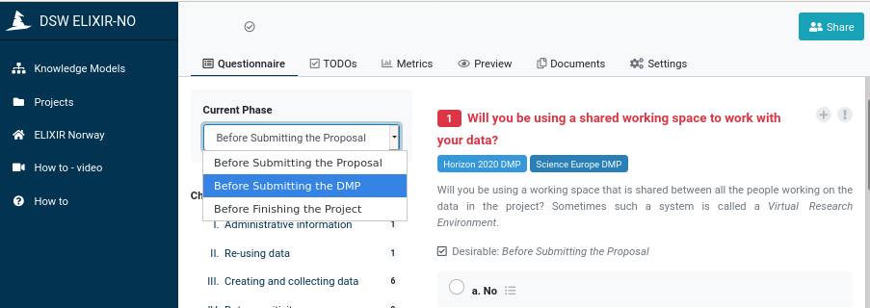
elixir-no.ds-wizard.org
https://ds-wizard.org
https://github.com/ds-wizard
Illustrative Icons from Font Awesome licensed under Creative Commons Attribution 4.0 International License

Slide 11
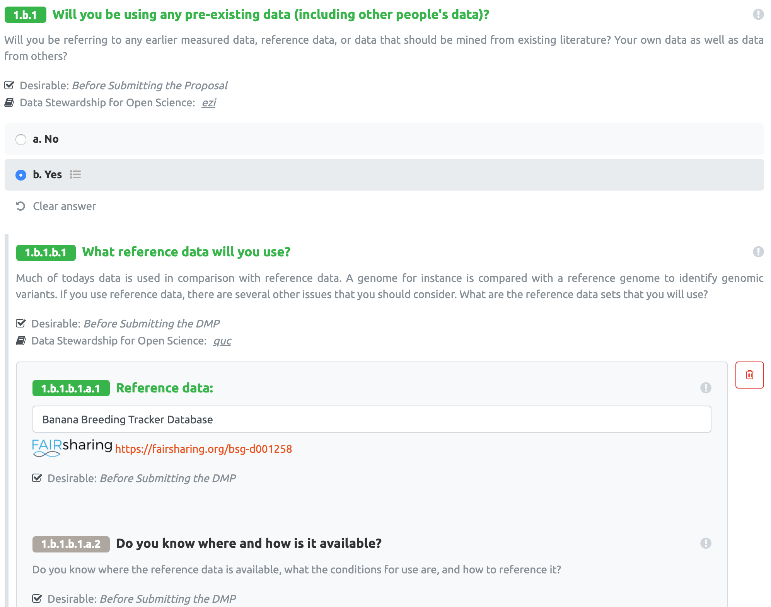
elixir-no.ds-wizard.org
ds-wizard.org
github.com/ds-wizard

Slide 12
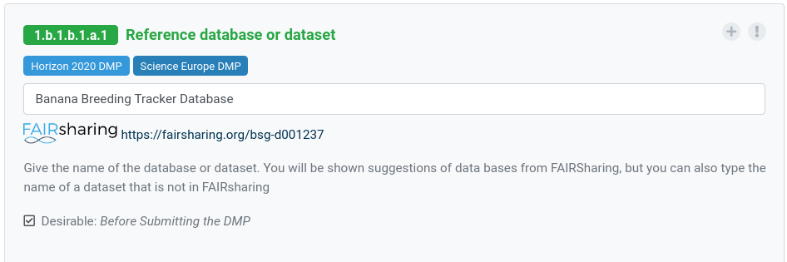
Guidance on Metadata Standards & Repositories
elixir-no.ds-wizard.org
https://ds-wizard.org
https://github.com/ds-wizard
https://fairsharing.org

Slide 13

Index of
… metadata standard
… data deposition repositories
… funder & publisher policies
fairsharing.org

Slide 14
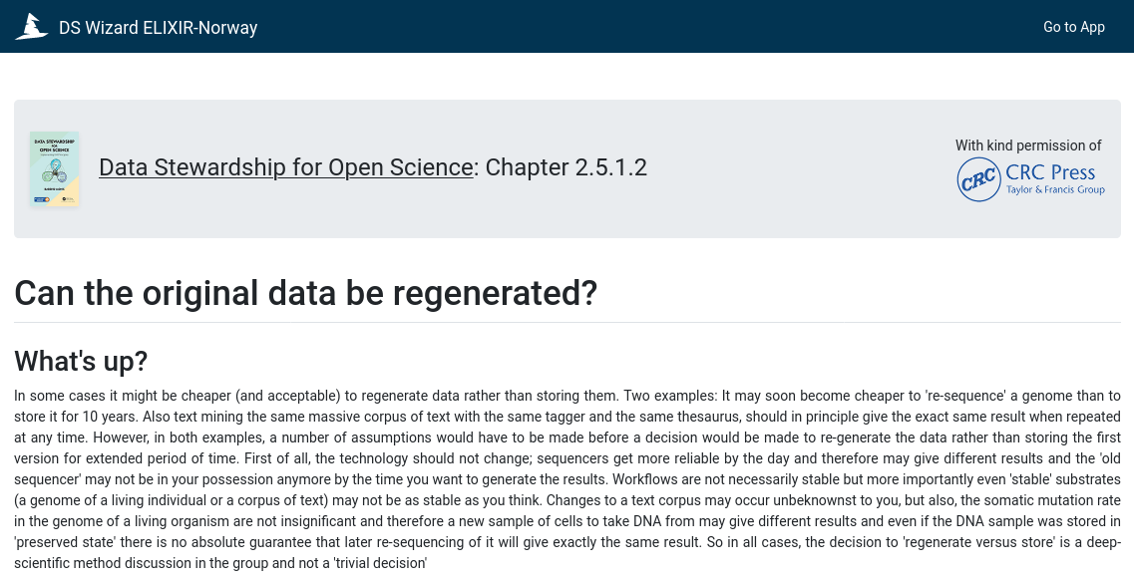
Barend Mons
elixir-no.ds-wizard.org
ds-wizard.org
github.com/ds-wizard

Slide 15
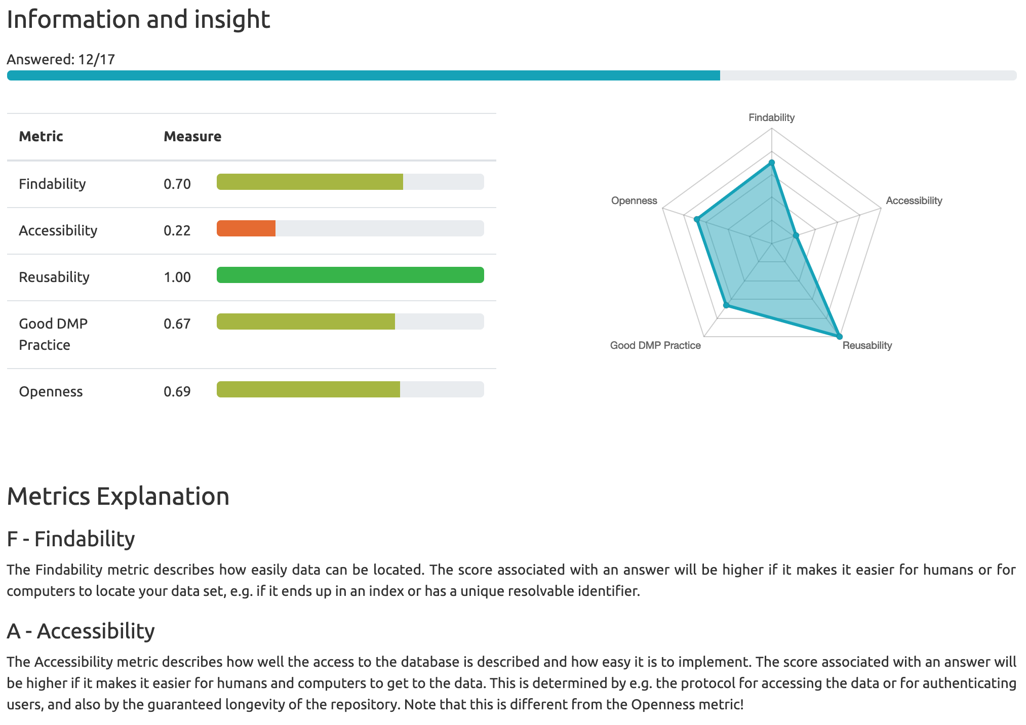
elixir-no.ds-wizard.org
ds-wizard.org
github.com/ds-wizard

Slide 16














elixir.no contact@bioinfo.no @elixirnorway
digitallifenorway.org korbinian.bosl@uib.no @DigitaltLiv
@BoslKorbinian
The Data Steward Wizard is provided by:

