Slide 1
WHAT is DataverseNO?

Slide 2
Basic features and facts
DataverseNO ...
is a national, generic repository for open research data
is curated, and aligned with the FAIR principles (cf. Conzett 2020), and CoreTrustSeal-certified since 2020;
runs on the Dataverse software;
is operated at UiT The Arctic University of Norway, and thereby
the northernmost Dataverse repository in the world.
Notes:
1. national, generic rep
2. We curated all inncoming datasets aligned with the FAIR principles
3. Dataverce.no is CoreTrustSeal-certified
4. Use Dataverse software
5. Operated at UiT

Slide 3
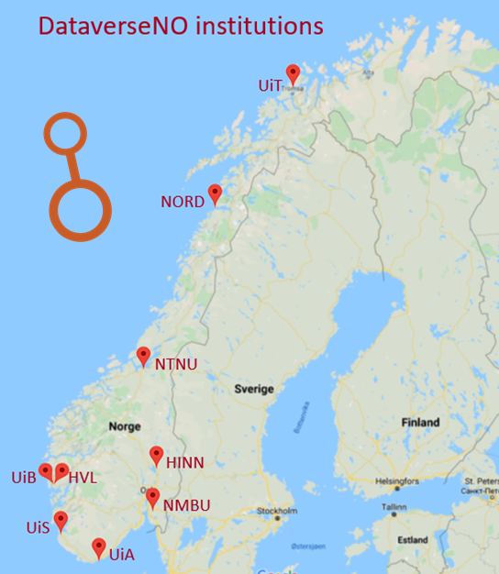
… a national repository
Has an institutional focus (cf. Schlatter & Ji, 2021)
Currently 9 partner institutions Universities and university colleges
Open for (individual) researchers from other Norwegian research organizations
Contains currently data from researchers affiliated with 40 Norwegian organizations
Notes:
Its a national repository, but we have an institutional focus.
Currently 9 partner institutions
But Dataverse is open to researchers from other Norwegian research organizations
Today we have data from researchers affiliated with 40 different Norwegian organizations
Individual researchers affiliated with Norwegian research institutions that are not partners of DataverseNO are granted up to 10 GB storage space for free. More information about how to get started with the repository is available here. If you need more storage space or more information, please contact us at researchdata@hjelp.uit.no.

Slide 4
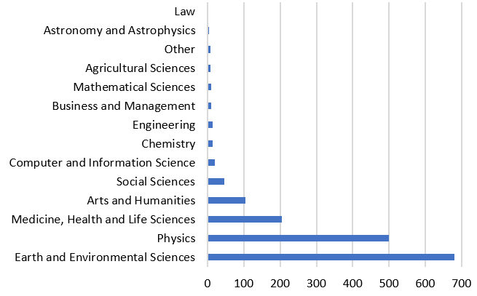
… a generic repository
Data from all domains of science
High numbers within Physics and Earth Sciences are due to large time series.
Apart from time series: Mostly background data for publications.
Numbers as of May 15, 2021
Note: Many datasets are classified as belonging to more than one domain.
Notes:
Its a generic repository with Data from all domains of science
High numbers within Physics and Earth Sciences are due to large time series.
Apart from time series: Mostly background data for publications.

Slide 5
WHY DataverseNO?

Slide 6
WHY DataverseNO? --- Background and rationale
DataverseNO
- Other universities became interested in UiT Open Research Data - UiT decided to expand service to become a national repository - DataverseNO launched in 2017 (inspired by DataverseNL) with UiT and the University of Agder (UiA) as the first partners
The Tromsø Repository of Language and Linguistics (TROLLing)
- Linguists at UiT needed a repository to
share their data worldwide - Result: TROLLing launched in 2014
- Based on Dataverse
- Part of CLARINO (Norw. node of CLARIN)
2015
2014
2017
UiT Open Research Data
- UiT needed an institutional repository for research data - UiT Open Research Data established in 2015 based on experiences and solutions used in TROLLing
Notes:
Dataverse.no have a history…going back to 2014…TROLLing launched in 2014
UiT needed an institutional repository for research data - UiT Open Research Data established in 2015 based on experiences and solutions used in TROLLing
DataverseNO launched in 2017 (inspired by DataverseNL) with UiT and the University of Agder (UiA) as the first partners

Slide 7
DataverseNO is one among many repositories
(Based on the OpenAIRE Guides for Researchers, UiT gives the following advice to its researchers on): How to select a data repository:
Funder or journal may require to use a specific repository.
Repository already established for your research domain (you may use the re3data registry to find a suitable repository).
UiT’s institutional collection within DataverseNO.
For data containing person-identifying information, we advise you to use NSD’s repository.
Notes:
When giving advise about what repository you should use….UiT follow OpenAIRE Guides for Researchers.
We encourage our researchers to use Repositories already established inside your research domain If that’s not possible – then use the institutional possibilities, i.e., Dataverse
If you have sensitive data that should not be published – use NSD`s repository (NSD: Norsk senter for forskningsdata)

Slide 8
HOW does DataverseNO work?

Slide 9
… basically as outlined in the DataverseNO Organization Chart:

Slide 10
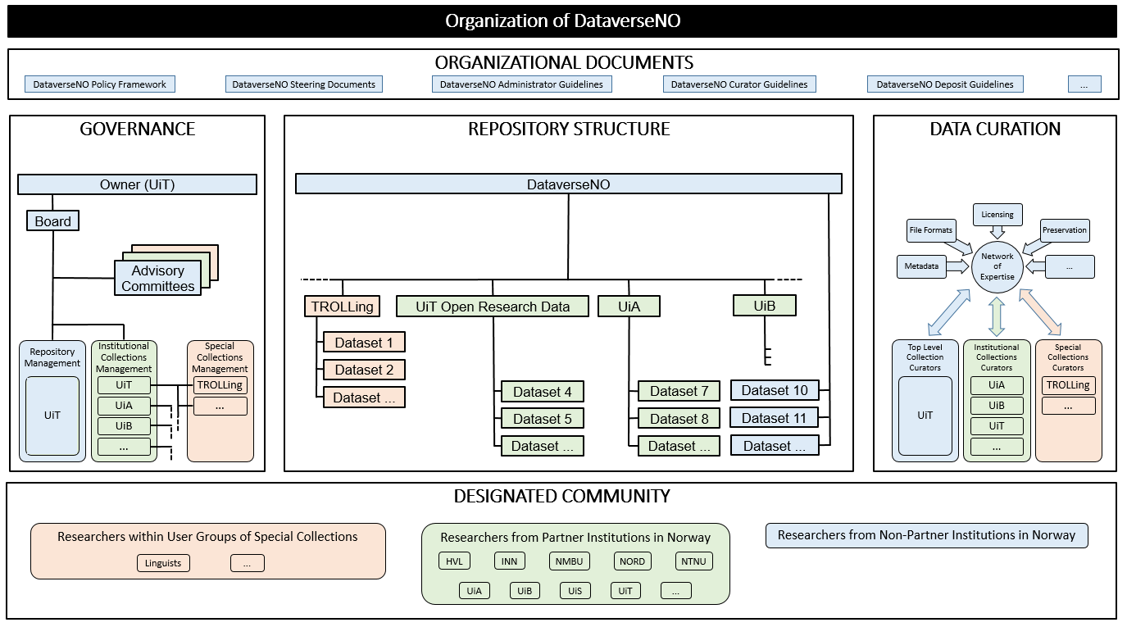
Notes:
Hierachical structure….that is….(Next slide)

Slide 11
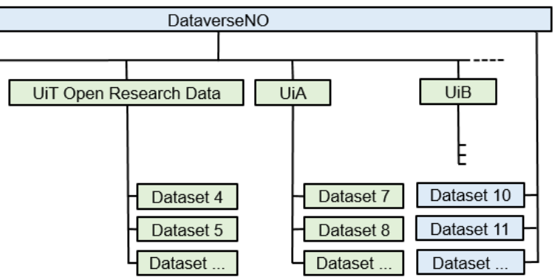
HOW? --- Repository structure
Each partner institution has its own collection (sub-dataverse)
... and researchers from non-partner institutions publish their data in the top-collection
Notes:
Its an Hierachical structure…. Where Each partner institution has its own collection (sub-dataverse)
and researchers from non-partner institutions publish their data in the top-collection

Slide 12
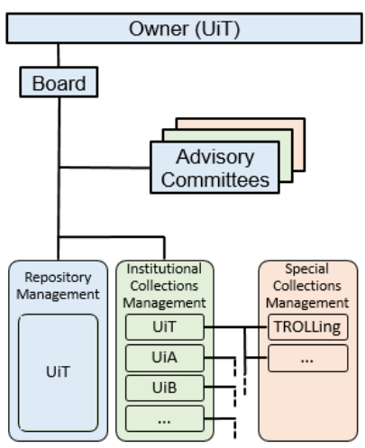
HOW? --- Governance
UiT is responsible for management and development of technical and functional core of the repository and training and support for collections managers.
Each partner is responsible for management of institutional collection.
The Board of DataverseNO is the highest management body of the repository.
An advisory committee discusses RDM and collaboration issues and gives advice to the board.
Notes:
UiT is responsible for management and development of technical and functional core of the repository and training and support for collections managers.
Each partner is responsible for management of institutional collection.
The Board of DataverseNO is the highest management body of the repository.
An advisory committee discusses RDM and collaboration issues and gives advice to the board.

Slide 13
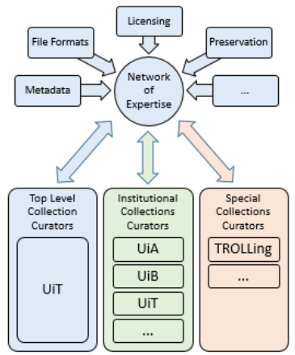
HOW? --- Data curation
In order to make published data as FAIR as possible, each dataset is curated by research support staff at the partner institutions before publication.
Only curators can publish datasets.
Curators are usually subject librarians (with a Phd or two...).
Curators share knowledge and experience in curator network across partner institutions.
Notes:
In Dataverse.no we try to add value to the data, that is….:
Collection managers and curators at partner institutions receive continuous support in issues related to archiving and curating data. Curators at partner institutions have access to a national competence network of DataverseNO curators.
By that we are building up local curation competence at the institutions.
To meet the requirements of CoreTrustSeal, DataverseNO uses a common set of guidelines for depositors and curators across partner institutions

Slide 14
HOW? --- Organizational documents
The organization of DataverseNO is based on a set of well-defined documents describing the responsibilities of partners and the FAIR-aligned stewardship of data handled in the repository:
DataverseNO Policy Framework:
Access and Use Policy
Accession Policy
Deposit Agreement
Preservation Policy
DataverseNO Guidelines:
DataverseNO Administrator Guidelines for Repository
DataverseNO Administrator Guidelines for Collections
DataverseNO Curator Guidelines
DataverseNO Deposit Guidelines
DataverseNO Steering documents:
Establishment of a Board for DataverseNO
Mandate Board for DataverseNO
Steering Document for DataverseNO
DataverseNO Partner Agreement (including data processor agreement):
Partners commit to manage their collections according to DataverseNO policies and guidelines

Slide 15
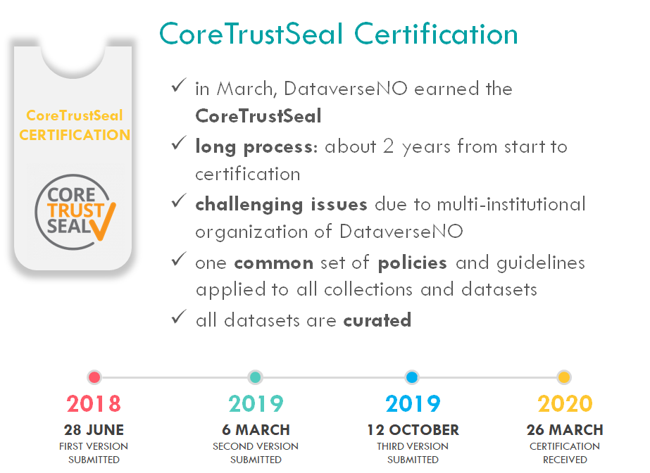
To demonstrate its commitment to FAIR data stewardship and trustworthy and sustainable repository management, DataverseNO has documented its approaches and workflows to obtain CoreTrustSeal certification.
Notes:
To demonstrate its commitment to FAIR data stewardship and trustworthy and sustainable repository management, DataverseNO has documented its approaches and workflows to obtain CoreTrustSeal certification.
We use 2 years from start to sertification.

Slide 16
Strengths and weaknesses/challenges
Strengths:
Based on approved technical solutions
Provides strong user support co-located researchers embedded at partner institutions
Part of strong international collaborative networks, e.g. Dataverse community (Harvard, DANS, ...), FAIRsFAIR, ...
Curate all datasets
Challenges:
Many subjects/domains to be covered
Challenging for small organizations to provide extensive user curation support
But: What are the alternatives in cases where no other, more appropriate (e.g. domain-specific) repositories are available?
Notes:
Our biggest strength: all datasets are curated

Slide 17
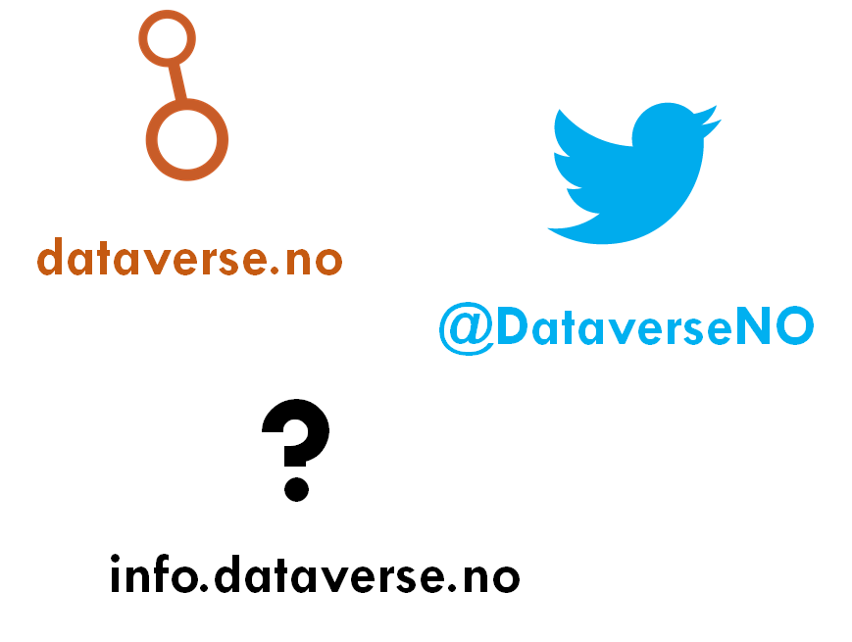
Questions (if time)…..?

