Slide 1

Archiving, preserving, sharing
Korbinian Bösl
Data management coordinator
ELIXIR Norway/Digital Life Norway
Illustrative Icons from Font Awesome licensed under Creative Commons Attribution 4.0 International License

Slide 2








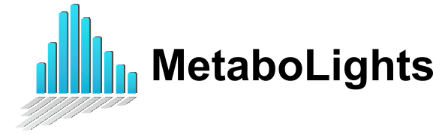
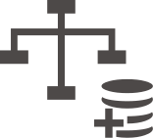



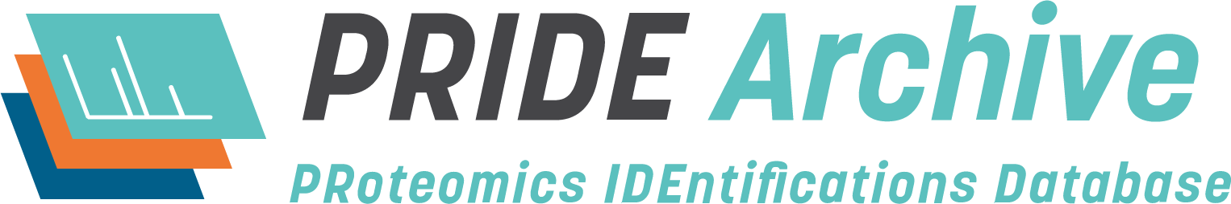








sensitive
data

Slide 3
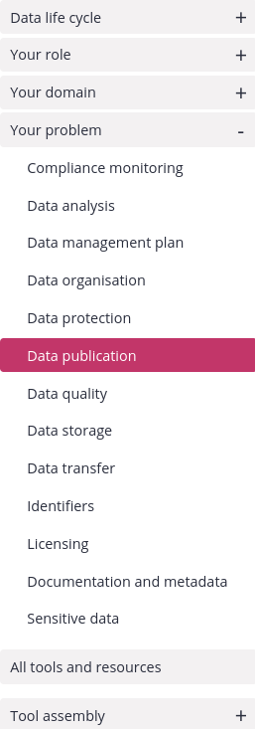


Link to RDMkit: https://rdmkit.elixir-europe.org/

Slide 4
Why should I deposit my data?
4 Increased Visibility (SEO) → 25% more citations
doi.org/10.1371/journal.pone.0230416

Slide 5
Why should I deposit my data?
4 Increased Visibility (SEO) → 25% more citations
D Value added Databases → more citations
doi.org/10.1371/journal.pone.0230416

Slide 6
Why should I deposit my data?
4 Increased Visibility (SEO) → 25% more citations
D Value added Databases → more citations
r FAIRification – Funding requirements //
doi.org/10.1371/journal.pone.0230416

Slide 7
Why should I deposit my data?
4 Increased Visibility (SEO) → 25% more citations
D Value added Databases → more citations
r FAIRification – Funding requirements //
$ Safe money on storage
doi.org/10.1371/journal.pone.0230416

Slide 8
Where should I deposit my data?
Preferably somewhere
where most things are taken care of?

Slide 9

/
/
/
/
FAIR illustrations icons from ARDC 2018 licensed under Creative Commons Attribution 4.0 International License

Slide 10
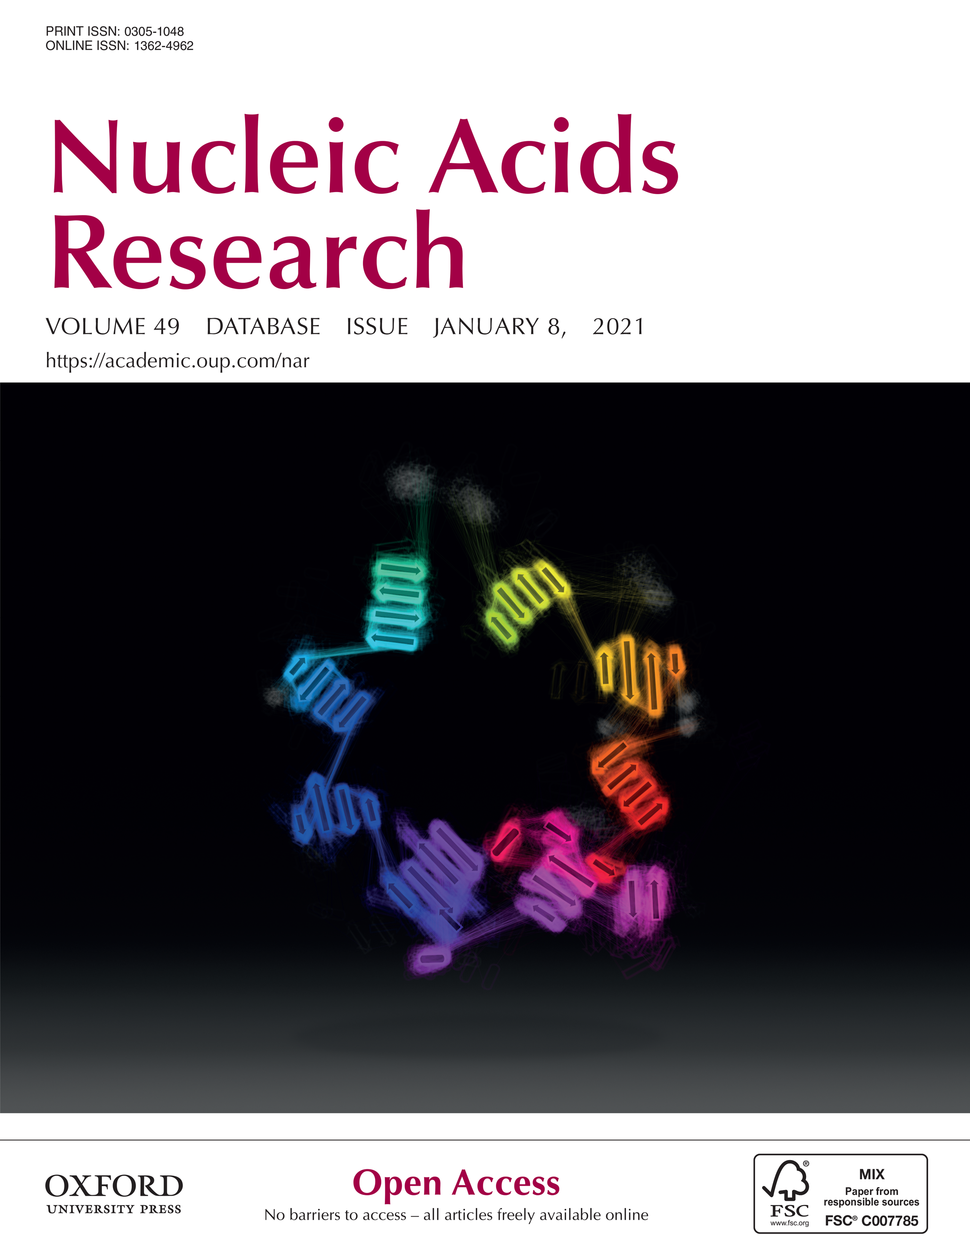
How to choose?
molecular biology
1641 databases
Rigden, D. J. & Fernández, X. M. licensed under Creative Commons Attribution 4.0 International License
The 2021 Nucleic Acids Research database issue and the online molecular biology database collection. Nucleic Acids Research 49, D1–D9 (2021).
.

Slide 11








-
Deposition

Slide 12


Where should I deposit my data?
fairsharing.org
re3data.org

Slide 13
Where should I deposit my data?
fairsharing.org
re3data.org

Slide 14

Where should I deposit my data?
Fits?
Yes
Domain
&
Datatype
specific
SRA

Slide 15
Where should I deposit my data?
No
Fits?
Yes
Yes
Domain
&
Datatype
specific
Domain
specific
SRA

Slide 16


Where should I deposit my data?
No
Fits?
No
Yes
Yes
Yes
Domain
&
Datatype
specific
Domain
specific
National
SRA

Slide 17

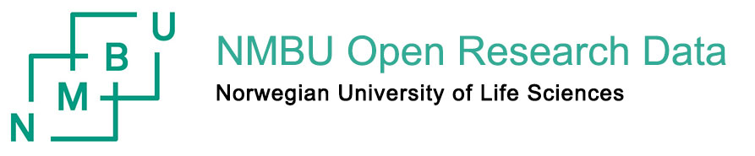


Where should I deposit my data?
No
Fits?
No
No
Yes
Yes
Yes
Yes
Domain
&
Datatype
specific
Domain
specific
National
Institutional
SRA

Slide 18



Where should I deposit my data?
No
Fits?
No
No
No
Yes
Yes
Yes
Yes
Domain
&
Datatype
specific
Domain
specific
National
Institutional
generic
SRA

Slide 19
Where should I deposit my data?
No
Fits?
No
No
No
Yes
Yes
Yes
Yes
Domain
&
Datatype
specific
Domain
specific
National
Institutional
own effort
generic
Standardization
SRA

Slide 20
Where should I deposit my data?
No
Fits?
No
No
No
Yes
Yes
Yes
(often)
Visibility for peers
Yes
Domain
&
Datatype
specific
Domain
specific
National
Institutional
own effort
generic
Standardization
SRA

Slide 21

Multiple Repositories – similar datatypes

Slide 22

SRA

Slide 23

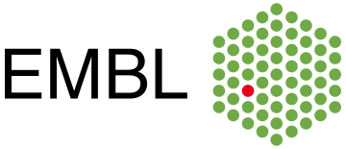

SRA

Slide 24


SRA

Slide 25
SRA

Slide 26


5
SRA

Slide 27
5
SRA

Slide 28
5
2017
SRA

Slide 29








Slide 30


Slide 31


Where should I deposit my data?
...
elixir-europe.org/platforms/data/core-data-resources
elixir-europe.org/platforms/data/elixir-deposition-databases

Slide 32
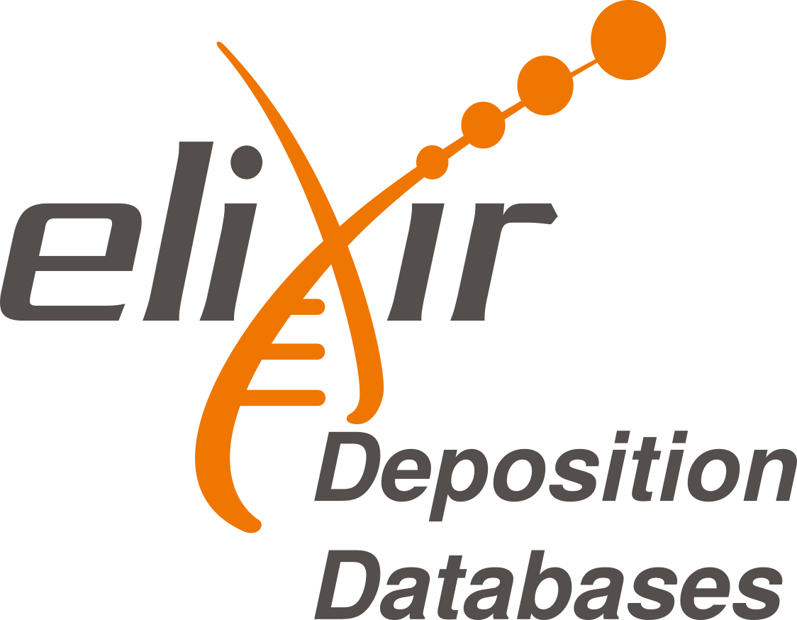
Where should I deposit my data?
Recognized & Recommended
https://elixir-europe.org/platforms/data/core-data-resources
https://elixir-europe.org/platforms/data/elixir-deposition-databases

Slide 33
Where should I deposit my data?
Recognized & Recommended
Free of charge
https://elixir-europe.org/platforms/data/core-data-resources
https://elixir-europe.org/platforms/data/elixir-deposition-databases

Slide 34
Where should I deposit my data?
Recognized & Recommended
Free of charge
Quick upload
https://elixir-europe.org/platforms/data/core-data-resources
https://elixir-europe.org/platforms/data/elixir-deposition-databases

Slide 35
Where should I deposit my data?
Recognized & Recommended
Free of charge
Quick upload
Not operated by single university/government
https://elixir-europe.org/platforms/data/core-data-resources
https://elixir-europe.org/platforms/data/elixir-deposition-databases

Slide 36
Where should I deposit my data?
Recognized & Recommended
Free of charge
Quick upload
Not operated by single university/government
Guided submission process
https://elixir-europe.org/platforms/data/core-data-resources
https://elixir-europe.org/platforms/data/elixir-deposition-databases

Slide 37
Where should I deposit my data?
Recognized & Recommended
Free of charge
Quick upload
Not operated by single university/government
Guided submission process
Generous embargo regulation (2yrs → )
https://elixir-europe.org/platforms/data/core-data-resources
https://elixir-europe.org/platforms/data/elixir-deposition-databases

Slide 38
Where should I deposit my data?
Recognized & Recommended
Free of charge
Quick upload
Not operated by single university/government
Guided submission process
Generous embargo regulation (2yrs → )
API access (upload from NeLS planned)
https://elixir-europe.org/platforms/data/core-data-resources
https://elixir-europe.org/platforms/data/elixir-deposition-databases

Slide 39

Where should I deposit my data?
...
elixir-europe.org/platforms/data/core-data-resources
elixir-europe.org/platforms/data/elixir-deposition-databases

Slide 40
Where should I deposit my data?
...
elixir-europe.org/platforms/data/core-data-resources
elixir-europe.org/platforms/data/elixir-deposition-databases

Slide 41
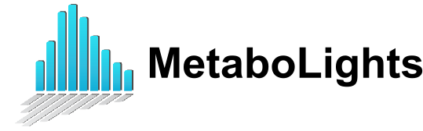
Where should I deposit my data?
...
elixir-europe.org/platforms/data/core-data-resources
elixir-europe.org/platforms/data/elixir-deposition-databases

Slide 42




Where should I deposit my data?
...
elixir-europe.org/platforms/data/core-data-resources
elixir-europe.org/platforms/data/elixir-deposition-databases

Slide 43

Where should I deposit my data?
Data Submission Wizard
https://www.ebi.ac.uk/submission/
...
elixir-europe.org/platforms/data/core-data-resources
elixir-europe.org/platforms/data/elixir-deposition-databases

Slide 44

NIRD archive
National, free depositing repository
Domain agnostic
Dublin-core metadata standard
DOI accessible
Supports machine readable metadata
harvesting
https://archive.norstore.no/

Slide 45

Generic archives
Less standard metadata → Re-usability ⤋
Domain agnostic → Findability ⤋
Guided submission process
Commercial actors: Size limitations, ...
https://zenodo.org/
https://b2share.eudat.eu/
https://figshare.com/

Slide 46

Archiving code/scripts
Good integration - easy to implement
Archival of each release
beta solutions for gitlab
https://zenodo.org/
https://guides.github.com/activities/citable-code/

Slide 47




What about sensitive data?
Central metadata accessibility
Secure storage
Implemented data access committees
Norwegian EGA
(for data that can not leave the country)
ega-archive.org

Slide 48
What about sensitive data?
Central metadata accessibility
Secure storage
Implemented data access committees
Norwegian EGA
(for data that can not leave the country)
Ensure your consent form & REC approval
allow controlled access archiving!
ega-archive.org

Slide 49

NSD archive
Domain agnostic
DOI accessible
Implemented data access committees
Main data type: Questionnaires, ...
https://arkivering.nsd.no/

Slide 50

Except where otherwise noted, this work is licensed under:
https://creativecommons.org/licenses/by/4.0/

