Slide 1
National storage infrastructures
NeLS/StoreBioInfo, NIRD, TSD
Erik Hjerde
Arturo Vera-Ponce de Leon
ELIXIR Norway

Slide 2






Data storage – from the researcher perspective
DATA
DATA STORAGE
EXPERIMENT
DATA DEPOSITION
METADATA
DATA ANALYSIS

Slide 3
Data storage – from the researcher perspective
DATA
DATA STORAGE
EXPERIMENT
DATA DEPOSITION
METADATA
DATA ANALYSIS

Slide 4
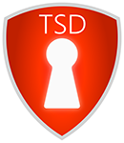


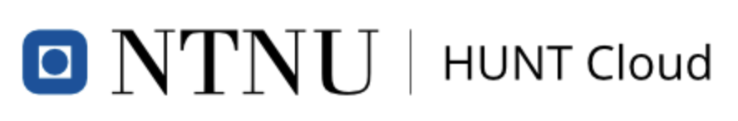
National storage infrastructures. Where to put my data???
Non-sensitive data
Sensitive data
DATA STORAGE
DATA ANALYSIS

Slide 5

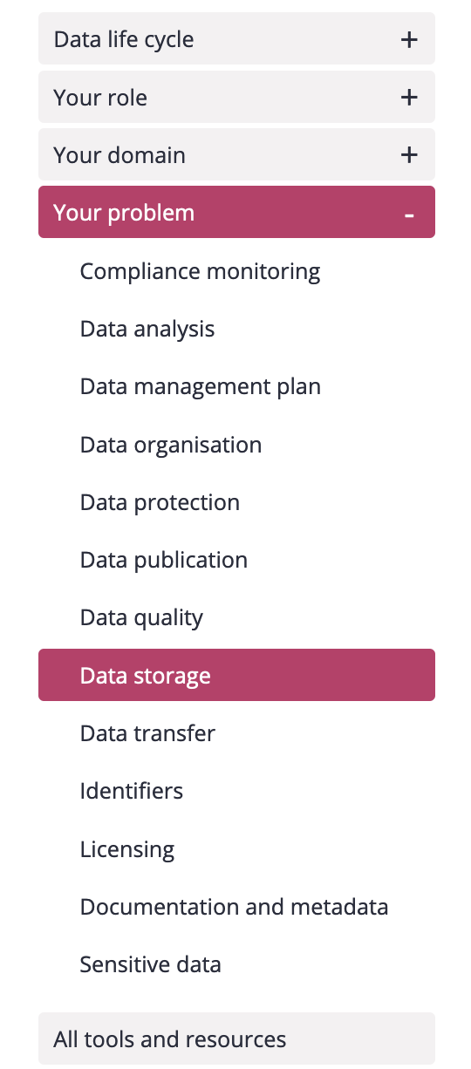
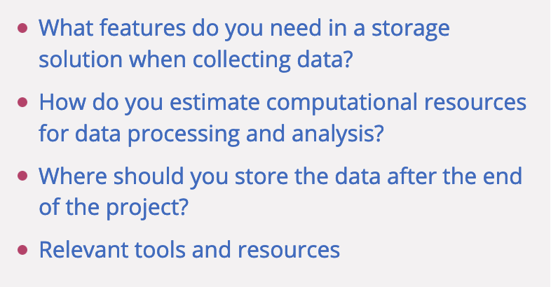
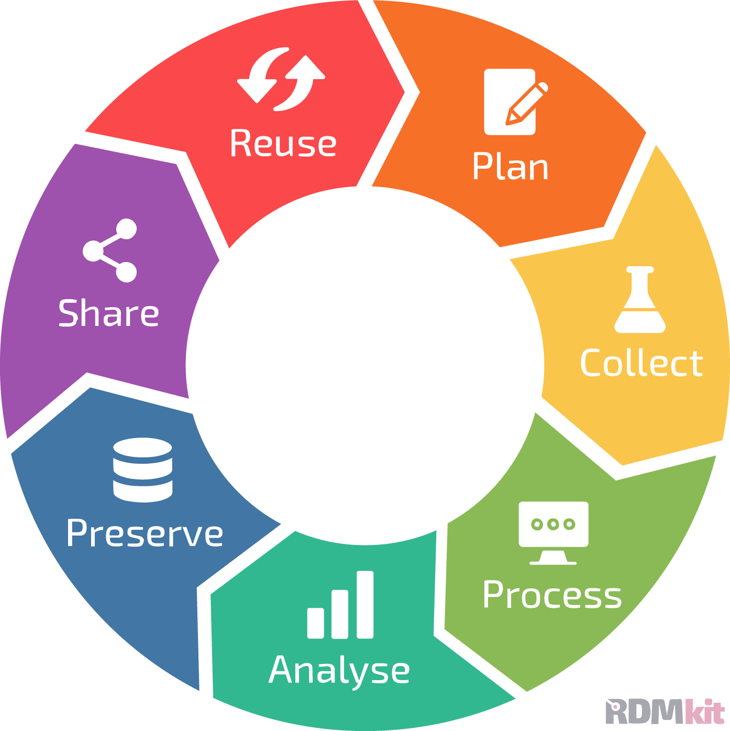
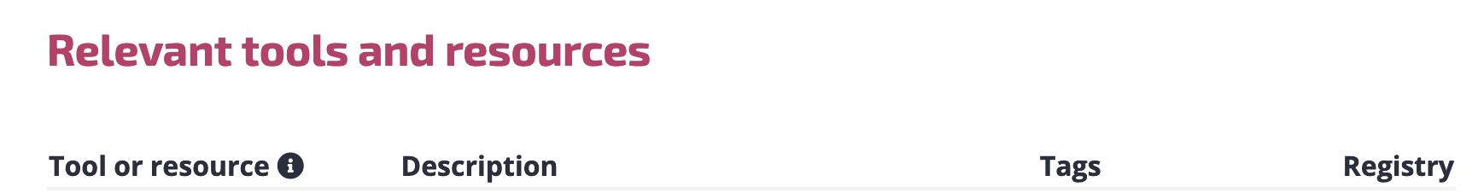
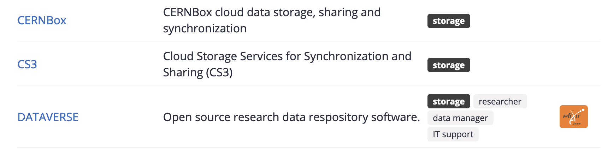
Data storage – General considerations
The ELIXIR Research Data Management kit
Link to RDMkit storage: https://rdmkit.elixir-europe.org/

Slide 6
Data storage – from the researcher perspective
DATA
DATA STORAGE
EXPERIMENT
DATA DEPOSITION
METADATA
DATA ANALYSIS

Slide 7
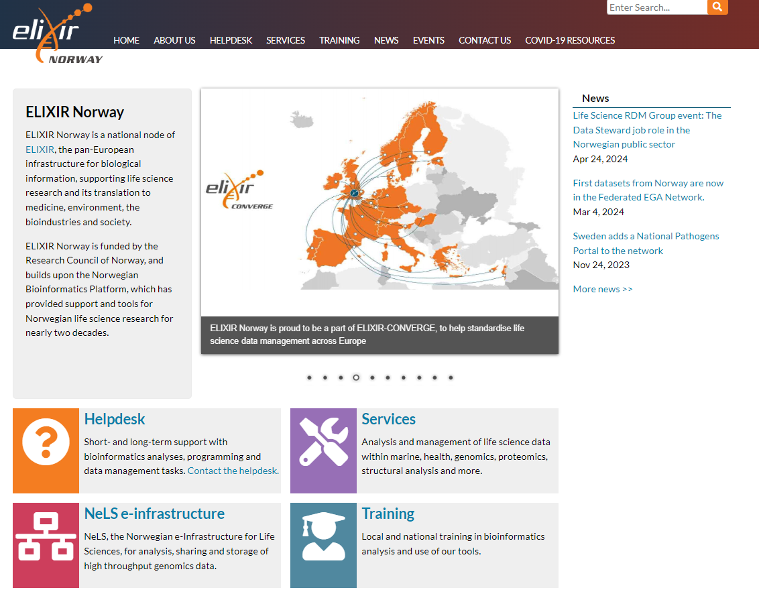
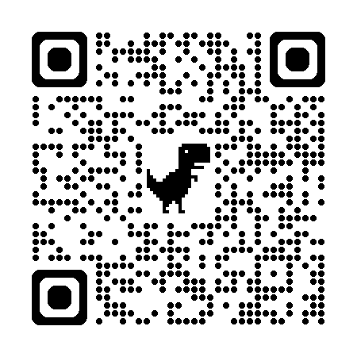
Elixir Norway
https://elixir.no/
Scan me!

Slide 8
Data storage in NeLS and StoreBioInfo (SBI)
Norwegian e-infrastructure for Life Sciences - developed and operated by Elixir Norway
NeLS in general
Available to all Norwegian researchers
Enable collaborative projects
Multiple storage layers
Integrated with compute
Multiple permission roles - shared data
Free of charge*
Support for data deposition
User support: Elixir Norway helpdesk
Type of data
Non-sensitive data
Support multiple data types
SEEK integration for metadata
NeLS
DATA
DATA STORAGE
DATA DEPOSITION
METADATA
DATA ANALYSIS

Slide 9
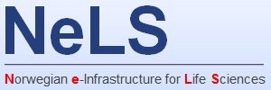

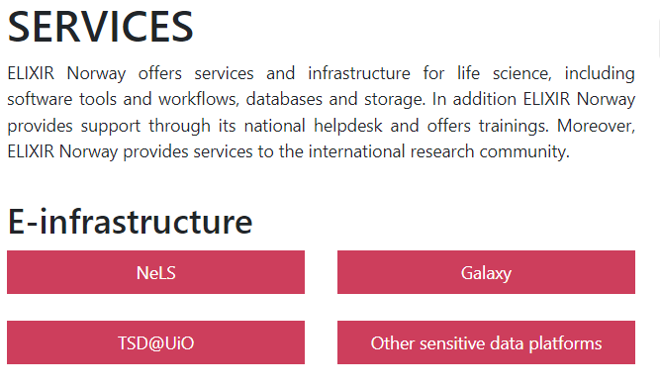
The Norwegian e-infrastructure for life sciences (NeLS),
is a unique national portal for sharing, analysis and midterm storage of non-sensitive molecular life science data. Free up to 10Tb

Slide 10
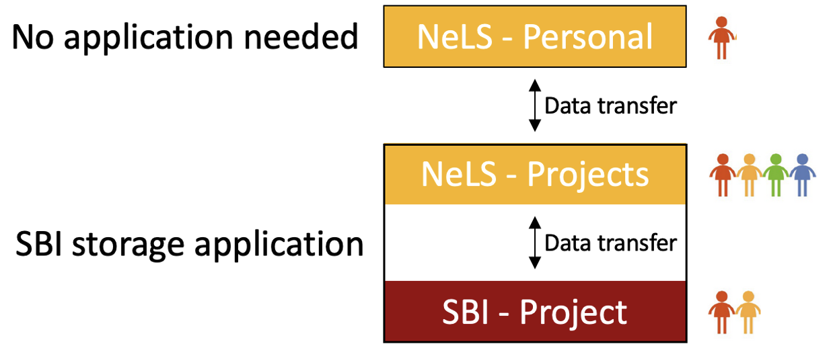
Data storage in NeLS/SBI – How to get access
Storage application needed for projects where data is shared by many users
Access via FEIDE user or NeLS idp can be made for non-FEIDE users
Free storage < 10 TB
Apply for storage: contact@bioinfo.no
Wiki for usage: https://nels-docs.readthedocs.io/en/latest/

Slide 11

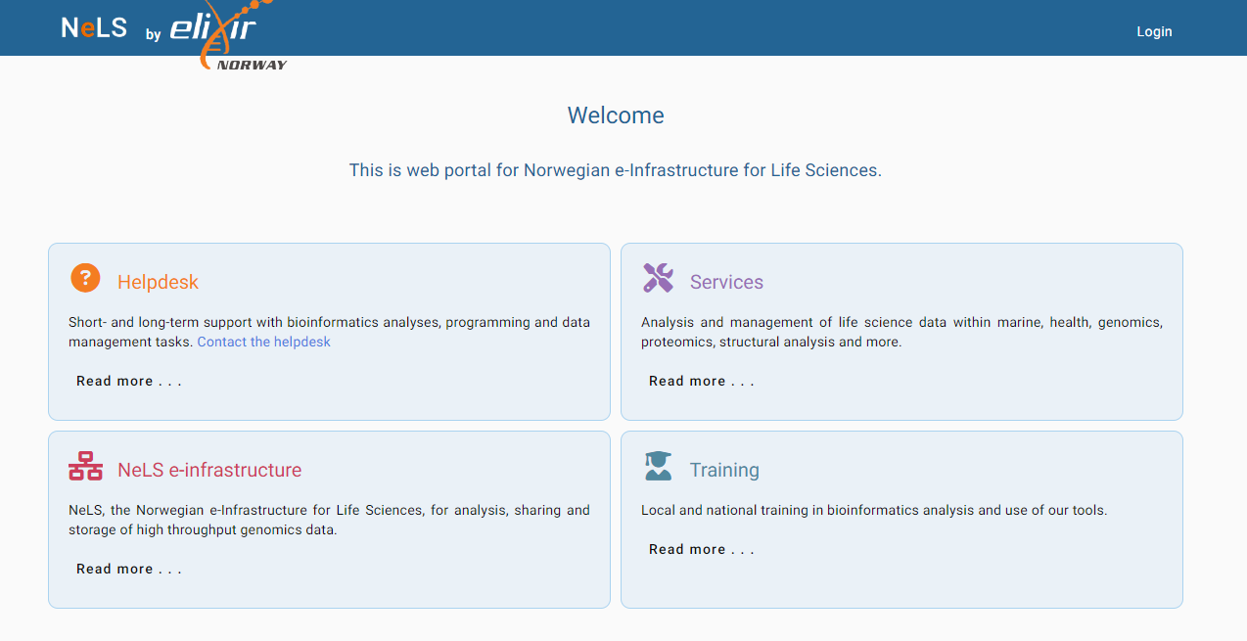
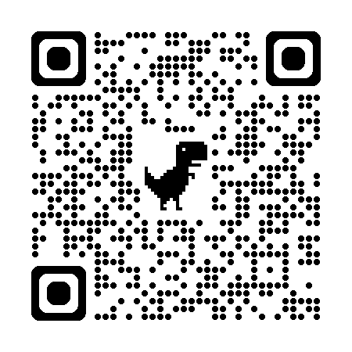
Login to NeLS using the WebPortal
https://nels.bioinfo.no/nels-web/#/
Scan me!

Slide 12
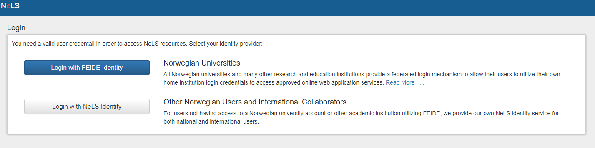
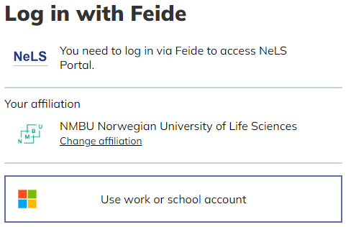
All users with FEIDE login credentials can access the NeLS Portal
https://nels.bioinfo.no/nels-web/#/

Slide 13
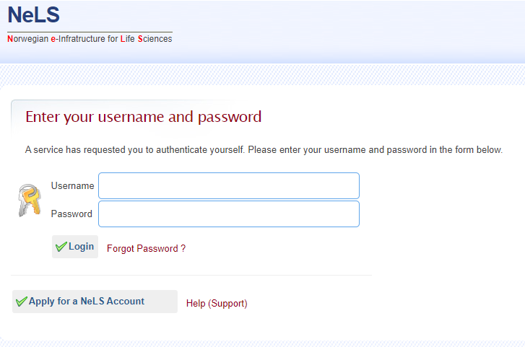
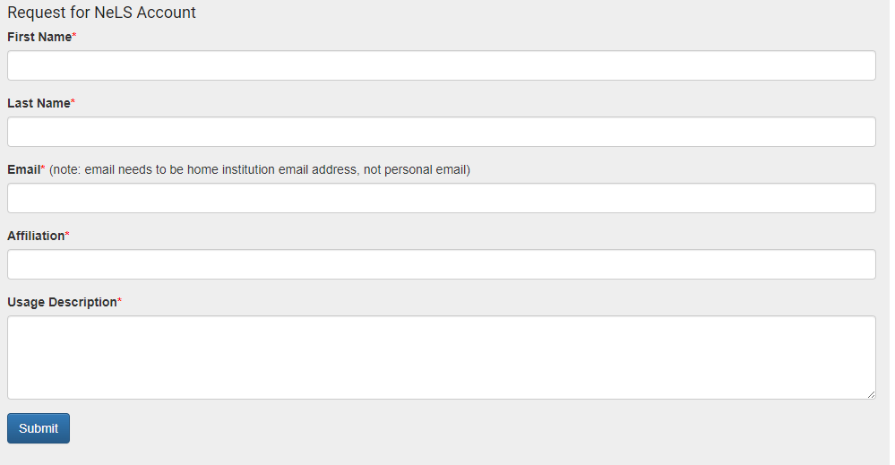
I don't have FEIDE login credentials (Non-Norwegian collaborators)
It is also possible to login to NeLS via a NeLS idp. You can apply for a NeLS idp

Slide 14
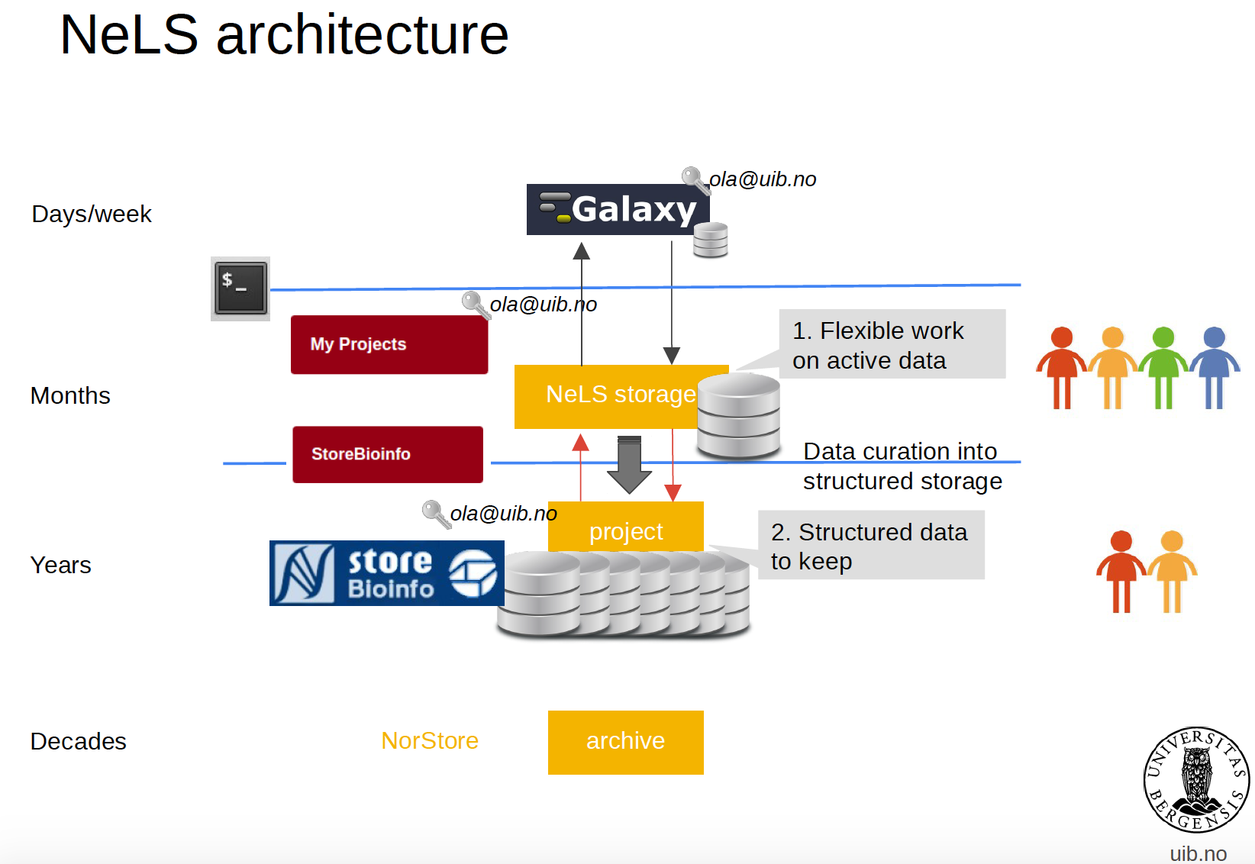






NeLS architecture
Research data archive

Slide 15



SEEK - sharing heterogeneous scientific research datasets, models or simulations, processes and research outcomes
The SEEK platform is a web-based tool for organising and storing data, and for exploring and annotating data
Norwegian users can link datasets stored in NeLS to a SEEK project using FAIRdom hub
Integrated
Datasets
eg. FASTQ fiiles
Metadata
(and datasets)
Notes:
Typically, organise the project with associated metadata (e.g. how sequencing libraries were prepared) in SEEK
Link datasets stored in NeLS to the SEEK project

Slide 16
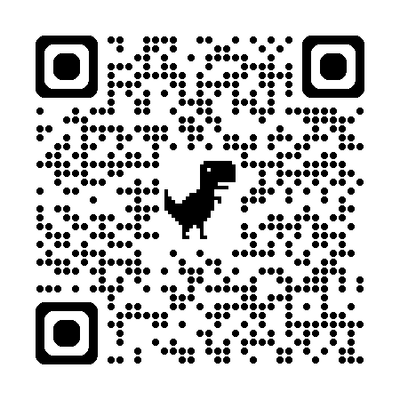
Data storage in NIRD
National e-Infrastructure for Research Data - owned and operated by UNINETT Sigma2
NIRD in general
Available to all users with account
Enable collaborative projects
Integrated with compute
Multiple permission roles - shared data
Free of charge*
User support: Metacenter support
Type of data
Non-sensitive data
Support multiple data types
All type of scientific data*
NIRD
DATA STORAGE
DATA ANALYSIS
Scan me!
Notes:
Available to any scientific discipline

Slide 17
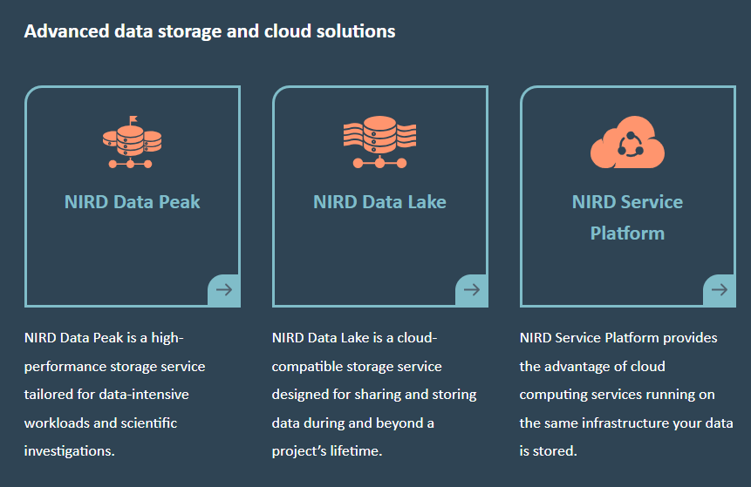
Data storage in NIRD
National e-Infrastructure for Research Data - owned and operated by UNINETT Sigma2
intensive I/O operations
Long term-storage
NIRDToolKit
Notes:
Available to any scientific discipline

Slide 18
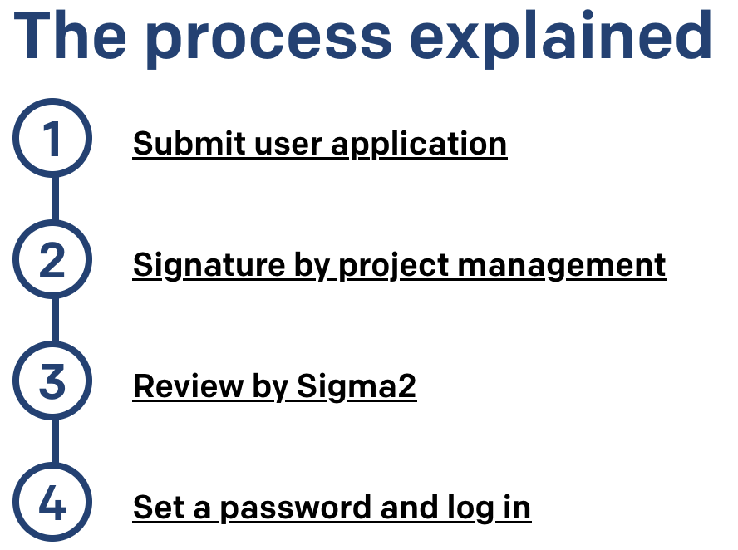
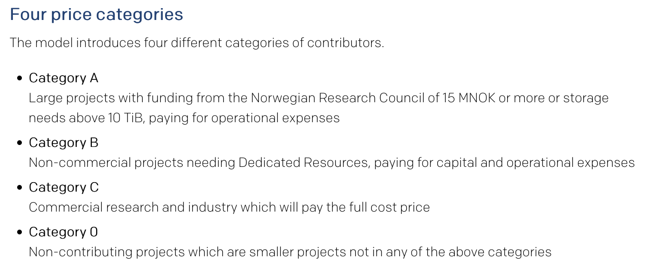
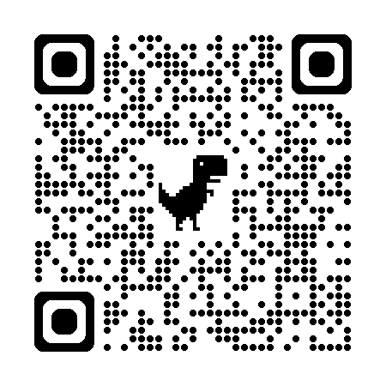
Data storage in NIRD – How to get access
Apply for a UNINETT SIGMA2 user
Apply for a storage quota - Free storage < 10 TB
Scan me!
https://www.sigma2.no/apply-e-infrastructure-resources

Slide 19
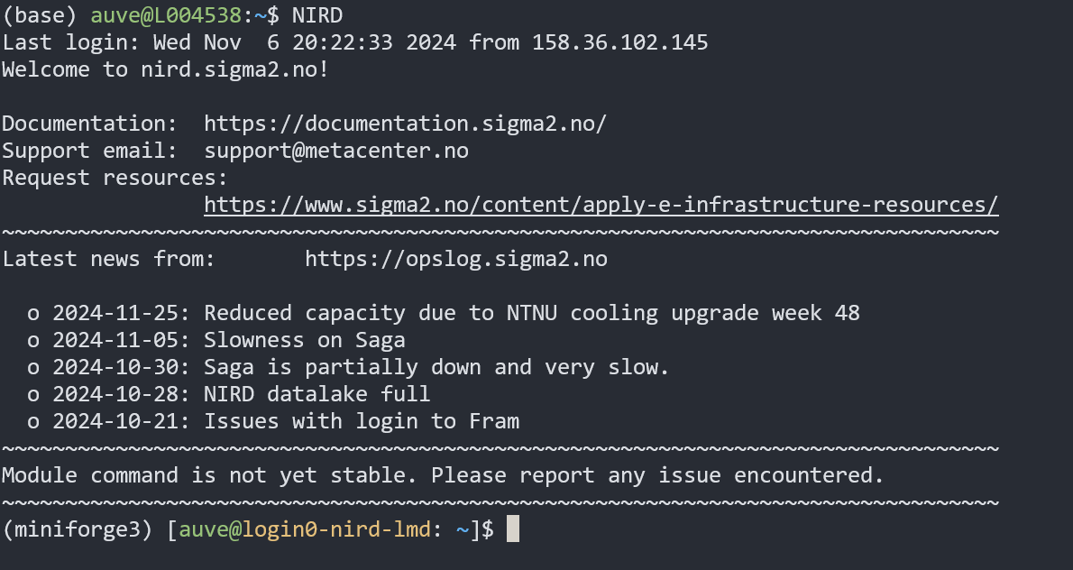
Access data storage in NIRD
The NIRD storage can be accessed via the command line using SSH
Data import/export via command line tools such as SCP or SFTP or other file transfer tools (e.g. WinSCP)

Slide 20
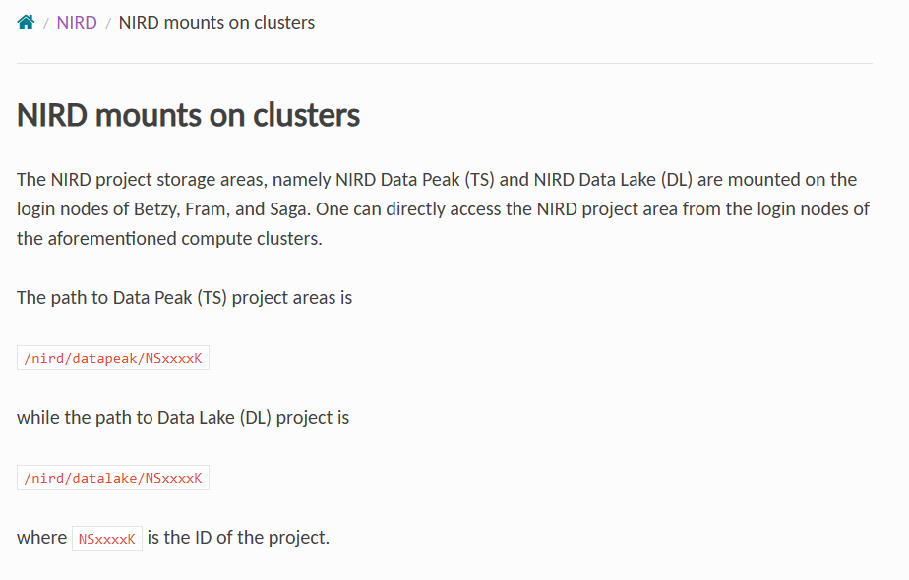
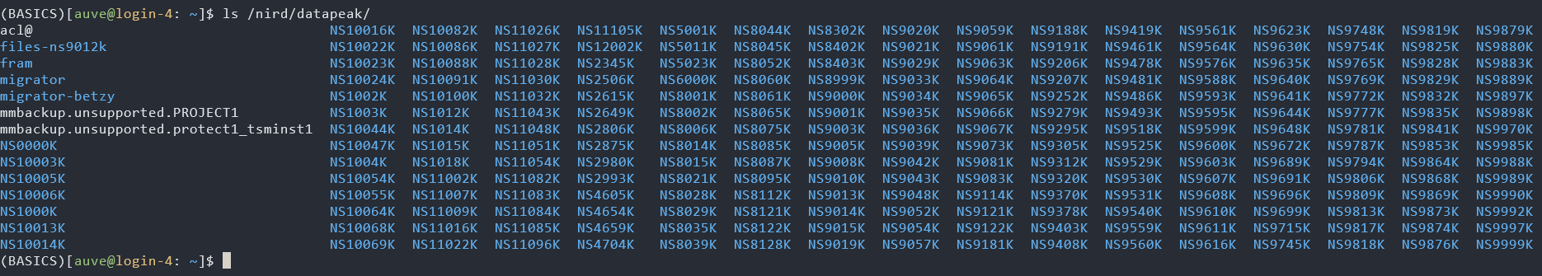
All data storage in NIRD can be accessed in all the Sigma2 HPC (e.g. SAGA)
https://documentation.sigma2.no/files_storage/nird/mounts_lmd.html

Slide 21
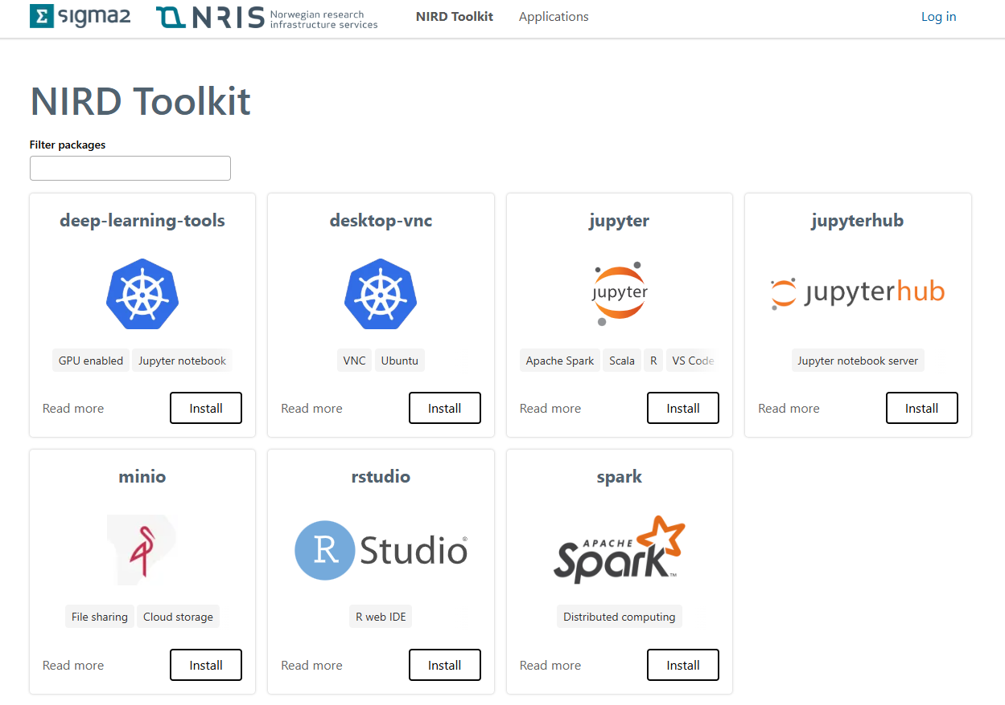
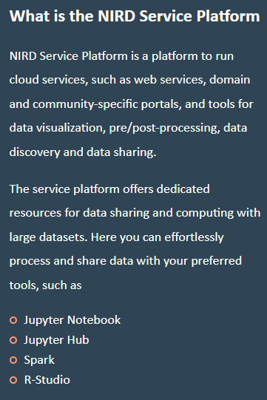
NIRD ToolKit
https://apps.sigma2.no/

Slide 22
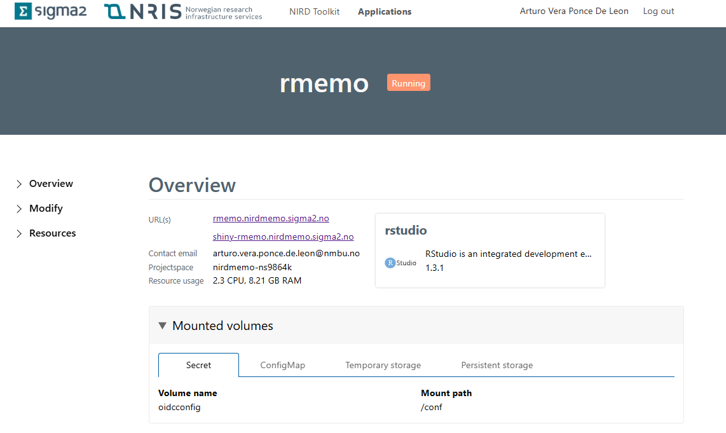
NIRD ToolKit: Run Rstudio to analize data directly on NIRD

Slide 23
Sensitive data storage
Non-sensitive data
Sensitive data
DATA STORAGE

Slide 24
Data storage in TSD
National service for sensitive data - developed and operated by UiO
TSD in general
Available to all users with account
Enable collaborative projects
Integrated with compute
Multiple permission roles - shared data
User support: Tech and admin support
Type of data
Sensitive data
Support multiple data types
DATA STORAGE
DATA ANALYSIS
Notes:
Available to any scientific discipline

Slide 25
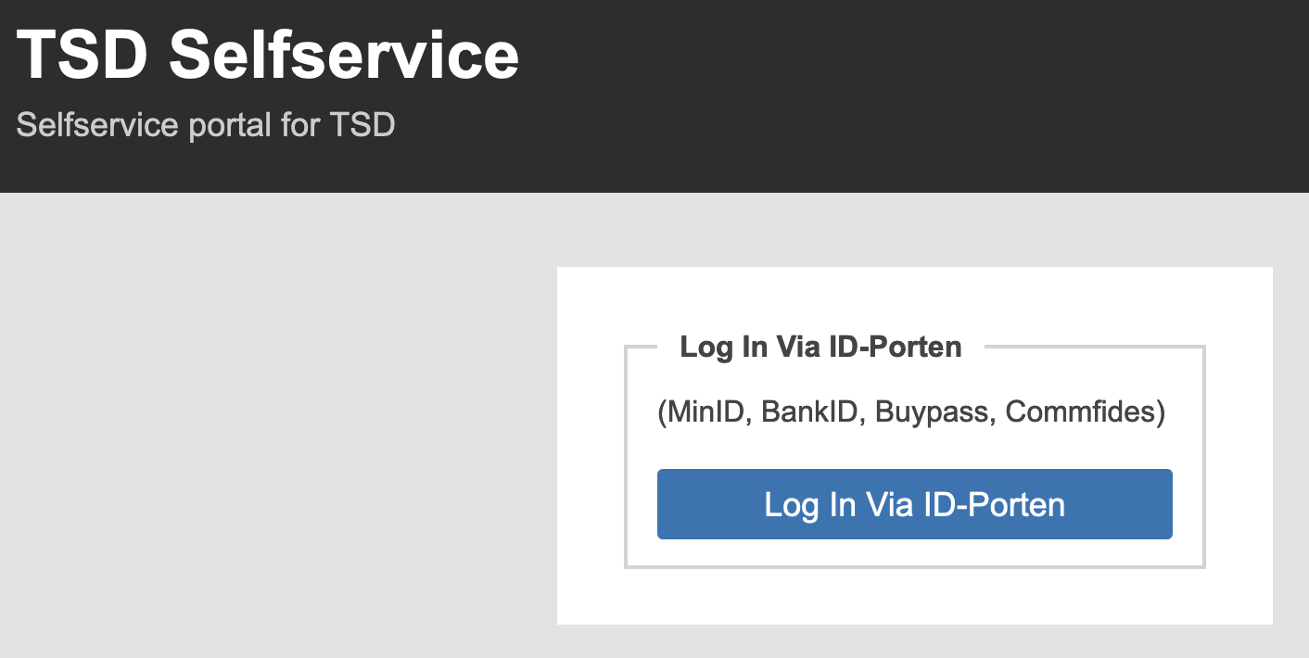
Data storage in TSD – How to get access
Apply for a project – need to document ethical approval (e.g. from REC)
Generate a TSD user – require 2-factor authentication
Payment models for storage
Apply for a TSD project through ELIXIR.NO:
ELIXIR Norway has a quota in TSD that, and users can get subsidised quota through ELIXIR in TSD
Generate user account: https://selfservice.tsd.usit.no/
Apply for project: https://www.uio.no/tjenester/it/forskning/sensitiv/hjelp/start/registrer.html
Wiki for usage: https://www.uio.no/tjenester/it/forskning/sensitiv/hjelp/start/index.html

Slide 26
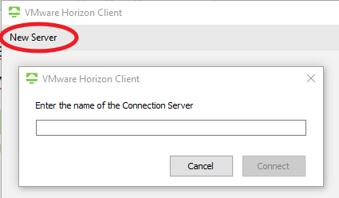
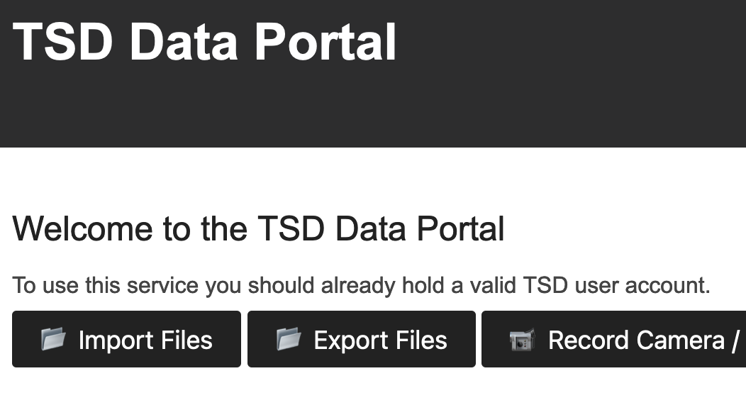
Access to data storage in TSD
The TSD storage can be accessed via VMware Horizon + 2-factor authentication
Import/export data via the web file upload service

Slide 27


Where should I store and share my life science data?
 | Sensitive data | Direct transfer from data producer | Web portal access* | Command line access | Shared projects | Integration for metadata | Support for data deposition | Free of charge
NeLS/SBI
NIRD
TSD
*Direct access to the data and project management through the web browser

Slide 28



Example - Data flow/handle using ELIXIR Norway
NIRD
DATA
DATA STORAGE
EXPERIMENT
DATA DEPOSITION
METADATA
DATA ANALYSIS

