Slide 1


Archiving, preserving, sharing
Korbinian Bösl
Data management coordinator
ELIXIR Norway & Digital Life Norway

Slide 2
RDM life cycle from RDMkit licensed under Creative Commons Attribution 4.0 International License

Slide 3
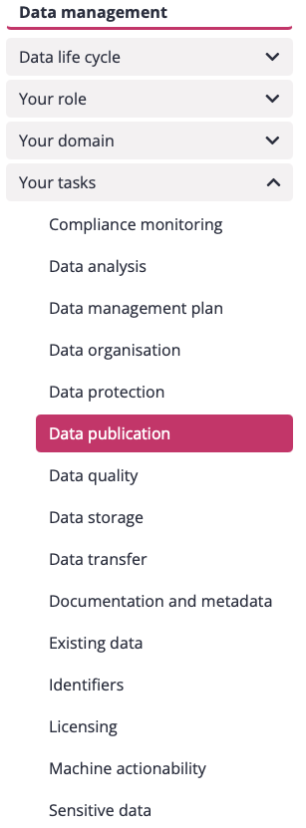
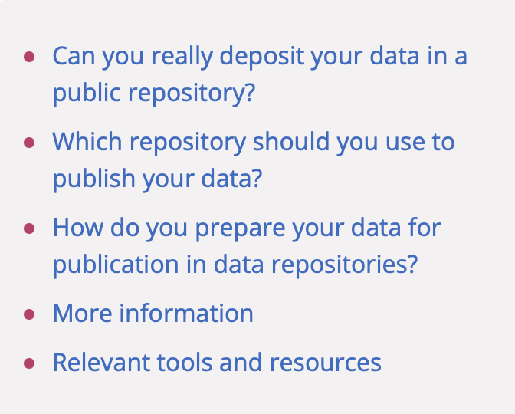
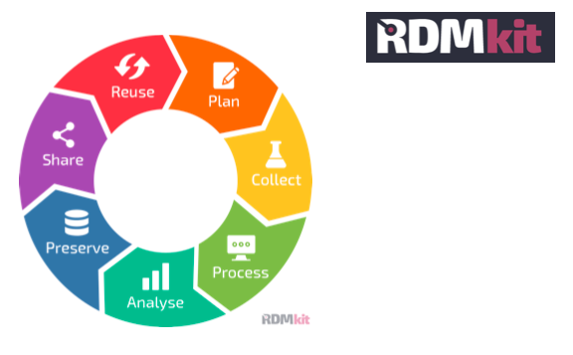
https://rdmkit.elixir-europe.org/
Notes:
resource for Data Management guidelines and good practices for the Life Sciences

Slide 4
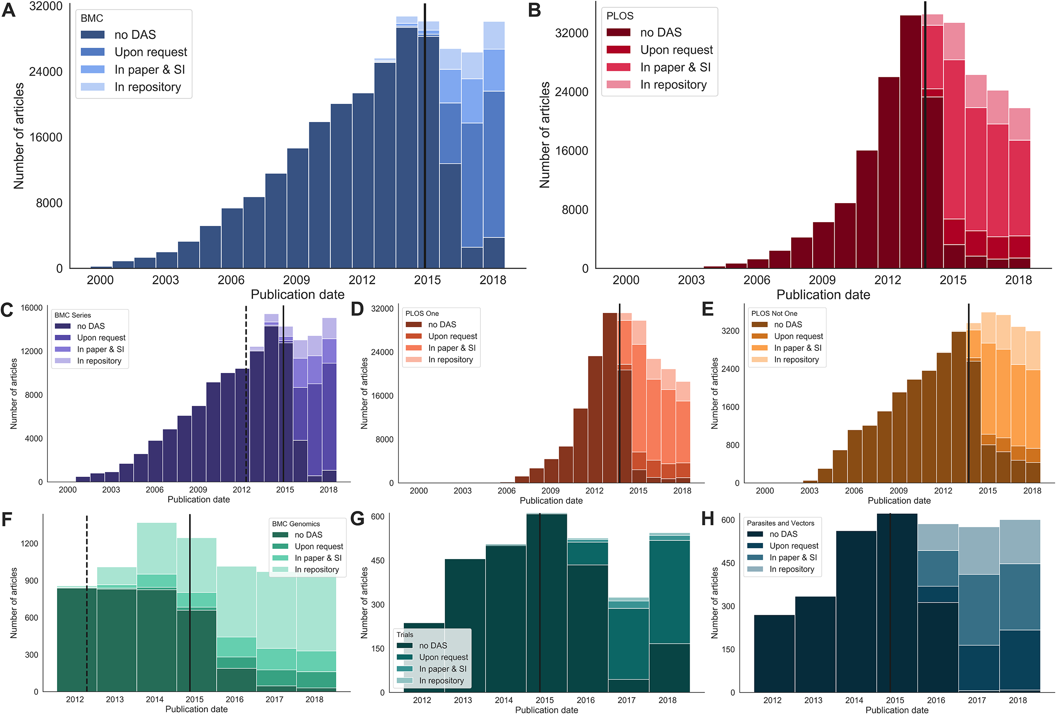
Why should I deposit my data?
Increased Visibility (SEO), added value → 25% more citations
Funding agencies requirement; institutions, and journal publishers policies
Save money on storage
http://doi.org/10.1371/journal.pone.0230416
Notes:
SEO: “search engine optimization”

Slide 5
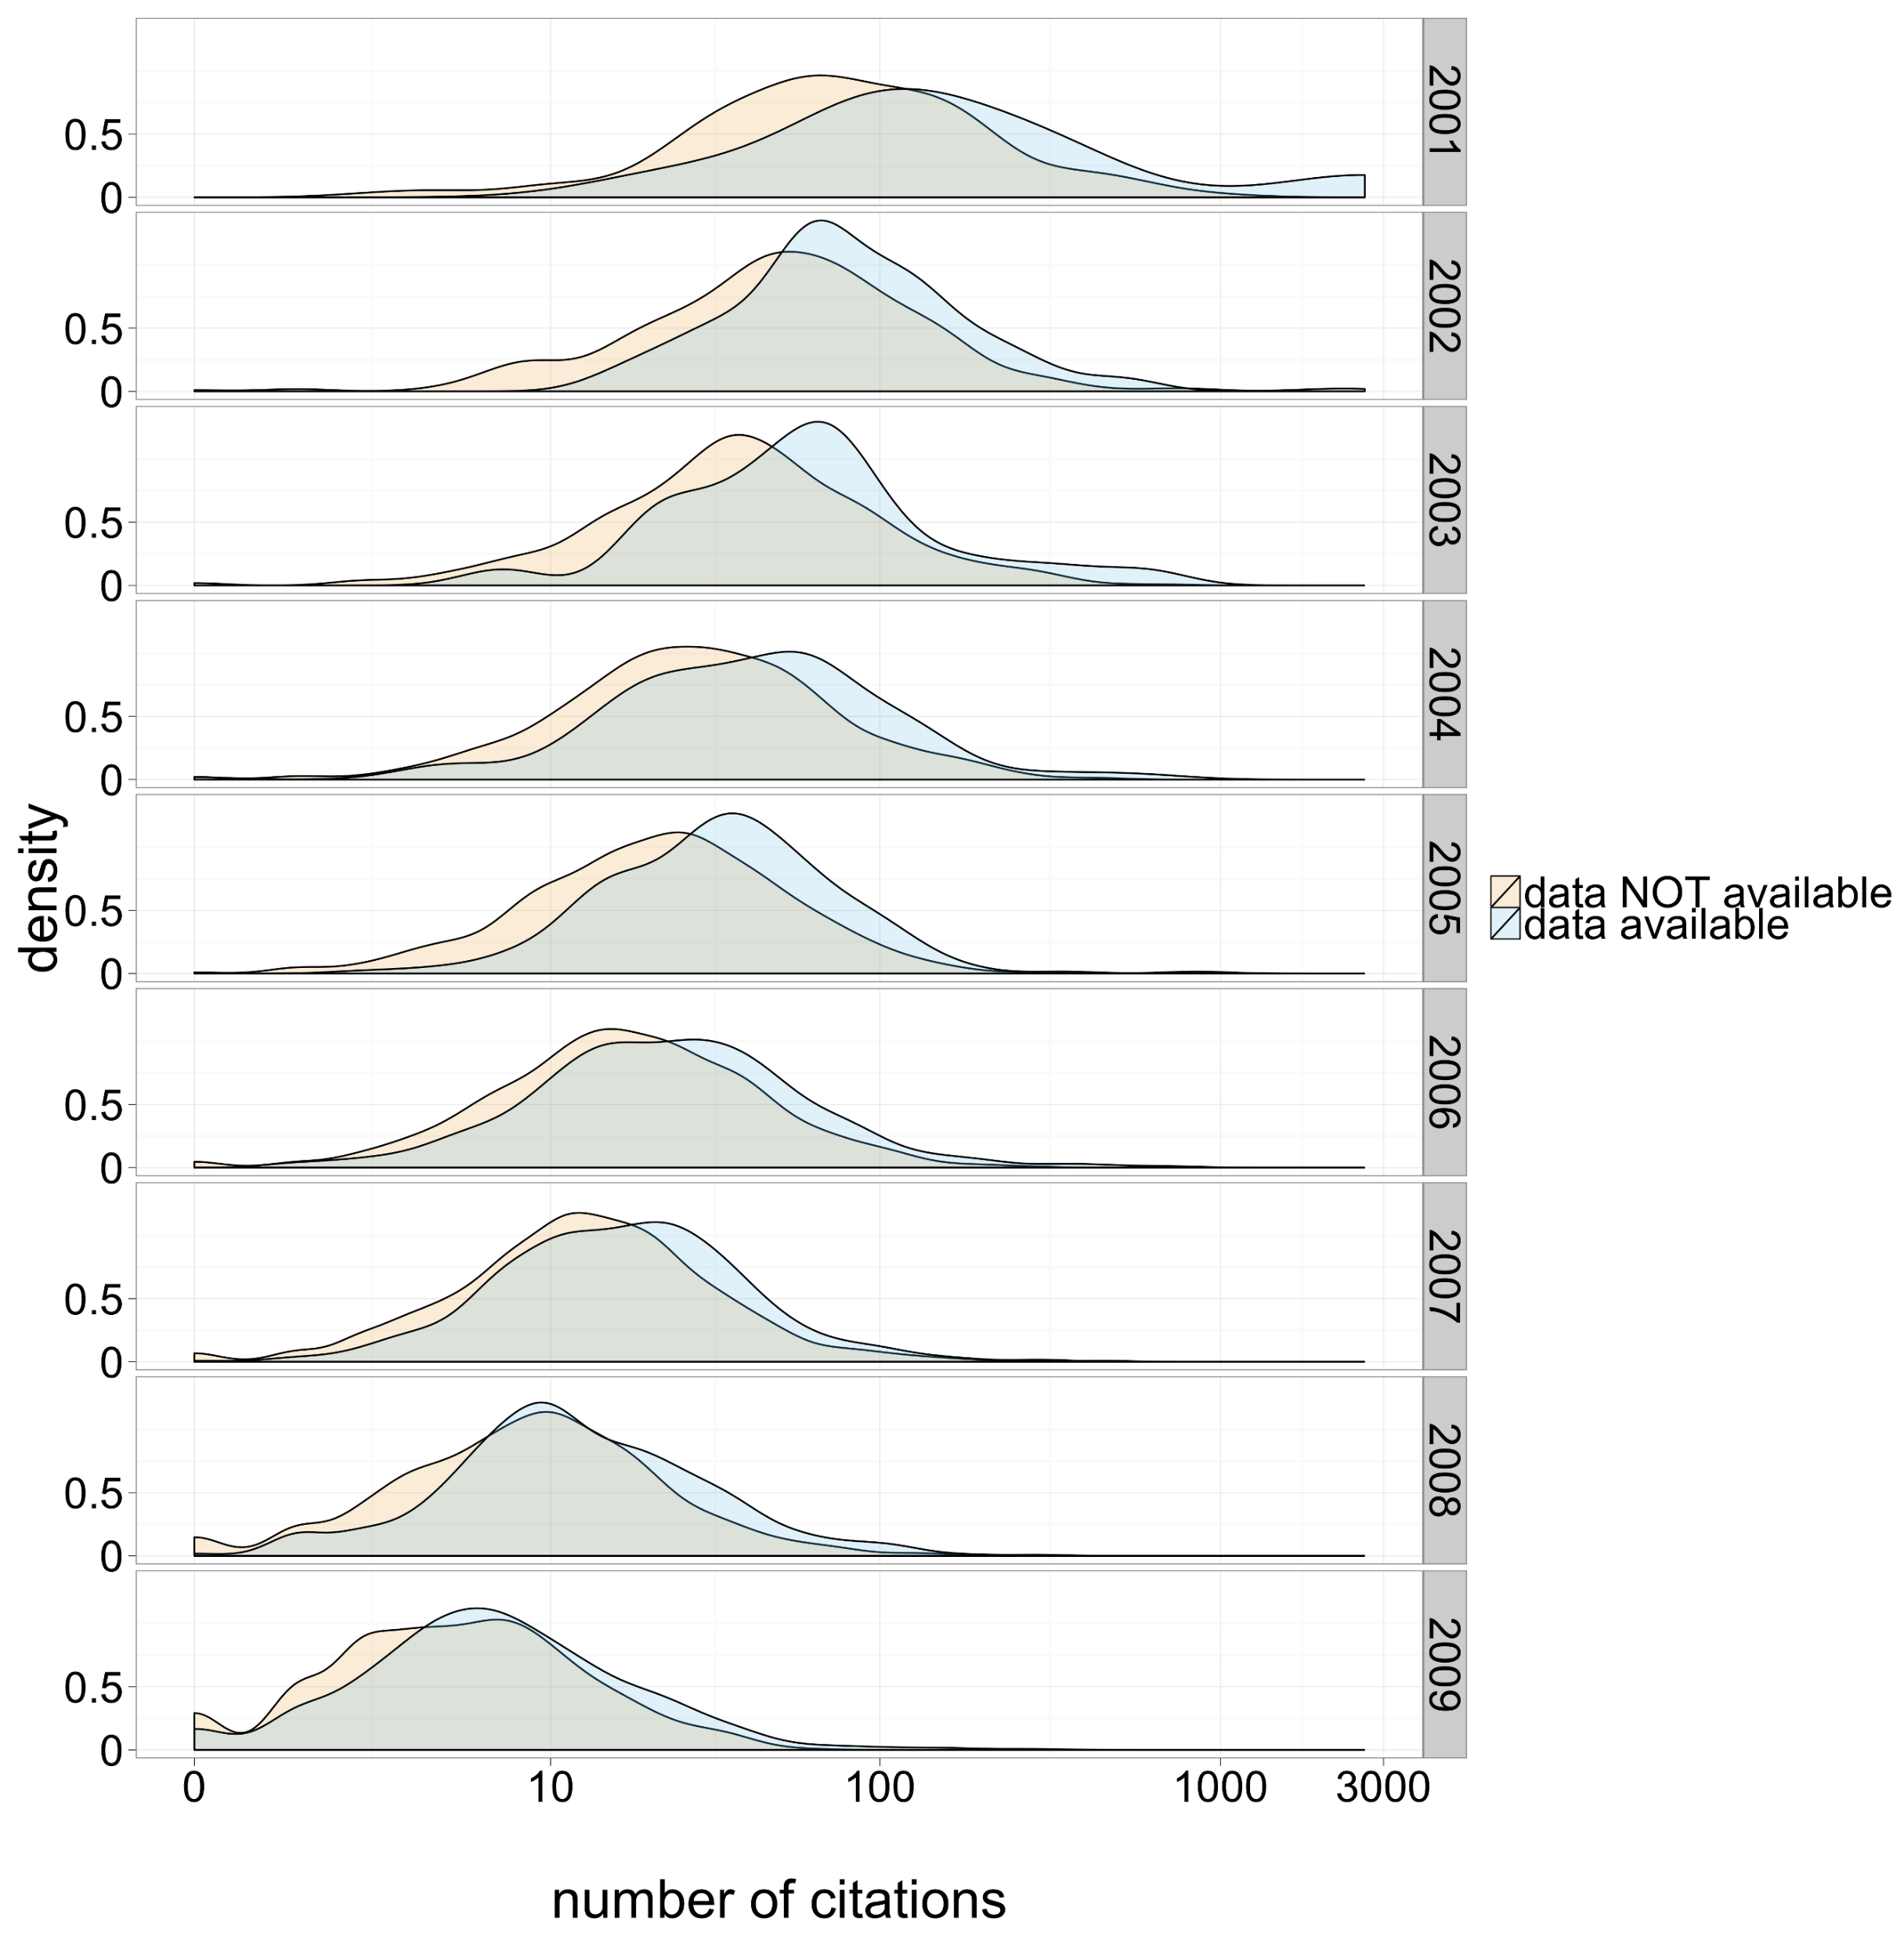
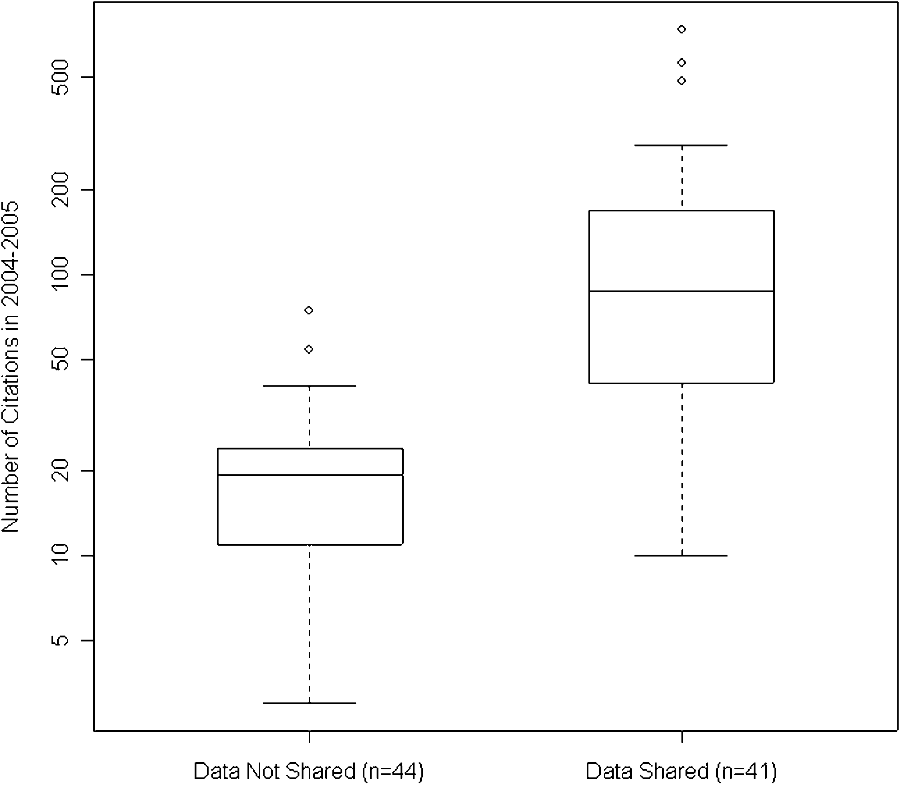
Articles with shared data have higher citation rates
Distribution of 2004–2005 citation counts of 85 trials by data availability.
“The 41 clinical trial publications which publicly shared their microarray data received more citations”
Heather A. Piwowar, Roger S. Day, and Douglas B. Fridsma. 2007. PLOS ONE, doi:10.1371/journal.pone.0000308. Figure licensed CC BY.
Citation density for papers with and without publicly available microarray data, by year of study publication.
Heather A. Piwowar, Roger S. Day, and Douglas B. Fridsma. 2007. PLOS ONE, doi:10.1371/journal.pone.0000308. Figure licensed CC BY.

Slide 6

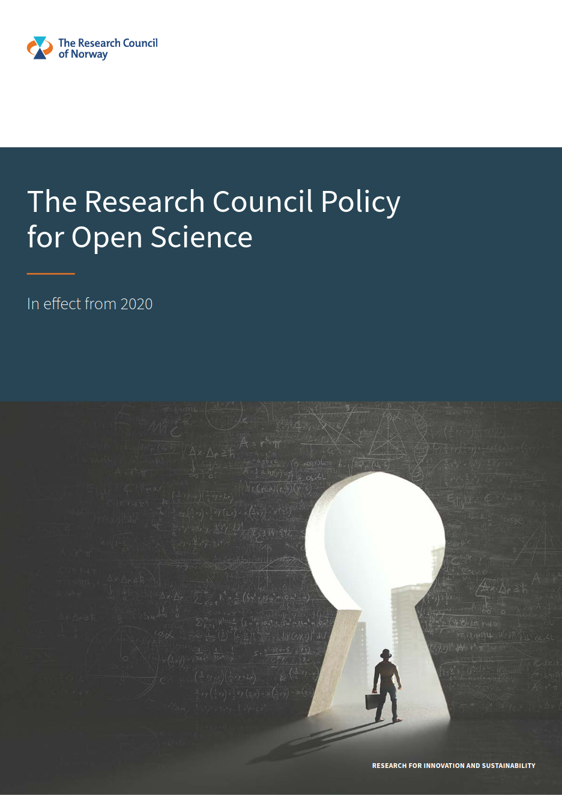
The Research Council Policy for Open Science
European Open Science Cloud (EOSC):
- European network of FAIR data and services
Since 2009: Open Access requirement
“…research data must be stored in a safe and secure manner for a minimum of 10 years.”
Early deposition & sharing
Data is deposited to trustworthy repository
Adopted Plan S
https://www.forskningsradet.no/siteassets/forskningspolitisk-radgivning/apen-forskning/nfr-policy-open-science-eng.pdf

Slide 7

Plan S
Research may be made openly available in one of the three following ways:
Publication via open access journals/platforms
Making peer-reviewed research works immediately available in open repositories;
Publication in journals participating in collective agreements (e.g. “publish and read” agreements) aimed at transitioning from a subscription-based model to open access
https://www.coalition-s.org/
Notes:
cOAlition S is an international consortium of research funding and performing organisations who are committed to making full and immediate Open Access to research publications a reality.

Slide 8
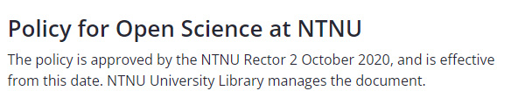
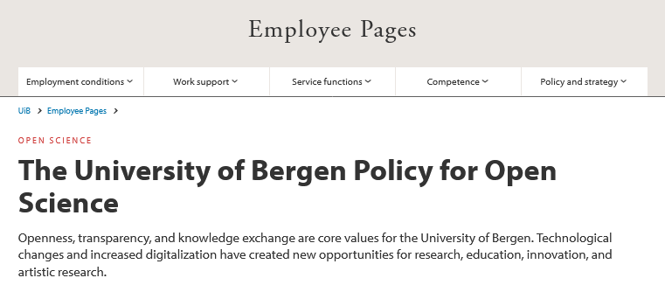
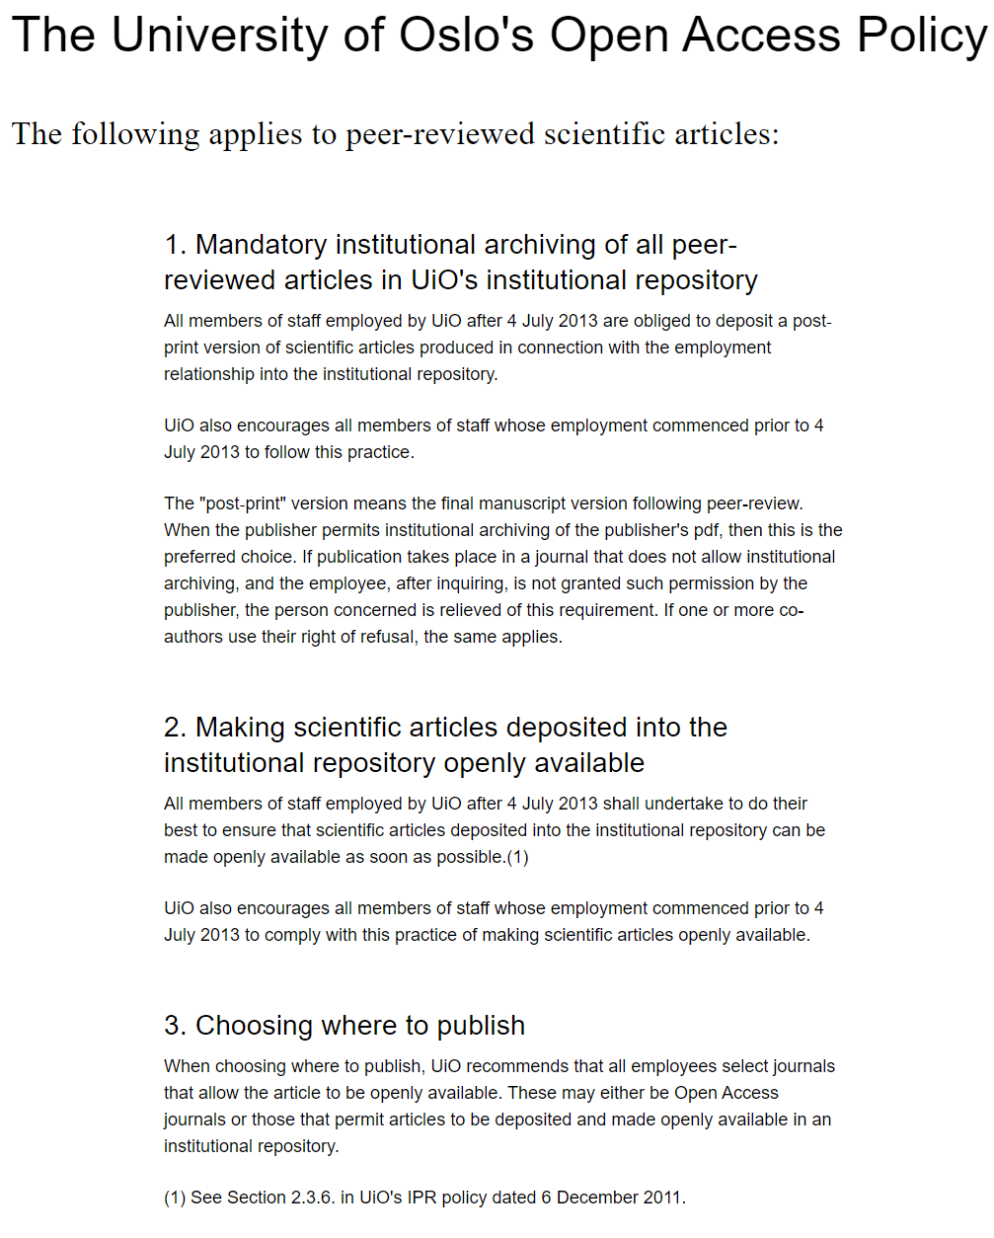
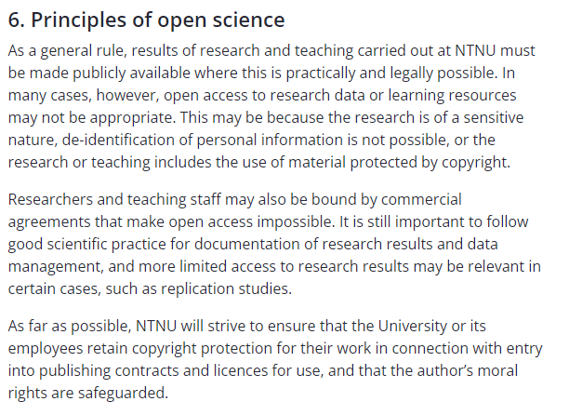


adopted by the University Board 24.09.2020
Open access to research publications and artistic research
Open access to research data
Open Innovation
Citizen Science
Open educational resources
UiB Policy for Open Science
https://www.ub.uio.no/english/writing-publishing/open-access/documents/open-access-policy.html
https://www.ntnu.edu/policy-for-open-science
https://www.uib.no/en/foremployees/142184/university-bergen-policy-open-science

Slide 9
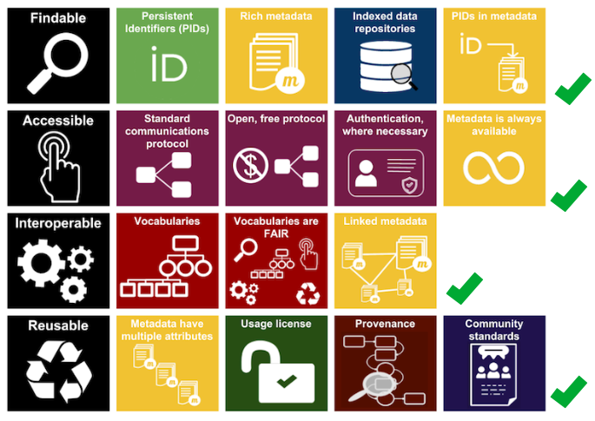
Where should I deposit my data?
Preferably somewhere where
most things are taken care of?
FAIR illustrations icons from ARDC 2018 licensed under Creative Commons Attribution 4.0 International License

Slide 10
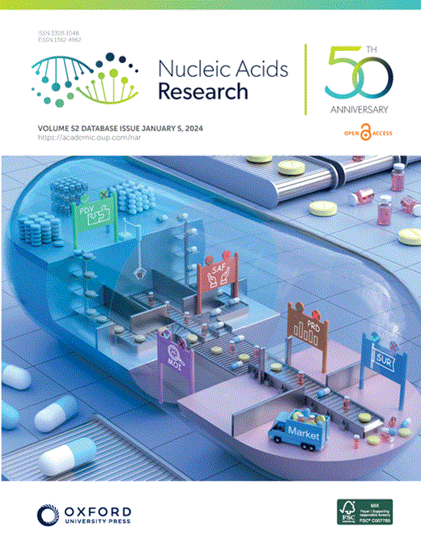


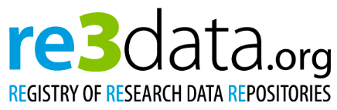
Where should I deposit my data?
1959 databases for molecular biology (2024)
Each journal publisher has its own policies and recommendations
fairsharing.org : 2123 registered database
Community-developed platform (including standards, repositories and policies across all disciplines)
re3data.org : 3217 registered database
Registry of Research Data Repositories (overview of existing international repositories of research data from all academic disciplines).
Rigden, D.J., and Fernández, X.M. (2024). The 2024 Nucleic Acids Research database issue and the online molecular biology database collection. Nucleic Acids Research 52, D1–D9. https://doi.org/10.1093/nar/gkad1173.

Slide 11



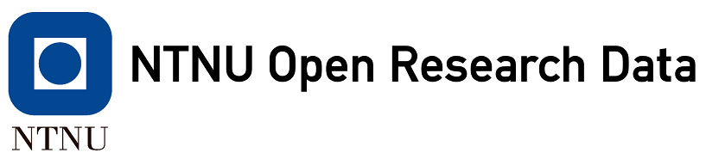


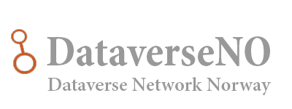





Where should I deposit my data?
No
Fits?
No
No
(often)
Visibility for peers
No
Yes
Yes
Yes
Yes
Domain
&
Datatype
specific
Domain
specific
National
Institutional
own effort
generic
Standardization
SRA

Slide 12
Some domain-specific archives
(and connected considerations)

Slide 13
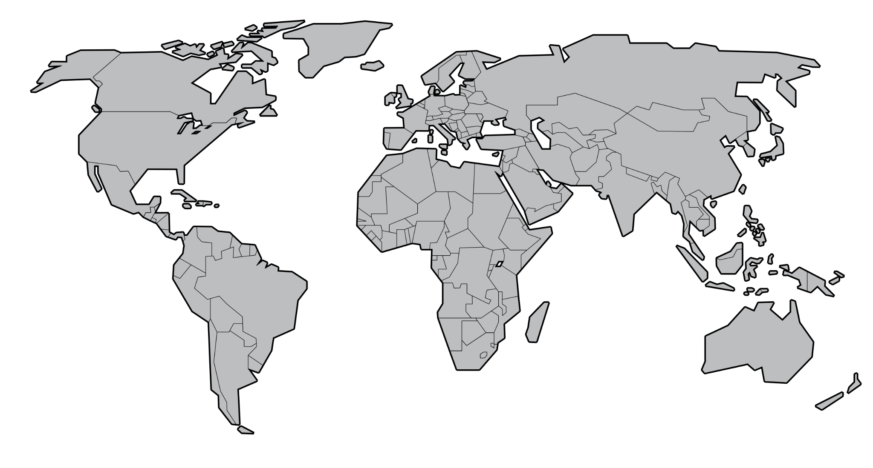
Multiple Repositories – similar data types

Slide 14
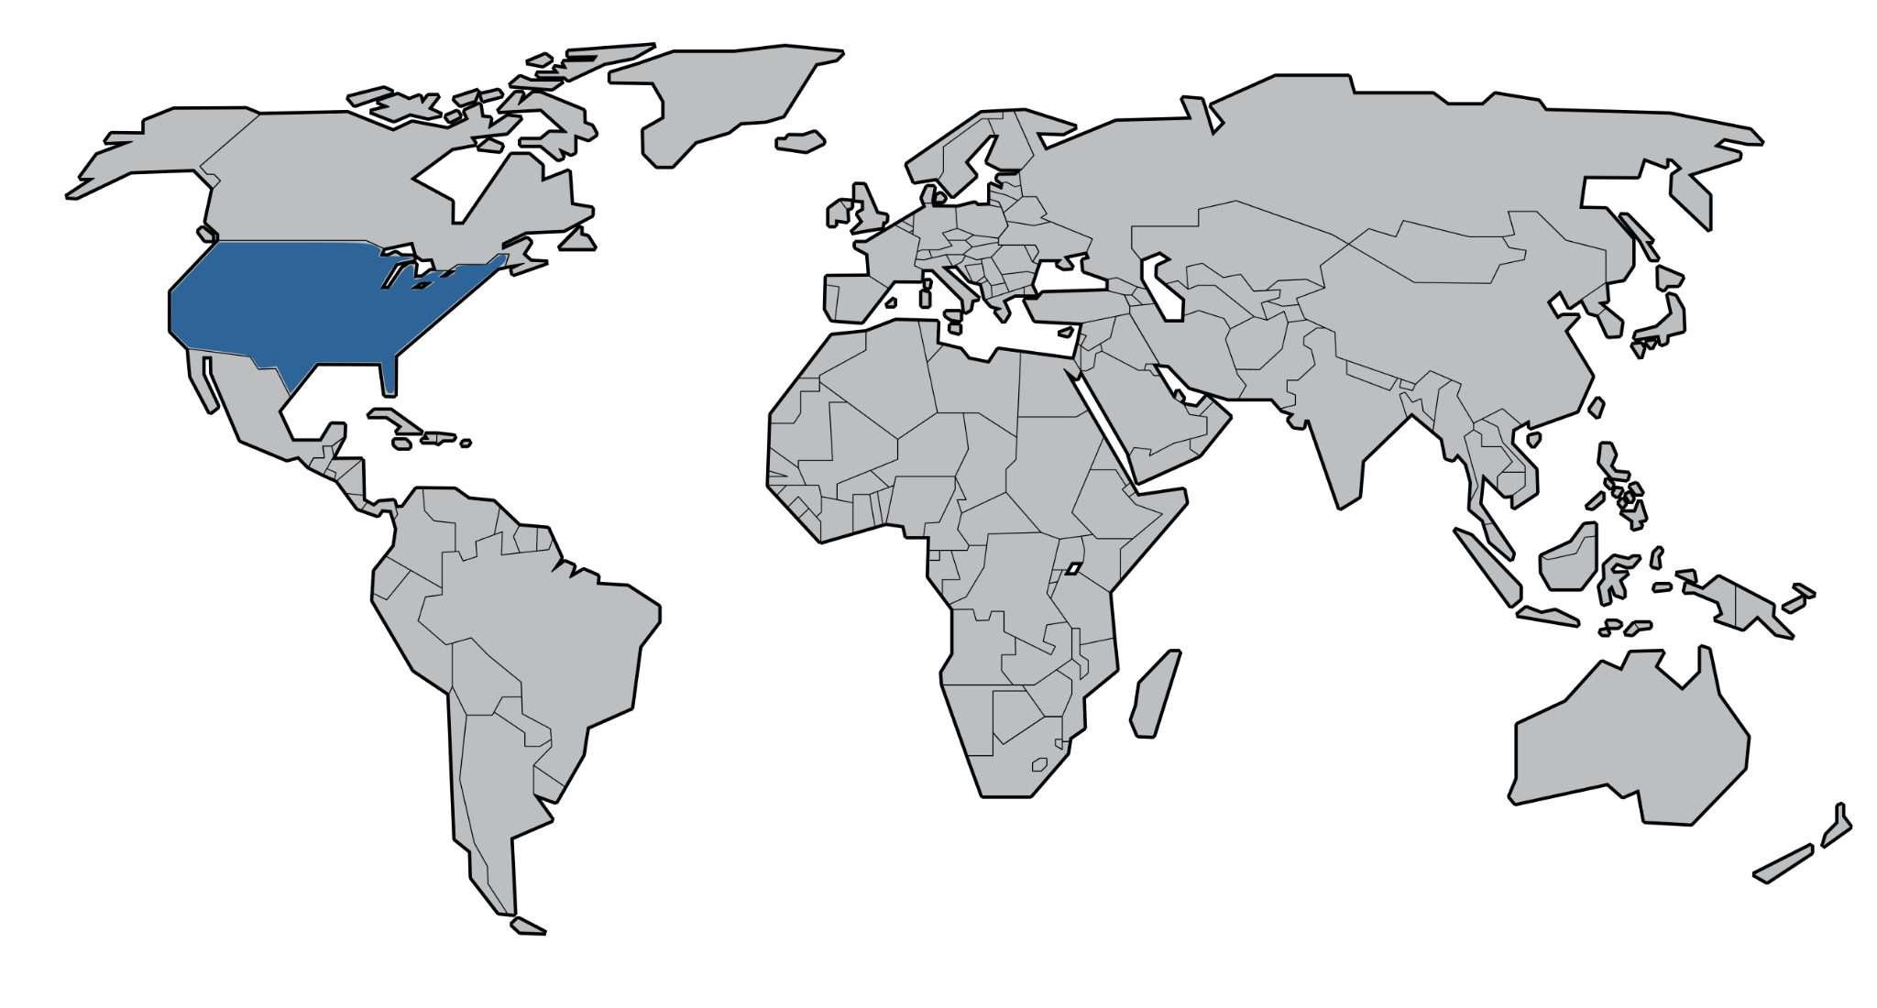
SRA

Slide 15


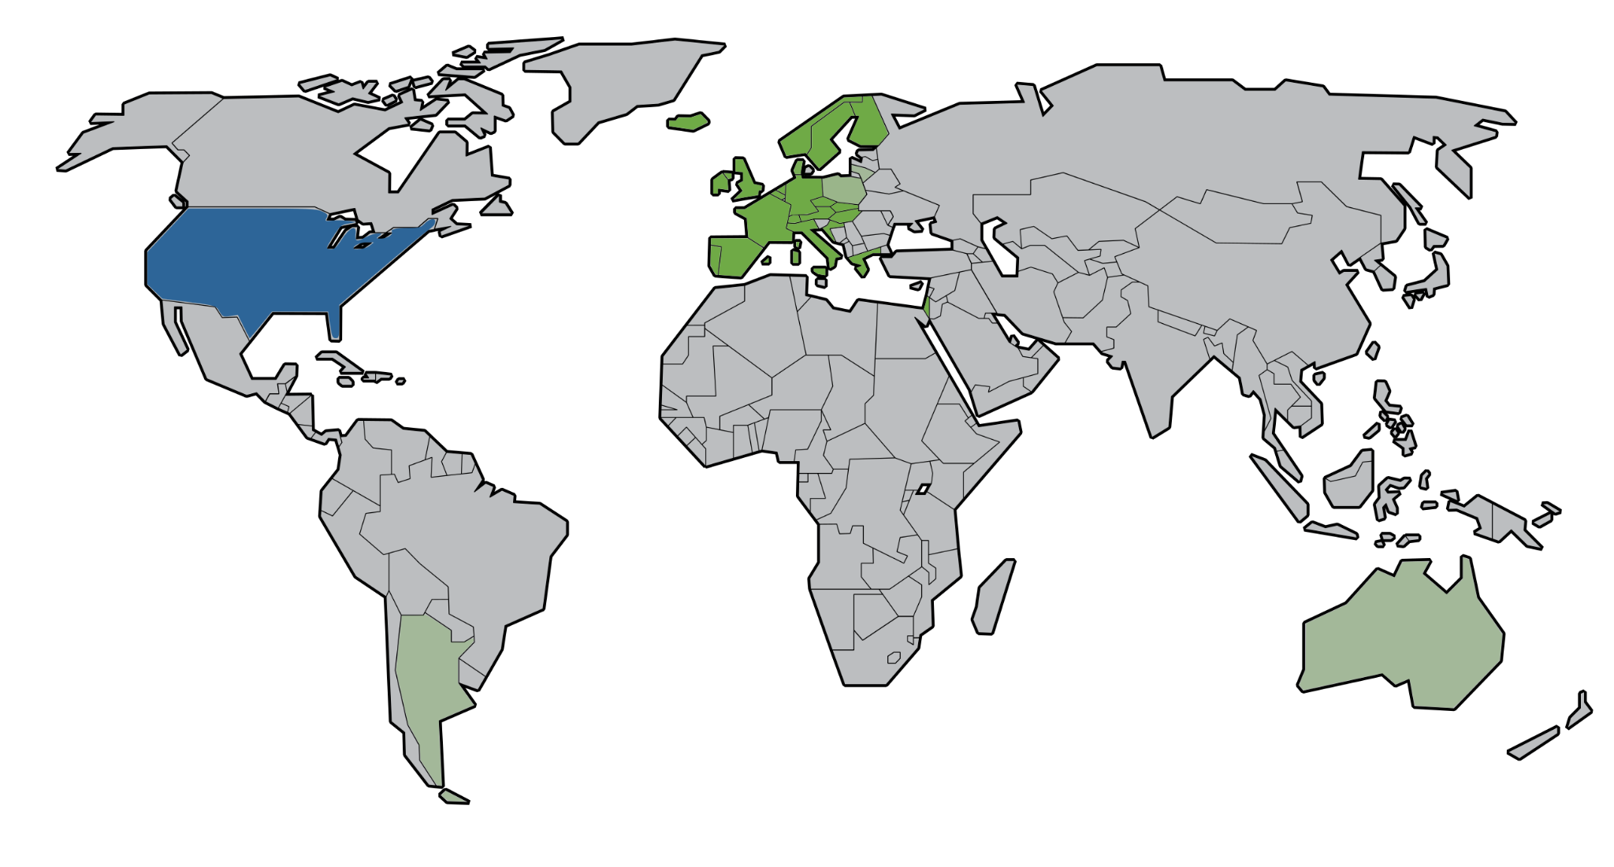
SRA

Slide 16




2017
SRA

Slide 17

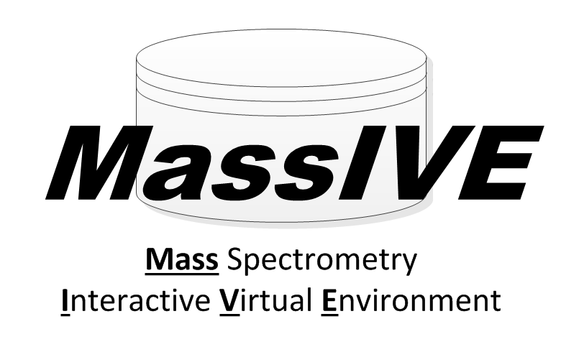







Slide 18

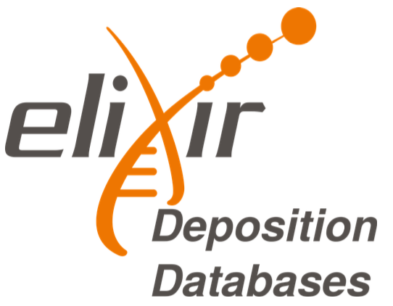
Elixir Data resource services
22 resources of fundamental importance to the wider life-science community and the long-term preservation of biological data
ELIXIR data resource services
12 deposition database for experimental
biomolecular data
https://elixir-europe.org/platforms/data/core-data-resources
https://elixir-europe.org/platforms/data/elixir-deposition-databases
Notes:
Among those resources, there are 22 that are considered as fundamental importance
to the wider life-science community and the long-term preservation of biological data. They are called the Elixir Core Data Resources.
Beside, there’re 12 of them which are listed as recommended deposition database for bimolecular experimental data.

Slide 19
Elixir Deposition Databases
Recognized & recommended
Free of charge
Quick upload
Not operated by single university/government
Guided submission process
Generous embargo regulation (2yrs)
API access (upload from NeLS)
https://elixir-europe.org/platforms/data/core-data-resources
https://elixir-europe.org/platforms/data/elixir-deposition-databases

Slide 20







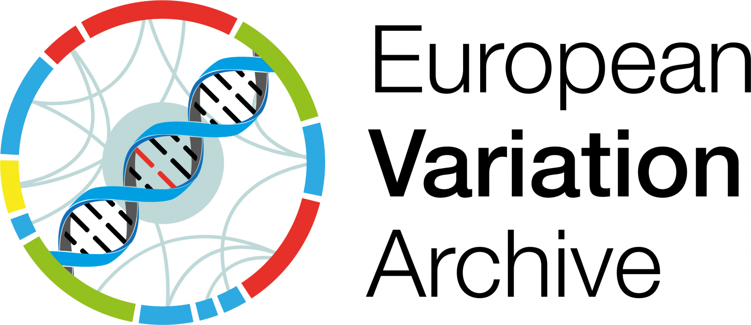



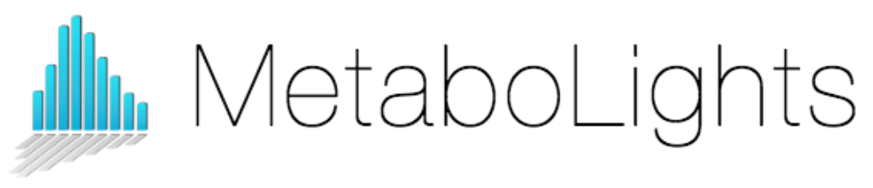

Elixir Deposition Databases
Notes:
Those are the Elixir Deposition Databases: including
Biostudies: collect metadata of a study and link to raw data
ArrayExpress for high-throughput functional genomics experiments, which is merging to BioStudies rencently
BioModels : for mathematical models of biological and biomedical systems.
BioSamples: stores and supplies descriptions and metadata about biological samples
EGA: for sensitive data
EMDB: electron microscopy data
ENA: nucleotide sequencing data
EVA: variant data
IntAct: for molecular interaction data
MetaboLights: Metabolomics experiments
PDBe: 3D structures of large biological molecules such as protein, nucleic acids
PRIDE: mass spectrometry proteomics data
Note that BioStudies can cross link to other repositories (including repo of EMBL-EBI, or outside of the plateform)

Slide 21
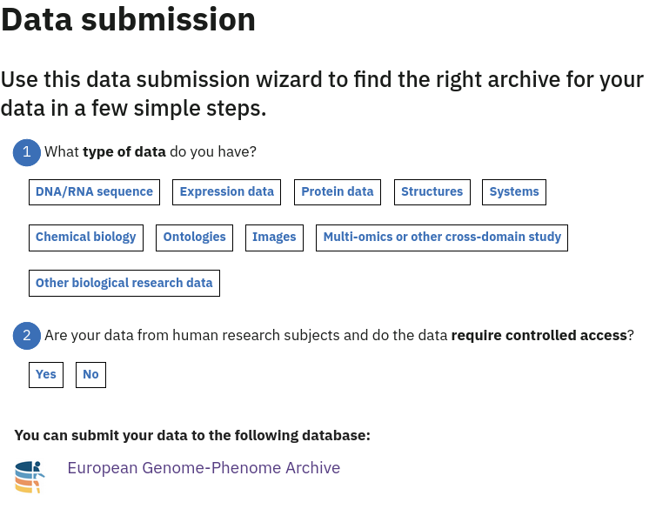

https://www.ebi.ac.uk/submission/

Slide 22

National repositories
Notes:
Next: as we have seen previously, if your data do not fit any domain specific database, you can consider to deposit to national or institutional repositories.

Slide 23
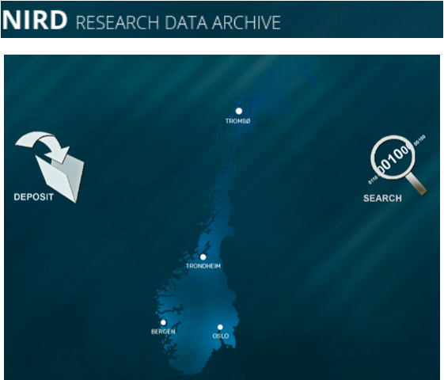
NIRD archive
National, free depositing repository
Domain agnostic
Dublin-core metadata standard
DOI accessible
Supports machine readable metadata harvesting
https://archive.norstore.no
Notes:
Norwegian Infrastructure for Research Data (NIRD)
From sigma2
Domain agnostic: general domain, archiving large data sets. Operated by UNINETT/Sigma2

Slide 24
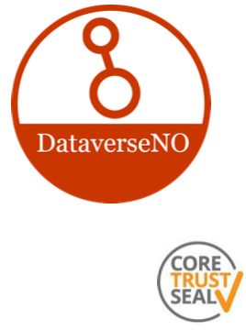
DataverseNO
National/Institutional, free depositing repositories
Domain agnostic
Manually curated by libraries
DOI accessible
8Gb max/upload - contact support >50Gb
https://dataverse.no
Notes:
provide national and institutional repository and are manually curated by libraries, with limited data size.
For this archive, Lars will talk about it more in details in the next

Slide 25


Sikt archive
Domain agnostic (focus social science)
DOI accessible
Implemented data access committees
Main data type: Questionnaires, ...
Reorganisation: Since 2022 NSD has merged with Uninett and Unit to form Sikt
– Norwegian Agency for Shared Services in Education and Research
https://sikt.no/en/archiving-research-data
Notes:
Then, we have NSD archive. This is mainly to store questionnaires data. And from 2022, NSD has merged with Uninett and Unit to form Sikt.
NSD has merged with Uninett AS and Unit to form the Norwegian Agency for Shared Services in Education and Research (Sikt). The new organisation will be established from 1 January 2022.
Unit: Directorate for ICT and joint services in higher education and research

Slide 26
Other types of data

Slide 27
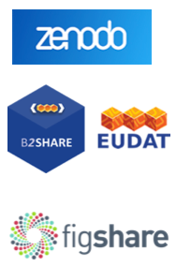
Generic archives
Less standard metadata → Re-usability ⤋
Domain agnostic → Findability ⤋
Guided submission process
Commercial factors: Size limitations, ...
https://zenodo.orgs/
https://b2share.eudat.eu/
https://figshare.com

Slide 28

Archiving code/scripts
Good integration - easy to implement
Archival of each release
beta version for gitlab
https://zenodo.org/
https://guides.github.com/activities/citable-code/
https://gitlab.com/sbeniamine/gitlab2zenodo
Notes:
For code/scripts, a recommended way is to put your code on GitHub and archive them in zenodo for each release. It’s a quite good and easy
process.
There’s developping beta version for gitlab

Slide 29
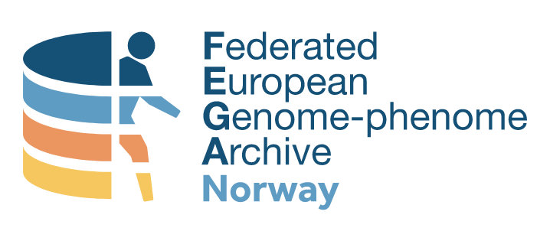




What about sensitive data?
Central metadata accessibility
Secure storage
Implemented data access committees
Norwegian EGA
(for data that can not leave the country)
ega-archive.org
ega.elixir.no
Notes:
What’s about sensitive data. There’s EGA repository: where the metadata is accessible ; so that everyone can search and know the existence of the data
without having free access to the data. And if someone request to access to a particular data that he is interested in, his request will be going to be accessed
by the data access committee and the owner of the data, and once it was approved you can download the data.
In Norway we have the federated Norwegian EGA for the data that can not leave the country.

Slide 30
What about sensitive data?
Central metadata accessibility
Secure storage
Implemented data access committees
Norwegian EGA
(for data that can not leave the country)
Ensure your consent form & REC approval allow controlled access archiving!
ega-archive.orgega.elixir.no
Notes:
You should ensure your consent form & REC approval allow controlled access archiving.

Slide 31
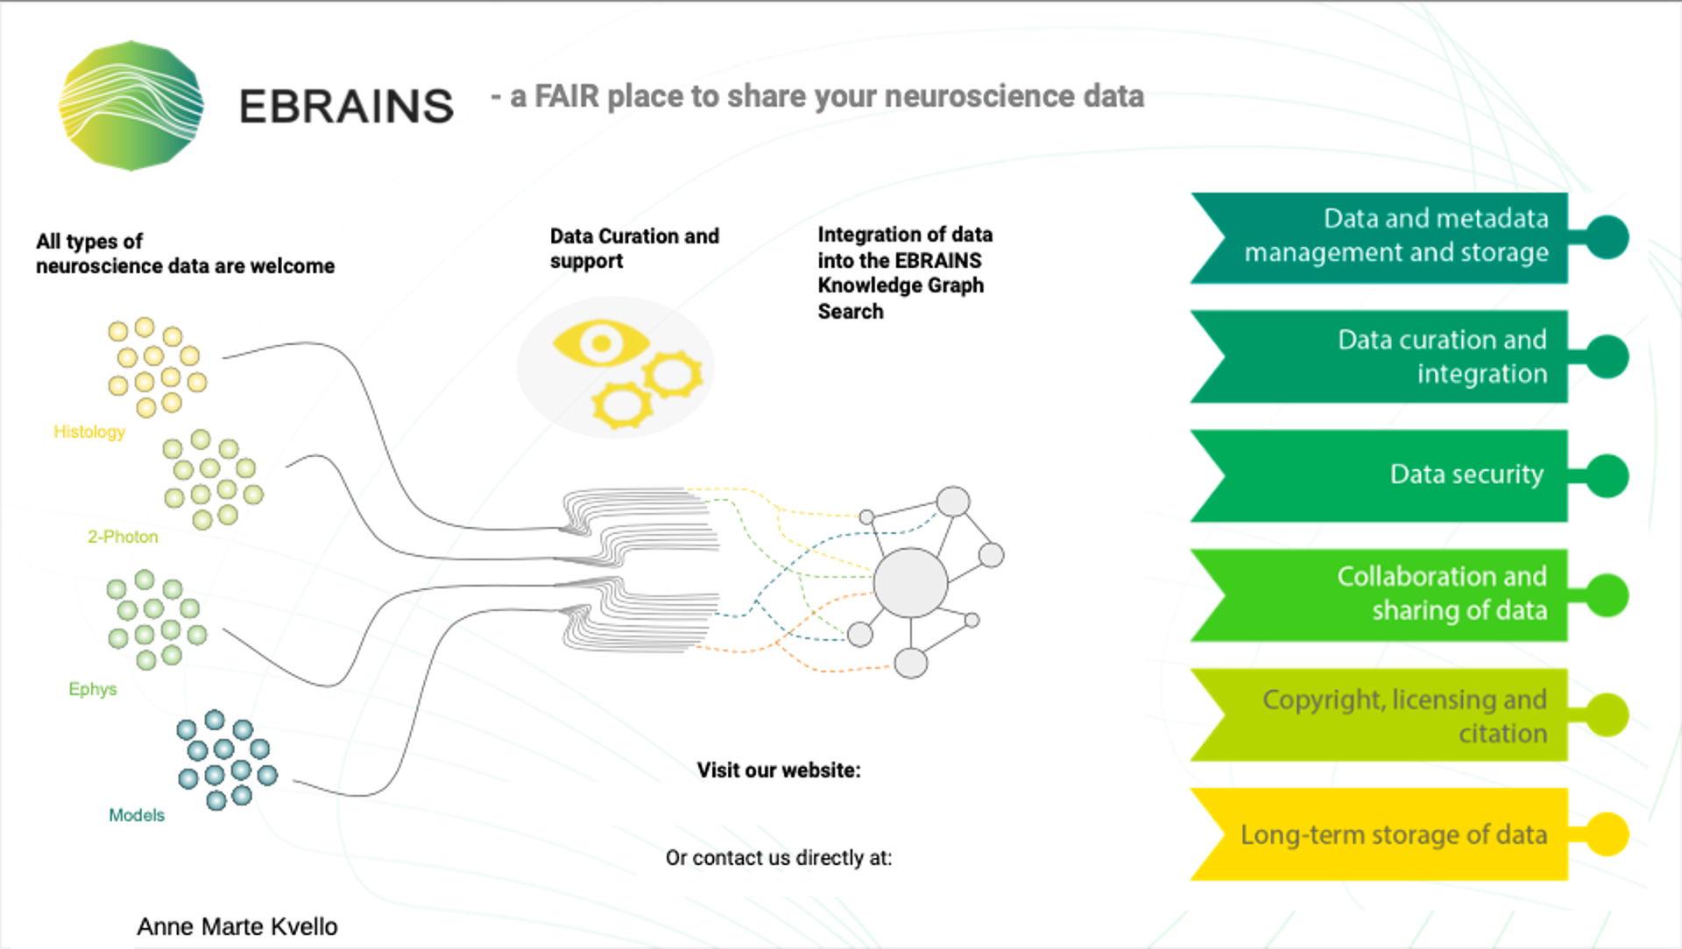
https://ebrains.eu/services/data-knowledge/share-data/
curation-support@ebrains.eu
CC-BY 4.0
Notes:
This welcome all types of neuroscience data. The submitted data would go through a data curation process; that make your data standardise and meet
required criteria before publishing. Then the data can be integrated with The Knowledge Graph Search. Where they integrate the data with tools, i.e. connect a dataset with the software tools that can be used for analysing or visualise that data. And that model makes expand the search capability and make your data more reachable and resuable.
Knowledge graph: Integrates registrered data, models, and software into a graph database, and outlines their relationship to each other (e.g. connecting a dataset to a software tools for analysis and visualization)
Digital tools and services -> challenges in brain research and brain-inspired technology development. Understand human brain function and disease
Different accessibility type (free access, controlled access …), clear, explicit filtering / searching

Slide 32
What to consider before
submitting to a long-term repository?
Outlined in the DMP:
Can your data be submitted to an open repository?
Who is the long-term contact person for the submitted dataset?
Familiarize yourself with the repository standards
What data, metadata or other information does the repository require me to submit?
Are my data compatible with the repository format standards?
When should I know which repository I should submit to? Preferably already before the project starts

