Slide 1

Welcome to the Life Science DMP- workshop on Zoom
Please feel free to switch your camera off during the session. We are happy if you turn your video on while speaking.
Use the chat function for questions
Mute yourself while not speaking
... or use the ‘hand up’ function if you want to ask a question in person
Please use the ‘rename’ function to indicate your department (if you want)
Example: Korbinian Bösl - II CBU

Slide 2

Data Management Plans and a short introduction to ELIXIR & Digital Life Norway
Korbinian Bösl
Data management coordinator
ELIXIR Norway/Digital Life Norway
Illustrative Icons from Font Awesome licensed under Creative Commons Attribution 4.0 International License

Slide 3
Schedule
21.04.2021
0900 - 0915 Introduction
0915 - 0945 Requirements from institutions & funding bodies
0945 - 1015 Information on national and local storage infrastructures
1015 - 1030 Short break
1030 - 1230 Data preservation, archiving and sharing

Slide 4
Schedule
22.04.2021
0900 - 1000 GDPR and other legal requirements for research on humans
1000 - 1015 Short break
1015 - 1045 Licensing of data, biological material and software
1045 - 1100 Intro Data Steward Wizard
1100 - 1300 Hands on training and assistance to generate a data management plan

Slide 5

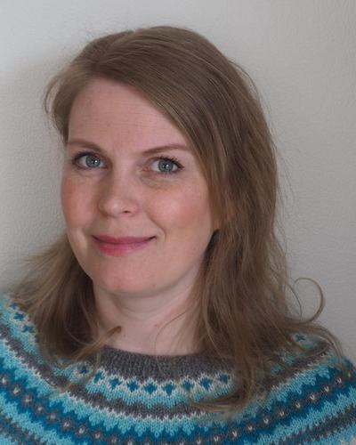
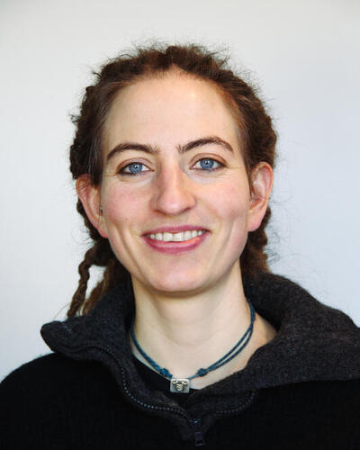
University Library
Research Data team
Kjersti Enerstvedt
Jenny Ostrop

Slide 6

University Library
Research Data team
Kjersti Enerstvedt
Jenny Ostrop
LAB-IT & SAFE
Tore
Linde

Slide 7


University Library
Research Data team
Kjersti Enerstvedt
Jenny Ostrop
Metacenter
LAB-IT & SAFE
Tore
Linde
Siri Kallhovd

Slide 8
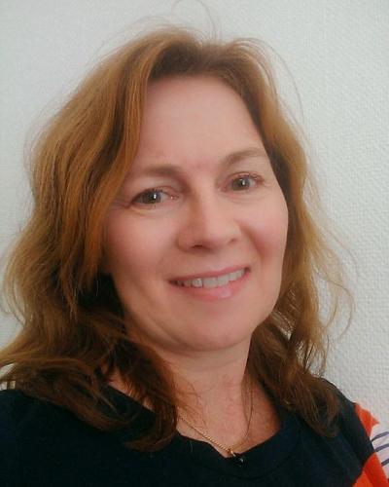

University Library
Research Data team
Kjersti Enerstvedt
Jenny Ostrop
Metacenter
LAB-IT & SAFE
Janecke
Veim
Tore
Linde
Siri Kallhovd
Janecke
Veim

Slide 9







University Library
Research Data team
Kjersti Enerstvedt
Jenny Ostrop
Metacenter
LAB-IT & SAFE
Janecke
Veim
Tore
Linde
Siri Kallhovd
Janecke
Veim
+
Espen Åberg
Erik
Hjerde
Federico Bianchini
Korbinian Bösl

Slide 10
ELIXIR Europe
‘Data for Life’
Mission:
To operate a sustainable European infrastructure for biological information, supporting life-science research and its translation to society, the bio-industries, environment and medicine

Slide 11
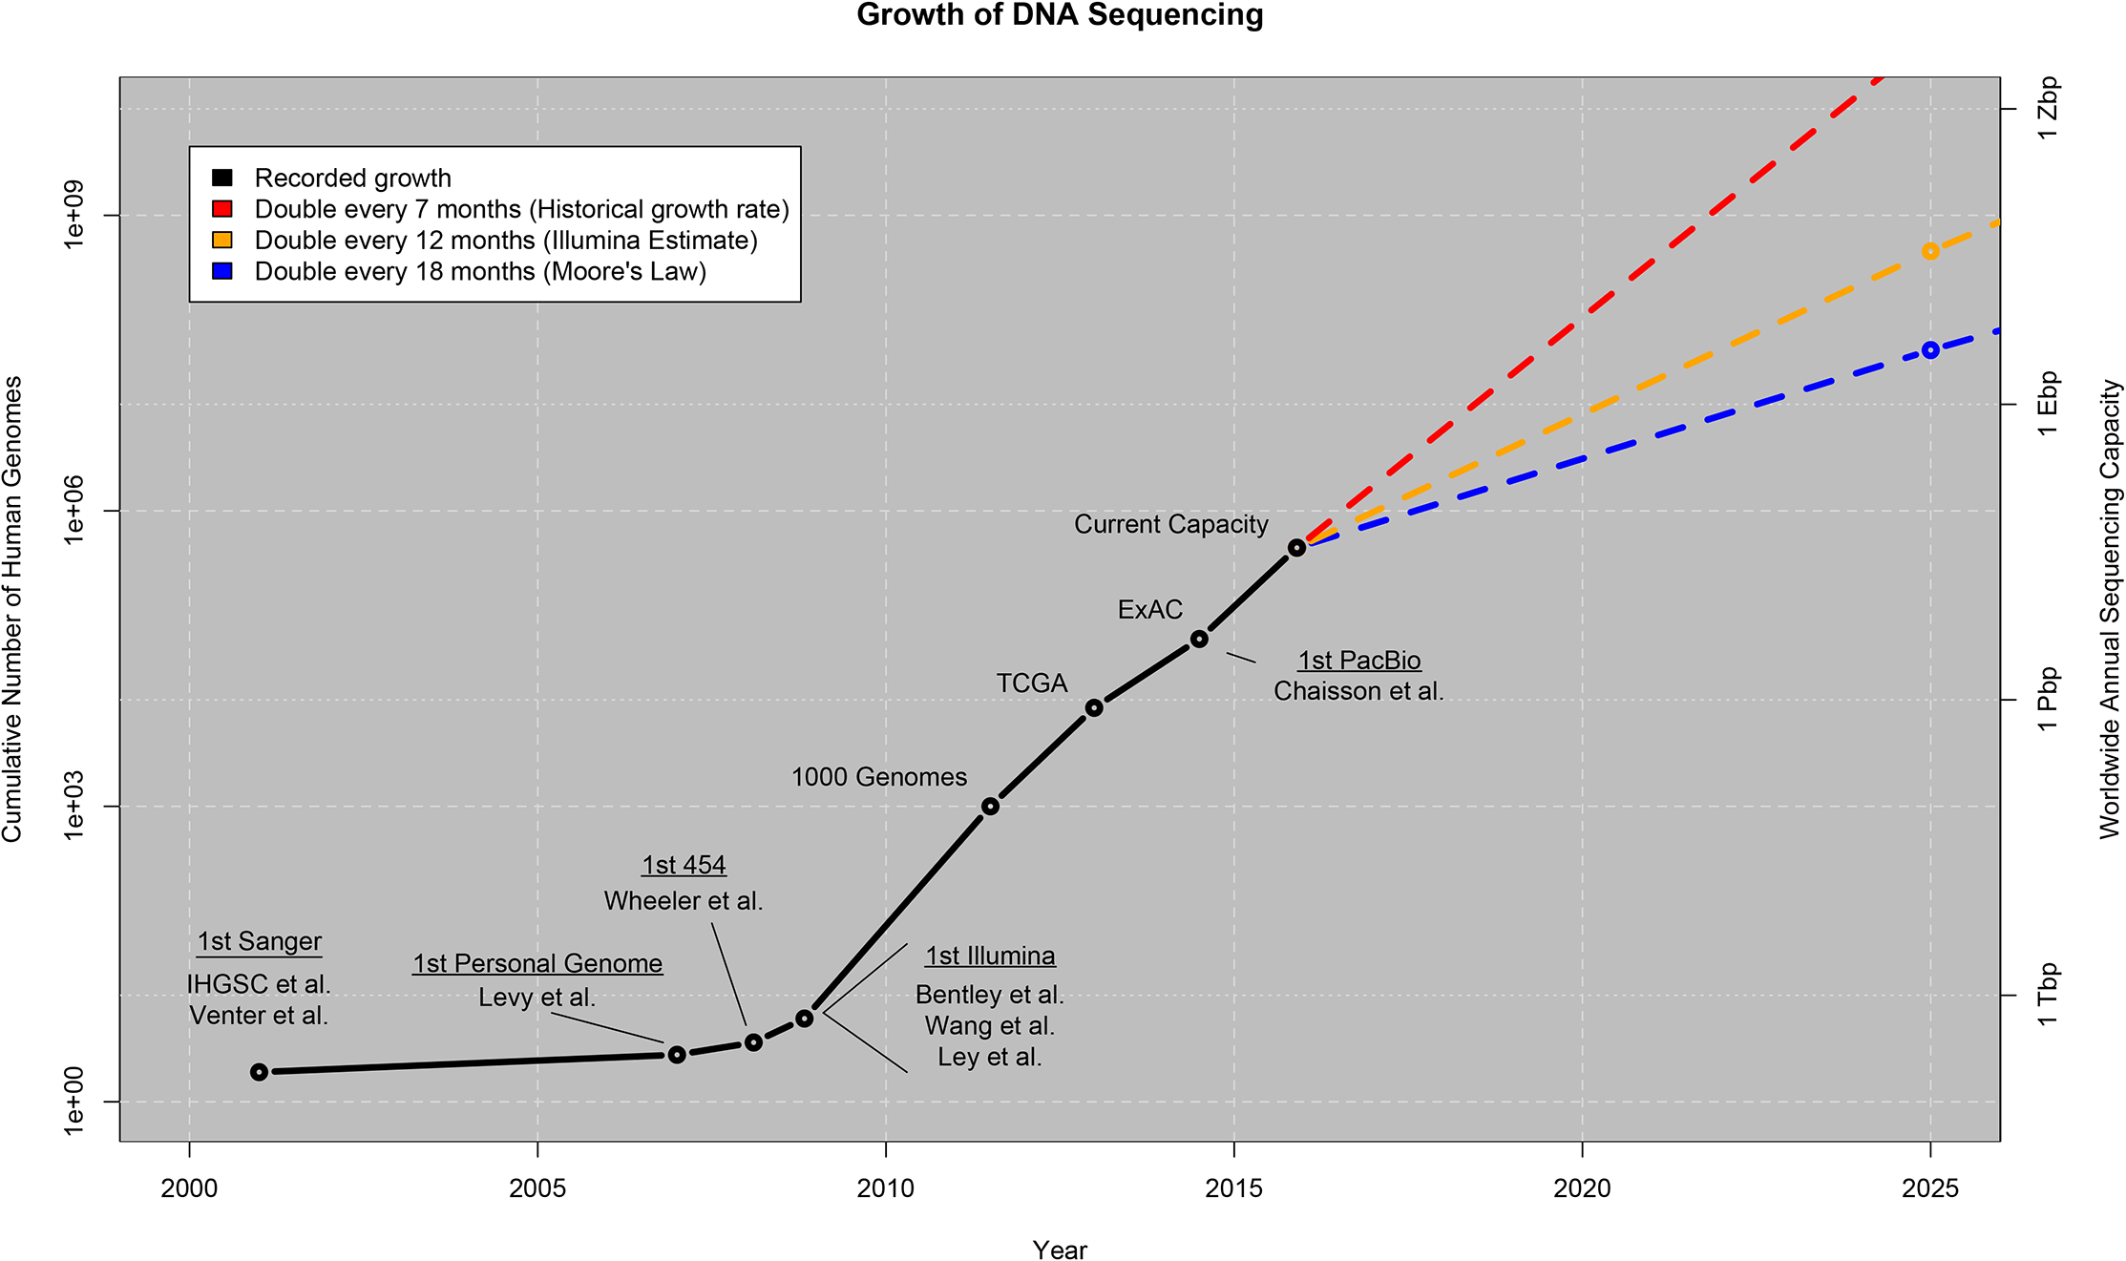
ELIXIR Europe
From: Stephens, Z. D. et al. Big Data: Astronomical or Genomical? PLOS Biology 13, e1002195 (2015).
licensed under Creative Commons Attribution 4.0 International License

Slide 12

ELIXIR Europe
Data stored in
ELIXIR/EBI-EMBL
Repositories
Cook, C. E. et al. The European Bioinformatics Institute in 2018: tools, infrastructure and training. Nucleic Acids Res 47, D15–D22 (2019).
licensed under Creative Commons Attribution 4.0 International License

Slide 13

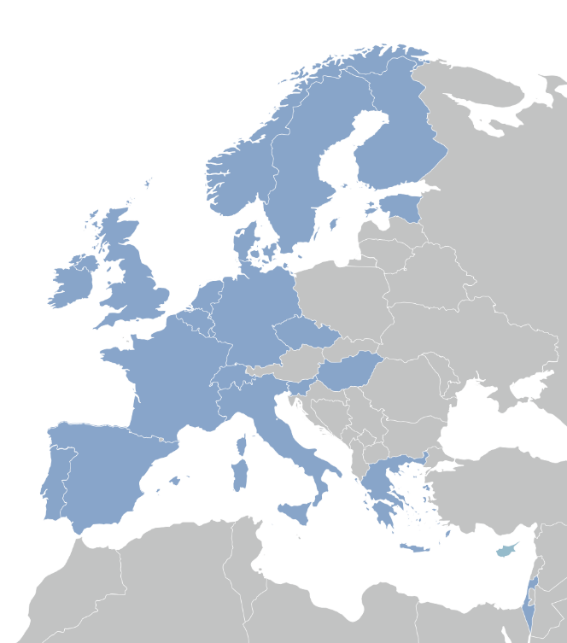

Slide 14

A distributed infrastructure to scale with the challenge
ELIXIR data infrastructure for Europe’s life science research sector
ELIXIR Nodes build local bioinformatics capacity throughout Europe
ELIXIR Nodes build on national strengths and priorities

Slide 15





ELIXIR Services
Data deposition:
ENA, EGA, PDBe, EuropePMC, …
Compute:
Secure data transfer, cloud computing, AAI
q
Data management:
Genome annotation
Data management plans
Bioinformatics tools:
Bio.tools, Benchmarking: OpenEBench
I
Industry:
Innovation and SME programme
Bespoke collaborations
D
Added value data:
UniProt, Ensembl, OrphaNet, …
Training:
TeSS, Data Carpentry, eLearning
Data Interoperability:
FAIRSharing, identifiers.org, OLS,
Bioschemas, …

Slide 16

ELIXIR Structure
Five technical Platforms for Compute, Data, Tools, Interoperability, and Training
Complemented by Communities for specific use cases within e.g. Human data, Metabolomics, Proteomics, Marine Metagenomics, Microbial Biotechnology, Structural Bioinformatics and others

Slide 17




ELIXIR Structure
The Norwegian node of ELIXIR Europe
Currently funded by:
  The Research Council of Norway (until 2021)
  The involved institutions; UiB, UiO, NMBU, NTNU and UiT
  Users
Services to national users
  Infrastructure, support and training
Deliverables to ELIXIR Europe
  Tools and databases

Slide 18
Our additional user services - Norway
Support – through our HelpDesk 2 days of service free of charge (enabled by RCN)
Training – in using our tools and workflows, and in data management
Bioinformatics infrastructure
Analysis, sharing and storage of data
contact@bioinfo.no

Slide 19


Support for trans-disciplinary participating projects:
Responsible Research and Innovation
Innovation and industry involvement
Training & Research school
Competence and infrastructure – incl. Data Management
Outreach & Communication

Slide 20
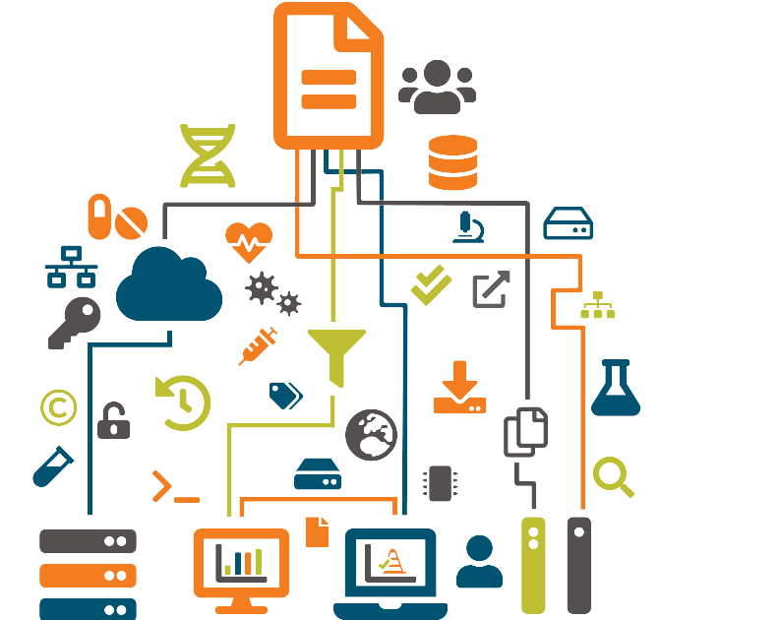
Data Management
Make research data and related metadata discoverable, accessible and understandable ...
... today, tomorrow, and well into the
future.
... across geographical distances.
... enabling efficient collaboration;
  even across disciplines.

Slide 21
Data Management
Make research data and related metadata discoverable, accessible and understandable ...
... today, tomorrow, and well into the
future.
... across geographical distances.
... enabling efficient collaboration;
  even across disciplines.

Slide 22
Data Management
Make research data and related metadata discoverable, accessible and understandable ...
... today, tomorrow, and well into the
future.
... across geographical distances.
... enabling efficient collaboration;
  even across disciplines.

Slide 23
Data Management
Make research data and related metadata discoverable, accessible and understandable ...
... today, tomorrow, and well into the
future.
... across geographical distances.
... enabling efficient collaboration;
  even across disciplines.

Slide 24








Slide 25
R

Slide 26
R
Discover,
Reuse & cite
Plan &
Design
Share &
Publish
Collect &
Capture
Manage, store &
preserve
Collaborate &
Analyse

Slide 27
Data creation &
deposit
R
Discover,
Reuse & cite
Plan &
Design
Share &
Publish
Collect &
Capture
Manage, store &
preserve
Collaborate &
Analyse

Slide 28
Data creation &
deposit
R
Discover,
Reuse & cite
Plan &
Design
Share &
Publish
Collect &
Capture
Manage, store &
preserve
Collaborate &
Analyse
Managing active
data

Slide 29
Data creation &
deposit
R
Discover,
Reuse & cite
Plan &
Design
Share &
Publish
Collect &
Capture
Manage, store &
preserve
Collaborate &
Analyse
Archives &
Data repositories
Managing active
data

Slide 30
Data catalogues & registries
Data creation &
deposit
R
Discover,
Reuse & cite
Plan &
Design
Share &
Publish
Collect &
Capture
Manage, store &
preserve
Collaborate &
Analyse
Archives &
Data repositories
Managing active
data

Slide 31



Slide 33


Slide 34


Slide 35


Slide 36


Slide 37



Slide 38








Slide 39


sensitive
data

Slide 41
Data Management Plan?
sensitive
data

Slide 42


/
/
/
/
/

Slide 43

]
/
/
/
/
/
/
sensitive
data

Slide 44



rdmkit.elixir-europe.org

Slide 45

rdmkit.elixir-europe.org

Slide 46

rdmkit.elixir-europe.org

Slide 47
inbuilt curated resources:
rdmkit.elixir-europe.org

Slide 48

inbuilt curated resources:
Repositories &
Metadata standards
rdmkit.elixir-europe.org

Slide 49

inbuilt curated resources:
Repositories &
Metadata standards
Software
rdmkit.elixir-europe.org

Slide 50

inbuilt curated resources:
Repositories &
Metadata standards
Software
Training
rdmkit.elixir-europe.org

Slide 51
Continuously growing ...
rdmkit.elixir-europe.org

Slide 52













elixir.no contact@bioinfo.no @elixirnorway
digitallifenorway.org korbinian.bosl@uib.no @DigitaltLiv
@BoslKorbinian
The Data Stewardship Wizard is provided by:

Slide 53

Except where otherwise noted, this work is licensed under:
https://creativecommons.org/licenses/by/4.0/

