Slide 1
SAFE
Her kan du skrive enhet/tilhørighet. Sett blank hvis dette ikke er aktuelt. Innhold i dette feltet styres her: Meny -> Sett inn (Mac= Vis) -> Topptekst og bunntekst
Tore Linde, IT-avdelingen

Slide 2
Agenda
What is SAFE?
What is a secure desktop?
UiBhjelp – our support system
Requesting a secure desktop in SAFE
Software – short version
Joining an existing project/Access document
Import/Export
Linux server

Slide 3
What is SAFE
At the IT-department at the University of Bergen, we have developed a solution for secure processing of sensitive personal data in research, SAFE. SAFE is based on “Norwegian Code of conduct for information security in the health and care sector” (Normen) and ensures confidentiality, integrity, and availability are preserved when processing sensitive personal date. Through SAFE, the IT-department offers a service where employees, students and external partners get access to dedicated resources for processing of sensitive personal data.

Slide 4
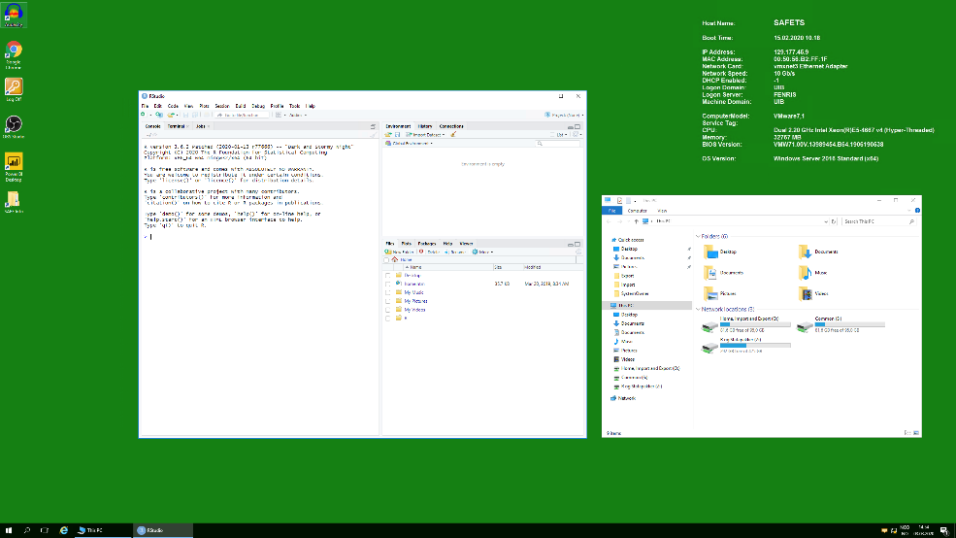
Secure desktop
Notes:
R, R Studio, Stata, SAS, Matlab, Office suite, VLC, Nvivo, etc

Slide 5
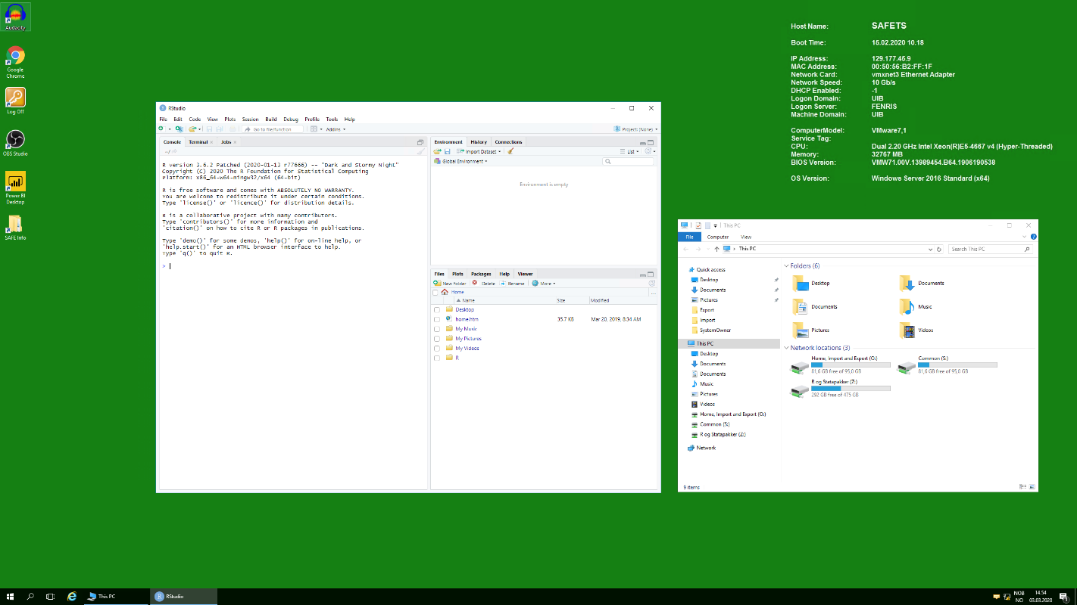
Secure desktop
Notes:
Forventningsvklaring

Slide 6
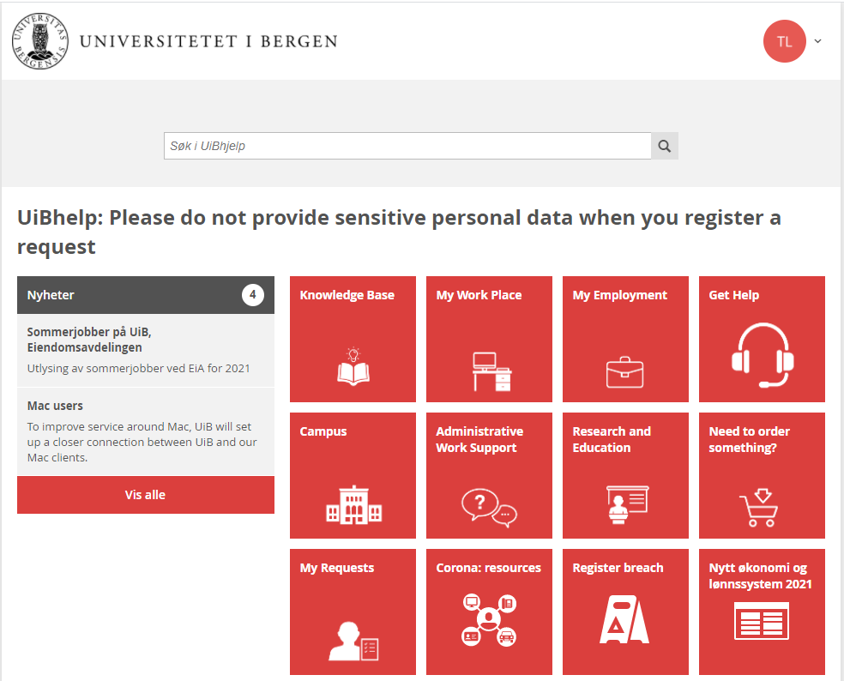
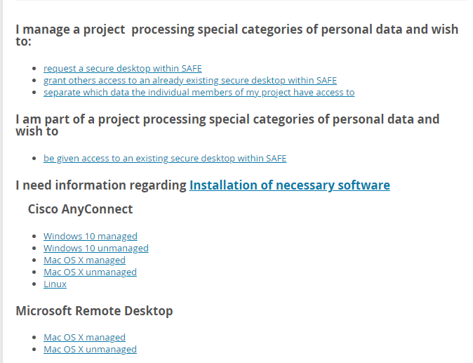
Requesting a secure desktop
https://hjelp.uib.no
Knowledge Base
IT
SAFE
To log in, use FEIDE.
Notes:
How to request a secure desktop and get information on software installation and necessary software. New ticketing system at the IT department. Go to the knowledgebase, IT, SAFE to find the relevant information/guides.

Slide 7
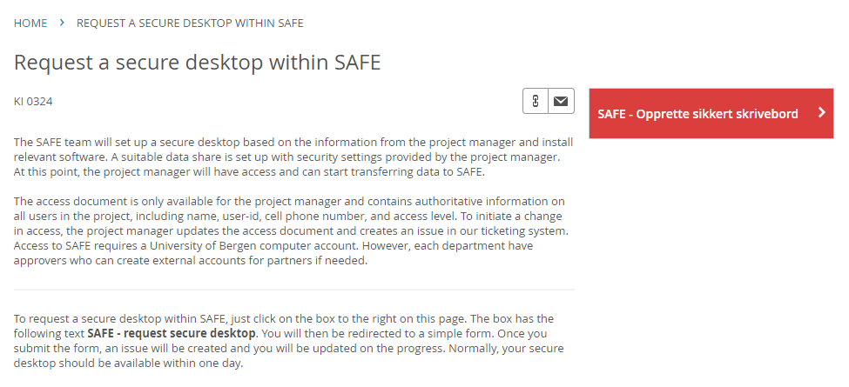
Requesting a secure desktop
Notes:
How to request a secure desktop in SAFE

Slide 8
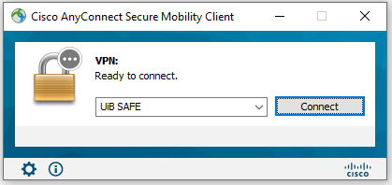
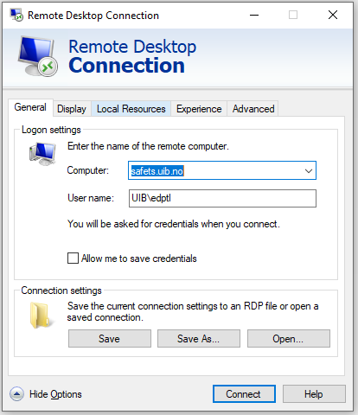
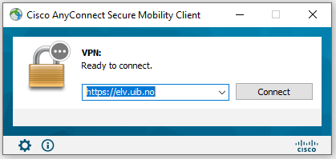
Software - Windows
Notes:
Cisco AnyConnect and Remote Desktop Connection

Slide 9
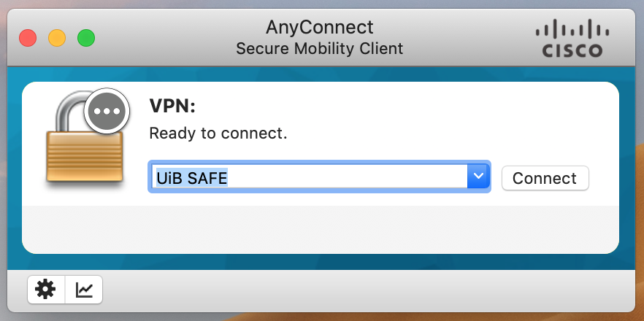
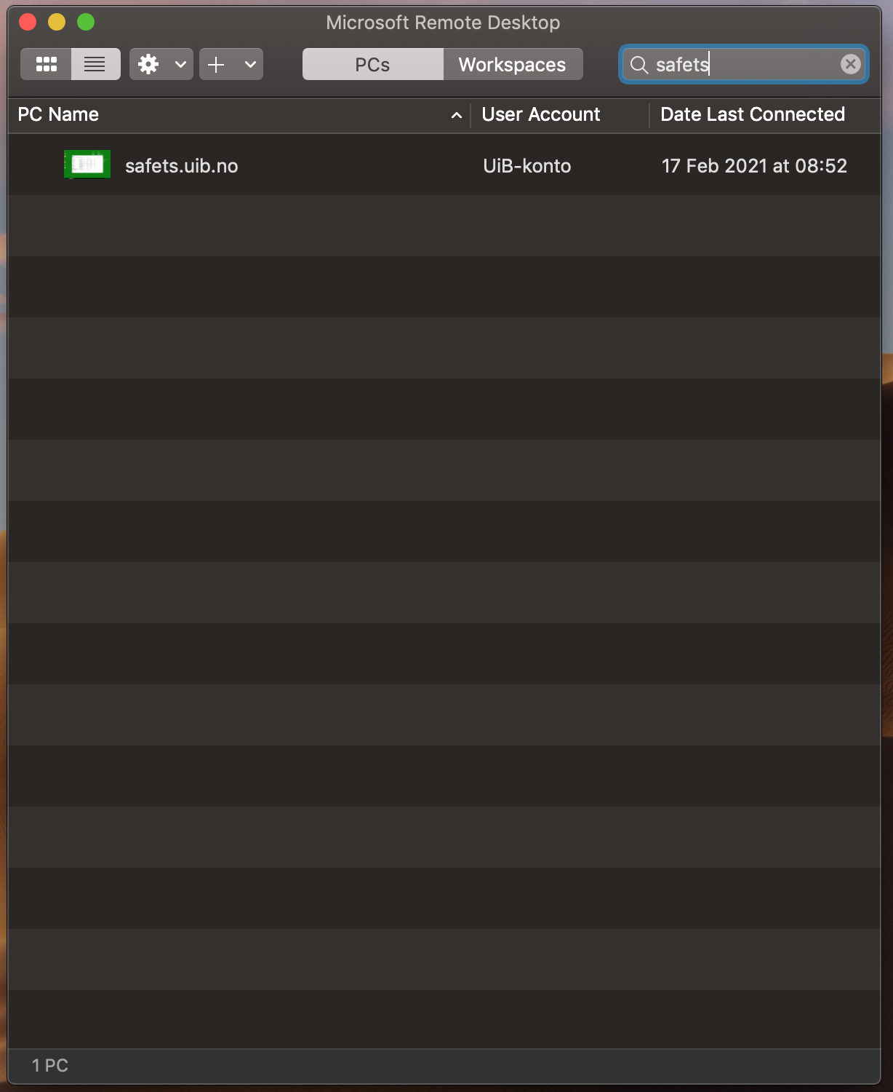
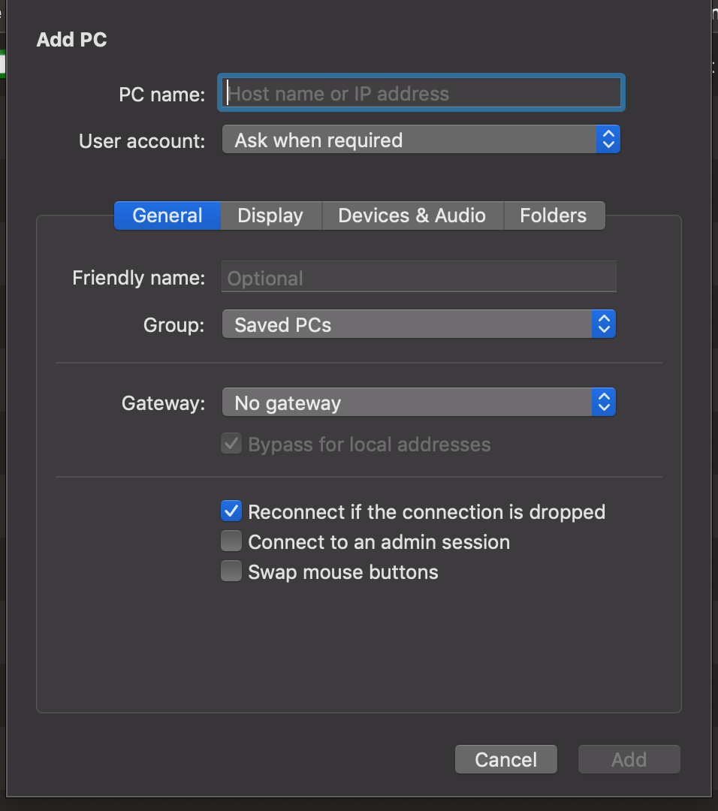
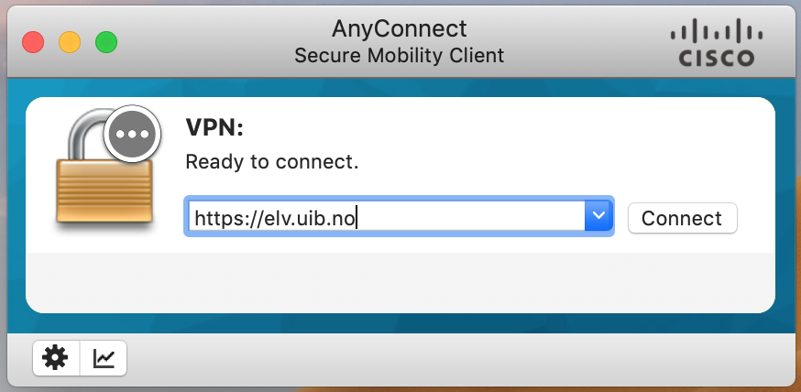
Software - Mac
Notes:
Cisco AnyConnect and Microsoft Remote Desktop

Slide 10
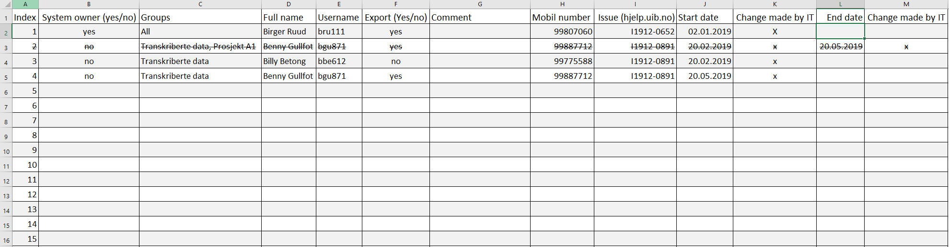
Joining an existing project/Access document
Only the project owner (or delegated) can grant access to the secure desktop. This is done be updating the access document. Also, the SAFE team need to be informed about the update in https://hjelp.uib.no/
Notes:
New version of the access document. Available under S:\SystemOwner\

Slide 11
Import
This is a generic method. If you have a UiB Windows 10 client, you can import directly to the secure desktop as U:\newyork\Import is available from there.
Notes:
Newyork.uib.no is the secure desktop. All secure desktops have names from American cities.

Slide 12
Export
Password to decrypt is kept in:
O:\Export\_password.txt
Notes:
A copy of all files exported are placed in the DataOutCopy folder only accessible to the project manager. Similar for UiB Windows 10 clients.

Slide 13
Linux server
If needed, each project can request a Linux server only available from their secure desktop.
This server is available using Putty.
Sudo-rights can be given as well.
Data is available from the secure desktop as well as from the Linux server
Red Hat Enterprise Linux 7
Notes:
Pricing. So far, a standard project in SAFE is free. A standard project is 2 vCPUs, 32 GB RAM, 1 TB of disk and up to 10 users. Typically, with a Linux server, more resources are needed as well.

Slide 14


