Slide 1

Data Storage Platforms
Korbinian Bösl
Data management coordinator
ELIXIR Norway/Digital Life Norway
Illustrative Icons from Font Awesome licensed under Creative Commons Attribution 4.0 International License

Slide 2






















sensitive
data

Slide 3


Storage @ UiB
Standard Storage kr 2,70 / GB / a
with tiering SSD -> HDD, snapshots & geo-duplication
Standard Storage w/o geo-duplication kr 1,70 / GB / a
Backup for other storage/own server kr 1,20 / GB / a
Billy - backup-ed long term tape storage kr 7.5 k / 30 TB / a
https://it.uib.no/en/File_storage_and_backup
https://it.uib.no/Prisliste_IT_tjenester
https://it.uib.no/Standard_Fillagring_Med_Tiering
contact: https://hjelp.uib.no/

Slide 4





NeLS
ola@uib.no
My Projects
Data curation
Tekle, et al. (2018) F1000Res
github.com/elixir-no-nels/nels-core
https://nels.bioinfo.no/

Slide 5
NeLS
ola@uib.no
Flexible work
on active data
My Projects
MMMM
Data curation
Tekle, et al. (2018) F1000Res
github.com/elixir-no-nels/nels-core
https://nels.bioinfo.no/

Slide 6

NeLS
S
ola@uib.no
ola@uib.no
Flexible work
on active data
My Projects
MMMM
Data curation
Tekle, et al. (2018) F1000Res
github.com/elixir-no-nels/nels-core
https://nels.bioinfo.no/

Slide 7
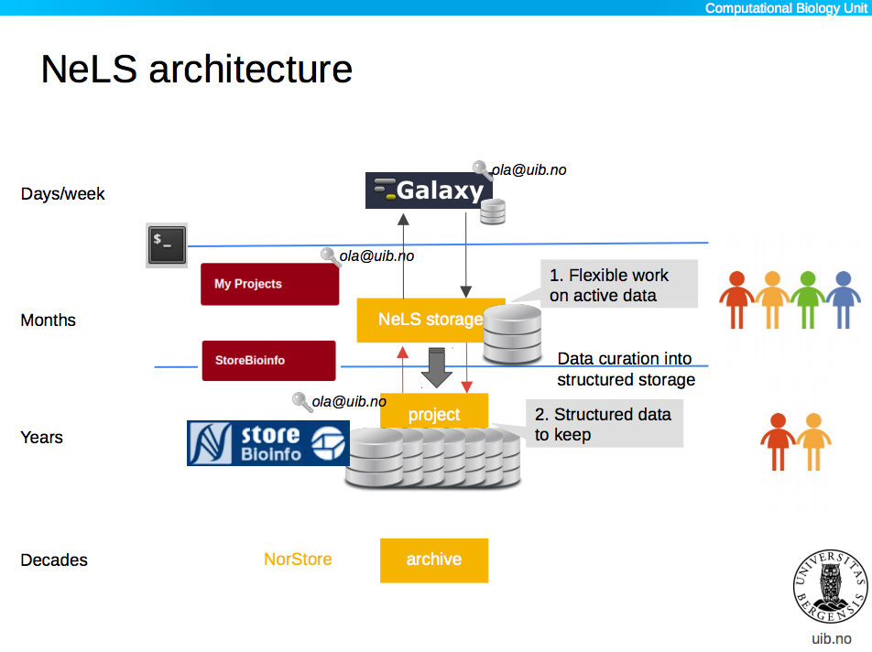





NeLS
S
ola@uib.no
ola@uib.no
Flexible work
on active data
My Projects
MMMM
Data curation
ola@uib.no
Structured data to keep
MM
MetaboLights
DOI
Tekle, et al. (2018) F1000Res
github.com/elixir-no-nels/nels-core
https://nels.bioinfo.no/
ArrayExpress

Slide 8
NeLS
S
ola@uib.no
Days - weeks
ola@uib.no
Flexible work
on active data
My Projects
MMMM
Months
Data curation
ola@uib.no
Structured data to keep
MM
Years
MetaboLights
DOI
Decades
Tekle, et al. (2018) F1000Res
github.com/elixir-no-nels/nels-core
https://nels.bioinfo.no/
ArrayExpress

Slide 9


NeLS - Accessibility
small datasets
ola@uib.no
https://nels.bioinfo.no/

Slide 10



NeLS - Accessibility
small datasets
larger datasets
ssh-key
sFTP
ola@uib.no
https://nels.bioinfo.no/

Slide 11
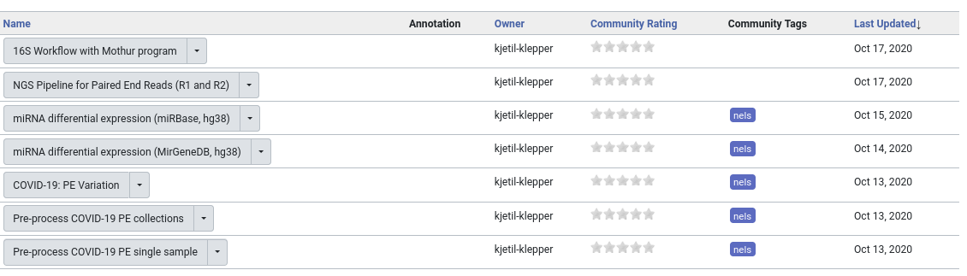
Data Analysis in NeLS
usegalaxy.no

Slide 12
NeLS - Getting Access
Typically > 1TB data
Free < 10TB & <15 mill. NOK
Allocation through Helpdesk: contact@bioinfo.no
Direct upload through Norseq facilities
https://nels.bioinfo.no/pages/user-terms.xhtml

Slide 13

SEEK
H N
https://seek4science.org/
https://fairdomhub.org/

Slide 14
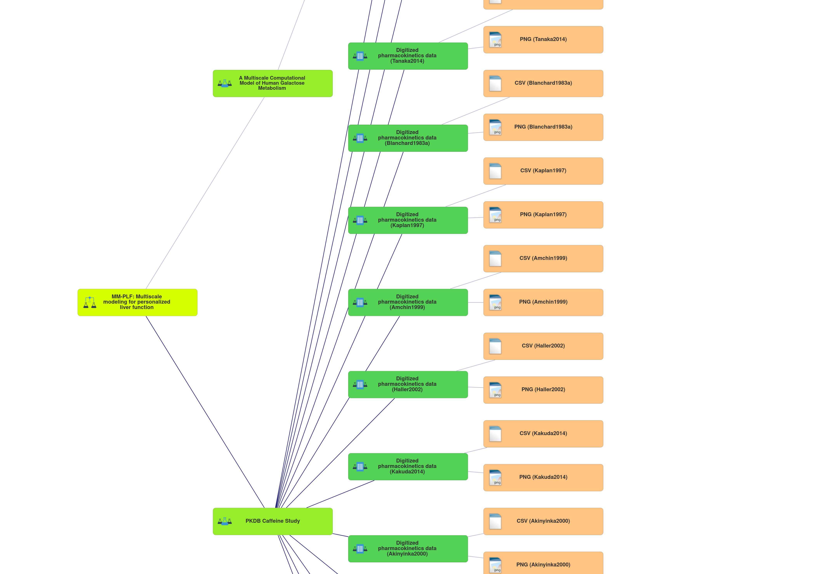
SEEK
Investigation
Study
Assay
https://seek4science.org/
https://fairdomhub.org/

Slide 15
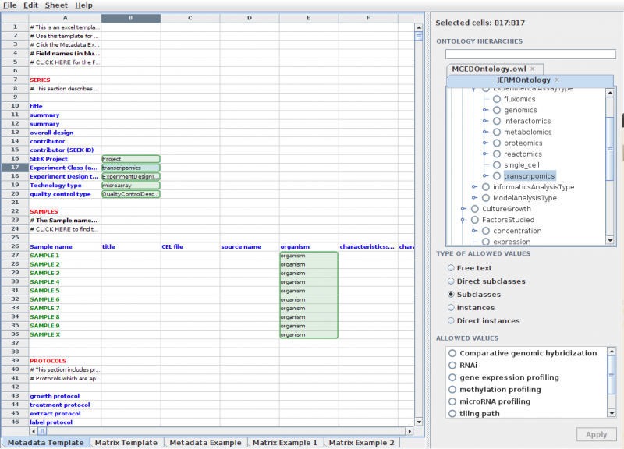

SEEK
https://seek4science.org/
https://rightfield.org.uk/

Slide 16



↔ Integration
Reference data in NeLS in SEEK
Access data in NeLS through SEEK
Save Metadata to SEEK through NeLS

Slide 17
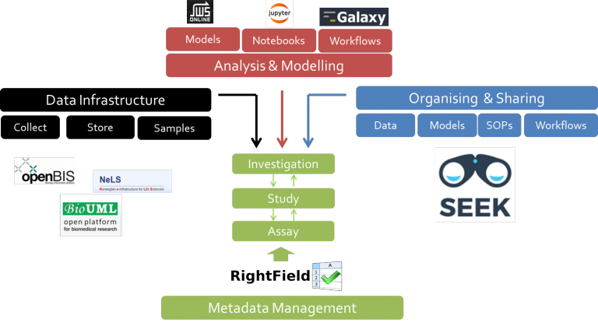

Slide 18

TSD – National sensitive data service
Maximum classification
2-factor authentication
Attached HPC resources
https://www.uio.no/english/services/it/research/sensitive-data/index.html

Slide 19

TSD – National sensitive data service
M

Slide 20


TSD – National sensitive data service
S
Google Authenticator
S
l
Password
M
S

Slide 21


TSD – National sensitive data service
S
Google Authenticator
S
l
Password
M
S

Slide 22
TSD – National sensitive data service
S
Google Authenticator
S
l
Password
M
S
DDD

Slide 23

TSD – National sensitive data service
S
Google Authenticator
Nettskjema
S
l
Password
M
S
DDD

Slide 24
TSD – National sensitive data service
S
Google Authenticator
Nettskjema
S
l
Password
M
S
Colossus
DDD

Slide 25
TSD – Getting Access
Subsidized access through Sigma2 calls
User contribution model (non UiO: min 15kNOK/a)
Free storage quotas through NeLS
https://www.uio.no/english/services/it/research/sensitive-data/access/prices/
https://nels.bioinfo.no/

Slide 26

Except where otherwise noted, this work is licensed under:
https://creativecommons.org/licenses/by/4.0/

