Slide 1

Metadata, Persistent identifiers & Ontologies
Korbinian Bösl
Data management coordinator
ELIXIR Norway/Digital Life Norway
Illustrative Icons from Font Awesome licensed under Creative Commons Attribution 4.0 International License

Slide 2






















sensitive
data

Slide 3
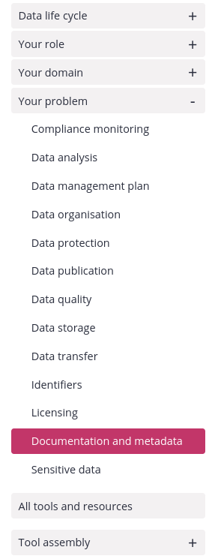


Link to RDMkit: https://rdmkit.elixir-europe.org/

Slide 4
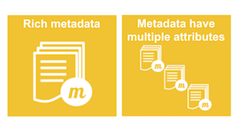
What is metadata?
FAIR illustrations icons from ARDC 2018 licensed under Creative Commons Attribution 4.0 International License

Slide 5
Experimental design
Outcome = Treatment effect + Biological effect + Technical effects + Error
Lazic, S.E. (2016). Cambridge University Press.

Slide 6
Experimental design
Outcome = Treatment effect + Biological effect + Technical effects + Error
Environment
Compound
Infection
Inhibitor
siRNA
sgRNA
Dose
Time
Lazic, S.E. (2016). Cambridge University Press.

Slide 7
Experimental design
Outcome = Treatment effect + Biological effect + Technical effects + Error
Environment
Compound
Infection
Inhibitor
siRNA
sgRNA
Dose
Time
Sex
Age
Weight
Litter
Genotype
Species
Cell line
Lazic, S.E. (2016). Cambridge University Press.

Slide 8
Experimental design
Outcome = Treatment effect + Biological effect + Technical effects + Error
Environment
Compound
Infection
Inhibitor
siRNA
sgRNA
Dose
Time
Sex
Age
Weight
Litter
Genotype
Species
Cell line
Operator
Batch
Plate
Cage
Array
Flowcell
Instrument
Day
Order
Source
Lazic, S.E. (2016). Cambridge University Press.

Slide 9
Experimental design
Outcome = Treatment effect + Biological effect + Technical effects + Error
Environment
Compound
Infection
Inhibitor
siRNA
sgRNA
Dose
Time
Sex
Age
Weight
Litter
Genotype
Species
Cell line
Operator
Batch
Plate
Cage
Array
Flowcell
Instrument
Day
Order
Source
Experimental
Treatment
Sampling
Measurement
Lazic, S.E. (2016). Cambridge University Press.

Slide 10
Experimental design
“Data”
“Metadata”
Outcome = Treatment effect + Biological effect + Technical effects + Error
Environment
Compound
Infection
Inhibitor
siRNA
sgRNA
Dose
Time
Sex
Age
Weight
Litter
Genotype
Species
Cell line
Operator
Batch
Plate
Cage
Array
Flowcell
Instrument
Day
Order
Source
Experimental
Treatment
Sampling
Measurement
Lazic, S.E. (2016). Cambridge University Press.

Slide 11
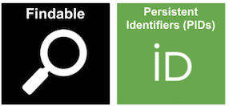
What is a PID and why do we need it?
FAIR illustrations icons from ARDC 2018 licensed under Creative Commons Attribution 4.0 International License

Slide 12

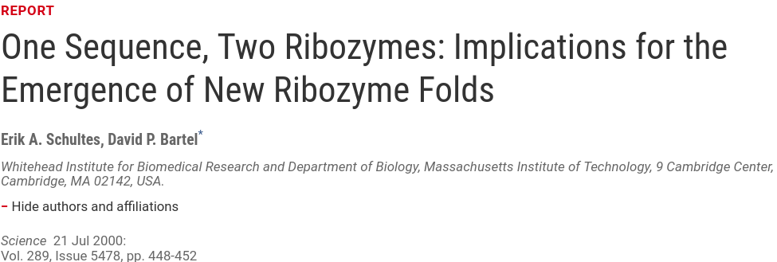
https://doi.org/10.1126/science.289.5478.448

Slide 13
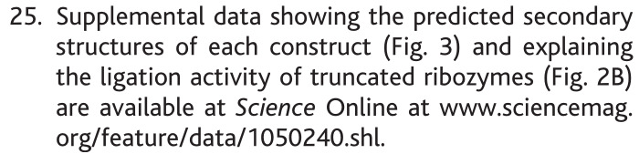

Slide 15
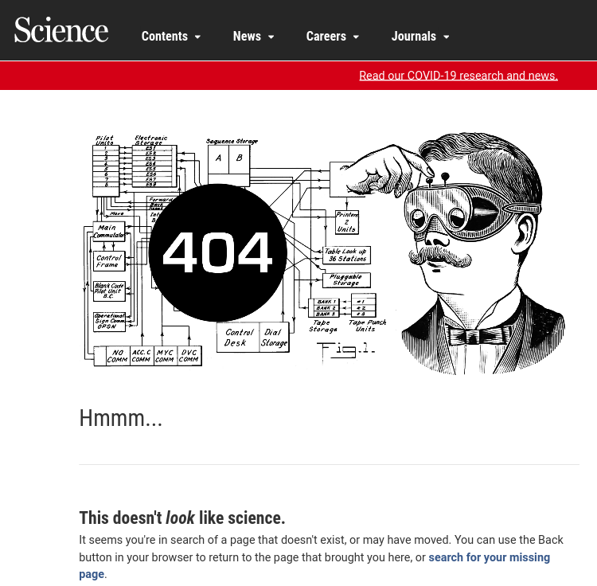

Slide 16
A PID consists of 2 components:
  a unique identifier
  a service that locates the resource over time even when it's location changes

Slide 17


Examples for digital objects
Digital Object Identifiers
Handels
Archival Resource Keys (ARK)
Persistent Uniform Resource Locator (URL)
Identifiers.org

Slide 18


PIDs exits also for
 Persons
$ Funding bodies
 Institutions
 Instruments (soon)

Slide 19
PIDs exits also for
 Persons
$ Funding bodies
 Institutions
 Instruments (soon)

Slide 20
PIDs exits also for
 Persons
$ Funding bodies
 Institutions
 Instruments (soon)

Slide 21
PIDs exits also for
 Persons
$ Funding bodies
 Institutions
 Instruments (soon)

Slide 22
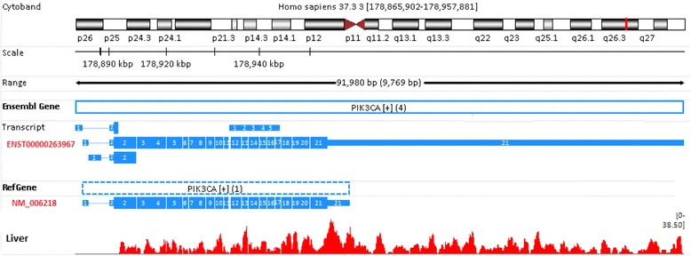
Sequence identifiers:
d Gene: PIK3CA
Figure 6 from Zhao, S., and Zhang, B. (2015). BMC Genomics 16 licensed under Creative Commons Attribution 4.0 International License

Slide 23
Sequence identifiers:
d Gene: PIK3CA
Figure 6 from Zhao, S., and Zhang, B. (2015). BMC Genomics 16 licensed under Creative Commons Attribution 4.0 International License

Slide 24
Sequence identifiers:
d Gene: PIK3CA
Figure 6 from Zhao, S., and Zhang, B. (2015). BMC Genomics 16 licensed under Creative Commons Attribution 4.0 International License

Slide 25
Sequence identifiers:
d Gene: PIK3CA
Figure 6 from Zhao, S., and Zhang, B. (2015). BMC Genomics 16 licensed under Creative Commons Attribution 4.0 International License

Slide 26
Sequence identifiers:
d Gene: PIK3CA
ENST00000263967.2
3
4
Figure 6 from Zhao, S., and Zhang, B. (2015). BMC Genomics 16 licensed under Creative Commons Attribution 4.0 International License

Slide 27
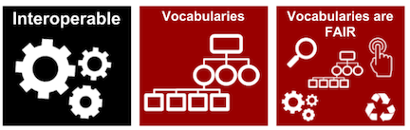
Why do we need standard vocabularies?
FAIR illustrations icons from ARDC 2018 licensed under Creative Commons Attribution 4.0 International License

Slide 28
How many way can you say “female”?

Slide 29
How many way can you say “female”?
18-day pregnant females
female (lactating)
individual female
worker caste (female)
2 yr old female
female (pregnant)
lgb*cc females
sex: female
400 yr. old female
female (outbred)
mare
female, other
adult female
female parent
female (worker)
female child
asexual female
female plant
monosex female
femal
castrate female
female with eggs
ovigerous female
3 female
cf.female
female worker
oviparous sexual females
female (phenotype)
cystocarpic female
female, 6-8 weeks old
worker bee
female mice
dikaryon
female, virgin
female enriched
female, spayed
dioecious female
female, worker
pseudohermaprhoditic female
femlale
diploid female
female(gynoecious)
remale
metafemale
f
femele
semi-engorged female
sterile female
famale
female, pooled
sexual oviparous female
normal female
femail
femalen
sterile female worker
sf
female
females
strictly female
vitellogenic replete female
female - worker
females only
tetraploid female
worker
female (alate sexual)
gynoecious
thelytoky
hexaploid female
female (calf)
healthy female
female (gynoecious)
female (f-o)
hen
probably female (based on morphology)
female (note: this sample was originally provided as a \"male\" sample to us and therefore labeled this way in the brawand et al. paper
and original geo submission; however, detailed data analyses carried out in the meantime clearly show that this sample stems from
a female individual)"
Courtesy of N. Silvester, European Nucleotide Archive, EMBL-EBI

Slide 30


Slide 31


Slide 32



Slide 33


Uberon
Onthologies
enable hierarchical searches

Slide 34

Controlled vocabulary & Ontologies

Slide 35

Controlled vocabulary & Ontologies

Slide 36

Controlled vocabulary & Ontologies

Slide 37

What is a metadata standard?
FAIR illustrations icons from ARDC 2018 licensed under Creative Commons Attribution 4.0 International License

Slide 38

but often following the same concept:
Investigation
Study(s)
Assay(s)
Technology & domain specific

Slide 39
but often following the same concept:
Investigation
Study(s)
Assay(s)
Persons
Organizations
Publications
Technology & domain specific

Slide 40
but often following the same concept:
Investigation
Study(s)
Assay(s)
Persons
Organizations
Publications
Design
Factor
Protocol
Technology & domain specific

Slide 41
but often following the same concept:
Investigation
Study(s)
Assay(s)
Persons
Organizations
Publications
Design
Factor
Protocol
Technology & domain specific
Measurement
Technology
Materials
Data

Slide 42
but often following the same concept:
Investigation
Study(s)
Assay(s)
Persons
Organizations
Publications
Design
Factor
Protocol
Controlled Vocabularies
Ontologies
Standards
Technology & domain specific
Measurement
Technology
Materials
Data

Slide 43
MINSEQE

Slide 44
MINSEQE
Administrative information:
Persons
Organizations
Publications

Slide 45
Experimental conditions/design
protocols:
treatment
sample collection
growth
nucleic acid extraction
conversion
nucleic acid library construction
nucleic acid sequencing
MINSEQE
Administrative information:
Persons
Organizations
Publications

Slide 46
Experimental conditions/design
protocols:
treatment
sample collection
growth
nucleic acid extraction
conversion
nucleic acid library construction
nucleic acid sequencing
MINSEQE
protocols:
high throughput sequence alignment
normalization data transformation
Administrative information:
Persons
Organizations
Publications
fastq
bam
csv/tsv

Slide 47
Experimental conditions/design
protocols:
treatment
sample collection
growth
nucleic acid extraction
conversion
nucleic acid library construction
nucleic acid sequencing
MINSEQE
protocols:
high throughput sequence alignment
normalization data transformation
Administrative information:
Persons
Organizations
Publications

Slide 48
Experimental conditions/design
protocols:
treatment
sample collection
growth
nucleic acid extraction
conversion
nucleic acid library construction
nucleic acid sequencing
MINSEQE
protocols:
high throughput sequence alignment
normalization data transformation
Administrative information:
Persons
Organizations
Publications
Ensembl ID
RefSeq ID
fastq
bam
csv/tsv

Slide 49

Experimental conditions/design
protocols:
treatment
sample collection
growth
nucleic acid extraction
conversion
nucleic acid library construction
nucleic acid sequencing
MINSEQE
Taxonomy
protocols:
high throughput sequence alignment
normalization data transformation
Administrative information:
Persons
Organizations
Publications
Ensembl ID
RefSeq ID
fastq
bam
csv/tsv

Slide 50
Experimental conditions/design
protocols:
treatment
sample collection
growth
nucleic acid extraction
conversion
nucleic acid library construction
nucleic acid sequencing
MINSEQE
Taxonomy
protocols:
high throughput sequence alignment
normalization data transformation
Administrative information:
Persons
Organizations
Publications
Ensembl ID
RefSeq ID
fastq
bam
csv/tsv
Interlinking with other resources

Slide 51

Experimental conditions/design
protocols:
treatment
sample collection
growth
nucleic acid extraction
conversion
nucleic acid library construction
nucleic acid sequencing
MINSEQE
Taxonomy
protocols:
high throughput sequence alignment
normalization data transformation
https://www.ebi.ac.uk/fg/annotare
Administrative information:
Persons
Organizations
Publications
Ensembl ID
RefSeq ID
fastq
bam
csv/tsv
Interlinking with other resources

Slide 53
Meta data standards
MINSEQE
MIAME
...

Slide 54
Meta data standards
MINSEQE
MIAME
...
HUPO-PSI TraML
MIAPE
...

Slide 55
Meta data standards
MINSEQE
MIAME
...
SRA-XML
HUPO-PSI TraML
MIAPE
...

Slide 56

Community standards vs. formal ISO standards
https://xkcd.com/927/
https://elixir-europe.org/events/elixir-guest-webinar-two-universes-one-world-community-standards-vs-formal-iso-standards-life

Slide 57

Which metadatastandard?
Demo
fairsharing.org

Slide 58
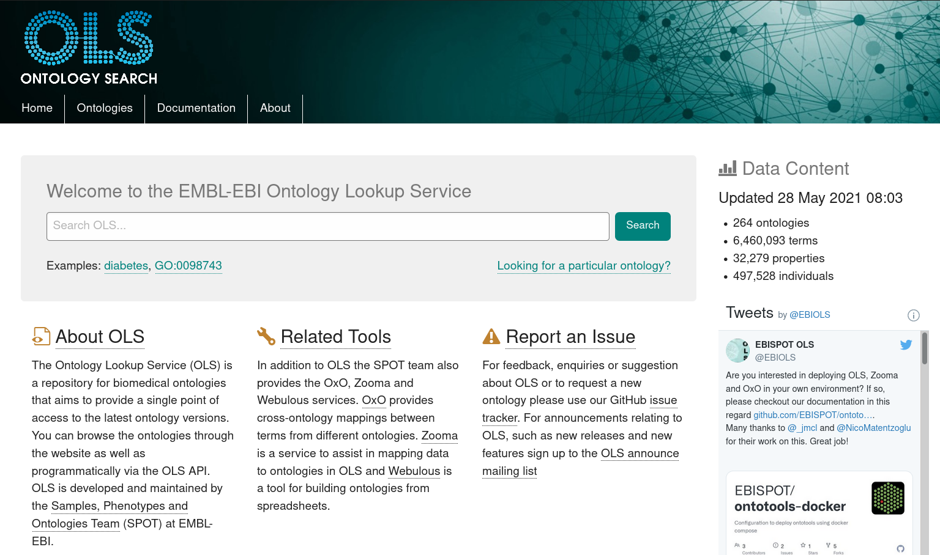
https://www.ebi.ac.uk/ols/index

Slide 59
Data format standards
Common formats
Non-proprietary formats (accessible with open source tools)
Avoiding binary data formats (data corruption)
Examples: FASTQ, TIFF, mzML,...

Slide 60
Data format standards
FASTQ
MAGE-ML
...
FASTA
FASTQ
...
mzML
mzQuantML
...

Slide 61


Metadata tracking platforms
Domain specific:
COPO for plant sciences
MOLGENIS for biobanking
...
https://copo-project.org/ https://www.molgenis.org/
https://openbis.ch/ https://seek4science.org/

Slide 62

Metadata tracking platforms
Domain specific:
COPO for plant sciences
MOLGENIS for biobanking
...
Adaptable (configuration requires domain knowledge):
Proprietary ELNs/LIMS - often poor support for ontologies
openBIS - open source ELN/LIMS
SEEK
https://copo-project.org/ https://www.molgenis.org/
https://openbis.ch/ https://seek4science.org/

Slide 63

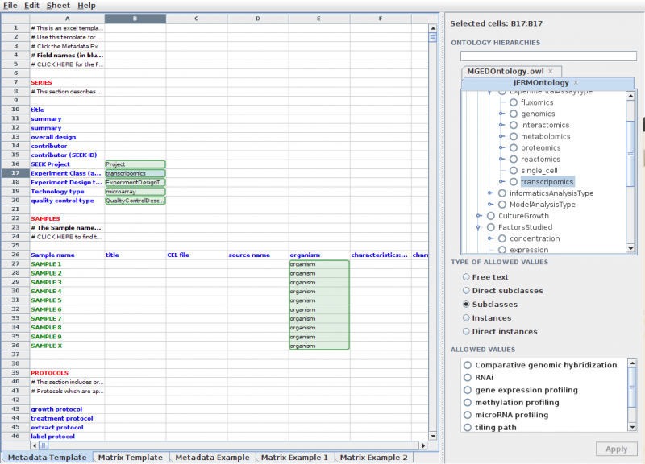
SEEK
https://seek4science.org/
https://rightfield.org.uk/
Notes:
RightField is an open-source tool for adding ontology term selection to Excel spreadsheets.
This means that for each annotation field, RightField can specify a range of allowed terms from a chosen ontology (subclasses, individuals or combinations). The resulting spreadsheet presents these terms to the users as a simple drop-down list.
Once such a template sheet is made, it can easily be re-used and edited to fit new needs in the project.

Slide 64


https://seek4science.org/
https://fairdomhub.org/
Notes:
The project were introduced to the SEEK platform through DLN.
First, to clarify some terms:
FAIRDOM is a European infrastructure project facilitating FAIR data management.
The SEEK is a database and web interface for sharing data, models and simulations management in systems biology.
fairdomhub.org is the publicly available instance of a FAIRDOM-SEEK commons

Slide 65
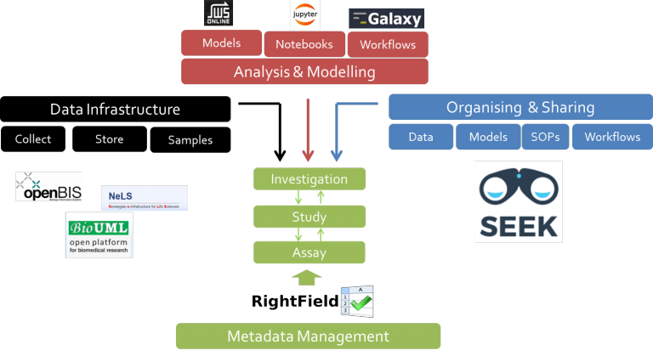
FAIRDOM integration
fair-dom.org
seek4science.org - github.com/seek4science/seek
rightfield.org.uk - github.com/myGrid/RightField
Notes:
In FAIRDOM, data infrastructure (like openBIS and NeLS) is combined with analysis and modelling (for example from jupyter or Galaxy) and organizing and sharing through SEEK. Finally, the Metadata is organized in the ISA structure, where you can implement ontology terms using RightField.

Slide 66
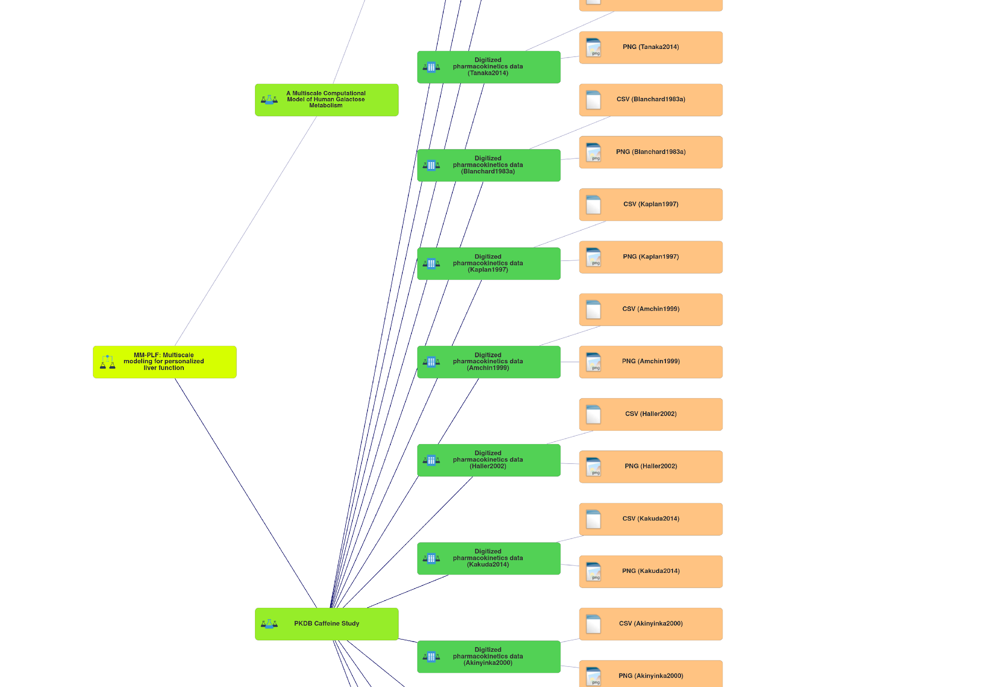
SEEK
Investigation
Study
Assay
https://seek4science.org/
https://fairdomhub.org/
Notes:
This is how it looks in SEEK

Slide 67

Except where otherwise noted, this work is licensed under:
https://creativecommons.org/licenses/by/4.0/

