Slide 1

Welcome to the Life Science DMP- workshop on Zoom
Turn your video on while speaking (optional)
Use the ‘hand up’ function for questions or just unmute yourself
Mute yourself while not speaking
... or ask questions in the chat
Please use the ‘rename’ function to indicate your department & institution

Slide 2

Data Management Plans and a short introduction to ELIXIR & Digital Life Norway
Korbinian Bösl
Data management coordinator
ELIXIR Norway/Digital Life Norway
Illustrative Icons from Font Awesome licensed under Creative Commons Attribution 4.0 International License

Slide 3
Schedule
04.04.2022
0830 - 0900 Login support
0900 - 0915 Introduction
0915 - 0930 Requirements from the RCN
0930 - 1000 Parallel session: Local recommendations & storage infrastructures Institutional DMP guidelines
1000 - 1015 Short break
1015 - 1100 Introduction DSW
1100 - 1120 Information on national storage infrastructures
1120 - 1135 Short break
1135 - 1230 Persistent identifiers, Controlled Vocabularies & Ontologies

Slide 4
Schedule
07.12.2021
0900 - 1000 Key legal requirements for research in the GDPR and Health research act
1000 - 1015 Short break
1015 - 1045 Relevant deposition repositories/ data archives
1045 - 1100 Short break
1100 - 1115 Licensing of data, biological material and software
1115 - 1300 Hands on training and assistance to generate a data management plan

Slide 5





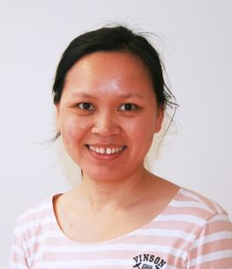
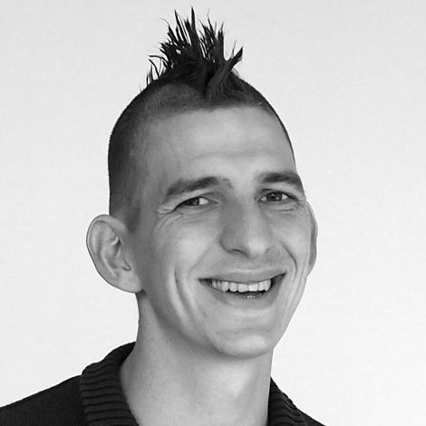





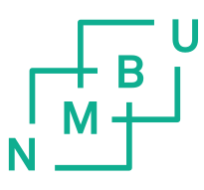


Erik
Hjerde
Espen Åberg
Eivind Coward
Nazeefa
Fatima
Federico Bianchini
Thu-Hien
To
Korbinian Bösl
Marta
Eide

Slide 6
ELIXIR Europe
‘Data for Life’
Mission:
To operate a sustainable European infrastructure for biological information, supporting life-science research and its translation to society, the bio-industries, environment and medicine

Slide 7

ELIXIR Europe
Data stored in
ELIXIR/EBI-EMBL
Repositories
Cook, C. E. et al. The European Bioinformatics Institute in 2018: tools, infrastructure and training. Nucleic Acids Res 47, D15–D22 (2019).
licensed under Creative Commons Attribution 4.0 International License

Slide 8

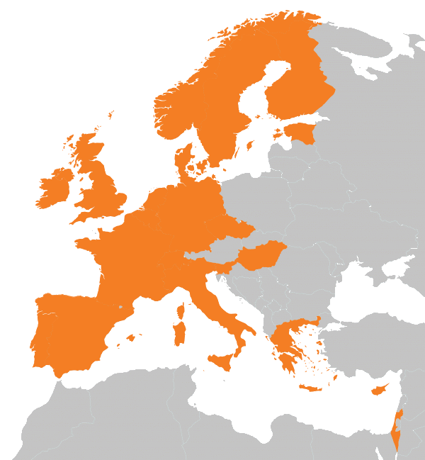
https://elixir-europe.org/about-us/who-we-are

Slide 9

A distributed infrastructure to scale with the challenge
ELIXIR data infrastructure for Europe’s life science research sector
ELIXIR Nodes build local bioinformatics capacity throughout Europe
ELIXIR Nodes build on national strengths and priorities

Slide 10
ELIXIR Services

Slide 11

ELIXIR Services
Data deposition:
ENA, EGA, PDBe, EuropePMC, …

Slide 12
ELIXIR Services
Data deposition:
ENA, EGA, PDBe, EuropePMC, …
q
Data management:
Genome annotation, RDMkit,
Data management plans

Slide 13
ELIXIR Services
Data deposition:
ENA, EGA, PDBe, EuropePMC, …
q
Data management:
Genome annotation, RDMkit,
Data management plans
D
Added value data:
UniProt, Ensembl, OrphaNet, …

Slide 14

ELIXIR Services
Data deposition:
ENA, EGA, PDBe, EuropePMC, …
q
Data management:
Genome annotation, RDMkit,
Data management plans
D
Added value data:
UniProt, Ensembl, OrphaNet, …
Data Interoperability:
FAIRSharing, identifiers.org, OLS,
Bioschemas, …

Slide 15

ELIXIR Services
Data deposition:
ENA, EGA, PDBe, EuropePMC, …
Compute:
Secure data transfer, cloud computing, AAI
q
Data management:
Genome annotation, RDMkit,
Data management plans
D
Added value data:
UniProt, Ensembl, OrphaNet, …
Data Interoperability:
FAIRSharing, identifiers.org, OLS,
Bioschemas, …

Slide 16

ELIXIR Services
Data deposition:
ENA, EGA, PDBe, EuropePMC, …
Compute:
Secure data transfer, cloud computing, AAI
q
Data management:
Genome annotation, RDMkit,
Data management plans
Bioinformatics tools:
Bio.tools, Benchmarking: OpenEBench
D
Added value data:
UniProt, Ensembl, OrphaNet, …
Data Interoperability:
FAIRSharing, identifiers.org, OLS,
Bioschemas, …

Slide 17
ELIXIR Services
Data deposition:
ENA, EGA, PDBe, EuropePMC, …
Compute:
Secure data transfer, cloud computing, AAI
q
Data management:
Genome annotation, RDMkit,
Data management plans
Bioinformatics tools:
Bio.tools, Benchmarking: OpenEBench
I
Industry:
Innovation and SME programme
Bespoke collaborations
D
Added value data:
UniProt, Ensembl, OrphaNet, …
Data Interoperability:
FAIRSharing, identifiers.org, OLS,
Bioschemas, …

Slide 18

ELIXIR Services
Data deposition:
ENA, EGA, PDBe, EuropePMC, …
Compute:
Secure data transfer, cloud computing, AAI
q
Data management:
Genome annotation, RDMkit,
Data management plans
Bioinformatics tools:
Bio.tools, Benchmarking: OpenEBench
I
Industry:
Innovation and SME programme
Bespoke collaborations
D
Added value data:
UniProt, Ensembl, OrphaNet, …
Training:
TeSS, Data Carpentry, eLearning
Data Interoperability:
FAIRSharing, identifiers.org, OLS,
Bioschemas, …

Slide 19

ELIXIR Structure
Five technical Platforms for Compute, Data, Tools, Interoperability, and Training

Slide 20
ELIXIR Structure
Five technical Platforms for Compute, Data, Tools, Interoperability, and Training
Complemented by Communities for specific use cases within e.g. Human data, Metabolomics, Proteomics, Marine Metagenomics, Microbial Biotechnology, Structural Bioinformatics and others

Slide 21


ELIXIR Structure
The Norwegian node of ELIXIR Europe
Currently funded by:
  The Research Council of Norway (until 2026)
  The involved institutions; UiB, UiO, NMBU, NTNU and UiT
  Users
Services to national users
  Infrastructure, support and training
Deliverables to ELIXIR Europe
  Tools and databases

Slide 22
Our additional user services - Norway
Support – through our HelpDesk 1 day of service free of charge (enabled by RCN)
Training – in using our tools and workflows, and in data management
Bioinformatics infrastructure
Analysis, sharing and managing of data
contact@bioinfo.no

Slide 23






Centre for Digital Life Norway (DLN 2.0) facilitates transdisciplinary research, innovation, and education in Life Science
Transdisciplinary collaborations
www.digitallifenorway.org
Education and career development
Responsible research and innovation
Innovation and commercialisation
Data management
Notes:
Korbinian and I are collegues in the Centre for Digital Life
DLN is an national initiative that includes the major instituations across the country. The centre aims to transform Norwegian biotechnology research and education. We offer guidance and support in the following focus areas:

Slide 24

35 transdisciplinary biotechnology projects all over the country.
Biotechnology with digital technology: health, aquaculture, agriculture & industrial biotechnology.
Notes:
Currently, 35 projects are connected to the centre.
They all vary greatly in their research are and approaches, but share a digital biotechnology approach.

Slide 25
Join us!
Open call for Digital Life Norway project membership
contact@digitallifenorway.org
... and join the DLN Research School at any time
https://www.digitallifenorway.org/news/open-call-project-membership.html
https://www.digitallifenorway.org/research-school/membership/index.html
Notes:
Currently, 35 projects are connected to the centre.
They all vary greatly in their research are and approaches, but share a digital biotechnology approach.

Slide 26
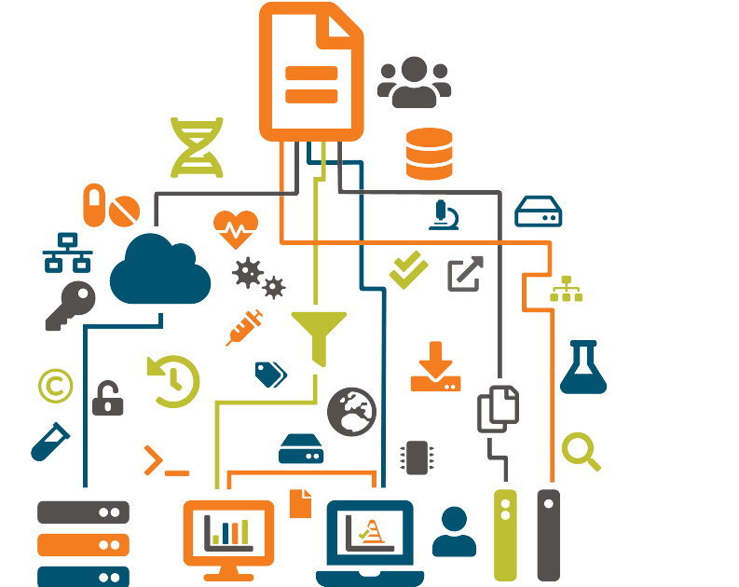
Data Management
Make research data and related metadata discoverable, accessible and understandable ...
... today, tomorrow, and well into the
future.
... across geographical distances.
... enabling efficient collaboration;
  even across disciplines.

Slide 27
Data Management
Make research data and related metadata discoverable, accessible and understandable ...
... today, tomorrow, and well into the
future.
... across geographical distances.
... enabling efficient collaboration;
  even across disciplines.

Slide 28
Data Management
Make research data and related metadata discoverable, accessible and understandable ...
... today, tomorrow, and well into the
future.
... across geographical distances.
... enabling efficient collaboration;
  even across disciplines.

Slide 29
Data Management
Make research data and related metadata discoverable, accessible and understandable ...
... today, tomorrow, and well into the
future.
... across geographical distances.
... enabling efficient collaboration;
  even across disciplines.

Slide 30








Slide 31
R

Slide 32
Data catalogues & registries
Data creation &
deposit
R
Discover,
Reuse & cite
Plan &
Design
Share &
Publish
Collect &
Capture
Manage, store &
preserve
Process &
Analyse
Archives &
Data repositories
Managing active
data

Slide 33



Slide 35


Slide 36


Slide 37


Slide 38


Slide 39

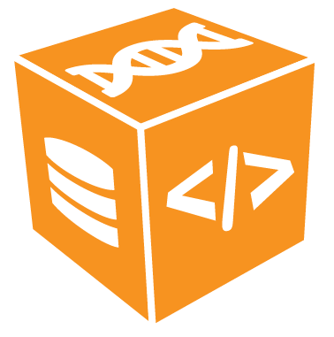

Slide 40








Slide 41


sensitive
data

Slide 43
Data Management Plan?
sensitive
data

Slide 44


/
/
/
/
/

Slide 45

]
/
/
/
/
/
/
sensitive
data

Slide 46



rdmkit.elixir-europe.org

Slide 47

rdmkit.elixir-europe.org

Slide 48

rdmkit.elixir-europe.org

Slide 49
inbuilt curated resources:
rdmkit.elixir-europe.org

Slide 50

inbuilt curated resources:
Repositories &
Metadata standards
rdmkit.elixir-europe.org

Slide 51

inbuilt curated resources:
Repositories &
Metadata standards
Software
rdmkit.elixir-europe.org

Slide 52

inbuilt curated resources:
Repositories &
Metadata standards
Software
Training
rdmkit.elixir-europe.org

Slide 53
Continuously growing ...
rdmkit.elixir-europe.org

Slide 54













elixir.no contact@bioinfo.no @elixirnorway
digitallifenorway.org contact@digitallifenorway.org @DigitaltLiv
korbinian.bosl@uib.no @BoslKorbinian
The Data Stewardship Wizard is provided by:

Slide 55

Except where otherwise noted, this work is licensed under:
https://creativecommons.org/licenses/by/4.0/

