Slide 1
Schedule - Day 2: Thursday, 6 June 2024
Time | Activity
09:00-10:00 | Key legal requirements, for life sciences research, in GDPR and Health research Act (and a lot more!)
10:00-10:15 | Break
10:15-10:45 | Relevant Deposition Repositories / Data Archives
11:00-11:15 | Licensing of data, biological material and software
11:15-11:30 | Hands-on training and assistance to generate a Data Management Plan (DMP)

Slide 2
Legal Requirements for Data Management
Nazeefa Fatima
Data Steward | Computational Biologist
ELIXIR Norway (University of Oslo)
nazeefaf@uio.no
6 June 2024

Slide 3
Disclaimer
This is not a legal advice

Slide 4


Important Relevant Legislations
Research Ethics Act
Health Research Act
Health Registry Act
Biotechnology Act
Archive Act
Patents Act
Copyrights Act
Health Register Act: https://lovdata.no/dokument/NL/lov/2014-06-20-43
Biotechnology Act: https://lovdata.no/dokument/NL/lov/2003-12-05-100
Archives Act: https://lovdata.no/dokument/NL/lov/1992-12-04-126
Patents Act: https://lovdata.no/dokument/LTI/lov/2019-06-21-49
Copyright Act: https://lovdata.no/dokument/NL/lov/2018-06-15-40

Slide 5

Important Relevant Legislations
Personal Data Act
Regulations on the processing of personal data
General Data Protection Regulation (GDPR)
The GDPR is an EU Regulation that applies
directly to Norway, as a member of the EEA.

Slide 6

Research Ethics Act
Withhold-, mislead about-, or selectively/secretly dispose of undesired results.
Conceal of scientific efforts and / or scientific achievements. Improper allocation of authorship etc.
Destruction of research data / material to prevent investigations of misconduct.
Research Ethics Act: https://lovdata.no/dokument/NL/lov/2017-04-28-23

Slide 7

Guidelines for the use of genetic studies of humans
General guidelines on research ethics
Guidelines for Research Ethics in Science and Technology
Guidelines for the inclusion of women
Guidelines for clinical trial of drugs
Guidelines for research ethics and scientific assessment of qualitative research projects
Read more at: forskningsetikk.no

Slide 8
The Vancouver Recommendations
Declaration of Helsinki
Oveido Convention
Otherwise known as: The Convention for the Protection of Human Rights and Dignity of the Human Being with regard to the Application of Biology and Medicine
Read more at: forskningsetikk.no

Slide 9


Health Research Act
Prior approval for health research
Consent from participants
Data access rights for participants
Biobank Regulations
Maximum data storage time for non-archived data
(Default: 5 years after end of project – exemptions: approval)
Regional Committees for Medical and Health Research Ethics (REK)
Health Research Act: https://lovdata.no/dokument/LTI/lov/2008-06-20-44

Slide 10




GDPR: General Data Protection Regulation
Protection of Personal Data
Privacy by Design
Data Protection Impact Assessment (DPIA)
Processing of Personal Data
Technical and organisational measure to secure data
Records of Processing Activities
Access rights, Right to be forgotten, Right on Information
Fines: 10-20 million, up to 4 % of total turnover of the preceding fiscal year
GDPR: https://eur-lex.europa.eu/legal-content/EN/TXT/PDF/?uri=OJ:L:2016:119:FULL
News on Datatilsynet: https://www.datatilsynet.no/en/news/

Slide 11

Personal Data Act & Personal Data Regulations
National Implementation of GDPR
Consent from participants (13 years and older)
Exceptions for archival, public interest, and scientific reasons
Authorities: Privacy Ombudsman, Privacy Committees,
Data Inspectorates (datatilsynet)
More information at:
Regulations on the processing of personal data: https://lovdata.no/dokument/SF/forskrift/2018-06-15-876
Transitional rules on the processing of personal data: https://lovdata.no/dokument/SF/forskrift/2018-06-15-877
Personal Data Act: https://lovdata.no/dokument/NL/lov/2018-06-15-38

Slide 12
Let’s find out: What is…?
Personal Data
Sensitive Personal Data
Genetics Data
Pseudonymisation
Anonymisation

Slide 13

What defines personal data?
Any information that relates to an identified or identifiable living individual
What if data can be de-identified, encrypted, or pseudonymised?
^Still, it is considered personal data!
Truly anonymised → anonymisation must be irreversible.
Further reading: https://ec.europa.eu/info/law/law-topic/data-protection/reform/what-personal-data_en

Slide 14

What is personal data? Examples:
Further reading: https://ec.europa.eu/info/law/law-topic/data-protection/reform/what-personal-data_en

Slide 15
What personal data is
considered sensitive?
Personal data revealing racial or ethnic origin, political opinions,
religious, or philosophical beliefs
Trade-union membership
Genetic data, biometric data processed solely to identify a human being
Health related data
Further reading - what personal data is considered sensitive?: https://ec.europa.eu/info/law/law-topic/data-protection/reform/rules-business-and-organisations/legal-grounds-processing-data/sensitive-data/what-personal-data-considered-sensitive_en

Slide 16
What defines genetic data?
Genetic data is defined as: “personal data relating to the inherited or acquired genetic characteristics of a natural person which give unique information about the physiology or the health of that natural person.” - GDPR article 4(13)
Always both: Personal identifier and sensitive information!
Further reading - what personal data is considered sensitive?: https://ec.europa.eu/info/law/law-topic/data-protection/reform/rules-business-and-organisations/legal-grounds-processing-data/sensitive-data/what-personal-data-considered-sensitive_en

Slide 17
Data Psuedonymisation
“The processing of personal data in such a manner that the personal data
can no longer be attributed to a specific data subject without the use of
additional information, provided that such additional information is kept
separately and is subject to technical and organisational measures to
ensure that the personal data are not attributed to an identified or
identifiable natural person” - GDPR article 4(13)
De-identified and not back traceable for the researcher without the identifier
Pseudonymised data is still personal data!

Slide 18
Anonymous Data
Anonymous data cannot in any way be used to identify individuals in a data material, either:
  directly by name or personal identification number or
  indirectly by additional information
Not possible for many data types, such as genetic data

Slide 19
What is…?
What does GDPR say about…?
Data subjects, processing, controller, and processors
Personal Data
Sensitive Personal Data
Storage and processing of personal (sensitive) data: How & When?
Genetics Data
Fairness and Transparency
Data Minimisation
Data Accuracy
Storage Limitation
Integrity and Confidentiality
Accountability
Pseudonymisation
Anonymisation

Slide 20
What does GDPR say about:
Data subjects, processing, controller, and processors
Data subject:
“the natural person information relates to.”- GDPR article 4(1)
Data Processing:
“any operation or set of operations which is performed on personal data or on sets of personal data.” - GDPR article 4(2)
Data Controller: determines the purposes and means of the processing of personal data
Data Processor: processes personal data on behalf of the controller
Further reading: https://eur-lex.europa.eu/legal-content/EN/TXT/HTML/?uri=CELEX:32016R0679&from=EN#d1e1489-1-1

Slide 21
Conditions to store/process personal (sensitive) data
Lawful and transparent manner (‘lawfulness, fairness and transparency’)
Specific purposes (‘purpose limitation’)
Only the personal data that is necessary to fulfil that purpose (‘data minimisation’)
Stored for no longer than necessary (‘storage limitation’)
Data Accuracy
Technical and organisational safeguards that ensure the security of the personal data, including protection against unauthorised or unlawful processing and against accidental loss, destruction or damage, using appropriate technology (‘integrity and confidentiality’)
Accountability → Immediate reporting of incidents
Further reading: https://eur-lex.europa.eu/legal-content/EN/TXT/HTML/?uri=CELEX:32016R0679&from=EN#d1e1807-1-1

Slide 22
Criteria to store/process personal (sensitive) data
Explicit consent from participant
Health Research Act
The data is processed for archiving, scientific or historical research purposes or statistical purposes on the basis of EU or national law.
“Tasks carried out in the public interest” - Article 6, GDPR
“It is not always possible to fully identify the purpose of personal data processing for scientific research purposes at the time of data collection” - GDPR, Recital 33
Further readings:
https://ec.europa.eu/info/law/law-topic/data-protection/reform/rules-business-and-organisations/legal-grounds-processing-data/sensitive-data/under-what-conditions-can-my-company-organisation-process-sensitive-data_en
https://lovdata.no/dokument/NL/lov/2008-06-20-44/KAPITTEL_4#KAPITTEL_4

Slide 23
Criteria to store/process personal (sensitive) data
Explicit consent from participant
Health Research Act
If you are using consent as your legal basis:
Make sure your consent form (& REK* approval)
allows controlled access deposition (e.g. to EGA**)
...before you start!
* REK: Regional Committees for Medical and Health Research Ethics
** EGA: European Genome Archive
Further readings:
https://ec.europa.eu/info/law/law-topic/data-protection/reform/rules-business-and-organisations/legal-grounds-processing-data/sensitive-data/under-what-conditions-can-my-company-organisation-process-sensitive-data_en
https://lovdata.no/dokument/NL/lov/2008-06-20-44/KAPITTEL_4#KAPITTEL_4

Slide 24
What is…?
What does GDPR say about…?
Data subjects, processing, controller, and processors
Personal Data
Sensitive Personal Data
Storage and processing of personal (sensitive) data: How & When?
Genetics Data
Fairness and Transparency
Data Minimisation
Data Accuracy
Storage Limitation
Integrity and Confidentiality
Accountability
Pseudonymisation
Anonymisation

Slide 25
Fairness and Transparency
Fairness: Not taking advantage of your position as a research institution, and not taking advantage of your position in relation to the data subjects
Transparency: Your data subjects shall be informed of what you do with their personal data, and and of how to exercise their/his/her rights
Provision of the required information in a clear and plain language
Further readings:
https://ec.europa.eu/info/law/law-topic/data-protection/reform/rules-business-and-organisations/legal-grounds-processing-data/sensitive-data/under-what-conditions-can-my-company-organisation-process-sensitive-data_en
https://eur-lex.europa.eu/legal-content/EN/TXT/HTML/?uri=CELEX:32016R0679&from=EN#d1e1888-1-1
https://lovdata.no/dokument/NL/lov/2008-06-20-44/KAPITTEL_8#KAPITTEL_8

Slide 26
Data Minimisation
The amount of personal data shall be limited to that necessary to achieve the purpose of data processing
Obligation to avoid collecting, storing or in any other way processing personal data that is not strictly necessary, even if it may be “nice to have”
Further readings:
https://ec.europa.eu/info/law/law-topic/data-protection/reform/rules-business-and-organisations/legal-grounds-processing-data/sensitive-data/under-what-conditions-can-my-company-organisation-process-sensitive-data_en
https://eur-lex.europa.eu/legal-content/EN/TXT/HTML/?uri=CELEX:32016R0679&from=EN#d1e1888-1-1

Slide 27
Data Accuracy
Important not only in consideration of the data subjects
but also for your research
Obligation to rectify or delete inaccurate personal data
Your data subject can ask for deletion of the data at any time
Further readings:
https://ec.europa.eu/info/law/law-topic/data-protection/reform/rules-business-and-organisations/legal-grounds-processing-data/sensitive-data/under-what-conditions-can-my-company-organisation-process-sensitive-data_en
https://eur-lex.europa.eu/legal-content/EN/TXT/HTML/?uri=CELEX:32016R0679&from=EN#d1e1888-1-1

Slide 28
Storage Limitation
Personal data shall not be stored for longer than necessary to fulfil the purpose
Once the purpose has been achieved, the data shall in principle be deleted or made anonymous
REK usually sets requirements for storage beyond the project period for reasons of verifiability - you may need to include this in your application!
Processing personal data for the purpose of verifiability is legitimate
Personal data may be stored for longer periods so far as the personal data is processed solely for scientific, historical, and/or statistical research purposes
Further readings:
https://ec.europa.eu/info/law/law-topic/data-protection/reform/rules-business-and-organisations/legal-grounds-processing-data/sensitive-data/under-what-conditions-can-my-company-organisation-process-sensitive-data_en
https://eur-lex.europa.eu/legal-content/EN/TXT/HTML/?uri=CELEX:32016R0679&from=EN#d1e1888-1-1

Slide 29

Integrity and Confidentiality
Personal data must be processed in a manner that ensures:
  appropriate security of the personal data,
  protect personal data against unauthorised access,
  unlawful processing,
  accidental loss, distribution, amendment, or damage
Follow institutional guidelines
Pseudonymisation
  Dedicated data analysis platforms
Image Source: https://uio.no/english/for-employees/support/research/funding/units/hf/imv/data-ethics/colors.html
More about TSD: https://www.uio.no/english/services/it/research/sensitive-data/

Slide 30
Accountability
Data controller shall be responsible for, and be able to demonstrate compliance with the principles
Obligation to document the processing of personal (sensitive) data
Follow institutional guidelines
System for Risk and compliance. Processing of personal data in research and student projects at UiB: https://rette.app.uib.no

Slide 31
What is…?
What does GDPR say about…?
Personal Data
Data subjects, processing, controller, and processors
Sensitive Personal Data
Storage and processing of personal (sensitive) data: How & When?
Genetics Data
Fairness and Transparency
Data Minimisation
Data Accuracy
Storage Limitation
Integrity and Confidentiality
Accountability
Pseudonymisation
Anonymisation

Slide 32


Let’s learn about (the importance of):
Data Protection Impact Assessment (DPIA)
Derogations for scientific purposes
International Data Transfers
Data Privacy Assessments
Approval/Reporting

Slide 33
Data Protection Impact Assessment (DPIA)
“Where a type of processing ... is likely to result in a high risk to the rights and freedoms of natural persons”
Based on new technologies, the nature, scope, context and purposes of the processing
Your research work is based on:
  “Processing of genetic data in conjunction with at least one other criterion” and
  “Processing of personal data using innovative technology in conjunction with at least one other criterion”
Identify risks and take measures to reduce the risk; DPIA helps ensure privacy of your data subject(s)
Tool Resource: https://www.cnil.fr/en/open-source-pia-software-helps-carry-out-data-protection-impact-assesment
Further reading: https://gdpr-info.eu/art-35-gdpr/

Slide 34
Derogations for scientific purposes
Further processing and storage limitation - Articles 5(1)(b) and (e), GDPR
Processing of special categories of data - Article 9(2)(j), GDPR
Information provided by third parties - Article 14(5)(b), GDPR)
Right to erasure - Article 17(3)(d), GDPR
Right to object - Article 21(6) GDPR
In addition, there are following derogations in the Norwegian Data protection act:
Right to access
Right to rectification
Right to restrict processing
Further reading: Chapter 5, The EU’s General Data Protection Regulation (GDPR) in a Research Context - Mondschein, C. F. & Monda, C. Springer 2019 https://www.ncbi.nlm.nih.gov/books/NBK543521/

Slide 35
International Data Transfers
EC has recognized:
Andorra, Argentina,
Canada, Faroe Islands,
Guernsey, Israel, Isle of
Man, Japan, Jersey,
New Zealand, Switzerland, Uruguay, and the UK
Key relevance in scientific research
Countries outside the EU/EEA (“Third countries”)
Transfer mechanism pursuant to GDPR chapter 5
Adequacy Decision
Most common: Standard Contractual Clauses (SCCs) adopted by
the European Commission (EC)
Additional safeguards - e.g. Pseudonymization
Further reading:
eur-lex.europa.eu/legal-content/EN/TXT/HTML/?uri=CELEX:32016R0679&from=EN#d1e4319-1-1
ec.europa.eu/info/law/law-topic/data-protection/reform/rules-business-and-organisations/obligations/what-rules-apply-if-my-organisation-transfers-data-outside-eu_en
https://gov.uk/government/news/eu-adopts-adequacy-decisions-allowing-data-to-continue-flowing-freely-to-the-uk

Slide 36
International Data Transfers
EC has recognized:
Andorra, Argentina,
Canada, Faroe Islands,
Guernsey, Israel, Isle of
Man, Japan, Jersey,
New Zealand, Switzerland, Uruguay, and the UK
Key relevance in scientific research
Countries outside the EU/EEA (“Third countries”)
Transfer mechanism pursuant to GDPR chapter 5
Adequacy Decision
Most common: Standard Contractual Clauses (SCCs) adopted by
the European Commission (EC)
Additional safeguards - e.g. Pseudonymization
Exchange of personal data & biological material (for research) in any direction requires special and careful additional consideration!
Further reading:
eur-lex.europa.eu/legal-content/EN/TXT/HTML/?uri=CELEX:32016R0679&from=EN#d1e4319-1-1
ec.europa.eu/info/law/law-topic/data-protection/reform/rules-business-and-organisations/obligations/what-rules-apply-if-my-organisation-transfers-data-outside-eu_en
gov.uk/government/news/eu-adopts-adequacy-decisions-allowing-data-to-continue-flowing-freely-to-the-uk

Slide 37

Data Privacy Assessments
Sikt carries out privacy assessments on behalf of Norwegian universities.
Processing personal data in project → Apply to Sikt
Minimum 30 days before data collection starts
https://sikt.no/en/data-protection-services

Slide 38
Data Privacy Assessments
Sikt carries out privacy assessments on behalf of Norwegian universities.
Processing personal data in project → Apply to Sikt
Minimum 30 days before data collection starts
Medical and health research projects → Apply in parallel to NSD+REK (depends on faculty and institution)

Slide 39




Responsible Authorities

Slide 40
Approval/Reporting
Type of project | Approving authority | Advisory authority
Research on personal data which are not health-related? | Privacy protection officer + Sikt | Datatilsynet/Privacy Protection ombud
Human biological material? | REK + Sikt | REK
Health data? | REK + Sikt | Datatilsynet + REK
Involving test persons? | REK + Sikt | REK
Medicines, dietary supplements, natural substances or other substances? | Norwegian Medicines Agency + REK +Sikt | Norwegian Medicines Agency + REK
Medical equipment is used on humans? | The Norwegian Directorate of Health + REK + Sikt | The Norwegian Directorate of Health
Radiation on humans? | REK + Sikt | REK

Slide 41
Approval/Reporting
Type of project | Approving authority | Advisory authority
Research on personal data which are not health-related? | Privacy protection officer + Sikt | Datatilsynet/Privacy Protection ombud
Human biological material? | REK + Sikt | REK
Health data? | REK + Sikt | Datatilsynet + REK
Involving test persons? | REK + Sikt | REK
Medicines, dietary supplements, natural substances or other substances? | Norwegian Medicines Agency + REK +Sikt | Norwegian Medicines Agency + REK
Medical equipment is used on humans? | The Norwegian Directorate of Health + REK + Sikt | The Norwegian Directorate of Health
Radiation on humans? | REK + Sikt | REK

Slide 42
Approval/Reporting
Type of project | Approving authority | Advisory authority
Research on personal data which are not health-related? | Privacy protection officer + Sikt | Datatilsynet/Privacy Protection ombud
Human biological material? | REK + Sikt | REK
Health data? | REK + Sikt | Datatilsynet + REK
Involving test persons? | REK + Sikt | REK
Medicines, dietary supplements, natural substances or other substances? | Norwegian Medicines Agency + REK +Sikt | Norwegian Medicines Agency + REK
Medical equipment is used on humans? | The Norwegian Directorate of Health + REK + Sikt | The Norwegian Directorate of Health
Radiation on humans? | REK + Sikt | REK

Slide 43
Approval/Reporting
Type of project | Approving authority | Advisory authority
Research on personal data which are not health-related? | Privacy protection officer + Sikt | Datatilsynet/Privacy Protection ombud
Human biological material? | REK + Sikt | REK
Health data? | REK + Sikt | Datatilsynet + REK
Involving test persons? | REK + Sikt | REK
Medicines, dietary supplements, natural substances or other substances? | Norwegian Medicines Agency + REK +Sikt | Norwegian Medicines Agency + REK
Medical equipment is used on humans? | The Norwegian Directorate of Health + REK + Sikt | The Norwegian Directorate of Health
Radiation on humans? | REK + Sikt | REK

Slide 44
Approval/Reporting
Type of project | Approving authority | Advisory authority
Research on personal data which are not health-related? | Privacy protection officer + Sikt | Datatilsynet/Privacy Protection ombud
Human biological material? | REK + Sikt | REK
Health data? | REK + Sikt | Datatilsynet + REK
Involving test persons? | REK + Sikt | REK
Radiation on humans? | REK + Sikt | REK

Slide 45
Approval/Reporting
Type of project | Approving authority | Advisory authority
Research on personal data which are not health-related? | Privacy protection officer + Sikt | Datatilsynet/Privacy Protection ombud
Human biological material? | REK + Sikt | REK
Health data? | REK + Sikt | Datatilsynet + REK
Involving test persons? | REK + Sikt | REK
Radiation on humans? | REK + Sikt | REK
Medicines, dietary supplements, natural substances or other substances? | Norwegian Medicines Agency + REK +Sikt | Norwegian Medicines Agency + REK

Slide 46
Approval/Reporting
Type of project | Approving authority | Advisory authority
Research on personal data which are not health-related? | Privacy protection officer + Sikt | Datatilsynet/Privacy Protection ombud
Human biological material? | REK + Sikt | REK
Health data? | REK + Sikt | Datatilsynet + REK
Involving test persons? | REK + Sikt | REK
Radiation on humans? | REK + Sikt | REK
Medicines, dietary supplements, natural substances or other substances? | Norwegian Medicines Agency + REK +Sikt | Norwegian Medicines Agency + REK
Medical equipment is used on humans? | The Norwegian Directorate of Health + REK + Sikt | The Norwegian Directorate of Health

Slide 47

Contact Information
Data Protection Officers
UiB Janecke.Veim@uib.no
NTNU: thomas.helgesen@ntnu.no
UiT personvernombud@uit.no
NMBU personvernombud@nmbu.no
UiO personvernombudet@uio.no
REK
rek-vest@uib.no
rek-midt@mh.ntnu.no
rek-nord@asp.uit.no
rek-sorost@medisin.uio.no
Sikt - sikt.no
rekportalen.no/#home/REK

Slide 48

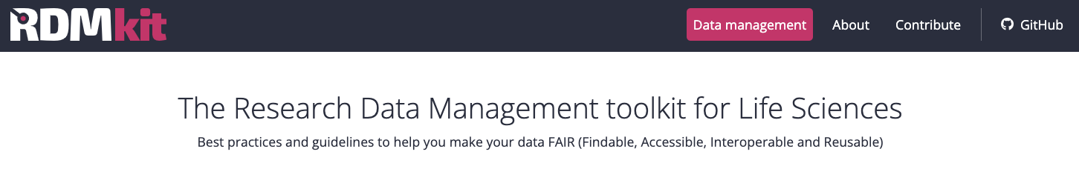
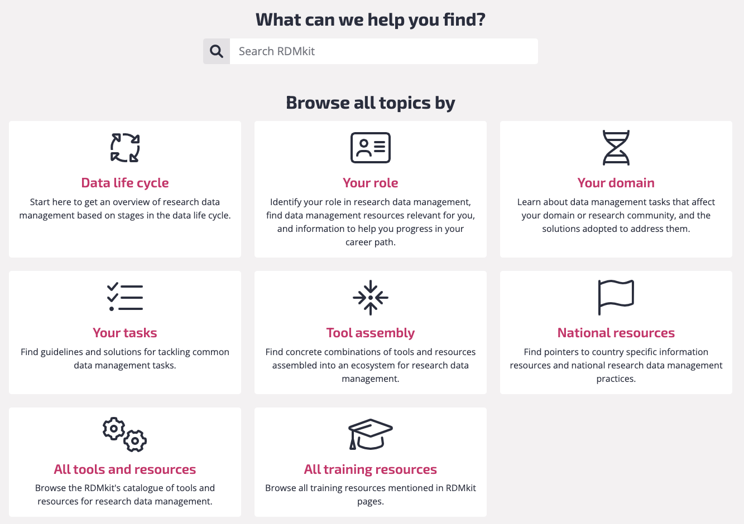

Research
Data
Management kit
https://rdmkit.elixir-europe.org

Slide 49
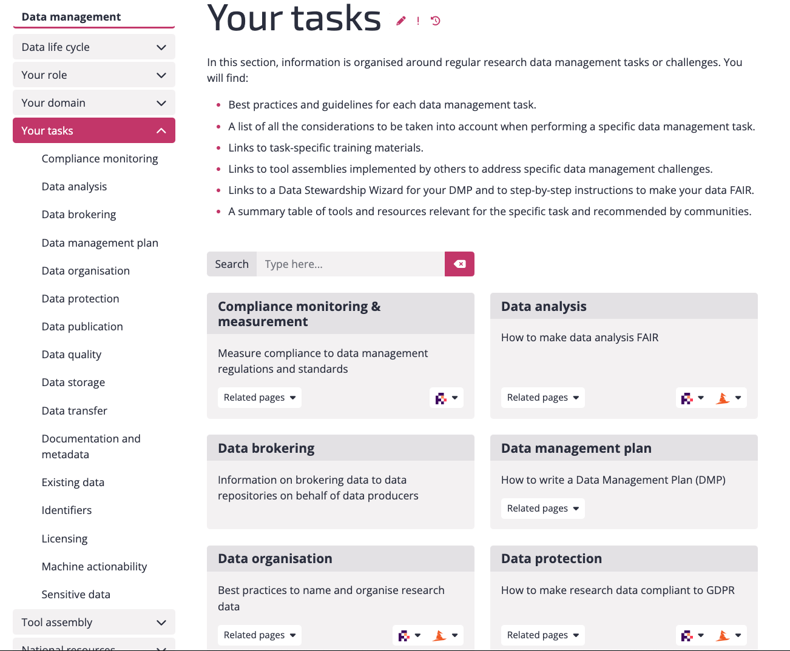

Slide 50
Research
Data
Management kit
https://rdmkit.elixir-europe.org/national_resources

Slide 51
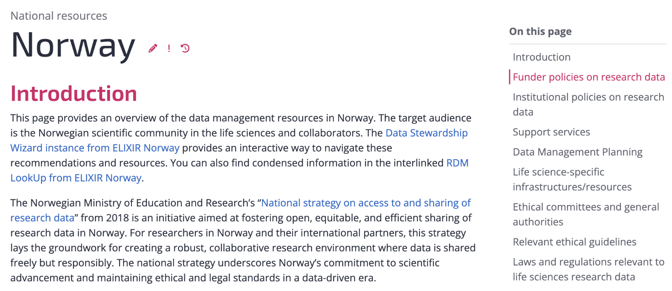
RDMkit: National resources in Norway
https://rdmkit.elixir-europe.org/no_resources

Slide 52

Thank you!
elixir-norway.org
support@elixir.no
@elixirnorway
Nazeefa Fatima, nazeefaf@uio.no
Except where otherwise noted, this work is licensed under a
Creative Commons Attribution 4.0 International License
https://creativecommons.org/licenses/by/4.0/

