Slide 1
Data deposition to public archives The ENA example
Arturo Vera-Ponce de Leon
ELIXIR Norway

Slide 2












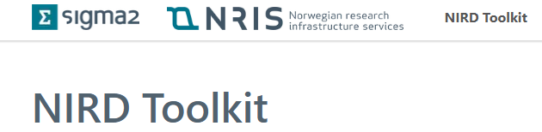

Example - Data flow/handle using ELIXIR Norway
NIRD
DATA
DATA STORAGE
EXPERIMENT
DATA DEPOSITION
METADATA
DATA ANALYSIS

Slide 3

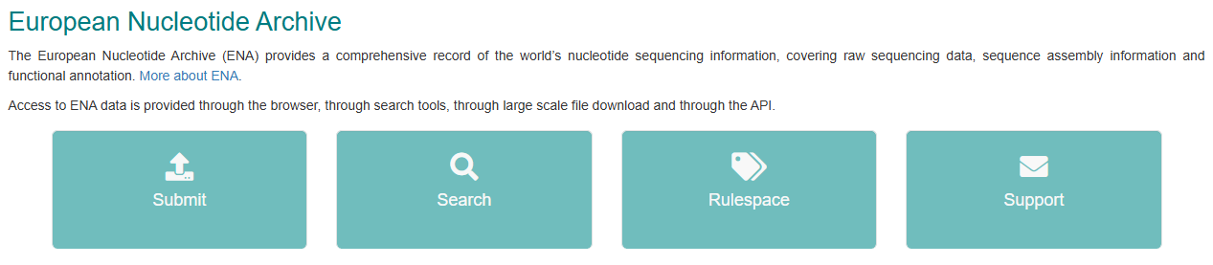
How to transfer data from NeLS, NIRD or Orion filesystem to ENA?

Slide 4
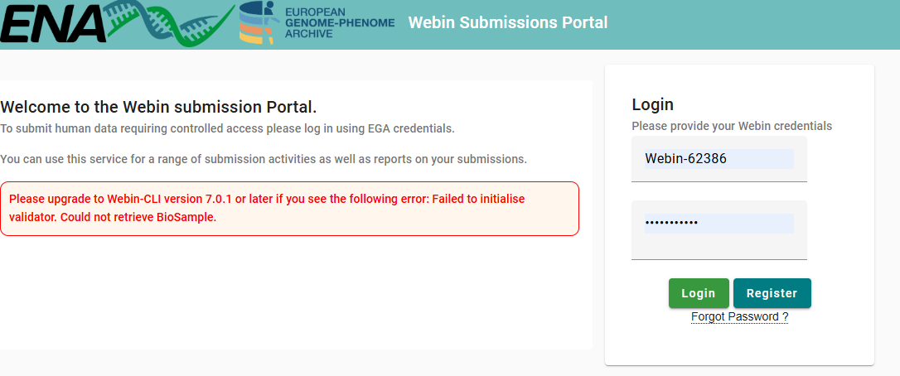
Use the Webin GUI Portal

Slide 5
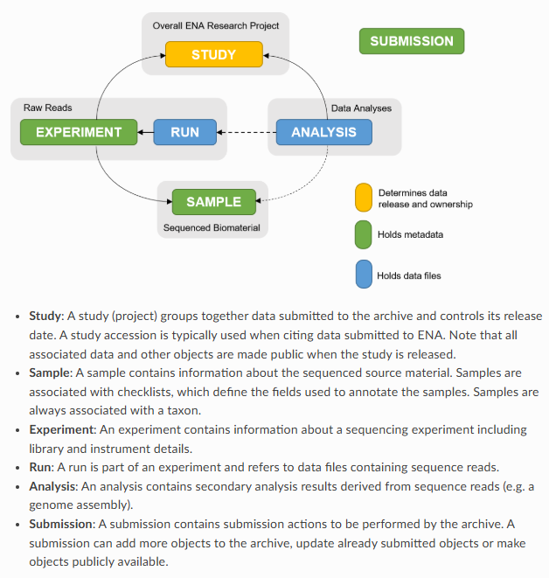
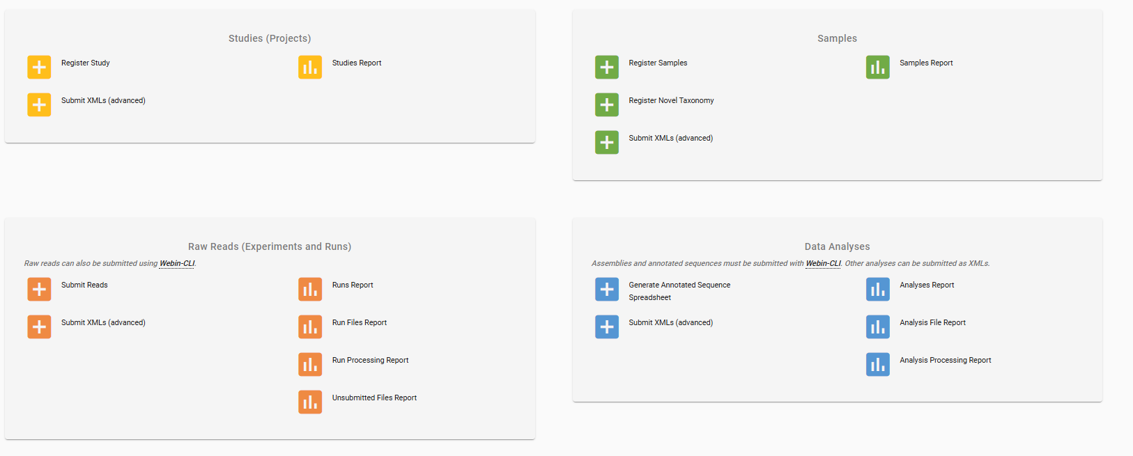
The ENA Metadata Model

Slide 6
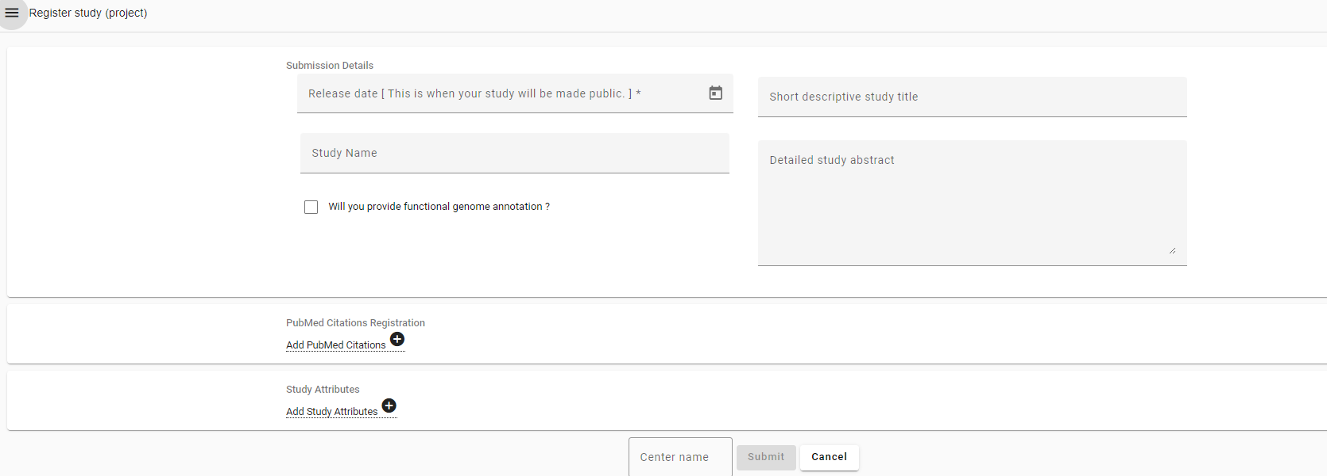
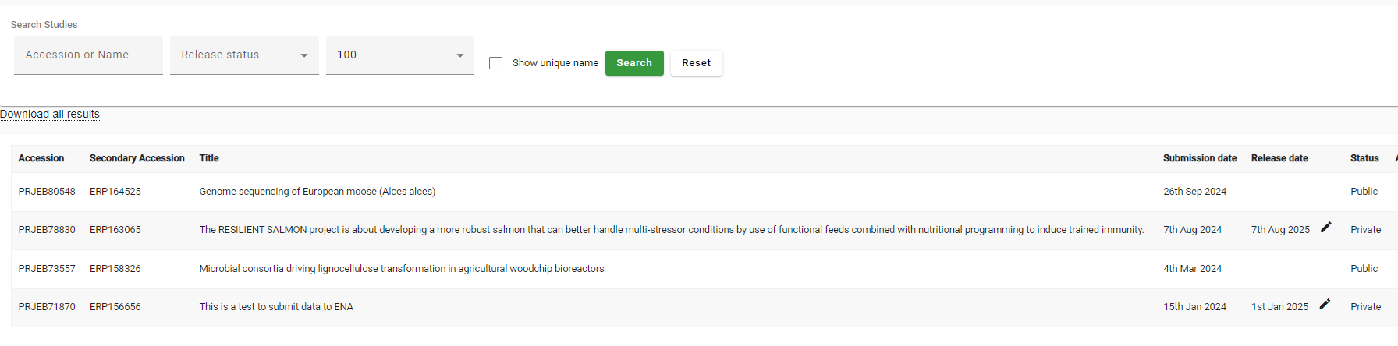
Registering study
The study (project) object is linked to samples and sequence reads via experiments, and is typically what you cite in publications.
Use in publications

Slide 7
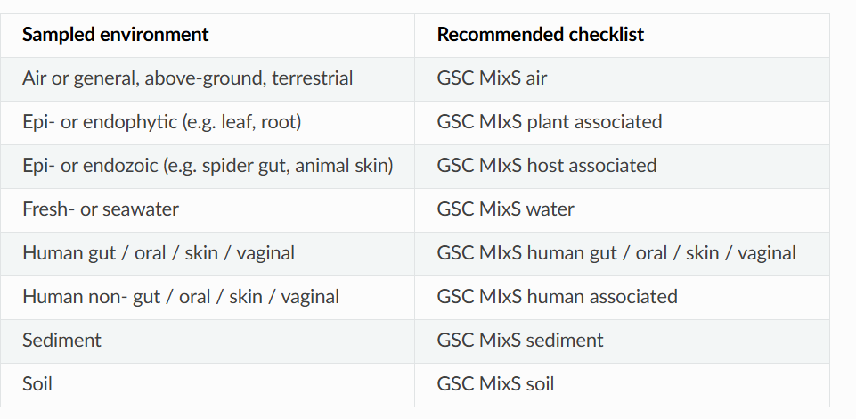
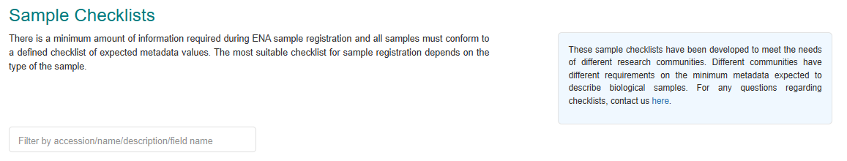
Registering samples
Samples are the source material from which your sequences derive, and the searchability and usability of your submitted data will depend on how well you document these samples
Select and fill the Checklist via spreadsheet
(Only one sample even for pair-end sequencing is a single sample)
Submit and check the result

Slide 8
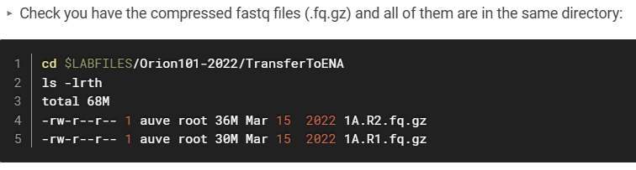
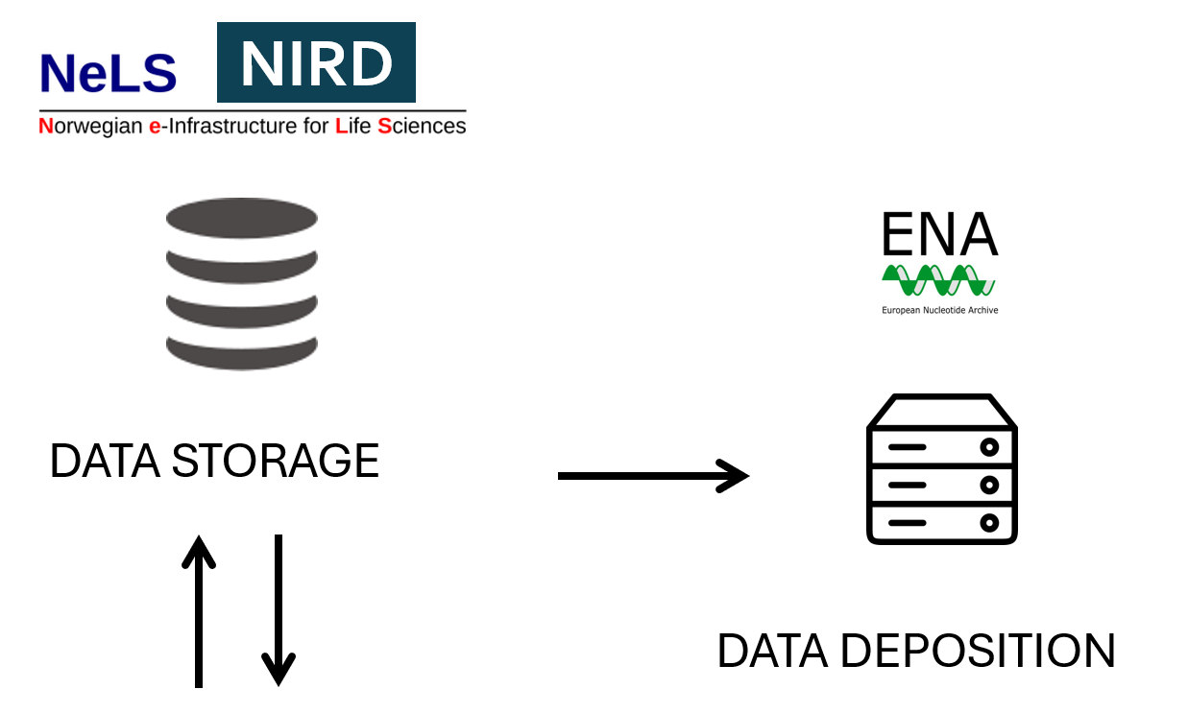
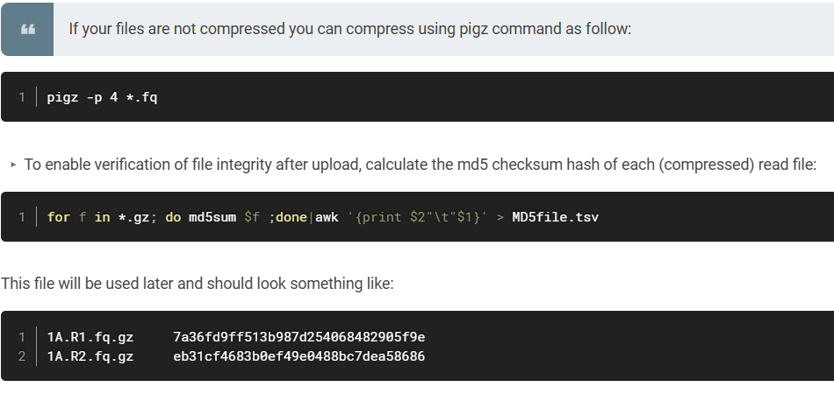
Prepare your data to be submitted
https://orion.nmbu.no/en/SubmitReadsToENA

Slide 9
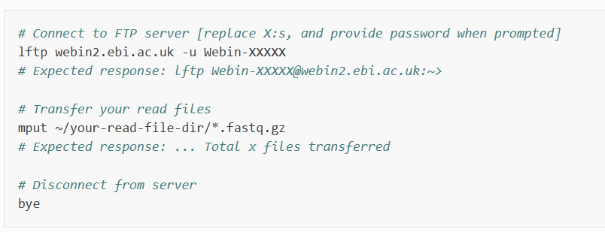
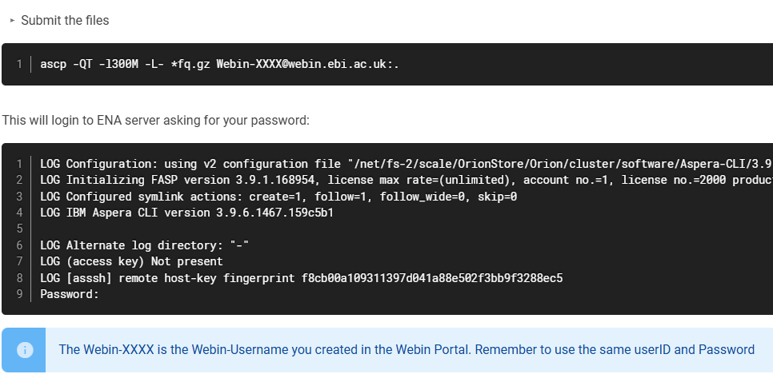
Submit your data using the CLI
Uploading Files Using Command Line FTP Client
Using Aspera ascp Command Line Program (Orion Users)
https://orion.nmbu.no/en/SubmitReadsToENA

Slide 10
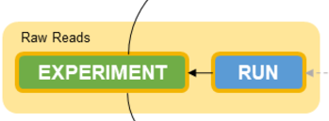
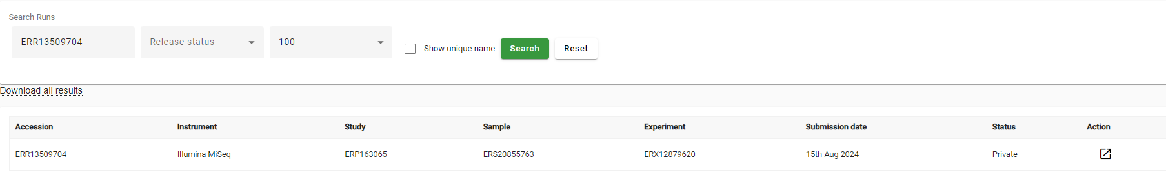
Prepare the Read submission spreadsheet template
In the ENA metadata model, an experiment refers to a sequencing event, and contains information on e.g. library construction and instruments, whereas runs represent the read files resulting from an experiment.

