Slide 1
Local NMBU storage
Arturo Vera-Ponce de Leon
ELIXIR Norway

Slide 2






Data storage – from the researcher perspective
DATA
DATA STORAGE
EXPERIMENT
DATA DEPOSITION
METADATA
DATA ANALYSIS

Slide 3


Storage of Research Data without personal information - tools
Research Data generated in ongoing projects should normally be stored at the LargeFile server (W: or P:).
External cooperation (should not be used as the primary place for storage): Sharing data using Office365 and OneDrive – NMBU services
LargeFile
server W:

Slide 4
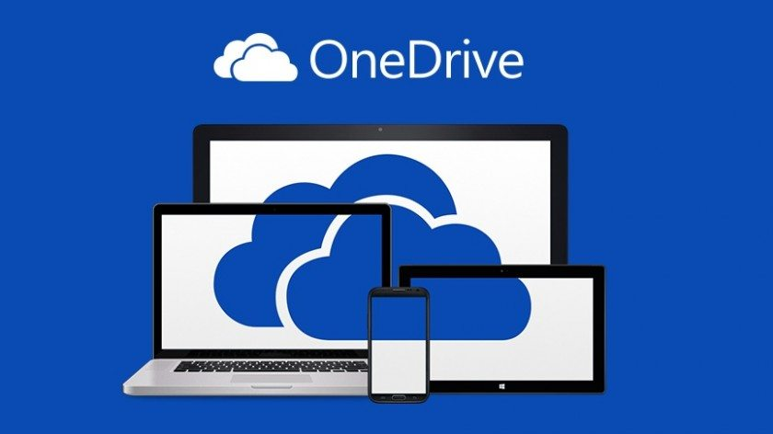
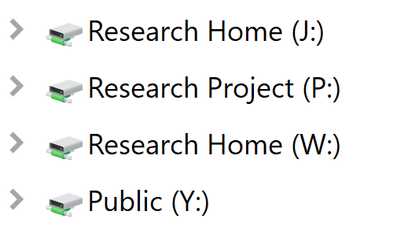
Where to storage all these data?
NMBU has a set of file directory / areas for different proposes:
Home directory: OneDrive for Business - Norwegian University of Life Sciences (~ 1Tb)
Common directory (Y:) It serves to share data with intra faculty members
LargeFile area (W:) Area for storing large amounts of data (> 1Tb)
NMBU Full-managed client.
LabFile area (P:) Area for storing data from Lab Machines.
https://nmbuhjelp.nmbu.no/

Slide 5
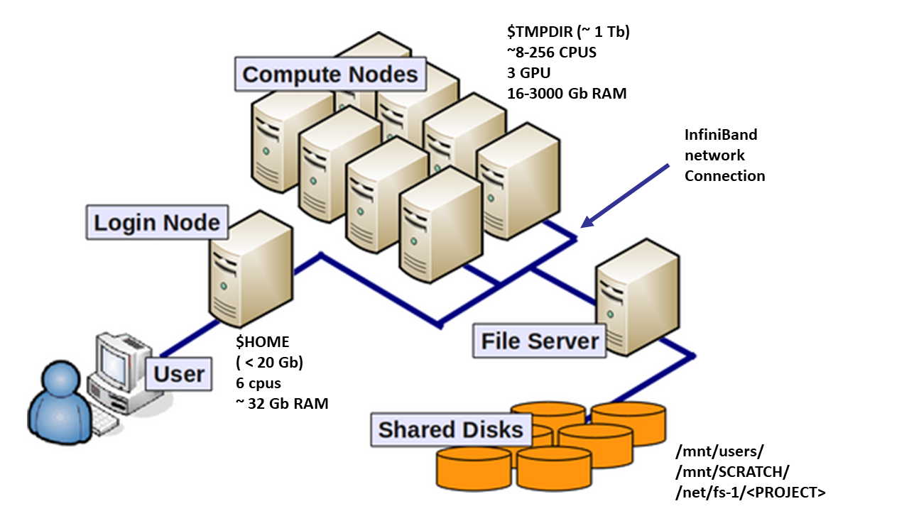
Access to the NMBU High-Performance Computing (HPC) grid Orion
The Orion HPC system currently consists of 1680 processor cores with more than 12 terabytes of RAM and 1 Pb of storage accessible on a 10/1 Gbit network via NFS.

Slide 6
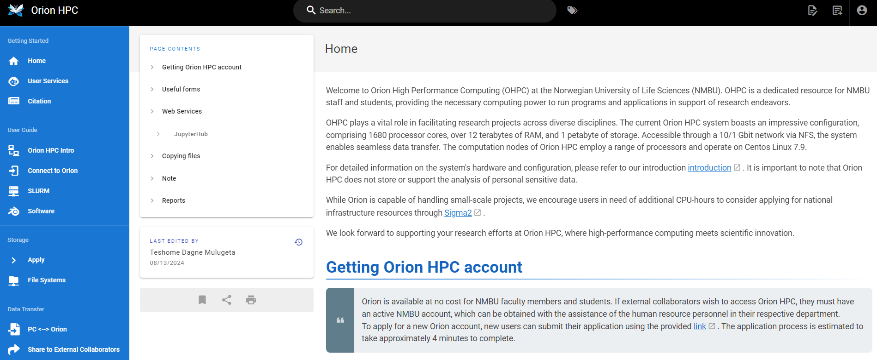
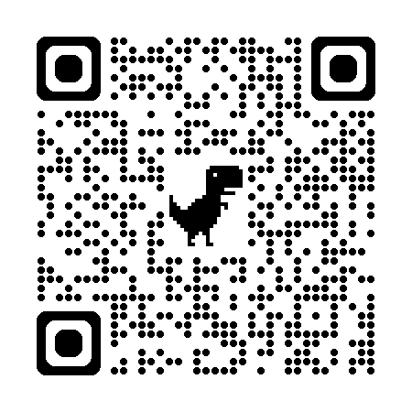
How can I get access to Orion?
https://orion.nmbu.no/
Free for all NMBU community ☺

Slide 7

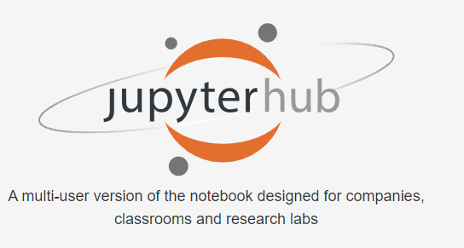
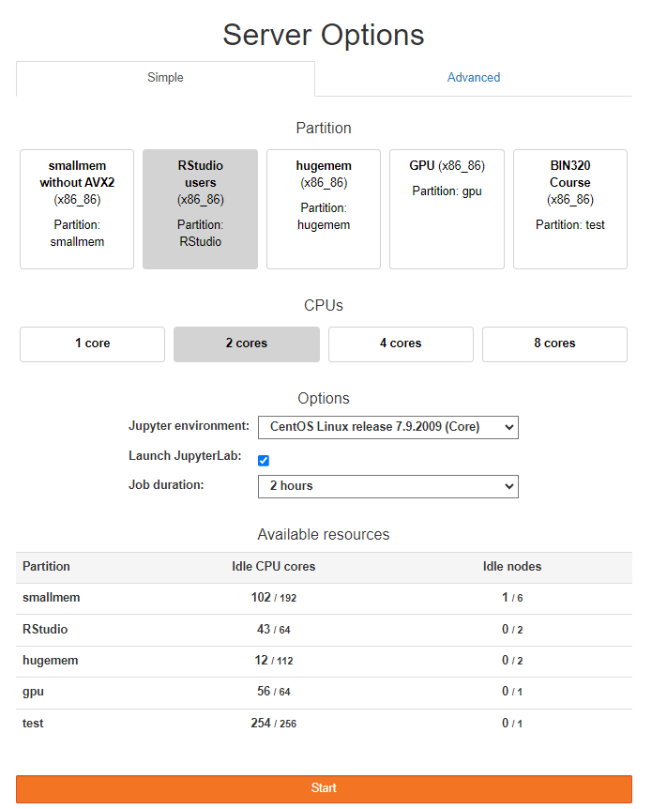
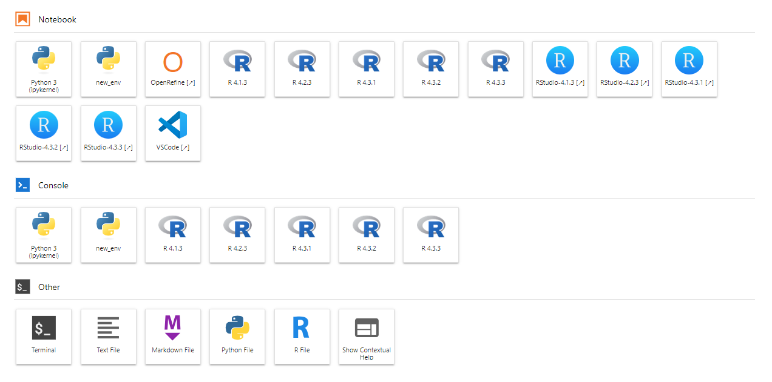
Virtual GUI services Orion offers

Slide 8






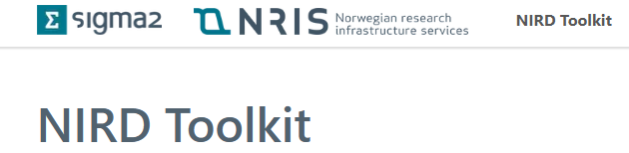

Example - Data flow/handle using ELIXIR Norway
NIRD
DATA
DATA STORAGE
EXPERIMENT
DATA DEPOSITION
METADATA
DATA ANALYSIS

