Slide 1

Requirements from funding bodies & institutions
Korbinian Bösl
Data management coordinator
ELIXIR Norway/Digital Life Norway
30th November 2020
Illustrative Icons from Font Awesome licensed under Creative Commons Attribution 4.0 International License

Slide 2



19/12/2017
National strategy on access to and sharing of research data
Research data must be as open as possible, as closed as necessary
Research data should be managed and curated to take full advantage of their potential.
Decisions concerning archiving and management of ­research data must
be taken within the research community
...
The Government expects:
the research institutions to develop procedures for (i) approving data management plans
…
https://www.regjeringen.no/en/dokumenter/national-strategy-on-access-to-and-sharing-of-research-data/id2582412/

Slide 3





FAIR-principles
Data Management Plan
Storage
Archival
Ethics
Deposition
https://innsida.ntnu.no/wiki/-/wiki/English/NTNU+Open+Data
https://www.nmbu.no/en/research/for_researchers/researchdata/node/34680
https://www.uio.no/english/for-employees/support/research/research-data-management/policies-and-guidelines/index.html
https://intranett.uit.no/Content/532111/cache=20170109133727/Principles%20and%20guidelines%20for%20research%20management%20at%20UiT_010917.pdf

Slide 4






-
DMP

Slide 5
Description & Re-use
Documentation & Data quality
Storage & Backups
Legal & Ethic requirements
Sharing & Preservation
Responsibilities & Resources (FAIR principles)
https://www.scienceeurope.org/media/jezkhnoo/se_rdm_practical_guide_final.pdf
https://www.scienceeurope.org/media/nsxdyvqn/se_guidance_document_rdmps.pdf
https://www.forskningsradet.no/en/forskningspolitisk-radgivning/open-science/open-access-to-research-data/

Slide 6
Description & Re-use
How will new data be collected or produced and/or how will existing data be re-used
https://www.scienceeurope.org/media/jezkhnoo/se_rdm_practical_guide_final.pdf

Slide 7
Description & Re-use
How will new data be collected or produced and/or how will existing data be re-used
What data (for example the kinds, formats, and volumes) will be collected or produced?
https://www.scienceeurope.org/media/jezkhnoo/se_rdm_practical_guide_final.pdf

Slide 8
Documentation & Data quality
What metadata and documentation (for example the methodology of data collection and way of organising data) will accompany data?
https://www.scienceeurope.org/media/jezkhnoo/se_rdm_practical_guide_final.pdf

Slide 9
Documentation & Data quality
What metadata and documentation (for example the methodology of data collection and way of organising data) will accompany data?
What data quality control measures will be used?
https://www.scienceeurope.org/media/jezkhnoo/se_rdm_practical_guide_final.pdf

Slide 10
Storage and backup during the research process
How will data and metadata be stored and backed up during the research process?
https://www.scienceeurope.org/media/jezkhnoo/se_rdm_practical_guide_final.pdf

Slide 11
Storage and backup during the research process
How will data and metadata be stored and backed up during the research process?
https://www.scienceeurope.org/media/jezkhnoo/se_rdm_practical_guide_final.pdf

Slide 12
Storage and backup during the research process
How will data and metadata be stored and backed up during the research process?
How will data security and protection of sensitive data be taken care of during the research?
https://www.scienceeurope.org/media/jezkhnoo/se_rdm_practical_guide_final.pdf

Slide 13
Legal and ethical requirements, codes of conduct
If personal data are processed, how will compliance with legislation on personal data and on data security be ensured?
https://www.scienceeurope.org/media/jezkhnoo/se_rdm_practical_guide_final.pdf

Slide 14
Legal and ethical requirements, codes of conduct
If personal data are processed, how will compliance with legislation on personal data and on data security be ensured?
How will other legal issues, such as intellectual property rights and ownership, be managed? What legislation is applicable?
https://www.scienceeurope.org/media/jezkhnoo/se_rdm_practical_guide_final.pdf

Slide 15
Legal and ethical requirements, codes of conduct
If personal data are processed, how will compliance with legislation on personal data and on data security be ensured?
How will other legal issues, such as intellectual property rights and ownership, be managed? What legislation is applicable?
How will possible ethical issues be taken into account, and codes of conduct followed?
https://www.scienceeurope.org/media/jezkhnoo/se_rdm_practical_guide_final.pdf

Slide 16
Data sharing and long-term preservation
How and when will data be shared? Are there possible restrictions to data sharing or embargo reasons?
https://www.scienceeurope.org/media/jezkhnoo/se_rdm_practical_guide_final.pdf

Slide 17
Data sharing and long-term preservation
How and when will data be shared? Are there possible restrictions to data sharing or embargo reasons?
How will data for preservation be selected, and where will data be preserved long-term (for example a data repository or archive)?
https://www.scienceeurope.org/media/jezkhnoo/se_rdm_practical_guide_final.pdf

Slide 18
Data sharing and long-term preservation
How and when will data be shared? Are there possible restrictions to data sharing or embargo reasons?
How will data for preservation be selected, and where will data be preserved long-term (for example a data repository or archive)?
What methods or software tools will be needed to access and use the data?
https://www.scienceeurope.org/media/jezkhnoo/se_rdm_practical_guide_final.pdf

Slide 19
Data sharing and long-term preservation
How and when will data be shared? Are there possible restrictions to data sharing or embargo reasons?
How will data for preservation be selected, and where will data be preserved long-term (for example a data repository or archive)?
What methods or software tools will be needed to access and use the data?
How will the application of a unique and persistent identifier (such as a Digital Object Identifier (DOI)) to each data set be ensured?
Open, (non-properitary)
data formats!
https://www.scienceeurope.org/media/jezkhnoo/se_rdm_practical_guide_final.pdf

Slide 20
Data management responsibilities and resources
Who (for example role, position, and institution) will be responsible for data management (i.e. the data steward)?
https://www.scienceeurope.org/media/jezkhnoo/se_rdm_practical_guide_final.pdf

Slide 21
Data management responsibilities and resources
Who (for example role, position, and institution) will be responsible for data management (i.e. the data steward)?
What resources (for example financial and time) will be dedicated to data management and ensuring that data will be FAIR (Findable, Accessible, Interoperable, Re-usable)?
https://www.scienceeurope.org/media/jezkhnoo/se_rdm_practical_guide_final.pdf

Slide 22




















/
/
/
/
/
/
sensitive
data

Slide 23


Data catalogues & registries
Data creation &
deposit
Open Data
Archives &
Data repositories
Managing active
data
“As open as possible - as closed as necessary”

Slide 24
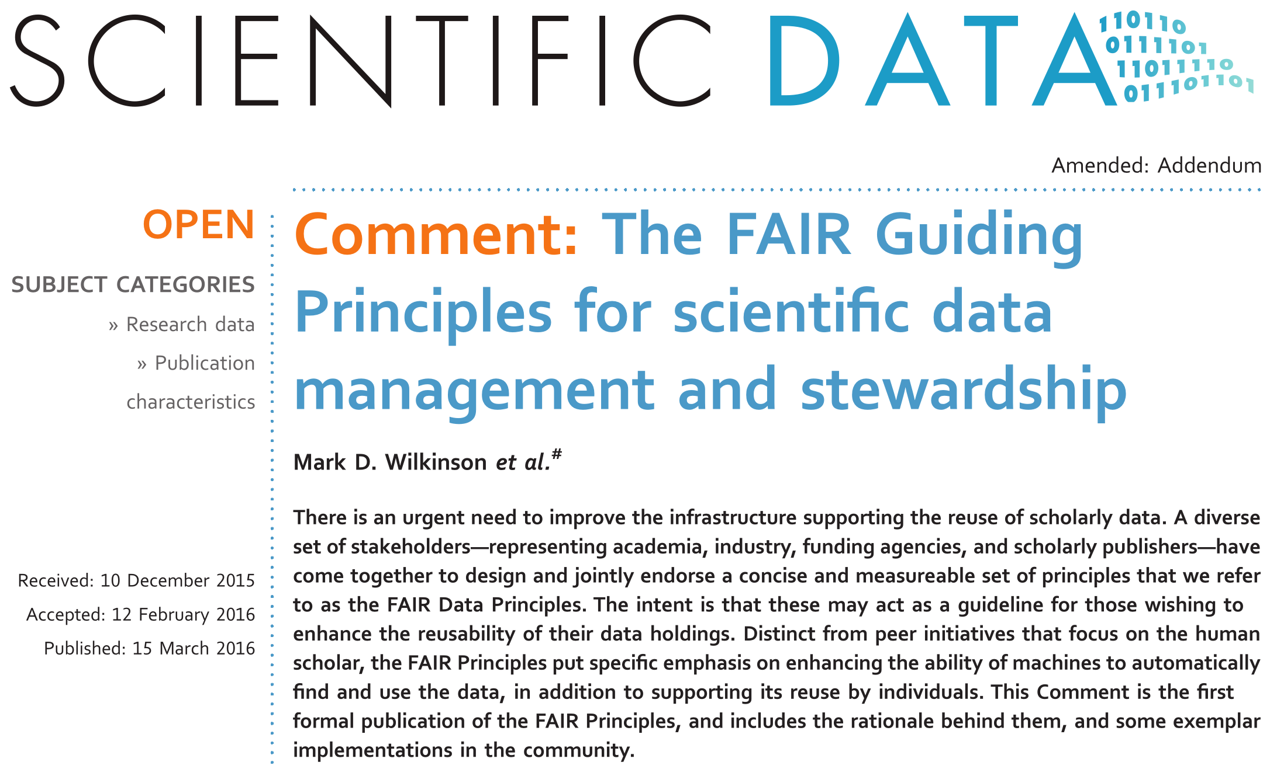
Mark D. Wilkinson et al. https://doi.org/10.1038/sdata.2016.18 licensed under Creative Commons Attribution 4.0 International License

Slide 25

FAIR illustrations icons from ARDC 2018 licensed under Creative Commons Attribution 4.0 International License

Slide 26


Identifiers.org
FAIR illustrations icons from ARDC 2018 licensed under Creative Commons Attribution 4.0 International License

Slide 27
community metadata standards
+
FAIR illustrations icons from ARDC 2018 licensed under Creative Commons Attribution 4.0 International License

Slide 28

...
FAIR illustrations icons from ARDC 2018 licensed under Creative Commons Attribution 4.0 International License

Slide 29
FAIR illustrations icons from ARDC 2018 licensed under Creative Commons Attribution 4.0 International License

Slide 30



HTTP, FTP, SMTP, ...
FAIR illustrations icons from ARDC 2018 licensed under Creative Commons Attribution 4.0 International License

Slide 31

FAIR illustrations icons from ARDC 2018 licensed under Creative Commons Attribution 4.0 International License

Slide 32
FAIR illustrations icons from ARDC 2018 licensed under Creative Commons Attribution 4.0 International License

Slide 33
FAIR illustrations icons from ARDC 2018 licensed under Creative Commons Attribution 4.0 International License

Slide 34
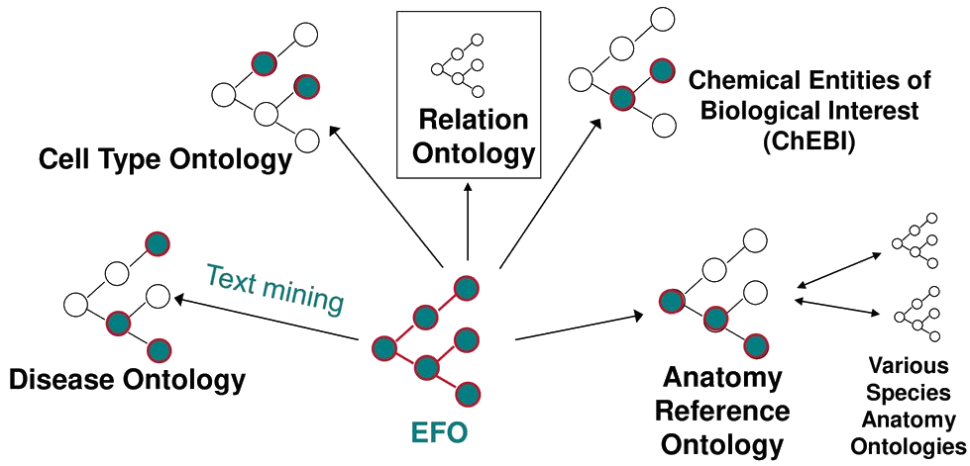

FAIR illustrations icons from ARDC 2018 licensed under Creative Commons Attribution 4.0 International License

Slide 35
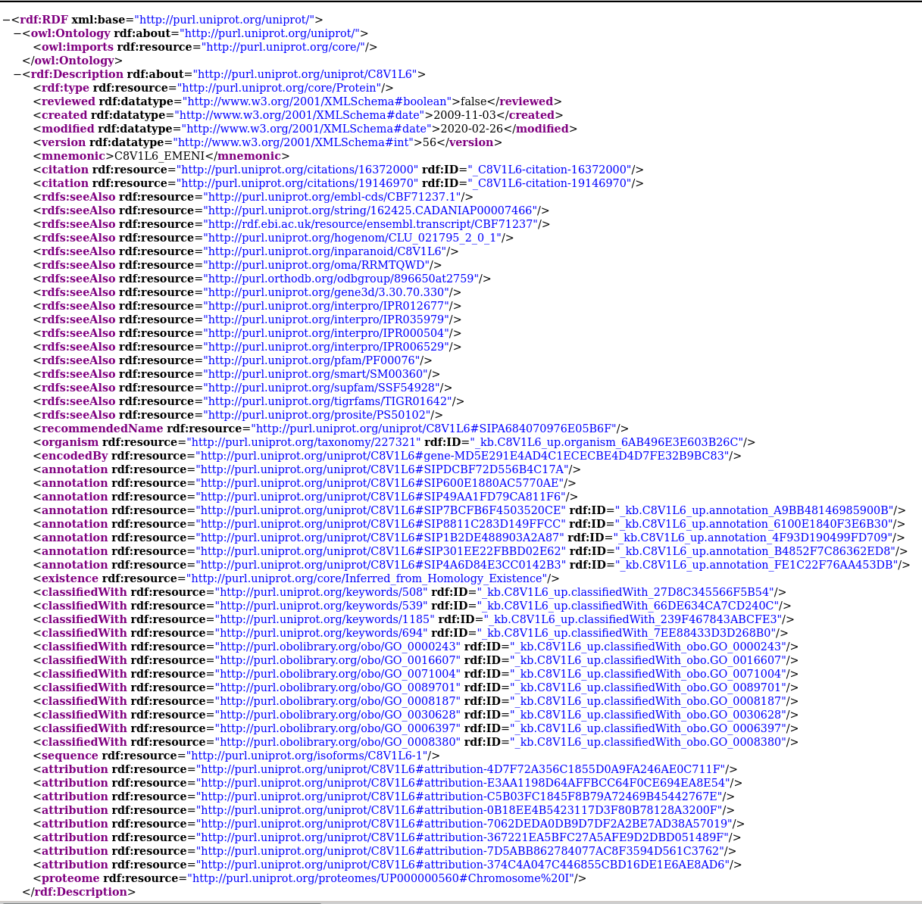

FAIR illustrations icons from ARDC 2018 licensed under Creative Commons Attribution 4.0 International License

Slide 36
FAIR illustrations icons from ARDC 2018 licensed under Creative Commons Attribution 4.0 International License

Slide 37
Describe the scope of your data: for what purpose was it generated/collected?
Mention any particularities or limitations about the data that other users should be aware of.
Specify the date of generation/collection of the data, the lab conditions, who prepared the data, the parameter settings, the name and version of the software used.
Is it raw or processed data?
Ensure that all variable names are explained or self-explanatory
Clearly specify and document the version of the archived and/or reused data.
FAIR illustrations icons from ARDC 2018 licensed under Creative Commons Attribution 4.0 International License

Slide 38


Ideal:
But also more closed license possible - has to be defined !
FAIR illustrations icons from ARDC 2018 licensed under Creative Commons Attribution 4.0 International License

Slide 39
Where does the sample come from?
Where other analysed performed on the same sample?
On what is this based?
Which reference data was used?
….
FAIR illustrations icons from ARDC 2018 licensed under Creative Commons Attribution 4.0 International License

Slide 40

MAGE-TAB
EFO
MIAME
ISA-TAB
PDBx/mmCIF
FAIR illustrations icons from ARDC 2018 licensed under Creative Commons Attribution 4.0 International License

Slide 41

Horizon 2020 → Horizon Europe
Open Research Data Pilot (ORD pilot)
Default since 2017 → mandatory 2021
-
DMP
outline
DMP
After 6 month
Update upon significant changes

Slide 42
Horizon 2020 → Horizon Europe
Data summary
FAIR data implementation
Resources
Data security
Ethics
https://ec.europa.eu/research/participants/data/ref/h2020/grants_manual/hi/oa_pilot/h2020-hi-oa-data-mgt_en.pdf
https://ec.europa.eu/research/participants/data/ref/h2020/grants_manual/hi/oa_pilot/h2020-hi-oa-data-mgt_en.pdf

Slide 43
Data Steward Wizard
Adapted for users & laws
in Norway
compatible
elixir-no.ds-wizard.org

