Slide 1

Data Storage Platforms
Korbinian Bösl
Data management coordinator
ELIXIR Norway/Digital Life Norway
30th November 2020
Illustrative Icons from Font Awesome licensed under Creative Commons Attribution 4.0 International License

Slide 2






















sensitive
data

Slide 3






NeLS
ola@uib.no
My Projects
Data curation
Tekle, et al. (2018) F1000Res
github.com/elixir-no-nels/nels-core
https://nels.bioinfo.no/

Slide 4
NeLS
ola@uib.no
Flexible work
on active data
My Projects
MMMM
Data curation
Tekle, et al. (2018) F1000Res
github.com/elixir-no-nels/nels-core
https://nels.bioinfo.no/

Slide 5

NeLS
S
ola@uib.no
ola@uib.no
Flexible work
on active data
My Projects
MMMM
Data curation
Tekle, et al. (2018) F1000Res
github.com/elixir-no-nels/nels-core
https://nels.bioinfo.no/

Slide 6
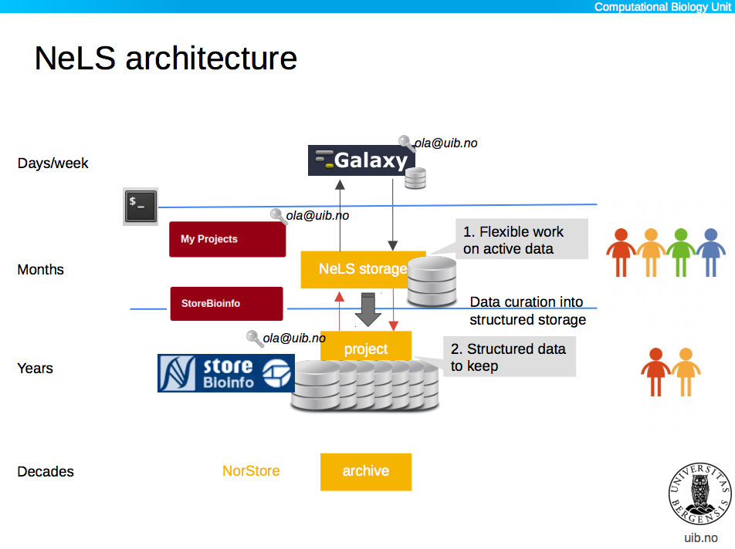





NeLS
S
ola@uib.no
ola@uib.no
Flexible work
on active data
My Projects
MMMM
Data curation
ola@uib.no
Structured data to keep
MM
MetaboLights
DOI
Tekle, et al. (2018) F1000Res
github.com/elixir-no-nels/nels-core
https://nels.bioinfo.no/
ArrayExpress

Slide 7
NeLS
S
ola@uib.no
Days - weeks
ola@uib.no
Flexible work
on active data
My Projects
MMMM
Months
Data curation
ola@uib.no
Structured data to keep
MM
Years
MetaboLights
DOI
Decades
Tekle, et al. (2018) F1000Res
github.com/elixir-no-nels/nels-core
https://nels.bioinfo.no/
ArrayExpress

Slide 8


NeLS - Accessibility
small datasets
ola@uib.no
https://nels.bioinfo.no/

Slide 9



NeLS - Accessibility
small datasets
larger datasets
ssh-key
sFTP
ola@uib.no
https://nels.bioinfo.no/

Slide 10
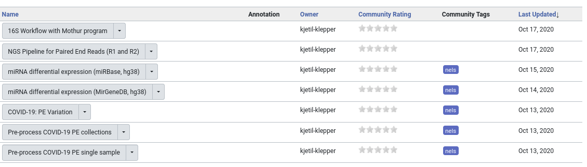
Data Analysis in NeLS
usegalaxy.no

Slide 11
NeLS - Getting Access
Typically > 1TB data
Free < 10TB & <15 mill. NOK
Allocation through Helpdesk: contact@bioinfo.no
Direct upload through Norseq facilities
https://nels.bioinfo.no/pages/user-terms.xhtml

Slide 12

SEEK
H N
https://seek4science.org/
https://fairdomhub.org/

Slide 13
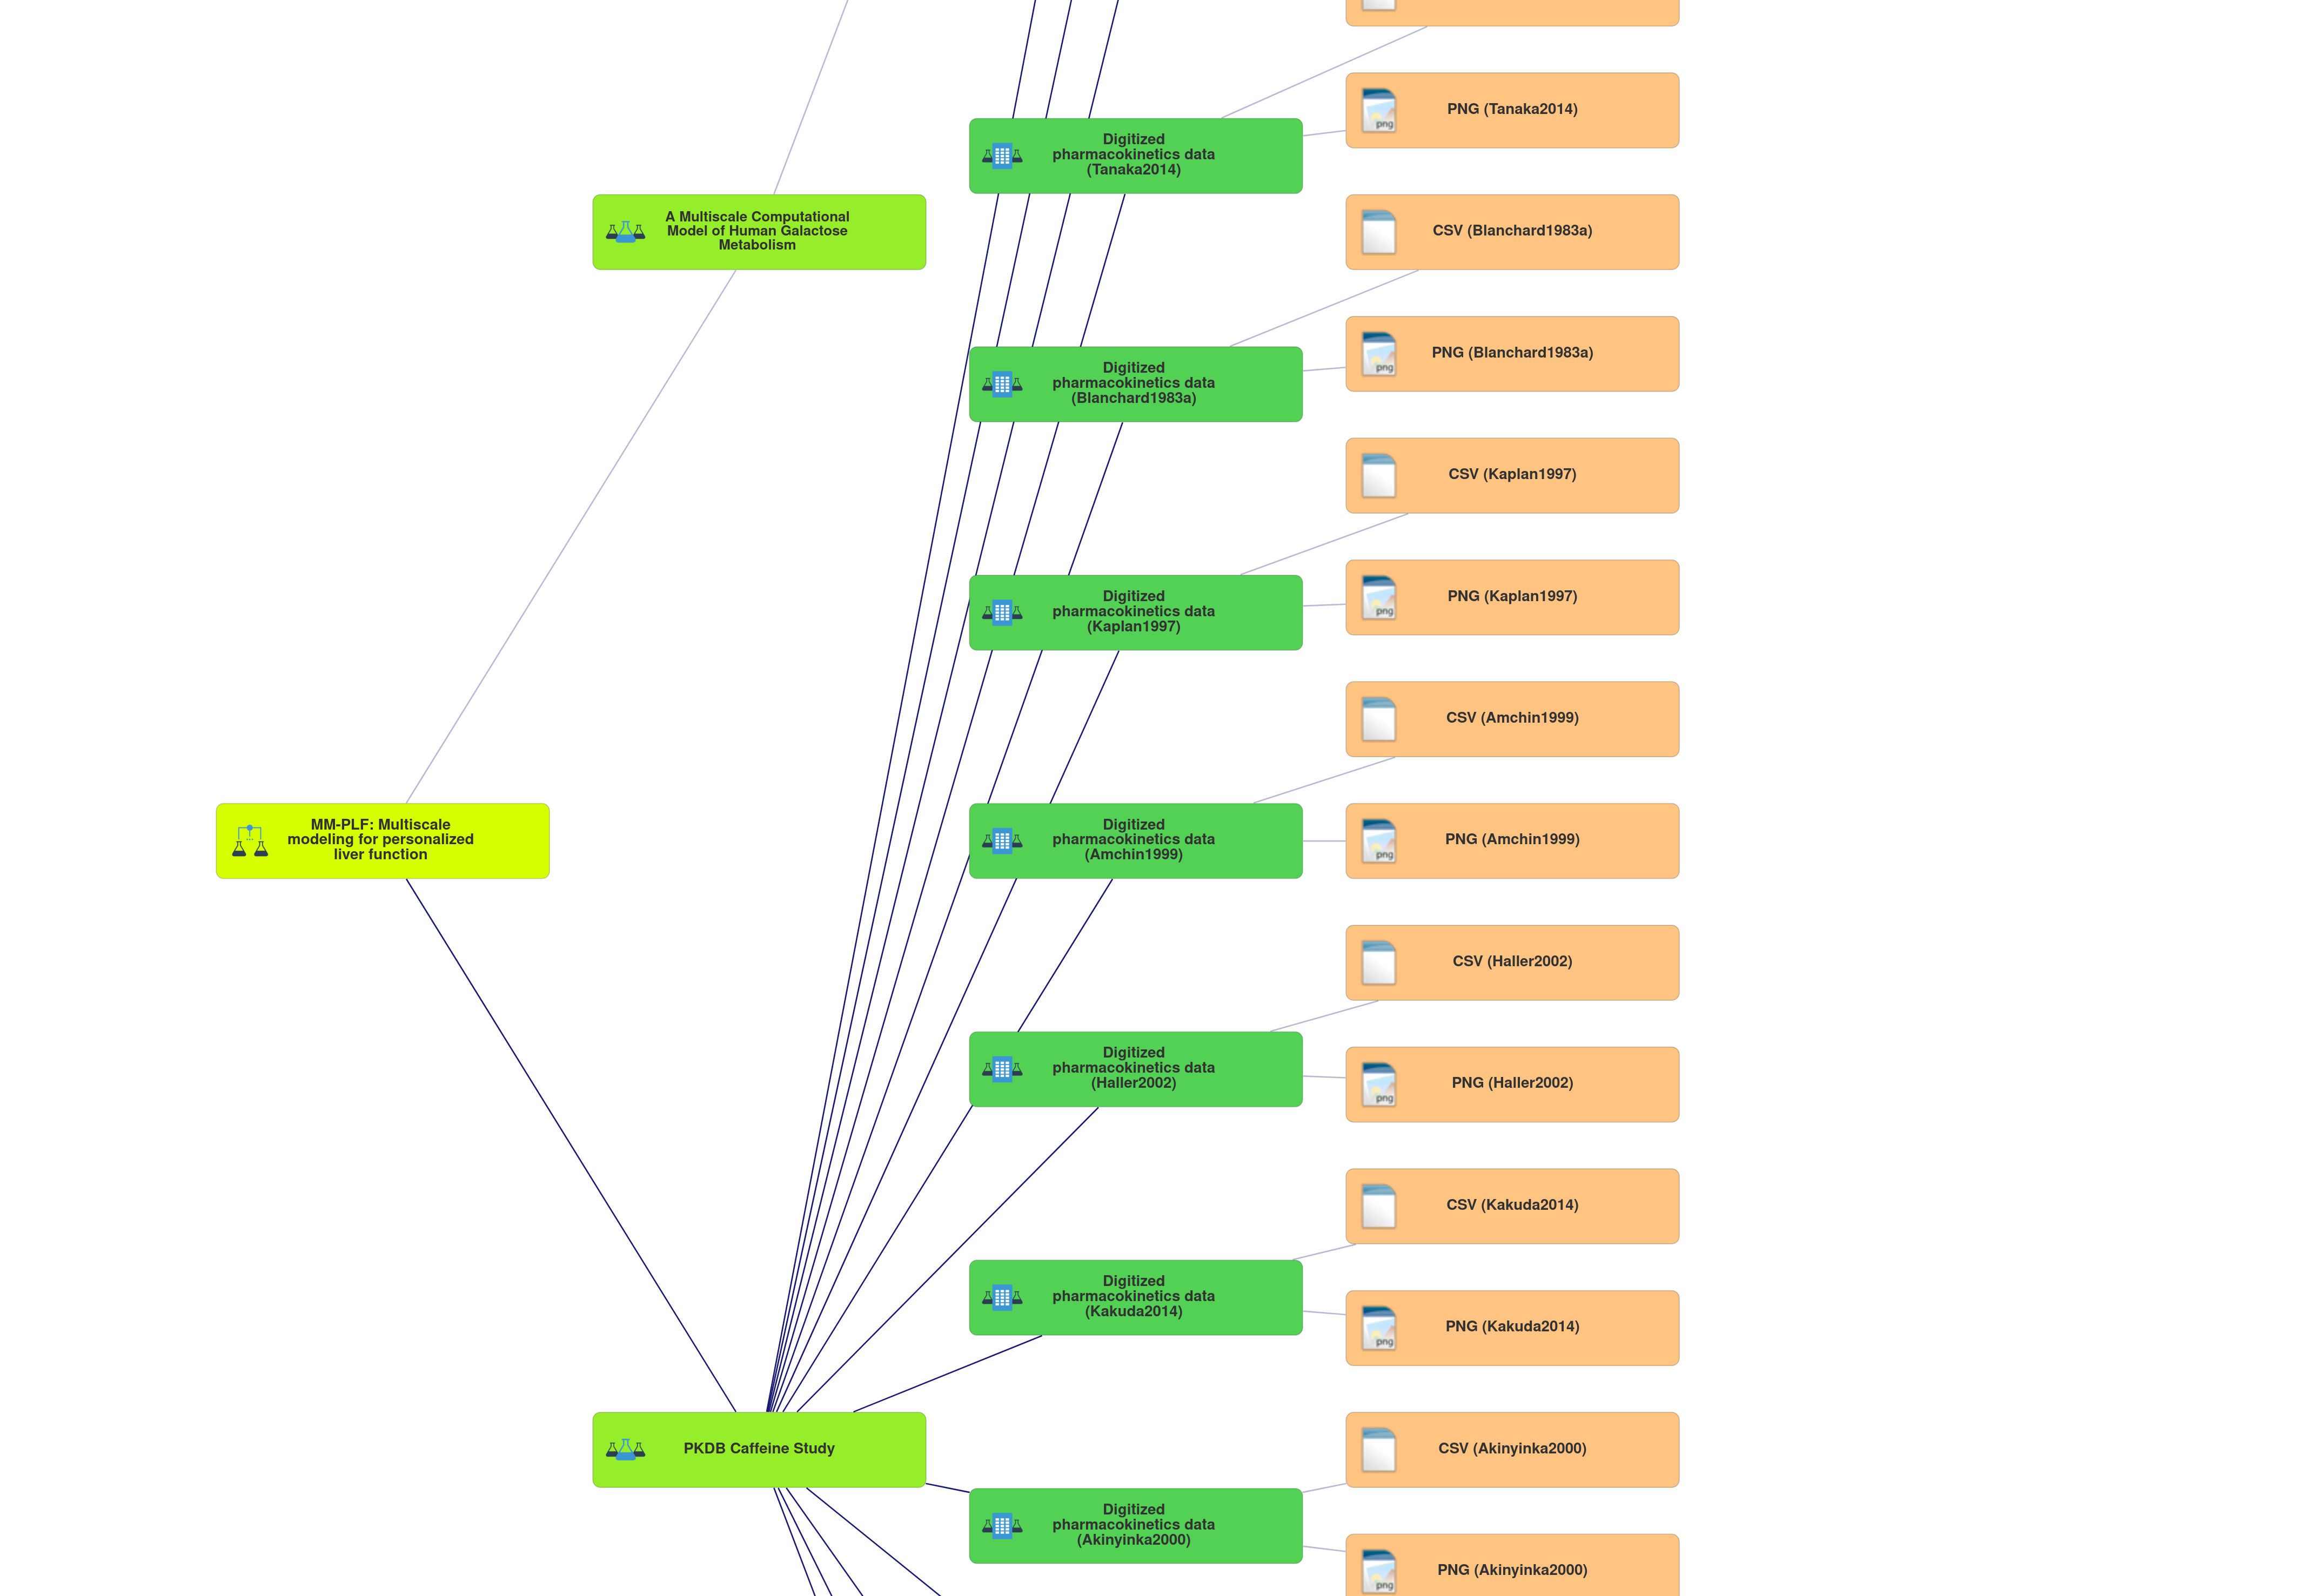
SEEK
Investigation
Study
Assay
https://seek4science.org/
https://fairdomhub.org/

Slide 14
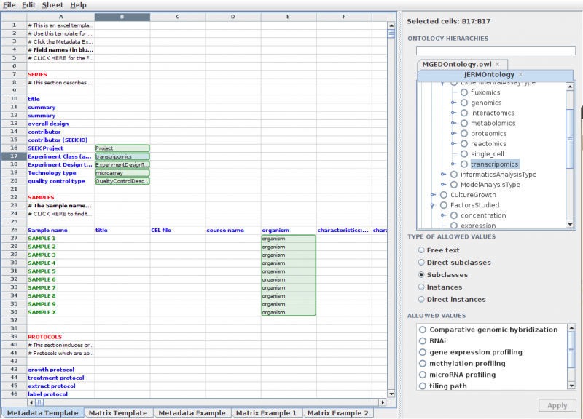

SEEK
https://seek4science.org/
https://rightfield.org.uk/

Slide 15



↔ Integration
Reference data in NeLS in SEEK
Access data in NeLS through SEEK
Save Metadata to SEEK through NeLS

Slide 16
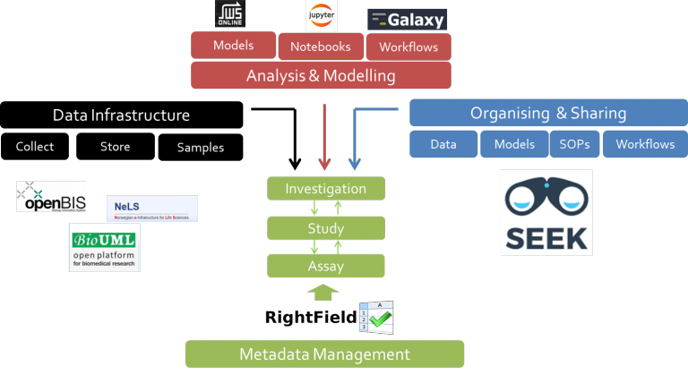

Slide 17

National HPC infrastructure
D Advanced Storage Needs
S Advanced Computing Resources
t Free Analysis Toolkit (Rstudio, Jupyternotebook)
https://www.sigma2.no/

Slide 18



National HPC infrastructure
NIRD
toolkit
DDD
=
Saga
NIRD
NIRD
archive
https://www.sigma2.no/

Slide 19
HPC infrastructure
Saga
244 nodes – 9824 cores – 32 GPUs
Total 75TB RAM – 186-3066GB/node
89TB + 60 TB NVMe+SSD
1PB file system
https://documentation.sigma2.no/quick/saga.html

Slide 20
Storage infrastructure - NIRD
Geo replicated
Nightly snapshots
12 PB (→ 36 PB next 3 yrs)
DDD
https://documentation.sigma2.no/storage/nird.html

Slide 21
Sigma2 - Getting Access
Bi-annual calls (January & July) – Reapplication (!)
User contribution model (projects > 15 mill. NOK)
Application for small grants continually
https://www.sigma2.no/how-apply-user-account
https://www.sigma2.no/data-storage#get-access

Slide 22

TSD – National sensitive data service
Maximum classification
2-factor authentication
Attached HPC resources
https://www.uio.no/english/services/it/research/sensitive-data/index.html

Slide 23

TSD – National sensitive data service
M

Slide 24

TSD – National sensitive data service
S
Google Authenticator
S
l
Password
M
S

Slide 25


TSD – National sensitive data service
S
Google Authenticator
S
l
Password
M
S

Slide 26
TSD – National sensitive data service
S
Google Authenticator
S
l
Password
M
S
DDD

Slide 27

TSD – National sensitive data service
S
Google Authenticator
Nettskjema
S
l
Password
M
S
DDD

Slide 28
TSD – National sensitive data service
S
Google Authenticator
Nettskjema
S
l
Password
M
S
Colossus
DDD

Slide 29
TSD – Getting Access
Subsidized access through Sigma2 calls
User contribution model (non UiO: min 15kNOK/a)
Free storage quotas through NeLS
https://www.uio.no/english/services/it/research/sensitive-data/access/prices/
https://nels.bioinfo.no/

