Slide 1

Data Steward Wizard
Korbinian Bösl
Data management coordinator
ELIXIR Norway/Digital Life Norway
1st December 2020
Illustrative Icons from Font Awesome licensed under Creative Commons Attribution 4.0 International License

Slide 2

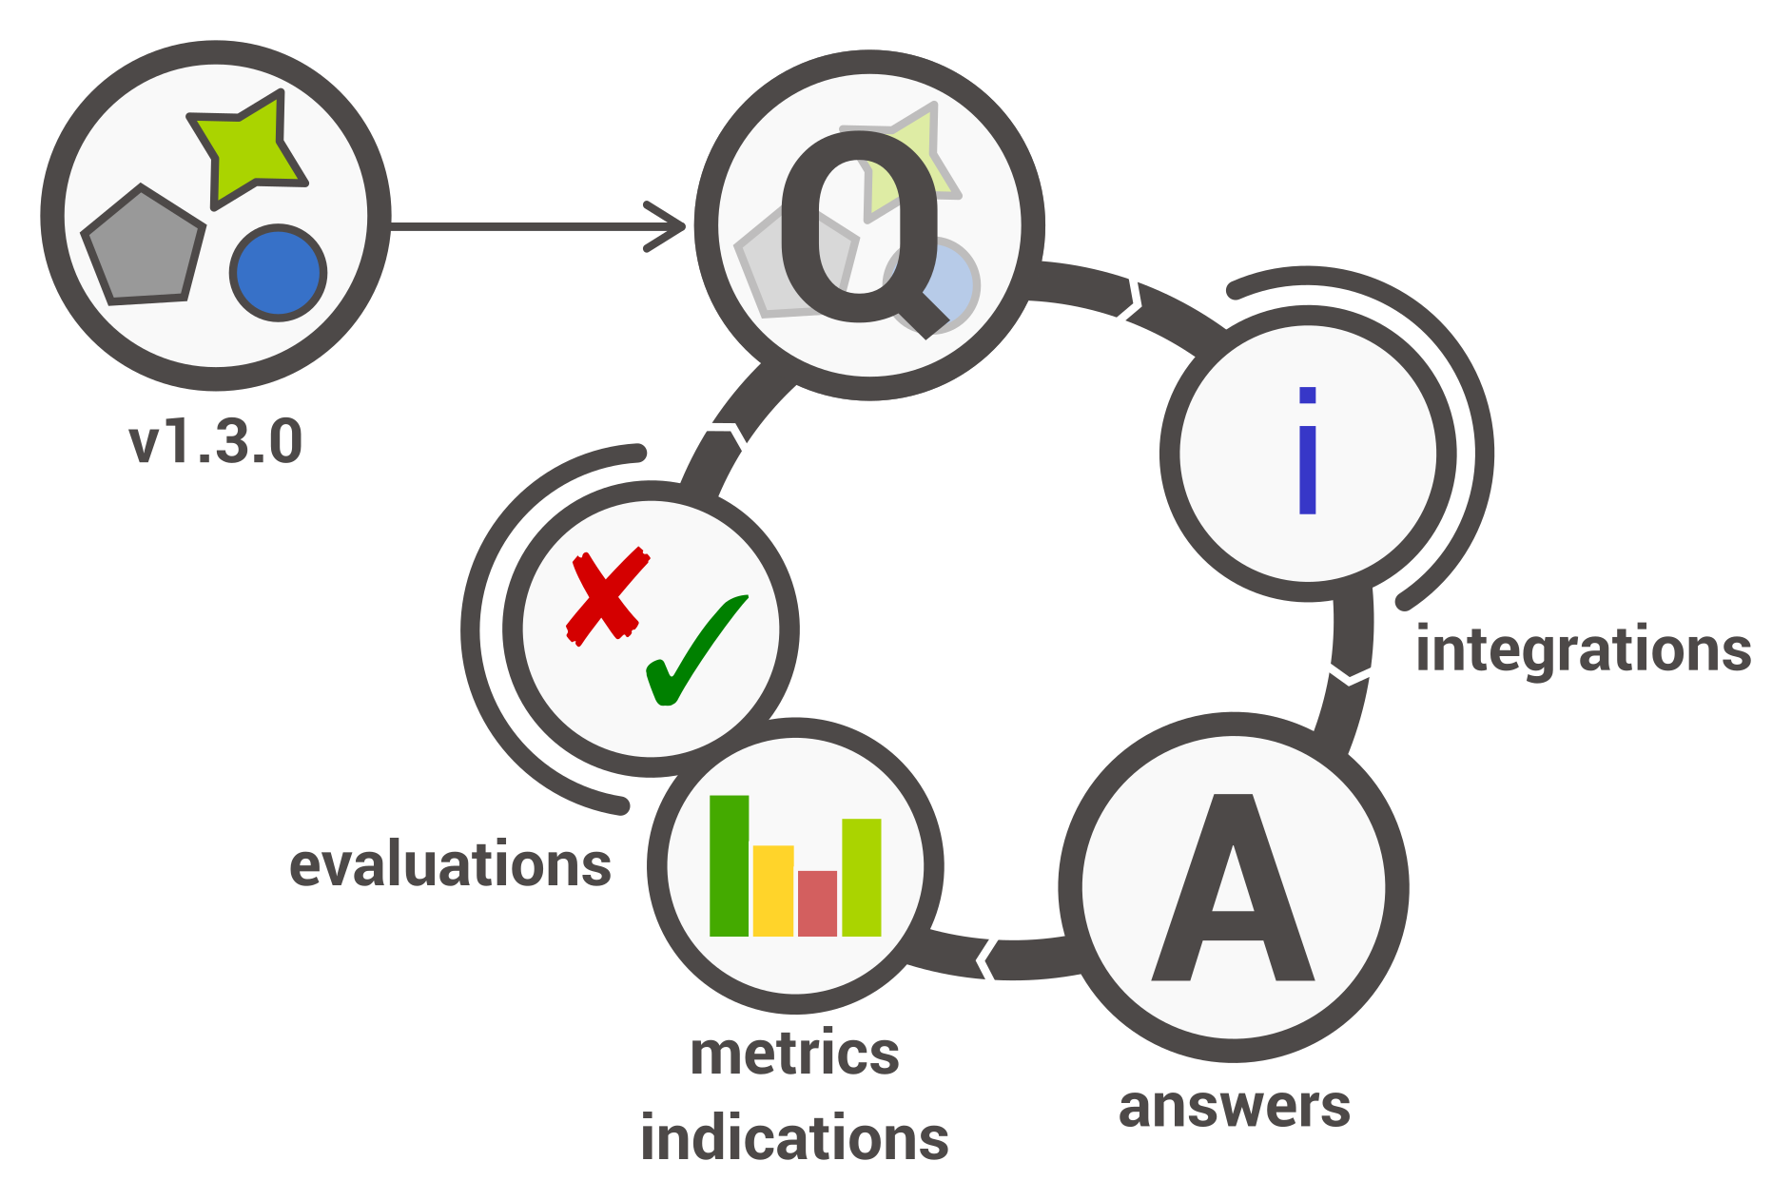

elixir-no.ds-wizard.org
ds-wizard.org
github.com/ds-wizard

Slide 3






-
DMP

Slide 4

Horizon 2020 → Horizon Europe
Open Research Data Pilot (ORD pilot)
Default since 2017 → mandatory 2021
-
DMP
outline
DMP
After 6 month
Update upon significant changes

Slide 5

Filled questionnaire → Template → DMP in various formats
once per funding body .docx, .tex, .html, .json
compatible
Adapted for Norwegian users
elixir-no.ds-wizard.org
ds-wizard.org
github.com/ds-wizard

Slide 6
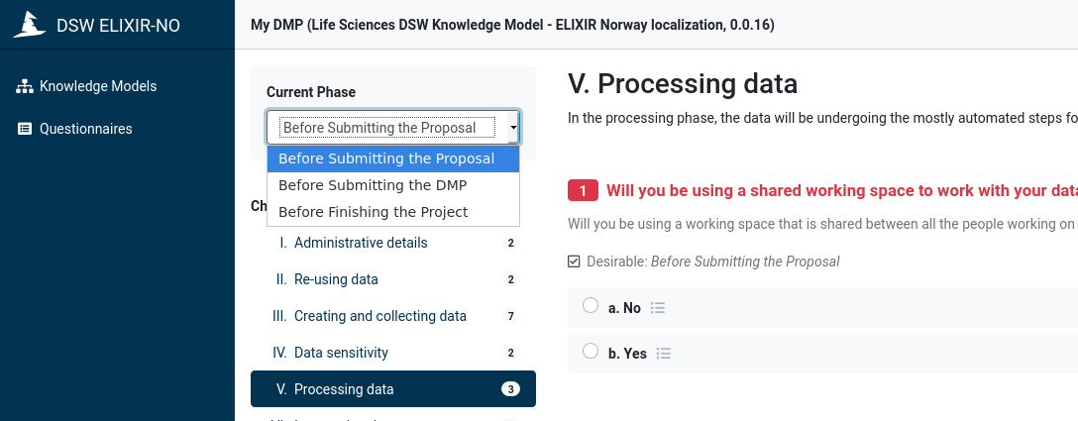
-
elixir-no.ds-wizard.org
ds-wizard.org
github.com/ds-wizard

Slide 7
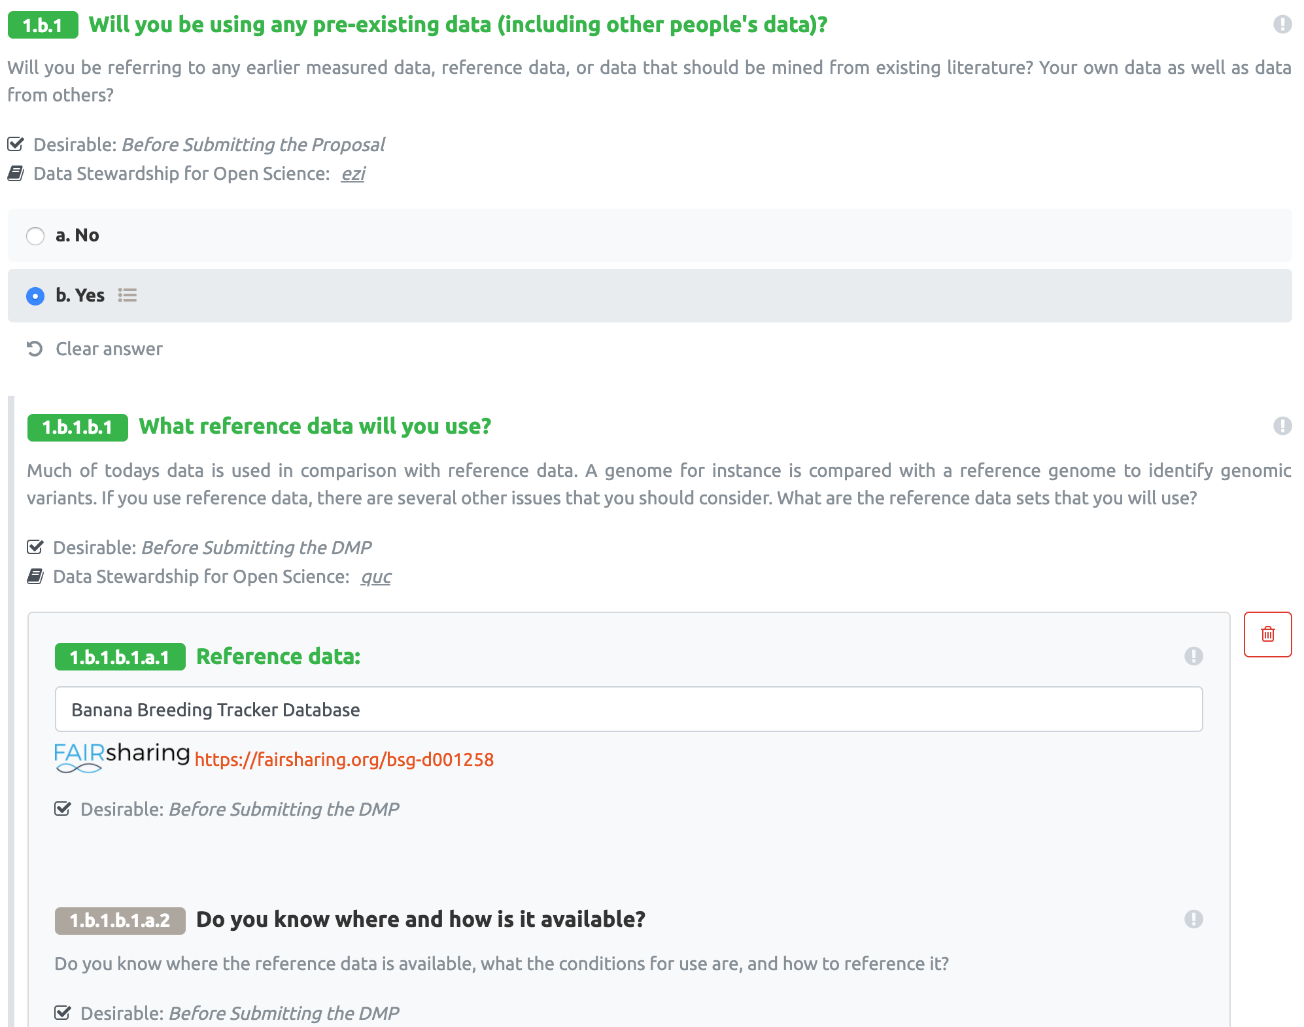
elixir-no.ds-wizard.org
ds-wizard.org
github.com/ds-wizard

Slide 8
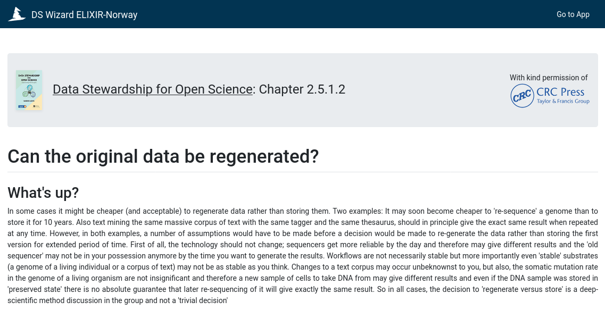
Barend Mons
elixir-no.ds-wizard.org
ds-wizard.org
github.com/ds-wizard

Slide 9
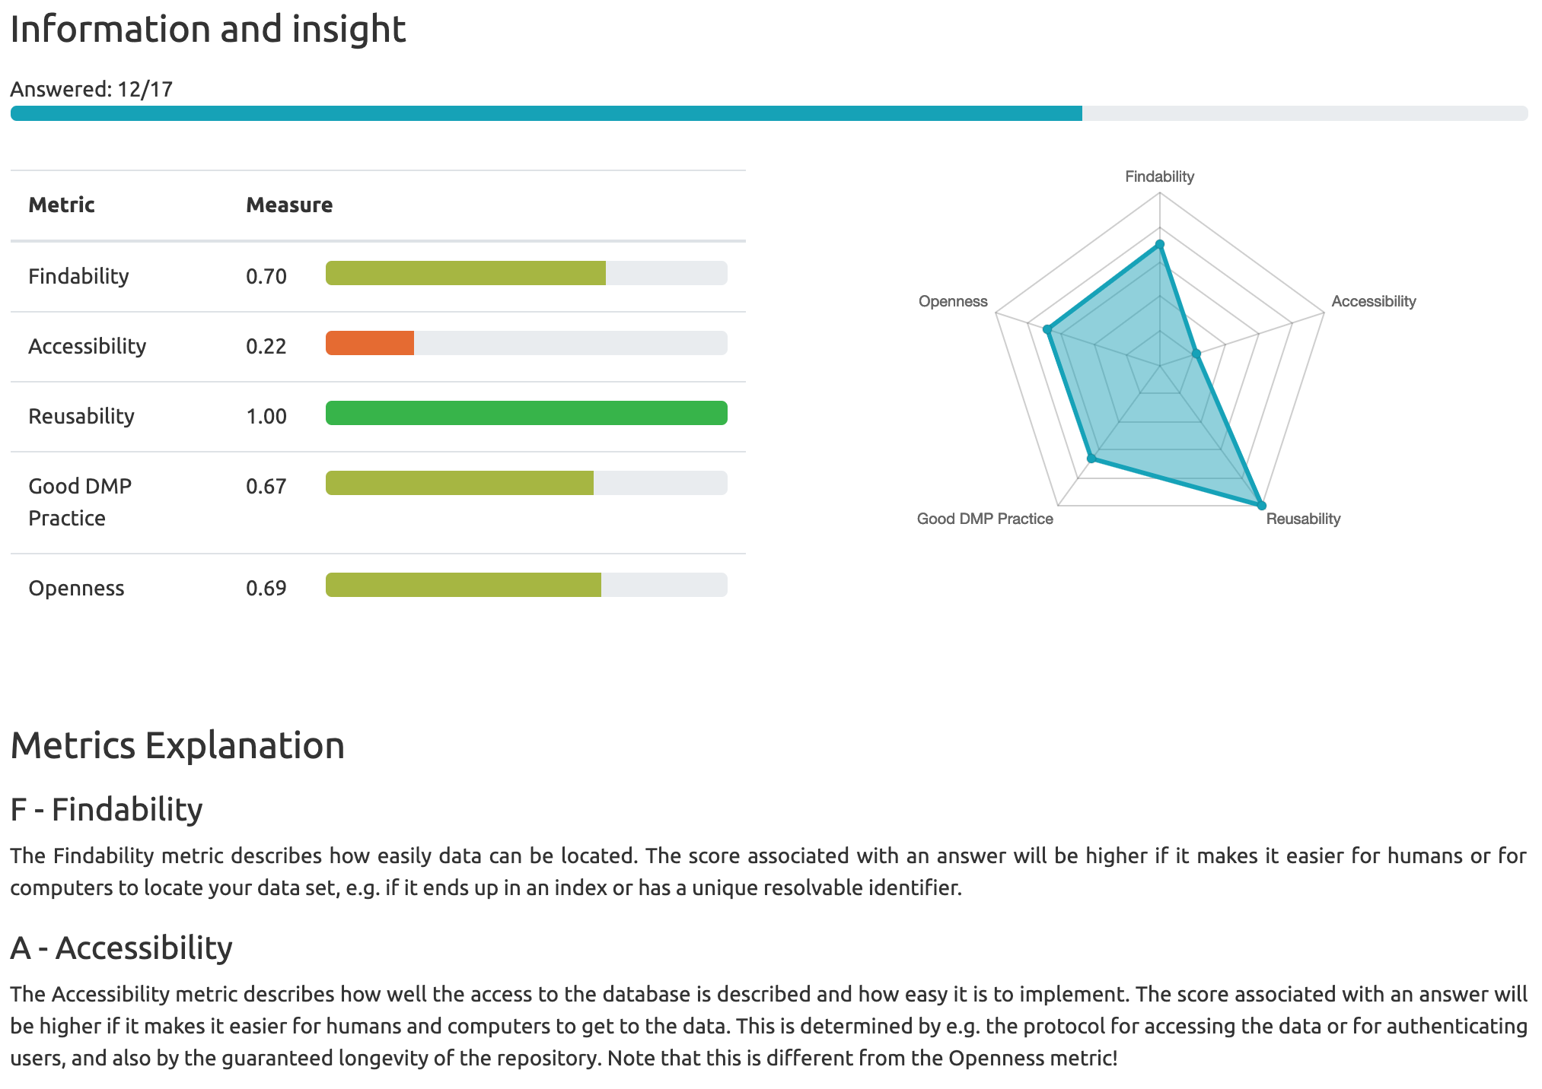
elixir-no.ds-wizard.org
ds-wizard.org
github.com/ds-wizard

Slide 10





N elixir-norway.org E contact@bioinfo.no
digitallifenorway.org
T @elixirnorway
@DigitaltLiv
Data Steward Wizard development

