Slide 1

Metadata & Persistent identifiers
Espen Åberg
Data Steward
ELIXIR Norway/BioMedData
Illustrative Icons from Font Awesome licensed under Creative Commons Attribution 4.0 International License

Slide 2






















sensitive
data

Slide 3
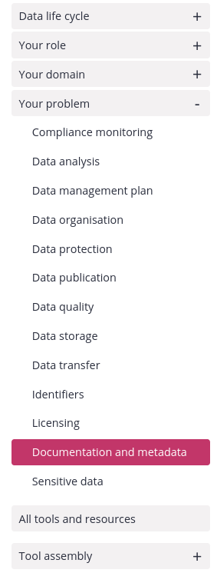


Link to RDMkit: https://rdmkit.elixir-europe.org/

Slide 4
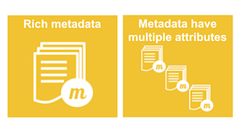
What is metadata?
“Data is content, and metadata is context. Metadata can be much more revealing than data, especially when collected in the aggregate.” — Bruce Schneier, Data and Goliath
“data on data”
“information about something”
“If data is the new oil, metadata is the refinery" — Adam Rauh
FAIR illustrations icons from ARDC 2018 licensed under Creative Commons Attribution 4.0 International License

Slide 5
Experimental design
Outcome = Treatment effect + Biological effect + Technical effects + Error
Lazic, S.E. (2016). Cambridge University Press.

Slide 6
Experimental design
Outcome = Treatment effect + Biological effect + Technical effects + Error
Environment
Compound
Infection
Inhibitor
siRNA
sgRNA
Dose
Time
Lazic, S.E. (2016). Cambridge University Press.

Slide 7
Experimental design
Outcome = Treatment effect + Biological effect + Technical effects + Error
Environment
Compound
Infection
Inhibitor
siRNA
sgRNA
Dose
Time
Sex
Age
Weight
Litter
Genotype
Species
Cell line
Lazic, S.E. (2016). Cambridge University Press.

Slide 8
Experimental design
Outcome = Treatment effect + Biological effect + Technical effects + Error
Environment
Compound
Infection
Inhibitor
siRNA
sgRNA
Dose
Time
Sex
Age
Weight
Litter
Genotype
Species
Cell line
Operator
Batch
Plate
Cage
Array
Flowcell
Instrument
Day
Order
Source
Lazic, S.E. (2016). Cambridge University Press.

Slide 9
Experimental design
Outcome = Treatment effect + Biological effect + Technical effects + Error
Environment
Compound
Infection
Inhibitor
siRNA
sgRNA
Dose
Time
Sex
Age
Weight
Litter
Genotype
Species
Cell line
Operator
Batch
Plate
Cage
Array
Flowcell
Instrument
Day
Order
Source
Experimental
Treatment
Sampling
Measurement
Lazic, S.E. (2016). Cambridge University Press.

Slide 10
Experimental design
“Data”
“Metadata”
Outcome = Treatment effect + Biological effect + Technical effects + Error
Environment
Compound
Infection
Inhibitor
siRNA
sgRNA
Dose
Time
Sex
Age
Weight
Litter
Genotype
Species
Cell line
Operator
Batch
Plate
Cage
Array
Flowcell
Instrument
Day
Order
Source
Experimental
Treatment
Sampling
Measurement
Lazic, S.E. (2016). Cambridge University Press.

Slide 11
Experimental design
“Data”
“Metadata”
And when you put all of this in files, the names of the files, their storage descriptions, types, sizes, versions, how they relate to each other, access rights, licensing etc, all become metadata in your project.
Outcome = Treatment effect + Biological effect + Technical effects + Error
Environment
Compound
Infection
Inhibitor
siRNA
sgRNA
Dose
Time
Sex
Age
Weight
Litter
Genotype
Species
Cell line
Operator
Batch
Plate
Cage
Array
Flowcell
Instrument
Day
Order
Source
Experimental
Treatment
Sampling
Measurement
Lazic, S.E. (2016). Cambridge University Press.

Slide 12
01000110 01100001
01110011 01110100
01110001 01100110
01101001 01101100
01100101
Metadata
PID

Slide 13
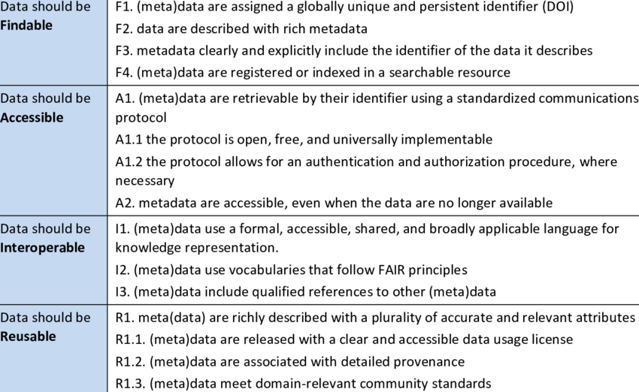
PIDs helps make data FAIR
Medyckyj-Scott, David et al. (2016).

Slide 14
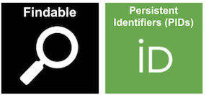
What is a persistent identifier (PID)?
FAIR illustrations icons from ARDC 2018 licensed under Creative Commons Attribution 4.0 International License

Slide 15
PID?
Physical objects: a dog, building, microscope, star, person etc
A persistent identifier (PID) is a long-lasting reference to a resource
Somebody commits to keeping it alive
Digital Objects: data, collections, metadata, software, publications, configurations, categories, workflows etc
globally unique string of characters

Slide 16
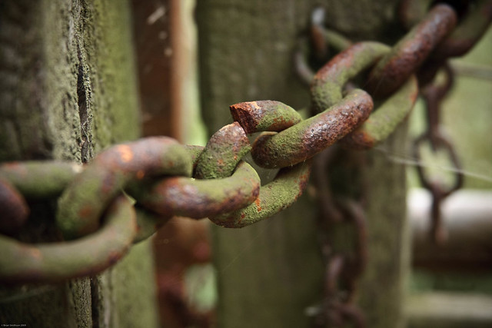
Why not just use a URL?
domain may change
resource may be relocated
URL may change
“Link rot”
farm3.staticflickr.com

Slide 17

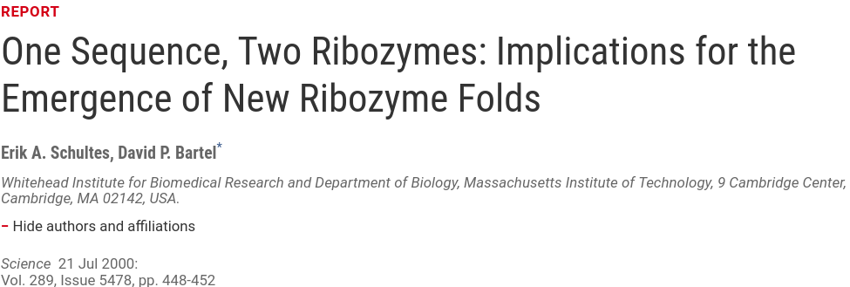
https://doi.org/10.1126/science.289.5478.448

Slide 18
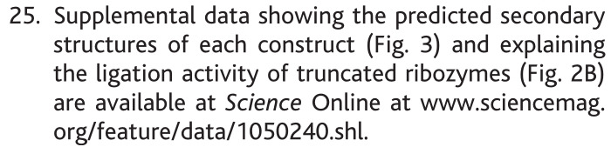

Slide 20
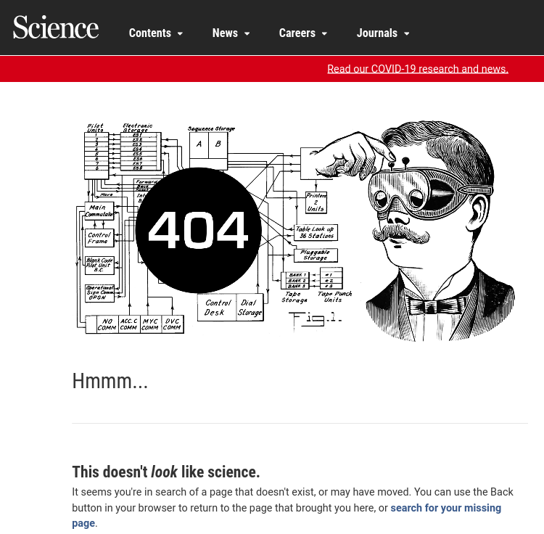

Slide 21
Persistent over time
.. by design
today
…
...
...
2030
PID is unique and always the same
11839/abc123
11839/abc123
http://www.example.com/
http://www.moved.com/
111000010001111
URL may change over time
111000010001111
Supports access to resource as it moves from one location to another.
Modified from https://b2drop.eudat.eu/s/TCYdyf3eqwE0Ust

Slide 22
Persistent over time
.. by design
today
…
...
2030
Stable
11839/abc123
11839/abc123
http://www.example.com/
http://www.moved.com/
Update information
Redirection
111000010001111
Responsibility of the PID owner to keep it up-to-date when the resource changes
111000010001111
Modified from https://b2drop.eudat.eu/s/TCYdyf3eqwE0Ust

Slide 23
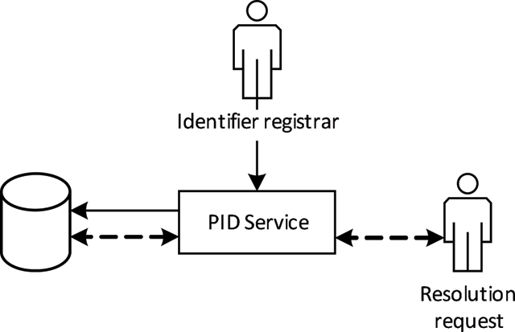
A PID consists of 2 components:
1. a unique identifier
2. a service that locates the resource over time even when it's location changes
http://doi.org/10.5334/dsj-2017-034
Notes:
A PID is resolvable when it allows both human and machine users to access

Slide 24




Examples for digital objects
Digital Object Identifiers
Handles
Archival Resource Keys (ARK)
Persistent Uniform Resource Locator (URL)
Identifiers.org

Slide 25
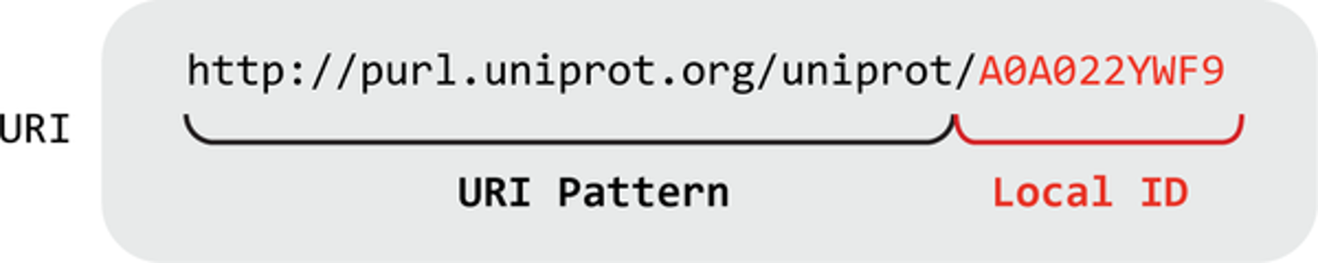
Anatomy of a web-based identifier
URL or URN
= an “Accession”
Only guaranteed to be locally unique within the database or source
Means that it is actionable: you can paste in a web browser address bar and be taken to the identified source.
McMurry JA et al. (2017) PLOS Biology 15(6)

Slide 26
How to recognize a PID
DOI: 10.5281/zenodo.6104400

Slide 27
Anatomy of a DOI
  globally unique together
https://doi.org/ 10.5281 / zenodo.6104400
Resolver service
Directory
indicator
Suffix
Prefix
Assigned by
DOI Foundation
Assigned by RA members (registrants)
e.g. F1000 Research
Assigned by
DOI Registration Agencies (RAs)
e.g. Crossref, DataCite, etc

Slide 28
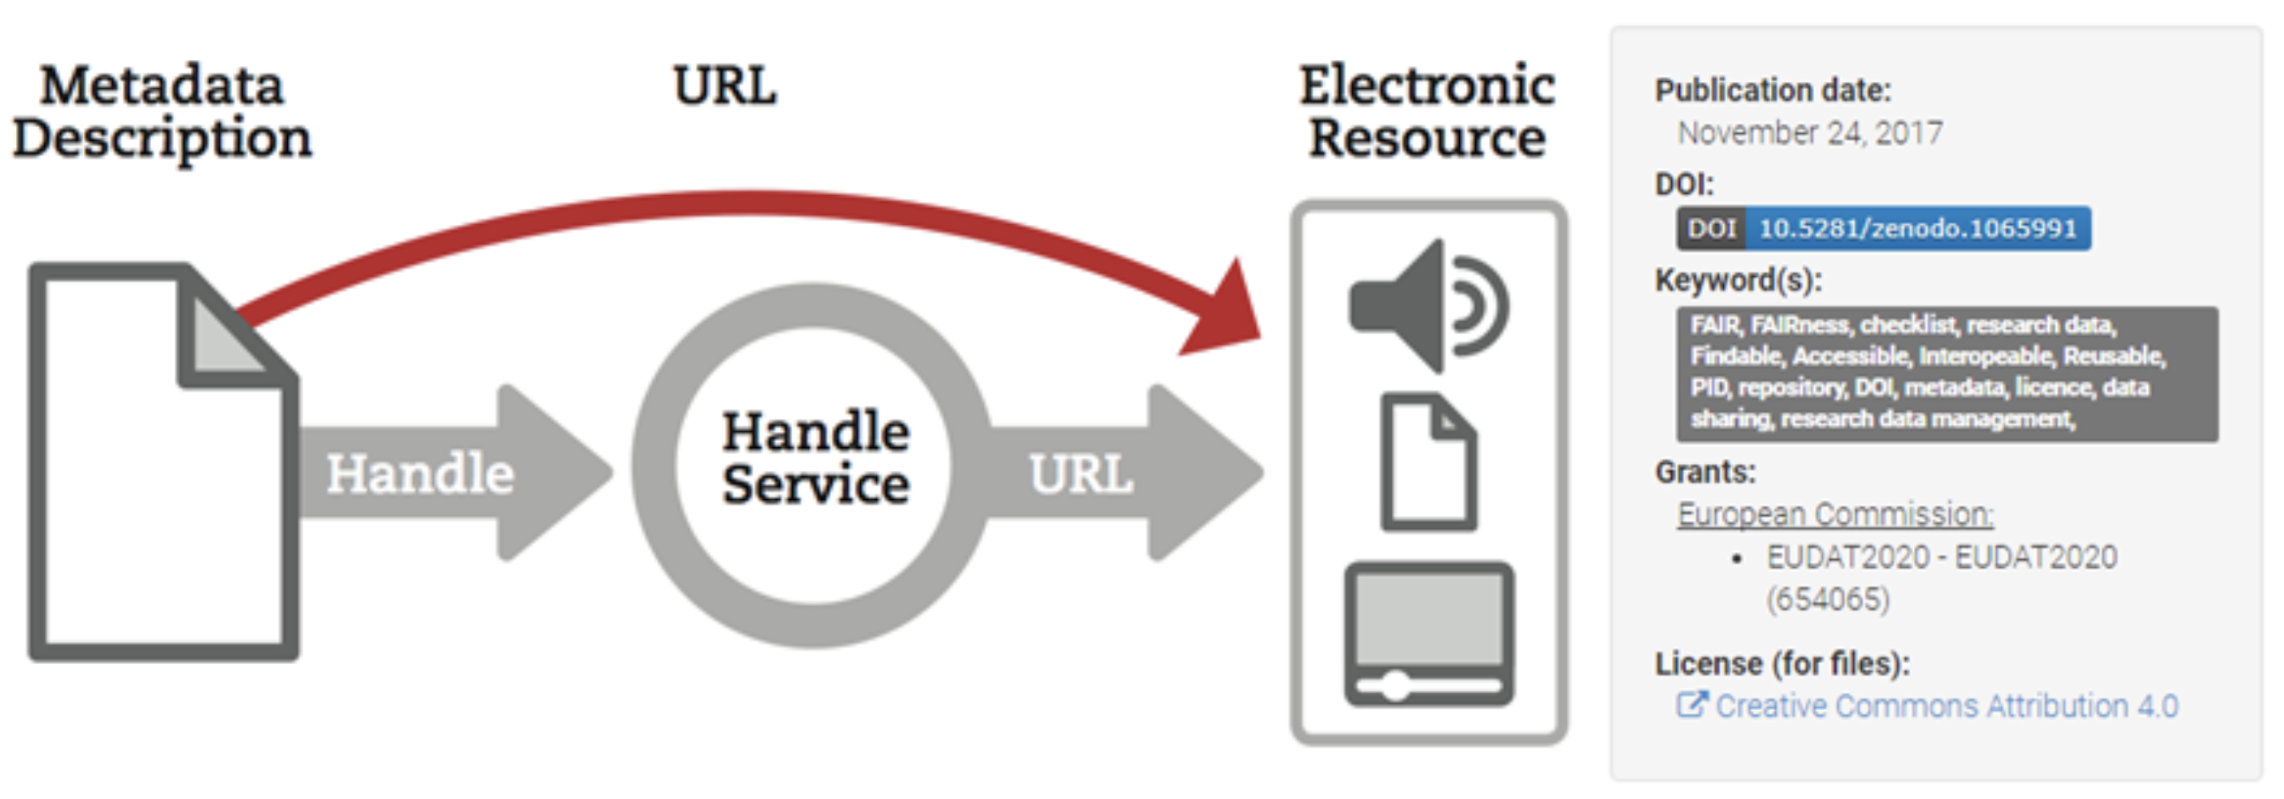
https://www.clarin.eu/sites/default/files/pid-CLARIN-ShortGuide.pdf

Slide 29



PIDs for
 People
$ Funding bodies
 Institutions
 Instruments (soon)

Slide 30
PIDs for
 People
$ Funding bodies
 Institutions
 Instruments (soon)

Slide 31


PIDs for
 People
$ Funding bodies
 Institutions
 Instruments (soon)

Slide 32

PIDs for
 People
$ Funding bodies
 Institutions
 Instruments (soon)

Slide 33
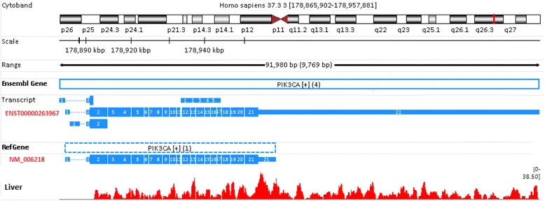
Sequence identifiers:
d Gene: PIK3CA
Figure 6 from Zhao, S., and Zhang, B. (2015). BMC Genomics 16 licensed under Creative Commons Attribution 4.0 International License

Slide 34
Sequence identifiers:
d Gene: PIK3CA
Figure 6 from Zhao, S., and Zhang, B. (2015). BMC Genomics 16 licensed under Creative Commons Attribution 4.0 International License

Slide 35
Sequence identifiers:
d Gene: PIK3CA
Figure 6 from Zhao, S., and Zhang, B. (2015). BMC Genomics 16 licensed under Creative Commons Attribution 4.0 International License

Slide 36
Sequence identifiers:
d Gene: PIK3CA
Figure 6 from Zhao, S., and Zhang, B. (2015). BMC Genomics 16 licensed under Creative Commons Attribution 4.0 International License

Slide 37
Sequence identifiers:
d Gene: PIK3CA
ENST00000263967.2
3
4
Figure 6 from Zhao, S., and Zhang, B. (2015). BMC Genomics 16 licensed under Creative Commons Attribution 4.0 International License

Slide 38
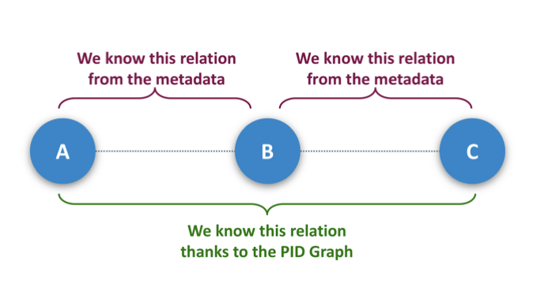

PIDs can do more
“I want to see all datasets funded by RCN cited by this article”
Publication
Datasets
Publication
Datasets
Publication
Funder/Grant
Datasets
Publication
Publication

Slide 39

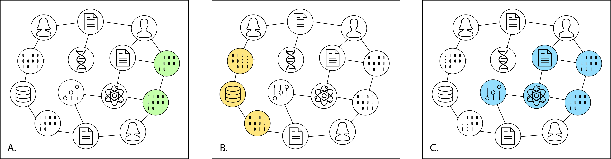
PID Graphs
Aggregate all citations for a research object: a publication, the data underlying the findings in the paper, and the software, samples, and reagents used to create those datasets.
Aggregate the citations for all versions
of a dataset or software source code
Aggregate the citations for all datasets hosted in a particular repository, funded by a particular funder, or created by a particular researcher
https://doi.org/10.5438/JWVF-8A66

Slide 40

Except where otherwise noted, this work is licensed under:
https://creativecommons.org/licenses/by/4.0/

