Slide 1
Requirements from institutions & funding bodies
Elixir Data Management Planning workshop for Life Science Projects 10/12/2020
Elin Stangeland, Digital services
University of Oslo Library

Slide 2
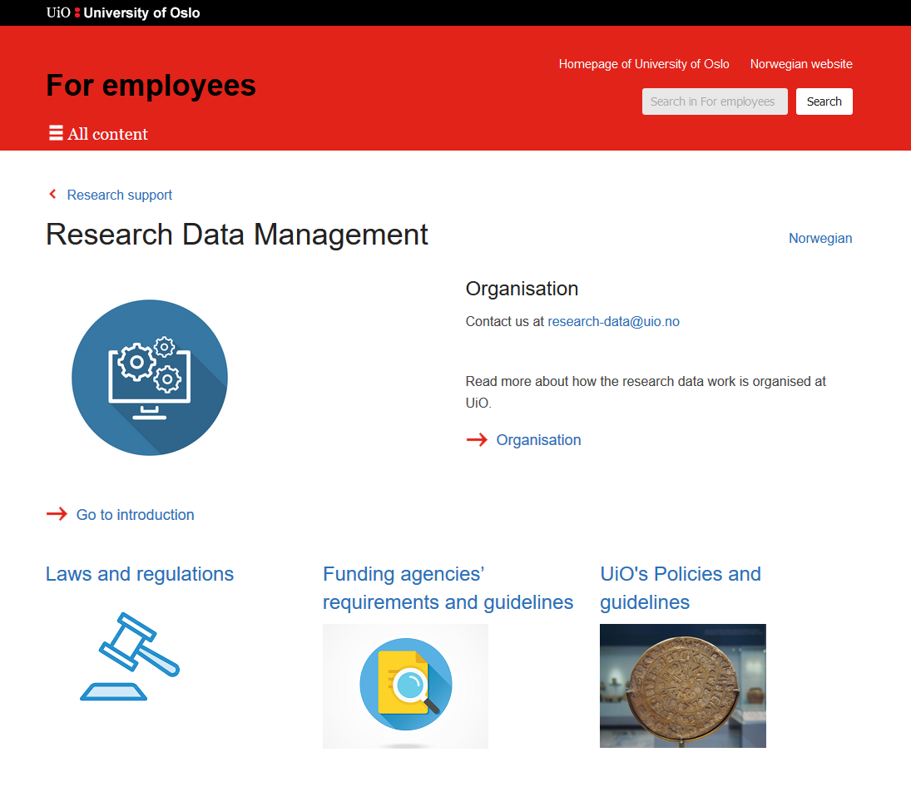
https://www.uio.no/english/for-employees/support/research/research-data-management/index.html
Notes:
https://www.uio.no/english/for-employees/support/research/research-data-management/index.html

Slide 3
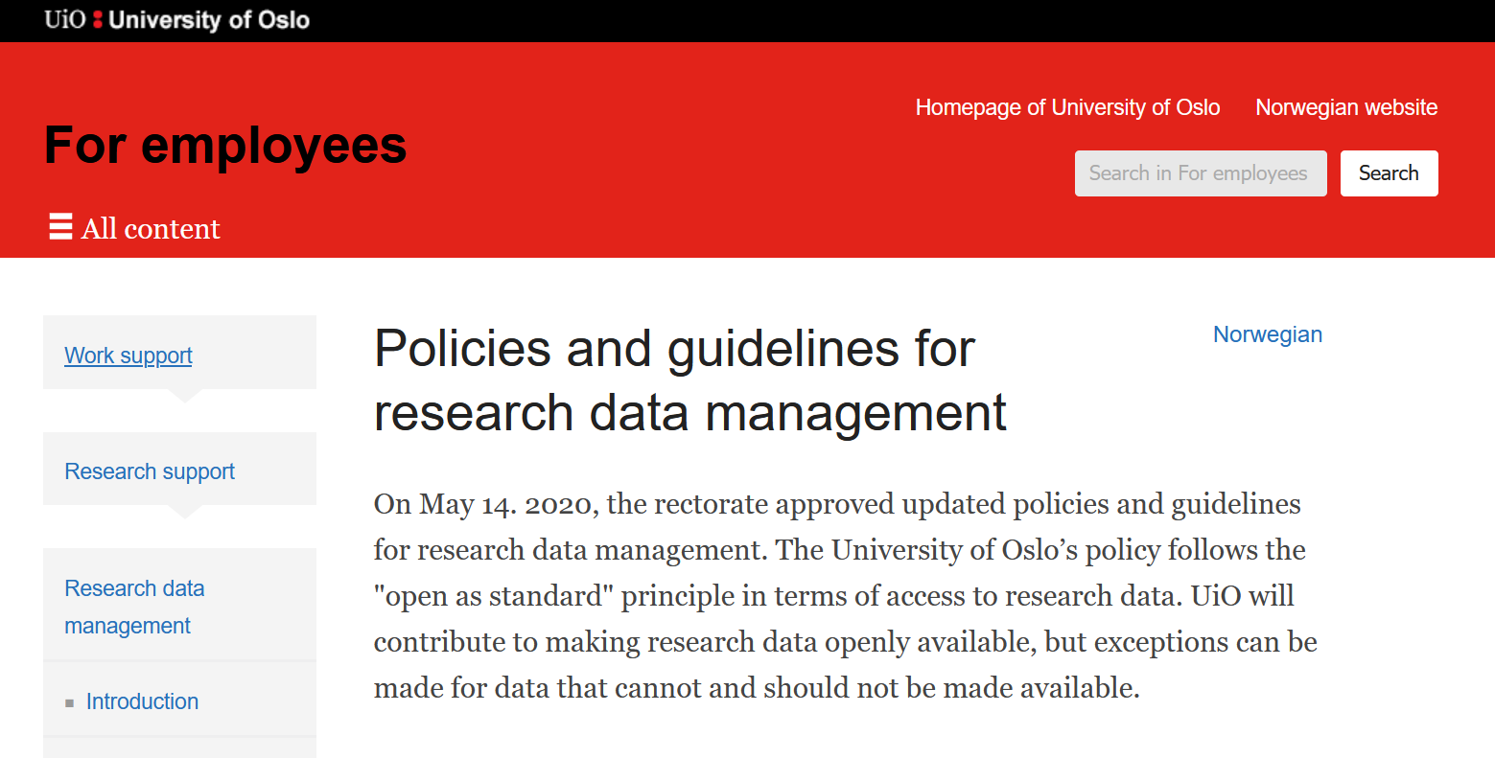
Source: https://www.uio.no/english/for-employees/support/research/research-data-management/policies-and-guidelines/

Slide 4
Research data are representations of observations, objects, or other entities used as evidence of phenomena for the purpose of research or scholarship
Observational data
Computational data
Experimental data
Records

Slide 5
The policy
The University of Oslo aims to manage research data according to international standards, such as the FAIR principles, CARE principles and thereby support the development of a global research community in which research data is widely shared. This should contribute to:
improved quality of research by building on previous works and compiling research data in new ways
transparency in the research process and better opportunity for verifiability of scientific results
increased cooperation and less duplication of research work
increased innovation in the private and public sectors
efficiency improvement and better utilisation of public funds

Slide 6
Research data should be:
accurate, complete, genuine, and reliable
findable, accessible, interoperable and reusable
securely stored and/or archived
maintained in accordance with legal and research-ethical obligations
shareable with others in line with relevant ethical principles for sharing of research data.
Made accessible at the earliest possible time, but after research team’s first right of use period.

Slide 7

Guidelines
Research data shall be made openly available for further usage
Research data should be made available at an early stage
Research data shall be provided with a data management plan
Research data shall have metadata and be documented
Research data must be securely archived
Research data shall be provided with licenses for access, reuse and redistribution
Research data should be made freely available, but the actual distribution cost should be covered

Slide 8
Responsibilities
UiO is responsible for facilitating the information flow, competence measures and research support systems that simplify the implementation process of the principles and requirements mentioned above.
Scientists and students are responsible for managing research data according to the principles and requirements stated above.
Supervisors of ph.d candidates and students have a special responsibility for ensuring that candidates and students attend courses and manage research data according to the above guidelines.

Slide 9
Exceptions to sharing research data open access
Security considerations
Sensitive personal data
Other legal provisions
Commercial conditions

Slide 10

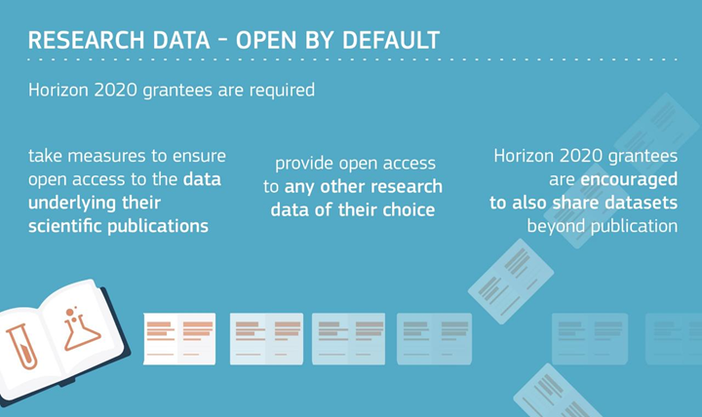
Notes:
Sources: https://www.openaire.eu/how-to-comply-to-h2020-mandates-for-data
and: https://ec.europa.eu/research/participants/data/ref/h2020/grants_manual/hi/oa_pilot/h2020-hi-oa-data-mgt_en.pdf

Slide 11
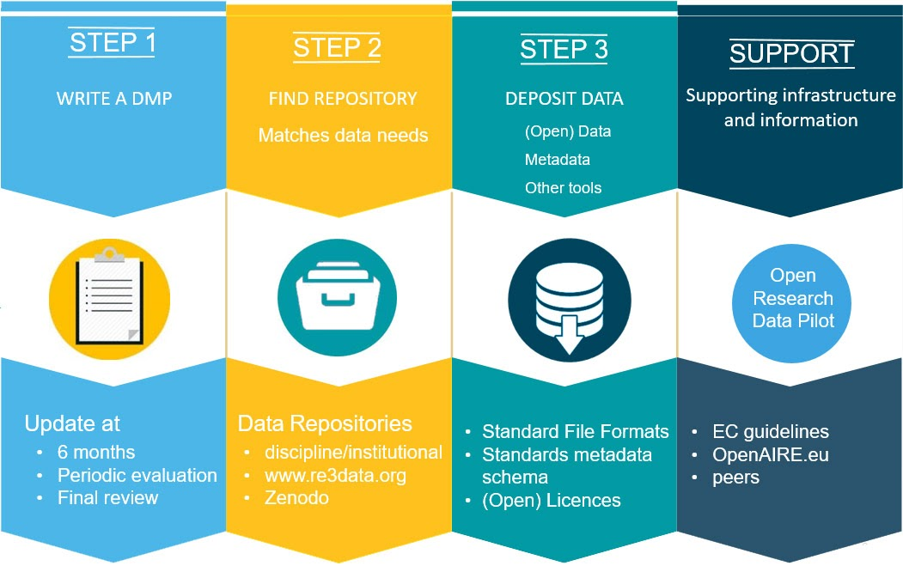

Slide 12
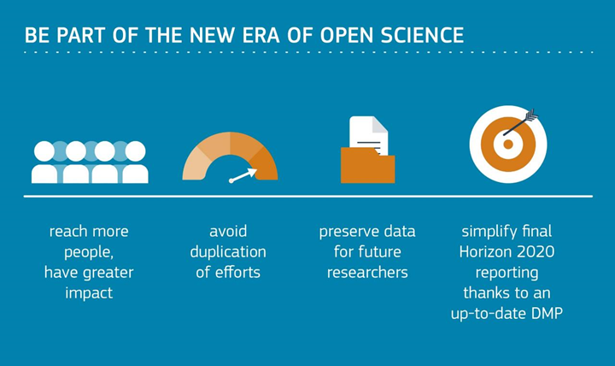
Notes:
e following…

Slide 13
Costs: - costs for data management are eligible for reimbursement for the duration of the grant agreement.
Opting-out: It is possible to opt-out (not share your data) at any stage: during the application phase or the grant agreement preparation phase or after signing the grant agreement. However, projects that opt out are still encouraged to submit a DMP on a voluntary basis.
Horizon Europe: Require research data to be FAIR and open by default

Slide 14

Frontier Research Grant (Starting Grant / Consolidator Grant / Advanced Grant / Synergy Grant)
All ERC projects funded under the Work programmes 2017 and later participate by default in the Horizon 2020 Open Research Data (ORD) pilot, with the possibility for grantees to opt out at any time.
Notes:
Source: https://erc.europa.eu/managing-project/open-access
Source: https://erc.europa.eu/sites/default/files/document/file/ERC_info_document-Open_Research_Data_and_Data_Management_Plans.pdf

Slide 15
Data management planning
Topics to be covered:
1.Data set description
2.Standards and metadata
3.Name and persistent identifier for the data sets
4.Curation and preservation methodology
5.Data sharing methodology

Slide 16

Open by default
Data created through research funded by the Research Council
FAIR – Findable, accessable, interoperable and reusable
Notes:
Source: https://www.forskningsradet.no/en/Adviser-research-policy/open-science/open-access-to-research-data/

Slide 17
Guidelines
Research data must be stored/archived in a safe and secure manner.
Research data must be made accessible for reuse.
Research data should be made accessible at an early stage.
Research data must be accompanied by standardised metadata.
Research data must be provided with a license for access, reuse and redistribution
Research data should be made accessible at the lowest possible cost.
The management of research data must be described in a data management plan.

Slide 18
Requirements
The R&D-performing institution must assess the need to develop a data management plan in relation to all projects awarded Research Council funding. If you decide that a data management plan is not needed, you must provide an explanation.
This plan must be delivered in connection with the revised grant application.
A final version of the data management plan in connection with the final report of the project.

Slide 19
The plan is a living document that follows the research project and specifies the following:
the kind of data that will be generated;
how the data will be described;
where the data will be stored;
whether and how the data can be shared.

