Slide 1

Data Storage Platforms
Korbinian Bösl
Data management coordinator
ELIXIR Norway/Digital Life Norway
10th December 2020
Illustrative Icons from Font Awesome licensed under Creative Commons Attribution 4.0 International License

Slide 2






















sensitive
data

Slide 3






NeLS
ola@uib.no
My Projects
Data curation
Tekle, et al. (2018) F1000Res
github.com/elixir-no-nels/nels-core
https://nels.bioinfo.no/

Slide 4
NeLS
ola@uib.no
Flexible work
on active data
My Projects
MMMM
Data curation
Tekle, et al. (2018) F1000Res
github.com/elixir-no-nels/nels-core
https://nels.bioinfo.no/

Slide 5

NeLS
S
ola@uib.no
ola@uib.no
Flexible work
on active data
My Projects
MMMM
Data curation
Tekle, et al. (2018) F1000Res
github.com/elixir-no-nels/nels-core
https://nels.bioinfo.no/

Slide 6
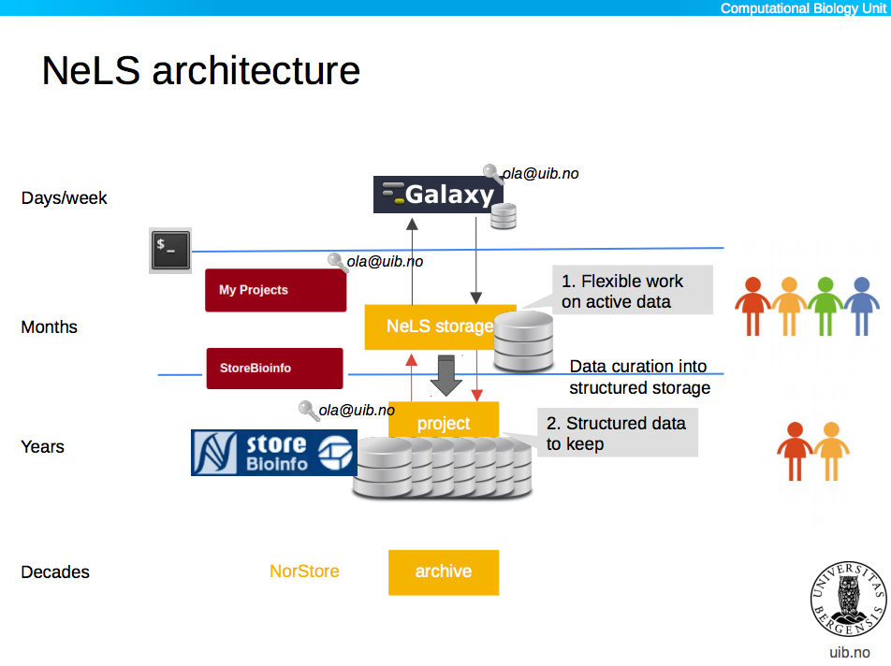





NeLS
S
ola@uib.no
ola@uib.no
Flexible work
on active data
My Projects
MMMM
Data curation
ola@uib.no
Structured data to keep
MM
MetaboLights
DOI
Tekle, et al. (2018) F1000Res
github.com/elixir-no-nels/nels-core
https://nels.bioinfo.no/
ArrayExpress

Slide 7
NeLS
S
ola@uib.no
Days - weeks
ola@uib.no
Flexible work
on active data
My Projects
MMMM
Months
Data curation
ola@uib.no
Structured data to keep
MM
Years
MetaboLights
DOI
Decades
Tekle, et al. (2018) F1000Res
github.com/elixir-no-nels/nels-core
https://nels.bioinfo.no/
ArrayExpress

Slide 8


NeLS - Accessibility
small datasets
ola@uib.no
https://nels.bioinfo.no/

Slide 9



NeLS - Accessibility
small datasets
larger datasets
ssh-key
sFTP
ola@uib.no
https://nels.bioinfo.no/

Slide 10
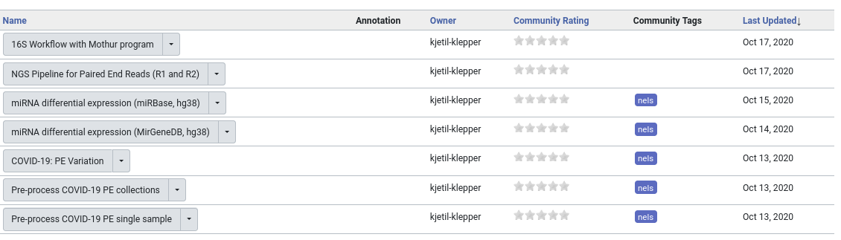
Data Analysis in NeLS
usegalaxy.no

Slide 11
Data Analysis in NeLS
Courses Q1 2021
usegalaxy.no

Slide 12
NeLS - Getting Access
Typically > 1TB data
Free < 10TB & <15 mill. NOK
Allocation through Helpdesk: contact@bioinfo.no
Direct upload through Norseq facilities
https://nels.bioinfo.no/pages/user-terms.xhtml

Slide 13

SEEK
H N
https://seek4science.org/
https://fairdomhub.org/

Slide 14
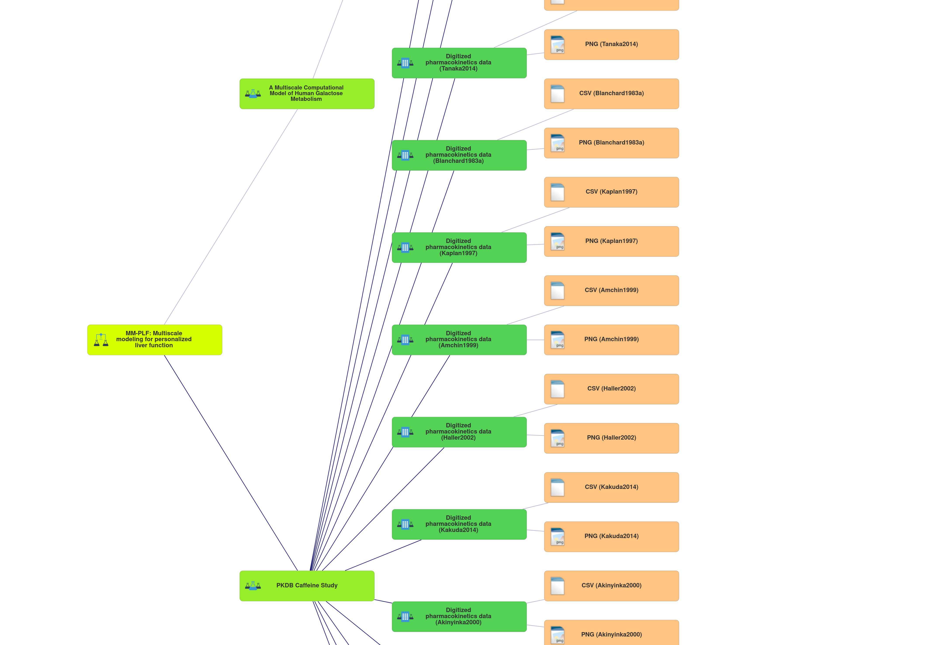
SEEK
Investigation
Study
Assay
https://seek4science.org/
https://fairdomhub.org/

Slide 15
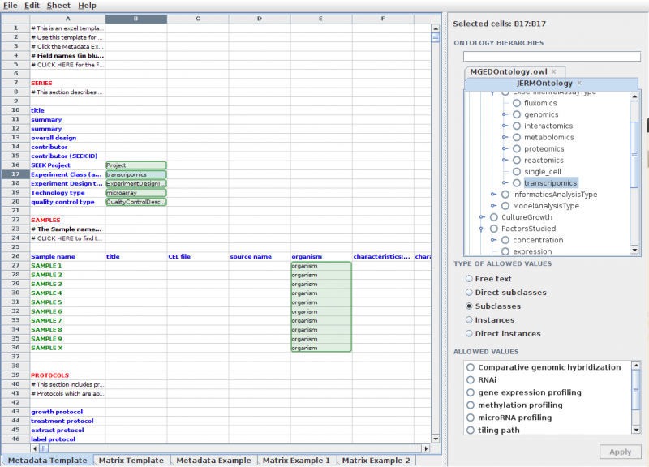

SEEK
https://seek4science.org/
https://rightfield.org.uk/

Slide 16



↔ Integration
Reference data in NeLS in SEEK
Access data in NeLS through SEEK
Save Metadata to SEEK through NeLS

Slide 17
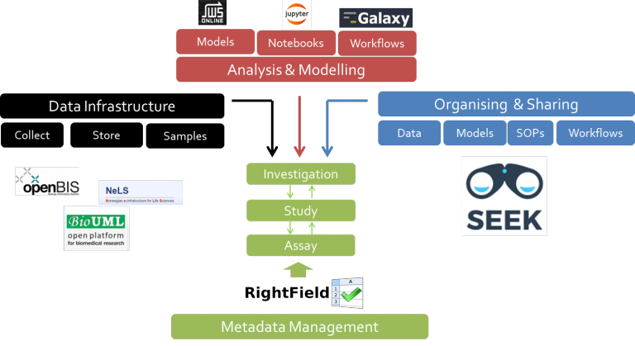

Slide 18

National HPC infrastructure
D Advanced Storage Needs
S Advanced Computing Resources
t Free Analysis Toolkit (Rstudio, Jupyternotebook)
https://www.sigma2.no/

Slide 19



National HPC infrastructure
NIRD
toolkit
DDD
=
Saga
NIRD
NIRD
archive
https://www.sigma2.no/

Slide 20
HPC infrastructure
Saga
244 nodes – 9824 cores – 32 GPUs
Total 75TB RAM – 186-3066GB/node
89TB + 60 TB NVMe+SSD
1PB file system
https://documentation.sigma2.no/quick/saga.html

Slide 21
Storage infrastructure - NIRD
Geo replicated
Nightly snapshots
12 PB (→ 36 PB next 3 yrs)
DDD
https://documentation.sigma2.no/storage/nird.html

Slide 22
Sigma2 - Getting Access
Bi-annual calls (January & July) – Reapplication (!)
User contribution model (projects > 15 mill. NOK)
Application for small grants continually
https://www.sigma2.no/how-apply-user-account
https://www.sigma2.no/data-storage#get-access

