Slide 1
Usegalaxy.no for analysis
Erik Hjerde
ELIXIR Norway, Norwegian e-infrastructure for Life Sciences and usegalaxy.no

Slide 2
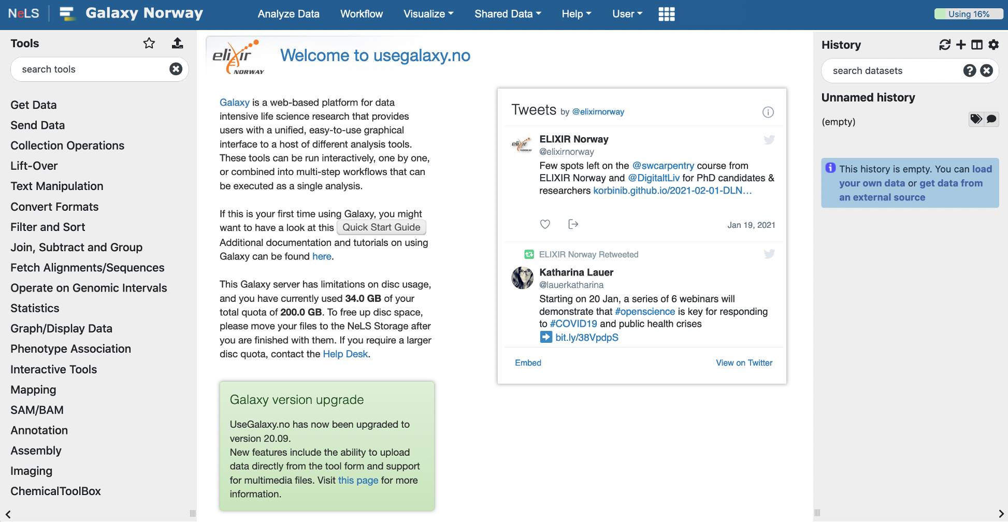
usegalaxy.no – The national Galaxy server
Web-based platform
Provide bioinformatic tools and workflows
Open to all Norwegian user and collaborators
Enable accessible, reproducible, and transparent computational biomedical research
Directly connected to the NeLS storage

Slide 3
usegalaxy.no – The basics
Main menu
Important features:
Tool menu with ~2000 tools sorted in sections
Current disk usage (default is 200 GB total personal disk space)
Server alerts
Quick start guide
Contact support
Q&A forum
Tool menu
Main window
History
Notes:
Quick start guide:
Galaxy basics
Uploading local data files into Galaxy
How to import/export data from NeLS storage
Running tools
Workflows

Slide 4
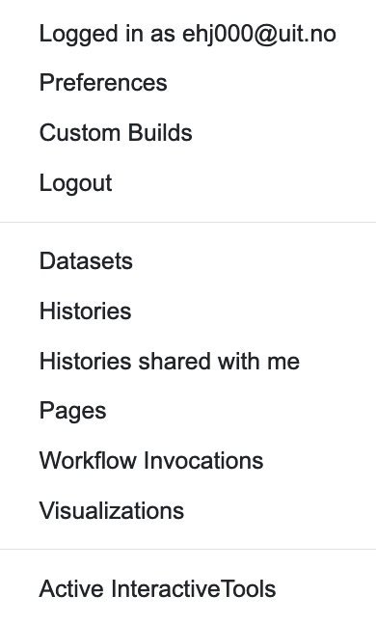
Your account and saved data
Account settings and saved data such as saved histories and visualizations
Histories other users have shared with you
Log of analysis workflows you have run
bon007@uit.no

Slide 5
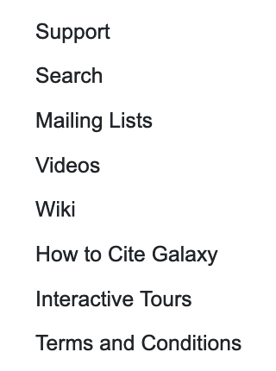
Support and tutorials
Contact ELIXIR Norway helpdesk for support
Access to Galaxy wiki, and tutorials

Slide 6
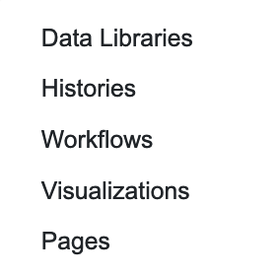
Shared data
Data shared by other users or ELIXIR-NO with all users of usegalaxy.no
E.g. workflows and complete histories
You can import shared data to you user
Instructions how to use ELIXIR-NO supported workflows are also here

Slide 7
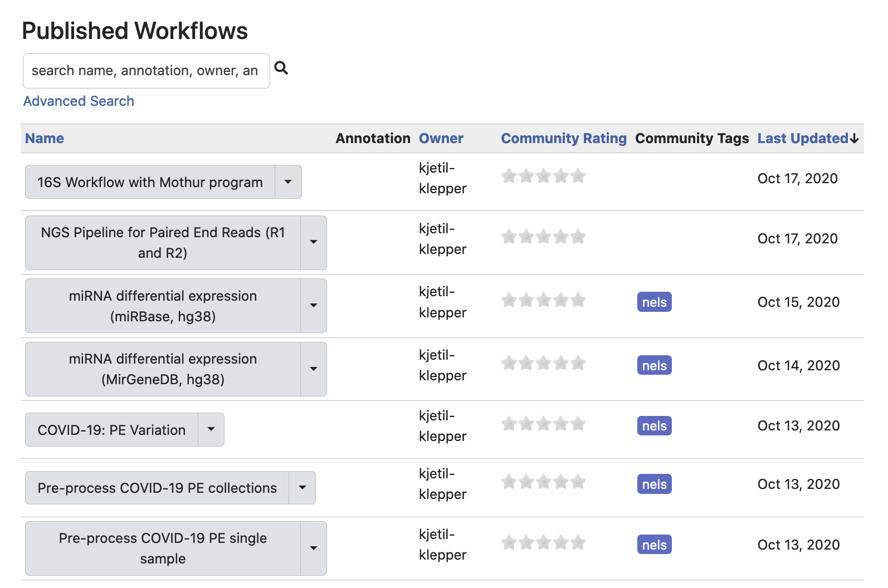
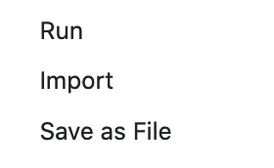
Shared data: workflows
List of all workflows that are shared with all usegalaxy.no users
You can import shared data to your user
By selecting any workflow you can run data analysis, import into your user or save it on another computer

Slide 8
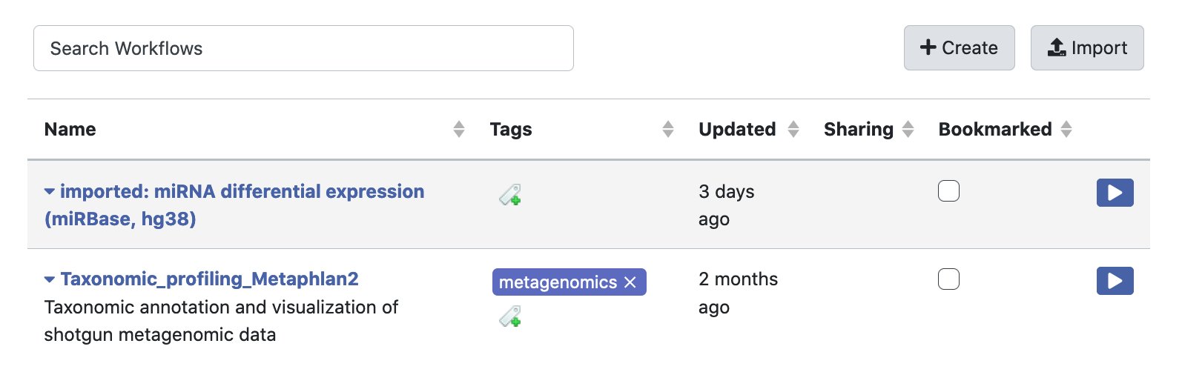
Workflows
Your workflows. These are the imported or the workflows you have made
You can create new workflows here

Slide 9
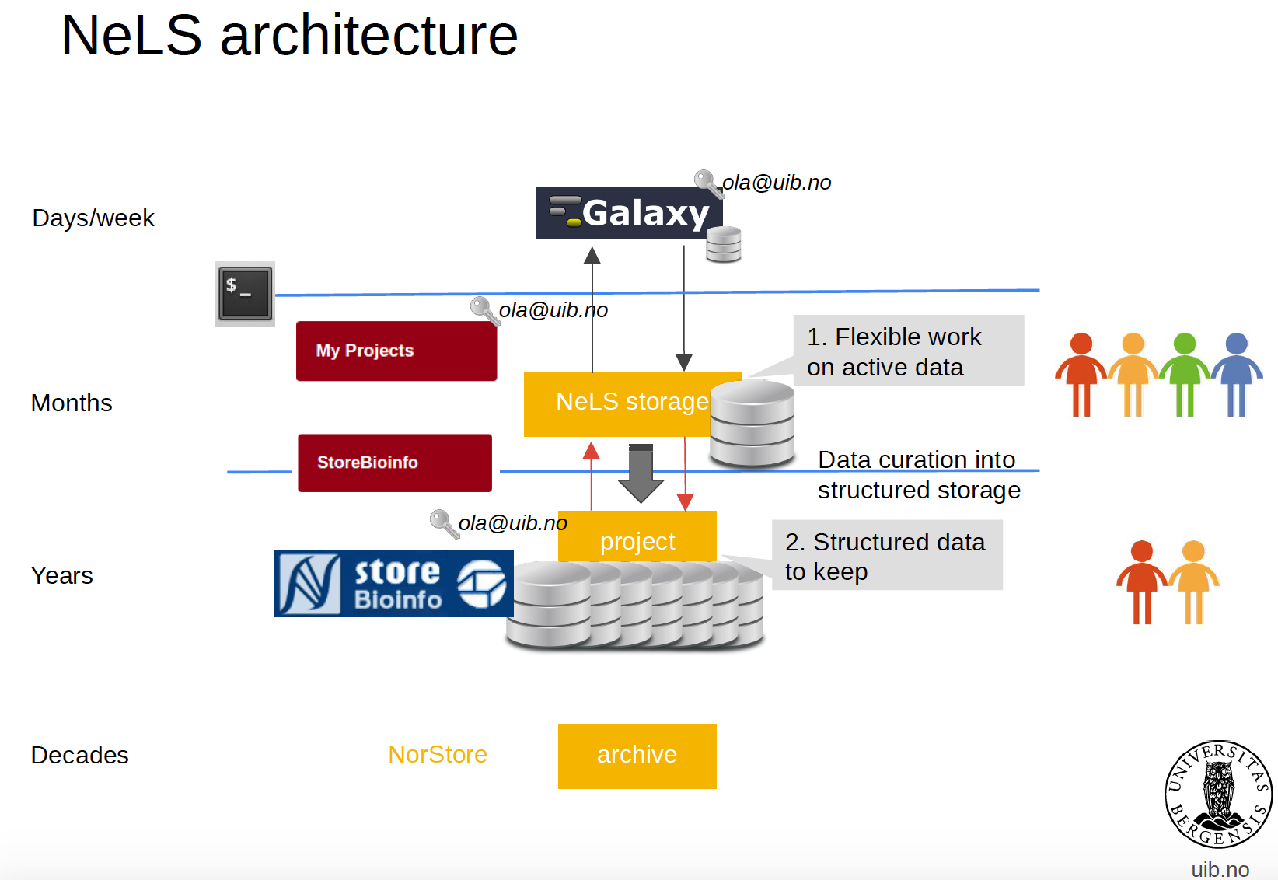





Usegalaxy.no is connected to NeLS
Data can be transferred directly
Research data archive

Slide 10
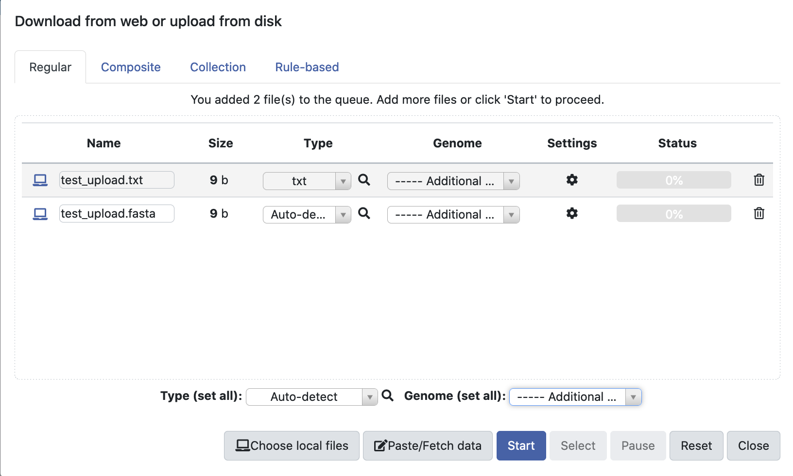
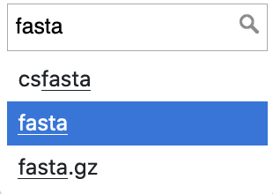
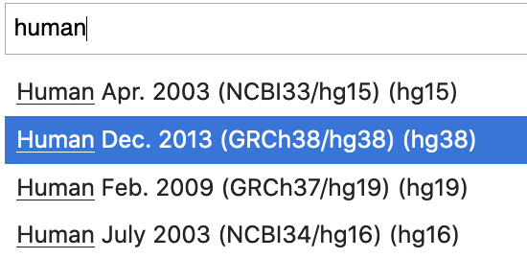
Importing data from your computer
Drag and drop, or browse and select file
Alternatively, paste url for data available on the web
Specify datatype if you know (e.g. Fasta)
If your data is aligned reads, specify the reference genome your data was aligned against
Notes:
If you have large files (> 100 MB) → use FTP upload
if you have many files (> 10) → use FTP upload
if datasets you are uploading have been deposited to SRA → use SRA upload

Slide 11
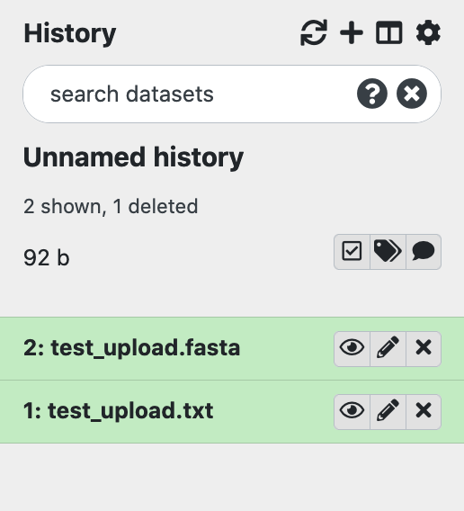
Importing data from your computer
The two imported files will appear as two datasets in your history
The datasets are displayed in the order in which they were created/imported, with the oldest/first shown at the bottom
Galaxy also adds an increasing number in front of the files

Slide 12
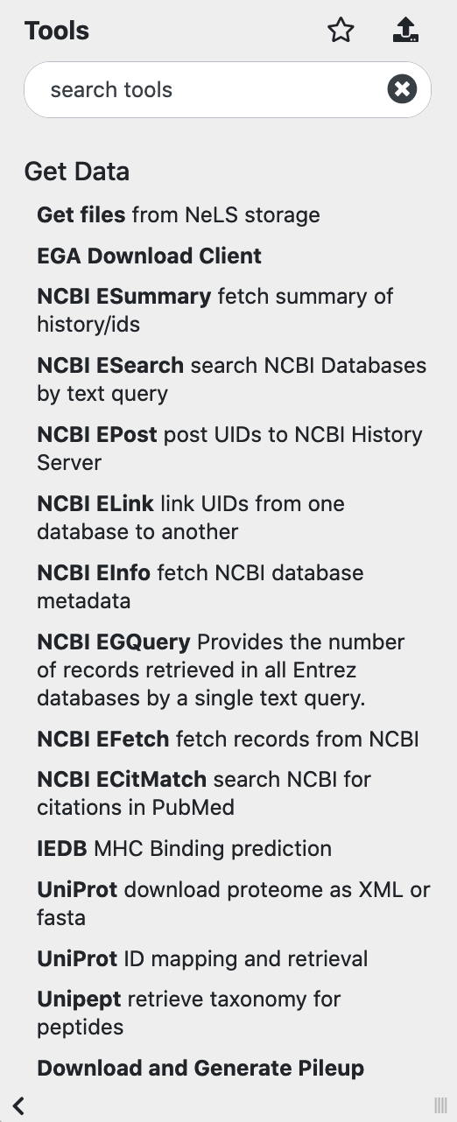
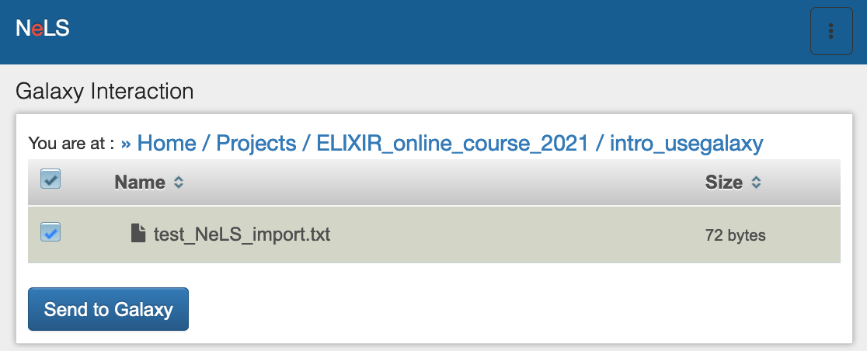
Importing data from NeLS
Import data from Personal or Project folders in NeLS
Redirect to the NeLS portal (require login)
Files are selectable

Slide 13
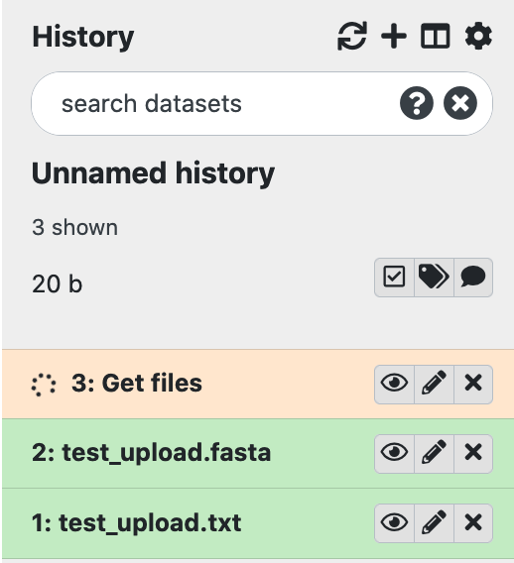
Importing data from NeLS
Redirect back to usegalaxy.no
Imported data from NeLS will appear in your history
Note: the yellow colour of files as this jobs are being processed (green = job complete)

Slide 14
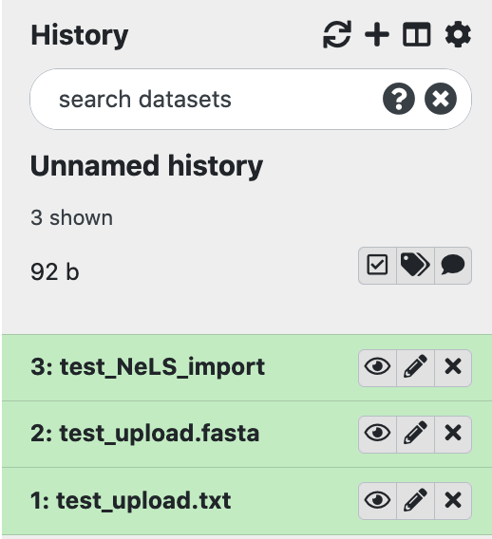
Use galaxy histories to organise data
The current history is ”your current work space”
The history panel displays datasets in the order in which they were created

Slide 15
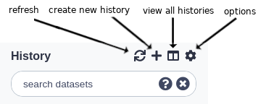
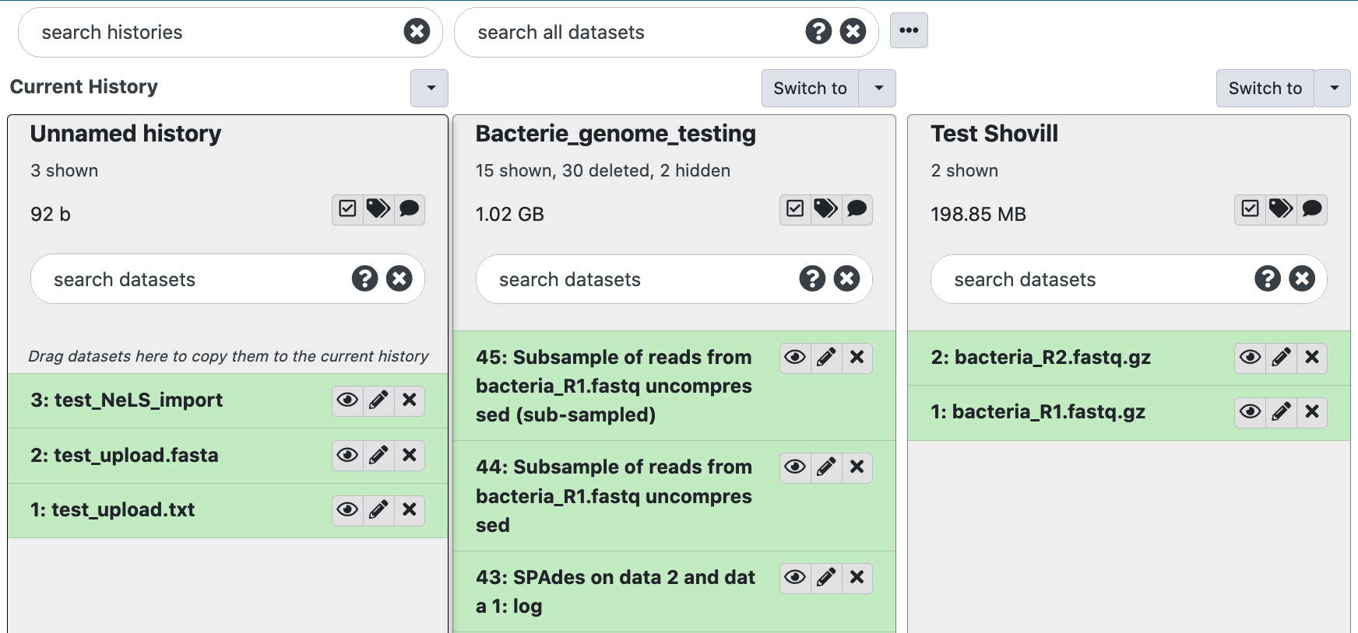
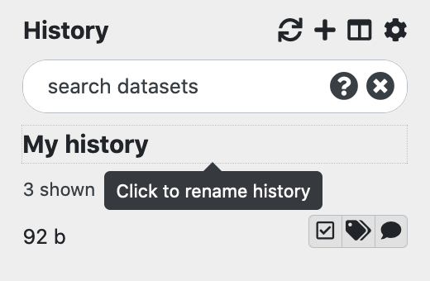
Use galaxy histories to organise data
You can make as many histories as you want and switch between them
Typically, you can have one history for each project or analysis
You can rename your histories, all must have unique names (Press enter to save the name)

Slide 16
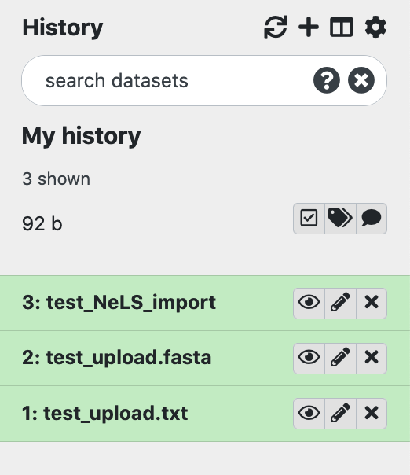
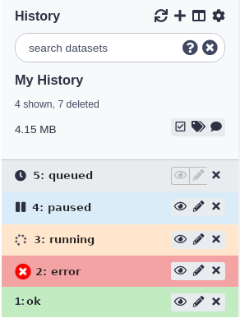
Datasets is equivalent to file(s)
In Galaxy the term dataset are the inputs and outputs of each step in an analysis project
Datasets also can be a collection of files, or a list of files
Datasets can have different states
Job has not yet started but will create this dataset
Paused jobs can be resumed but will create this dataset
Job is running but will create this dataset
The job failed with an error
The job completed successfully

Slide 17
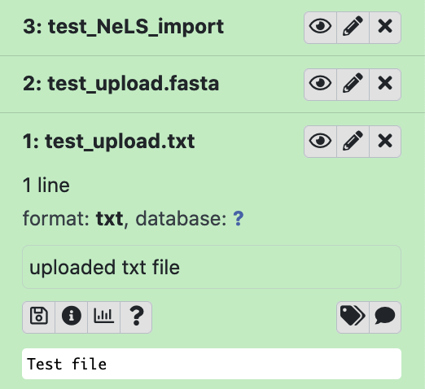
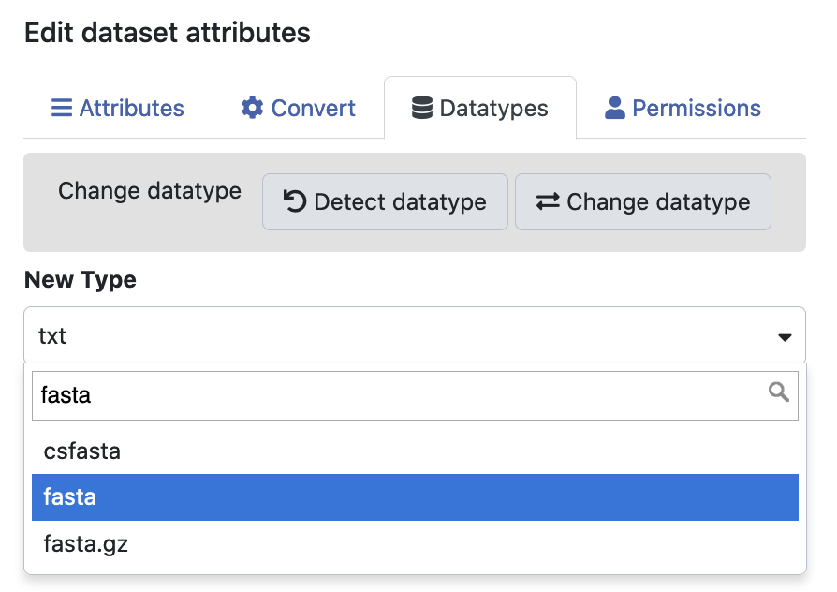
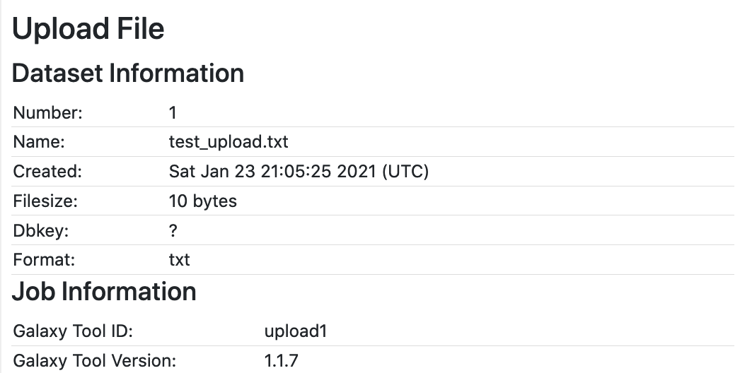
Operations and information on datasets
View data
Edit attributes
Delete data
Multiple operations can be performed on each dataset
View dataset by clicking on the filename
Change format (datatype) of dataset
Extensive information for each dataset in the history
E.g. version of the tool and database used in an analysis
Data description
Download data
Detailed information

Slide 18
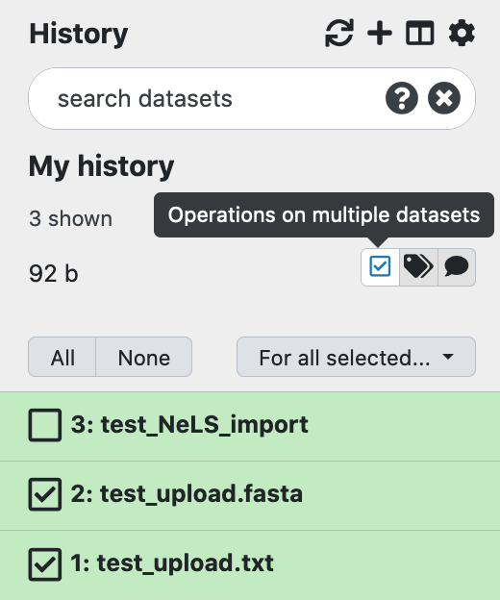
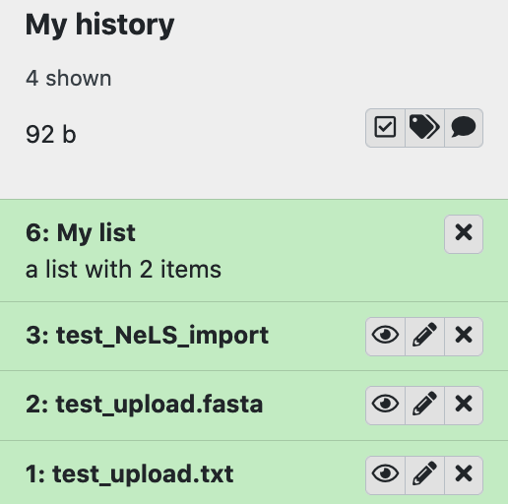
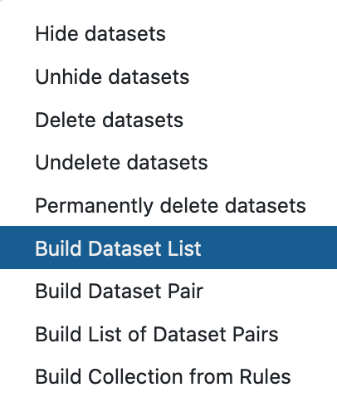
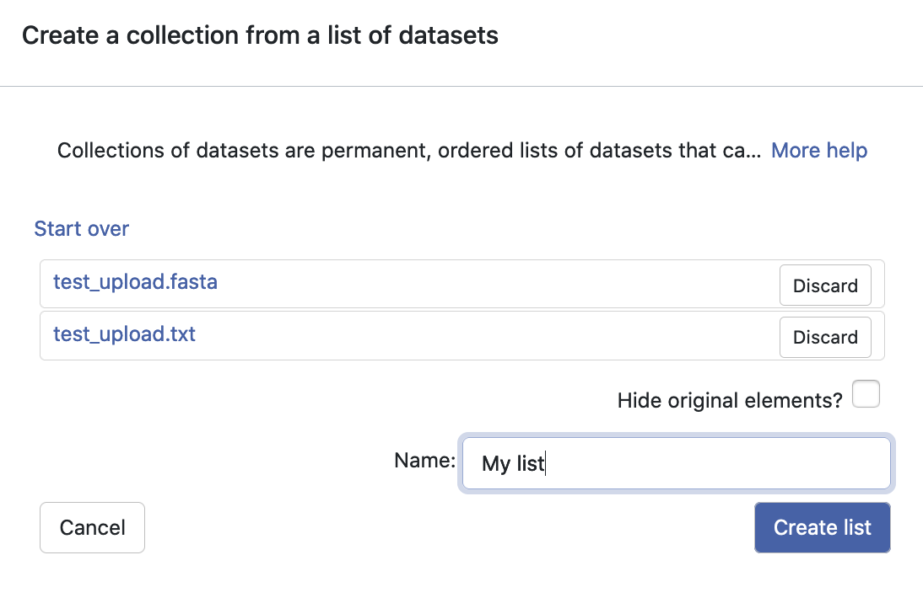
Dataset Collections for operation on multiple files
You can create dataset collections or list of multiple datasets that will be sent through the same analysis
Different types of collections and list are created by selecting dataset from your history
After naming the collection/list, it will appear in your history

Slide 19
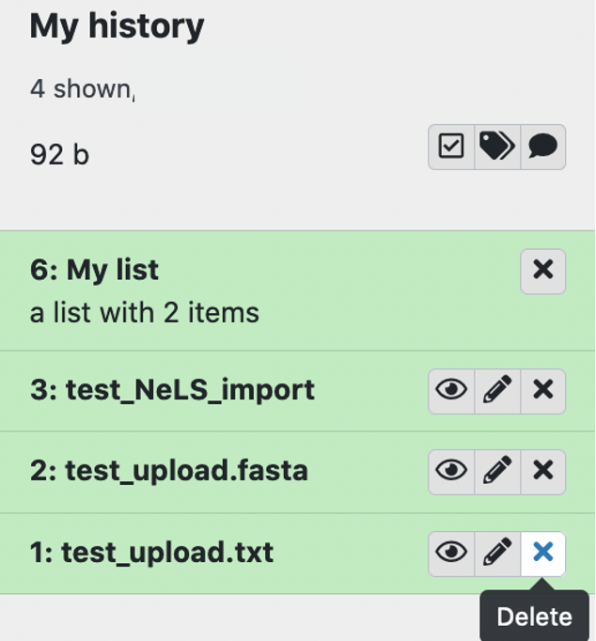
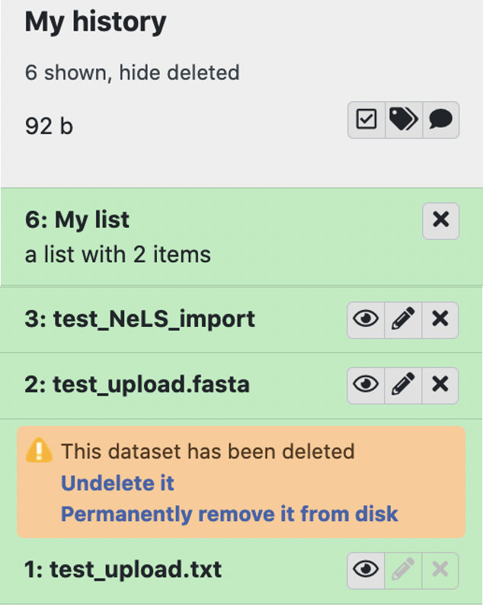
Delete and permanently delete datasets
Deleting a dataset (and histories) is equal to hiding the data, or putting it in the trash bin
It is possible to recover deleted datasets
Permanently deleting (purging) datasets (and histories) will free up disk space and cannot be recovered

Slide 20
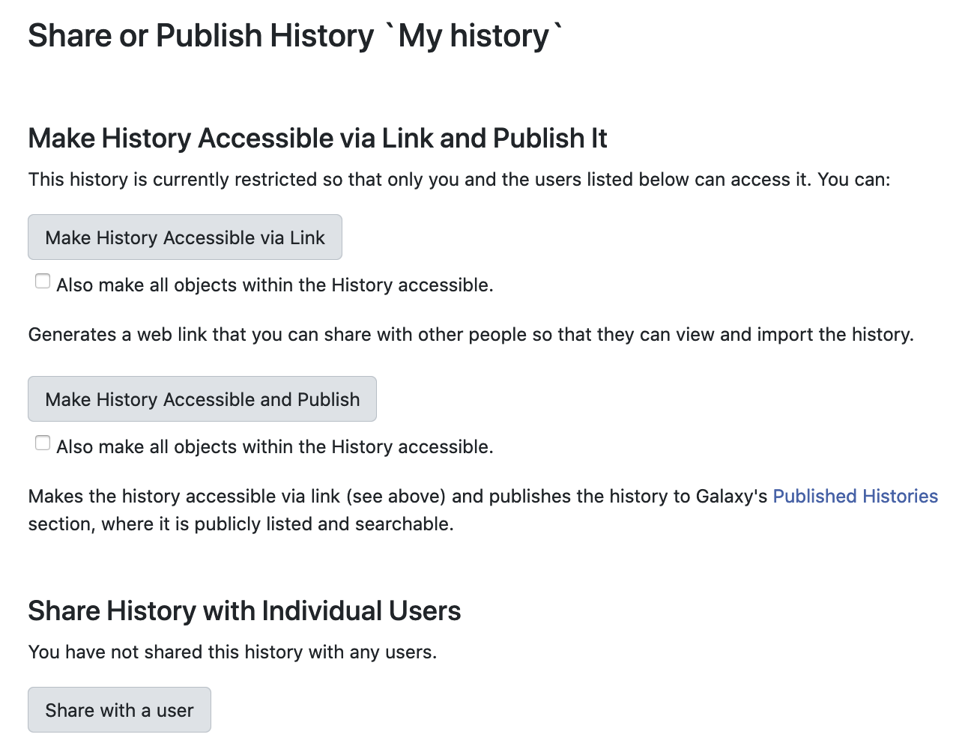
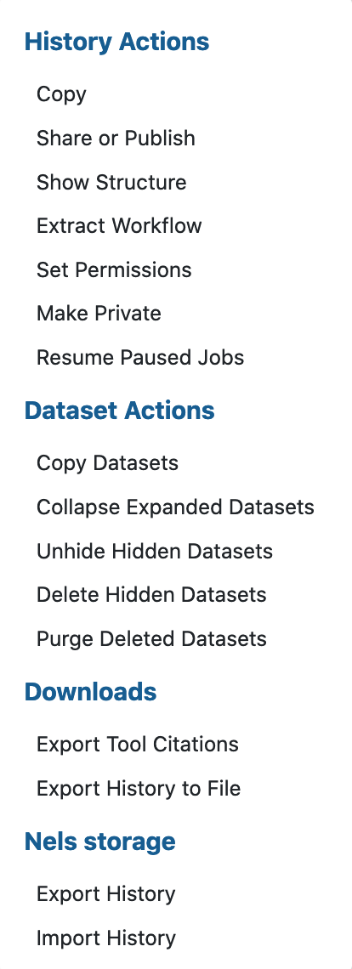
Galaxy sharing data
An efficient method for sharing analysis with collaborators
Good practice to get support from the Helpdesk

Slide 21
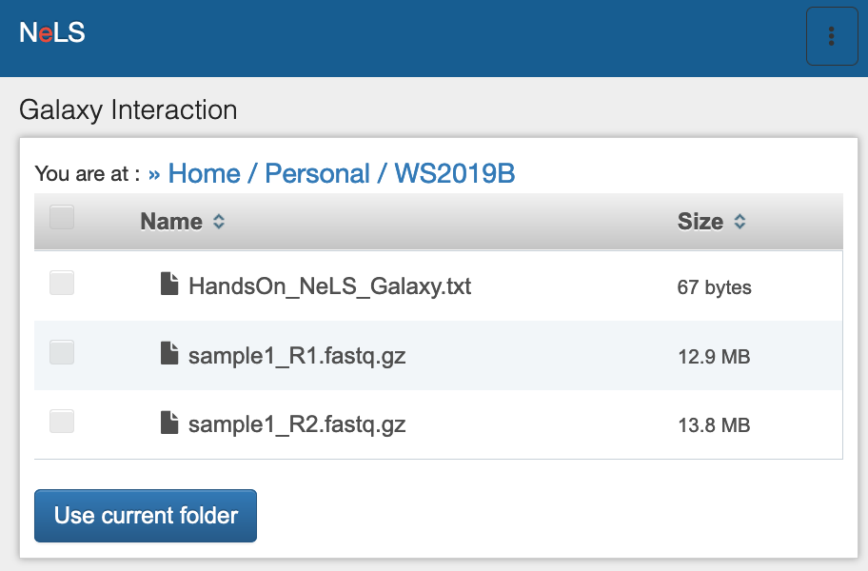
Exporting data
IMPORTANT: usegalaxy.no is not meant for storage
Please move your data when your data analysis is done
You can export a complete history including datasets to a file on your local system or to NeLS

