Slide 1
Troubleshooting issues and how to get help
Thu-Hien TO, NMBU
ELIXIR Norway, Norwegian e-infrastructure for Life Sciences and usegalaxy.no

Slide 2
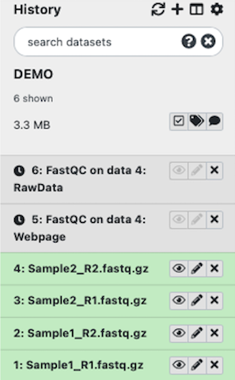
When something goes wrong..
Your job is pending in grey status for too long

Slide 3
When something goes wrong..
Your job is pending in grey status for too long
Server is busy/down – your jobs requires more than available
resources

Slide 4
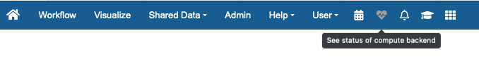
When something goes wrong..
Your job is pending in grey status for too long
Server is busy/down – your jobs requires more than available
resources
=> Check the status back-end

Slide 5
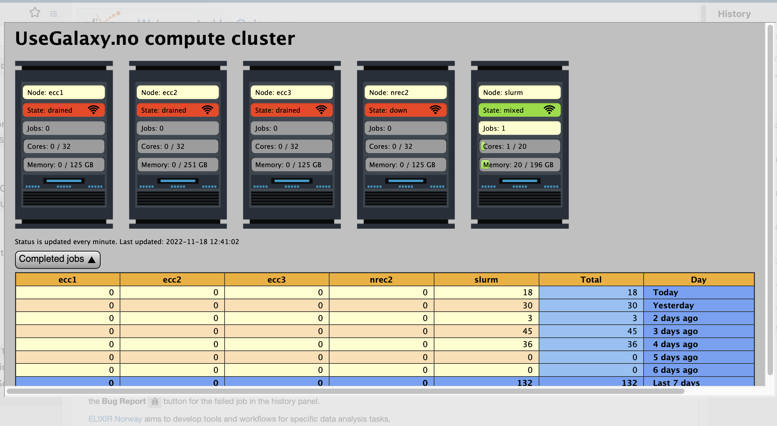
Compute backend status:
Node status, number of cores, memory available etc

Slide 6
When something goes wrong..
Your job is pending in grey status for too long
Server is busy/down – your jobs requires more than available
resources
If the tool has never been run before, it will be installed at the
first run

Slide 7
When something goes wrong..
Your job is pending in grey status for too long
Server is busy/down – your jobs requires more than available
resources
If the tool has never been run before, it will be installed at the
first run
=> Wait until the installation is finished

Slide 8
When something goes wrong..
Your job is pending in grey status for too long
Server is busy/down – your jobs requires more than available
resources
If the tool has never been run before, it will be installed at the
first run
Something goes wrong with the server, job is not picked up

Slide 9
When something goes wrong..
Your job is pending in grey status for too long
Server is busy/down – your jobs requires more than available
resources
If the tool has never been run before, it will be installed at the
first run
Something goes wrong with the server, job is not picked up
Check if there’s any announcement about server problem of
the main page

Slide 10

When something goes wrong..
Your job is pending in grey status for too long
Server is busy/down – your jobs requires more than available
resources
If the tool has never been run before, it will be installed at the
first run
Something goes wrong with the server, job is not picked up
If the problem is not resolved, contact support

Slide 11
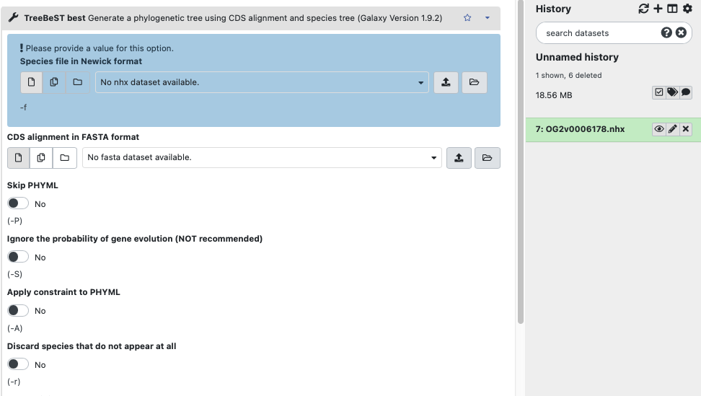
When something goes wrong..
Your data is not pickup as input files:
File format is not correctly recognized

Slide 12
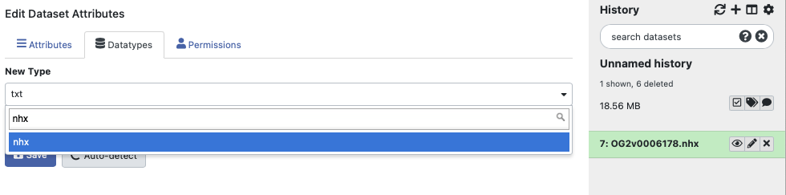
When something goes wrong..
Your data is not pickup as input files:
File format is not correctly recognized
-> Edit attributes

Slide 13
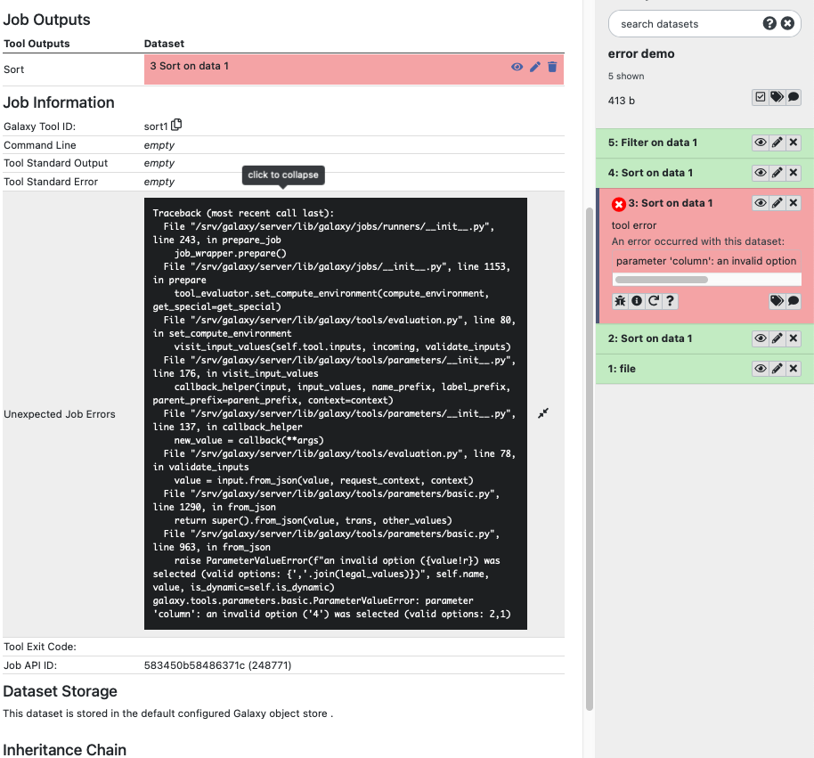

When something goes wrong..
Your job finished with red status
1. Click View details button
to see the complete Output (stdout) and Error logs (stderr)

Slide 14
When something goes wrong..
Your job finished with red status
1. Click View details button
to see the complete Output (stdout) and Error logs (stderr)
Wrong input file type, format
Wrong setting parameters
Tool bugs
Memory issue
Admin related problem

Slide 15
When something goes wrong..
Your job finished with red status
1. Click View details button
to see the complete Output (stdout) and Error logs (stderr)
Wrong input file type, format
Wrong setting parameters
Tool bugs
Memory issue
Admin related problem
https://galaxyproject.org/support/tool-error
https://help.galaxyproject.org
https://training.galaxyproject.org/training-material/faqs/galaxy/#troubleshooting
https://gitter.im/Galaxy-Training-Network/Lobby
https://gitter.im/galaxyproject/Lobby

Slide 16
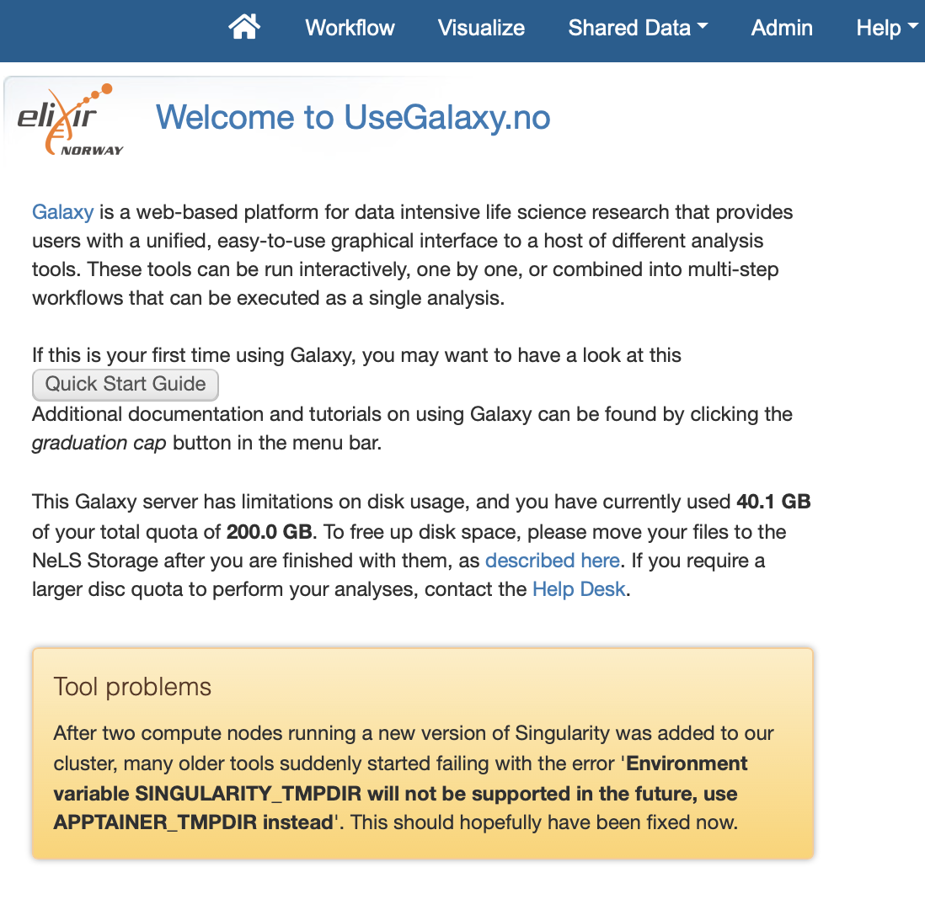
When something goes wrong..
Your job finished with red status
1. Click View details button
to see the complete Output (stdout) and Error logs (stderr)
2. Check announcement on the main page

Slide 17
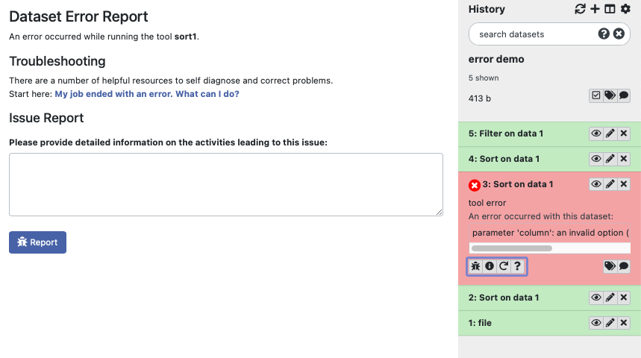

When something goes wrong..
Your job finished with red status
1. Click View details button
to see the complete Output (stdout) and Error logs (stderr)
2. Check announcement on the main page
3. Still unsure: submit a bug report

Slide 18
When something goes wrong..
Your job finished with red status
1. Click View details button
to see the complete Output (stdout) and Error logs (stderr)
2. Check announcement on the main page
3. Still unsure: submit a bug report
4. for general issues not associated to a specific job

Slide 19
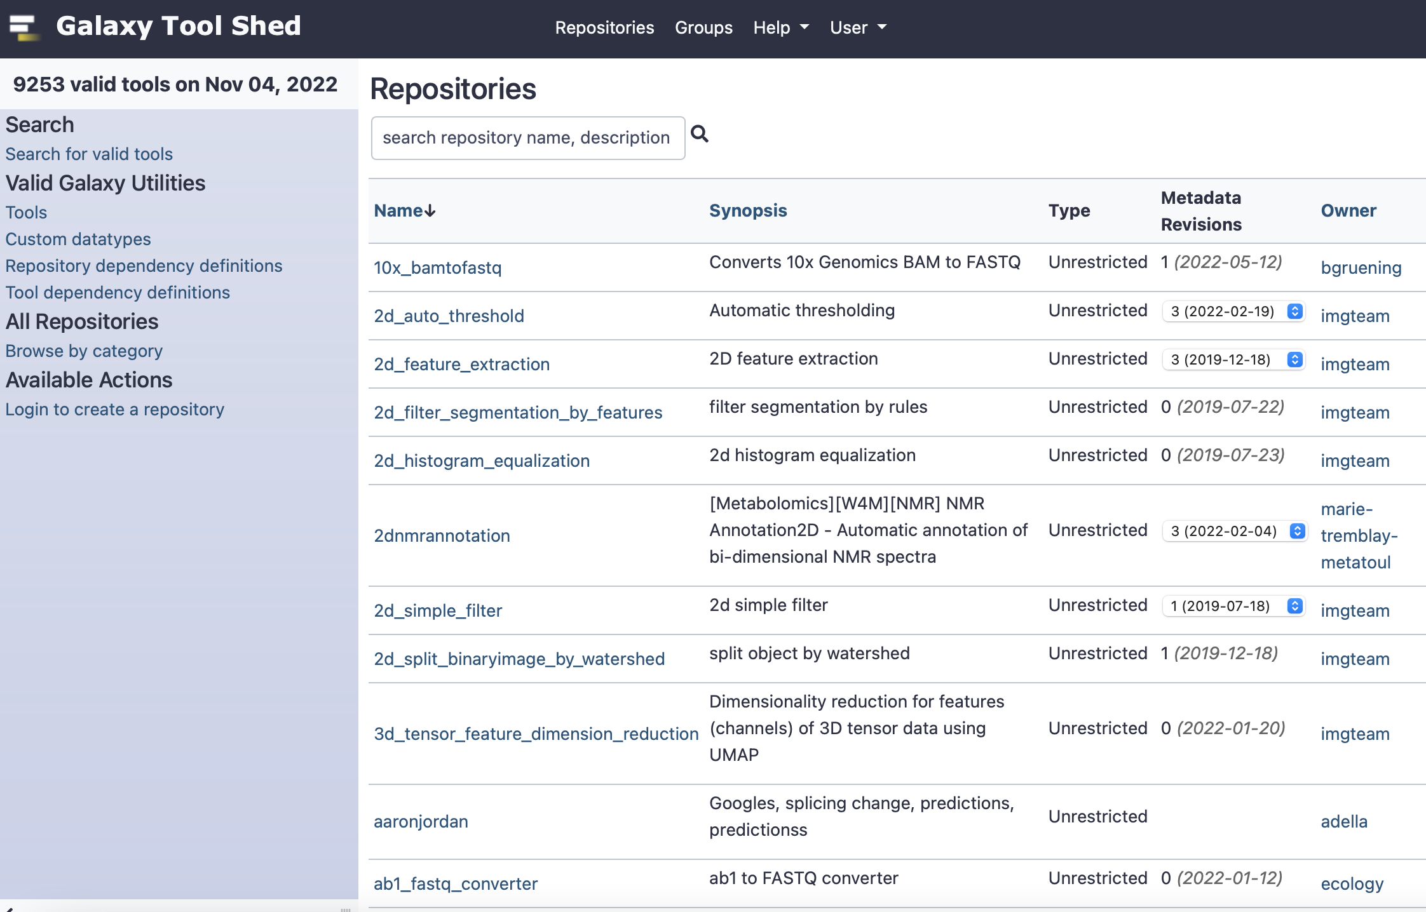
Would like to add new tools ....
If the tools you want to install are available on toolshed
https://toolshed.g2.bx.psu.edu , it’s easy and fast to the admin to install them.
Otherwise, it will take more time for the admin to write the wrappers for the tools

Slide 20
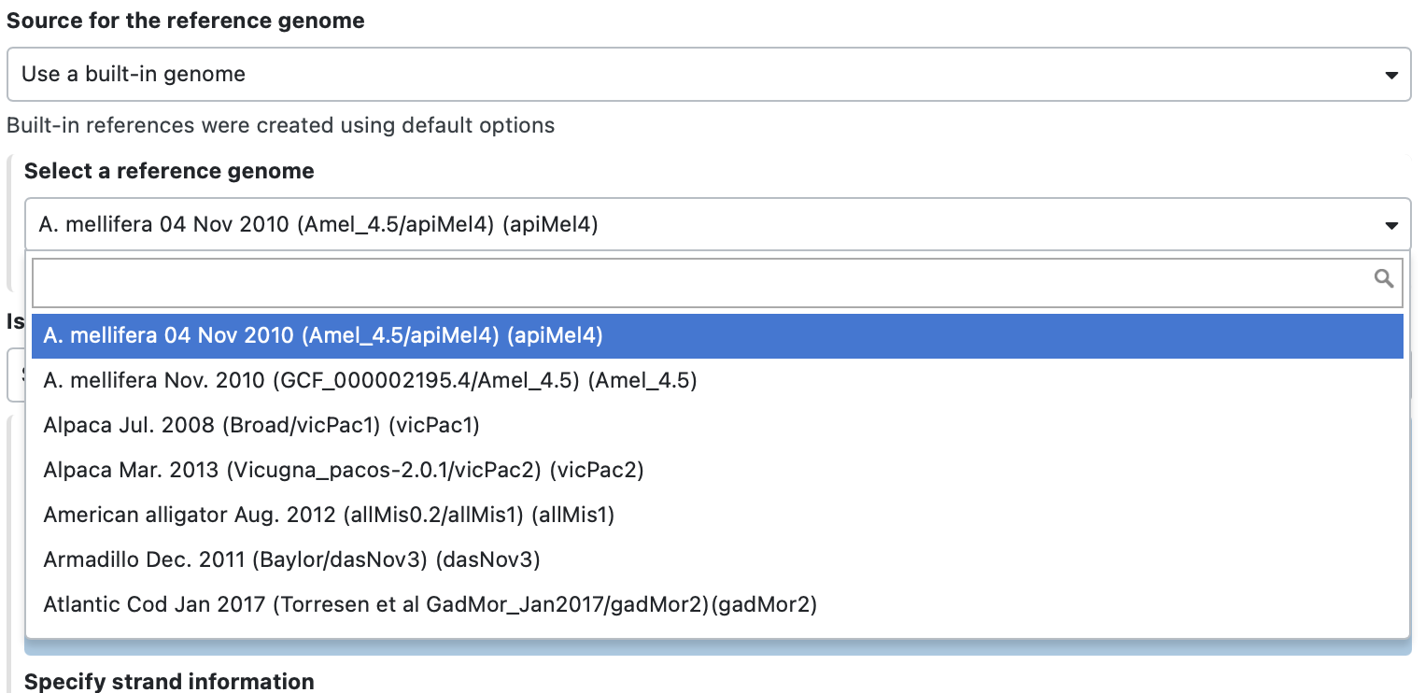
Would like to add new built-in reference genome …
provide the exact data file or data path that you want to build

