Slide 1
Do you need help with life science data?
Get it by ELIXIR-Norway
Arturo Vera Ponce de Leon
ELIXIR Norway
Centre for Integrative Genetics (CIGENE)
Norwegian University of Life Sciences

Slide 2
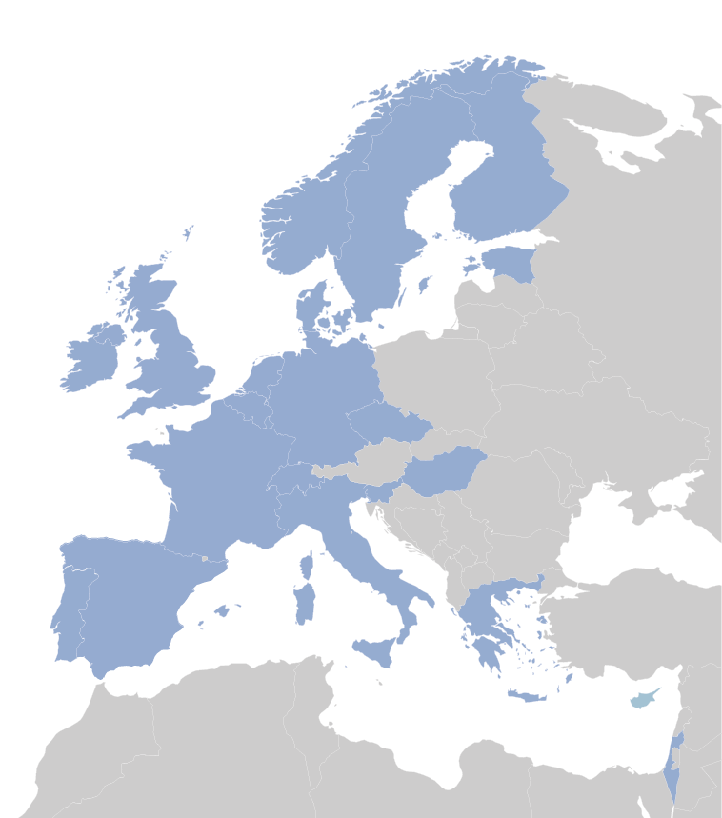
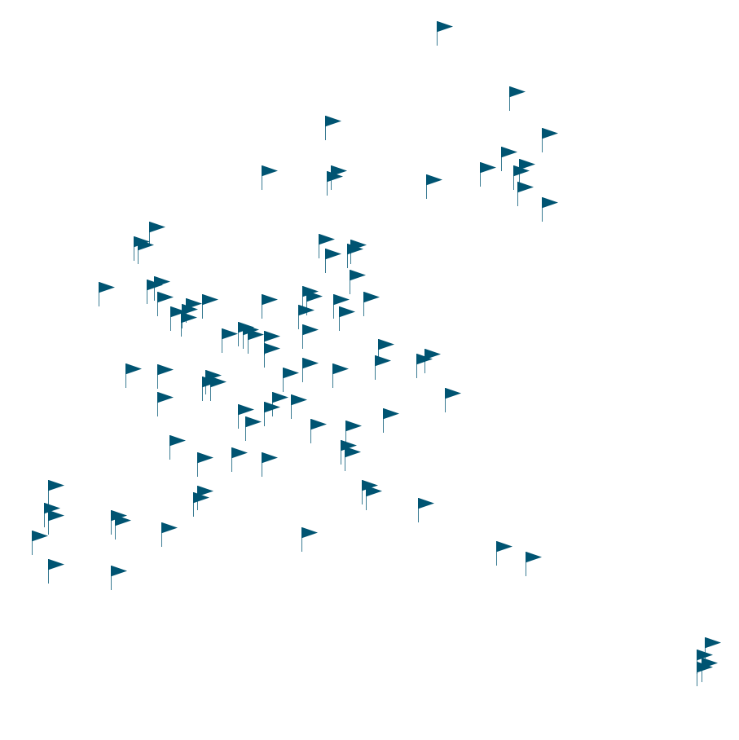
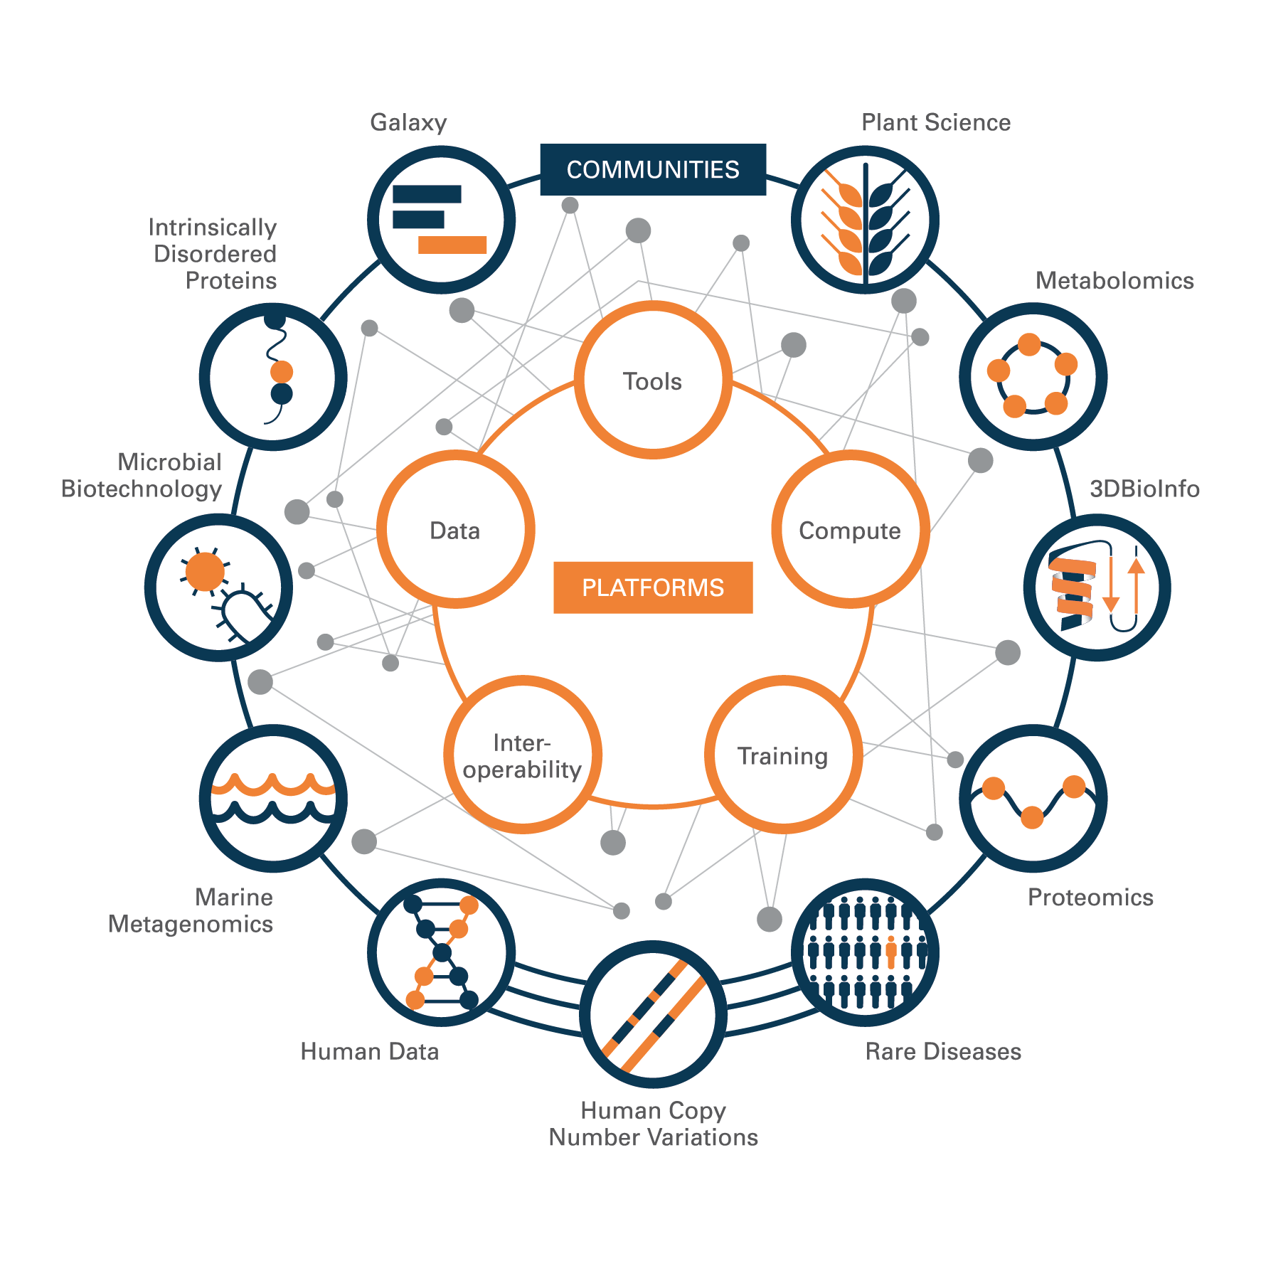
ELIXIR - A distributed infrastructure for Life Science data
ELIXIR is an intergovernmental organization that brings together life science resources from across Europe. The resources include databases, software tools, training materials, cloud storage and supercomputers.
Slide by David Dolan

Slide 3
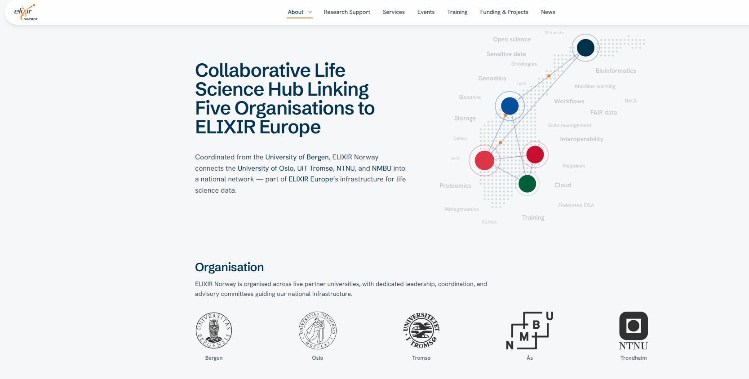

ELIXIR Norway
https://elixir.no/

Slide 4
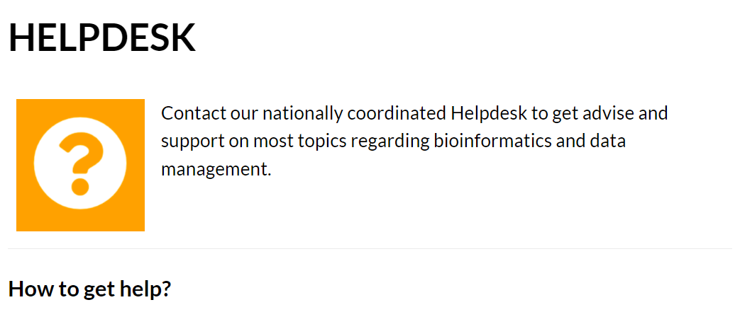
Support model
Projects that can be solved within a (two) working day are free of charge!!
Contact us by email at support@elixir.no

Slide 5
Examples of topics ELIXIR-NMBU can help
NB! ELIXIR-Norway is not University-IT
Assistance analyzing ‘omics data (genomics, transcriptomics, proteomics and metabolomics)
Assistance with scripting and coding (R, Python, Bash, Perl, etc.)
Assistance submitting ‘omics data to public repositories (ENA, GenBank, PRIDE)

Slide 6
Topics ELIXIR-NMBU can help with.
Assistance using Linux/Unix servers and high-performance computing (HPC) environments (Orion or Sigma2)
Allocation of storage space (up to 10 Tb) at the Norwegian e-Infrastructure for Life Sciences (NeLS)
Assistance applying for resources at National e-infrastructure services (Sigma2) for HPC usage and storage

Slide 7
Topics ELIXIR-NMBU can help with.
Assistance using the platform Galaxy for bioinformatics
Assistance creating and developing data-management plan (DMP)
Providing courses on bioinformatics and omics data analysis

Slide 8
ELIXIR-NMBU cannot help with
NB! ELIXIR-Norway is not IT
Installing software in the Sigma2 servers
Provide HPC computational power
Copy or move data between Orion and Sigma2 servers
Helping with the printer when is not working

Slide 9

What if do I need assistance for more than 2 days?
Projects that require an effort beyond technical assistance/consultancy may be set up as a research collaboration (e.g. by providing funding for a percentage of the position of a helpdesk member).

Slide 10

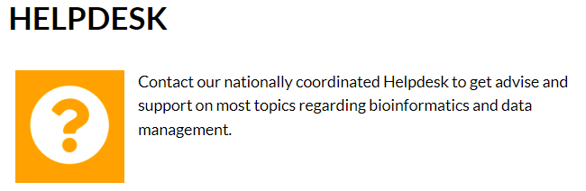
ELIXIR-How to get help?
If your research group is generating life science data using molecular analyses and ‘omics technologies, we exist to support your current and future efforts in data management, data storage, and data analyses.
Contact us by email at support@elixir.no
Scan me

Slide 11










Where else can ELIXIR Norway help?
IDEA
APPLICATION
PUBLICATION(S)
DATA
DATA STORAGE
EXPERIMENT
DATA DEPOSITION
METADATA
DATA ANALYSIS
DATA MANAGEMENT PLAN

Slide 12
Do you need to storage/share large amount of data?
Get up to10Tb space in NeLS
Arturo Vera Ponce de Leon
ELIXIR Norway
Centre for Integrative Genetics (CIGENE)
Norwegian University of Life Sciences

Slide 13

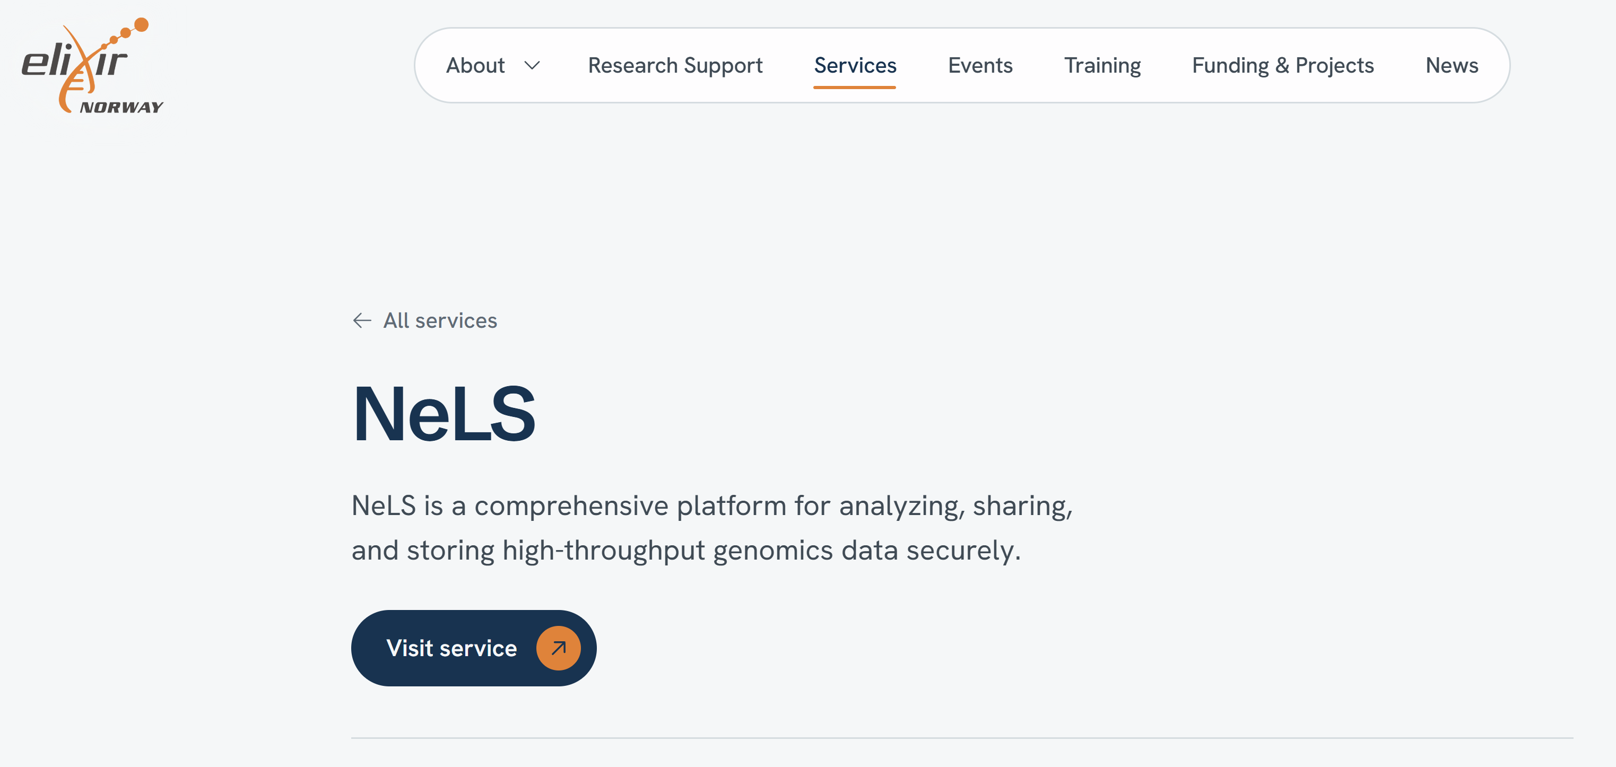

The Norwegian e-infrastructure for life sciences (NeLS),
is a unique national portal for sharing, analysis and midterm storage (up to 10Tb) of non-sensitive molecular life science data.

Slide 14

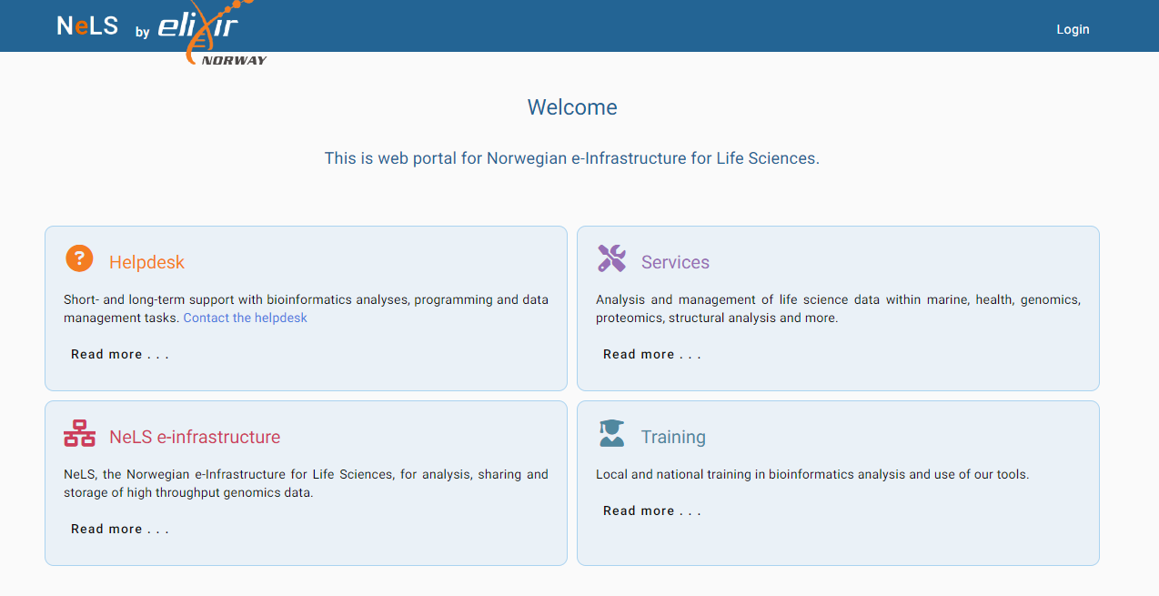

Login to NeLS using the WebPortal
https://nels.ELIXIR.no/nels-web/#/
Scan me!

Slide 15
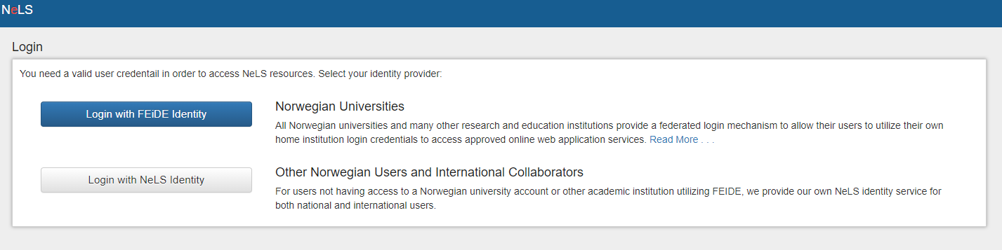
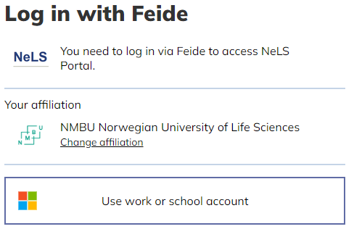
All users with FEIDE login credentials can access the NeLS Portal

Slide 16
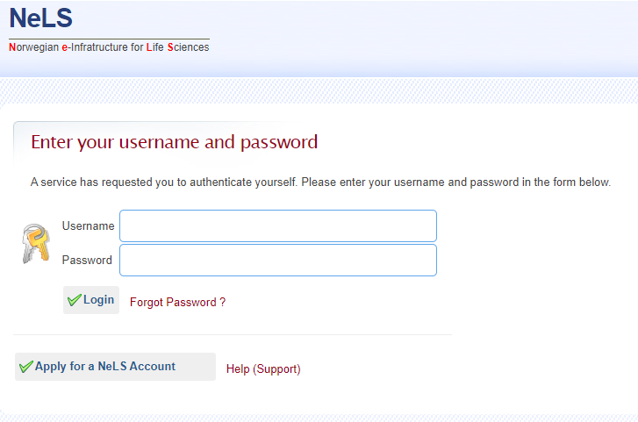
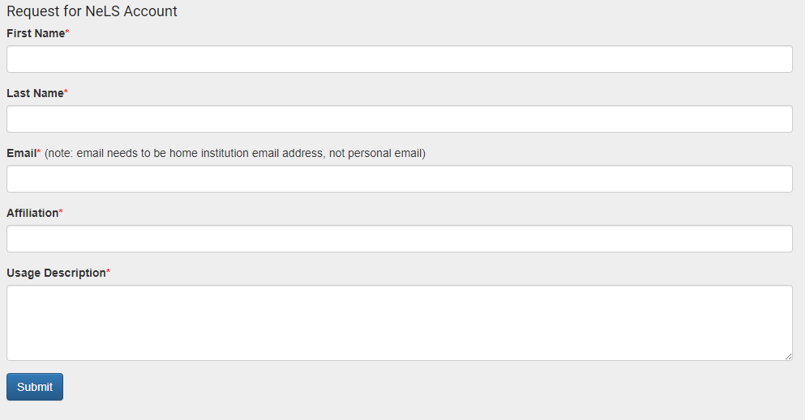
I don't have FEIDE login credentials
(Non-Norwegian collaborators)
It is also possible to login to NeLS via a NeLS idp. You can apply for a NeLS idp

Slide 17
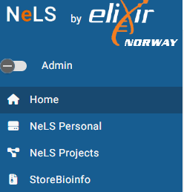
The NeLS filesystem
Personal area (from 1-10 Tb) space Not allowed to share
Share area (1-10Tb) with multiple sub-folder
Sharing capability
StoreBioInfo (SBI) is for long term storage of project data.

Slide 18
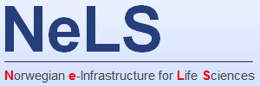
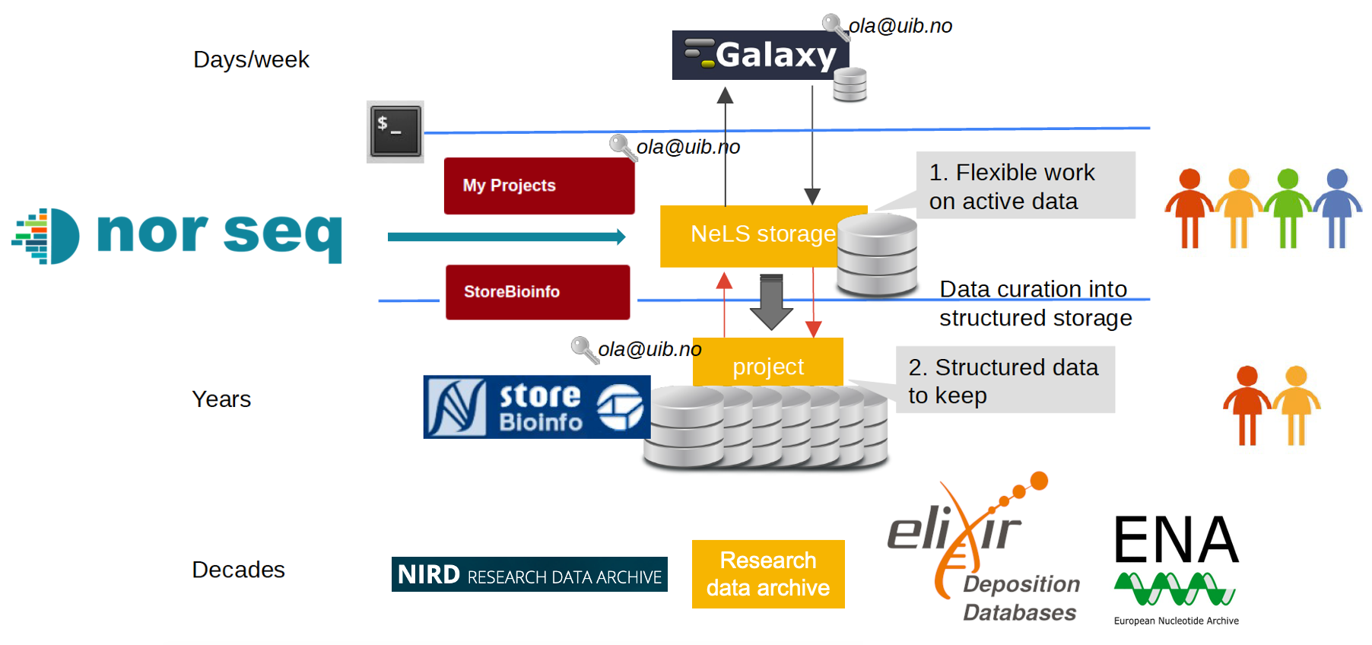
How does NeLS work?

Slide 19
Apply for a project in NeLS for sharing data within and outside Norway
Send an email to support@elixir.no
You will get a form to fill, after fill it a new project will be created

Slide 20
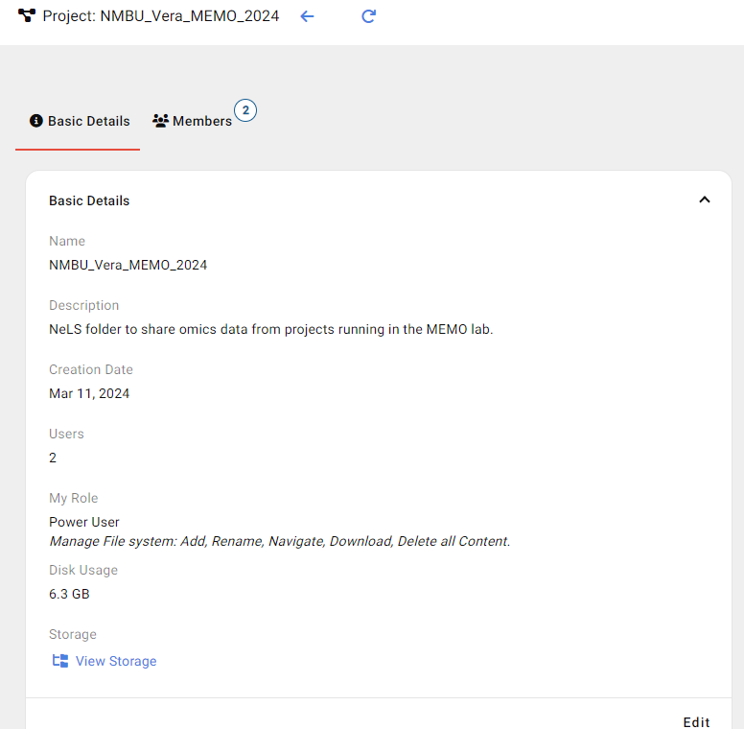

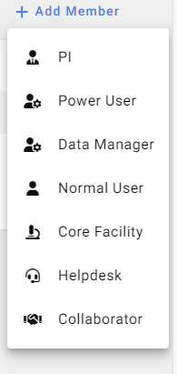
Adding members to a project
If you have created a project in NeLS you can add members to that to share data.
To add people, users must be register in NeLs before adding it to the project

Slide 21
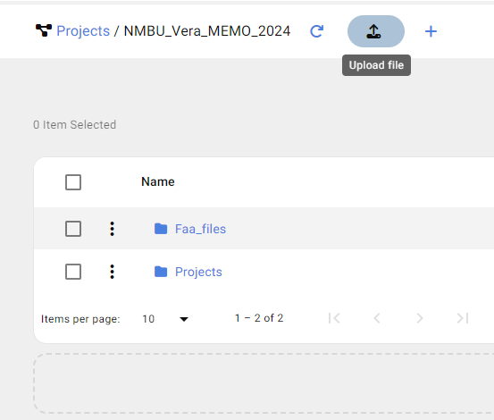
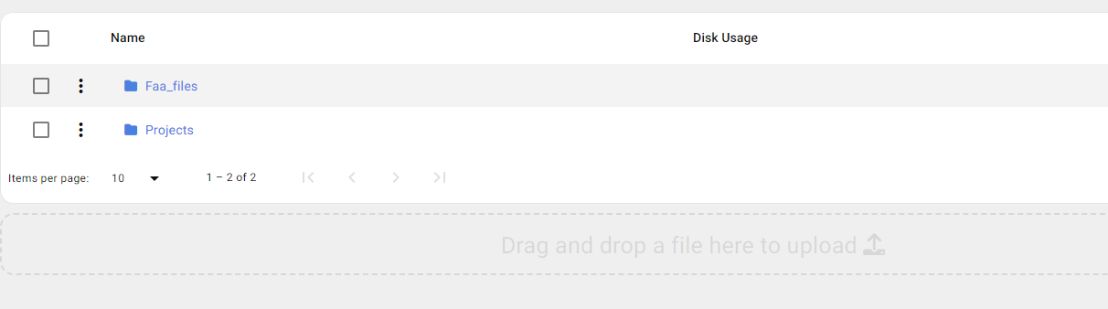
Transfer data to and from NeLS
(Using the web-portal)

Slide 22


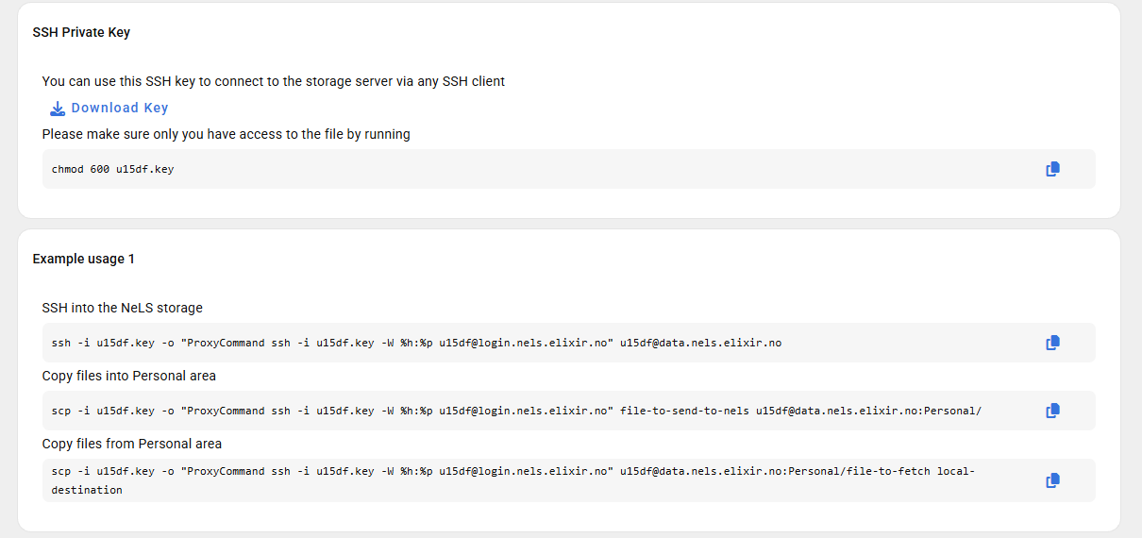
Using NeLS trough the CLI
NeLS servers can be reached directly from the CLI using Secure Shell (SSH) protocol:

Slide 23
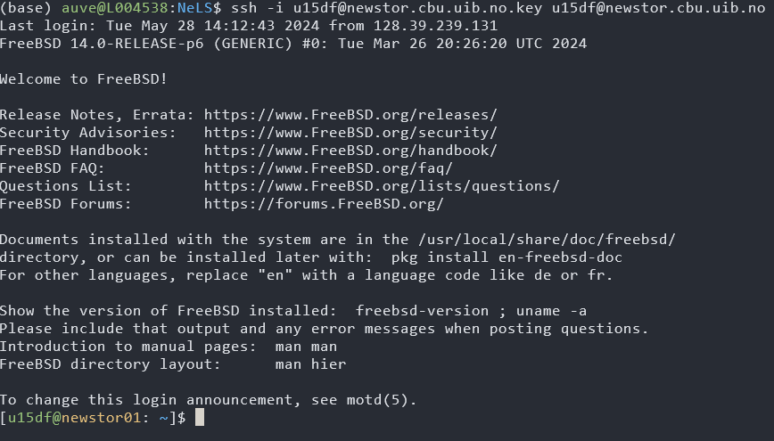
Using NeLS trough the CLI

Slide 24
usegalaxy.no

Slide 25

IDEA
APPLICATION
PUBLICATION(S)
StorBioInfo/NIRD/TSD
DATA
DATA STORAGE
EXPERIMENT
DATA DEPOSITION
Analysis!
METADATA
DATA ANALYSIS
DATA MANAGEMENT PLAN

Slide 26
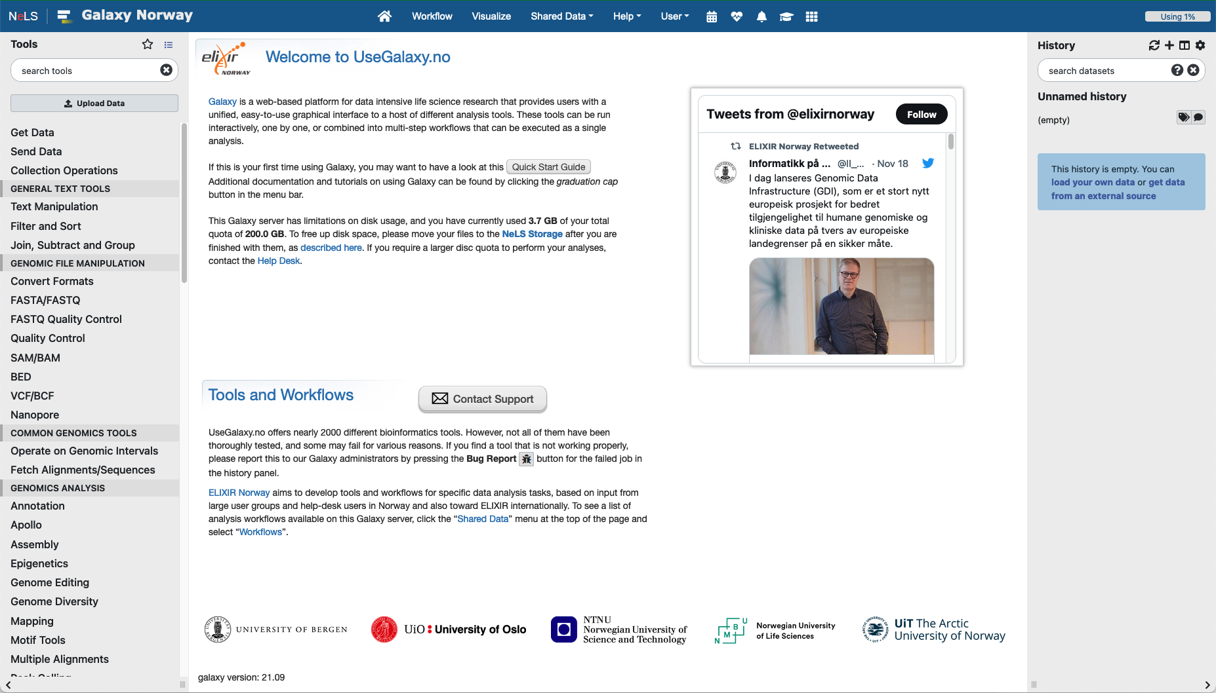
usegalaxy.no – The national Galaxy server
Web-based platform
Provide bioinformatic tools and workflows
Open to all Norwegian users and collaborators
Enable accessible, reproducible, and transparent computational biomedical research
Directly connected to the NeLS storage

Slide 27
usegalaxy.no – The basics
Main menu
Important features:
Tools menu with ~2000 tools sorted in sections
Current disk usage (default is 200 GB total personal disk space)
Status of compute backend
Quick start guide
Contact support
Help and guides
History
Main window
Tools menu

Slide 28
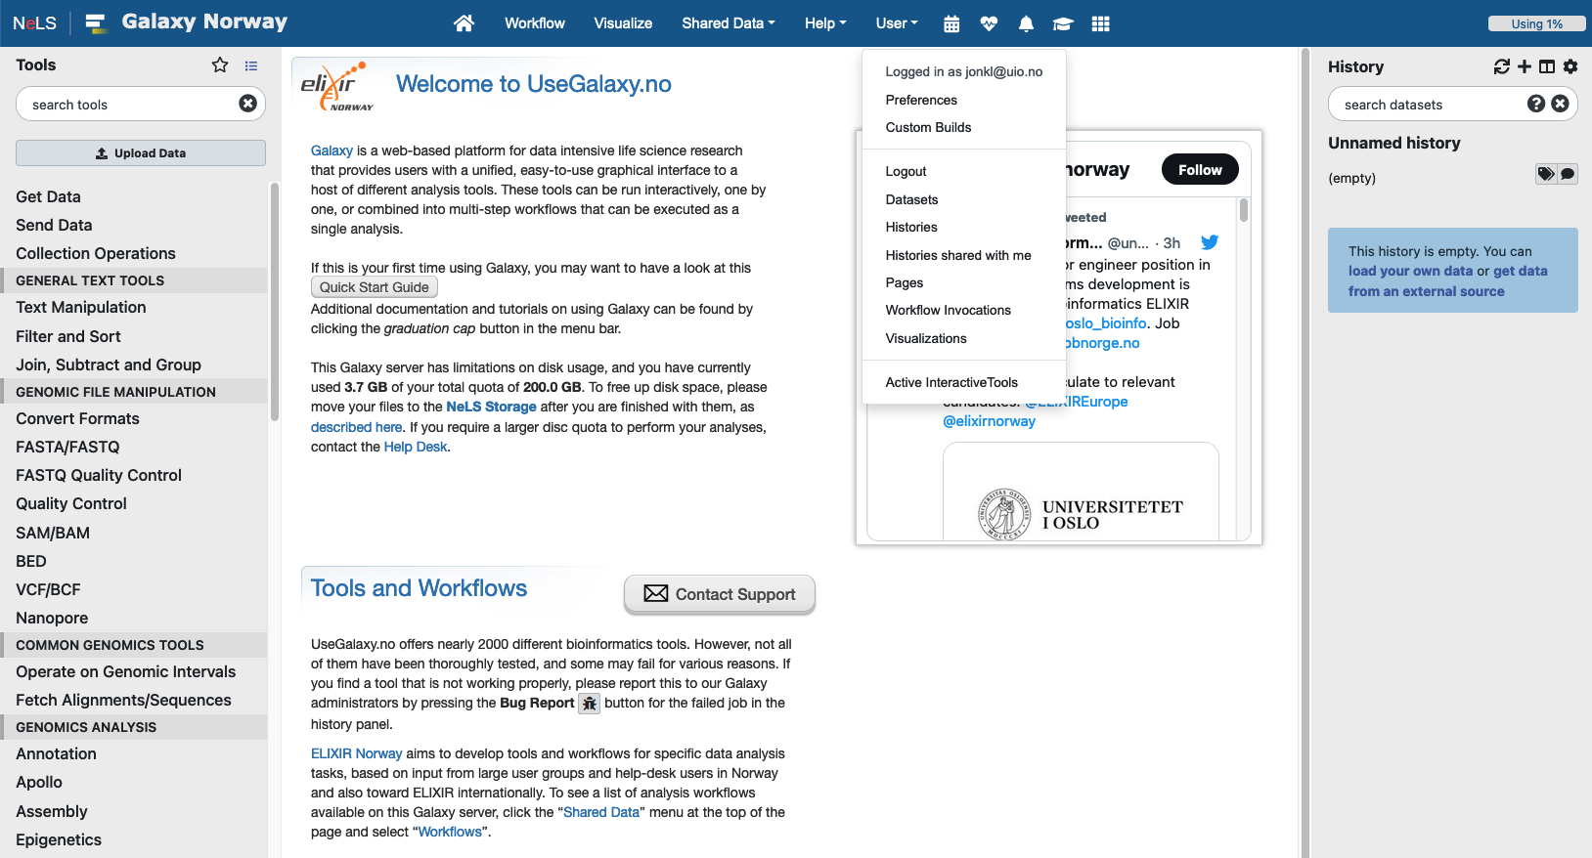
Your account and saved data
“Home”
Account settings and saved data such as saved histories and visualizations
Histories other users have shared with you
Log of analysis workflows you have run

Slide 29
Hands on Galaxy
How to perform RNAseq analysis and Differential Gene Expression in Galaxy.no
https://training.galaxyproject.org/training-material/topics/transcriptomics/tutorials/ref-based/tutorial.html

