Slide 1

A high performance, open source universal RPC framework
Mehdi ELKHEMIRI

Slide 2



Timeline
Valeur apportée à nos salariés
What is gRPC
PROTOBUF
HTTP/2
How it works (typical flow)
Four kind of service method
Demo: Banking Kata
contact@shodo.io

Slide 3
Valeur apportée à nos salariés
What is gRPC ?
Remote Procedure Call (RPC) framework
High performance
Developed by Google to connect microservices in their datacenters
Open Source in 2016
Part of Cloud Native Computing Foundation (CNCF) since 2017
contact@shodo.io
Notes:
RPC : A protocol that enables a machine to invoke some code on another distant (on the network) machine as if it was a local function call, without the need to learn about network details.

Slide 4

Valeur apportée à nos salariés
High Performance
gRPC = PROTOCOL BUFFERS + HTTP/2
contact@shodo.io
Notes:
RPC : A protocol that enables a machine to invoke some code on another distant (on the network) machine as if it was a local function call, without the need to learn about network details.

Slide 5
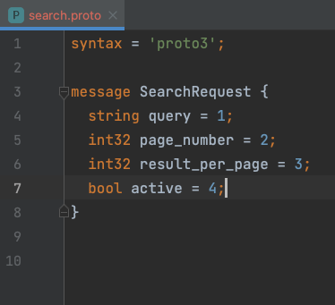
Valeur apportée à nos salariés
PROTOCOL BUFFERS (PROTOBUF)
Data exchange format
Language & Platform agnostic
Like JSON, but smaller and faster
Binary
Encoding structured data
Strongly typed
Message schema defined in proto file
contact@shodo.io
https://developers.google.com/protocol-buffers/docs/proto3

Slide 6
Valeur apportée à nos salariés
PROTOCOL BUFFERS (PROTOBUF)
Official Libraries and Tools
gRPC Core - C, C++, Ruby, Node.js, Python, PHP, C#, Objective-C
gRPC Java - The Java gRPC implementation. HTTP/2 based RPC
gRPC Kotlin - The Kotlin gRPC implementation. Based on gRPC Java
gRPC Node.js - gRPC for Node.js
gRPC Go - The Go language implementation of gRPC. HTTP/2 based RPC
gRPC Swift - The Swift language implementation of gRPC
gRPC Dart - The Dart language implementation of gRPC
gRPC C# - The C# language implementation of gRPC
gRPC Web - gRPC for Web Clients
gRPC Ecosystem - gRPC Ecosystem that complements gRPC
gRPC contrib - Known useful contributions around github
grpc_cli - gRPC CLI tool
contact@shodo.io
https://github.com/grpc-ecosystem/awesome-grpc
Notes:
Tools to generate classes from schema defined in proto file for all programming Languages

Slide 7
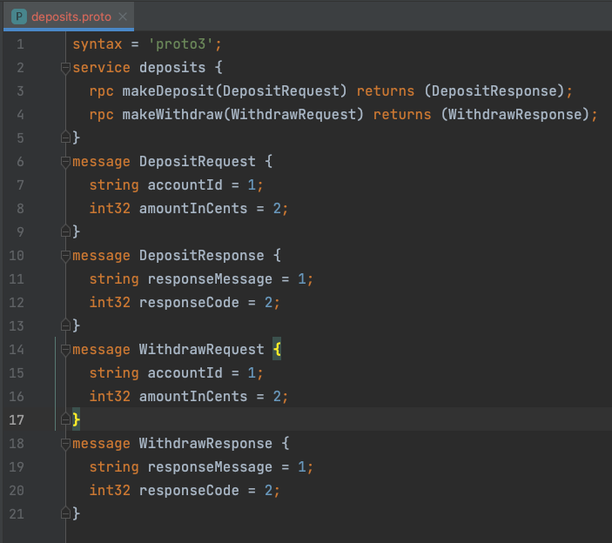
Valeur apportée à nos salariés
PROTOCOL BUFFERS (PROTOBUF)
gRPC uses PROTOBUF also as Interface Description Language (IDL).
Define services by specifying methods, parameters and return types.
Same tools to generate classes for :
Client : to make RPC calls.
Server: to fulfill RPC requests.
contact@shodo.io

Slide 8
Valeur apportée à nos salariés
PROTOCOL BUFFERS (PROTOBUF)
deposits.proto
Service makeDeposit
Proto Request
Service Accounts
gRPC stub
gRPC Server
Proto Response
Python Client
Java Server
contact@shodo.io

Slide 9
Valeur apportée à nos salariés
HTTP/2
Key differences to HTTP/1.1
Secure by default
Header compression
Binary instead of textual
Multiplexing
Server push
https://http2.github.io
contact@shodo.io

Slide 10
Valeur apportée à nos salariés
HTTP/2 Multiplexing
HTTP/1.x has a problem called “head-of-line blocking,” where effectively only one request can be outstanding on a connection at a time.
https://http2.github.io
contact@shodo.io

Slide 11


Valeur apportée à nos salariés
HTTP/2 Multiplexing
HTTP/1.1
GET index.html
TCP Connection
index.html
main.js
main.css
img.jpg
contact@shodo.io

Slide 12
Valeur apportée à nos salariés
HTTP/2 Multiplexing
HTTP/1.1
GET main.js
TCP Connection
contact@shodo.io

Slide 13
Valeur apportée à nos salariés
HTTP/2 Multiplexing
HTTP/1.1
GET main.css
TCP Connection
contact@shodo.io

Slide 14
Valeur apportée à nos salariés
HTTP/2 Multiplexing
HTTP/2
GET index.html
TCP Connection
index.html
main.js
main.css
img.jpg
contact@shodo.io

Slide 15
Valeur apportée à nos salariés
HTTP/2 Multiplexing
HTTP/2
GET main.js
Stream id 1
GET main.css
Stream id 2
GET img.jpg
Stream id 3
TCP Connection
contact@shodo.io

Slide 16
Valeur apportée à nos salariés
HTTP/2 Multiplexing
HTTP/2
TCP
Only One TCP Connection
Stream header 1
Stream header 3
Stream header 2
Stream data 1
Stream data 2
Stream data 1
contact@shodo.io

Slide 17
Typical Flow
Valeur apportée à nos salariés
gRPC Client
gRPC server
13
1
7
8
Encoding/Decoding
Encoding/Decoding
stub
6
9
12
2
gRPC Runtime
gRPC Runtime
11
3
5
10
Transport Layer
Transport Layer
4
HTTP/2
4
11
11
Stream header 1
Stream header 3
Stream header 2
Stream data 1
Stream data 2
Stream data 1
contact@shodo.io

Slide 18
Valeur apportée à nos salariés
Four kind of service method
Unary RPC : One Request -> One Response
rpc SayHello(HelloRequest) returns (HelloResponse);
Server Streaming RPC : One Request -> Stream of Responses
rpc SayHello(HelloRequest) returns (stream HelloResponse);
Client Streaming RPC : A sequence of requests -> One Response
rpc SayHello(stream HelloRequest) returns (HelloResponse);
Bidirectional Streaming RPC : Both sides send a sequence of messages.
rpc SayHello(stream HelloRequest) returns (stream HelloResponse);
contact@shodo.io

