Slide 1
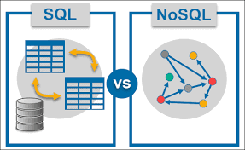

Slide 2
SQL vs NoSQL
A Database is a Relational Database and uses structured data. It typically uses the Structured Query Language and implements storage in the standardized Information Storage Language. Thus, a SQL Database offers great accessibility and consistency in terms of storage and query handling.
NoSQL Databases such as MongoDB, on the other hand, are Non-relational and utilize unstructured data to be able to store and process non-similar data sets that are associated with each other.
Thus, NoSQL Databases offers fewer restrictions and more flexibility with the use of dissimilar fields within a collection. However, one must have a better coding proficiency to be able to implement the same.

Slide 3
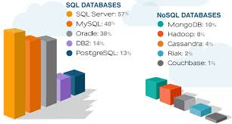
EXEMPLES

Slide 4
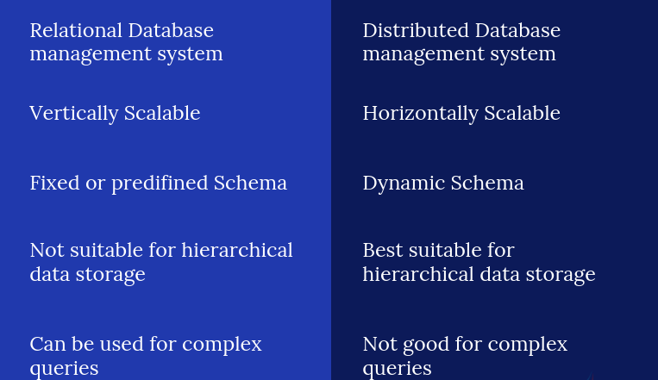
SQL VS mongoDB

Slide 5
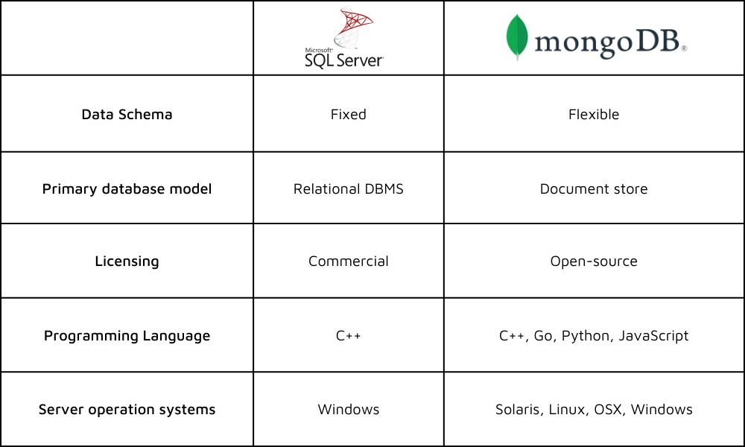
SQL VS mongoDB

Slide 6

Scalability

Slide 7
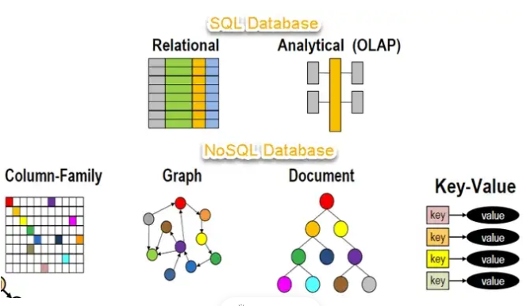
Structure

Slide 8
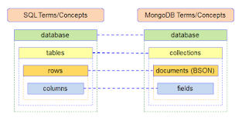
Structure

Slide 9
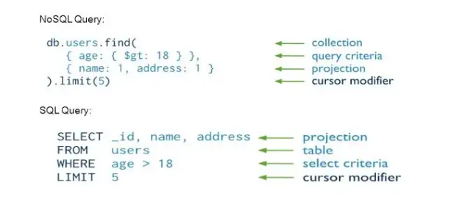
Language

