Slide 1
Bytebenders
Condrat Radu-Cosmin
Iacob Rares-Marian

Slide 2
ABOUT the app
Name of our app is DishDiary.
DishDiary is a mobile application designed for food enthusiasts and home cooks. It offers a platform where users can create personal accounts to log in. Once logged in, they can share their own recipes with the wider DishDiary community. The app allows users to post detailed recipes, including ingredients, cooking steps, and photos of their culinary creations. This feature enables users to showcase their cooking skills and exchange recipes with others, fostering a community of shared culinary knowledge and experiences. Additionally, DishDiary may include functionalities such as commenting on and rating recipes, which further encourages interaction and feedback among users.

Slide 3
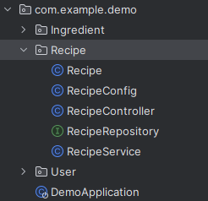
What we have done so far
CLASSES AND PACKAGES

Slide 4
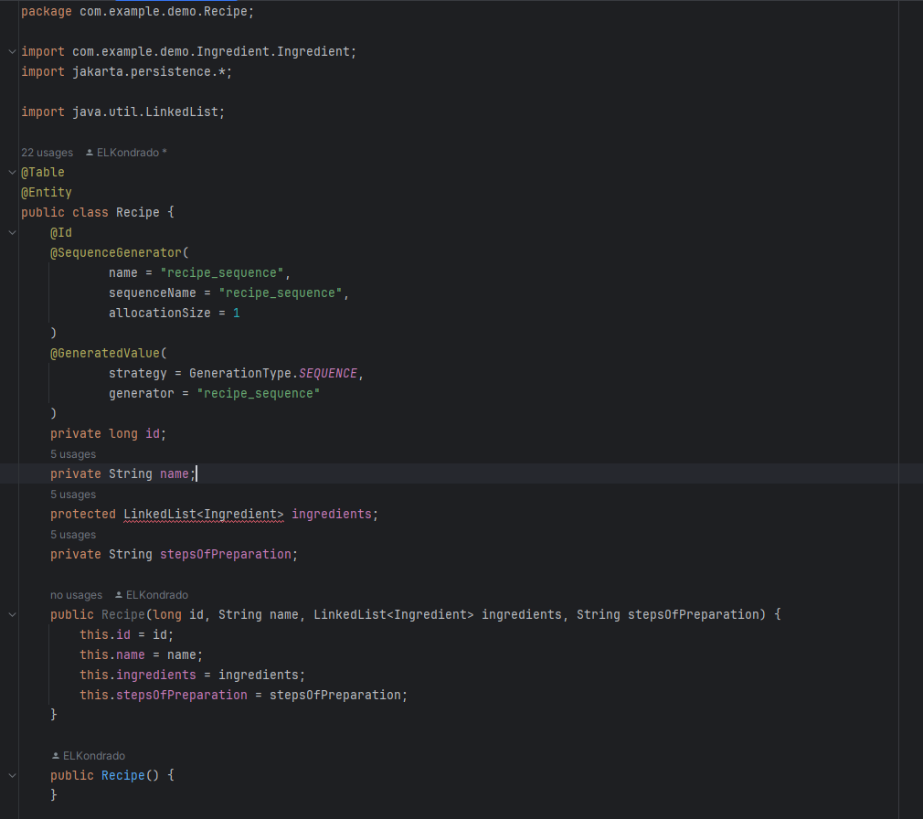
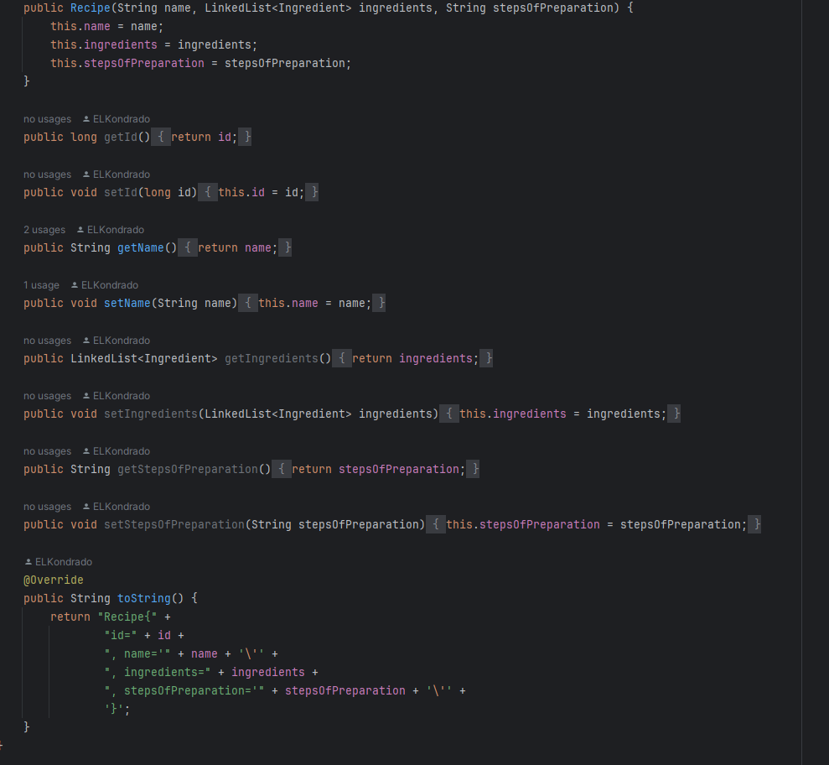
Recipe class

Slide 5
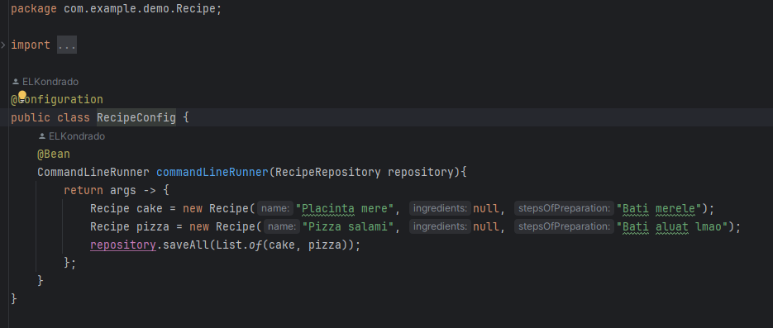
Recipe config

Slide 6
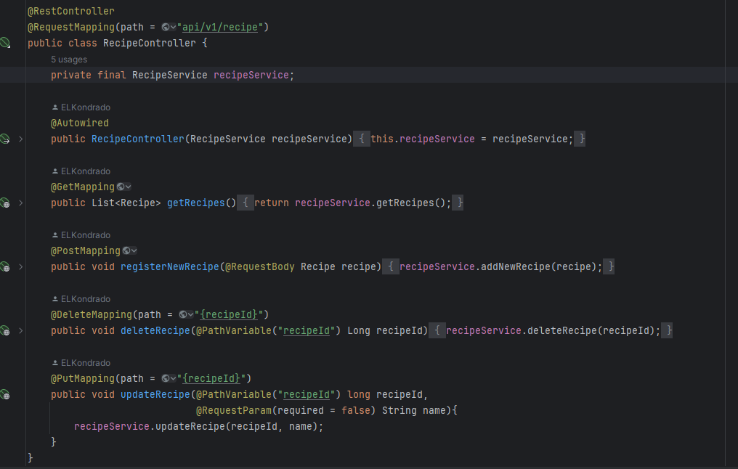



Recipe controller

Slide 7
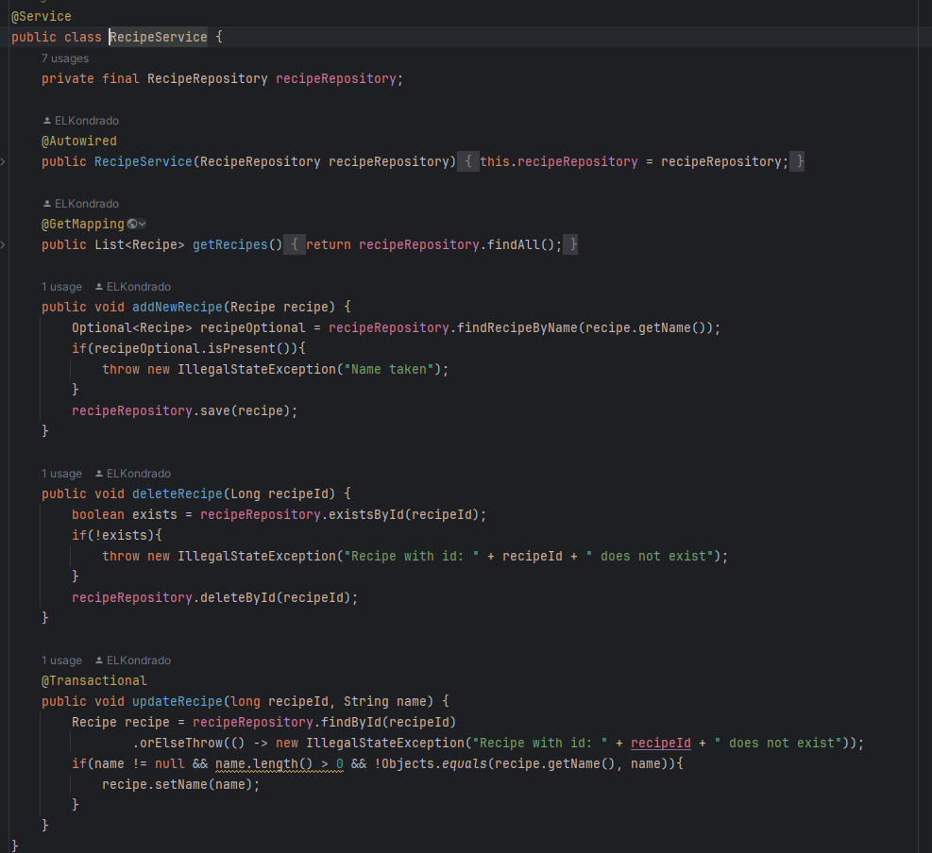



Recipe service

Slide 8
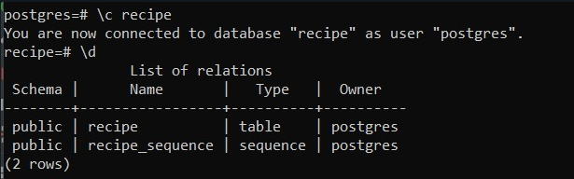
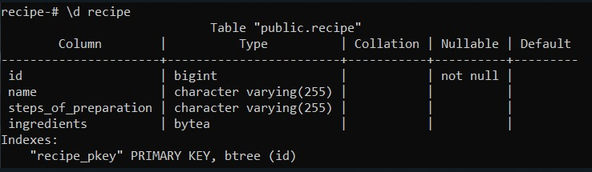
database
We use Postgres for our database.
It is connected successfully.
We have a sequence for Recipes and the ID’s are generated by themselves.

Slide 9
What is shown so far

