Slide 1
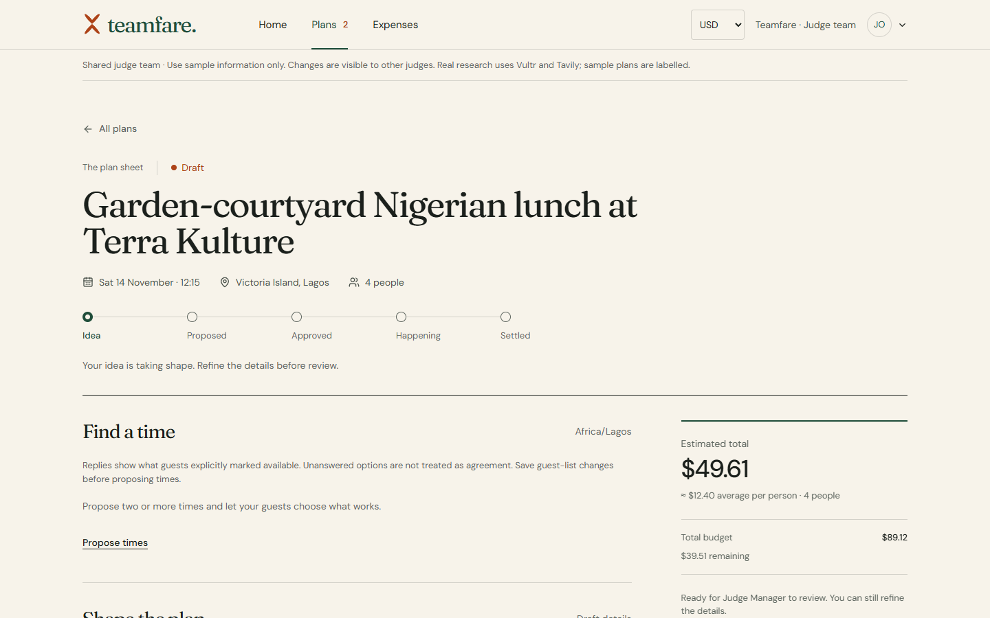
VULTR AGENT RUSH HACKATHON
TEAMFARE
AI-assisted planning and coordination for team outings
Research venues, agree on a time, approve a budget and keep the expense record together.
Challenge: Powering the Future of Work
Participation: Online · November 2026
teamfare.dixmail.xyz
Figure 1. A real Plan Sheet saved from sourced research.
TEAMFARE | VULTR AGENT RUSH | POWERING THE FUTURE OF WORK
1 / 11
Notes:
Introduce the project, the target users and the chosen hackathon challenge. The screenshot shows a real editable draft created from live research.

Slide 2
PROBLEM STATEMENT AND PROJECT OBJECTIVE
A team outing combines employee engagement with operational work. Decisions often move between messages, calendars and spreadsheets.
1. Planning information is scattered
Organisers compare venues, collect availability and follow up on attendance through separate conversations.
PROJECT OBJECTIVE
Provide a shared workflow that carries an outing from researched options through scheduling, manager review, attendance and expense reporting.
2. Spending needs a clear decision
Managers need the estimated total, allowance and approval history before a team proceeds.
3. Expense evidence arrives afterwards
Receipts and spending entries must be collected and consolidated into a report.
TEAMFARE | VULTR AGENT RUSH | POWERING THE FUTURE OF WORK
2 / 11
Notes:
Explain the three operational handoffs and the objective without invented market or revenue figures.

Slide 3
SOLUTION OVERVIEW: THE SHARED PLAN SHEET
Teamfare stores the outing in one document. The organiser, manager and guests each act on the same current plan.
A complete proposal
Date, place, headcount, itinerary, cost assumptions and allowance stay together.
Role-based actions
Organisers refine; a separate manager reviews; named guests reply and RSVP.
A retained record
Status changes, review notes and recorded expenses remain attached to the outing.
Figure 2. Live researched draft with named guests and a cost summary.
Idea
Proposed
Approved
Happening
Settled
TEAMFARE | VULTR AGENT RUSH | POWERING THE FUTURE OF WORK
3 / 11
Notes:
Explain the central document and its actors. The stage line is the product journey, with cancelled outings retained separately.

Slide 4
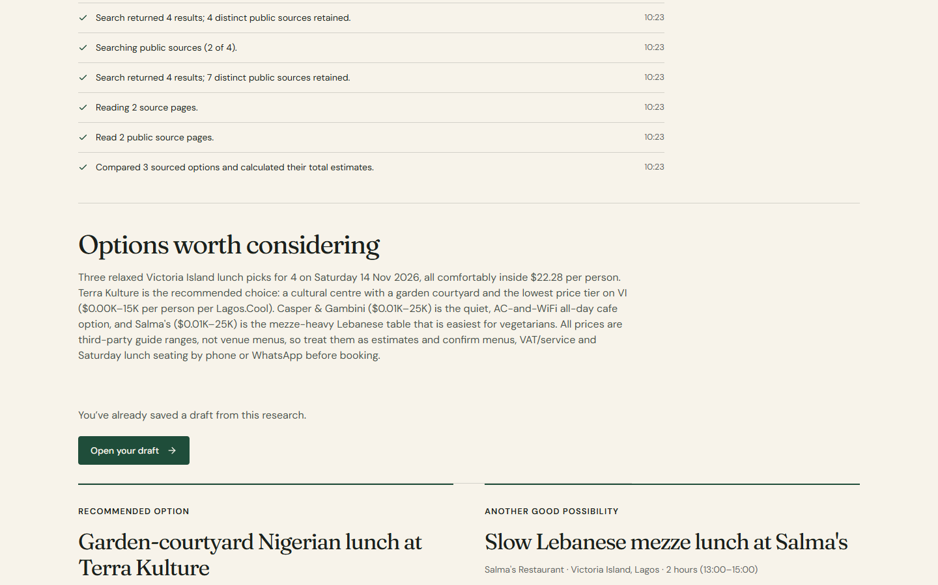
AI RESEARCH: QWEN, VULTR AND TAVILY
The agent turns the brief into researched options. The organiser chooses which option becomes an editable plan.
Reasoning and tool calls
Qwen runs through Vultr Serverless Inference and requests bounded research actions.
Public-source research
Tavily searches and extracts pages. Options retain citations, estimates and questions to confirm.
Deterministic totals
Server code calculates costs. Fixed and per-person lines remain editable before review.
Figure 3. Actual venue options from the deployed Qwen/Vultr/Tavily run.
Observed run, 5 Nov 2026: 2 searches · 2 pages read · 3 sourced options.
TEAMFARE | VULTR AGENT RUSH | POWERING THE FUTURE OF WORK
4 / 11
Notes:
Describe actual tool execution and distinguish research evidence from confirmed venue availability or pricing.

Slide 5
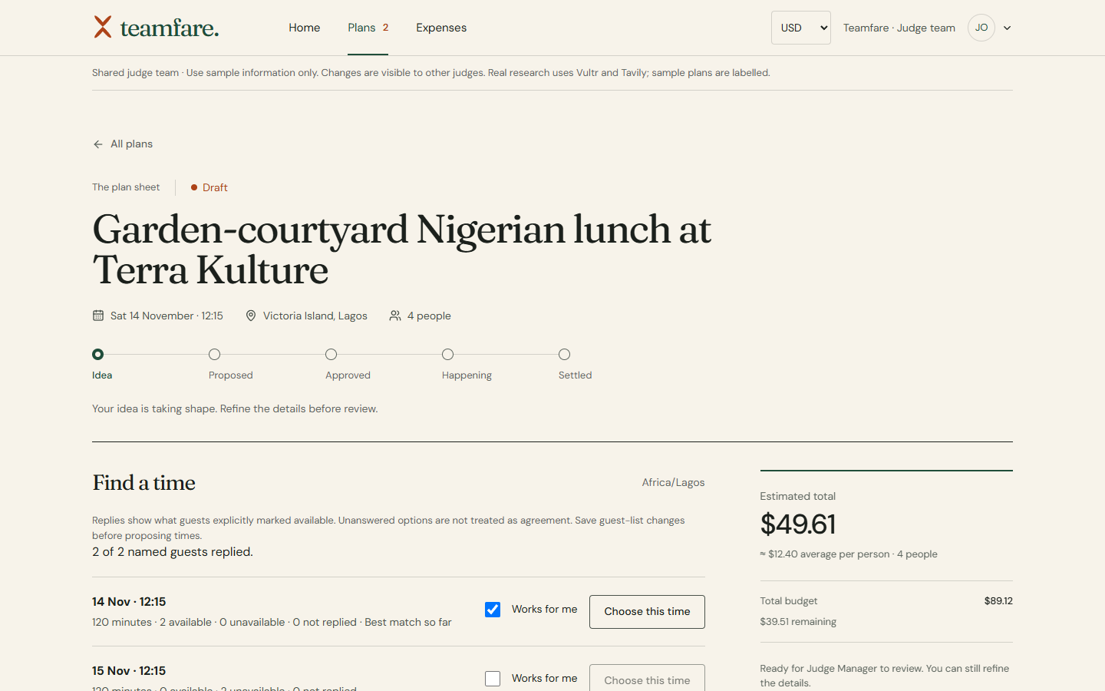
SCHEDULING AND TEAM COORDINATION
Availability is based on explicit teammate replies. Unanswered invitations remain visible instead of being treated as agreement.
Find interested teammates
Saved activity interests help organisers select the guest list.
Compare proposed times
Guests mark which slots work. Ranking separates available, unavailable and unanswered guests.
Coordinate after approval
Opted-in invitations and reminders support RSVP and calendar downloads.
Figure 4. Two named demonstration guests have replied to the proposed times.
The organiser chooses a time and acknowledges any conflicts or missing replies. Calendar files use the saved date, start time and duration.
TEAMFARE | VULTR AGENT RUSH | POWERING THE FUTURE OF WORK
5 / 11
Notes:
The example contains two actual replies from the shared demonstration accounts. Calendar export is not external calendar synchronisation.

Slide 6
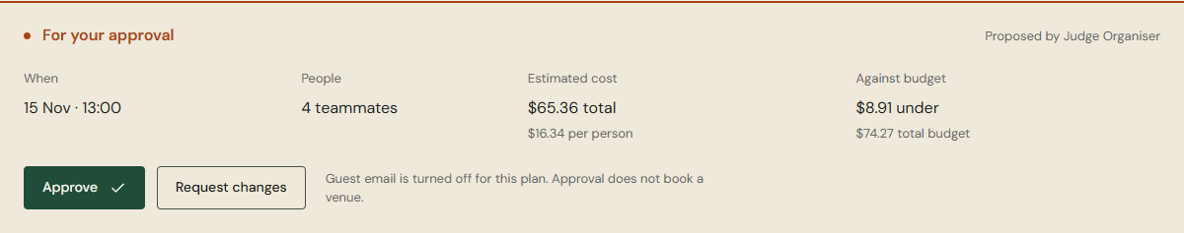
MANAGER REVIEW AND BUDGET CONTROL
A separate manager reviews the proposal before approval. The review exposes timing, headcount, estimated cost and the remaining allowance.
Figure 5. Live review panel for a sample four-person proposal.
Independent approval
Actionable feedback
Server-side checks
The organiser cannot approve their own proposal. A manager records the decision.
Request changes with a required note. The organiser revises and resubmits.
Over-budget approval and stale revisions are rejected. Activity records the actual actor.
TEAMFARE | VULTR AGENT RUSH | POWERING THE FUTURE OF WORK
6 / 11
Notes:
The sample proposal is illustrative, not a real venue quote. The separate-manager, required-note and stale-revision checks are implemented on the server.

Slide 7
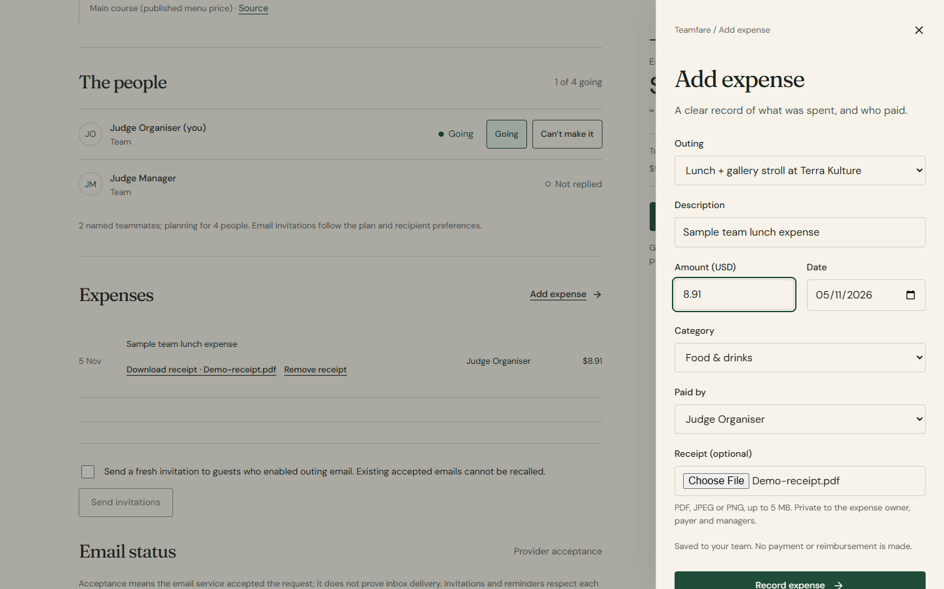
EXPENSE RECORDING AND REPORTING
Recorded spending and its supporting files remain attached to the approved outing, ready for the manager’s report.
Private receipt evidence
PDF, PNG and JPEG uploads have size limits. Access is restricted to the expense creator, payer and managers.
Consistent expense reporting
Filter records by outing and inclusive dates. Totals and formula-safe CSV use the same selected rows.
Explicit report sharing
A private-team manager can email the filtered report to a verified teammate. Real delivery was tested separately.
Figure 6. Receipt upload form (sample entry, not submitted).
TEAMFARE | VULTR AGENT RUSH | POWERING THE FUTURE OF WORK
7 / 11
Notes:
A receipt is private evidence attached to an expense. No payment, booking or reimbursement is initiated. Public judge outbound email is disabled.

Slide 8
SYSTEM ARCHITECTURE
Vultr is the operating core: Cloud Compute hosts the application and workflow engine, Serverless Inference serves Qwen, and Object Storage protects recovery.
VULTR SERVERLESS INFERENCE
Qwen reasoning + tool calls
VULTR CLOUD COMPUTE
qwen3.8-flash-next
PUBLIC WEB APP
Node.js / Fastify backend
React + TypeScript
HTTPS
Bounded research tool loop
Approval and scheduling rules
Expense ledger + receipt access
Encrypted durable email outbox
Tavily
Organiser · manager · guest
Secure cookie sessions
Public web search and page extraction
Resend
persist
Account and opted-in workflow email
Private SQLite / WAL
encrypt + back up
Accounts, plans, replies, expenses, receipts
Vultr Object Storage
Amsterdam · AES-256-GCM snapshots
Docker + Caddy on one Vultr VM · HTTPS · private persistent data · independent uptime checks · operator-led recovery
TEAMFARE | VULTR AGENT RUSH | POWERING THE FUTURE OF WORK
8 / 11
Notes:
Preserves the approved page-8 architecture: the browser talks to the Vultr backend, which orchestrates Qwen, Tavily and Resend, persists private SQLite records, and backs up encrypted snapshots to Vultr Object Storage.

Slide 9
SECURITY AND OPERATIONAL RELIABILITY
The model researches options; authenticated product rules control the decisions, records and external messages.
Account and team protection
Bounded agent work
Normal accounts verify email ownership and use password-plus-code sign-in. Origin, CSRF and team-scope checks protect requests.
Search, source reading and option submission have time, call and usage limits. Source IDs and price claims are validated.
Workflow integrity
Backup and recovery
Revision checks reject stale writes. Transactions and encrypted durable email jobs support retries and duplicate protection.
Encrypted off-VM backups include receipt bytes. Downloads, decryption, integrity and restore checks have been exercised.
Public judge accounts are deliberately isolated and restricted; ordinary accounts retain email verification.
TEAMFARE | VULTR AGENT RUSH | POWERING THE FUTURE OF WORK
9 / 11
Notes:
These are implemented boundaries, not a claim that every possible vulnerability has been excluded. The research agent does not execute arbitrary model-generated code.

Slide 10
IMPLEMENTATION AND VALIDATION RESULTS
Verification combines automated checks with real deployed accounts, providers, restart persistence and offsite recovery.
AREA
RESULT
WHAT WAS EXERCISED
API and security
31 checks passed
Authentication, permissions, revisions, receipts, outbox retries, calendar/CSV serialization and backups.
Browser workflows
17 journeys passed
12 preview journeys, 4 account/workflow journeys and 1 fixture-backed research journey.
Real integration
4 verified users
Actual email proofs, research, scheduling, review, RSVP, private receipts and reporting.
Read workload
160 reads; 0 failures
16 requests in flight across 4 users. Median 176 ms; p95 527 ms in one measured run.
Restart persistence
Restart verified
Sessions, RSVP, receipt bytes and 8 reminders persisted. Cancellation stopped all 8.
Offsite recovery
Independent restore
Encrypted objects restored on the developer’s PC; receipt hashes and original accounts matched.
Scope: controlled technical checks and a small-team read test; no claim of zero bugs or general capacity.
TEAMFARE | VULTR AGENT RUSH | POWERING THE FUTURE OF WORK
10 / 11
Notes:
All numbers describe actual test runs already recorded in the repository. The read workload is a small-team measurement, not an enterprise-scale capacity test.

Slide 11
CONCLUSION AND PROJECT ACCESS
Teamfare delivers a working research → scheduling → approval → attendance → expense-reporting workflow. Employees organise time together while managers retain a clear spending record.
Vultr runs the web application, backend, model inference and encrypted backup storage. Venue bookings and payments remain external; calendar files are exports.
Live app:
https://teamfare.dixmail.xyz
Repository:
https://github.com/ELLA0VICTOR/teamfare
PUBLIC JUDGE ACCESS — use separate browser profiles for the two roles
ROLE
EMAIL
PASSWORD
Organiser
organiser@judges.teamfare.invalid
TeamfareOrganiser2026!
Manager
manager@judges.teamfare.invalid
TeamfareManager2026!
Shared demonstration team: use sample information. Normal accounts require email verification and sign-in codes.
TEAMFARE | VULTR AGENT RUSH | POWERING THE FUTURE OF WORK
11 / 11
Notes:
Invite the judges to try both roles. Public credentials are intentional demonstration accounts, not real inboxes. The reference academic deck was used only for presentation style.

