Slide 1
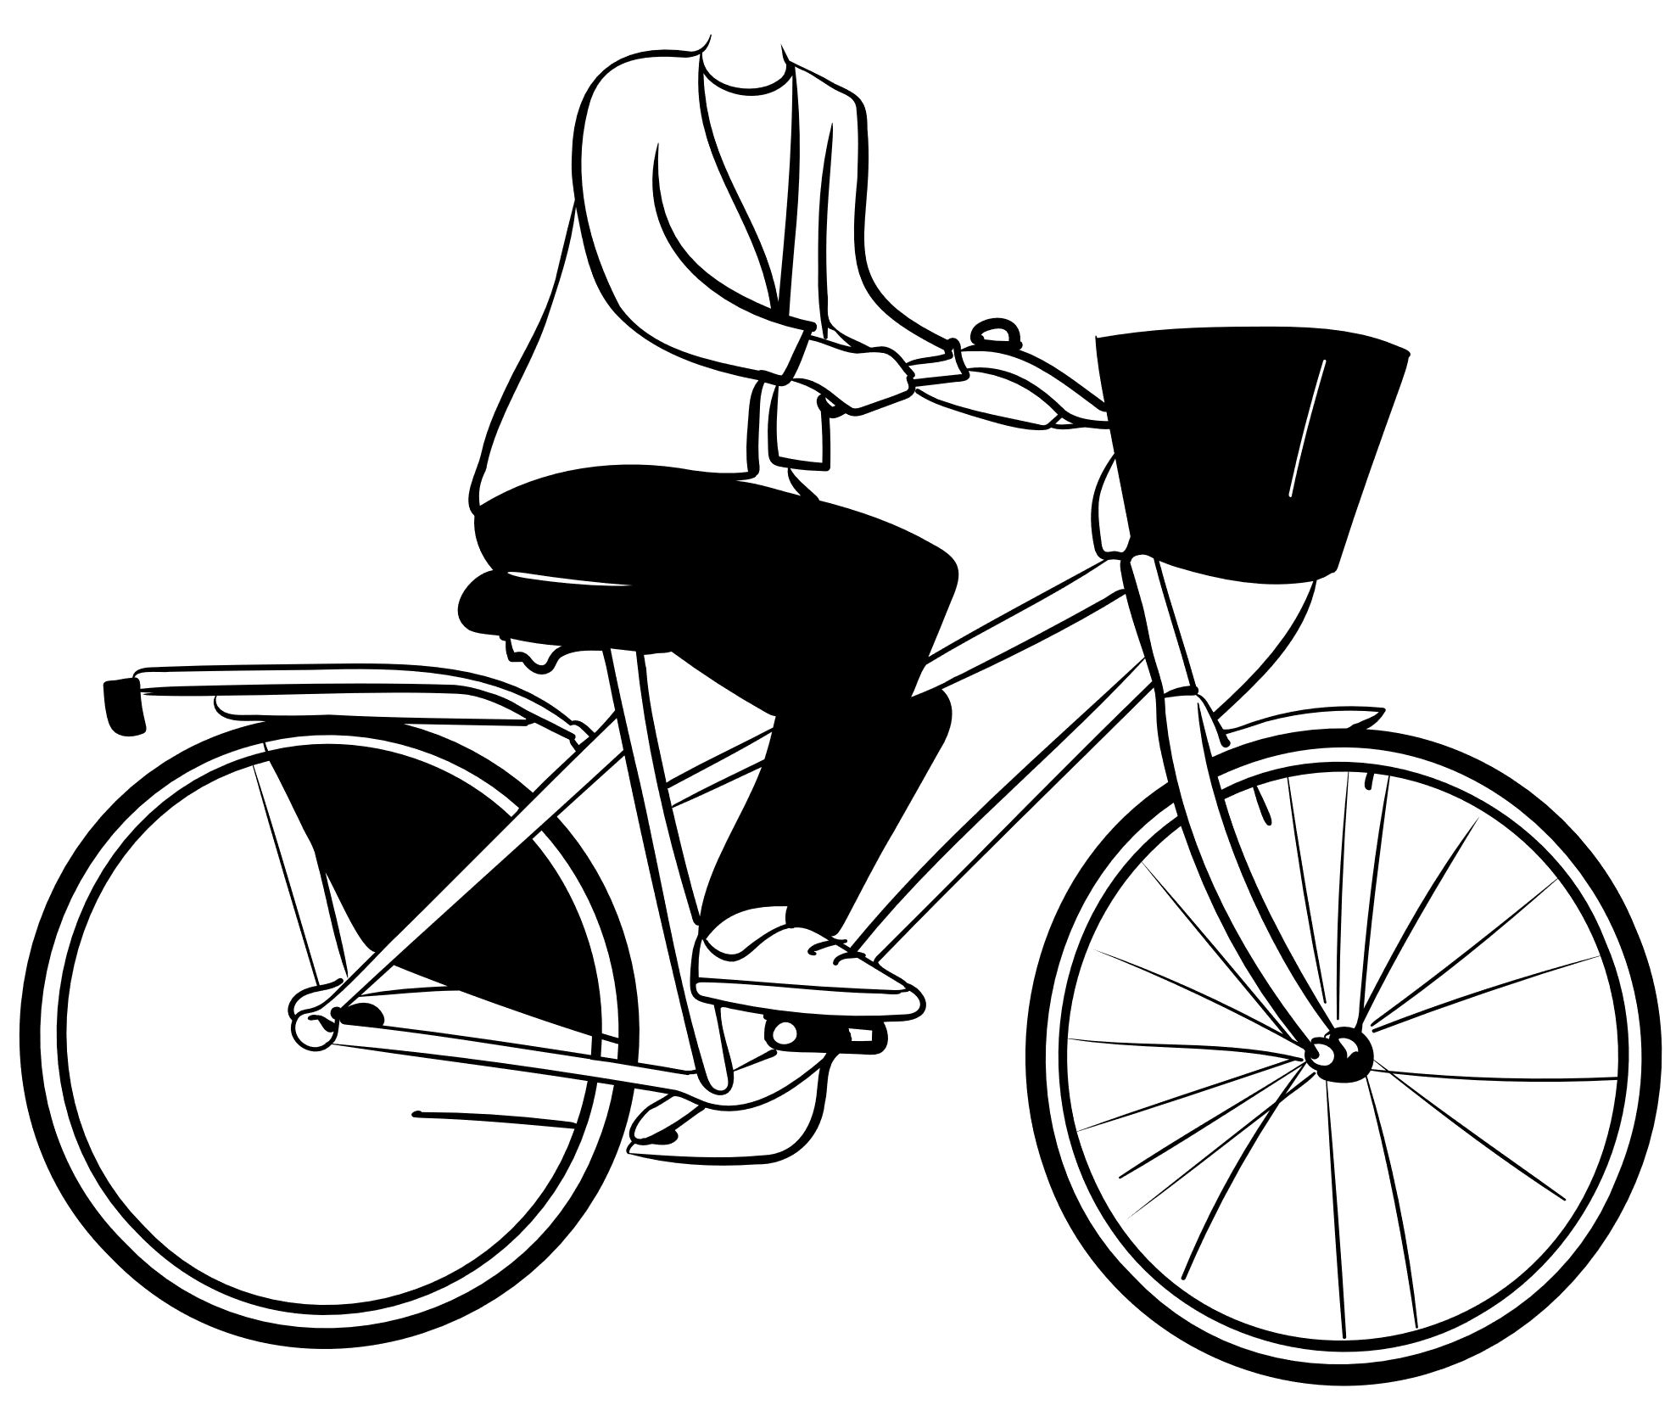
Cyclistic DATA ANALYTICS: CASE STUDY
Marinelle Toralba
April 2023

Slide 2
Agenda
BACKGROUND 3
PRIMARY GOALS 6
PROCESS OF CLEANING DATA 8
ANALYSIS 10
SUMMARY & RECOMMENDATION 16

Slide 3

Background
In 2016, Cyclistic launched a successful bike-share offering. Since then, the program has grown to a fleet of 5,824 bicycles that are geotracked and locked into a network of 692 stations across Chicago.
Cyclistic sets itself apart by also offering reclining bikes, hand tricycles, and cargo bikes, making bike-share more inclusive to people with disabilities and riders who can’t use a standard two-wheeled bike.

Slide 4
Casual Rider vs. Cyclistic Member
Casual Rider:
Customer who purchase single-ride or full-day passes.
Cyclistic Member:
Customer who purchase annual membership.

Slide 5
Sources of data
Previous 12 months of Cyclistic trip data (January 2022 – December 2022)
Made available by Motivate International Inc. under data license agreement (https://ride.divvybikes.com/data-license-agreement)
Approximately 5.6 million data points conducted DIVVY and the City of Chicago

Slide 6
Primary goals

Slide 7
Primary goals:
Differentiate how annual members and casual riders use Cyclistic.
Promote Cyclistic to casual riders using digital media.

Slide 8
Data cleaning process

Slide 9
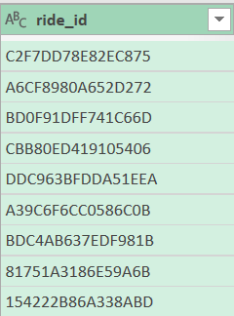
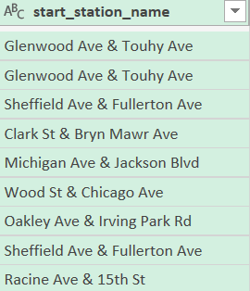
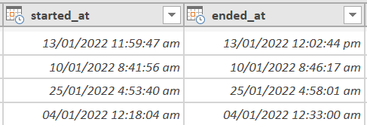
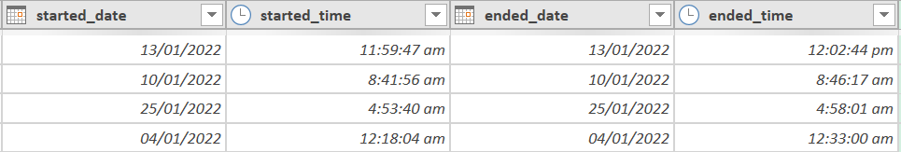
Tools: MS Excel, Power Query & Pivot Table
Columns removed:
Blank rows were retained.
Splitted timestamps:
From these:
To these:

Slide 10
Data analysis

Slide 11
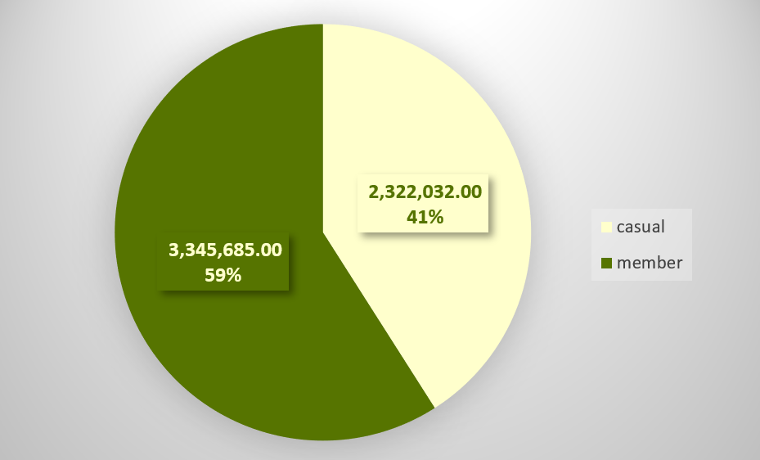
All Riders:
Total riders: 5,667,717

Slide 12
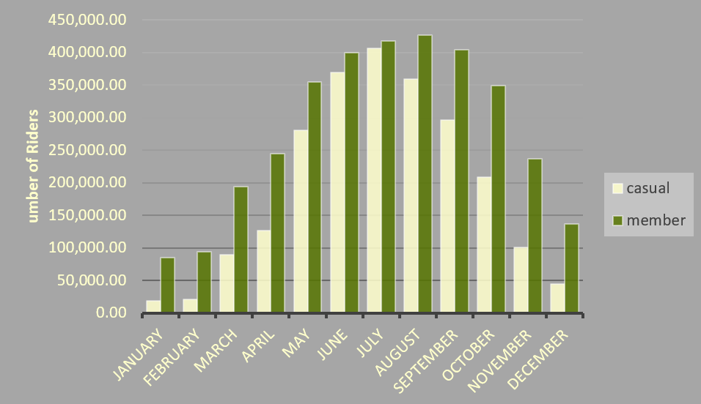
Monthly Riders:

Slide 13
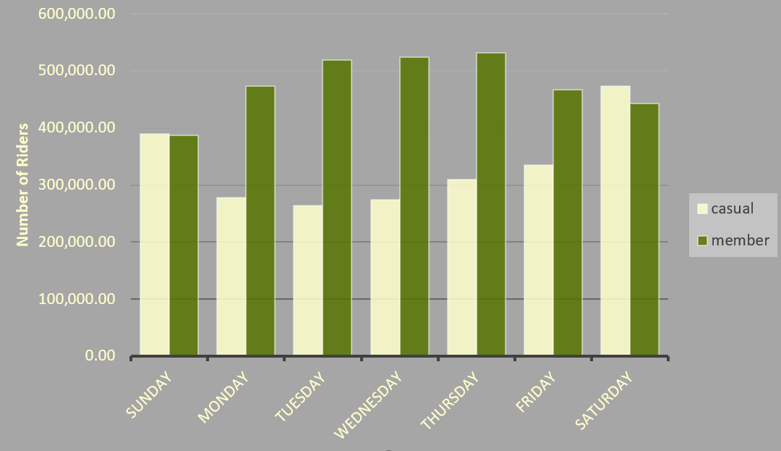
Weekly Riders:

Slide 14
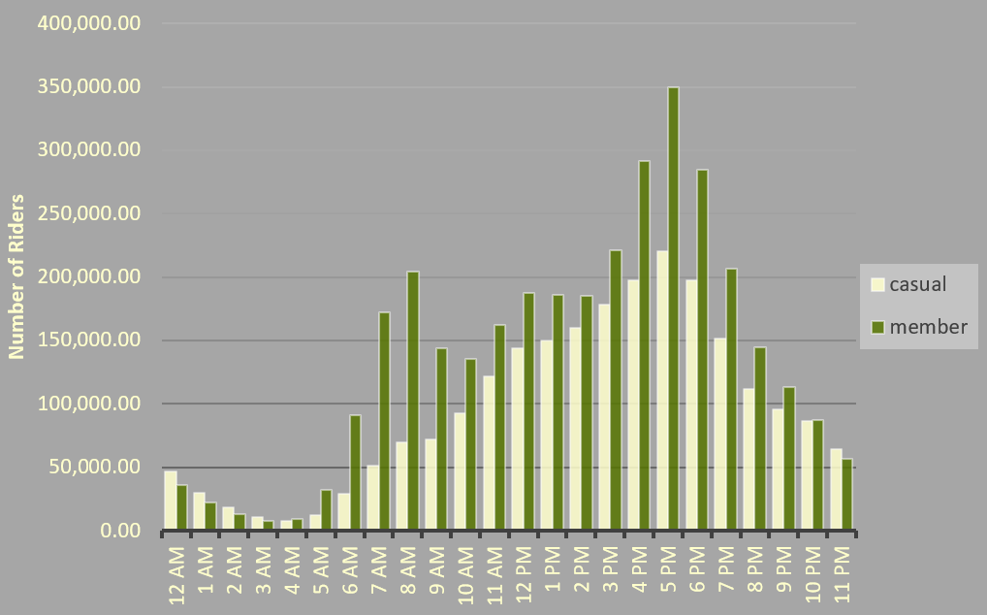
Riders Start Time:

Slide 15
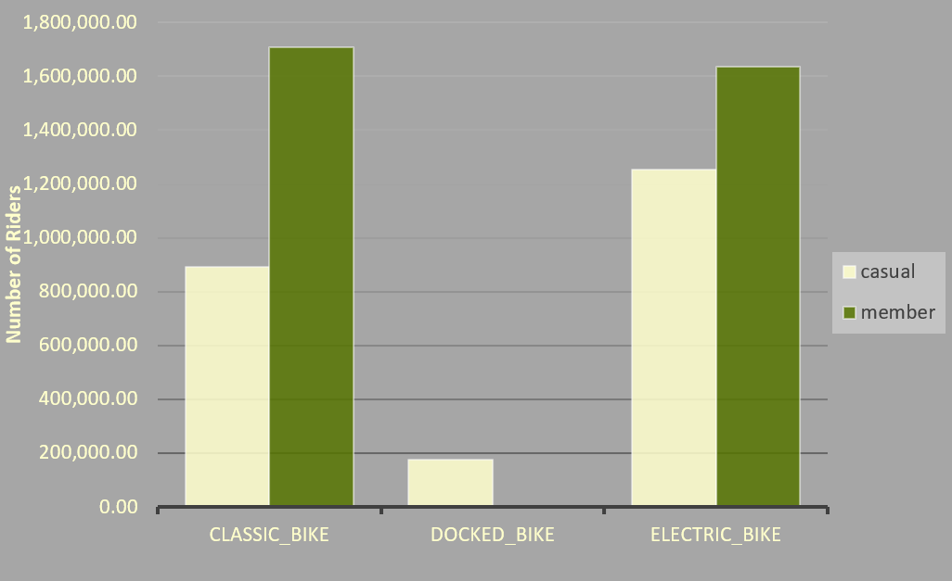
Preferred Bike Type:

Slide 16
Summary:
Overall riders
Prefer to ride during summer months.
Mostly rides between 3pm to 6pm.
Prefer to use Classic and Electric Bikes than Docked Bikes
Members vs. casual riders
There are approximately 18% more members than casual riders.
Members preferred to ride during weekdays while casual rider preferred weekends.

Slide 17
Recommendations:
Provide more bikes specially during summer months.
Membership discount rate during weekdays will attract more casual riders who prefers to ride during weekends only.
Additional Classic Bikes and Electric Bikes than Docked Bikes will be good since overall riders uses more of those two than the Docked Bikes.

Slide 18
Thank you
Marinelle Toralba
marinelletoralba@gmail.com.com

