Slide 1

Chicago Crime
Rob Mowry
Heena Waichulis
Esther Lowe
Kevin Stradigner

Slide 2

Overview
Observable crime trends in Chicago based on demographics
API calls from
data.cityofchicago.org
gmaps api
Folium
Modules used
Pandas
Geo pandas
Matplotlib
Sodapy
json

Slide 3
Police Station locations vs Crime
Data exploration and cleanup process
Crime prior year and present data set
Police location data set
City of Chicago API data is clean data
Analysis process
Police station location API call from data.cityofchicago.org
Crime data API call from data.cityofchicago.org
Police station location plot
Crime heatmap layer

Slide 4

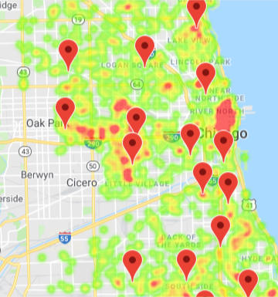
Police Station locations vs Crime
West Garfield Park
Loop
2012 Police Station consolidation
http://chicago47.org/wp-content/uploads/District-Consolidation-FAQs.pdf
https://www.chicagotribune.com/news/breaking/chi-chicago-police-districts-close-in-costcutting-plan-20120303-story.html

Slide 5
Crime vs Location type
Data exploration and cleanup process
Crime prior year and present data set
City of Chicago API data is clean data
Analysis process
Top location types: Street, Residence, Apartment, Sidewalk, Parking, Other
Pivot using aggfunc to count crime cases
Iloc to create bar charts

Slide 6
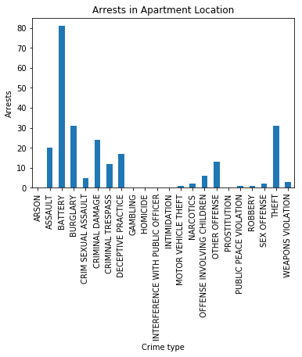
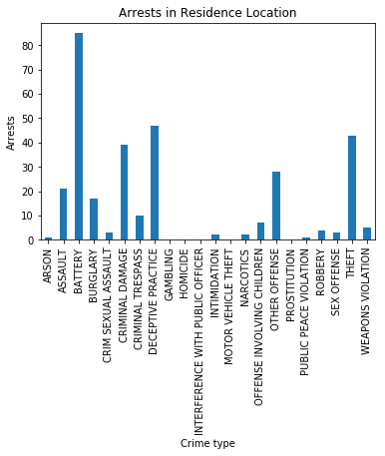
Apartment vs Residence

Slide 7
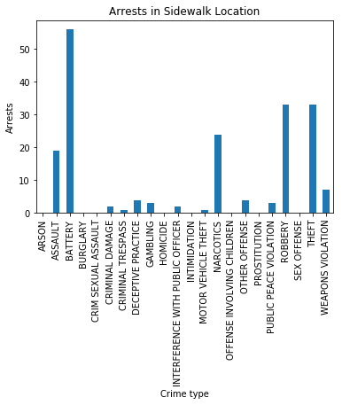
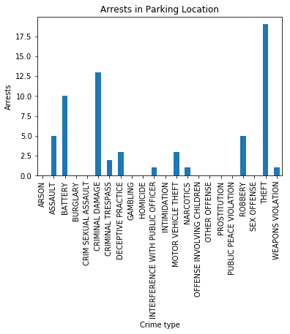
Sidewalk vs Parking

Slide 8
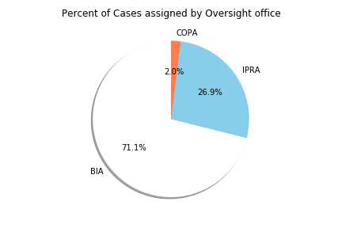
Understanding Police Accountability
Data exploration and cleanup process
Create new DFs & manually rename values to streamline data
Filtered out unhelpful data(BIA)
Analysis process
Understand different organizations
Analyze complaint types

Slide 9
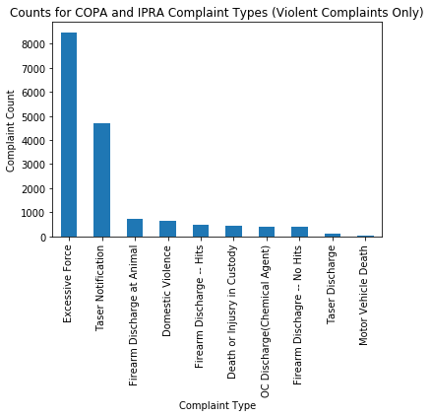
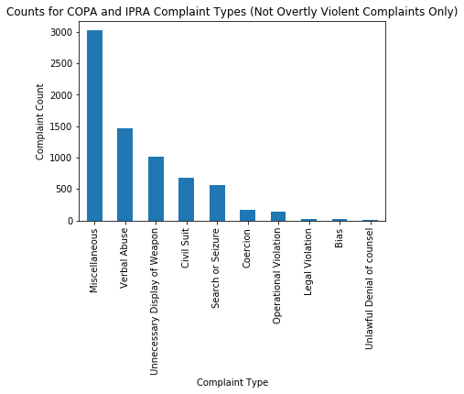
Complaint types: Violent vs Not (Overtly) Violent

Slide 10
Case Outcomes: COPA vs IPRA
Data exploration and cleanup process
Groupbys & new DFs to sort between organizations
Renames to streamline spelling discrepancies
Analysis process
Understanding investigation process & outcomes
Sort by organization to determine efficacy

Slide 11
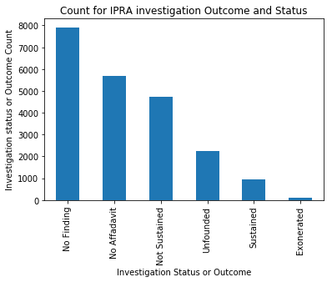
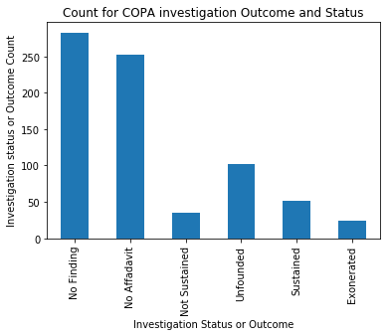
Case Outcomes: COPA vs IPRA

Slide 12
6 Months “At A Glance” - 2018 vs 2019
Data exploration and cleanup process
Exported two csv files, split date columns.
Faster computing and data analysis.
Analysis process
Asked questions of the data to see if any trends were apparent.
Created graphs to consider what the data was revealing.
Factors related to time such as seasonal temperature were considered.
Statistics

Slide 13
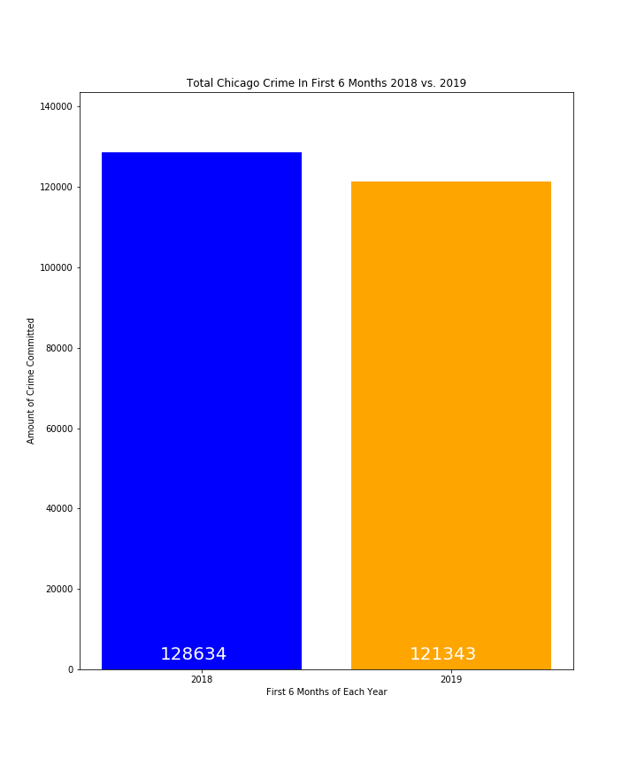
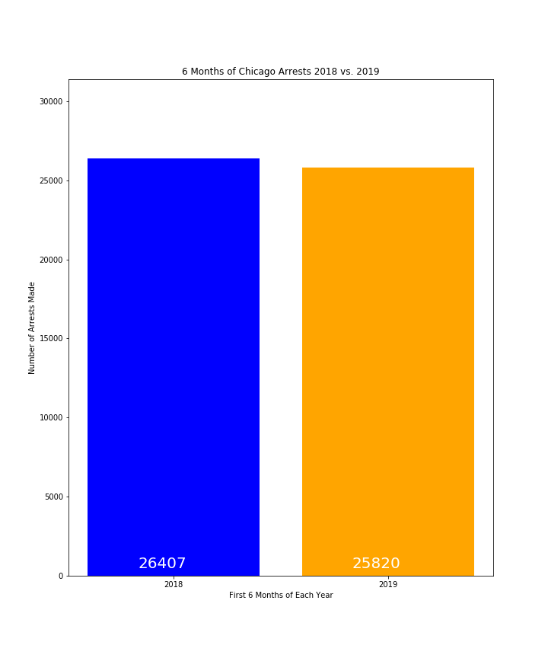
Results: Analysis of the Totals
The first question asked of the data was about the overall totals. Overall, was there anything significant about the crime committed in the first 6 months of 2018 vs. the first 6 months of 2019?
The total crime committed for the first 6 months of 2019 was unavailable.
Student’s T-Test
The subsequent question was regarding the arrest rates over the total crime for each dataset. Was there a difference in the ratio of arrest crimes and total crimes?
The percent of crimes with arrest was 21% each year, indicating that there was no difference in the arrest rate from the first 6 months of 2018 and the first 6 months of 2019.
If nothing conclusive was obvious about the totals, how about the monthly breakdown of crimes?

Slide 14
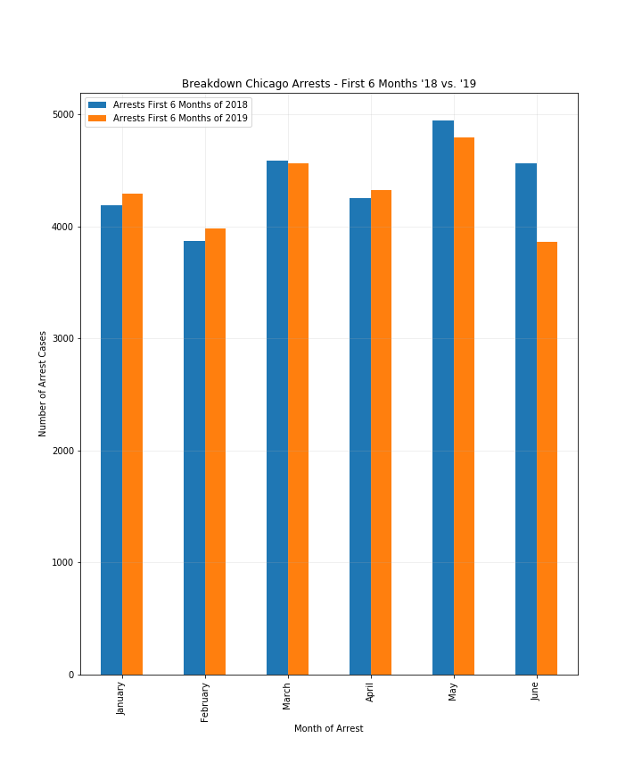
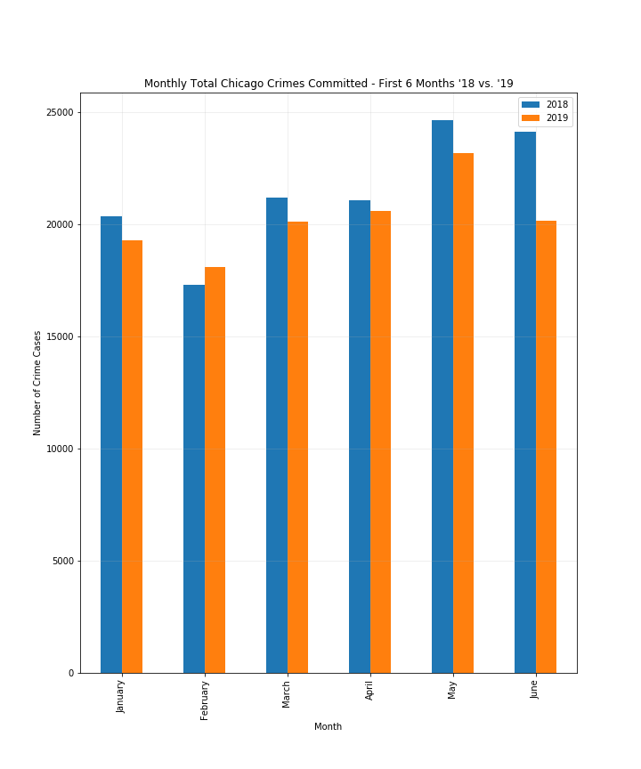
Results: Monthly Analysis
Would monthly analysis break down data into more significant units of time?
In line with the former t-test, no significant differences between the amount of crime committed nor arrests in 2018 and 2019 stand out.
The least crime appears to be committed in January and February and the most in May and June. Further research may indicate a trend that temperature influences crime levels.
Is there a trend in the crimes committed by primary description?

Slide 15
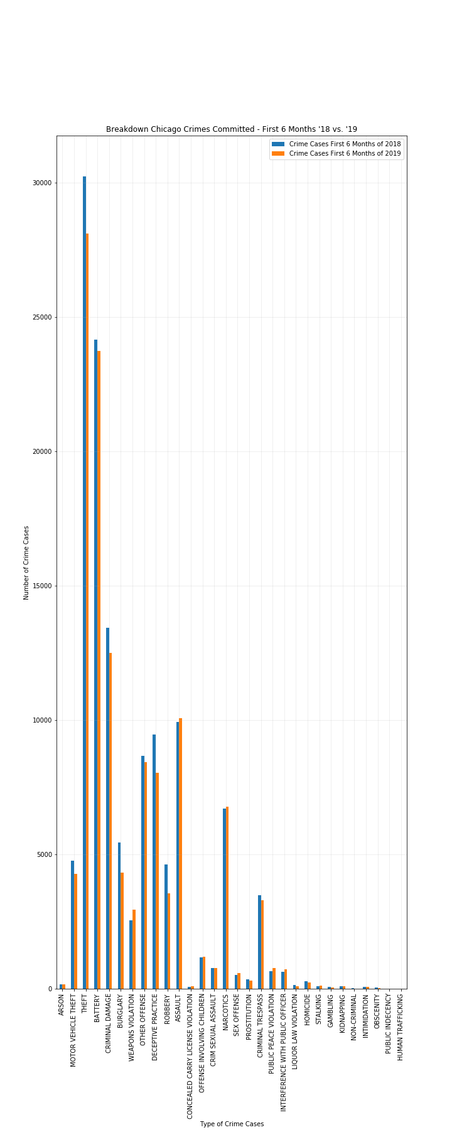
Results: Crime Analysis By Type
What type of crime cases are the most prevalent?
Are there any trends apparent in those categories?

Slide 16
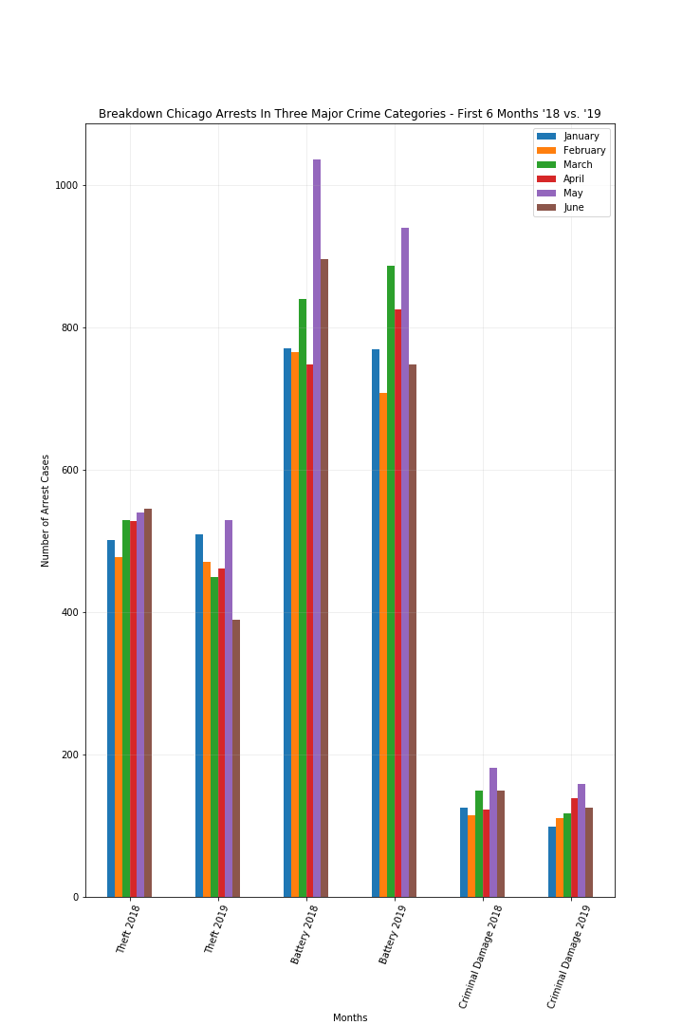
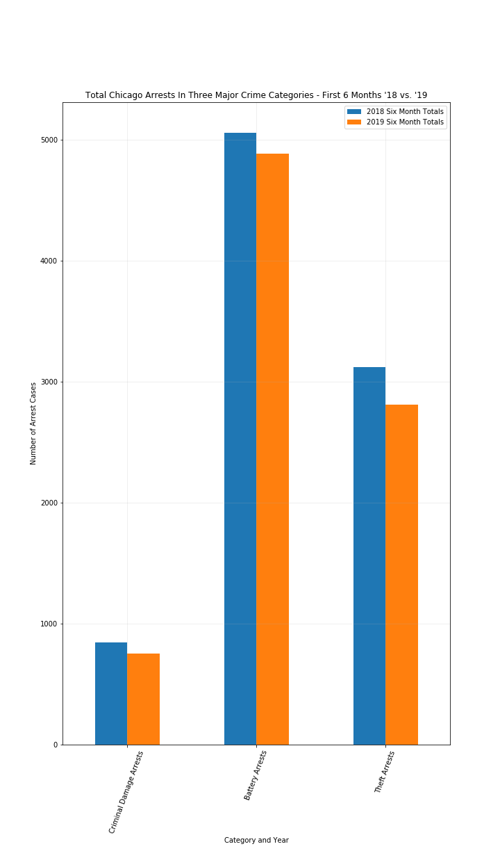
Results: Three Major Crimes
Is there anything notable about battery, criminal damage, and theft arrest crimes over time?
Arrest rates are relatively consistent accept for battery, where May arrests spiked in 2018 and 2019.

Slide 17
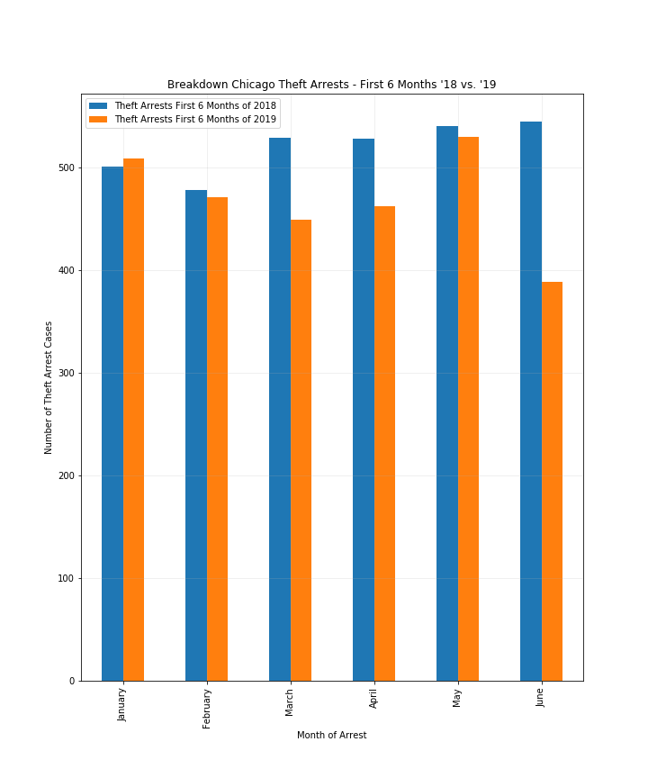
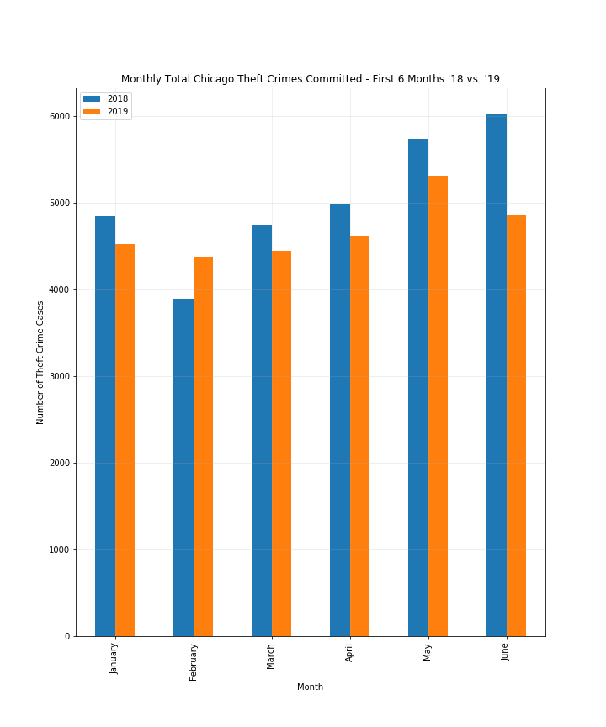
Results: Theft
Are there any trends in theft crimes and arrests?
The crime level appears to dip with lower temperatures and rise with warmer ones although arrest levels remain at relatively the same level.

Slide 18
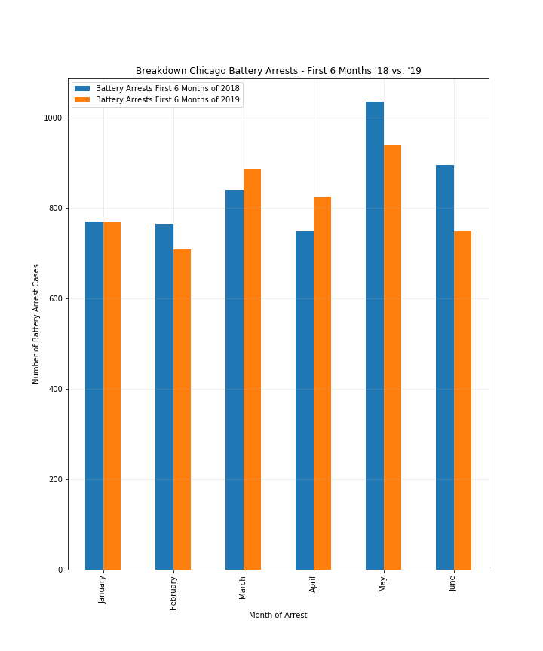
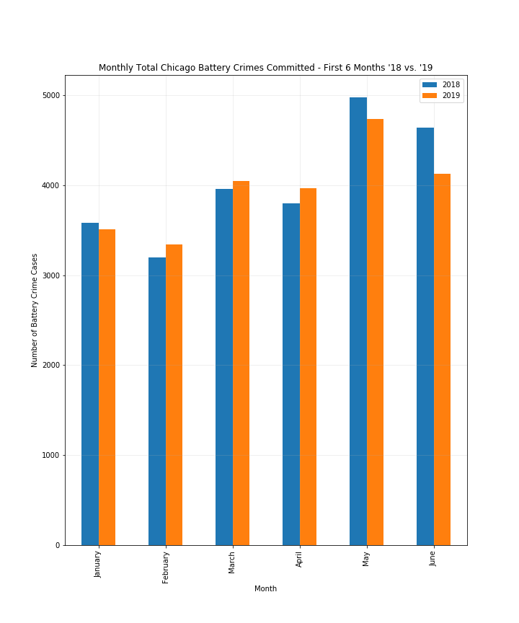
Results: Battery
Are there any trends in Battery crimes and arrests?
The crime level appears to dip with lower temperatures.

Slide 19
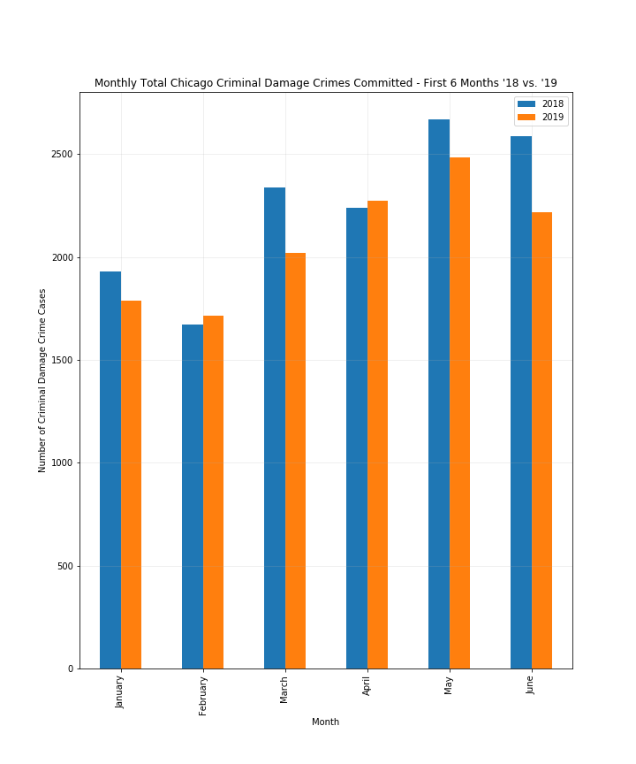
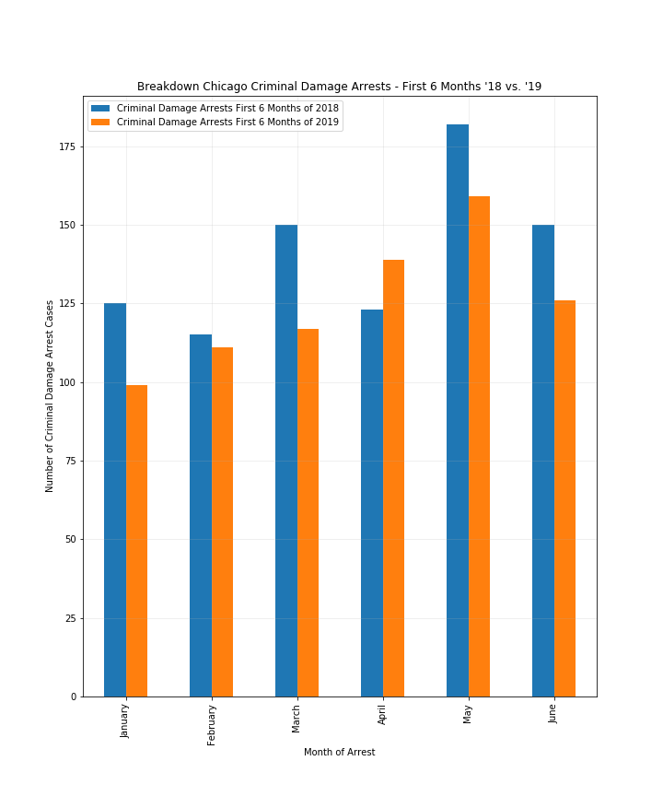
Results: Criminal Damage
Are there any trends in criminal damage crimes and arrests?
The crime level appears to dip with lower temperatures and rise with warmer ones.

Slide 20
Conclusions: First Six Months 2018 vs. 2019
Monthly differences in temperature may influence crime committed in Chicago.
Changes in the yearly level of crime may be more statistically significant and reveal notable trends when comparing years farther apart. Perhaps a trend may also become apparent and help predict future crime levels.
It is interesting that theft arrests remain at roughly 450 - 650 per month regardless of the amount of theft crimes committed, the year, or the month analyzed. Further analysis of this category may explain this notable feature in the data.

Slide 21
Crime by Chicago Neighborhood
Data exploration and cleanup process
Crimes- One year prior to present data set
Chicago Neighborhood boundaries data set
Chicago Boundaries GeoJSON
City of Chicago API is clean data
Analysis process
Neighborhood and Crime data API calls from data.cityofchicago.org
Boundaries GeoJSON converted to DF with Geopandas
Choropleths built using boundaries and crime data
Pins and popups added for description

Slide 22
What is a Choropleth Map?
A choropleth map is a thematic map in which areas are shaded or patterned in proportion to the measurement of the statistical variable being displayed on the map, such as population density or per-capita income.
Choropleth maps provide an easy way to visualize how a measurement varies across a geographic area or show the level of variability within a region. A heat map is similar but does not use geographic boundaries.

Slide 23
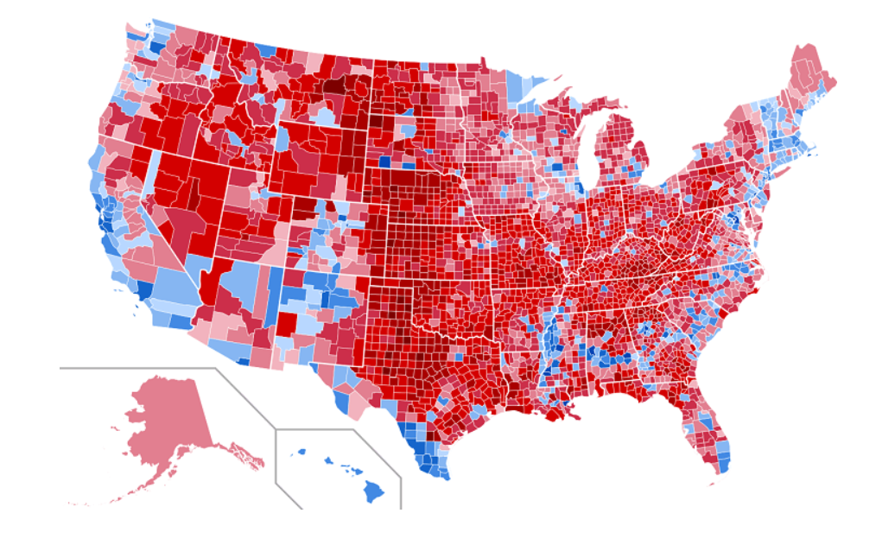
2016 Election Results By County

Slide 24
Chicago Crime Maps by Neighborhood
Total Crime Choropleth: ..\OneDrive\Desktop\NU Homework\NU-Homework\Project\total_crime_map.html
Murder Choropleth:..\OneDrive\Desktop\NU Homework\NU-Homework\Project\murder.html
Narcotics Choropleth: ..\OneDrive\Desktop\NU Homework\NU-Homework\Project\narcotics.html
Battery Choropleth: ..\OneDrive\Desktop\NU Homework\NU-Homework\Project\battery.html
Layered Choropleth: ..\OneDrive\Desktop\NU Homework\NU-Homework\Project\layered.html
Conclusions and Implications
Mantra of the South and West sides being bad holds.
West Garfield Park leads total crime, murders, and battery violations
Thefts heavily prevalent on south and west sides
Battery is more evenly dispersed, but still concentrated on West and South Sides
Narcotics violations are heavily concentrated in 4 neighborhoods…West town interesting given the demographics of Wicker Park/Bucktown situated next to Humboldt Park.

Slide 25
Conclusions
Crime seems to be present where police stations are not located
Complaints seems to be more likely to involve a violent offense from an officer
Complaints handled by COPA seems to be more likely to be sustained than a complaint handled by IPRA
Crime may have changed over time due to temperature
Crime seems to be prevalent in the neighborhoods that are anecdotally "bad"...South and West sides.

Slide 26
Questions?

