Slide 1
Spring is not magic · part 1 of 2
How a bean is born
Scanning, injection, scopes, lifecycle — the whole path from @Component to your object
github.com/ELMAALMIA/minispring
Ayoub EL Maalmi · Java & Spring Boot · 45 minutes
Notes:
Welcome. Set the contract in one sentence: by the end you will have seen everything that happens between writing @Component and holding the object.
Say that this is part one of two, and what part two covers: proxies, @Transactional and auto-configuration. Nobody should feel they are missing half a story.
Say who you are in ten seconds. The credibility comes from the code.

Slide 2
Where we are going
Six steps, from what Spring is to a fully built bean
1
Spring, then Spring Boot
4
Who reads which annotation
WAR, JAR, who owns the server
minispring, Spring, and XML
2
Why injection at all
5
Creating the bean
who chooses the implementation
constructor, scopes, lifecycle, cycles
3
What an annotation really is
6
Takeaways
bytecode, javap, reflection
and what part 2 covers
Notes:
Do not read the agenda out loud. Point at two things: the javap demo, and the error messages at the end.
Tell them about the lightning symbol in the notes: deep dives for people who already know Spring. Beginners can let those wash over them.

Slide 3
You have written this a thousand times
@Service
public class OrderService {
@Autowired
private OrderRepository repository;
}
Who creates this object?
And how does it know what to put inside?
Today we read the answer, line by line. It is not magic, it is about 1,200 lines.
Notes:
Ask the room: who here uses @Autowired every day? Most hands go up. Then: who has read the class that processes it? Almost none.
That gap is the whole talk. Do not apologise for it: nobody reads AutowiredAnnotationBeanPostProcessor, because it is 700 lines of edge cases. Mine is 40.
Keep this slide short, thirty seconds. The energy comes from the question, not from the code.

Slide 4
1
Spring, then Spring Boot
What actually changed between the two
Notes:
Five minutes, no more. Many juniors have never seen a WAR file; many seniors deployed hundreds. Frame it as ownership: who starts whom.

Slide 5
Twenty years, one model
The source of metadata changed. The model never did.
2003
2007
2009
2014
2022
Spring 1.0
Spring 2.5
Spring 3.0
Spring Boot
Spring 6
XML: <bean>
@Component, @Autowired
@Configuration, @Bean
auto-configuration
AOT, native images
Whatever the source — XML, annotations, Java, auto-configuration — the container sees one thing: a BeanDefinition.
Notes:
The key line is the callout, and it pays off twice: on the XML slide later, and in part 2 with auto-configuration.
If someone asks why XML lost: annotations put the metadata next to the code it describes. XML kept it in a file nobody opened. Both feed the same model.
Do not spend more than ninety seconds here.

Slide 6
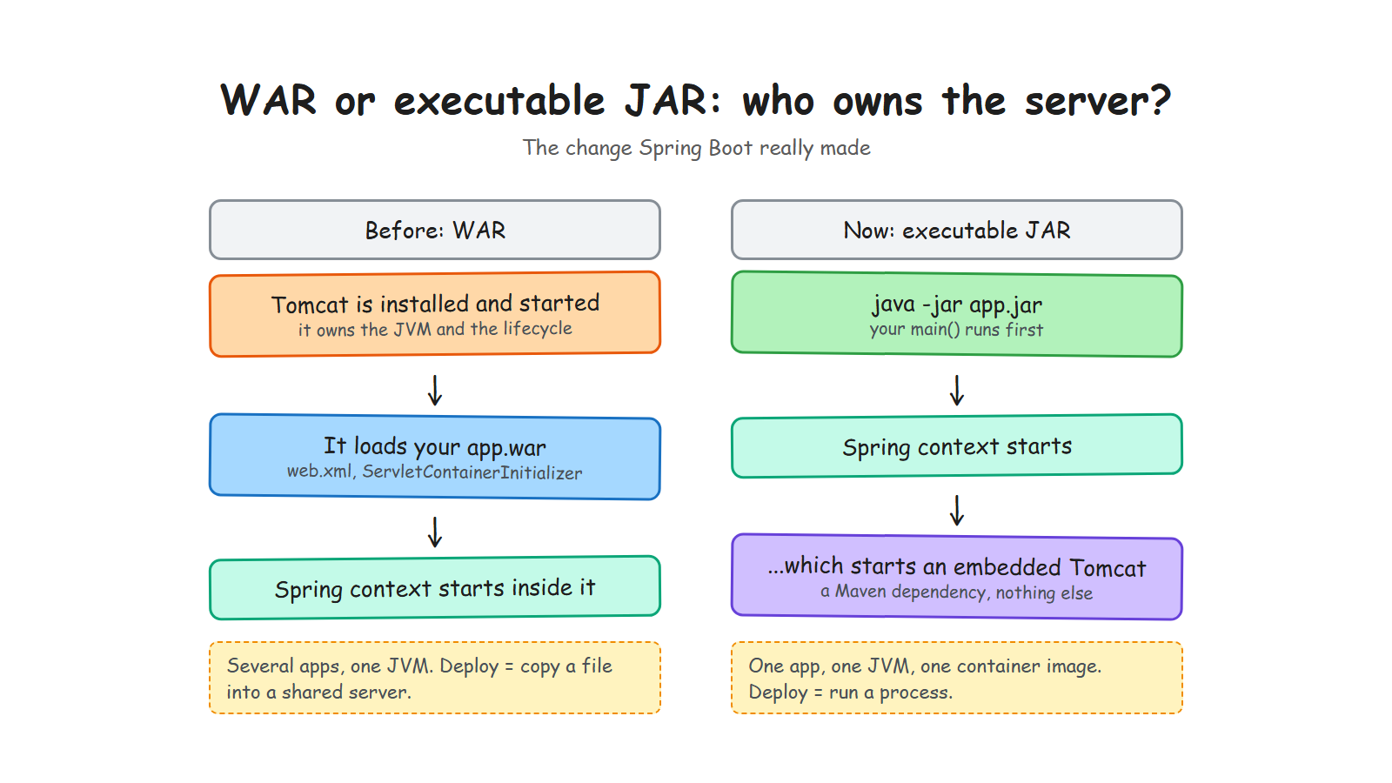
Notes:
Say it as a reversal: before, Tomcat started and then loaded your application. Now your application starts, and then starts Tomcat. Everything else follows: one app per JVM, one container image, deploy by running a process.
If you have time for one anecdote, tell the story of a shared Tomcat with five WARs where one memory leak took down all five.

Slide 7
2
Why injection at all
The problem before the solution
Notes:
Seven minutes. This is the part I added after a talk where people understood the mechanism but not the point. Do not skip it.

Slide 8
Before the container: you wire it yourself
Everybody has written this
var repository = new InMemoryOrderRepository();
var audit = new AuditService();
var service = new OrderServiceImpl(repository, audit, publisher);
var controller = new OrderController(service);
It works — until the graph has forty objects instead of four
Every caller has to know the whole graph, just to build one object
Swapping an implementation means editing every place that says new
And someone has to decide who gets closed, in which order
The problem was never typing new. It is that the caller has to know everything.
Notes:
Start here, not at the container. Ask the room to picture this code in a real service with forty beans.
Take the four bullets one by one, they are the four pains that justify everything that follows. The last one matters more than people expect: shutdown order is exactly what @PreDestroy solves later.
Do not say 'boilerplate'. Say 'the caller has to know everything'. That is the real problem, and it sets up the next slide.

Slide 9
What you actually gain
It is not fewer lines. It is who chooses.
@Component
class OrderServiceImpl implements OrderService {
OrderServiceImpl(OrderRepository repository, AuditService audit) { ... }
}
try (var context = AnnotationApplicationContext.scan("com.example")) {
context.getBean(OrderController.class); // the graph is built for you
}
The class still asks for what it needs: nothing is hidden, it is all in the constructor
But it no longer chooses which implementation it gets — that is the inversion of control
So a test builds it with a fake repository, in one line, with no framework at all
Dependency injection is a design decision. The container is only the tool that carries it out.
Notes:
The sentence to land, slowly: the class still asks for what it needs, it simply no longer decides what it gets.
The third bullet is the argument that convinces seniors: constructor injection means your tests need no framework. new OrderServiceImpl(fakeRepository, audit) and you are done. That is why field injection is discouraged — it takes that away.
Close with the callout: the pattern is the point, the container is the plumbing.

Slide 10
A container is a Map, plus rules
Map<String, Object>
The interesting part is not the Map. It is the rules that fill it:
Find the classes to manage
Describe them before creating them
Create each one after its dependencies
Run lifecycle callbacks at the right moment
Let something wrap a bean before it is handed out (part 2)
Decide whether a bean should exist at all (part 2)
Notes:
Six rules. The first four are this talk, the last two are part 2. Say that: it tells the audience where the story stops today.
The line that lands: Spring's DefaultListableBeanFactory is 2,000 lines, but the model underneath is a map from name to object. Everything else is rules about how entries get in there, and in which order.

Slide 11
3
What an annotation really is
The part nobody explains, and everything depends on
Notes:
Twelve minutes, and the heart of the talk. Slow down: this is where beginners either get it or lose the thread.
The sentence to repeat three times: an annotation does nothing, something has to read it.

Slide 12
An annotation is an interface with no code
The real file from the project
@Documented
@Retention(RetentionPolicy.RUNTIME)
@Target(ElementType.TYPE)
public @interface Component {
String value() default "";
}
Six lines.
No code runs. No class is created. It only says: someone might be interested in this class.
The interesting part is the two lines above it.
@interface, not interface. The compiler turns it into metadata stored in the class file.
Notes:
Show the file in the IDE if you can, it is more convincing than a slide.
Insist: there is no behaviour anywhere in this file. Beginners assume @Component does something. It does not. It is a sticker.
Then set up the next slide: so if it does nothing, how does a class end up in the container?

Slide 13
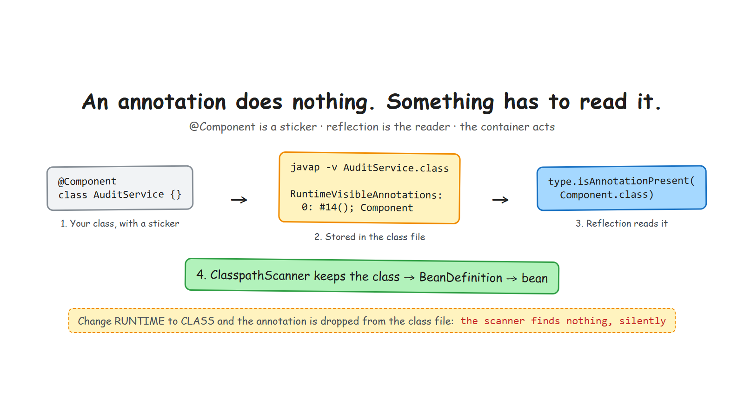
Notes:
Walk the three boxes left to right, one sentence each: the sticker, the class file, the reader.
The metaphor to use out loud: the annotation is a sticker on a box, reflection is the pair of glasses, the container is the person who acts on what is written. Remove any of the three and nothing happens.
The red line at the bottom is the demo you are about to run.

Slide 14
Proof: javap, and one word changed
The demo that makes it click
$ javap -v AuditService.class
RuntimeVisibleAnnotations:
0: #14()
io.minispring.container.annotation.Component
$ javap -v AuditService.class
RuntimeInvisibleAnnotations:
0: #14()
io.minispring.container.annotation.Component
RUNTIME
CLASS — the default
One word, and the scanner finds nothing — with no error message. Everyone hits this once.
Notes:
DEMO. Run javap live if the room is small, otherwise play the recording. Rehearse it: the command must be one line, already typed, in a large font.
Script: compile, run javap, point at RuntimeVisibleAnnotations. Then change RUNTIME to CLASS in Component.java, recompile, run javap again: the attribute name changed. Run the app: NoSuchBeanException.
Bolt for seniors: SOURCE retention disappears at compile time entirely — that is what Lombok and annotation processors use, because they work before the class file exists.

Slide 15
The three retentions, and who uses them
Retention | Lives until | Read by | Example
SOURCE | the compiler | annotation processors | @Override, Lombok
CLASS | the class file | bytecode tools | nullability annotations
RUNTIME | for ever | reflection, at run time | @Component, @Autowired
@Target says where the sticker may be put: a class, a method, a parameter. The compiler enforces it, nothing else does.
A framework that reads annotations at run time needs RUNTIME. That is the whole rule.
Notes:
[CUT IF LATE] this is a reference slide; the javap demo already made the point.
Keep it to sixty seconds. The useful nuance: CLASS is the default, which is exactly the wrong default for framework authors. That is why the mistake is so common.
Bolt: Spring 6 and Quarkus read annotations at build time now, which brings us back to the SOURCE and CLASS rows. The annotations did not change; the moment they are read did.

Slide 16
The reflection API, as used by the container
Six calls. That is the whole toolbox.
The call | What it does | Where in minispring
Class.forName(n, false, cl) | load a class without initialising it | ClasspathScanner
type.isAnnotationPresent(..) | read the sticker | ClasspathScanner
type.getDeclaredConstructors() | find the constructor to use | BeanDefinitionReader
constructor.newInstance(args) | create the bean | BeanFactory
method.invoke(bean) | run @PostConstruct | BeanFactory
Proxy.newProxyInstance(..) | wrap the bean (part 2) | TransactionalProcessor
If you know these six calls, you can write a dependency injection container.
Notes:
This is the slide that turns 'framework magic' into 'a list of JDK methods'. Read the first column slowly.
Mention setAccessible in passing: the container calls constructors and methods that are not public, and that is normal — it is a deliberate, documented choice in the code.
Bolt: this is also why reflection-heavy frameworks are slow to start and hard to compile natively. Each of these calls costs, and none of them is visible to the compiler.

Slide 17
4
Who reads which annotation
minispring, Spring, and the XML we used to write
Notes:
Fifteen minutes. The table on the next slide is the one people photograph — pause and say so.
Then two zooms only, and the three slides that close the story: scopes, lifecycle, cycles.

Slide 18
Who reads what
Same model, three ways to feed it
Annotation | Read by, in minispring | The Spring class | In XML, before
@Component | ClasspathScanner | ClassPathBeanDefinitionScanner | <context:component-scan>
@Autowired | BeanDefinitionReader | AutowiredAnnotation...Processor | <constructor-arg ref>
@Qualifier @Primary | DependencyResolver | QualifierAnnotation...Resolver | <qualifier>, primary=
@Scope | BeanDefinitionReader | ScopeMetadataResolver | scope="prototype"
@PostConstruct @PreDestroy | LifecycleMethods | CommonAnnotation...Processor | init-method=, destroy-method=
@Configuration @Bean | BeanDefinitionReader | ConfigurationClassPostProcessor | factory-bean, factory-method
The annotation is never the mechanism. It is one of three ways to write the same BeanDefinition.
Notes:
Say the promise out loud: photograph this slide, it is the map of the part of Spring we are covering today.
Then use the last column to make the point that annotations are not special. Everyone who wrote Spring XML in 2010 recognises init-method and scope=prototype. The container has not changed; the way we write metadata has.
Do not read every row. Read the @Component row and the @PostConstruct row, then move on.
Note for yourself: several class names are identical on both sides because I deliberately mirrored Spring's naming. It helps people navigate the real Spring source afterwards.

Slide 19
The same bean, written three ways
Different syntax, identical BeanDefinition
2008 — XML
Today — annotations
<bean id="orderService"
class="shop.OrderServiceImpl">
<constructor-arg ref="orderRepository"/>
</bean>
<bean id="orderRepository"
class="shop.InMemoryOrderRepository"
init-method="open"
destroy-method="close"
scope="singleton"/>
@Component
class OrderServiceImpl implements OrderService {
OrderServiceImpl(OrderRepository repo) { }
}
Today — Java configuration
@Configuration
class AppConfig {
@Bean
OrderService orderService(OrderRepository r) {
return new OrderServiceImpl(r);
}
}
The container reads all three into the same object. XML did not disappear because it was wrong, but because the metadata sat far from the code.
Notes:
Ask the room first: who has already written Spring in XML? The hands tell you how much history to give.
Point at the three XML attributes that survived as annotations: init-method became @PostConstruct, destroy-method became @PreDestroy, scope became @Scope. Same model, different spelling.
Then be fair to XML: it kept configuration outside the code, which is exactly what you still want for things that change per environment. What killed it was putting the wiring there too.
Bolt: Java configuration is the interesting middle ground — it is code, so it is typed and refactorable, and it stays outside the class, so a library class you do not own can still become a bean.

Slide 20
Zoom 1 — finding the classes
Java has no API to list the classes of a package
private static boolean isInstantiableComponent(Class<?> type) {
int modifiers = type.getModifiers();
return isComponent(type)
&& !type.isInterface()
&& !Modifier.isAbstract(modifiers)
&& (!type.isMemberClass() || Modifier.isStatic(modifiers));
}
Ask the ClassLoader for the package directory, then walk it with Files.walk
Load with Class.forName(name, false, loader): finding must not run static initialisers
Sort the result, so that startup order never depends on the file system
Notes:
[CUT IF LATE] the idea survives without the code, if you are behind.
The line that surprises people: there is no way to ask Java for the classes of a package. You ask the class loader where the folder is and you read files. Spring does the same, with more cases.
Bolt: this is also why my scanner does not see classes inside jars, and why Spring Boot's auto-configuration uses an index file instead of scanning — which is a part 2 story.
Mention the sorting: a one-line decision that makes startup deterministic and tests reproducible.

Slide 21
Zoom 2 — choosing a constructor, then a bean
Two rules, and an error message that does the teaching
One constructor: use it, no annotation needed — that is why @Autowired disappeared from modern Spring code
Several: use the one marked @Autowired; several marked, or none: fail, and list the candidates
Then, per parameter: type match, then @Qualifier by name, then @Primary. Never a guess.
2 beans of type com.example.PaymentGateway match, required by
parameter 'gateway' of bean 'checkout': [stripeGateway, paypalGateway].
Mark one with @Primary, or choose one with @Qualifier("name").
An error message that names the parameter and every candidate is worth more than a page of documentation.
Notes:
The first bullet answers a question juniors always have: why do I see @Autowired in old code but not in new code? Because with a single constructor it became unnecessary in Spring 4.3.
Read the error message out loud, slowly. Then say: this is a design decision, not a detail. Spring's version of this message is famously unhelpful, and it costs the ecosystem thousands of hours.
Bolt: parameter names only survive compilation with the -parameters flag. Without it you get arg0, which is why the message would be useless.

Slide 22
Scopes: how many instances exist
One shared, or one per request
@Component // one instance, created at startup
class Cache { }
@Component @Scope(ScopeType.PROTOTYPE) // a new one on every lookup
class ShoppingCart { }
Singletons are created at startup, so a wiring mistake fails then — not at three in the morning
A prototype is created on every request, and the container keeps no reference to it
Which is why a prototype never receives @PreDestroy: nobody is holding it for you
A prototype injected into a singleton is created once, and once only. Same in Spring, and it surprises everyone.
Notes:
The callout is the part worth the slide. Explain why: the singleton is built once, so its constructor runs once, so it receives exactly one prototype and keeps it for ever.
The fix in Spring: inject an ObjectProvider or a Provider and ask for a fresh instance each time. In my container, ask the context. Say it in one sentence, do not go further.
Two tests in the repository state both rules: returnsANewPrototypeOnEveryLookup and injectsAPrototypeIntoASingletonOnlyOnce.

Slide 23
The lifecycle: after injection, before the end
Order is the whole feature
init service with repository true <- @PostConstruct, after injection
destroy controller <- close(), in reverse creation order
destroy service
destroy repository
@PostConstruct runs after injection, so the dependencies are usable — that is its only purpose
close() destroys in reverse creation order, so a bean dies before what it depends on
A failing @PreDestroy is logged, and the other beans are still closed
If startup fails halfway, what was already created is destroyed before the error propagates
Notes:
This is the slide that answers the fourth pain from the wiring-by-hand slide: who closes what, and in which order. Point back to it.
Reverse order is not a detail: a repository must still work while the service that uses it is shutting down. Spring does exactly the same.
Bolt: the container keeps the raw bean for @PreDestroy, not the proxy, because a JDK proxy only exposes interface methods. That is a part 2 detail, drop it if nobody is asking.

Slide 24
Circular dependencies: why a constructor cannot
And why that is good news
class Chicken { Chicken(Egg egg) { } }
class Egg { Egg(Chicken chicken) { } }
Circular dependency: rock -> paper -> scissors -> rock. Constructor injection cannot
create a bean before its own dependencies exist; move the shared logic into a
separate bean to break the cycle.
With constructors it is simply impossible: A cannot exist before B if each needs the other
Spring resolves cycles only for field injection, by handing out a half-built object from an early cache
So a cycle is a design problem, and constructor injection is what makes it visible
The container refuses, and shows the whole chain. That is a feature, not a limitation.
Notes:
A classic interview question, and now you can answer it from the mechanism rather than from memory.
How the chain is printed: the container keeps the beans being created in an insertion-ordered set. When one is requested while still in that set, the set read from that bean onwards is the cycle.
If someone says Spring handles cycles fine: it does, for field injection, and Spring Boot 2.6 turned that off by default. The reason is exactly this slide.

Slide 25
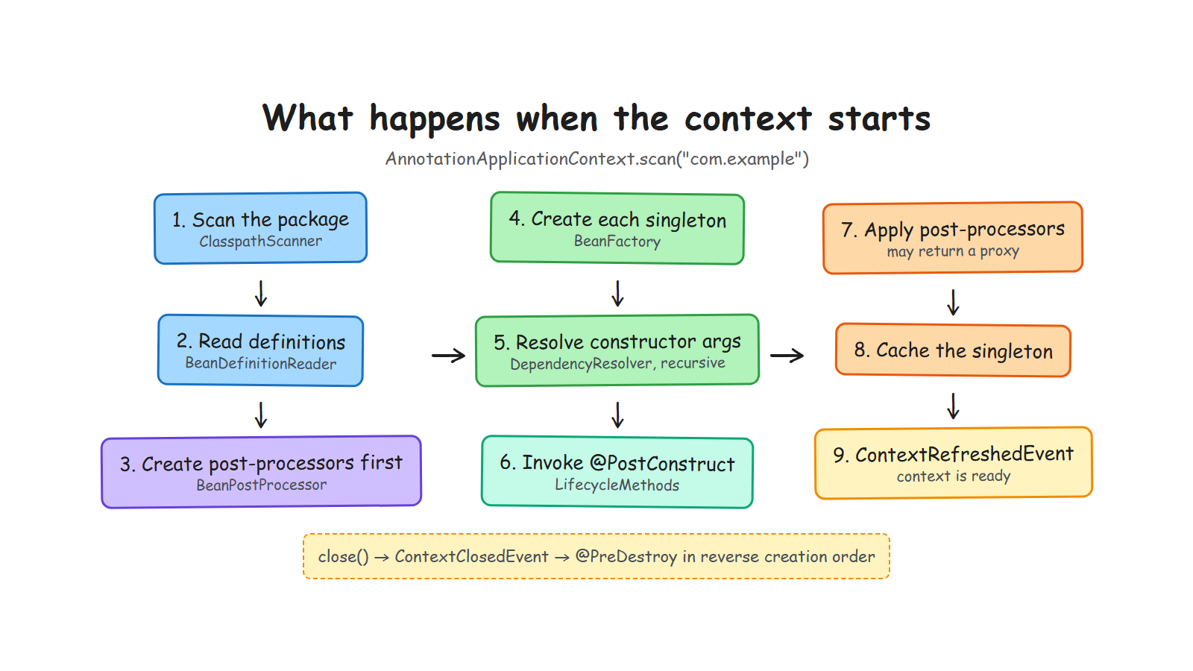
Notes:
Recap slide. Walk it once, quickly, naming the annotation that matters at each step.
Then point at steps 7 and 8, and say: this is where part 2 starts. The bean is built, and something is about to replace it.
[CUT IF LATE] it repeats what they just saw.

Slide 26
Three things to take home
1
An annotation does nothing
Something has to read it. javap showed you exactly what that something reads.
2
A container is a Map and a few rules
Definitions first, instances second. Every feature follows that order.
3
Constructor injection is a design choice
It makes your dependencies visible, and your cycles impossible to ignore.
github.com/ELMAALMIA/minispring
Part 2: why your @Transactional sometimes does nothing, and how @Conditional decides.
Notes:
Close on the three sentences, then stop talking.
The call to action that works: clone it and read the commit history in order, one concept per commit.
Announce part 2 in one sentence, then open the floor. Expected questions: field injection, why no CGLIB, is it production-ready (no, and say so).

