Slide 1
Spring is not magic · part 2 of 2
What happens to your bean
Post-processors, proxies, @Transactional, and how auto-configuration decides
github.com/ELMAALMIA/minispring
Ayoub EL Maalmi · Java & Spring Boot · 45 minutes
Notes:
Open by naming the two questions this hour answers: why does @Transactional sometimes do nothing, and why is that bean not there.
Say that part 1 is not required: the next two slides catch everyone up.
If some of the room saw part 1, thank them, then go anyway — repetition costs you two minutes and buys everyone else the whole talk.

Slide 2
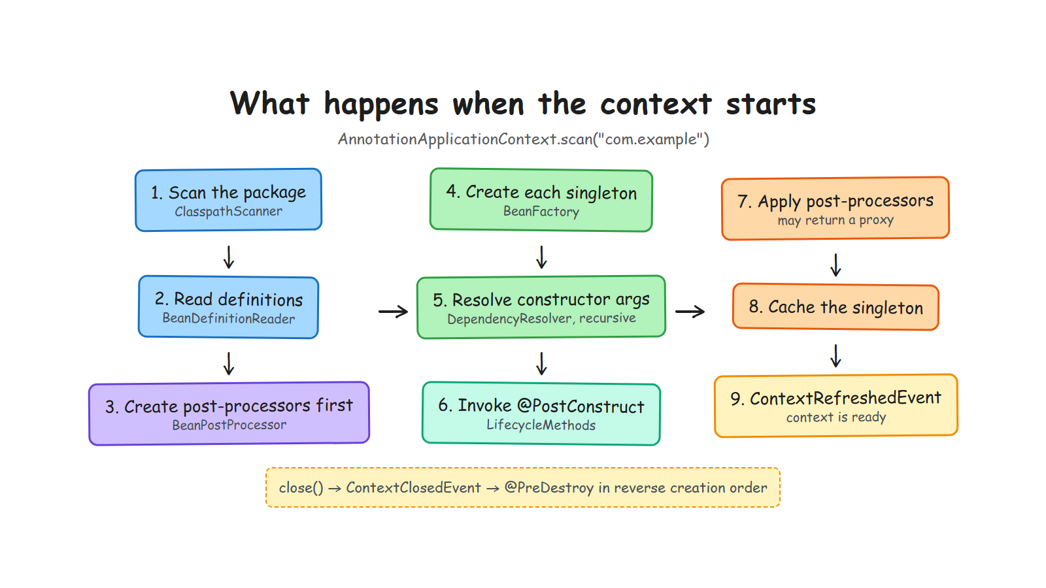
Notes:
The recap in one picture. Walk steps 1 to 6 quickly: scan, describe, create, inject, initialise.
Then stop at step 7 and say: this is where today starts. The bean exists, it is initialised, and something is about to be allowed to replace it.

Slide 3
Where we left off
Part 1, in four sentences
An annotation does nothing. Something has to read it — and javap showed us exactly what it reads.
A definition describes a bean; the factory creates it after its dependencies, recursively.
Scopes decide how many exist; @PostConstruct and @PreDestroy decide when things happen.
At that point the bean is built, initialised, and about to be handed to you.
Today: what happens between 'the bean is built' and 'you get it' — and who decides it should exist at all.
Notes:
Three minutes maximum. The room is either the same one as last time, or a new one: this slide has to work in both cases.
If a few people saw part 1, ask them to nod. Then say the one thing they need for today: the container builds an object, and only then does it decide what to hand over.
The diagram before this slide carries the detail. Here, say the four sentences and move on.

Slide 4
1
The seam
One method, and everything else is built on it
Notes:
Five minutes. Do not rush this: without the post-processor, the proxy slides look like magic again.

Slide 5
The seam: something may replace your bean
One method, and everything else follows
public interface BeanPostProcessor {
default Object postProcessAfterInitialization(
Object bean, String beanName) {
return bean; // ...or something else entirely
}
}
The container creates the post-processors first, then passes every other bean through them
A processor may return a different object — that one line is what makes AOP possible
It runs after @PostConstruct, so a proxy always wraps a fully initialised bean
Everything in this talk is built on this single method.
Notes:
Slow down on the comment in the code: 'or something else entirely'. That is the whole idea, and people miss it.
Spring has the same interface, with a before and an after method, and dozens of implementations. Two of them are AutowiredAnnotationBeanPostProcessor and the AOP auto-proxy creator.
The ordering point is worth ten seconds: if post-processing ran before @PostConstruct, your initialisation method would run on a proxy, and a transaction could be opened around it.

Slide 6
Who reads what, part two
The annotations that need more than a definition
Annotation | Read by, in minispring | The Spring class | In XML, before
@Transactional | TransactionalProcessor | TransactionInterceptor | <tx:advice> + <aop:config>
@RestController | DispatcherServer | RequestMappingHandlerMapping | <mvc:annotation-driven>
ApplicationListener | ApplicationEventMulticaster | SimpleApplicationEvent...caster | a <bean> implementing it
@Conditional | ConditionEvaluator | ConditionEvaluator (same name) | no equivalent
The last row is why Spring Boot could not have been built in the XML era.
Notes:
[CUT IF LATE] it is a map, not an argument; the proxy slides carry the section on their own.
The punchline is the last row, and it is the bridge to the auto-configuration part. XML could describe beans; it could not describe a decision that depends on the classpath and on what you already declared.
If someone objects that XML had profiles: true, and profiles are the closest ancestor of @Conditional.

Slide 7
2
Proxies
The container does not always hand you your bean
Notes:
Twelve minutes, and the emotional peak of the talk. The self-invocation slide is what people will tell their colleagues about.

Slide 8
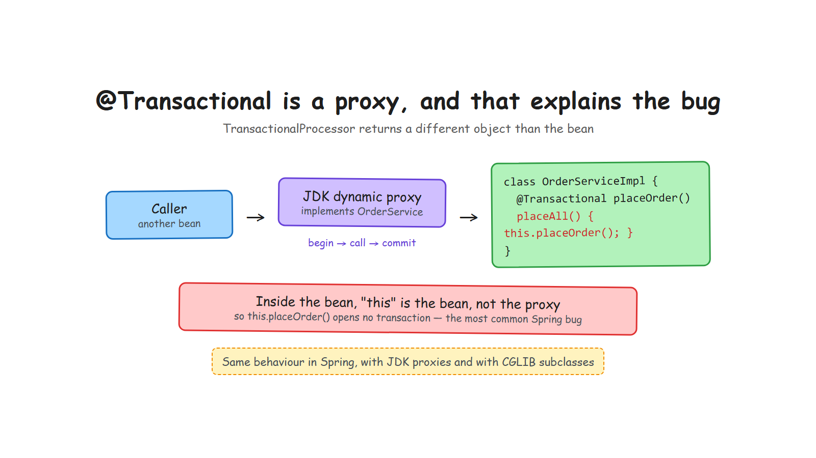
Notes:
Build the picture in words before the audience reads it: the caller does not hold your bean, it holds a proxy that implements the same interface.
The post-processor is 40 lines: find the @Transactional methods, ask the JDK for a proxy, call the transaction manager around each call.
Then pause, because the next slide is the one people will remember.

Slide 9
The bug you have already hit
The most common @Transactional mistake in production
@Override
public void placeAll(List<String> items) {
items.forEach(this::placeOrder); // "this" is the bean, not the proxy
} // -> no transaction, and no warning
The test that pins it down:
void selfInvocationBypassesTheProxyAndStartsNoTransaction() { ... }
Same behaviour in Spring, with JDK proxies and with CGLIB. Fifteen lines of your own code explain a day of debugging.
Notes:
Ask the room first: who has already lost time on a @Transactional that did nothing? Hands go up, and you have their full attention.
Then explain with the diagram still fresh: the proxy wraps the bean from outside. Inside the bean, this is the bean. An internal call never crosses the proxy boundary.
Say the workarounds briefly: split into two beans, inject the bean into itself, or use AopContext. The first one is the honest fix.
This is the story that got the most reactions on my LinkedIn post. It is relatable, not academic.

Slide 10
Spring's other proxy: a generated subclass
Same idea, different trick — and it is what makes @Configuration work
OrderServiceImpl$$SpringCGLIB$$0 extends OrderServiceImpl
 | JDK dynamic proxy (minispring) | CGLIB subclass (Spring Boot default)
How | implements the interfaces | extends the class, overrides its methods
Requires | an interface | a class and methods that are not final
getBean(Impl.class) | fails: the proxy is not that type | works: the proxy is a subclass
Built by | the JDK | bytecode generated at run time, with ASM
Self-invocation | bypassed | bypassed too — nothing changes
It also rewrites @Configuration classes, so one @Bean method calling another returns the singleton. That is the one thing minispring cannot do.
Notes:
This slide answers the question someone always asks after the proxy section: Spring proxies classes that have no interface, so how?
Explain the mechanism in one sentence: CGLIB writes a new class that extends yours and overrides every method to call the interceptor first.
Then the consequences, in order: no interface needed; a final class or a final, private or static method is silently never intercepted; getBean on the implementation class works because the proxy really is one; and the proxy is built without calling your constructor, using Objenesis, so its own fields stay null — it is only a switchboard in front of the real bean.
Three facts for questions: CGLIB has been repackaged inside spring-core since Spring 3.2; it is built on ASM; and it does not work in a GraalVM native image, which is part of why Spring 6 introduced AOT processing.

Slide 11
3
Invent your own annotation
The moment this stops being someone else's framework
Notes:
Eight minutes. This is the part that converts spectators into people who will try it tonight.
If the room is with you, do it live in the IDE.

Slide 12
@Timed, in three steps
The same pattern as @Transactional
@Retention(RUNTIME) @Target(METHOD)
public @interface Timed { }
1. The sticker
public Object postProcessAfterInitialization(Object bean, String name) {
// if a method carries @Timed, return a proxy that measures the call
return Proxy.newProxyInstance(loader, interfaces, handler);
}
2. A BeanPostProcessor that wraps the bean · 3. A test that proves the duration is logged
Thirty lines. You have just written the mechanism behind @Cacheable, @Retry and @Async.
Notes:
DEMO if possible. Write the annotation, copy TransactionalProcessor, rename, run the test. Five minutes, rehearsed.
The sentence to land: every method-level annotation in Spring works this way. @Cacheable, @Retry, @Async, @PreAuthorize — same pattern, more edge cases.
Then warn them, honestly: in real projects, use the existing ones. The point is not to rewrite Spring, it is to stop being afraid of it.

Slide 13
4
Auto-configuration
How @Conditional decides what gets wired
Notes:
Ten minutes. Tell the true story: this part exists because someone asked the question in a LinkedIn comment. It makes the talk feel alive.

Slide 14
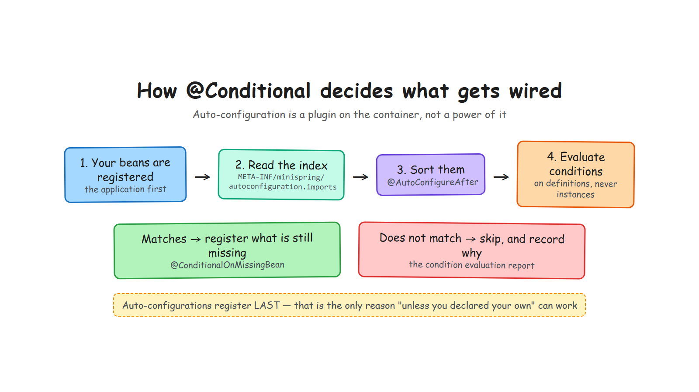
Notes:
Walk the four boxes. Insist on the first one: your beans are registered first. Everything else depends on that ordering.
Say what auto-configuration is in one sentence: a plugin that contributes bean definitions through an extension point, after you, and only for what is missing.
In my implementation the container knows nothing about it: a separate module, 300 lines.

Slide 15
Two rules, and everything follows
1. Conditions read definitions,
never instances
2. Auto-configurations
register last
Deciding whether a bean should exist must not create beans, or the question answers itself.
Only then can @ConditionalOnMissingBean mean "unless you declared your own".
@Bean
@ConditionalOnMissingBean
public Notifier notifier() { return message -> System.out.println("NOTIFY " + message); }
Same classes, opposite registration order, different application. There is a test for it.
Notes:
These two rules are the answer to the question that started this part, and the takeaway of the whole section.
Rule two explains the warning in Spring's own documentation: @ConditionalOnMissingBean is only reliable inside an auto-configuration. Now they know why, instead of just obeying.
Bolt: @ConditionalOnClass has to name classes as strings in my version, because reading a Class attribute pointing at an absent class fails — which is exactly the case it exists for. Spring solves it by reading annotations from the bytecode with ASM. One constraint, and a dependency people never question suddenly makes sense.

Slide 16
The @ConditionalOnX family
Each one is an ordinary @Conditional with a name
Annotation | Registers the bean when | What it is for
@ConditionalOnClass(name=) | every named class is on the classpath | a starter stays quiet without its library
@ConditionalOnMissingClass | none of them is | fall back to another implementation
@ConditionalOnBean(X.class) | a bean of that type is already there | complete what the application started
@ConditionalOnMissingBean | no bean of that type exists yet | provide the default, and step aside
@ConditionalOnProperty | a property says so | let people switch you off
The container knows none of them. Writing your own condition takes about a dozen lines.
Notes:
[CUT IF LATE] the two rules slide already carries the idea; this is the reference version.
The point to make: these five cover almost everything Spring Boot does. When you read a starter's source, you will recognise all of them.
The Condition interface itself returns a decision plus a reason, which is what makes the next slide possible.

Slide 17
"Why is my bean not there?"
Every decision is recorded, with its reason
CONDITION EVALUATION REPORT
Positive matches:
none
Negative matches:
NotifierAutoConfiguration
- property 'minispring.notifier.enabled' is 'false', expected 'true'
In Spring Boot: start with --debug. In minispring: minispring.autoconfigure.report=true.
Notes:
This is the practical takeaway people can use on Monday morning, whatever framework they run.
Say it plainly: most developers debug auto-configuration by guessing. The report turns guessing into reading.
DEMO: run the three-scenario demo from the repository. Default bean, your own bean, starter switched off. Ninety seconds.

Slide 18
5
What it costs
The honest slide
Notes:
Three minutes. Never end a rebuild talk on a victory lap — the audience knows Spring does infinitely more. Owning that is what makes the rest credible.

Slide 19
100 ms against 1.7 s, and why that is fair
The same application, on both containers
Spring Boot does this | minispring does not
Evaluates hundreds of conditional auto-configurations | reads one small index file
Reads annotation metadata from the whole classpath with ASM | reflects over one package
Builds an Environment from many property sources | four sources, in order
Initialises a logging system, generates CGLIB subclasses | neither
Runs a real servlet container | a 100-line HTTP dispatcher
The gap is not a flaw in Spring. It is the price of the features I chose not to build.
Notes:
Deliver this without irony. The audience includes people who maintain large Spring applications; respect that.
If someone asks how to make Spring Boot start faster: lazy initialisation, fewer starters, and AOT with native images. One sentence, do not start a second talk.
Own my own limitations too: constructor injection only, JDK proxies only, no jar scanning, not thread-safe during startup. They are choices, and they are in the README.

Slide 20
The whole thing, in numbers
So you know what 'small' means here
1,500
0
129
92%
lines, both modules
runtime dependencies
tests, no mocks
coverage, gate at 90%
Small enough that every claim in this talk can be checked in one afternoon.
Notes:
[CUT IF LATE] the numbers are nice, not necessary.
Use them to set expectations, not to brag. If someone asks about the tests: JUnit 5 and AssertJ only, no Mockito. When a test needs a mock, the design is too coupled — that rule alone improved the container's design twice.
SonarCloud reports zero bugs, zero vulnerabilities and zero code smells, and the build fails below 90% coverage. Say it once, then stop.

Slide 21
Three things to take home
1
A post-processor may hand you a different object
That single method is where @Transactional, @Cacheable and @Async come from.
2
Self-invocation bypasses the proxy
Inside the bean, this is the bean. No proxy, no transaction, no warning.
3
Conditions read definitions, and run last
That is the only reason "unless you declared your own" can work.
github.com/ELMAALMIA/minispring
Read it commit by commit: one concept each, all green.
Notes:
Close on the three sentences, then stop talking. Do not add a fourth point.
Then open the floor. Expected questions: why no CGLIB in your container; does @Transactional work on private methods (no, and now they know why); is it production-ready (no); how long did it take.

