Slide 1
Morris water maze
Reinforcement learning assignment.
Computational Neuroscience
Group RL2: Giorgia Marchesi, Germonda Mooij, Else Meulman

Slide 2
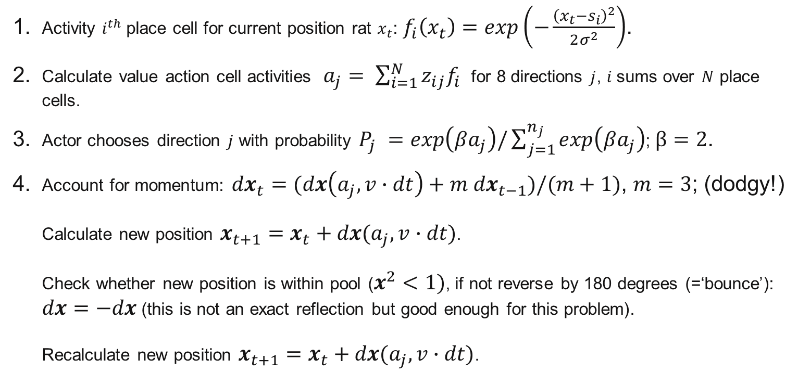
Water maze with place cells - equations
Activity $i^{th}$place cell for current position rat $x_{t}$: $f_{i}\left(x_{t}\right)=exp\left(−\frac{{\left(x_{t}−s_{i}\right)}^{2}}{2σ^{2}}\right)$.
Calculate value action cell activities $a_{j}= \sum_{i=1}^{N}{z_{ij}f_{i}}$ for 8 directions $j$, $i$sums over $N$ place cells.
Actor chooses direction $j$ with probability $P_{j} =exp\left(βa_{j}\right)/\sum_{j=1}^{n_{j}}{exp\left(βa_{j}\right)}$; $β=2$.
Account for momentum: ${dx}_{t}=(dx\left(a_{j},v∙dt\right)+m {dx}_{t−1})/(m+1)$, $m=3$; (dodgy!) Calculate new position $x_{t+1}=x_{t}+dx(a_{j},v∙dt)$. Check whether new position is within pool ($x^{2}<1)$, if not reverse by 180 degrees (=‘bounce’): $dx=−dx$ (this is not an exact reflection but good enough for this problem). Recalculate new position $x_{t+1}=x_{t}+dx(a_{j},v∙dt)$.

Slide 3
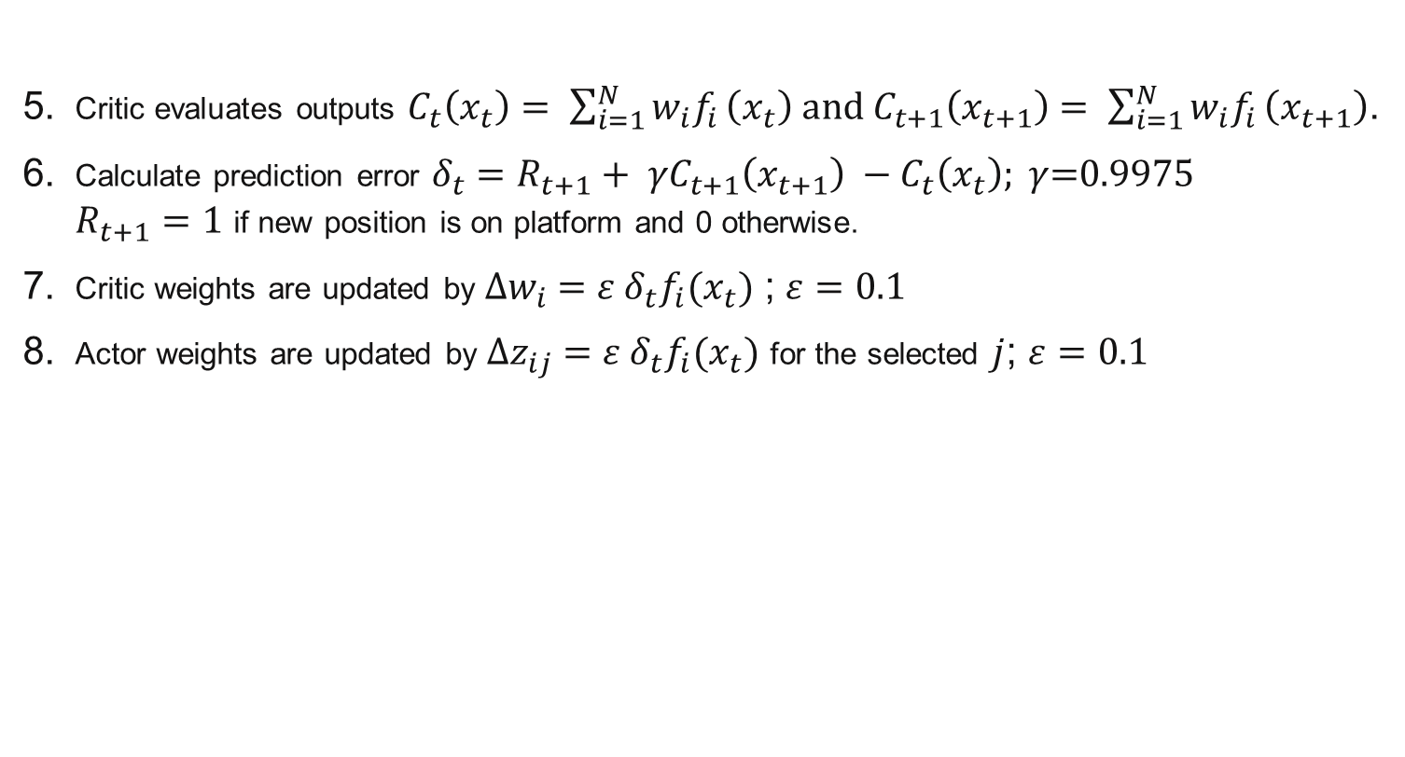
Water maze with place cells - equations
Critic evaluates outputs $C_{t}\left(x_{t}\right)= \sum_{i=1}^{N}{w_{i}f_{i}}\left(x_{t}\right) and C_{t+1}\left(x_{t+1}\right)$ $= \sum_{i=1}^{N}{w_{i}f_{i}}\left(x_{t+1}\right)$.
Calculate prediction error ${δ_{t}=R_{t+1}+ γC}_{t+1}\left(x_{t+1}\right) −C_{t}\left(x_{t}\right); γ$=0.9975 $R_{t+1}=1$ if new position is on platform and 0 otherwise.
Critic weights are updated by ${∆w}_{i} =ε δ_{t}f_{i}(x_{t})$ ; $ε=0.1$
Actor weights are updated by ${∆z}_{ij} =ε δ_{t}f_{i}(x_{t})$ for the selected $j$; $ε=0.1$

Slide 4
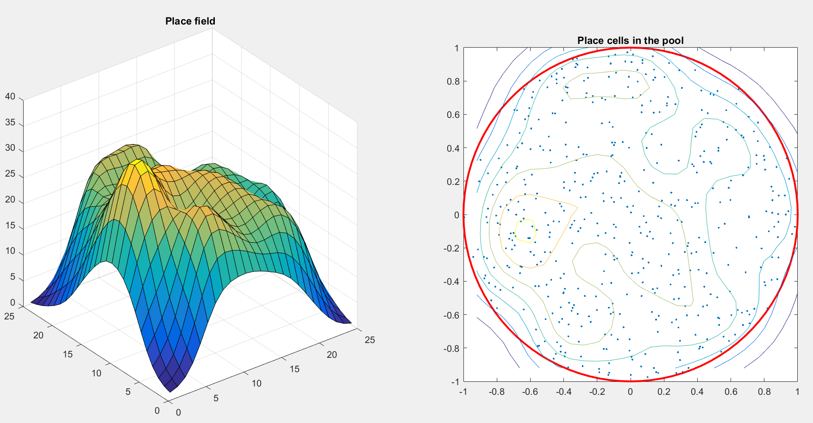
Water maze model setup
..

Slide 5
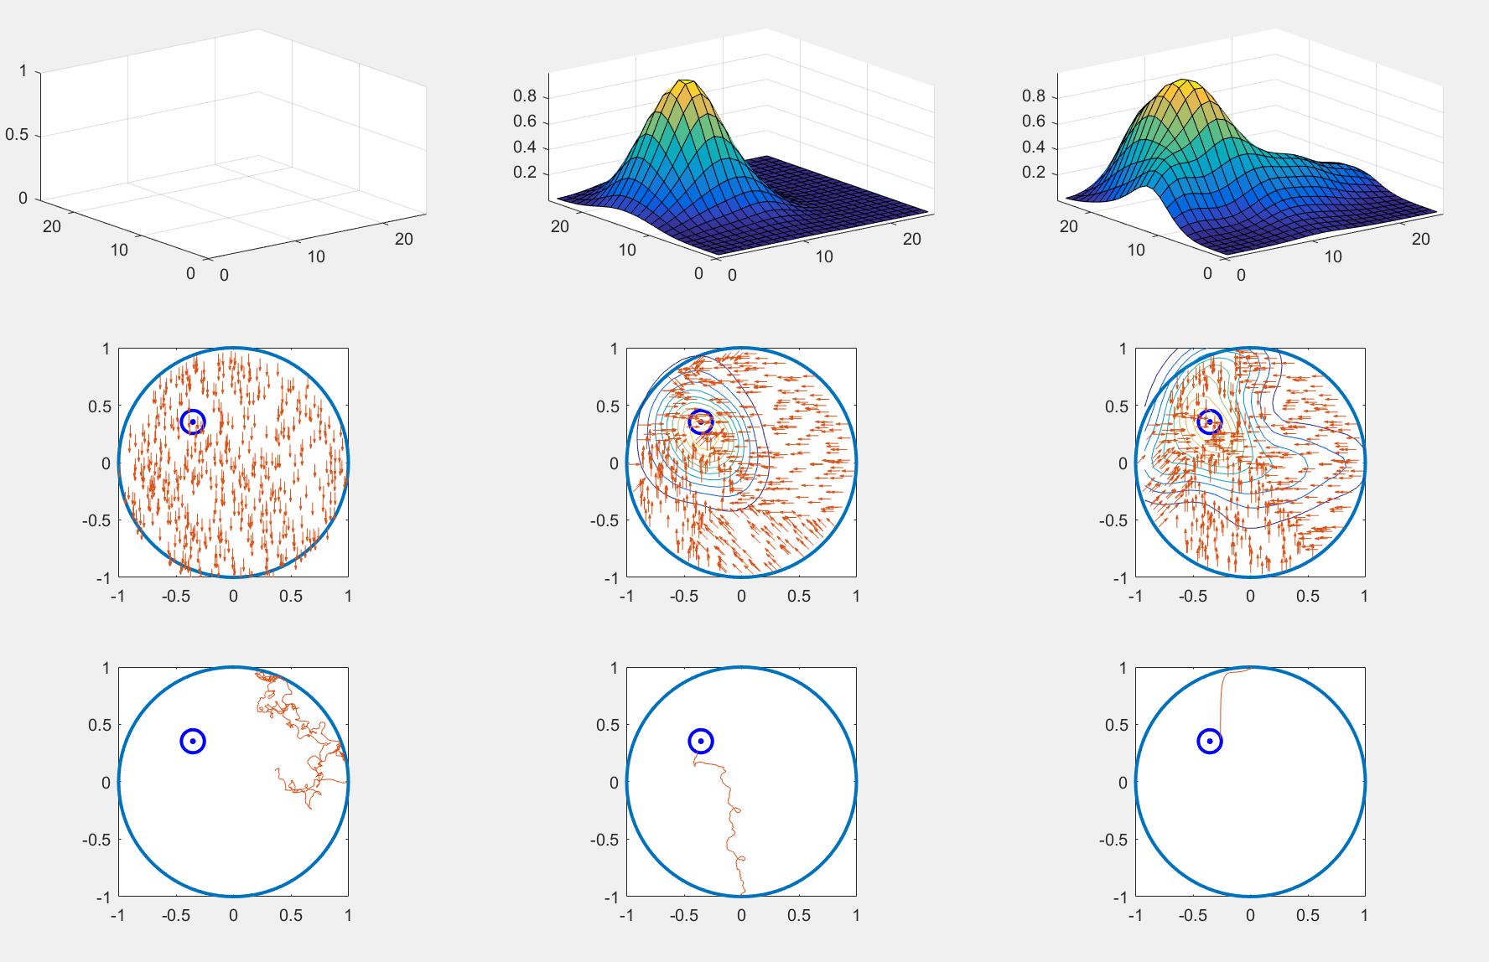



Water maze model results
After 2 trials
After 7 trials
After 22 trials
$$C_{p}$$
$$z_{i}$$
$$x_{t}$$

Slide 6
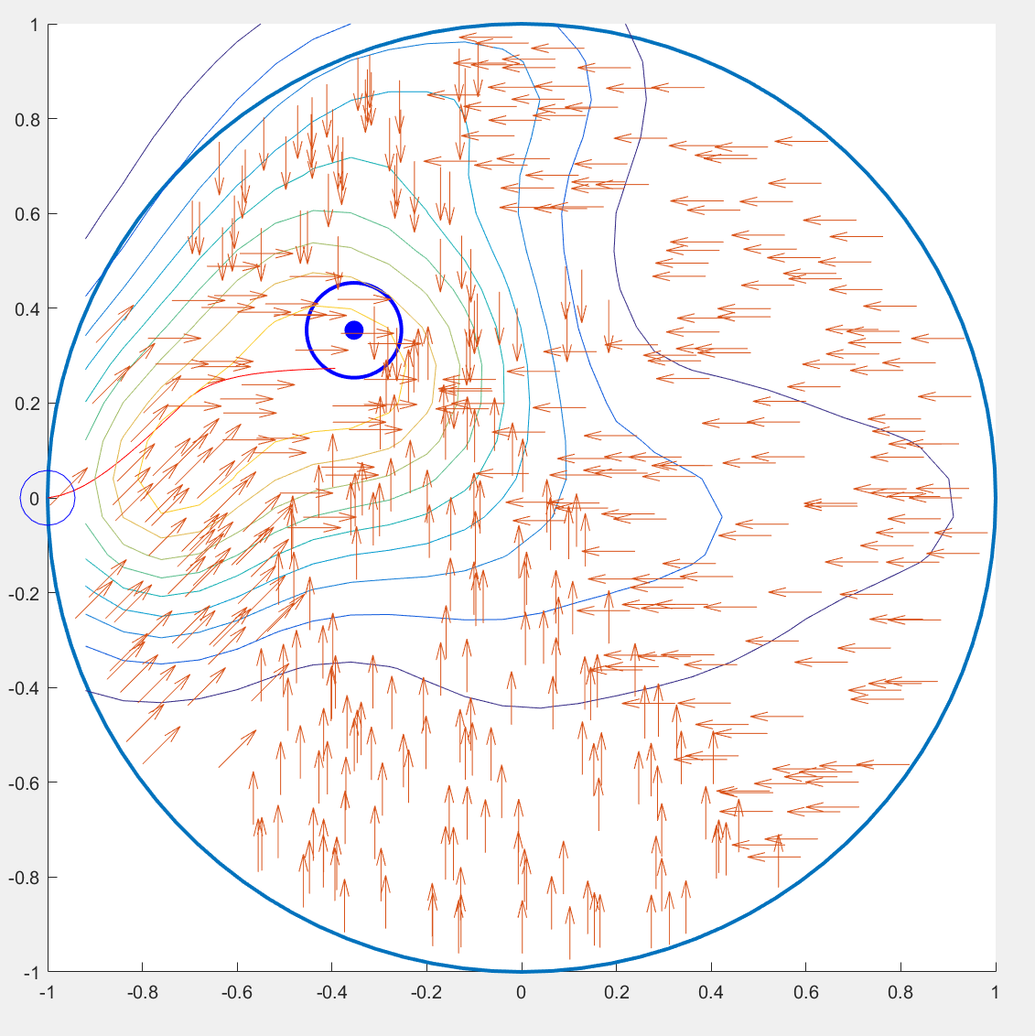

Water maze model result after 25 trials
..
$$z_{i}$$

Slide 7
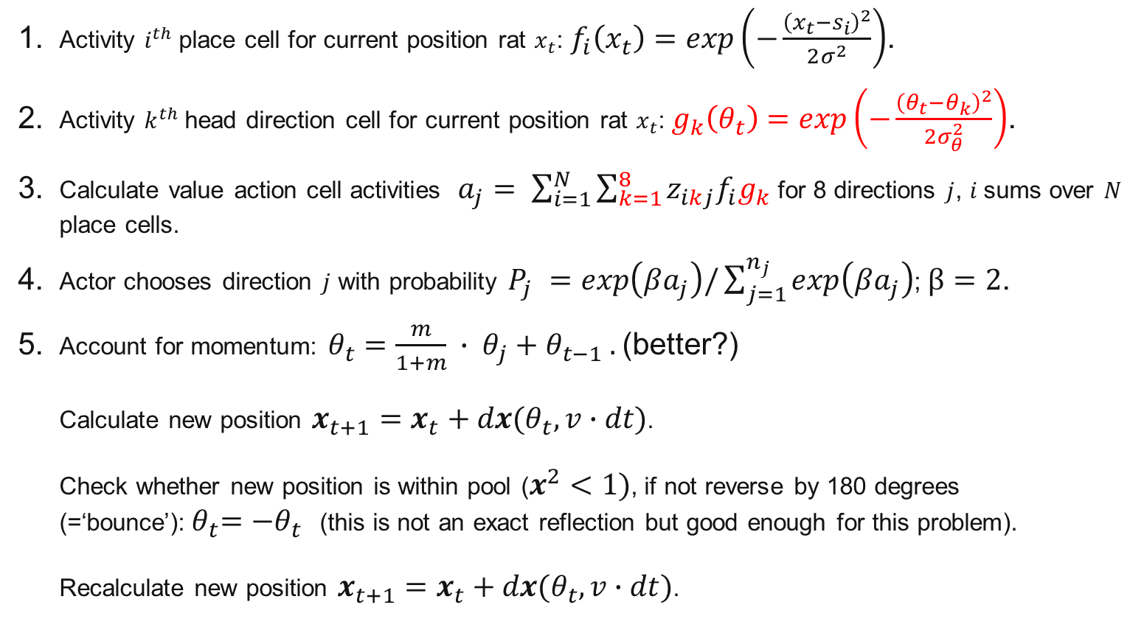
Water maze with head direction cells - equations
Activity $i^{th}$place cell for current position rat $x_{t}$: $f_{i}\left(x_{t}\right)=exp\left(−\frac{{\left(x_{t}−s_{i}\right)}^{2}}{2σ^{2}}\right)$.
Activity $k^{th}$head direction cell for current position rat $x_{t}$: $g_{k}\left(θ_{t}\right)=exp\left(−\frac{{\left(θ_{t}−θ_{k}\right)}^{2}}{2σ_{θ}^{2}}\right)$.
Calculate value action cell activities $a_{j}= \sum_{i=1}^{N}{\sum_{k=1}^{8}{{{z_{ikj}f}_{i}g}_{k}}}$ for 8 directions $j$, $i$sums over $N$ place cells.
Actor chooses direction $j$ with probability $P_{j} =exp\left(βa_{j}\right)/\sum_{j=1}^{n_{j}}{exp\left(βa_{j}\right)}$; $β=2$.
Account for momentum: $θ_{t}=\frac{m}{1+m} ∙ θ_{j}+θ_{t−1} .$(better?) Calculate new position $x_{t+1}=x_{t}+dx(θ_{t},v∙dt)$. Check whether new position is within pool ($x^{2}<1)$, if not reverse by 180 degrees (=‘bounce’):${ θ}_{t}=−θ_{t}$ (this is not an exact reflection but good enough for this problem). Recalculate new position $x_{t+1}=x_{t}+dx(θ_{t},v∙dt)$.

Slide 8
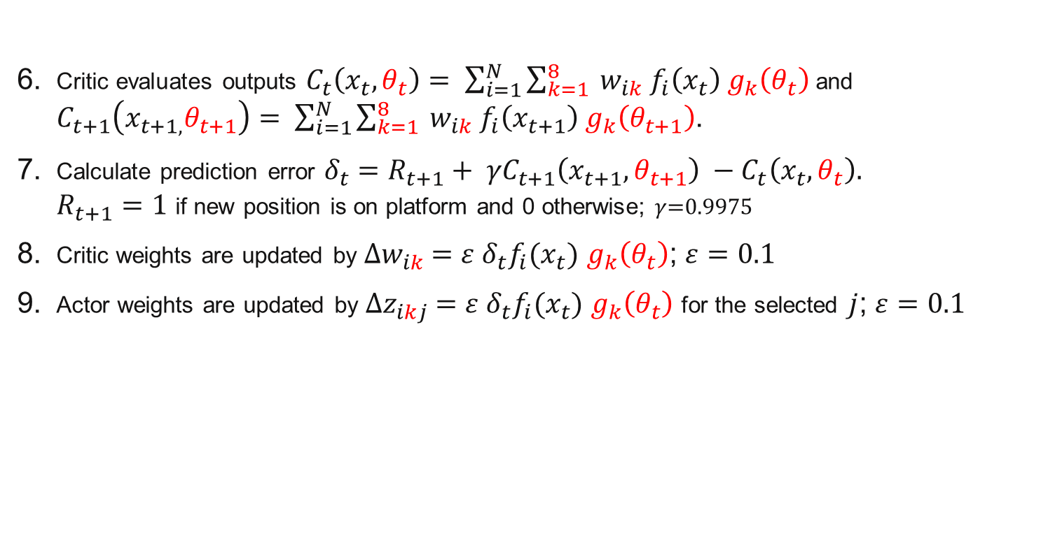
Water maze with head direction cells - equations
Critic evaluates outputs $C_{t}\left(x_{t},θ_{t}\right)= \sum_{i=1}^{N}{\sum_{k=1}^{8}{{{ w_{ik} f}_{i}\left(x_{t}\right) g}_{k}\left(θ_{t}\right)}}$and $C_{t+1}\left(x_{t+1,}θ_{t+1}\right)= \sum_{i=1}^{N}{\sum_{k=1}^{8}{{{ w_{ik} f}_{i}\left(x_{t+1}\right) g}_{k}\left(θ_{t+1}\right)}}$.
Calculate prediction error ${δ_{t}=R_{t+1}+ γC}_{t+1}\left(x_{t+1},θ_{t+1}\right) −C_{t}\left(x_{t},θ_{t}\right).$ $R_{t+1}=1$ if new position is on platform and 0 otherwise; $γ$=0.9975
Critic weights are updated by ${∆w}_{ik} =ε δ_{t}f_{i}(x_{t})$ $g_{k}\left(θ_{t}\right)$; $ε=0.1$
Actor weights are updated by ${∆z}_{ikj} =ε δ_{t}f_{i}(x_{t})$ $g_{k}\left(θ_{t}\right)$ for the selected $j$; $ε=0.1$

Slide 9
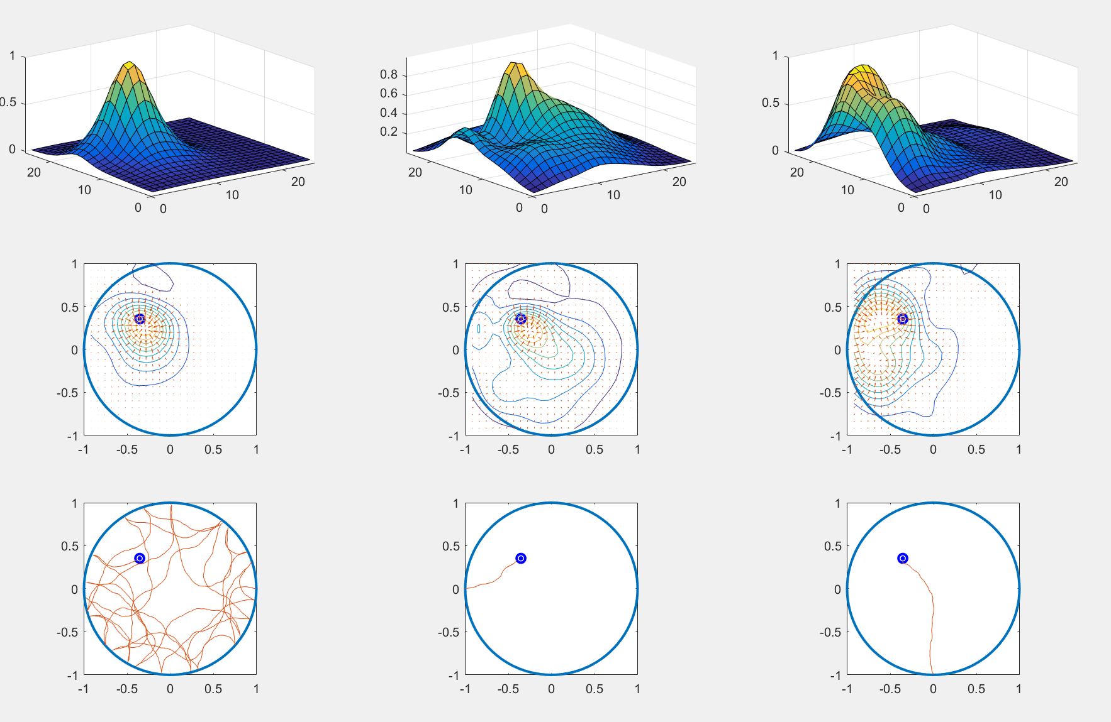



Water maze model results
After 20 trials
After 70 trials
After 220 trials
$$C_{p}$$
$$C_{p}$$
$$x_{t}$$

Slide 10
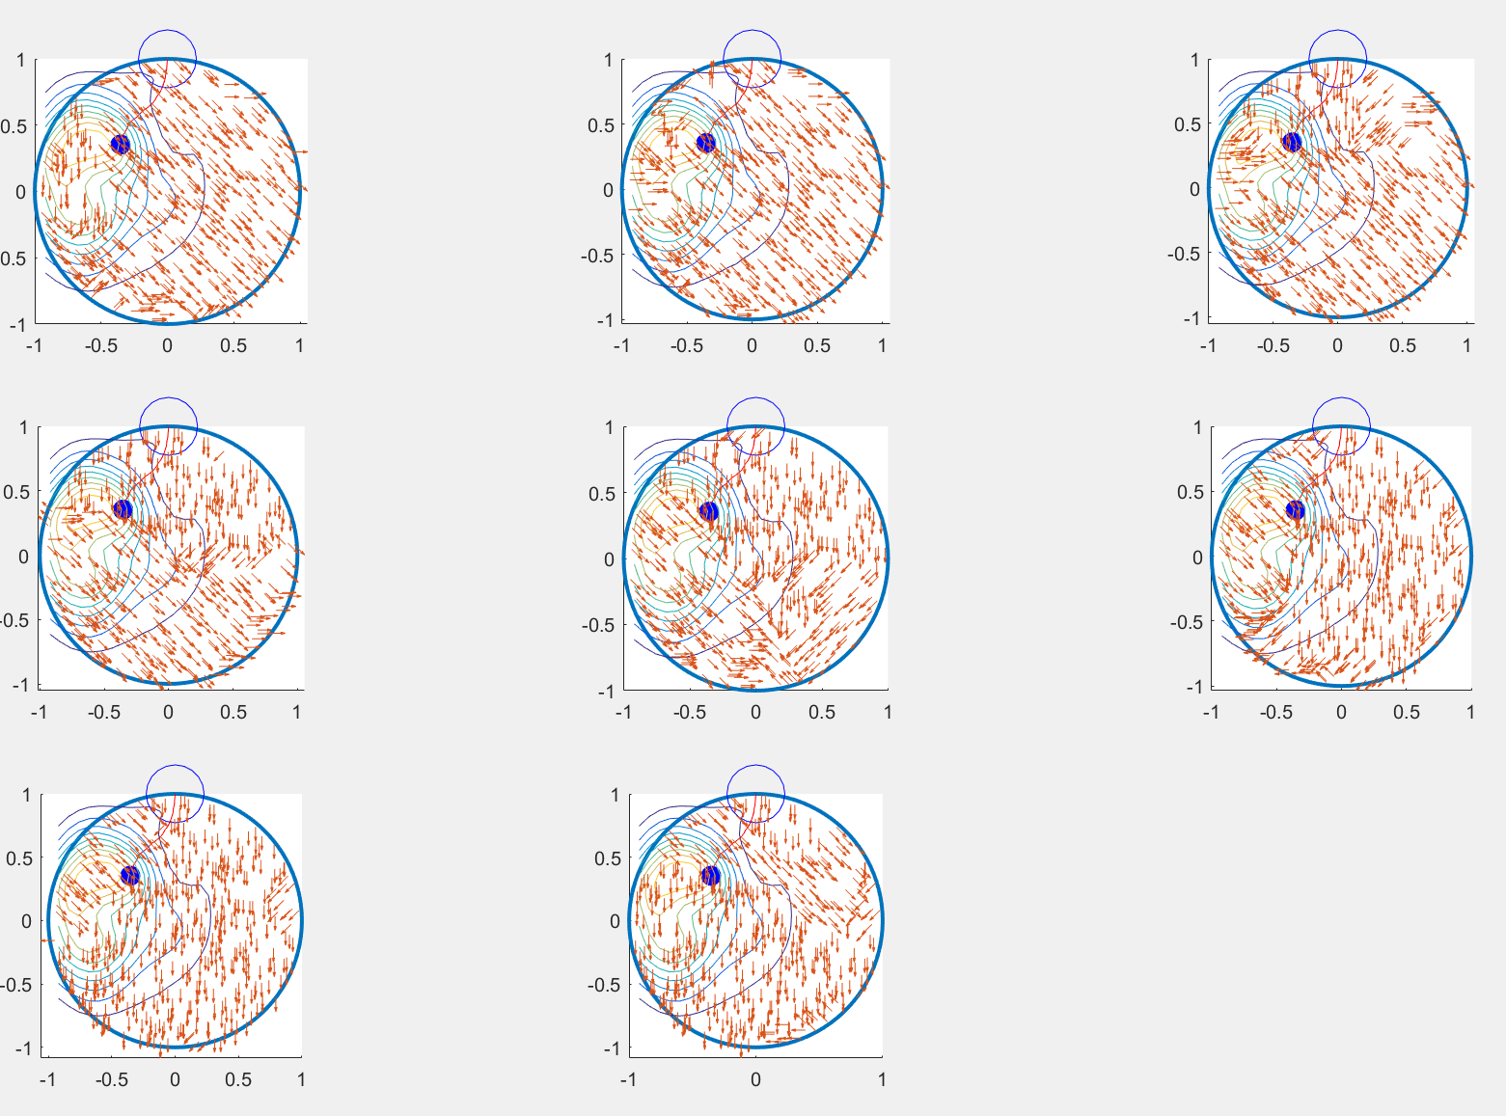

Water maze model result after 25 trials
..
$$z_{ik}$$

