Slide 1
Q-SIEVE
Confidence. With context.
How close can a quantum kernel really get to classical —
and does it survive on real hardware?
An honest, hardware-validated study — on a real anti-money-laundering problem.
Team Q-SIEVE · Quantum × Finance Hackathon, Hanken · Best Technical Implementation
Notes:
[0:00-0:30 HOOK] Let's be honest - everyone here already knows quantum can't beat tuned classical on real data today. So why are we here? Why not a Classical x Finance hackathon? People draw quantum as a curve crossing the classical line; on a problem like ours it bends the wrong way - more data, more expensive, no more accurate. That stuck place is our whole project: how close can quantum get, why was it losing, does the fix survive real hardware?

Slide 2
BUSINESS MODEL
The uncomfortable truth — and our testbed
In 2026, on real-world data, a quantum kernel usually can't beat tuned classical.
Most teams hide that. We built our project around understanding it — on a real financial problem.
Anti-money-laundering
Banks flag ~388k accounts/year.
96% are innocent, cleared by hand.
The trust layer
Q-SIEVE auto-clears the
confidently-innocent. Never accuses.
The quantum kernel
At its core: “how similar are
two accounts?” — that's our question.
Notes:
[0:30-0:52 TESTBED] IBM AML data - 5M payments, ~388k flagged account-weeks, almost all innocent. The bank already flags; what it lacks is permission to REMOVE work. Our trust layer clears only when sure an account is clean - never accuses, logs every call. Quantum does one job: how similar are two account-weeks?

Slide 3
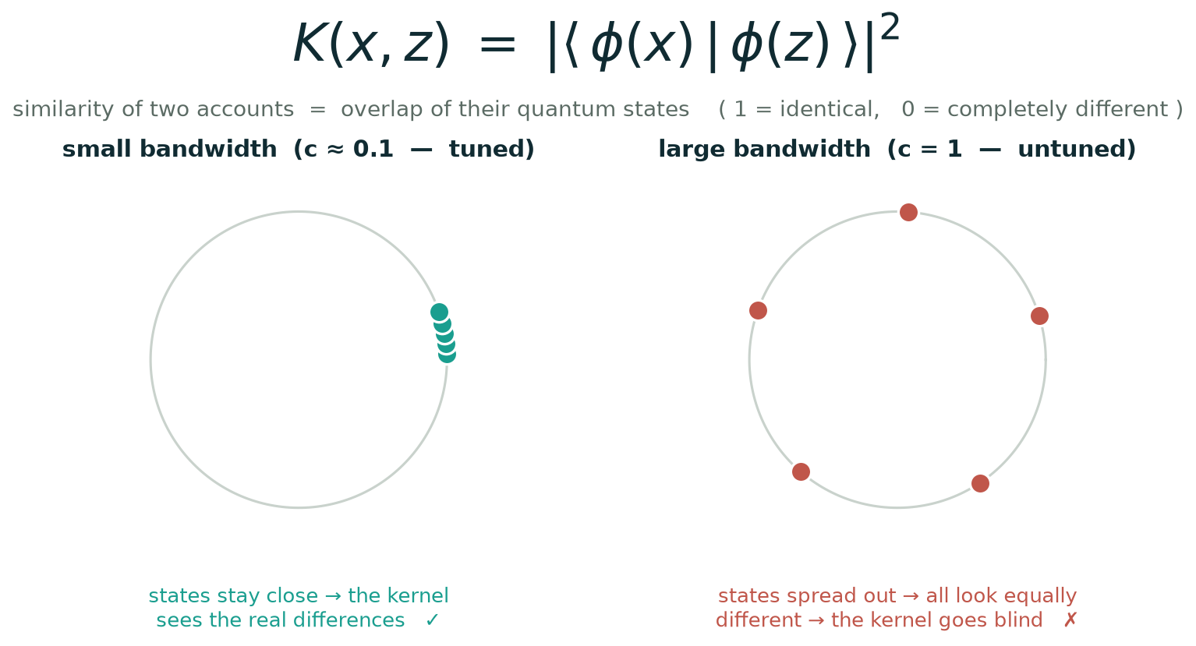
THE MECHANISM
How the kernel works — and the one knob that matters
Similarity = overlap of two account-states. “Bandwidth” = how far we rotate the data — and it decides whether the kernel can see at all. Hold that thought.
Notes:
[0:52-1:14 MATH] 30 seconds on how it works. Each account becomes a quantum state; the kernel is how much two states overlap (identical = 1, opposite = 0). The catch, and it's our whole result: rotate too far and every account spreads to opposite corners, all look equally different - the kernel goes blind. How far you rotate is one number: the bandwidth. Hold that word.

Slide 4
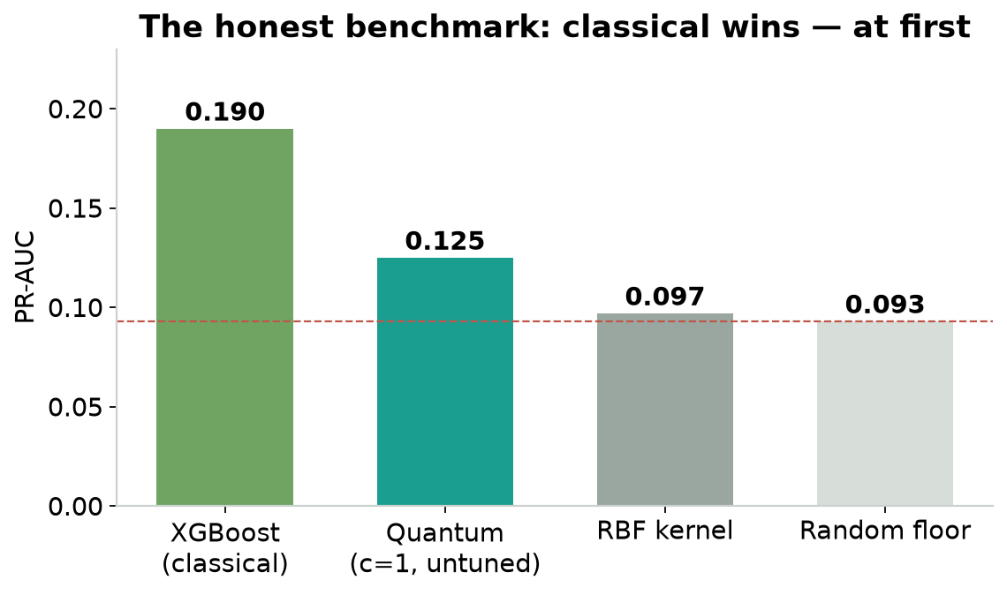
METHODOLOGY
We ran a fair fight — classical won. At first.
Tuned classical vs quantum, identical data.
• XGBoost 0.19 beat quantum 0.125.
• We could have spun it. We asked WHY —
• and tested 4 encodings, 8 scalings, training, a hybrid.
• All the same spot. Quantum looked stuck.
Notes:
[1:14-1:34 BENCHMARK] Fair fight first: tuned tree 0.19, quantum 0.12 (random 0.09; beats RBF 0.097, loses to the tree). We asked why - four encodings, circuit training, a hybrid; 93 windows moved, the score didn't. Stuck.

Slide 5
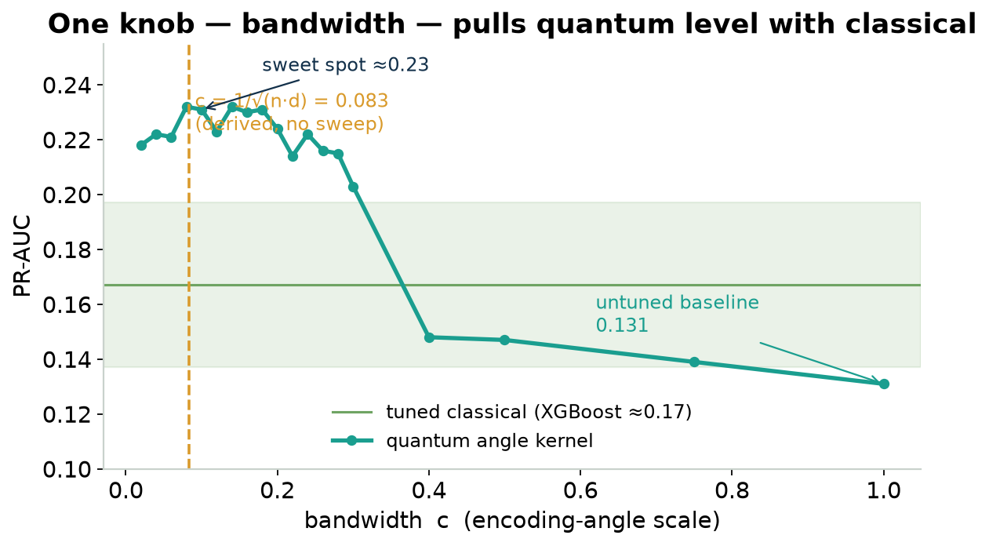
INNOVATIVENESS
The culprit: bandwidth — and we derived it
Wrong scale → the kernel “concentrated”, lost signal.
• Shrink the angles → 0.125 → 0.18.
• Level with the tuned classical tree.
• No trial-and-error — derived: c = 1/√(n·d) = 0.083,
• landing exactly on the measured peak.
Notes:
[1:34-2:06 BANDWIDTH] Found it: the bandwidth was wrong, the kernel blind. Shrink the angles to ~a tenth: 0.12 -> 0.18, level with the tree (0.17). Error bars overlap = a TIE, not a win - say it plainly. And we DERIVED the scale, 1/sqrt(n*d) = 0.083, hitting the measured peak. No trial-and-error.

Slide 6
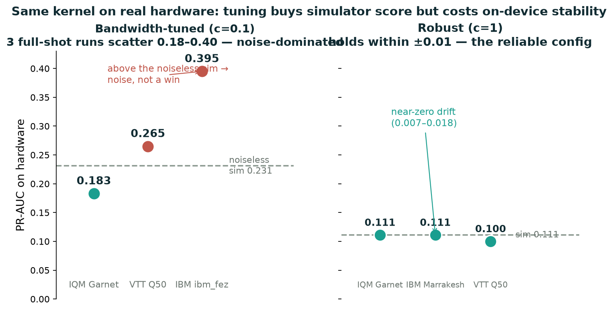
METHODOLOGY · PROGRESS
On three real quantum computers
Disciplined sim → noise-model → real metal. The robust config reproduces the simulator on all three vendors (near-zero drift). The tuned config runs — but its score is noise-dominated. A finding, honestly reported.
Notes:
[2:06-2:38 HARDWARE] A simulator tie is cheap. 3 real QPUs - Garnet, IBM, Q50 - sim, noise model, then chip. The ROBUST 6-qubit config held rock-solid: Garnet & IBM reproduce the sim exactly (0.111->0.111), Q50 off one point, near-zero drift. That's the result we trust. Honest part: the aggressive TUNED kernel bounced 0.18 to 0.40 across runs - one IBM run even above the noiseless sim, impossible for real signal. Cause: the tuned model is near-degenerate, amplifying tiny noise into huge swings. Tuning buys sim score, costs on-device stability. The robust config is the one that runs.

Slide 7
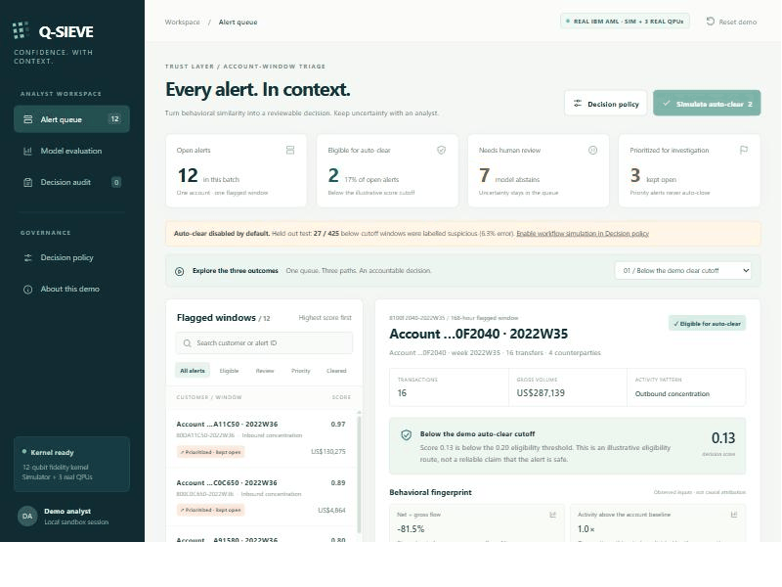
METHODOLOGY
A working trust layer — live
Queue → auto-clear → benchmark → the 3-QPU panel → full audit trail. (Animates in slideshow.)
Notes:
[2:38-2:52 DEMO] All live: the ranked queue, the auto-clear, an audit line per decision, and the evaluation page with the three-machine table. Real data, real results.

Slide 8
The honesty is the achievement.
We can't tell you quantum beats classical on money-laundering today —
and anyone who does is selling you something.
What we can give you: the first rigorous, hardware-validated map of exactly
how close it gets, why it was stuck, and how to fix it — analytically.
Diagnose. Derive. Validate on real hardware.
Team Q-SIEVE — thank you.
Notes:
[2:52-3:10 CLOSE] What we WON'T claim: it doesn't empty the queue (safe threshold clears 0), and the tree is faster (0.1s vs 18s) - say it before they ask. The honest map is the contribution: why it was stuck, the derived fix, 3 real machines. The curve hasn't crossed the line - but we found the line and know which way it moves. Diagnose, derive, validate. Team Q-SIEVE. Thank you.

