Slide 1
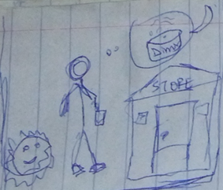
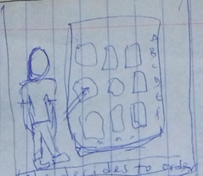
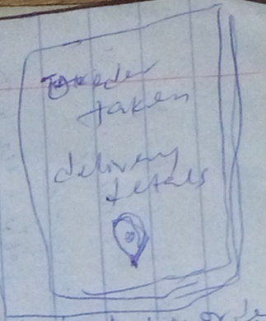
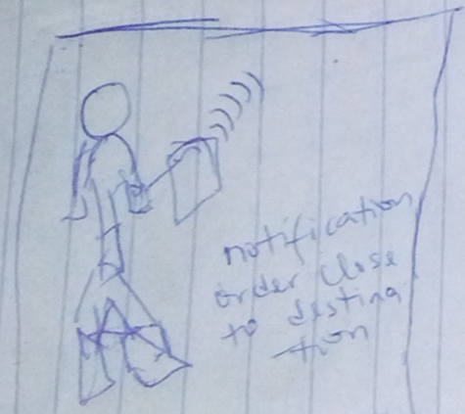
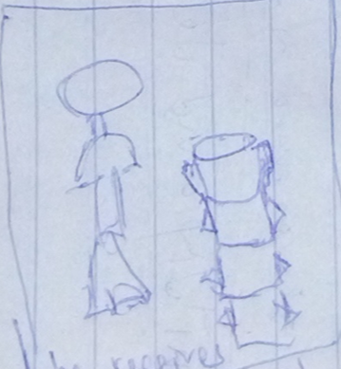
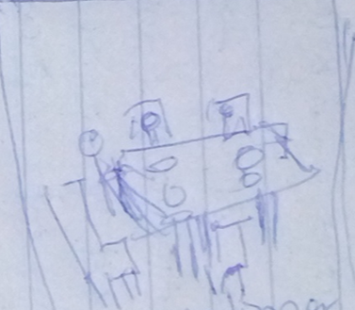
UX Design Storyboard: Delivery Tracking App for a Modern Restaurant
Scenario: tracking in realtime, the current position of orders en route from the restaurant to the delivery destination (big story)
Joseph wants to get dinner from a restaurant that’s far from both his home and his store
He remembers that the restaurant has an home delivery option, and he can track the delivery real time, so he opens the app
He makes his order, and adds his delivery location, and he’s given a link to track his delivery, and he’s also able to set notifications.
He receives auto notification when the delivery agent is almost close to the delivery venue based on the custom notifications set
He gets to the delivery location and receives the ordered food from the agent, and then confirms order delivery on the app
Joseph is able to eat at hose with is children and they are very happy that the food was still good

