Slide 1
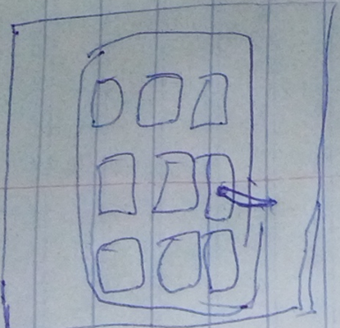
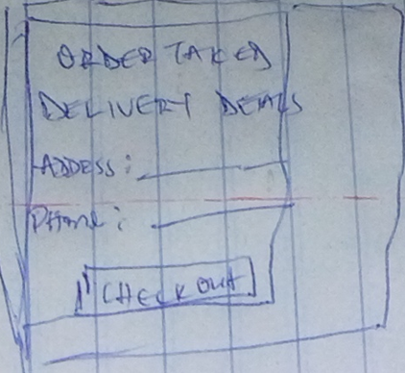
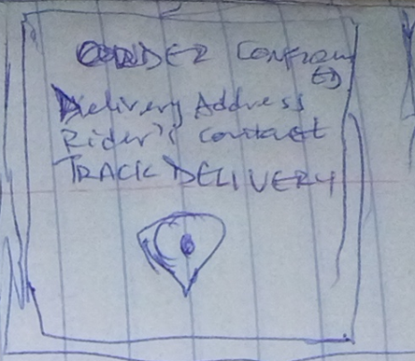
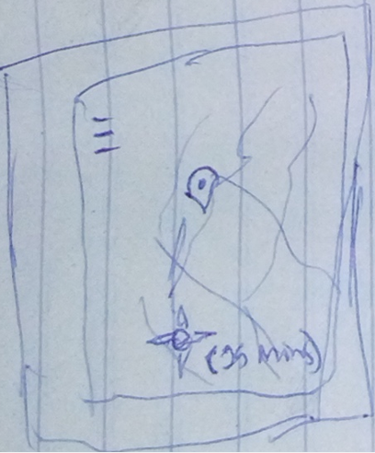
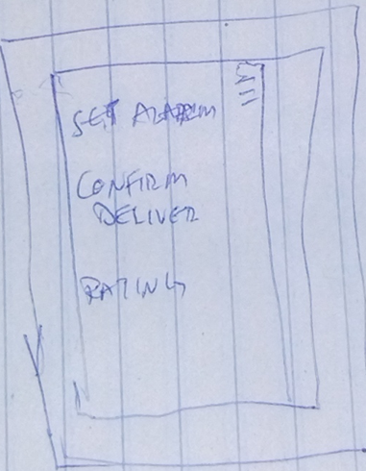
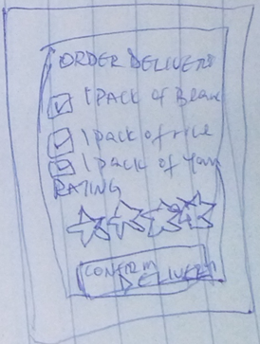
UX Design Storyboard: Delivery Tracking App for a Modern Restaurant
Scenario: tracking in real time, the current position of orders en route from the restaurant to the delivery destination (close up)
Joseph selects the restaurant’s delivery app from his app gallery
He placed his order, adds his delivery details and clicks checkout
The order was confirmed and a tracking link is sent in the order confirmation page
He is able to track the real time location of the order, and estimated time to get to the delivery location
He is able to set alarm/notifications from the tracking menu and can confirm delivery when the order arrives
When the order arrived, he checks all ordered goods are intact, gives his rating and confirms that the order has been delivered

