Slide 1


EVENT MANAGEMENT PLATFORM - CONGRESSI INTERAZIONALI
(AS, ATTENDEE)

Slide 2
INDEX
ROLE
FEATURE OF ORGANIZER
HELP-PAGE
Who is an Attendee?
Login to the Platform
Register for the Event
Accessing Help & Support During the Event
Manage Profile
Join & Participate in the Event
Interact with Exhibitors
Post-Event Actions
Check-In for Onsite Events

Slide 3
Who is an Attendee? (ROLE)
An attendee is an individual who participates in an event, either virtually or in person. Attendees can include:
General participants who register for and join an event.
Professionals attending for networking, learning, or business opportunities.
Guests invited by the organizer.
Speakers, panelists, or moderators (if they are also required to register as attendees).
Employees of a company attending as part of a corporate event.
Attendees access event sessions, engage with exhibitors, participate in Q&A, and use various platform features like live chat, polls, and resource downloads.
Notes:
Participant in Italian, Add index participant management

Slide 4
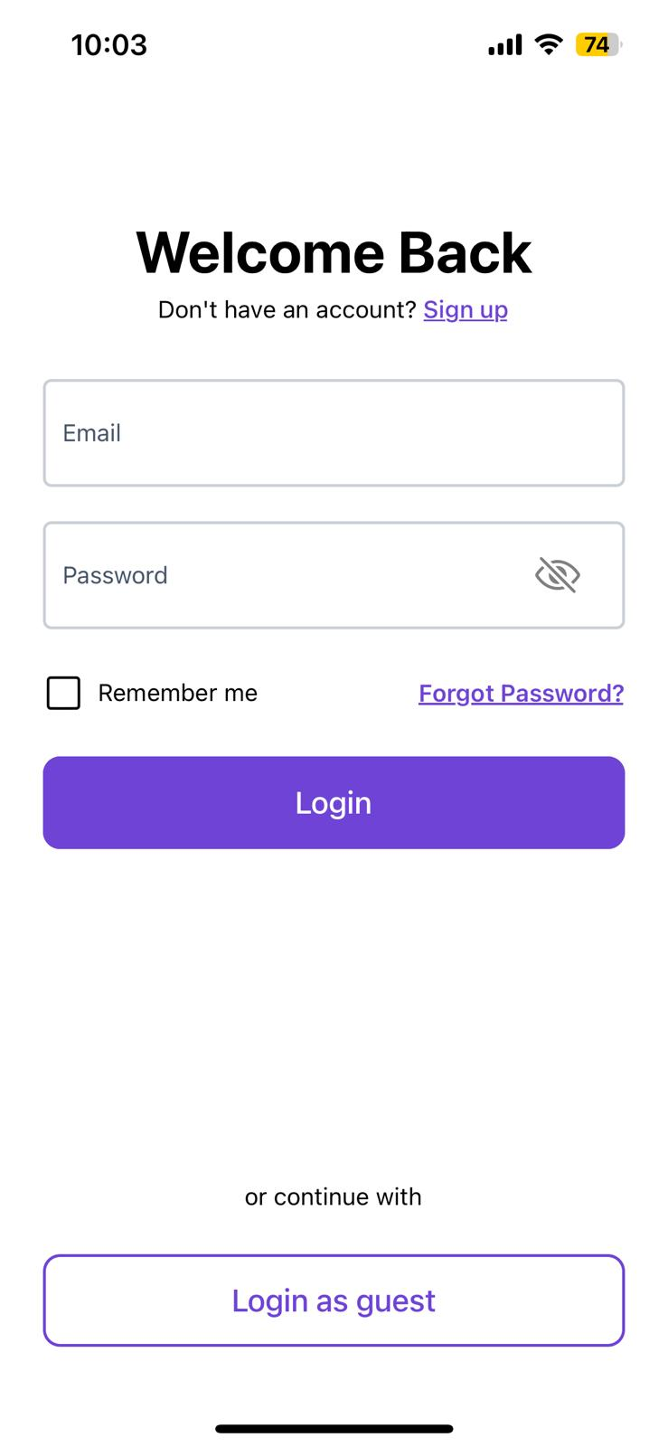
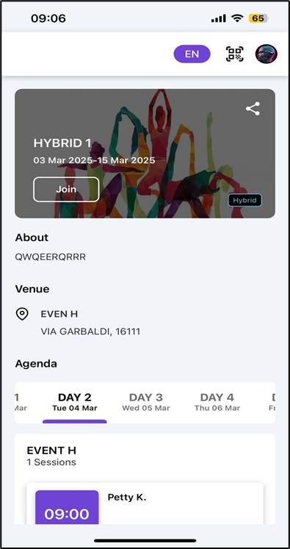
Login to the Platform: (FEATURE)
Step 1: Open a web browser/Phone and go to the event management platform’s login page.
Step 2: Enter your registered email and password in the provided fields.
Step 3: Click the Login button to proceed.
Step 4: If logging in for the first time, you may be prompted to reset your password. Follow the instructions sent to your email.
Step 5: Once successfully logged in, you will be redirected to the attendee dashboard.
Step 6: From the dashboard, you can view upcoming events, manage your profile, and access event details.
Login
Dashboard

Slide 5
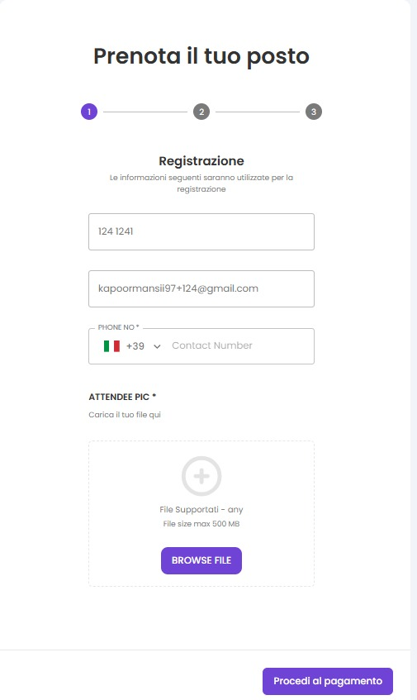
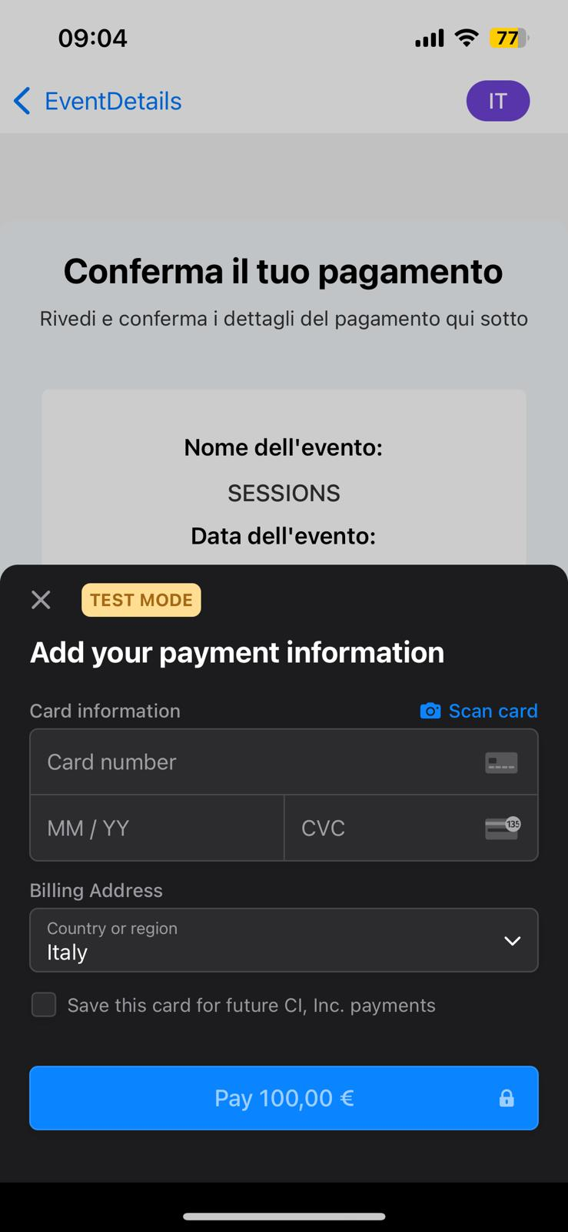
Register for the Event: (FEATURE)
Step 1: Click the event registration link shared via email, website, or social media.
Step 2: Fill out the required fields in the registration form (e.g., name, email, company, designation, etc.).
Step 3: Select the ticket type (if applicable) and proceed to payment.
Step 4: Complete the payment process (if required) through the available payment gateways.
Step 5: Receive a confirmation email with event details and login credentials (if applicable).
Step 6: Save the event details or add them to a calendar for reminders the confirmation email for future reference, which may include login credentials or a QR code for event check-in.

Slide 6
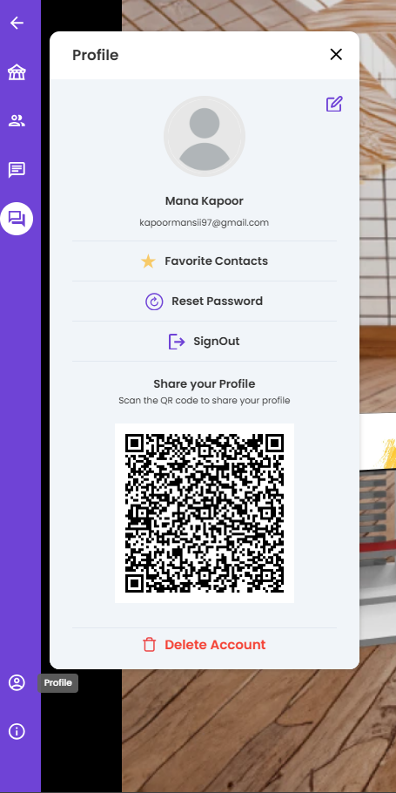

Manage Profile: (FEATURE)
Step 1: Upload Profile Picture: Add an image to personalize your attendee profile.
Step 2: Update Personal Information: Edit name, email, and contact details.
Step 3: Generate QR Code: Use this for quick check-in at onsite events.
Step 4: Mark Favorite Contacts: Save and manage favorite attendees or exhibitors.
Step 5:Share Profile: Generate a profile link to share with other attendees for networking.

Slide 7
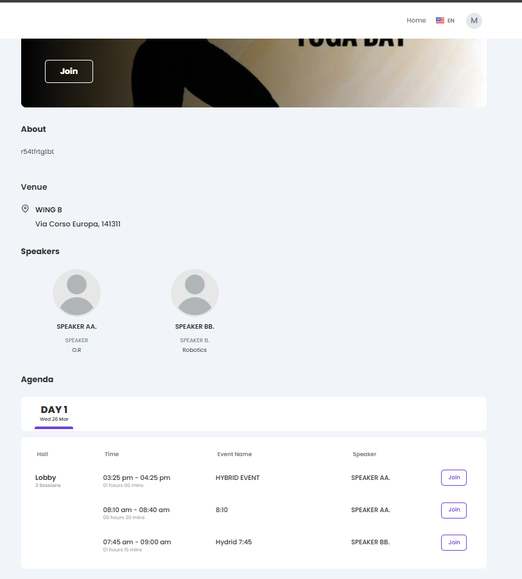
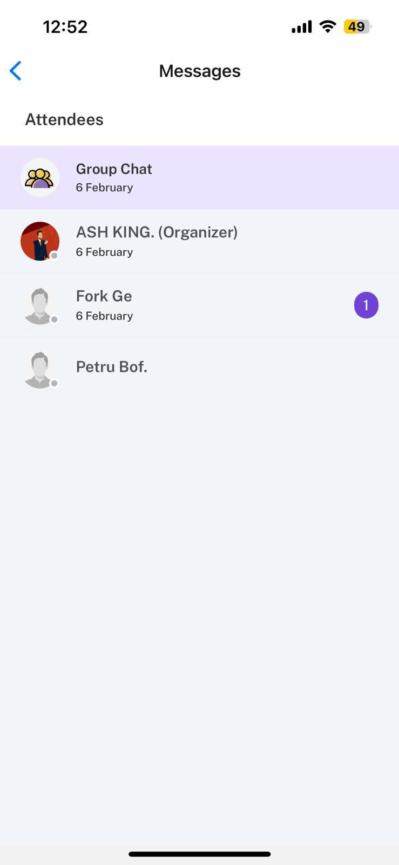
Join & Participate in the Event: (FEATURE)
Step 1: Access the Event Dashboard: Navigate to the event section to find scheduled sessions.
Step 2: Join Live Sessions: Click on the session links provided to attend live presentations or discussions.
Step 3: Engage in Live Polls & Q&A: Participate in real-time polls or ask questions to speakers using the interactive chat features.
Step 4: Network with Other Attendees: Use chat and networking features to interact with other participants.
Step 5: View & Download Event Resources: Access recordings, presentation slides, and other materials shared during the event.

Slide 8
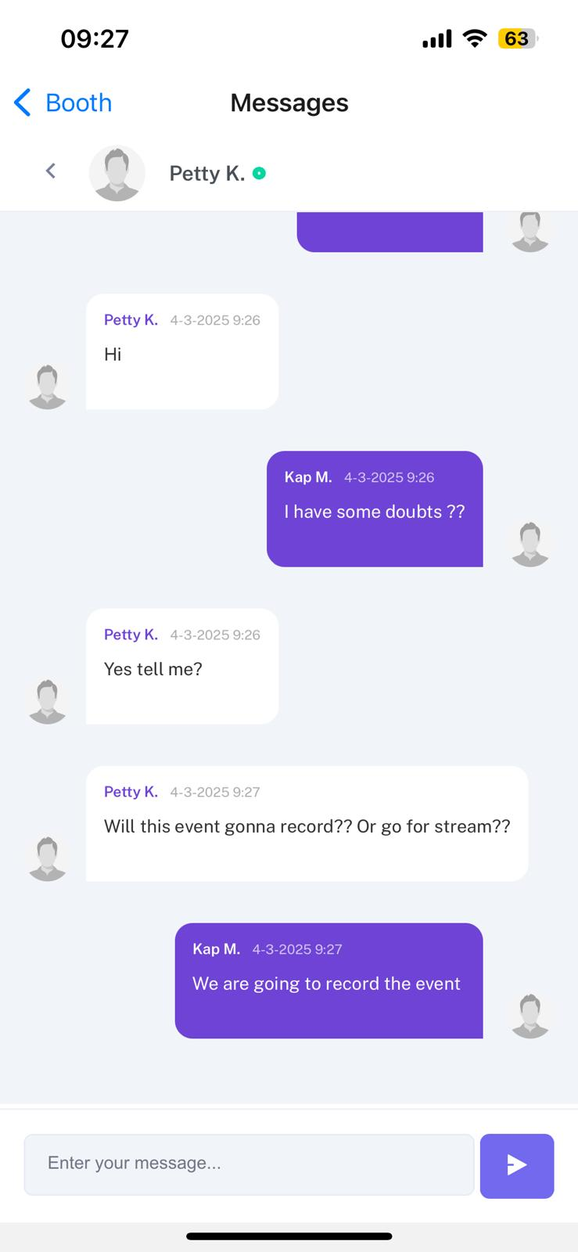
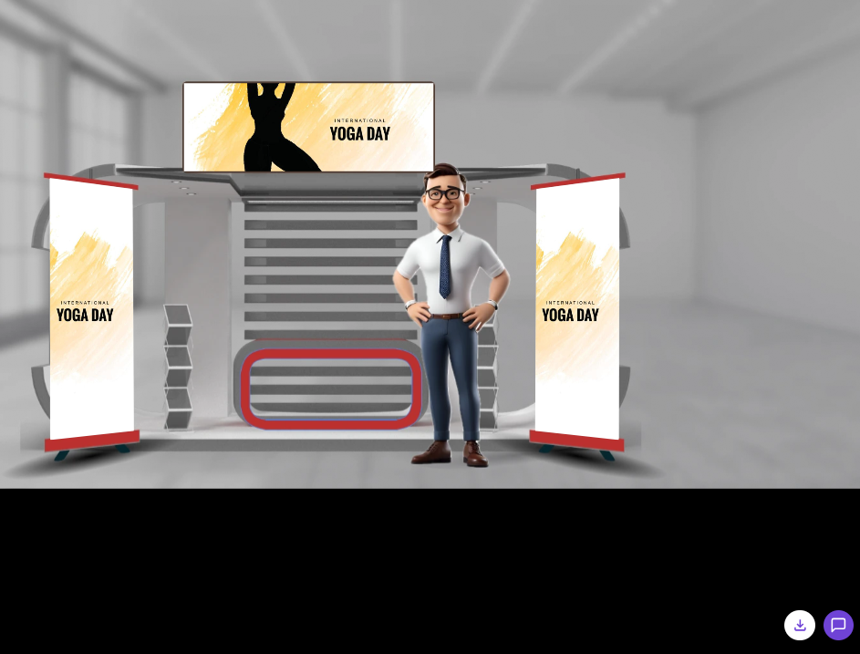
Interact with Exhibitors: (FEATURE)
Step 1: Navigate to the exhibitor section on the platform.
Step 2: View a list of participating exhibitors and their virtual booths.
Step 3: Click on an exhibitor's booth to explore their products and services.
Step 4: Access and download brochures, catalogs, and other provided materials.
Step 5: Use the chat feature to ask questions and interact with exhibitor representatives.
Step 6: Schedule one-on-one meetings or demos with exhibitors if available.
“Download”

Slide 9
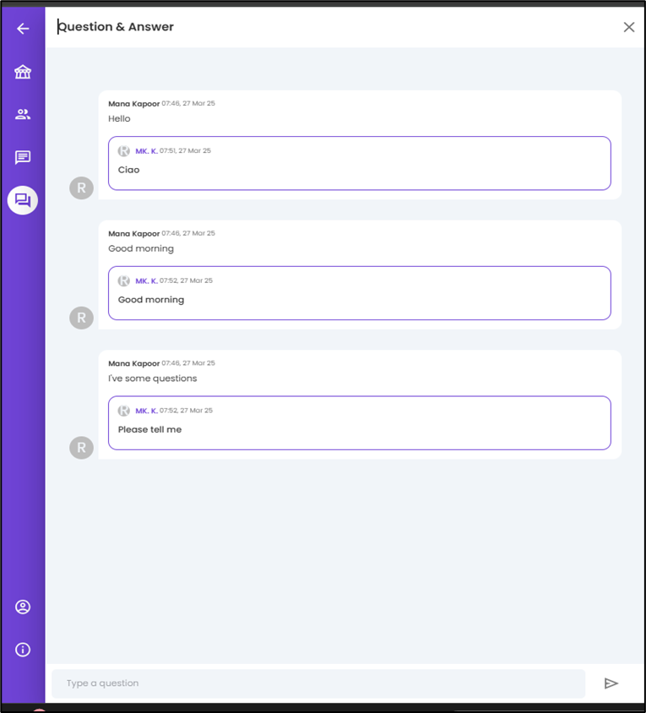
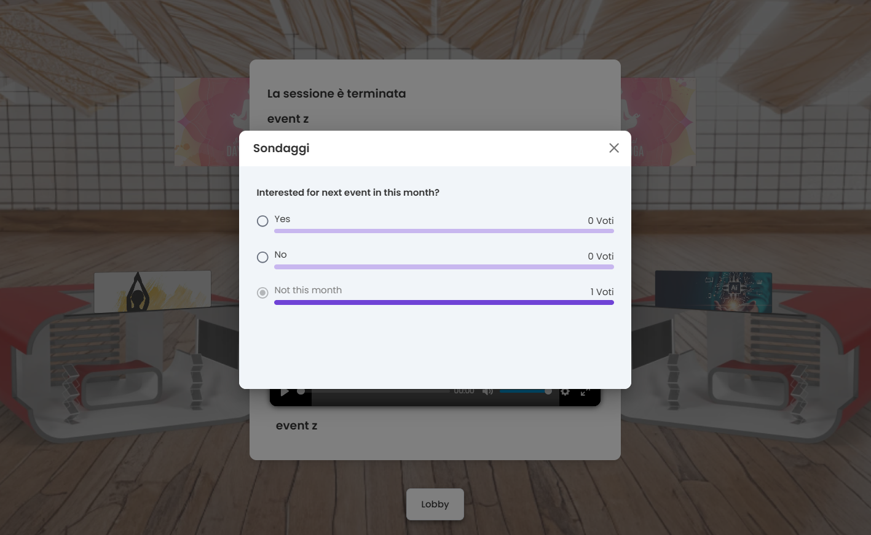
Post-Event Actions: (FEATURE)
Step 1: Download Event Resources: Log in to the platform and navigate to the event page. Download session recordings, presentations, and other shared materials.
Step 2: Provide Feedback: Fill out event surveys and feedback forms to help improve future events.
Step 3: Share Event Participation: Use the social media sharing option to post about your event experience. You may receive a digital certificate if applicable.
Step 4: Continue Networking: Use the platform’s chat feature to stay in touch with connections made during the event (messages may not persist after logout).
Step 5: Review Event Summary: Check insights on your attendance, session participation, and interactions via your attendee dashboard.
LIVE POLL
FEEDBACK & Q/A

Slide 10
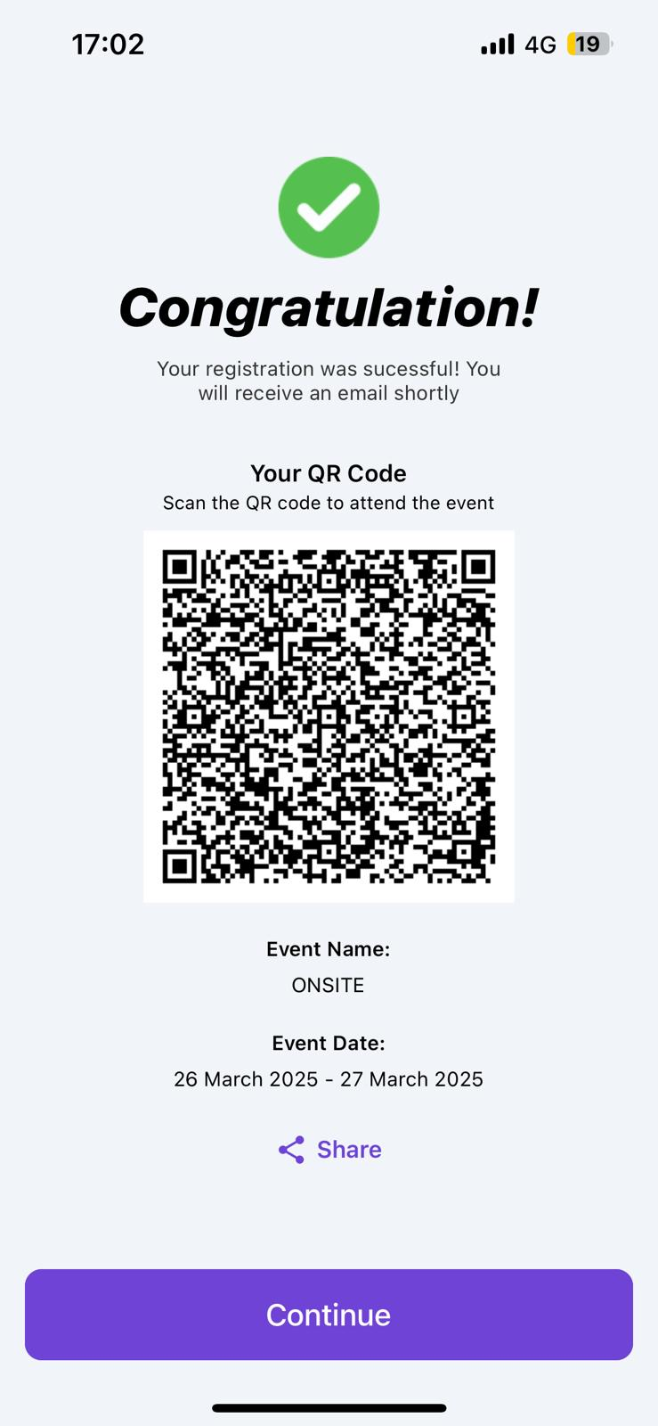
Check-In for Onsite Events: (FEATURE)
Step 1: Locate the Check-In Area: Find the designated check-in counters or kiosks at the event venue.
Step 2: Use the Check-In Application: Open the event management platform’s check-in app on your device or at the kiosk.
Step 3: Scan Your QR Code: If you generated a QR code during registration, scan it for a quick check-in.
Step 4: Manual Check-In Option: If you do not have a QR code, enter your registered email or booking reference to check in manually.
Step 5: Receive Event Badge: After verification, collect your event badge or wristband (if applicable).
Step 6: Proceed to the Event: Once checked in, you can enter the event space and start exploring sessions, exhibitors, and networking opportunities.

Slide 11
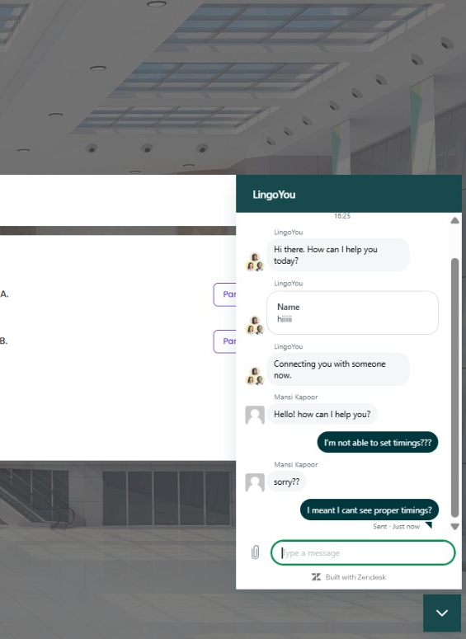
Accessing Help & Support During the Event
A dedicated help page is available throughout the event.
Attendees can seek support for technical issues, such as webpage loading problems or account management difficulties.
Support inquiries can be made directly through the system.
A dedicated support team is available to provide real-time assistance.
Responses will be provided promptly to resolve any issues and ensure a smooth event experience.

